Slide 1
Travel Policy Updates
September 2023

Slide 2
Travel Streamlining
The University of Houston Controller’s Office Accounts Payable Department has reviewed its travel operations to identify opportunities to improve travel processes, including simplifying rules and streamlining reimbursements.
The changes below will be effective once the MAPP is revised and published. AP will send a notification via the CDA Listserv once this occurs.
MAPP 04.02.01A
Travel Paid From State-Appropriated Funds
  Although there are some housekeeping edits to MAPP 04.02.01A, they do not include any changes to the policy. All requirements for travel on state funds remain the same.
  See detail at: https://fmx.cpa.texas.gov/fmx/travel/textravel/index.php

Slide 3
MAPP 04.02.01B
Travel Paid from Local Funds
UH Travel will continue using the Combined Travel Meals and Lodging Limits.
Meals/Lodging expenses exceeding the daily cap will no longer require a MAPP exception, but the appropriate Division Vice President’s approval will be required. (VP approval can be added to the Concur Approval Flow)
Instructions for how to add the Appropriate Vice president can be found on the Travel Website at: https://www.uh.edu/office-of-finance/ap-travel/concur-tcard/tm-printable/creating-a-travel-request.pdf)
Note: An exception has been added to Concur to alert the expense report initiator and Travel office if the GSA rate has been exceeded. This would indicate receipts are required.
(

Slide 4
Lavish/Extravagant Expenses
The IRS requires all travel expenses to be reasonable and ordinary, specifically precluding lavish and extravagant expenses from reimbursement. Lavish/Extravagant expenses are not allowed.
The following expenses may be defined as “lavish/extravagant”:
    Hotel: Resort Hotel (except for conference) or Suite/ Room upgrade without appropriate explanation
    Meals: 200% of GSA rate
    Car rental: SUV or van for less than three business travelers, sports car or limousine. (If an SUV or van is needed for less than three people an appropriate explanation must be provided and is subject to AP approval.)
    Any upgrades other than additional charges for airfare and rental car for three or more travelers, as mentioned in the MAPP

Slide 5
Conference/Workshop/Convention/Training Hotels
If the conference hotel is used, and the daily meals/lodging combined amount does not exceed the university daily limit, the amount will be reimbursed without additional documentation;
If the conference hotel is used, and the daily meals/lodging combined amount exceeds the university daily limit, the published hotel expenses and actual meals up to the federal travel regulation meal rate (M&IE) for the travel destination may be reimbursed if the traveler provides one of the following:
    The publicized document showing the conference hotel rate (must be the lowest rate) in the expense report;
    or
    The appropriate Division Vice President’s approval
  (VP approval can be provided in the form of an e-mail or by adding them to the workflow)

Slide 6
Travel Days
  The University of Houston will allow travelers to travel to their business destination one contiguous day before and one contiguous day after business days without providing additional documentation or explanation.(Note that these days will be counted as business days in calculating business versus personal days.)
  Travel days more than one day before a business purpose or more than one day after a business day will require additional explanation and documentation, such as an airfare price quotation showing better value, and may be counted as personal days if the delay is for personal purposes.

Slide 7
Airfare
Add-ons to economy airfare
Add-ons to economy airfare - The University will allow travelers to book economy airfare with added services such as extra legroom, additional luggage, early-bird check-in, and seat selection fees without additional justification.
The University will not pay or reimburse for business class or first class airfare.
One-way airfare to or from the business destination may be reimbursed for combined business and personal trips if:
  The business and personal trip can be clearly segregated – there are separate destinations for the business and personal portions of the travel; and
  Travel Request is prepared only for the business portion of the travel with business only destination.

Slide 8
Rental Car
The University will expand its allowable rental vehicle rules from allowing only vehicles up to full-size to allowing sports utility vehicles and vans when there are three or more business travelers in the party. The Concur Expense Report must indicate the number of travelers in the expense comments field.
Reminder:
State-contracted rental car costs include liability and loss/damage waiver (LDW) insurance in the base rate, while non-contracted rental car costs do not. If a non-contracted rental car company is used, it is the traveler’s responsibility to obtain the proper insurance coverage.
Instructions on how to book a State-contracted rental car can be found at: https://www.uh.edu/office-of-finance/ap-travel/uh-travel/transportation/rental-rates/

Slide 9
Communication
The travel department will endeavor to return each expense report only once and flag all the incorrect items the first time, but if new information is provided upon resubmittal, the travel team will have to re-evaluate.
You may have already noticed that our team will reach out if an expense report has been returned more than twice for the same reason. In addition, each rejection should provide details such as:
Date received by AP
A detailed description of each error, including:
  Concur field
  Nature of error
  Exact steps for correcting
  What to do if the traveler does not have the necessary information

Slide 10
Review of College/Division Requirements
Our review found that Twenty Colleges/Divisions have additional travel requirements, whether forms, additional documentation, additional approvals, or additional limitations. Many travelers are unaware that these limitations come from their College/Division.
We encourage you to inform your travelers that these forms originate in your area or that your College/Division consider using the university standards established in MAPP 04.02.01A and MAPP 04.02.01B.

Slide 11
Training
AP Travel is developing additional training for travelers and business personnel on travel regulations and Travel Expense Report submission.
Expense report rejections by college/unit are also being tracked to assist in identifying areas that require more training. If the expense report rejection rate is 50% or over for a specific unit, the AP Travel Manager will invite them to training.

Slide 12
Webpage Updates
All these updates and other travel-related topics will be available via the Website once the MAPP is revised and published.
You can already find information on topics such as:
  Recent changes – Travelers can easily see new or changed requirements
https://uh.edu/office-of-finance/ap-travel/general/recent-changes/
  Common Denials -to assist travelers and business offices in preparing their Travel Expense Reports
https://uh.edu/office-of-finance/ap-travel/general/common-denials/
  Travel cheat sheets- which are one-page guides for things to do and know before traveling, during travel, and after travel
  https://www.uh.edu/office-of-finance/ap-travel/uh-travel/cheatsheet/
  Specific web pages for all travel rules, divided into major categories (such as Transportation, Meals/Lodging, Incidentals, etc.) and sub-categories to simplify finding the rules and requirements. Each page references the regulation that requires the rule.

Slide 13
Questions?

Slide 14
Tejas Office Supplies
Core List items

Slide 15
Tejas: Exclusive Contract
The University must purchase office supplies identified as Core Items from Tejas.

Slide 16
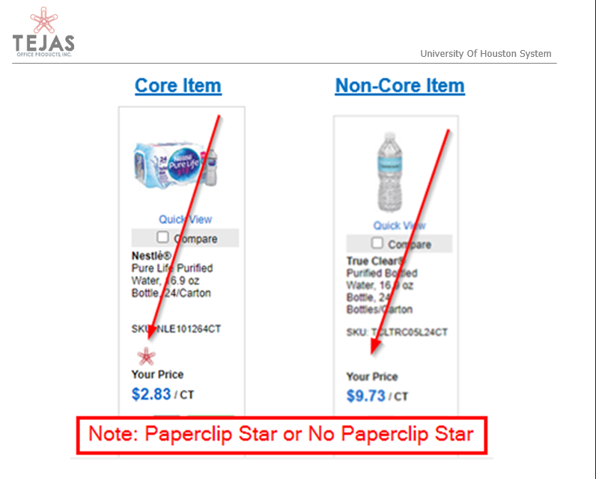
The Tejas website identifies core items with the red star paper clip, as shown below.

Slide 17
P-Card and Core list items
If an item is not on the core list and it is purchased from another vendor for a lower price, a snapshot from the Tejas website showing that it is not a core item must be uploaded to the expense report for it not to be considered an Unauthorized Purchase for the card holder otherwise a violation will be recorded.

Slide 18
Updated P-Card Tejas Violations
Office supplies were not purchased from Tejas. – Unauthorized Purchase (CH)
  Violation can be updated to a lack of doc/approval if documentation is later uploaded showing the purchase is not a core item.
Core items were not purchased from Tejas – Unauthorized Purchase (CH)
  Is a permanent violation and cannot be updated with additional documentation.

Slide 19
Exceptions
The only exception to not purchasing a core item from Tejas is if the item is not available at the time of purchase.
  If the item is unavailable, a written communication from a Tejas representative stating that the specific item is not available must be provided.
If core items are purchased from other vendors because of a price difference, it will still be an Unauthorized Purchase for the card holder.
If you have any questions please contact Accounts Payable.

Slide 20
Questions?

Slide 21
Thank you.

