Slide 1

WINGS Account Creation
This briefing contains FOR OFFICIAL USE ONLY (FOUO) information that must be protected under the Privacy Act of 1974 (see AFI 33-332). Do not release outside of DoD channels without the consent of the originator's office.

Slide 2
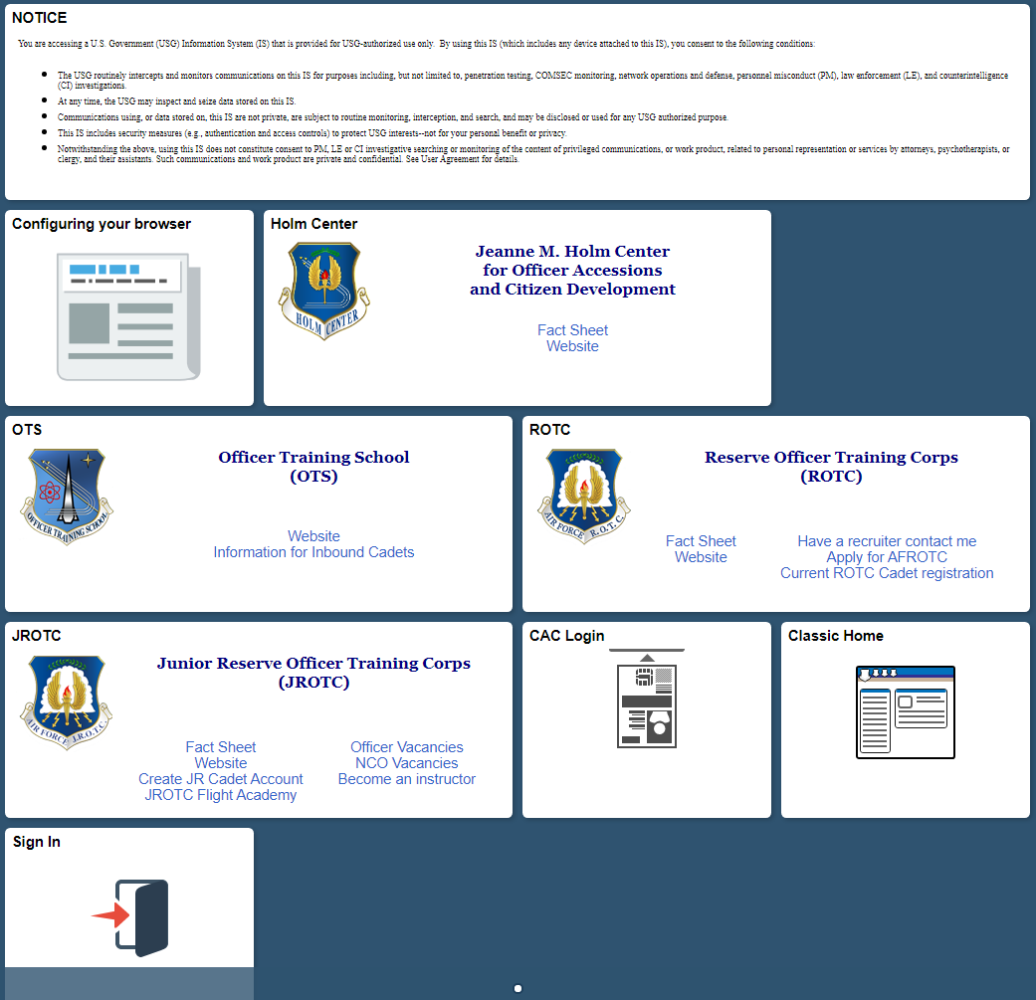
WINGS Account
1. Head to: https://wings.holmcenter.com/
2. Click on “Apply for AFROTC”

Slide 3
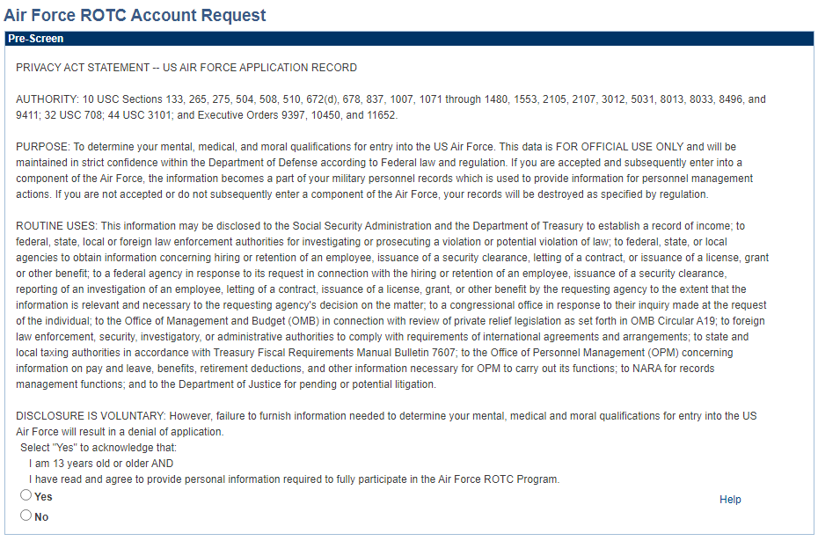
WINGS Account
3. Read the Pre-Screen Information and select “Yes”

Slide 4
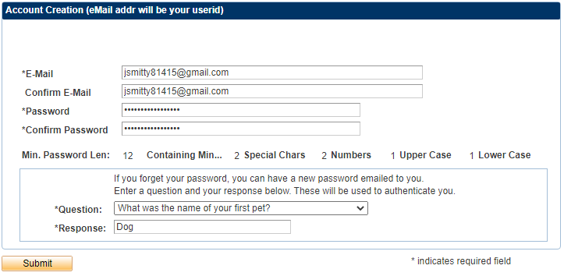
WINGS Account
4. It is HIGHLY recommended that you use your Ole Miss email (___@olemiss.edu) as it is where AFROTC will contact you at.

Slide 5
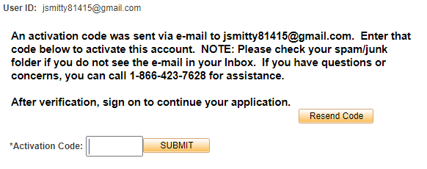
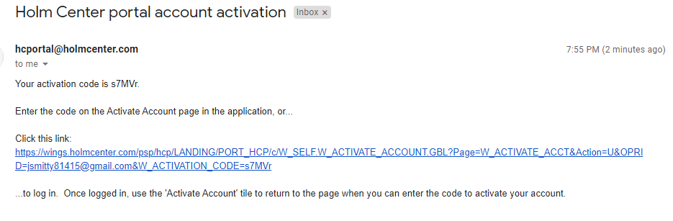
WINGS Account
5. Now you will be prompted to enter a Security Code, this will be sent to the email that you just inputted.

Slide 6
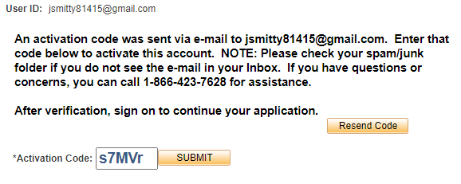
WINGS Account
6. Enter the code and click submit.

Slide 7
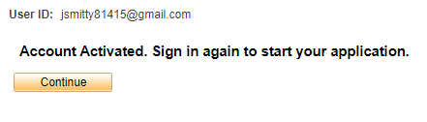
WINGS Account
7. Now, you will be prompted that your account is activated, click “continue”.

Slide 8
WINGS Account
8. You will be returned to Holm Center home portal at this time, please click “sign in”

Slide 9
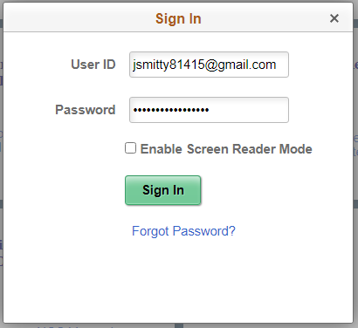
WINGS Account
9. Now you will be prompted to sign in please enter your email in the “User ID” section and enter the password you created in the “Password” section. Once this is complete click the Sign In button.

Slide 10
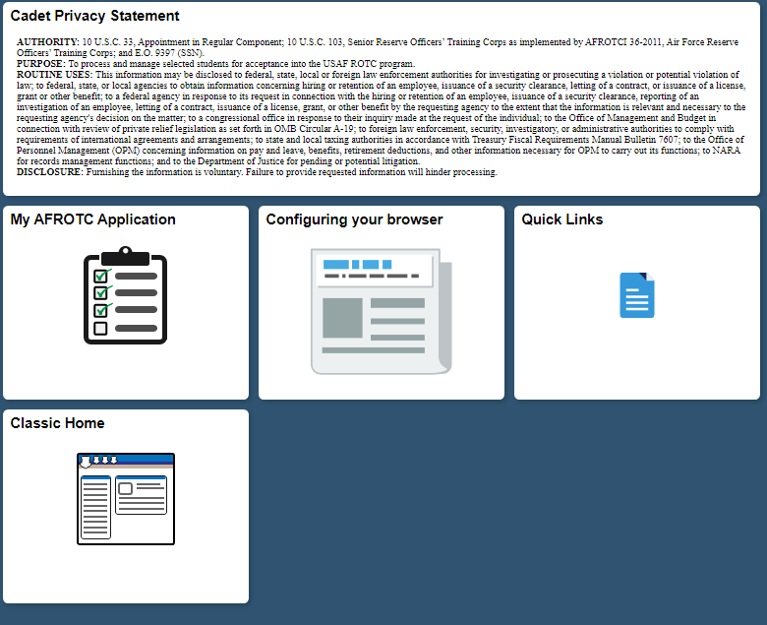
WINGS Account
10. Click "My AFROTC Application”

Slide 11
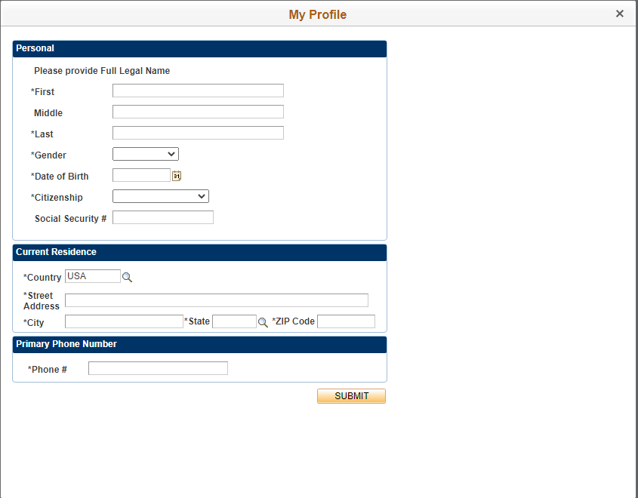
WINGS Account
11. Now complete the My Profile page with the requested information. Ensure that you put your Home of Record (Where you stay when you are not at Ole Miss) in the “Current Residence” section. Once you have entered all your information, click the “SUBMIT” button.

Slide 12
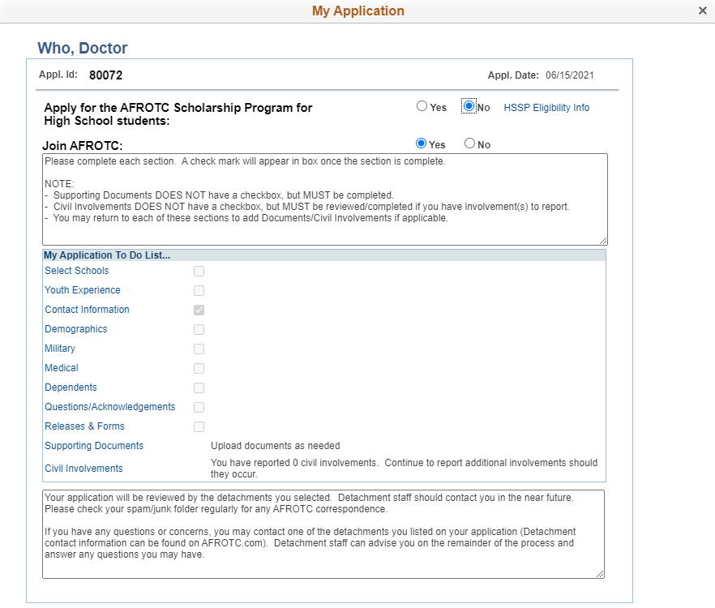
WINGS Account
12. Click on each blue hyperlink and complete the questions for each section

Slide 13
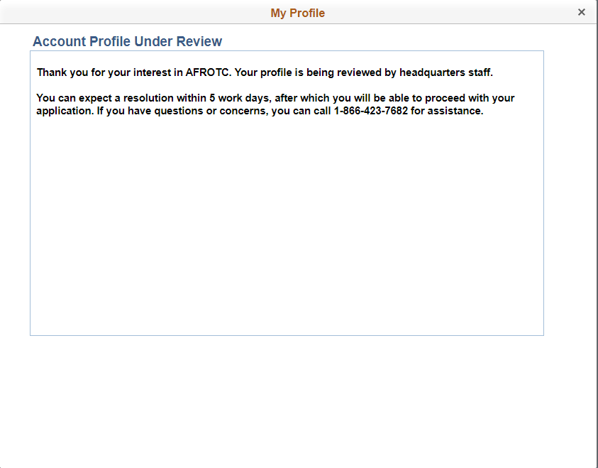
WINGS Account
13. Now you will receive the message Account Profile Under Review. At this point you are finished with your WINGS account!

