Slide 1
Are Your Course Materials Accessible?
Dr. Teresa Acosta Fang Fang and Jingyuan Fu
Faculty and Departmental Instructional Support CLASS Office of Educational Technology

Slide 2
in partnership with the OFFICE OF THE PROVOST

Slide 3
Are Your Course Materials Accessible?

Slide 4
Goals of this Presentation
Overview of UH course material accessibility challenges
Introduce Ally for Blackboard
Discuss UH course content accessibility goals
Examples of using Ally in real courses
Q&A

Slide 5
How We Got Here
What's the issue?
Lawsuits around the country and very recently in Houston:
https://www.click2houston.com/education/things-to-know-about-ut-medical-student-whos-suing-ut-health-in-houston
Accessibility is NOT ABOUT QUALITY. Users with disabilities can't read some content with their assistive devices.

Slide 6
Learning Management System Common File Types
What do you mean by CONTENT?
PDFs, Word Doc, PowerPoint, OpenOffice/LibreOffice files
Images
Videos
Publisher/OER Materials
Web (html) files
Bottom Line: Potential for inaccessibility

Slide 7
How to Address?
How to address the issues?
Where to start?? No ability to inventory all content items in Blackboard
Content-creation tools accessibility features not intuitive or obvious
Financial constraints

Slide 8
Content Assessment and Technology Review
Content assessment within Blackboard Learn
Years of data—Bb currently maintains 2 years' worth of courses, but content goes back farther
Approximately 4k courses per term
Too much content for manual interventions
Ally for Blackboard Review
Integrates with Bb Learn 9.1
Produces a system-wide LMS inventory
Offers solutions and alternatives
Educates the end-user
Good deal for the UH System. (UHV launch, Fall 2019)

Slide 9
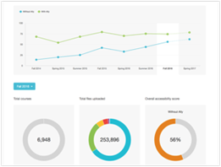
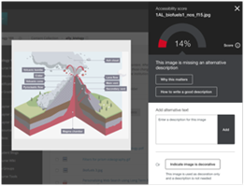
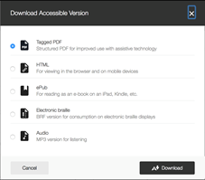
Ally for Blackboard Features Release to UH Timeline
Institutional Reports--ON Instructor Feedback-- Testing Alternative versions--Coming
PHASE 1 PHASE 2 PHASE 3

Slide 10
Ally for Bb Institutional Reports UH at a Glance (PHASE 1)
Fall 2018-Summer 2019
52% Accessibility

Slide 11
Ally for Bb Institutional Report Fall 2019
Fall 2019 (most current report) 72% Accessibility

Slide 12
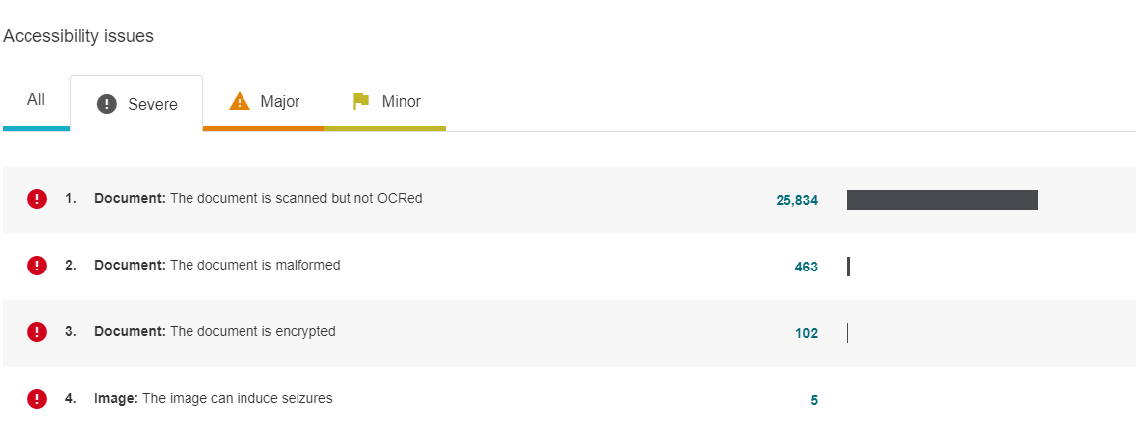
Ally for Bb Institutional Reports Severe Issues
Most severe and prevalent: Scanned but not OCR'ed documents. Approaching 26K documents.

Slide 13
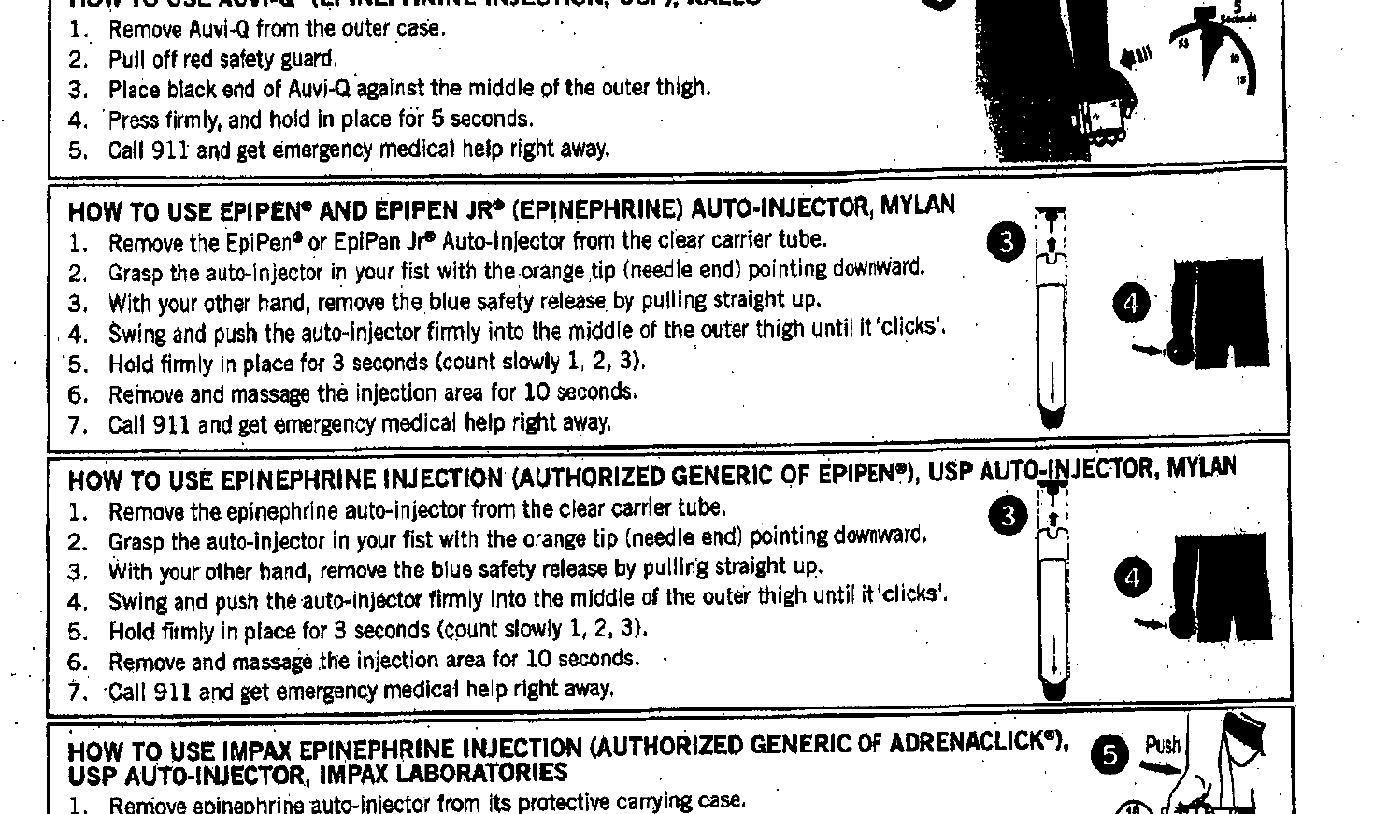
Scanning/OCR Practices
Optical Character Recognition (OCR) software— pre-processes images for the screen reader
Course Material Scanning Best Practices on Instruction@UH
Example of scan, not OCR'ed document

Slide 14
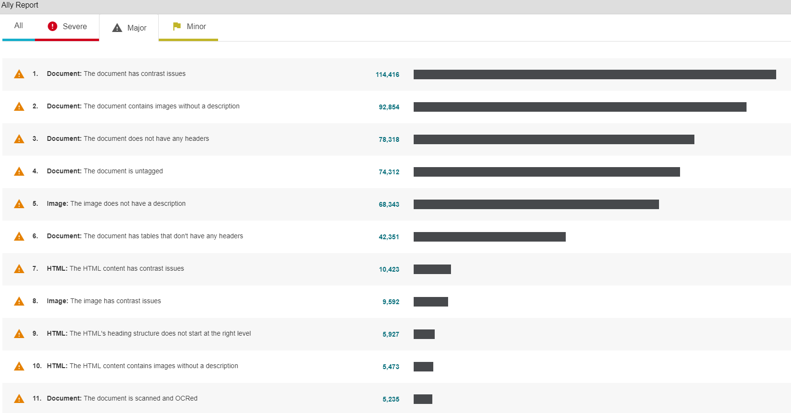
Ally for Bb Institutional Reports Major Issues
Major issues around formatting/style, contrasts, and omissions.

Slide 15
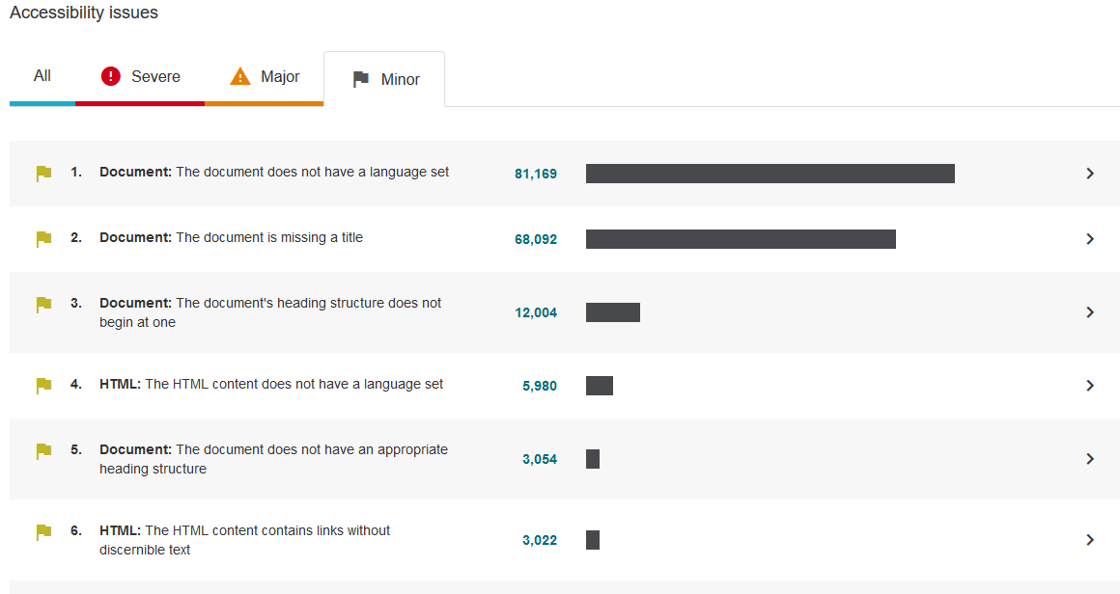
Ally for Bb Institutional Reports Minor Issues
Minor issues around document/HTML formatting and language sets

Slide 16
Ally for Bb Instructor Feedback (PHASE 2)
Instant Feedback and Re-scoring
(TESTING and PILOTING)

Slide 17
Ally for Bb Accessibility Score—Instructor/Course Level
Content Collection or Content Area
Low (0-33%): There are severe accessibility issues.
Medium (34-66%): The file is somewhat accessible and needs improvement.
High (67-99%): The file is accessible, but more improvements are possible.
Perfect (100%): Ally didn't identify any accessibility issues, but further improvements may still be possible.

Slide 18
Ally for Bb Instructor Workflow
IMPORTANT: Ally scores materials displayed to students
1. Upload a file to the content area of the course or Content Collection 2. Look for a document with a colored gauge (displayed to students)
3. Click to open Feedback report

Slide 19
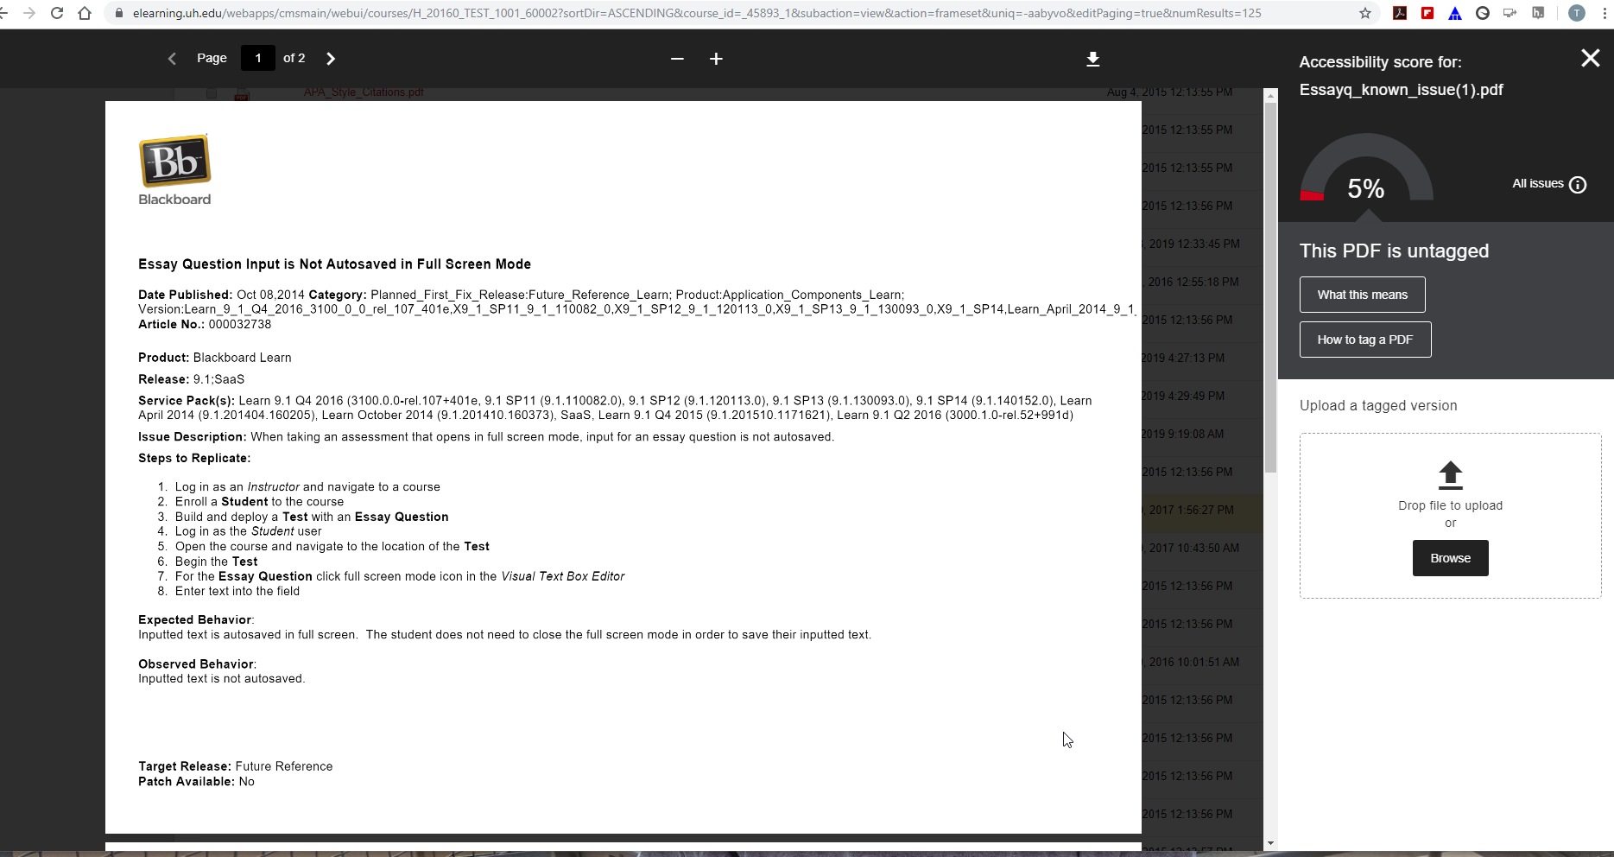
Ally for Bb Feedback Report Per Item

Slide 20
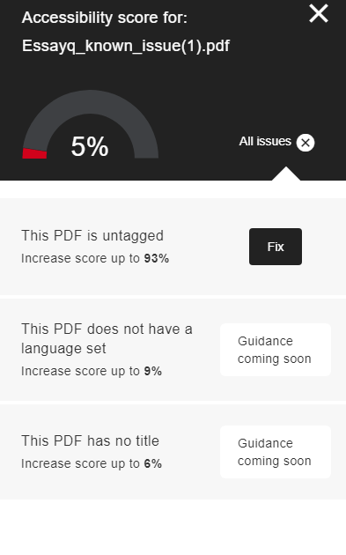
Ally for Bb What Needs to Corrected by Item
Just tagging would bring this document up to 93%

Slide 21
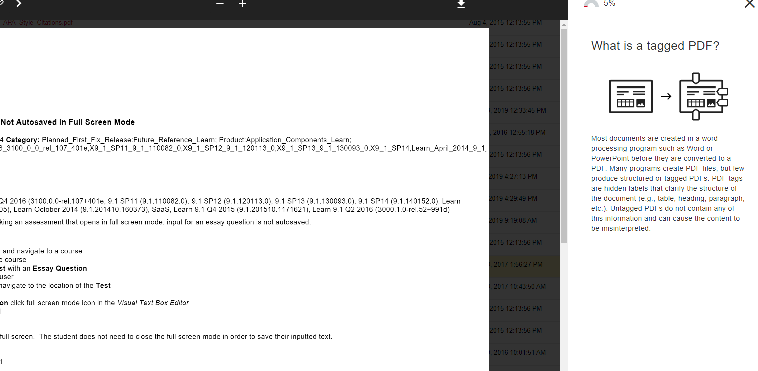
Ally for Bb Explanation of the Issue

Slide 22
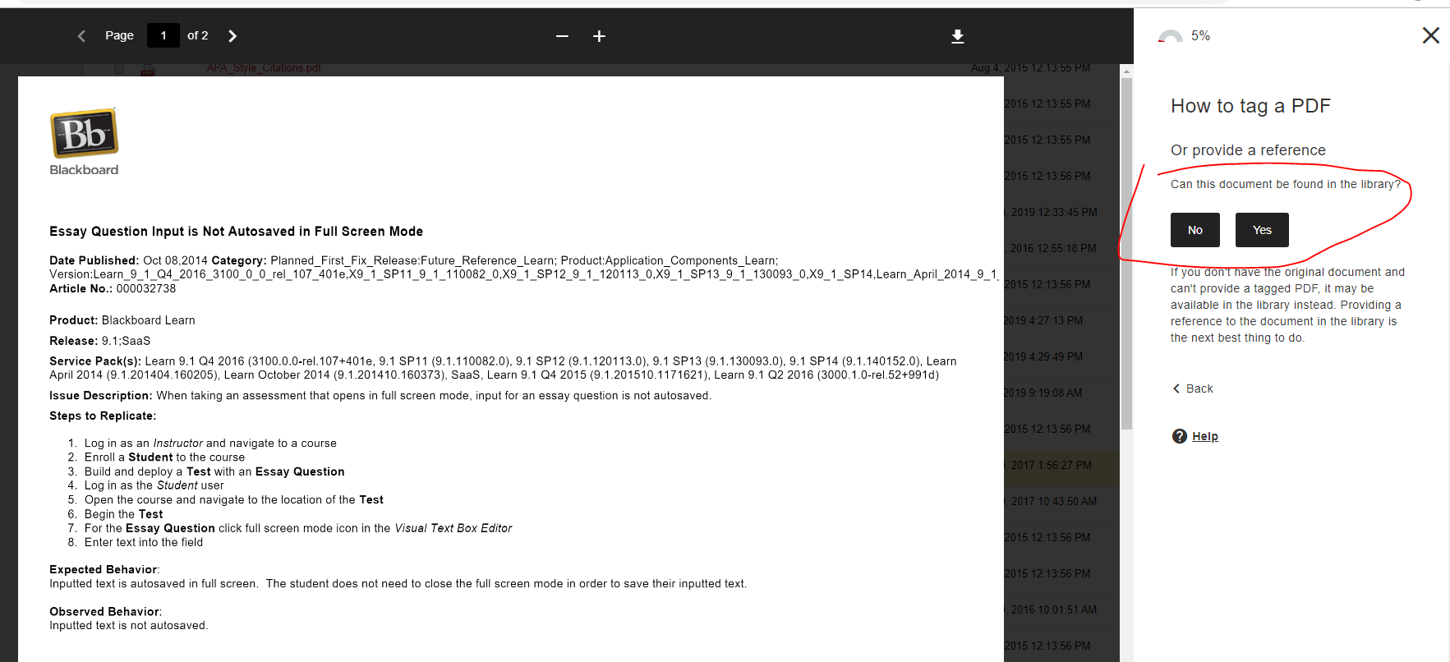
Ally for Bb Options to Correct the File

Slide 23
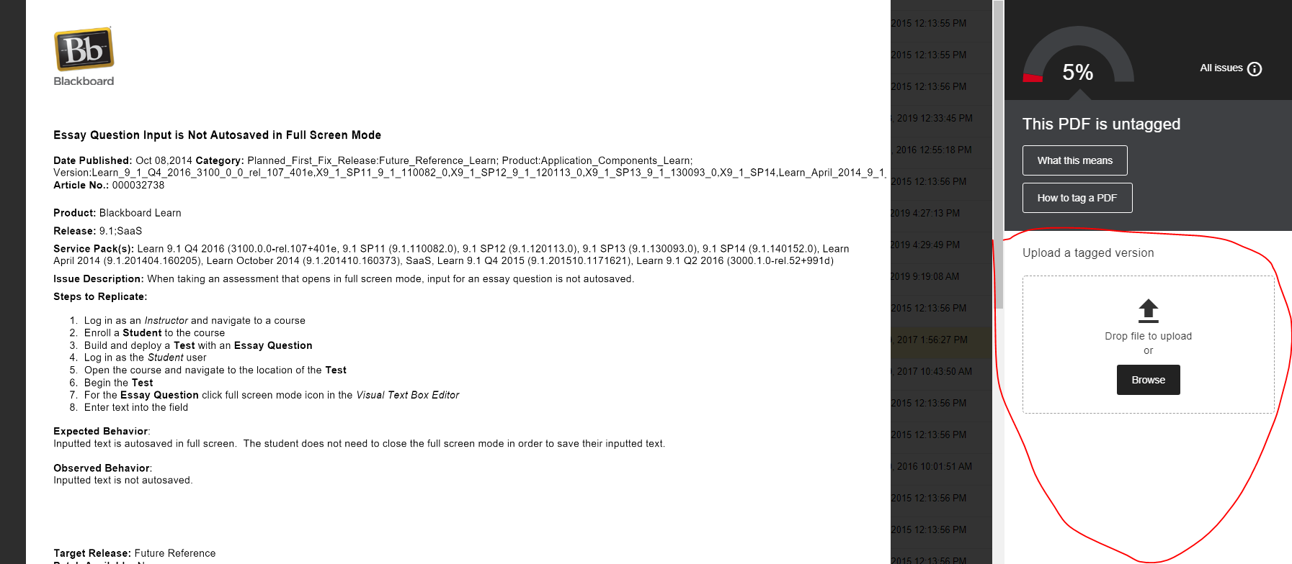
Ally for Bb Re-Upload and Re-Score

Slide 24
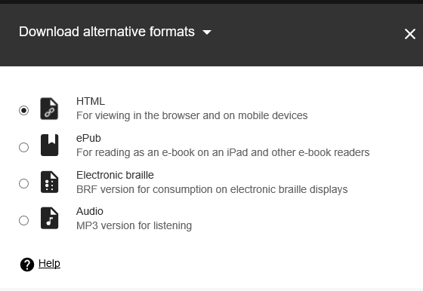
Ally for Bb Student Features (Phase 3)
Alternatives for Students

Slide 25
Ally for Bb Alternative Versions
Students will be offered:
Tagged PDF—improves the document to use with assistive reader technology
HTML—to view in a browser or mobile device
Epub—e-book for iPad, Kindle, etc
Electronic braille—for electronic braille displays
Mp3—audio files

Slide 26
Ally for Bb Limitations from Initial Testing
Ally Bugs/Issues
Corrected items in individual courses slow to update.
Ally reports do not generate in Microsoft Edge
Some Ally reports are difficult to interpret
Special concerns for STEM and special content
Alternative version may not be accurate--notation, symbols and hand-written materials, music compositions, some language content (e.g. Middle English), etc.
If faculty make an alternative available to students, they will need to check the accuracy

Slide 27
Ally for Bb Opportunities
Cutting-edge, pioneering technology—room to grow
Committed Bb team on this. They want the feedback from all users.
Raises awareness for ALL content creators
Reach more of our students
Provides more options for our students regardless of physical or cognitive abilities

Slide 28
UH Accessibility Goals for Course Materials
Goal end of Summer 2020
Move the needle—Bb content will INCREASE from 52% accessibility. TREND UP
Great place to start: Your Syllabus
A syllabus will have several elements to practice with, especially, headings, tables, and other formatting, as well as image tagging and html linking.
Use the Accessibility checker in Word, Ppt, Pdf maker, etc.
Learn more about accessibility. Many resources.
Talk to an Instructional Designer

Slide 29
UH Accessibility Goals for Course Materials
Instructional Designers + Bb Admins are working behind the scenes
Template creation
.css updates last spring
Upgrades to the theme from Original to "2016 Theme"
Learning the new Ally functionalities
Learning about accessibility in general
Creating tutorials and articles in Instruction@UH blog
TESTING, TESTING, TESTING
Some things we are focusing on...

Slide 30
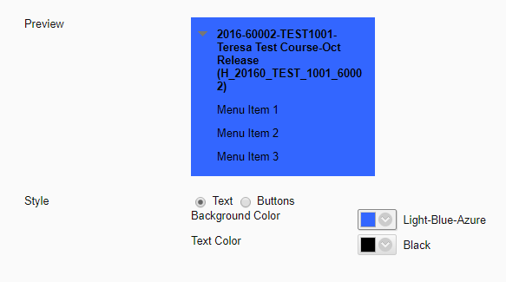
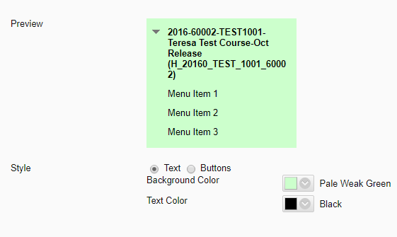
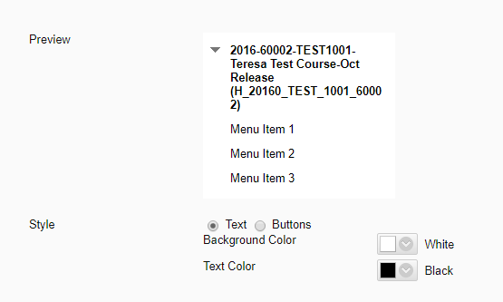
Bb Menu Contrast issues
Not enough contrast
Better
Preferred: Background select: FFFFFF;
Text select: Black
Customization>Teaching Styles

Slide 31
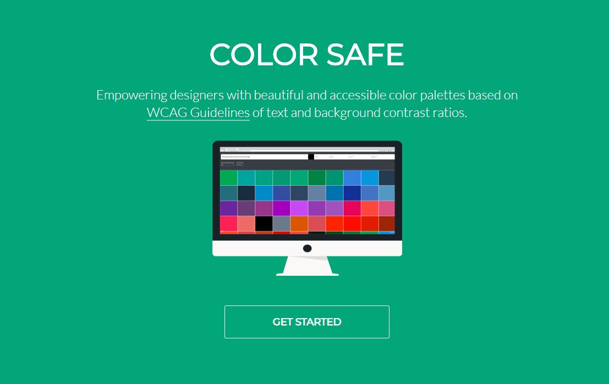
Bb HTML Color Contrast Preferred Ratios
http://colorsafe.co/
https://www.cuidiz.com/web-accessibility-contrast-conundrums/

Slide 32
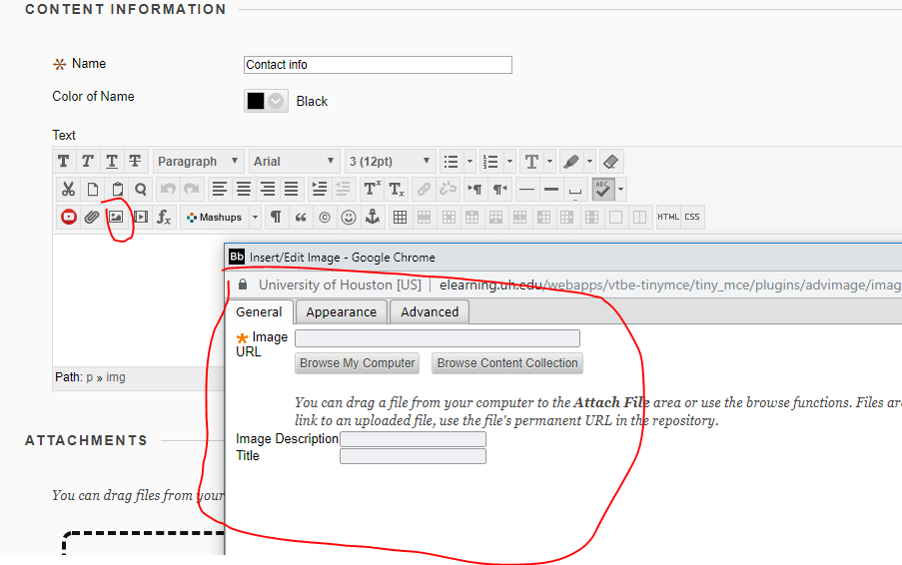
Image Tagging

Slide 33
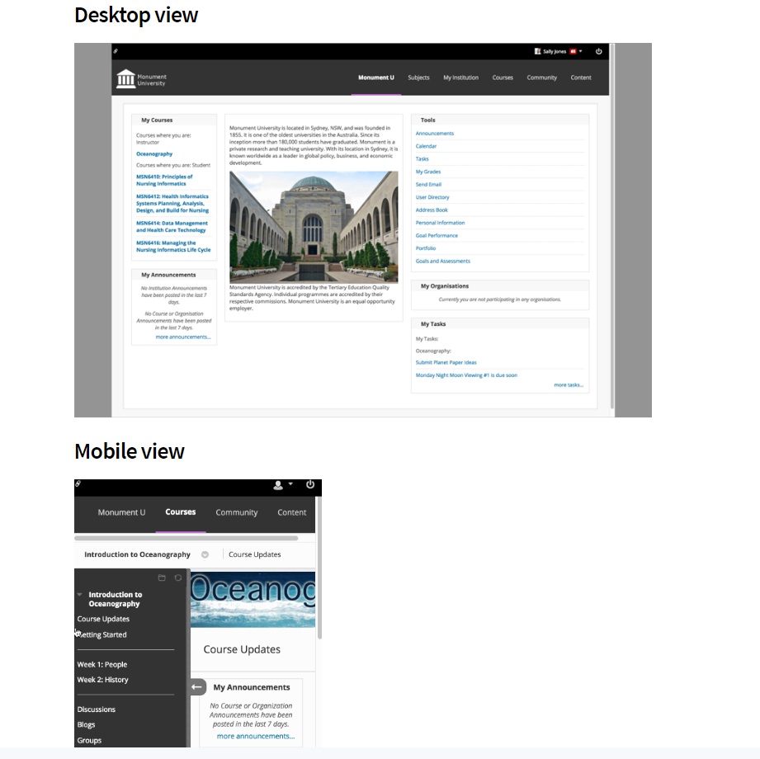
Bb 2016 Theme coming 2020
Learn 2016 theme, follows WCAG 2.1 principles and accessibility guidelines for structure, color contrast, and navigation. Fully visible keyboard focus has been built directly into this theme as well as best practices for the definition of buttons and menus used for navigation. ARIA landmarks have been added in courses to the course menu and the content area to define the page structure and assist users with screen readers in navigating page elements.
2016 Theme moves the needle!

Slide 34
UH Course Content Accessibility Wrap-Up
HELP MOVE THE NEEDLE
Bb content will increase from 52% accessibility by end of summer 2020
Run an accessibility review and update your Syllabus as needed
Use the Accessibility Checker in Word, Ppt, Pdf maker, etc.
Start tagging your images
Make sure your scanned documents are OCR'ed
Work with your Instructional Designer and Librarians
Learn more about accessibility

Slide 35
Examples of using Ally in real courses

Slide 36
Examples of using Ally in real courses
CHNS3396-Chinese Popular Culture​
Dr. Melody Yunzi Li

Slide 37
Images
Issue One: The image does not have a description./The description is not descriptive enough.
Missing!
How we fixed it:
Added alt text in Image Editing.
Enter text in the Description field (not the Title field).
Alt text for image Description and the Title should be different.

Slide 38
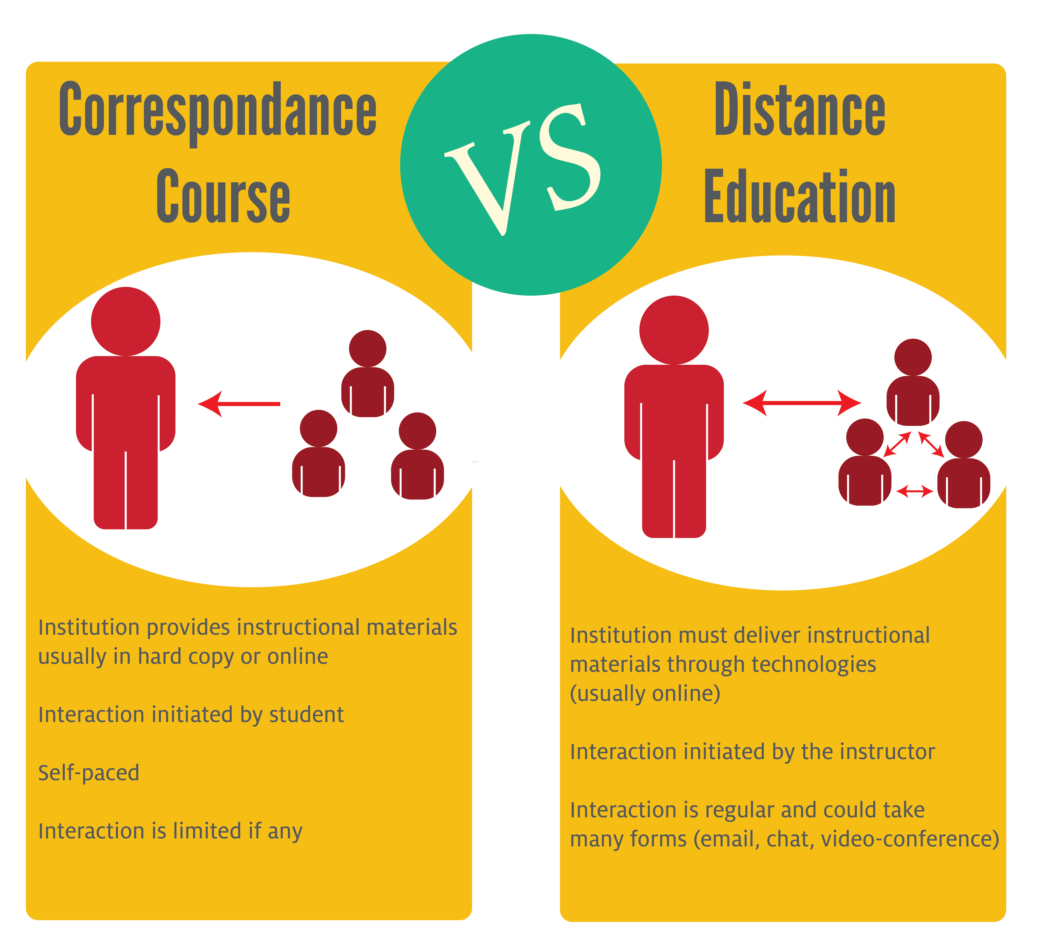
Images
Issue One: The image does not have a description./The description is not descriptive enough.
How we fixed it: ​
Included the exact same text in alt text​.
Described the image in the content and provided a short alt text.​

Slide 39
Images
Issue One: The image does not have a description./The description is not descriptive enough.
1. Image alt text should not include "picture of/image of...
2. Make sure to delete all the images that you are no longer using for the course in Course Content Collection.
3. Try to avoid using images of text. Instead, replace the image with actual text.

Slide 40
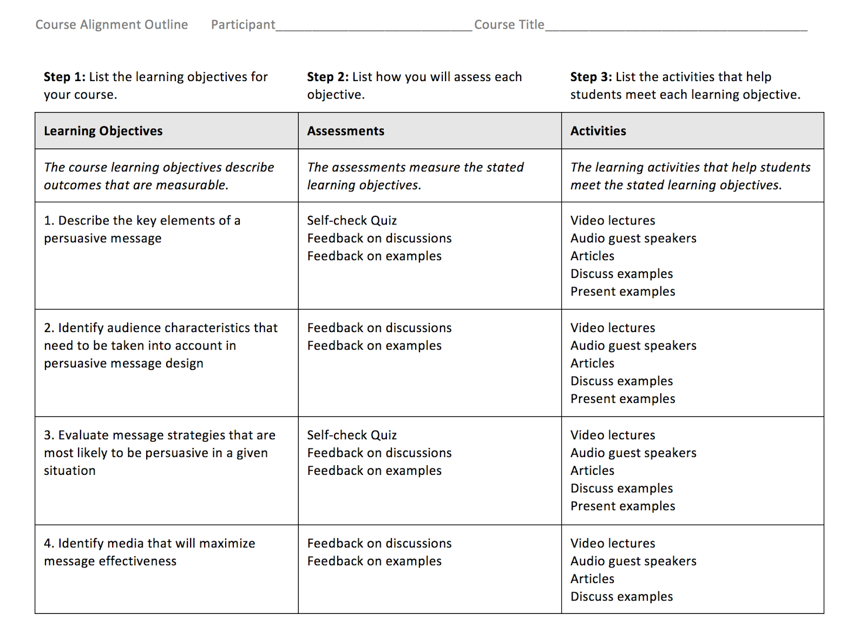
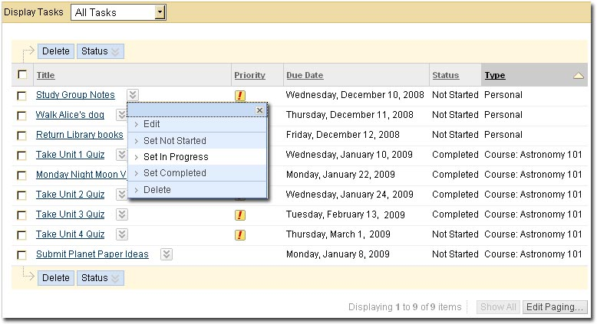
Images
Issue Two: The image has contrast issue.
How we fixed it:
1. Made changes to the original document.
2. Or uploaded an image to a PPT slide and adjusted the contrast of the image using Picture Format feature.

Slide 41
Images
Issue Two: The image has contrast issue.
When you use an image that contains text, make sure that the text is readable by creating a high-contrast ratio between the text and its background.
Photo editing tools:
Canva, Pixlr, Ribbet, Photoshop, Lightroom...

Slide 42
Images
Issue Three: The image can induce seizures.
Animated Gifs
Flashing
Intense patterns
How to fix it: Replace the image with an alternative image.

Slide 43
YouTube Videos
Issue: The HTML content contains videos without captions.
Ally checks YouTube videos for captions.
Ally checks for both embedded YouTube videos and links to YouTube videos.
Auto-generated YouTube captions are NOT considered to be valid captions
Captioning your YourTube Videos

Slide 44
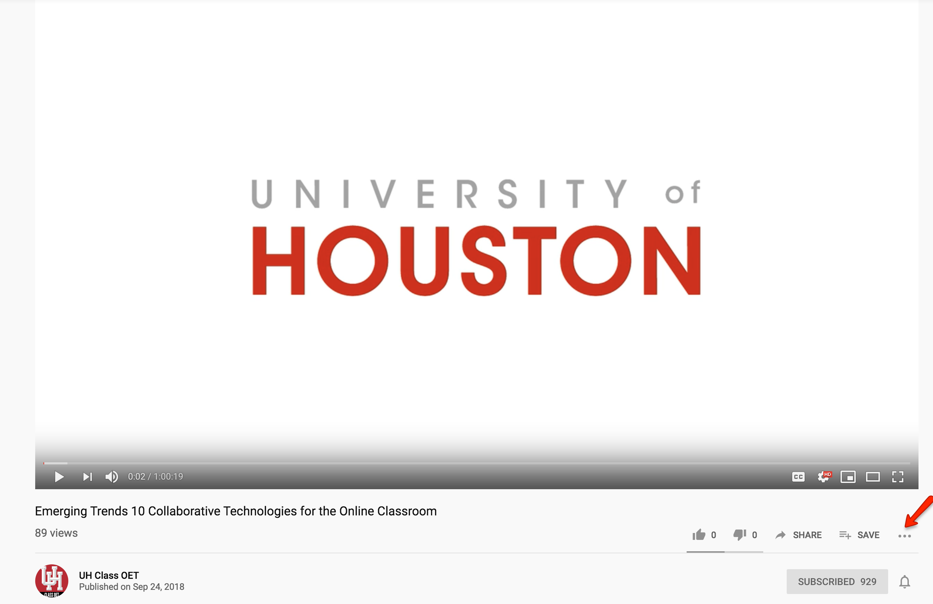
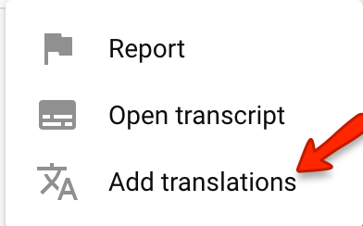
YouTube Videos
Issue: The HTML content contains videos without captions.
How to Contribute Subtitles to Someone Else's YouTube Video

Slide 45
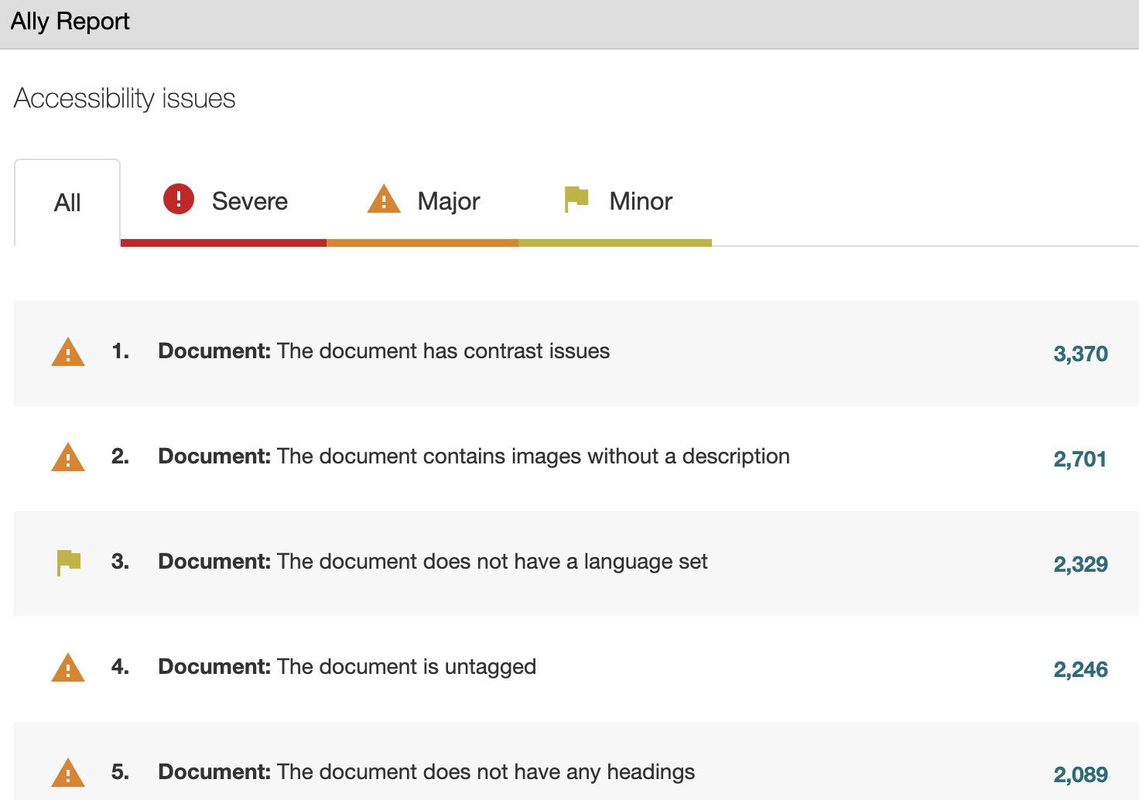
Document Issues

Slide 46
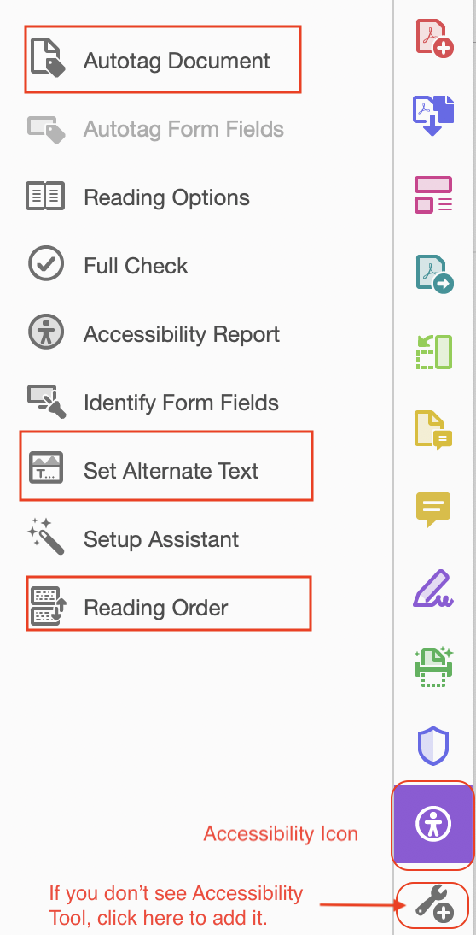
How to Fix PDF files
Common Accessibility Issues in PDF | Suggested Solutions/Software
1. Scanned PDF not OCRed | Adobe Acrobat – Edit PDF Tool
2. Untagged document, or missing headings/titles.
3. Missing Alternate Text
4. Unclear reading order
5. No language set | In Adobe Acrobat, Select File -> Properties -> Advanced -> Reading Options -> Language
Notes:
1. OCR (Ally explanation): These documents are either entirely scanned or contain pages that are scanned. Screen readers are unable to convert an image into words, even if the image only consists of text, so people with screen readers or other assistive devices will not be able to read those pages. Scanned documents, especially those of poor quality or those containing handwriting, can be difficult to read for everyone. They also have other usability issues such as not being able to search inside the document.
2. Tags: These PDF documents are not tagged. PDF tags are hidden labels that clarify the structure of the document and define what's a heading, paragraph, table, list, etc. Without these tags, PDF documents are essentially just a bag of difficult to distinguish words that can be really hard to navigate and understand for people with screen readers or other assistive devices.
3.

Slide 47
PDF Design
Before creating a PDF file, keep these in mind:
Selecting an authoring application
Planning the document structure
Defining the names and purpose of all the images and figures
After a PDF is completed:
Running a Full Check
Reviewing Accessibility Report
Manually fixing if needed
Resource:
PDF Cheat Sheet

Slide 48
How to fix documents in Blackboard
Common Accessibility Issues | Suggested Solutions
1. Missing headings/titles | Using formatting tools provided in Blackboard
2. Low contrasting, especially between text and background | Default background and text Make font larger or bold can also help resolve low contrasting Avoid high contrasting as well Color contrast theory
3. Bullet points are not nested correctly | Using list tool + Increase/Decrease Indent key
4. No language set | Adding HTML attribute <html lang=" "> through the HTML tab
Notes:
Contrast: when there’s not enough contrast between type and the background color, people with certain visual problems might have trouble reading the text.
When choosing more than two colors, try to focus on one main dominant color and use the other colors to support it. Complementary colors – Two colors that are directly opposite each other on the color wheel, such as yellow and purple, or blue and orange.
Complementary colors – Two colors that are directly opposite each other on the color wheel, such as yellow and purple, or blue and orange.
Analogous colors – Three colors that are next to each other on the color wheel, such as red, red-purple and purple or orange, orange-yellow and yellow.
Triadic colors – Three colors that are evenly spaced on the color wheel (like a triangle).
https://www.google.com/search?q=how+to+check+colours+compliment+each+other&oq=how+to+check+color+compl&aqs=chrome.2.69i57j33l2.7941j0j7&sourceid=chrome&ie=UTF-8
A critical step toward creating an accessible data table is to designate row and/or column headers. In the markup, the <td> element is used for table data cells and the <th> element is used for table header cells. Going back to our original data table example, the column headers for this table are Name, Age, and Birthday. The row headers are Jackie and Beth. Also note the associated caption.
Shelly's Daughters
Table headers should never be empty. This is particularly of concern for the top-left cell of some tables

Slide 49
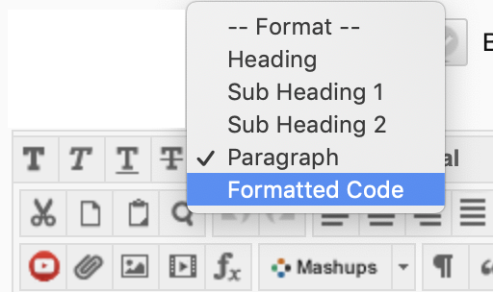
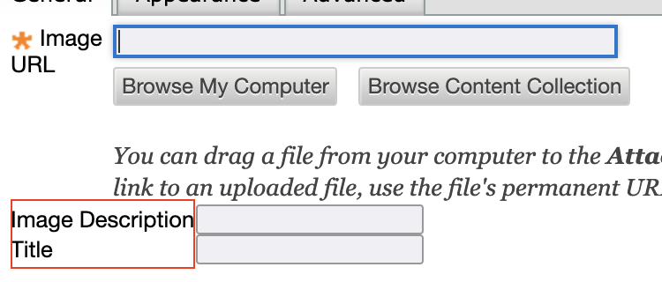
Document Building in Blackboard
If you write text, insert images, set up lists etc. directly in Blackboard
Using the "Format" menu to structure headings and paragraph
Fill all boxes when inserting an image
Create all list elements first and then set up nesting structure
Caution about Tables
If you copy content from another application such as Word
Consider to remove formatting
Notes:
Headings: 6 levels, do not go beyond it.

Slide 50
Resources
Course Material Scanning Resources: http://www.instruction.uh.edu/2019/07/17/accessible-course-content-ares-course-reserves-and-pdf-best-practices/ Video outlining scanning best practices and how to work with a UH Librarian to get your course reserves together.
Accessibility on Instruction@UH: http://www.instruction.uh.edu/category/accessibility/ UH Blog by Instructional Designer with a section devoted to Accessibility best practices.
Wringer, B. (no date). Web Accessibility: Fixing Contract Conundrums [blog post]. Retrieved from: https://www.cuidiz.com/web-accessibility-contrast-conundrums/
Pick a color palette with a good contrast: http://colorsafe.co/
CLASS Live! Webinars: http://www.uh.edu/class/oet/class-live/
Faculty Café: http://www.uh.edu/class/oet/faculty-cafe/
Cheat Sheet: http://ncdae.org/resources/cheatsheets/
Ally for Blackboard resources: https://help.blackboard.com/Ally/Ally_for_LMS/Instructor

Slide 51
Resources
9. Web Aim Screenreader Survey: https://webaim.org/projects/screenreadersurvey7/
10. Instructional Designers by College: http://www.uh.edu/fdis/resources/instructional-designer-teams/

Slide 52
Thanks For Participation!

