Slide 1
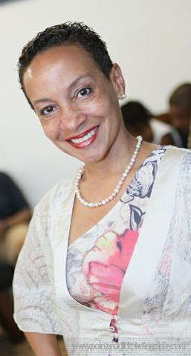
Rhonda Radford Adams

Slide 2
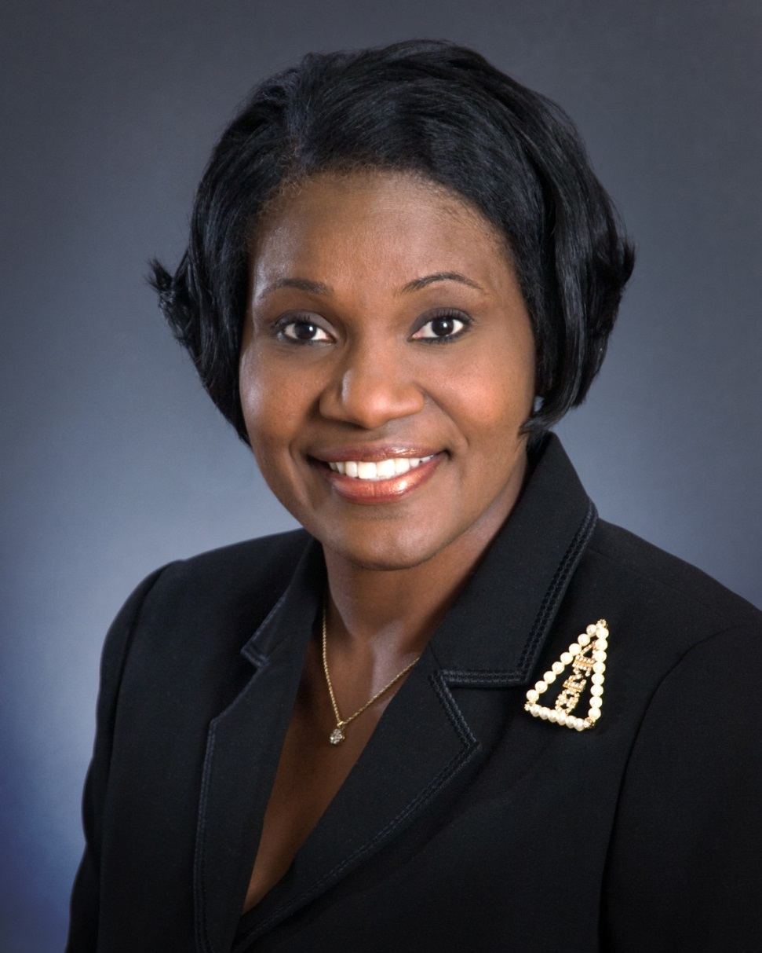
Wanda Adams

Slide 3
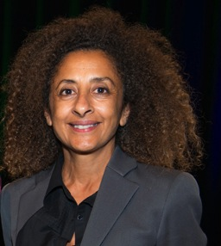
Dina Alsowayel

Slide 4
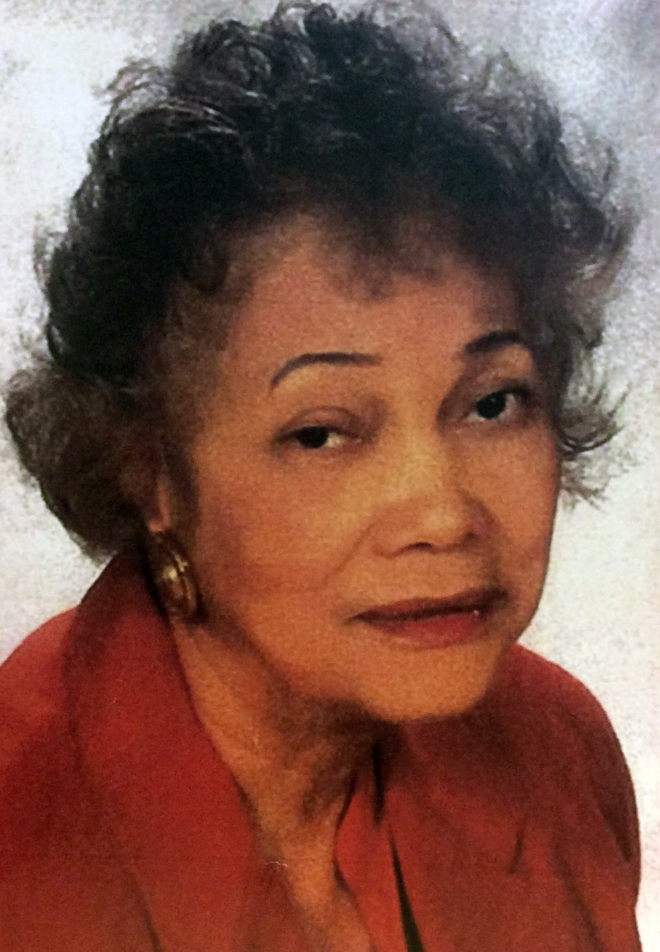
Jacqueline Whitting Bostic

Slide 5
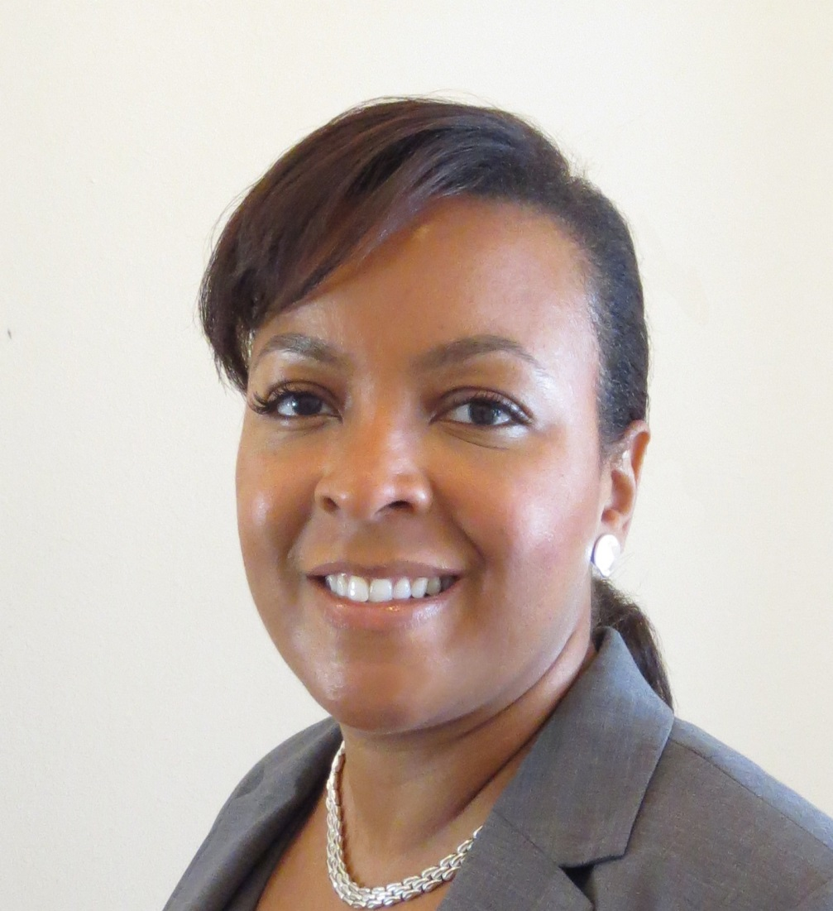
Lemar Brown

Slide 6
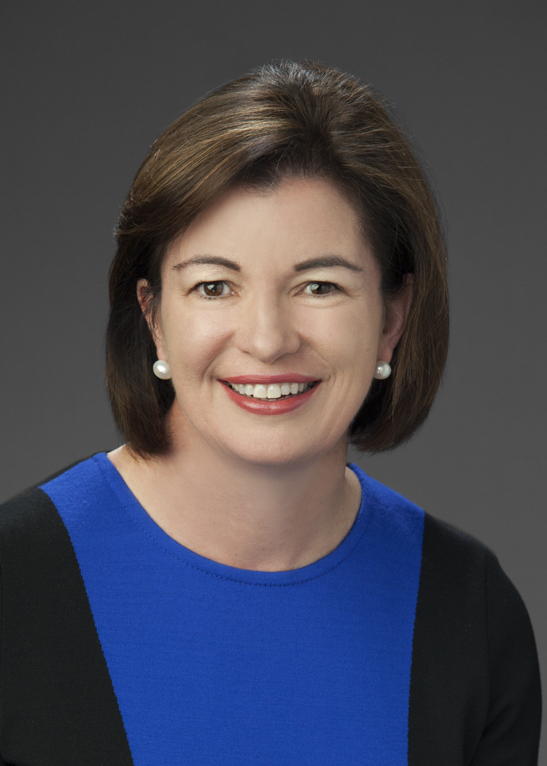
Elizabeth Cheney

Slide 7
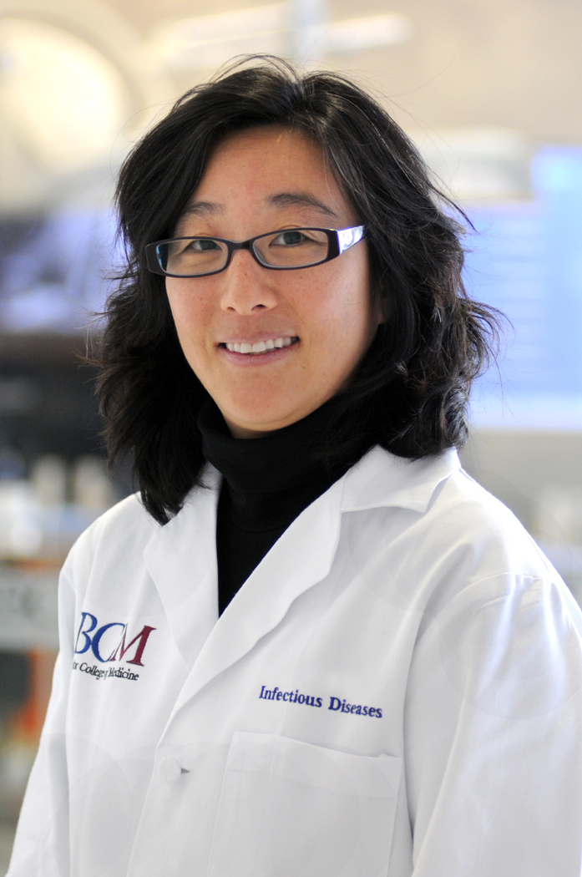
Elizabeth Chiao, MD, MPH

Slide 8
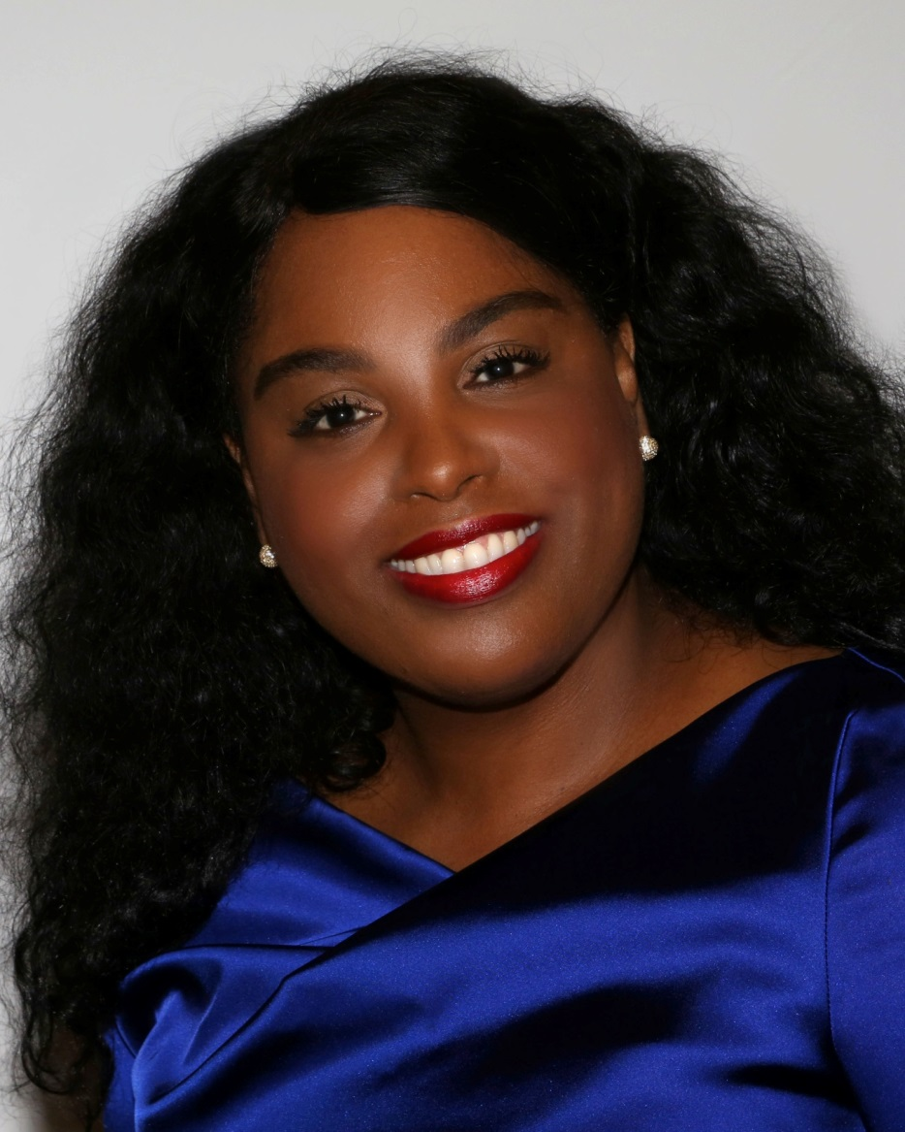
Deavra Daughtry

Slide 9
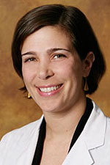
Damla Dryden, MD

Slide 10
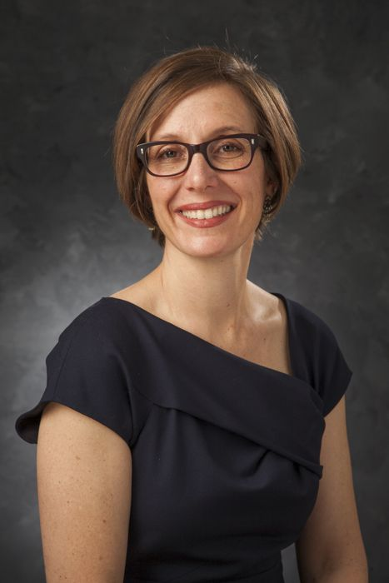
Anna Eastman

Slide 11
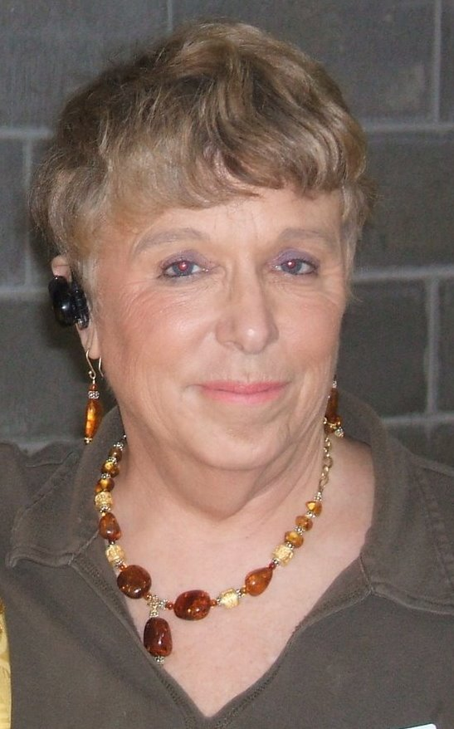
Gayle Fallon

Slide 12
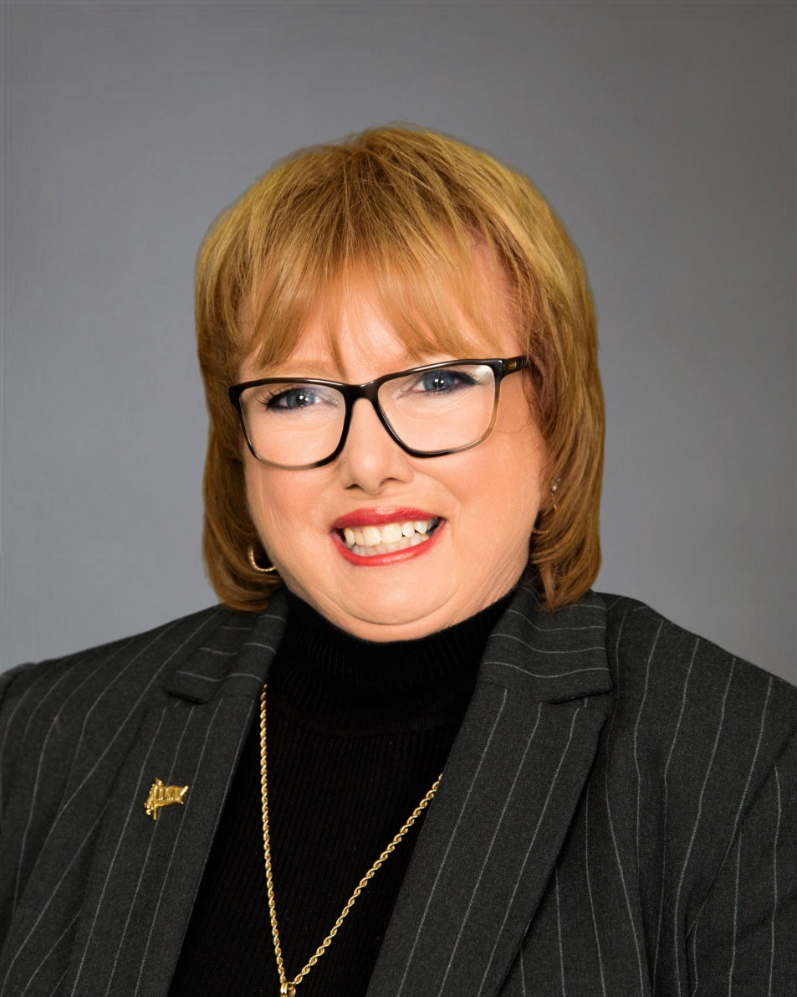
Andrea Gardner

Slide 13
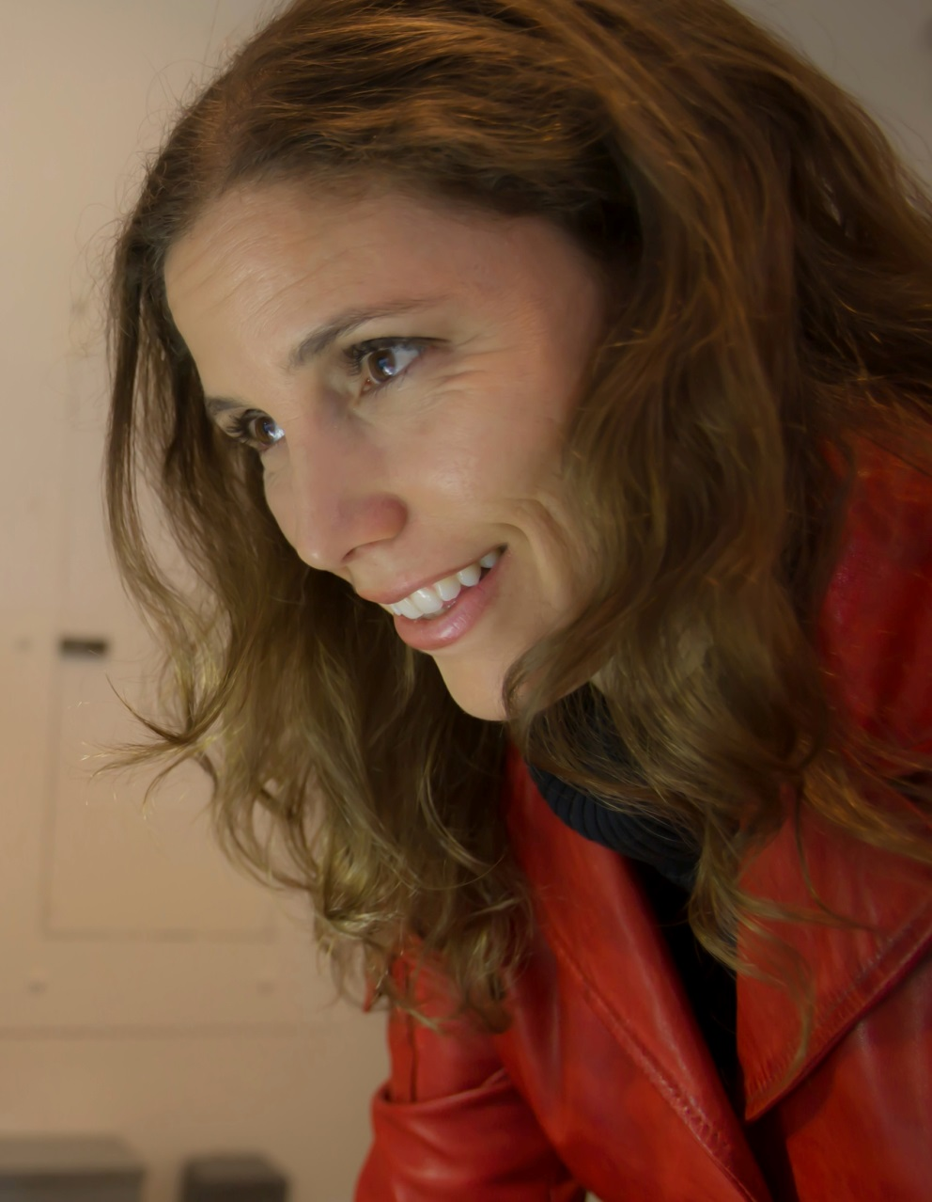
Maria Gaztambide, PhD

Slide 14
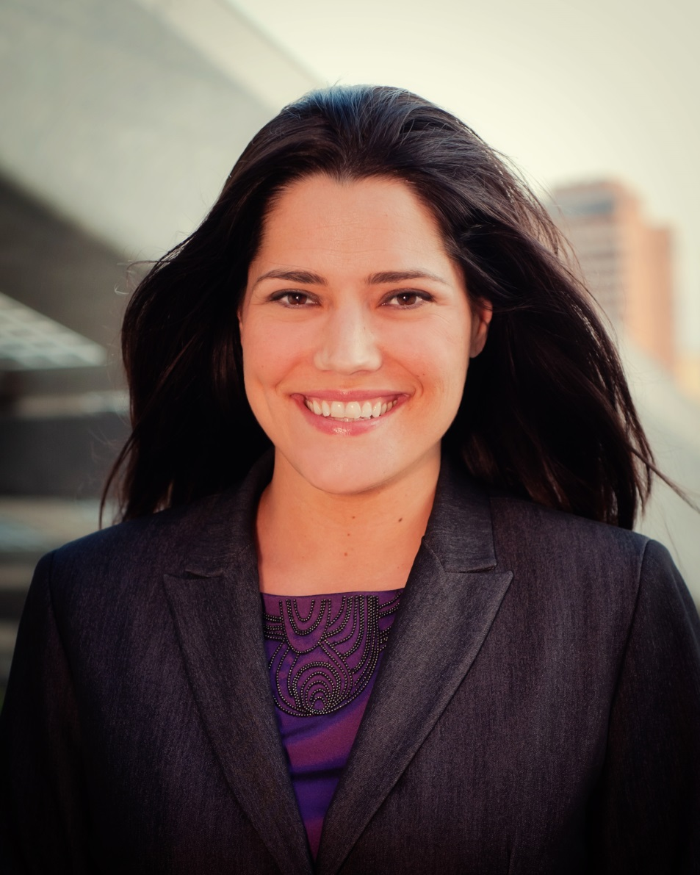
Christina Canales Gorczynski

Slide 15
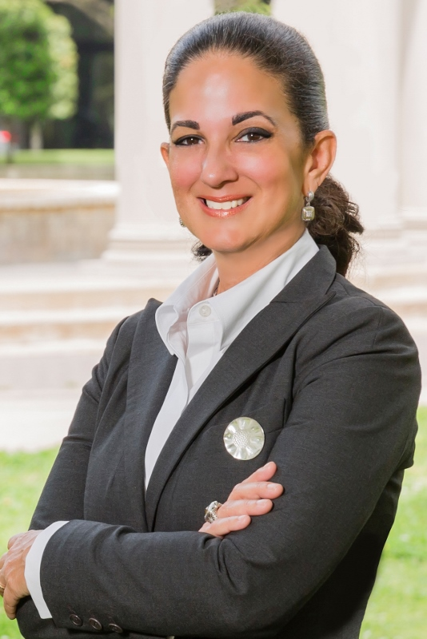
Licia Green-Ellis

Slide 16
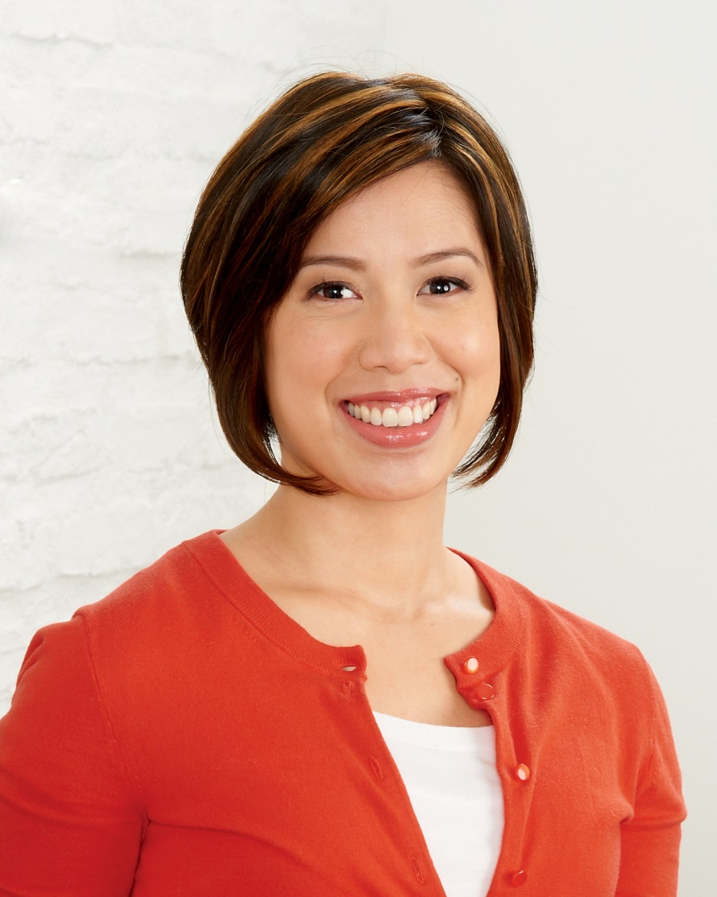
Christine Ha

Slide 17
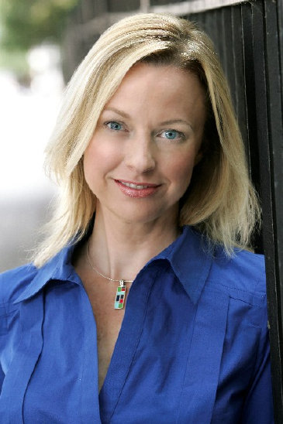
Reyne Hirsch

Slide 18
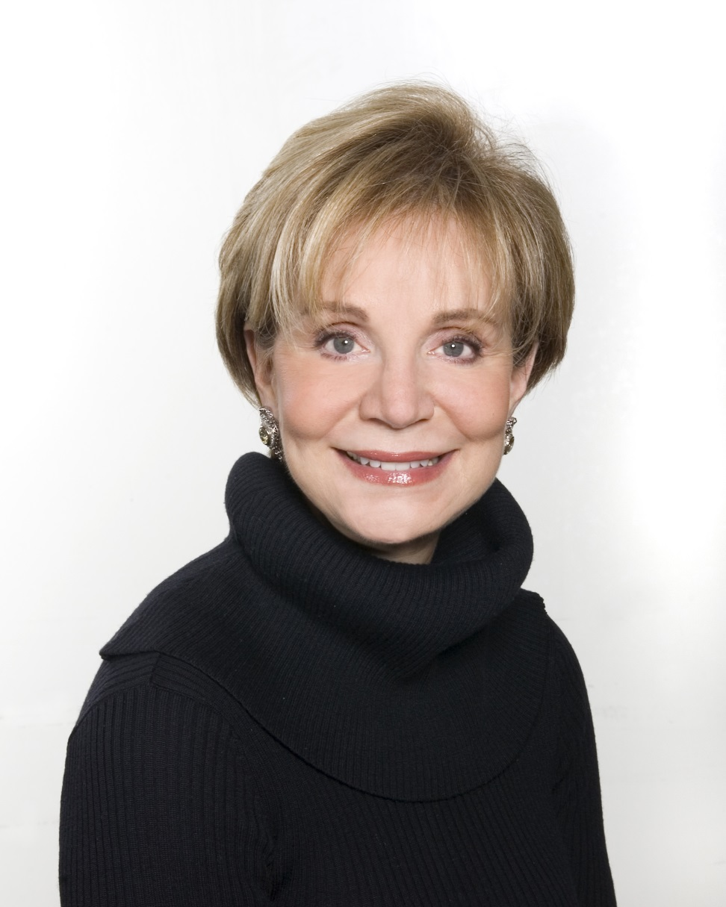
Leisa Holland-Nelson

Slide 19
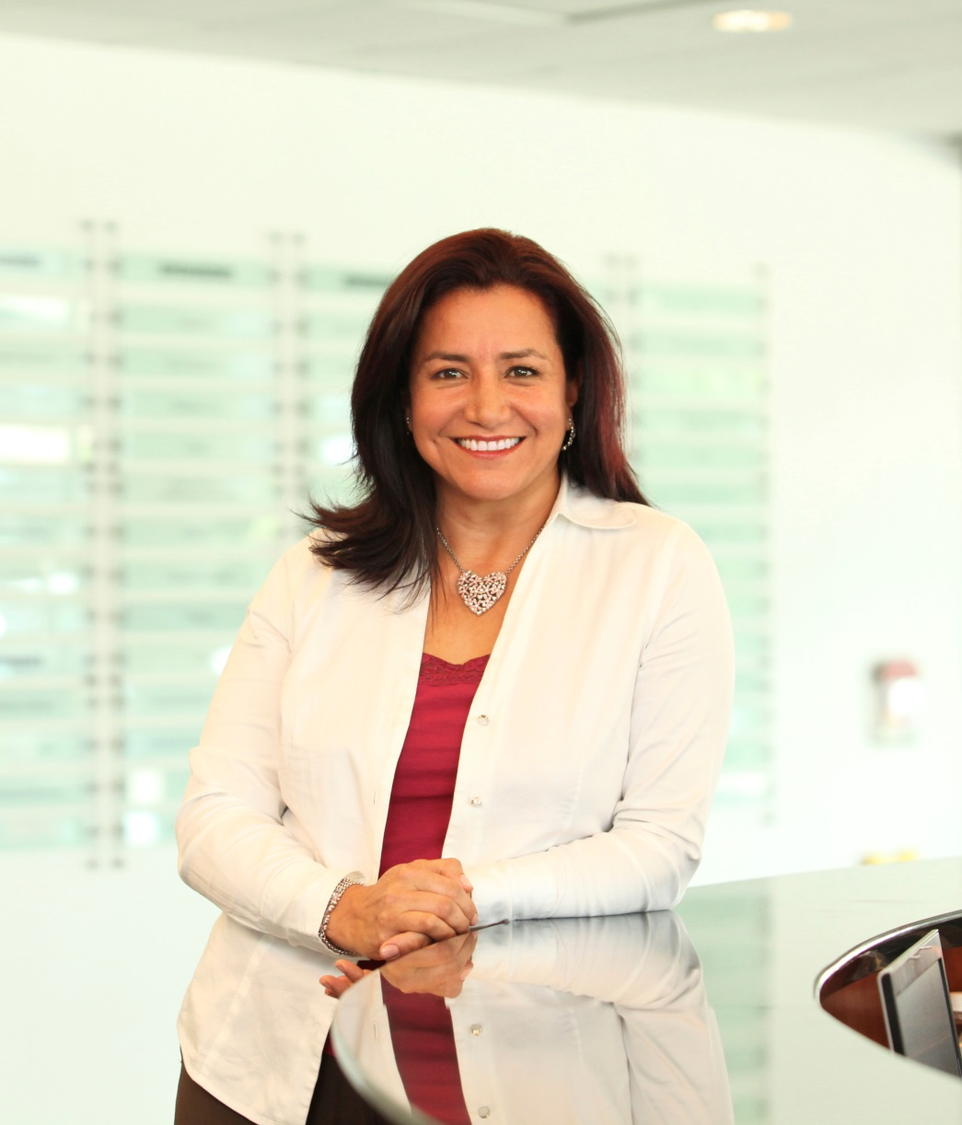
Yamile C. Jackson, PhD, PE, PMP

Slide 20
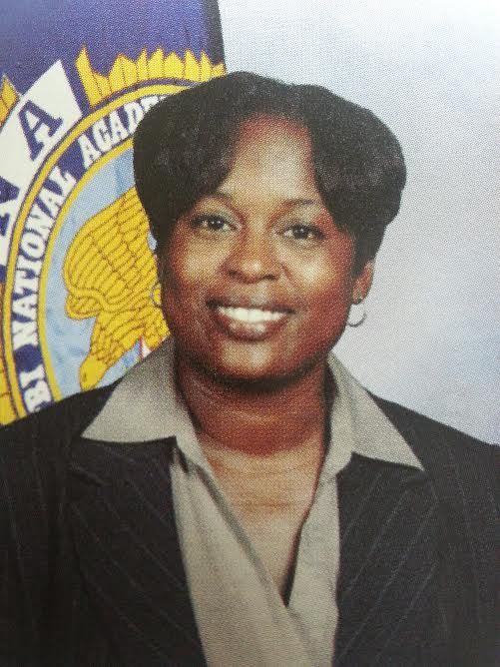
Sheila Jones

Slide 21
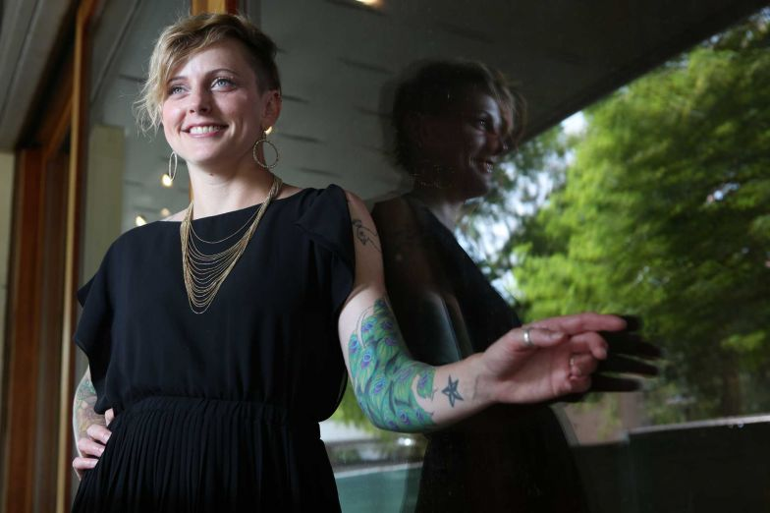
Lacy Johnson

Slide 22
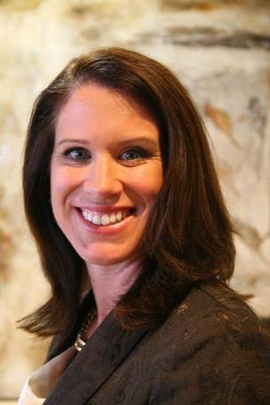
Carmen Jordan

Slide 23
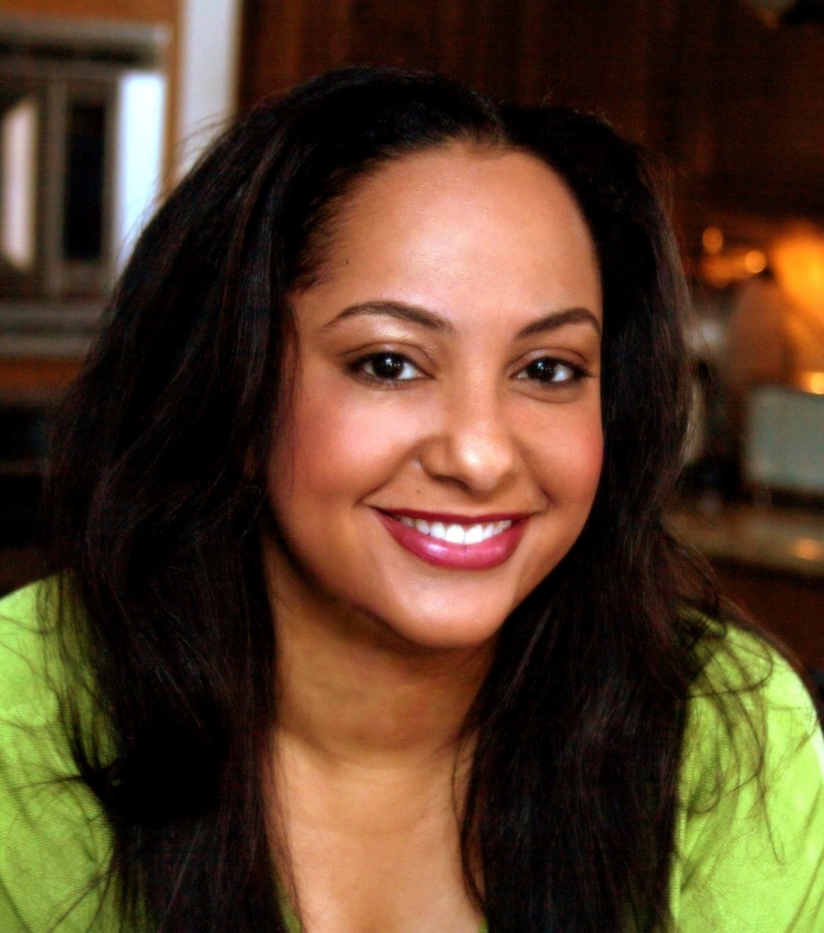
Noreen Khan-Mayberry, PhD

Slide 24
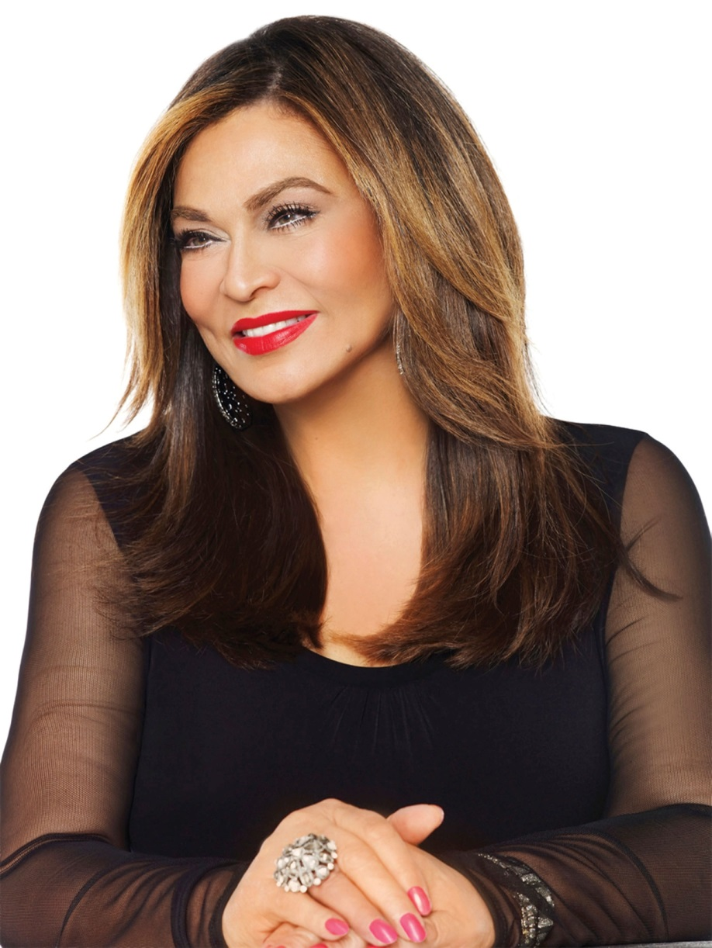
Tina Knowles

Slide 25
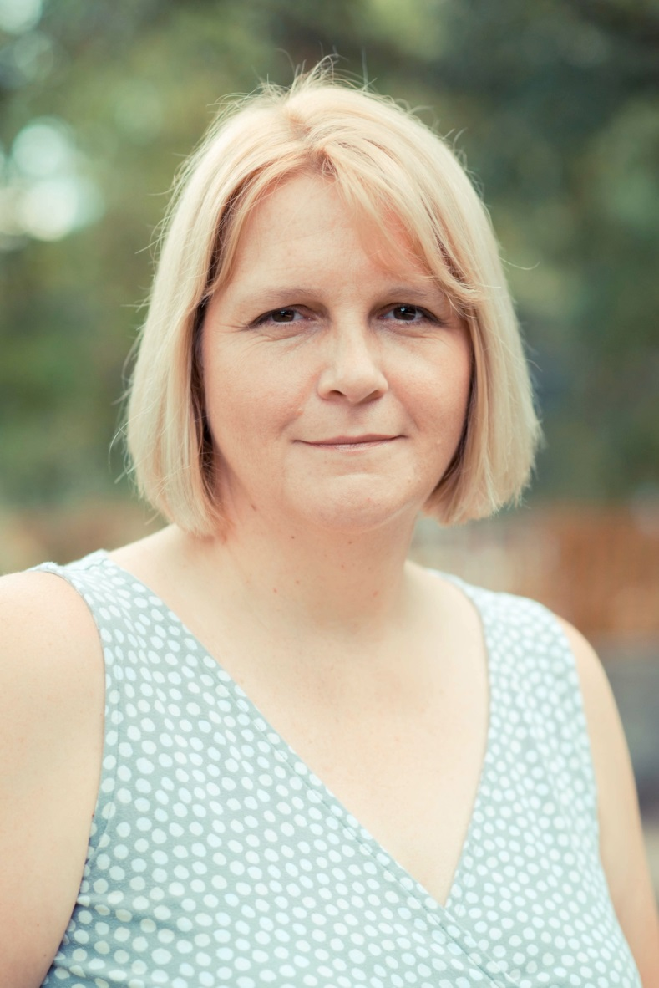
Caroline Leech

Slide 26
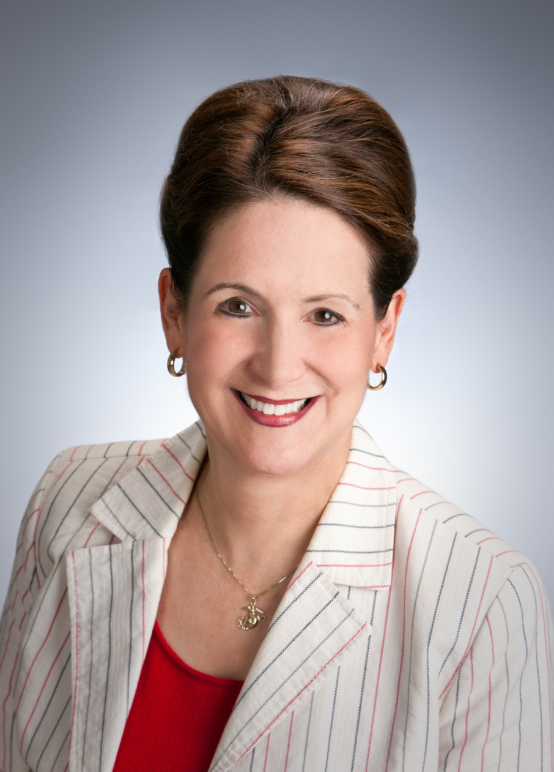
Lynne Liberato

Slide 27
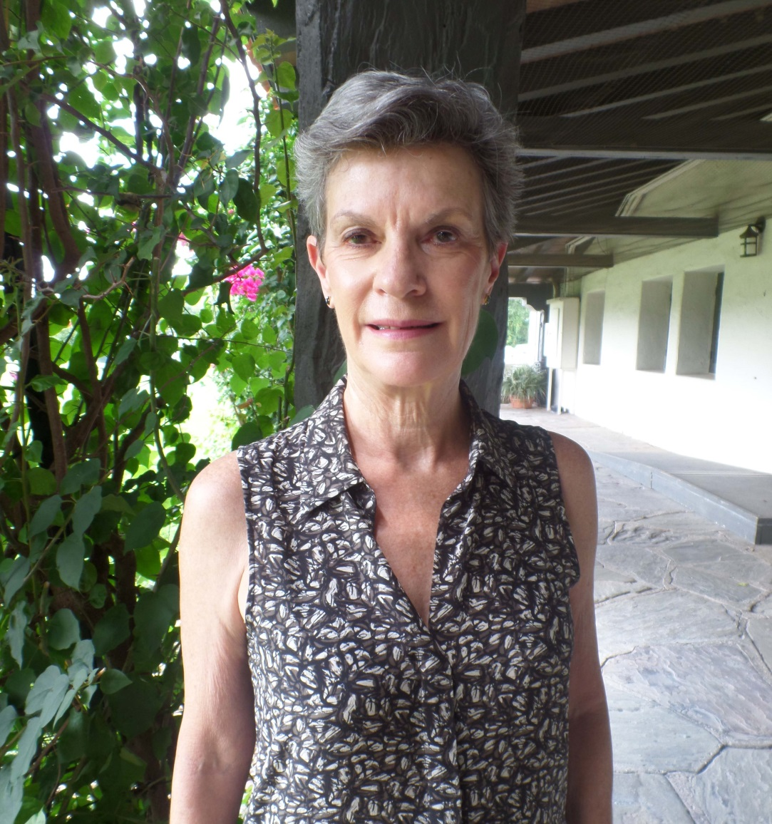
Marley Lott

Slide 28
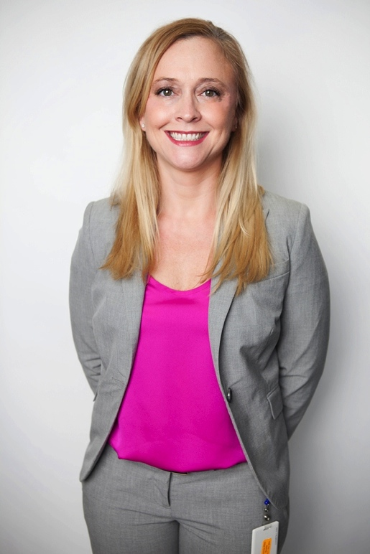
Elizabeth Maberry

Slide 29
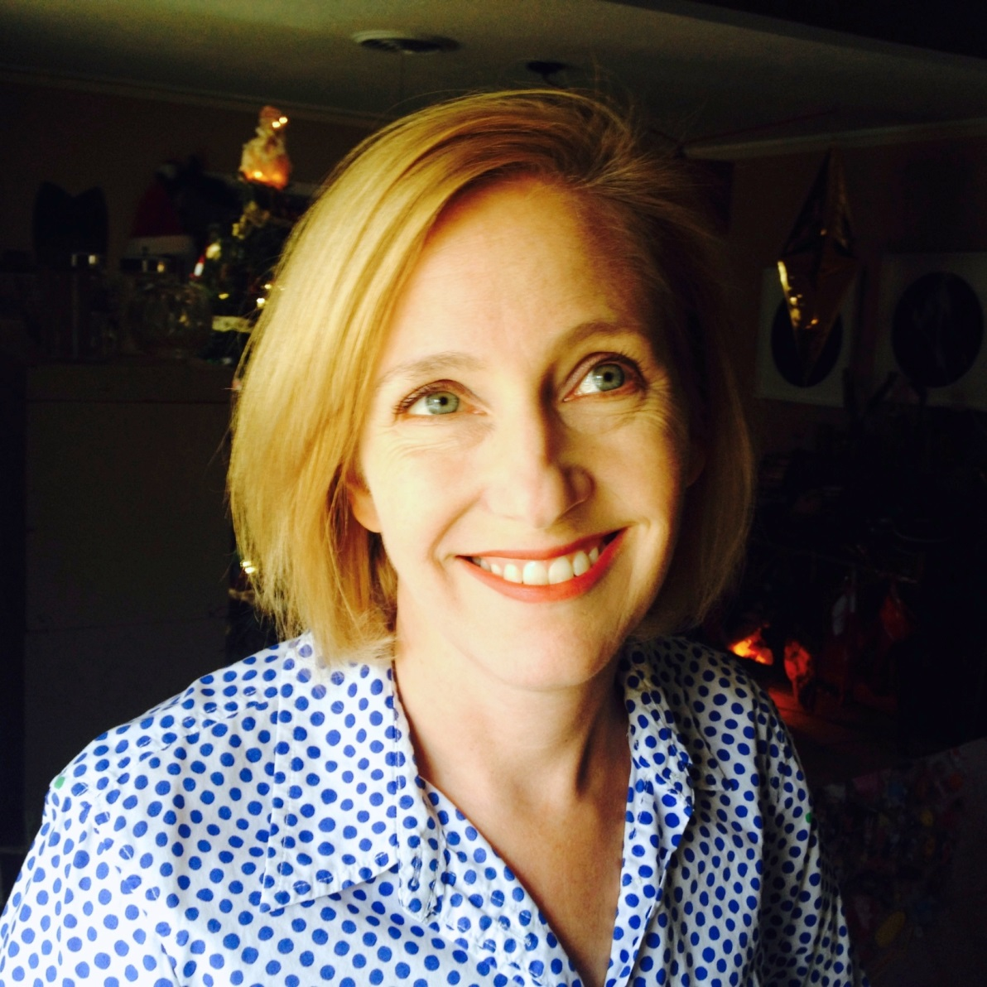
Mary Magsamen

Slide 30
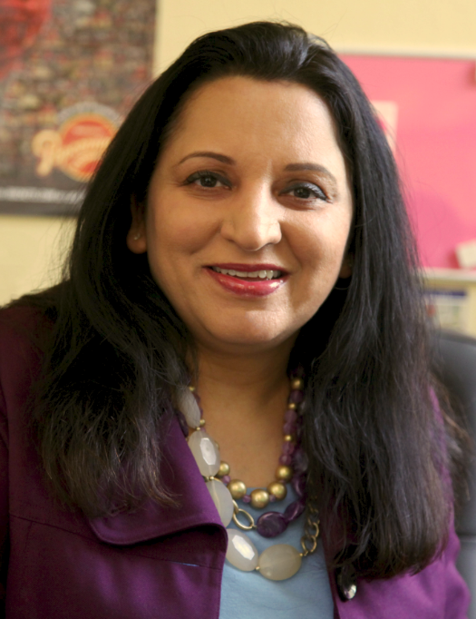
Jyoti Malhan

Slide 31

Ruchi Mukherjee

Slide 32
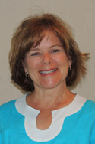
Teresa O’Donnell

Slide 33
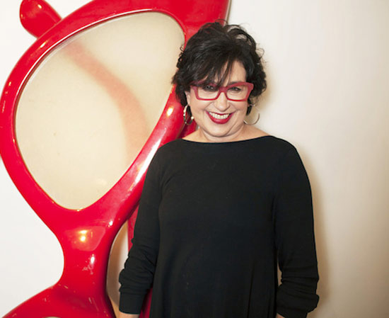
Roz Pactor

Slide 34
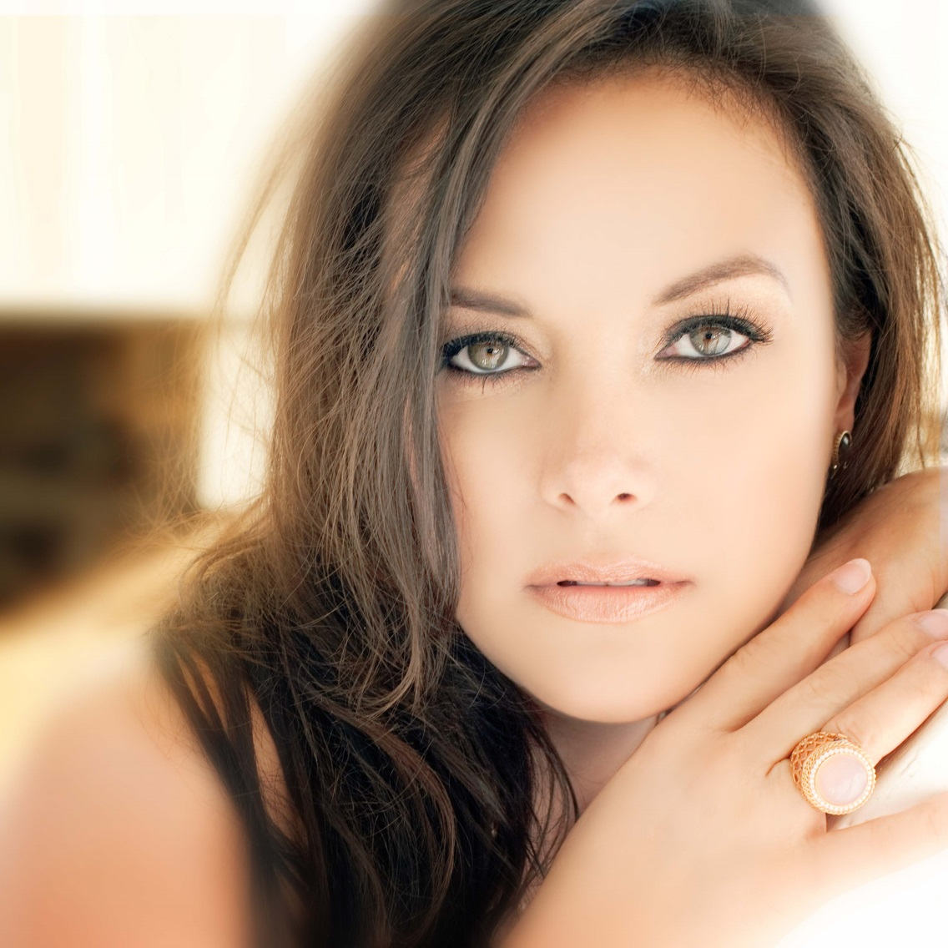
Barbara Padilla

Slide 35
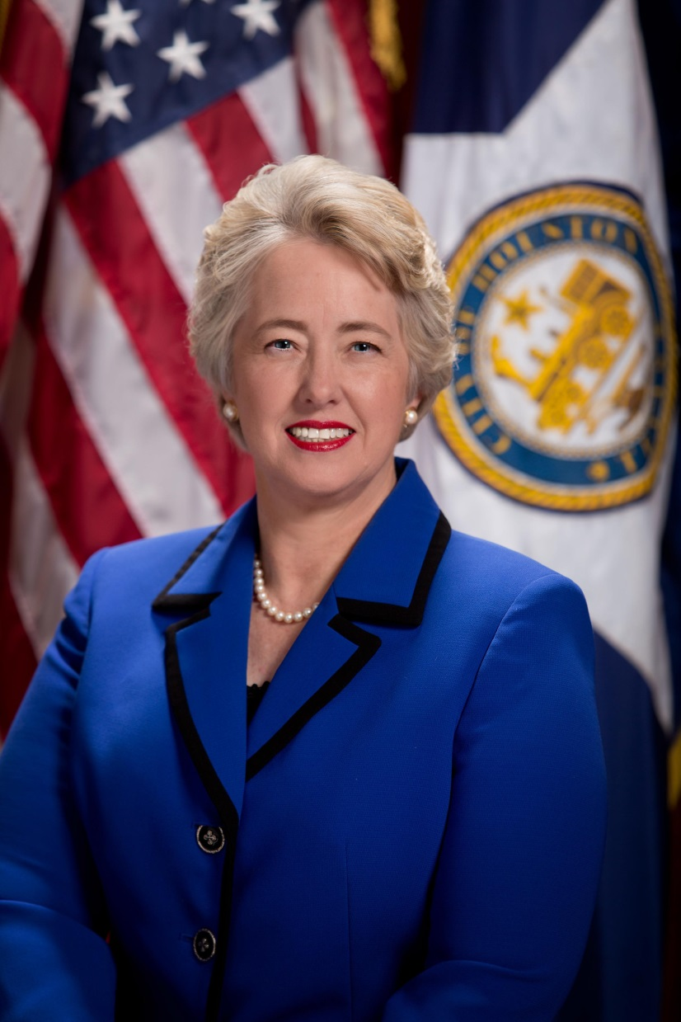
Annise Parker

Slide 36
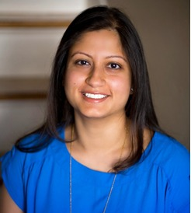
Purva Patel

Slide 37
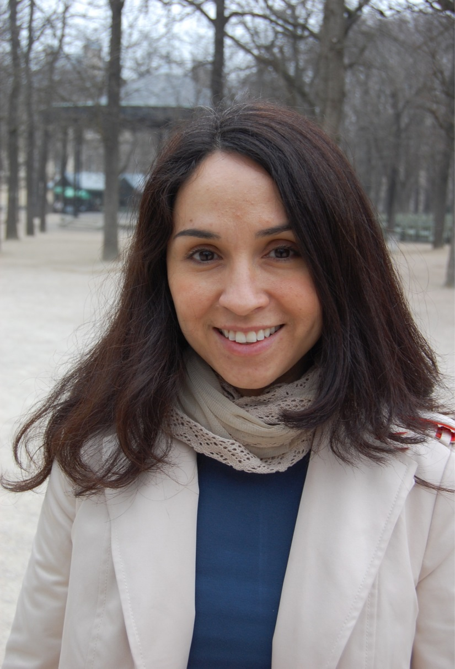
Carmen Peña Abrego

Slide 38
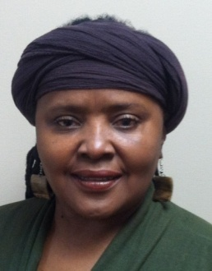
Theola Petteway

Slide 39
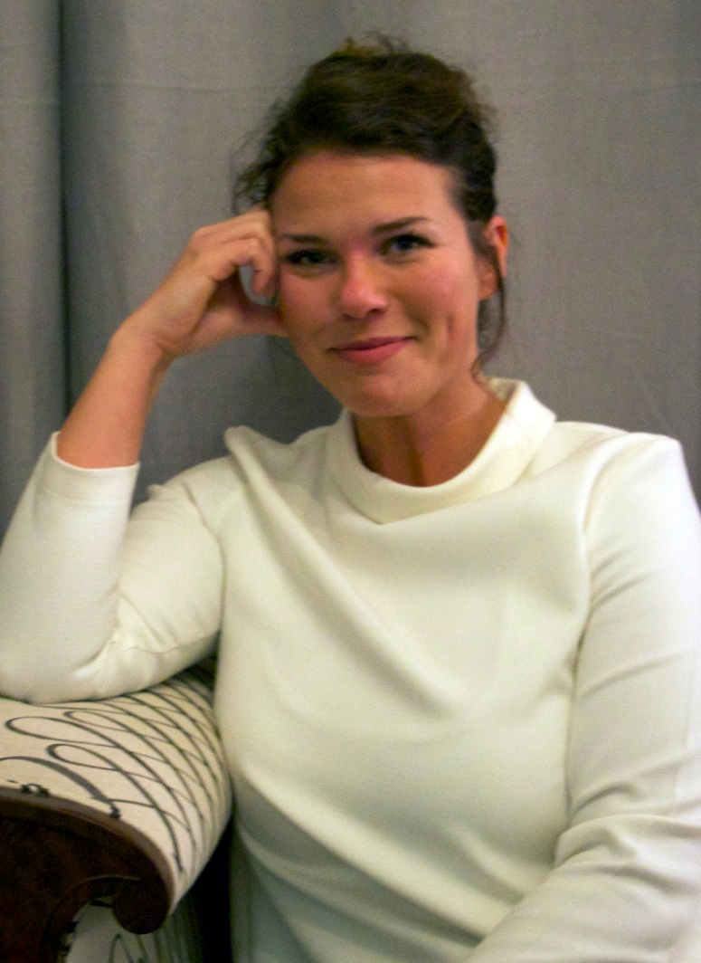
Jessica Phifer

Slide 40
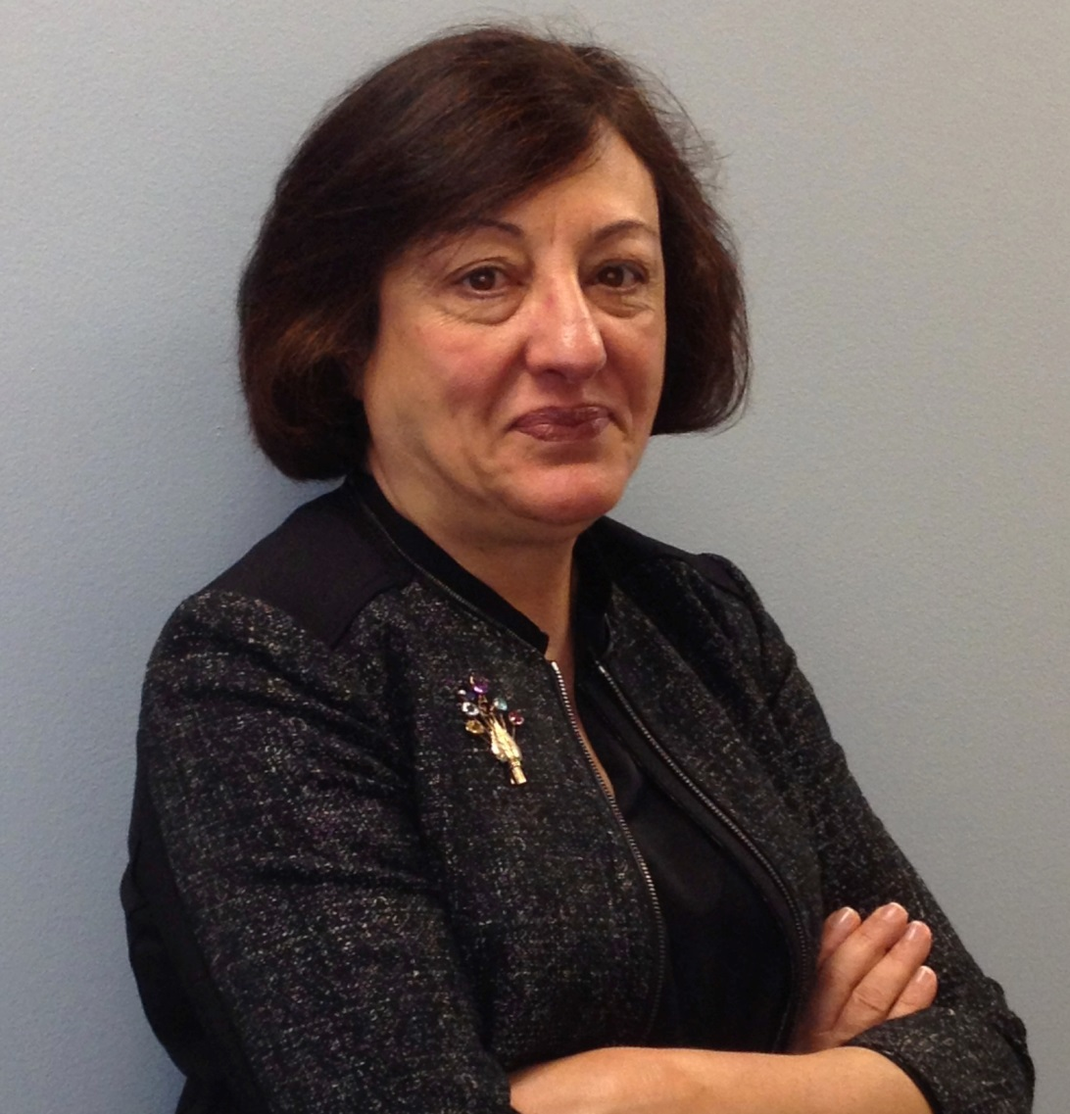
Sina Raouf

Slide 41
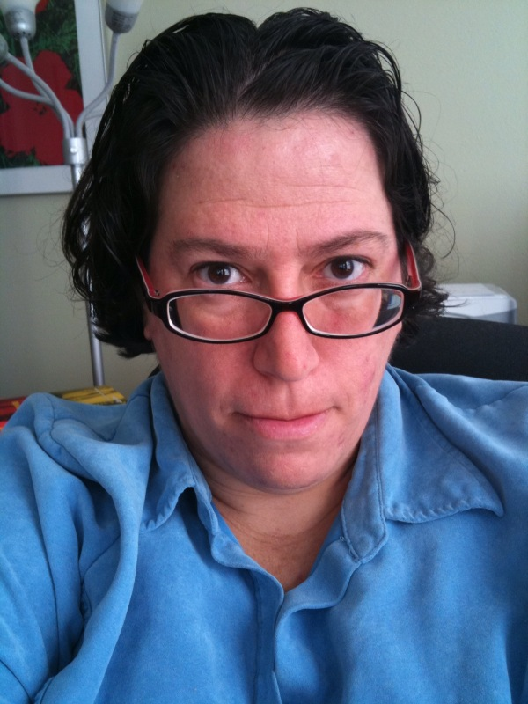
Robin Reagler

Slide 42
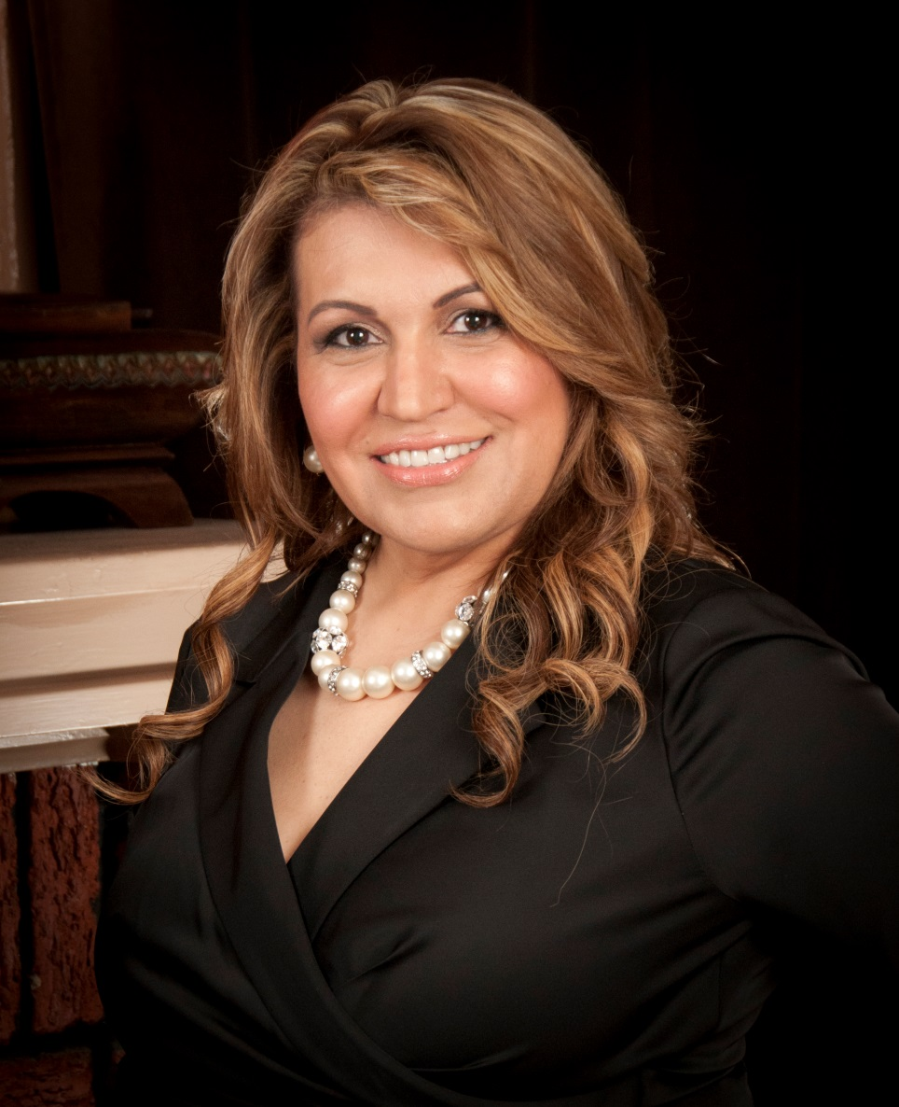
Maria Rios

Slide 43
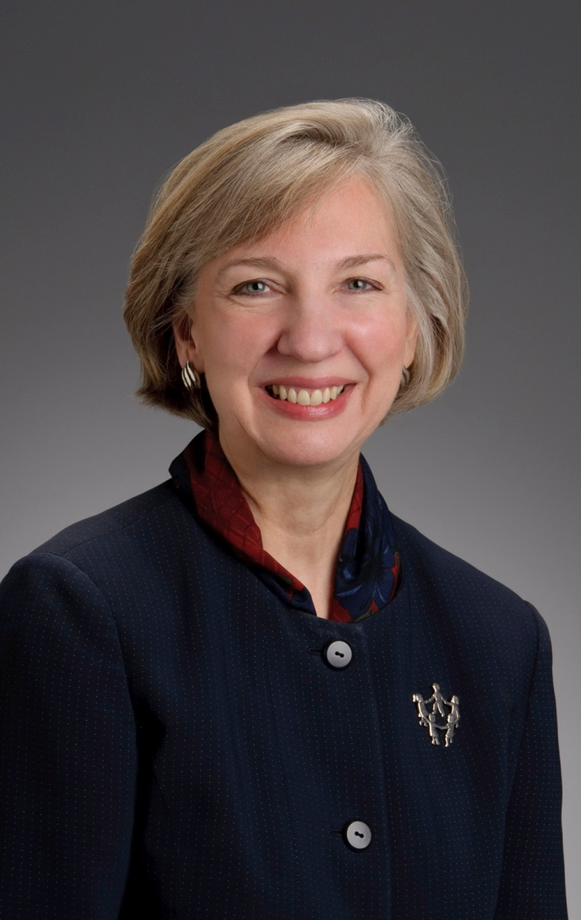
Carol Shattuck

Slide 44
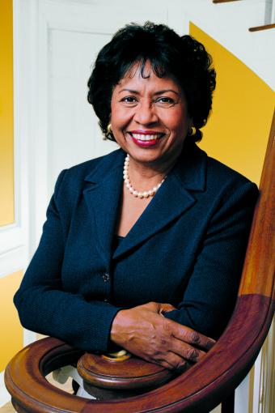
Ruth Simmons, PhD

Slide 45
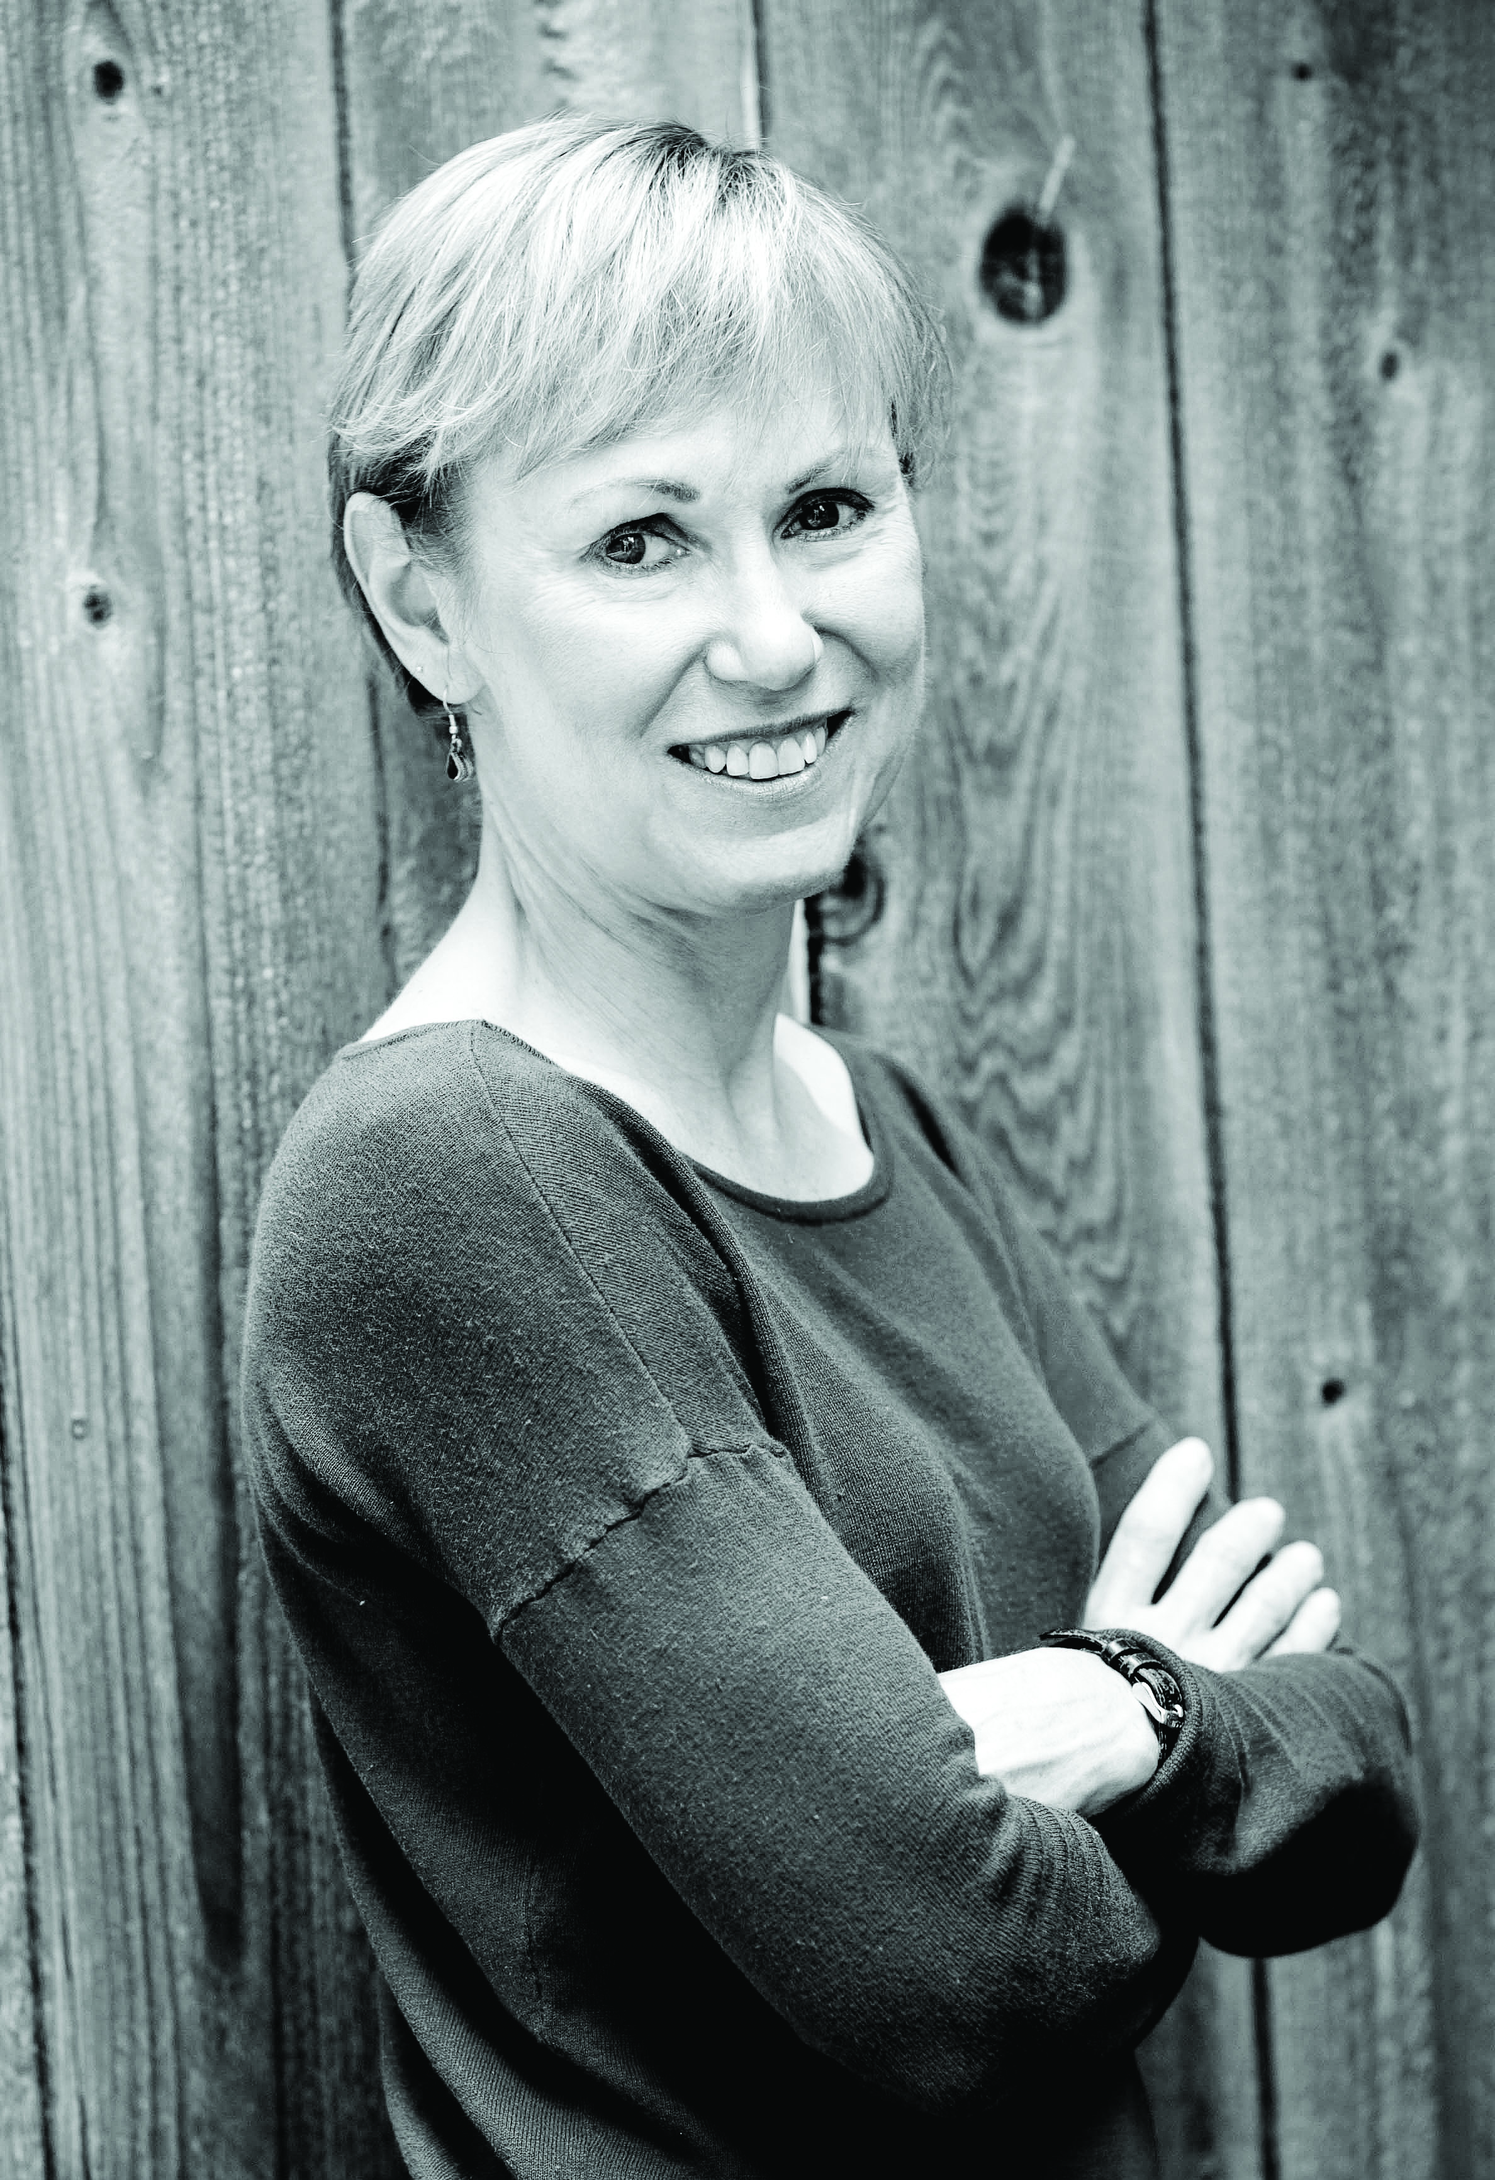
Marian Szczepanski

Slide 46
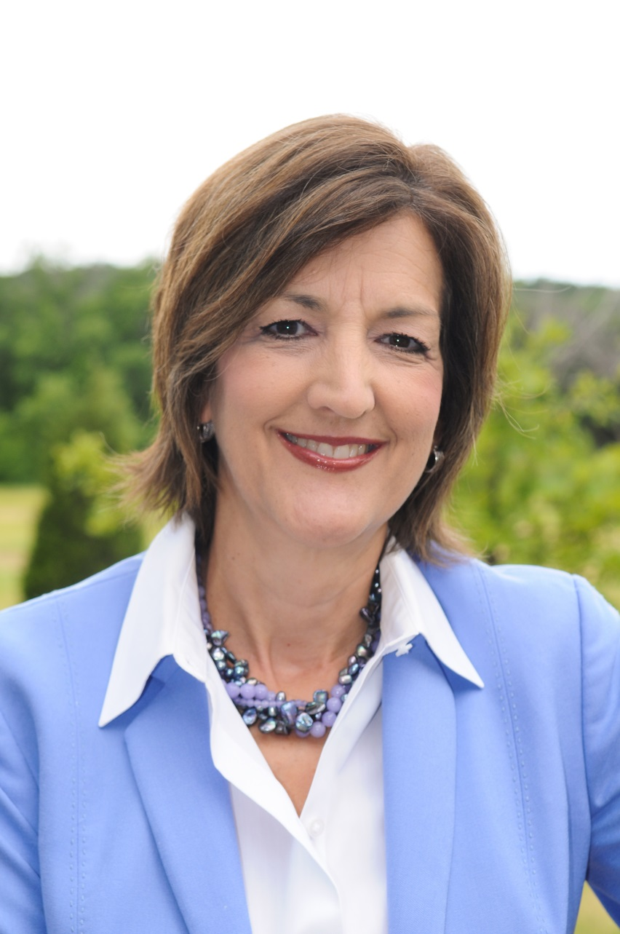
Anne Taylor

Slide 47
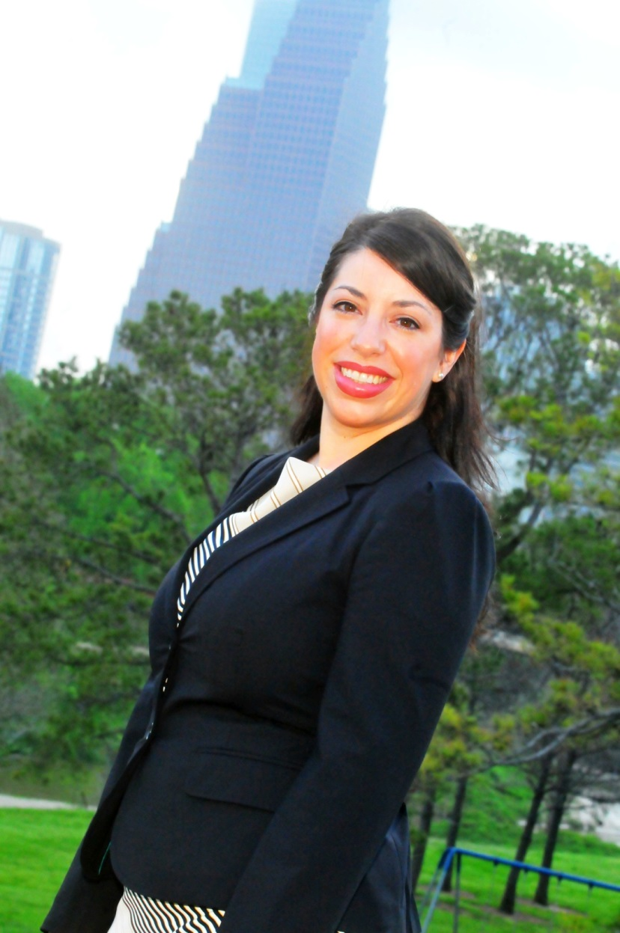
Maria Trujillo

Slide 48
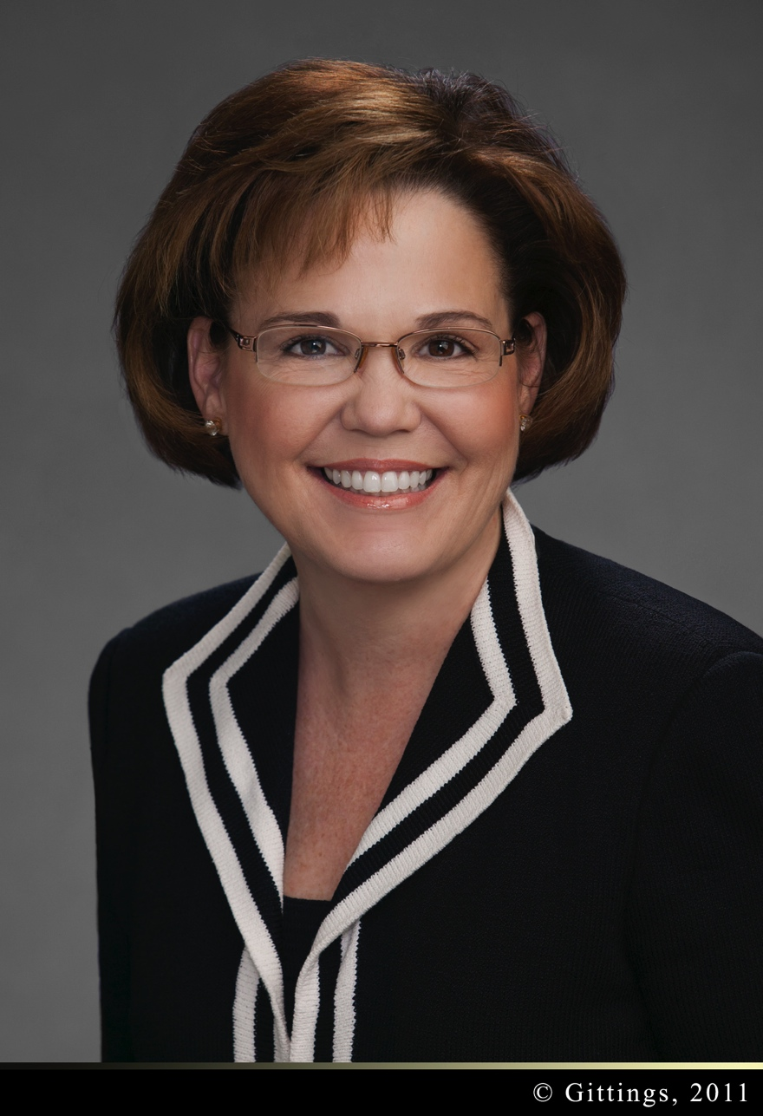
Hallie Vanderhider

Slide 49
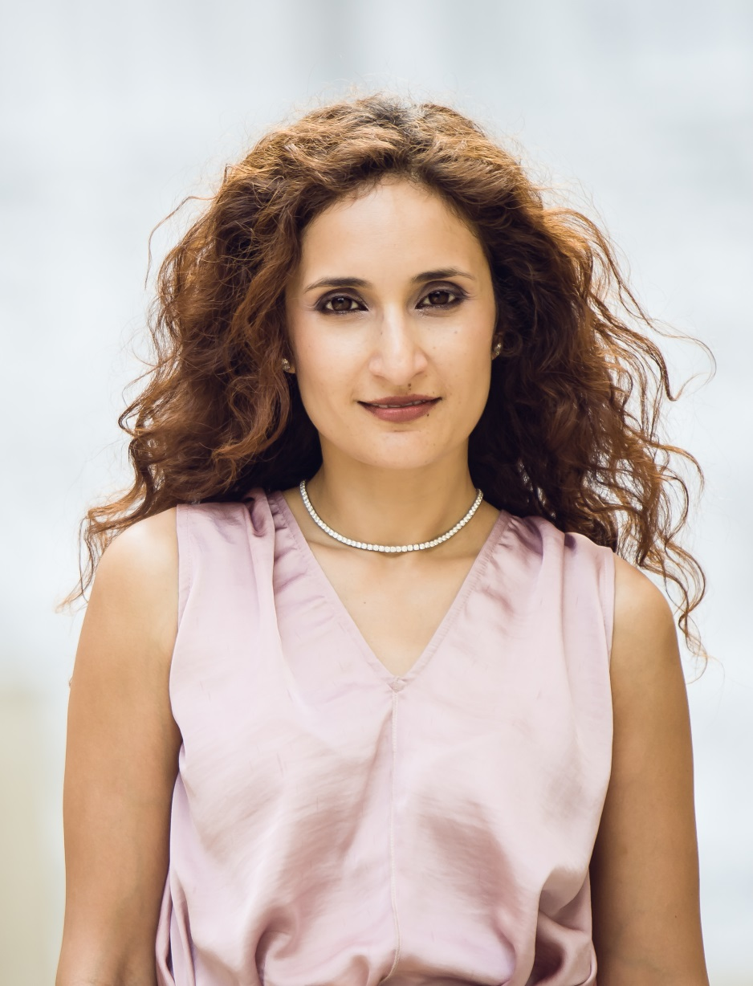
Sannam Warrender

Slide 50
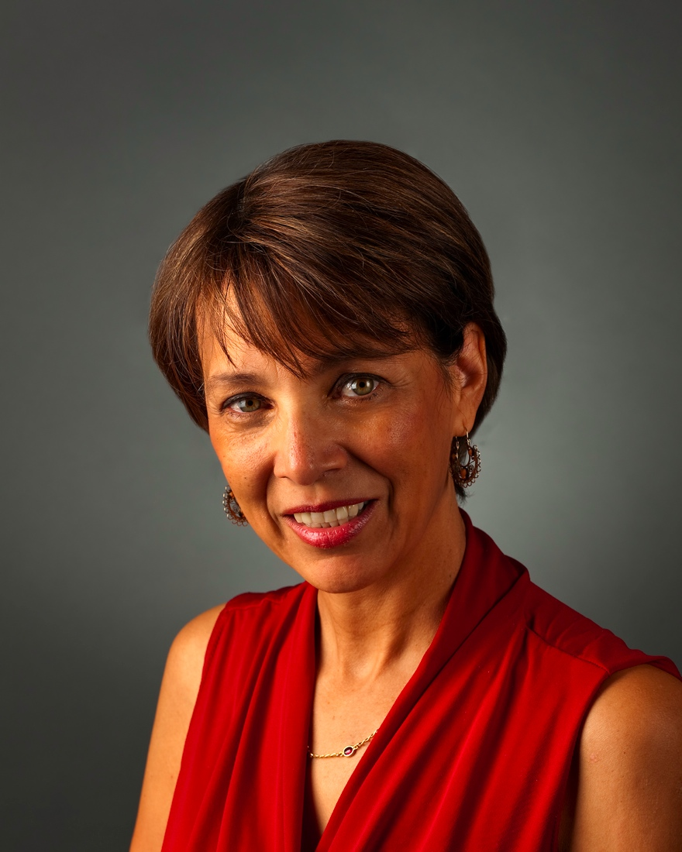
Lorie Westrick

Slide 51
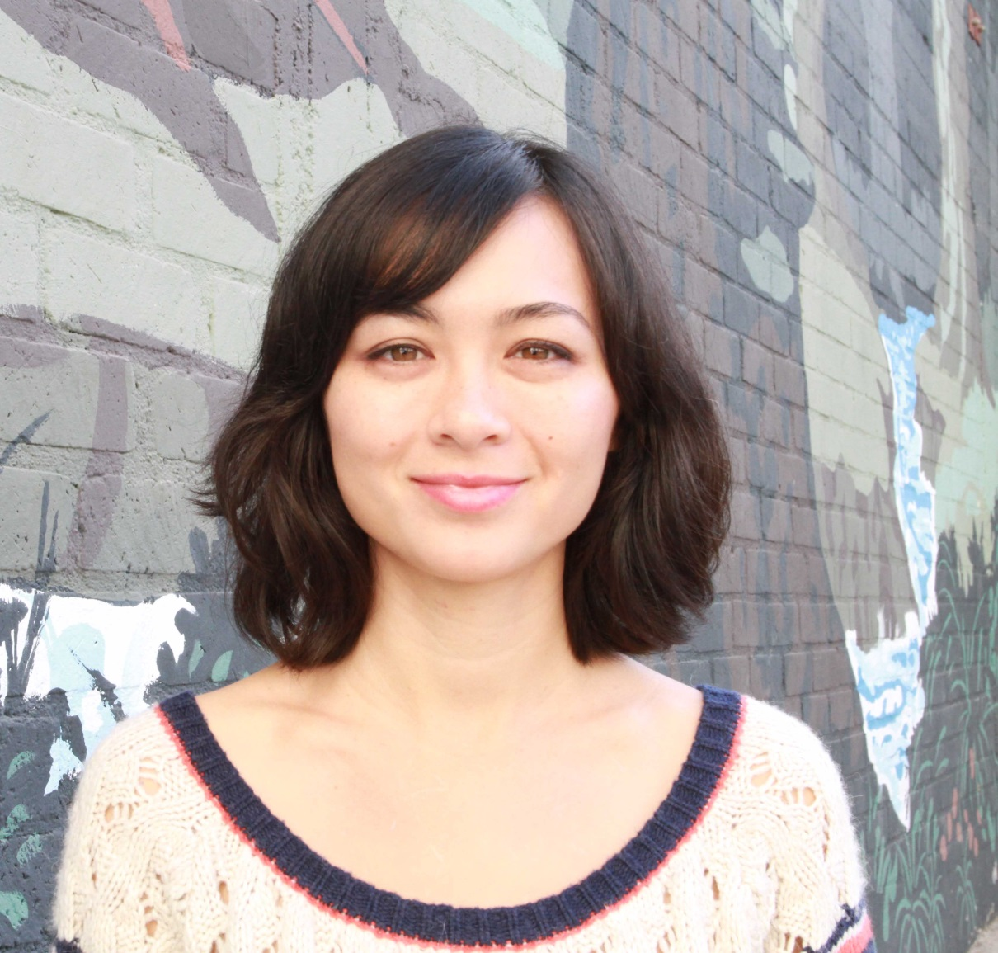
Kristin Wong

Slide 52

Mia Knight Wright

