Slide 1

Educational Diagnostician Certification Examination

Slide 2
Process and Timeline
December 17, 2017
October 25-27, 2018
September 8, 2020
Standards
Test Framework Committee
253 First Administration
Effective Date
153 Last Administration
September, 1, 2018
August 31, 2020
Submission and questions to your program specialist.
E-mail your program specialist for updated alignment charts

Slide 3
Resources: Updates to Standards
Key Changes
Standards
Removal of “beginning” from standards
  (1) The [beginning] educational diagnostician knows and understands:
Specifying least restrict environment
  (D) issues, assurances, and due process rights related to evaluation, eligibility, and placement in the least restrictive environment within a continuum of services; and
  (A) the characteristics, needs, and rights of individual students in relation to assessment and evaluation for placement in the least restrictive environment within a continuum of services;
Specifying RTI, native language, and PBIS
  (I) procedures for screening, prereferral, including RTI (e.g., response to intervention/multi-tiered support), referral, and eligibility;
  (D) ways in which native language and diversity may affect evaluation; and
  (A) requirements and procedures for functional behavioral assessment, manifestation determination review, and behavioral intervention plans that incorporate positive behavioral supports and interventions ;
19 TAC Chapter 239, Student Services Certificates, Subchapter C, Educational Diagnostician Certificate
http://ritter.tea.state.tx.us/sbecrules/tac/index.html

Slide 4
Test Frameworks
Exam Domains | Educational Diagnostician 153 | Educational Diagnostician 253
Domain I | Students with Disabilities | Identification and Assessment
Domain II | Assessment and Evaluation | Curriculum, Instruction and Intervention
Domain III | Curriculum and Instruction | Professional Responsibilities
Domain IV | Foundations and Professional Roles and Responsibilities | Analysis and Response
Candidate completes written response based on prompt and authentic documents
http://www.tx.nesinc.com/Home.aspx
https://tea.texas.gov/Texas_Educators/Certification/Educator_Testing/New_Educator_Standards_and_Test_Frameworks/

Slide 5
Educational Diagnostician 253
Exam Domains | Domain Names | Competencies
Domain I | Identification and Assessment | 001: Identification for Special Education Evaluation and Services 002: Evaluation, Planning, Selection, and Administration 003: Interpretation and Reporting of Evaluation Results
Domain II | Curriculum, Instruction and Intervention | 004: Academic Instruction and Strategies 005: Functional Skill Instruction and Strategies
Domain III | Professional Responsibilities | 006: Consultation and Collaboration 007: Legal and Ethical Practices
Domain IV | Analysis and Response | 008: Analysis and Response

Slide 6
Key Changes to Test Framework
Educational Diagnostician 253
Identification and Assessment
Curriculum, Instruction and Intervention
Professional Responsibilities
Analysis and Response
Structure and ordering of domains

Slide 7
Key Changes to Test Framework
Educational Diagnostician 253
Identification and Assessment
Curriculum, Instruction and Intervention
Professional Responsibilities
Analysis and Response
Support schools in understanding how Response to Intervention can impact the need for a special education evaluation

Slide 8
Key Changes to Test Framework
Educational Diagnostician 253
Identification and Assessment
Curriculum, Instruction and Intervention
Professional Responsibilities
Analysis and Response
Focus on creating measurable and ambitious goals for students

Slide 9
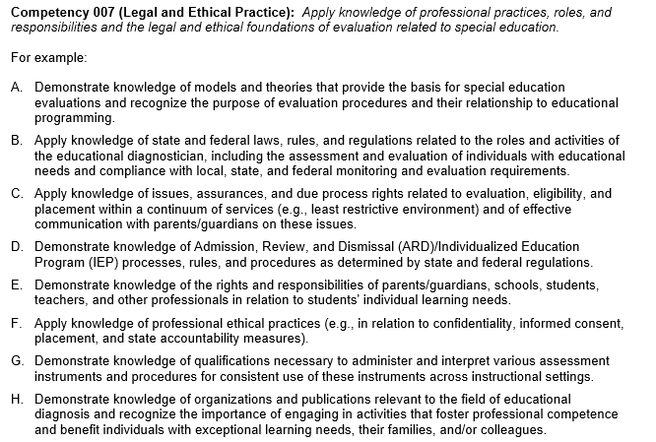
Key Changes to Test Framework
Educational Diagnostician 253
Identification and Assessment
Curriculum, Instruction and Intervention
Professional Responsibilities
Analysis and Response

Slide 10
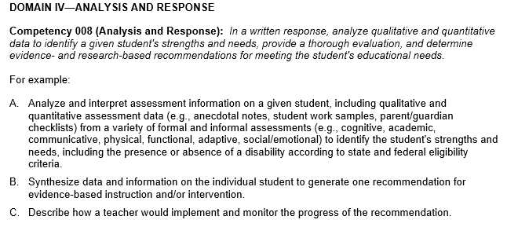
Key Changes to Test Framework
Educational Diagnostician 253
Identification and Assessment
Curriculum, Instruction and Intervention
Professional Responsibilities
Analysis and Response

Slide 11
Process and Timeline
December 17, 2017
October 25-27, 2018
September 8, 2020
Standards
Test Framework Committee
253 First Administration
Effective Date
153 Last Administration
September, 1, 2018
August 31, 2020
Submission and questions to your program specialist.
E-mail your program specialist for updated alignment charts

