Slide 1
Huisache Control
Trey Barron
Texas Parks and Wildlife
Wildlife Diversity Biologist

Slide 2
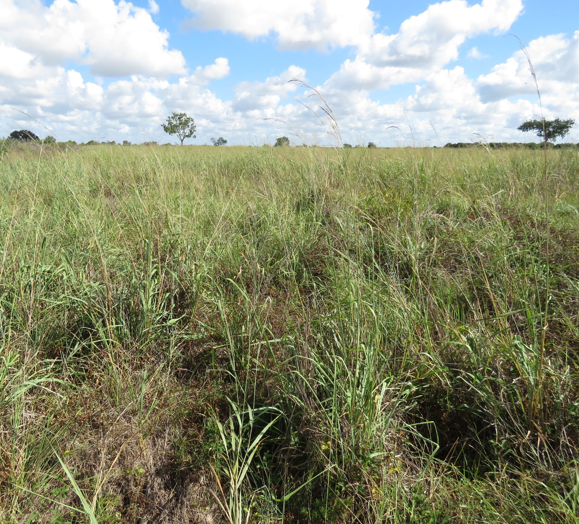
Establish Goals and Expectations
What is the target species?
Why?
How large is the area?
Budget?
What method will be best?
Is it the best option given the above?
Will it need follow up?

Slide 3
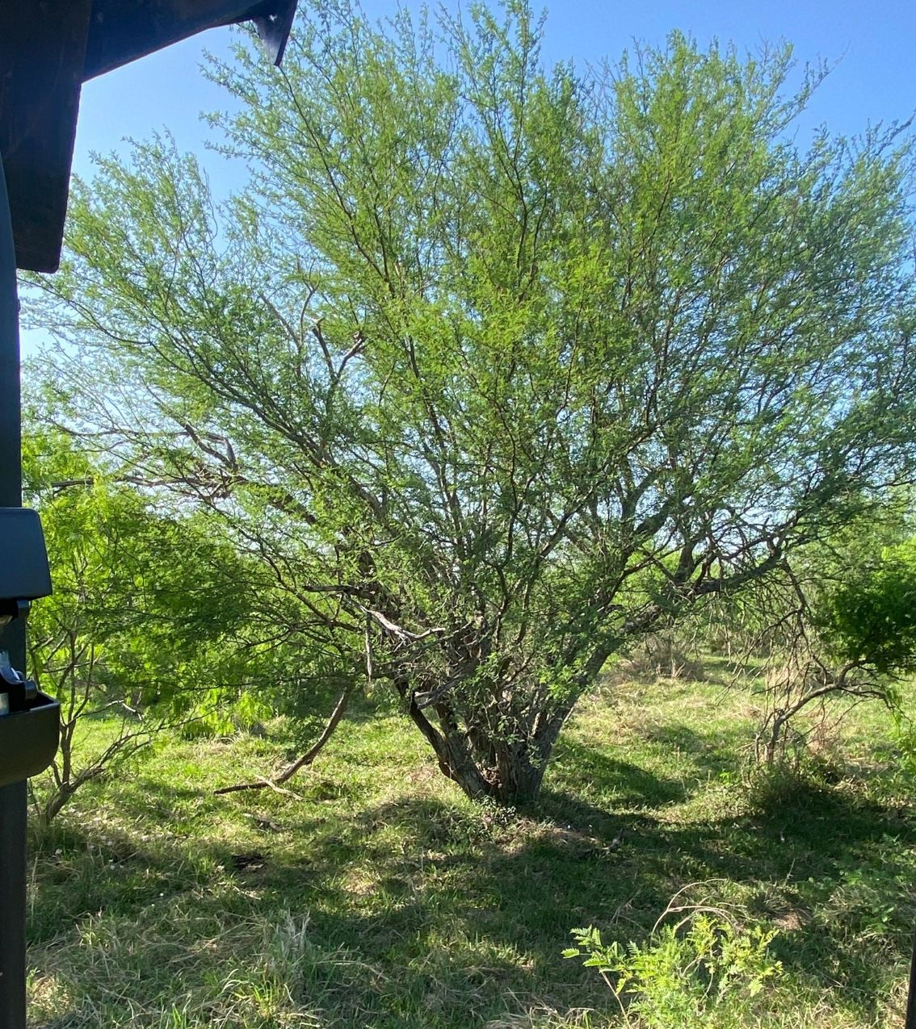
Huisache Methods
Broadcast
  Large areas with moderate to heavy brush
High-volume Foliar
  Light to moderate brush
Low Volume Basal
  IPT
Basal Cut-Stump
  IPT
Mechanical
  Grubbing
  Cut-spray

Slide 4
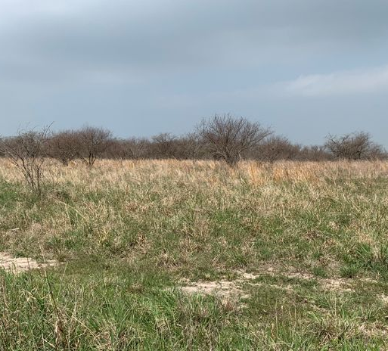
Huisache Methods
Broadcast –Aerial
  3 year application
    Year 1- Spray solid block
    Year 2 – Spray 1 and skip 1
    Year 2 –Spray 1 and skip 1
      Opposite of year 2 application
  GrazonNext, Tordon22K and MSM60 (sub Sendero and MezaVue)
  Avg cost is ~$21-31per acre at 3 gallons/acre

Slide 5
Huisache Methods – Year 1

Slide 6
Huisache Methods – Year 1 Treatment

Slide 7
Huisache Methods –Results from Year 1

Slide 8
Huisache Methods – Year 2 Treatment

Slide 9
Huisache Methods – Results from Year 2

Slide 10
Huisache Methods – Year 3 Treatment

Slide 11
Huisache Methods – Final Results

Slide 12
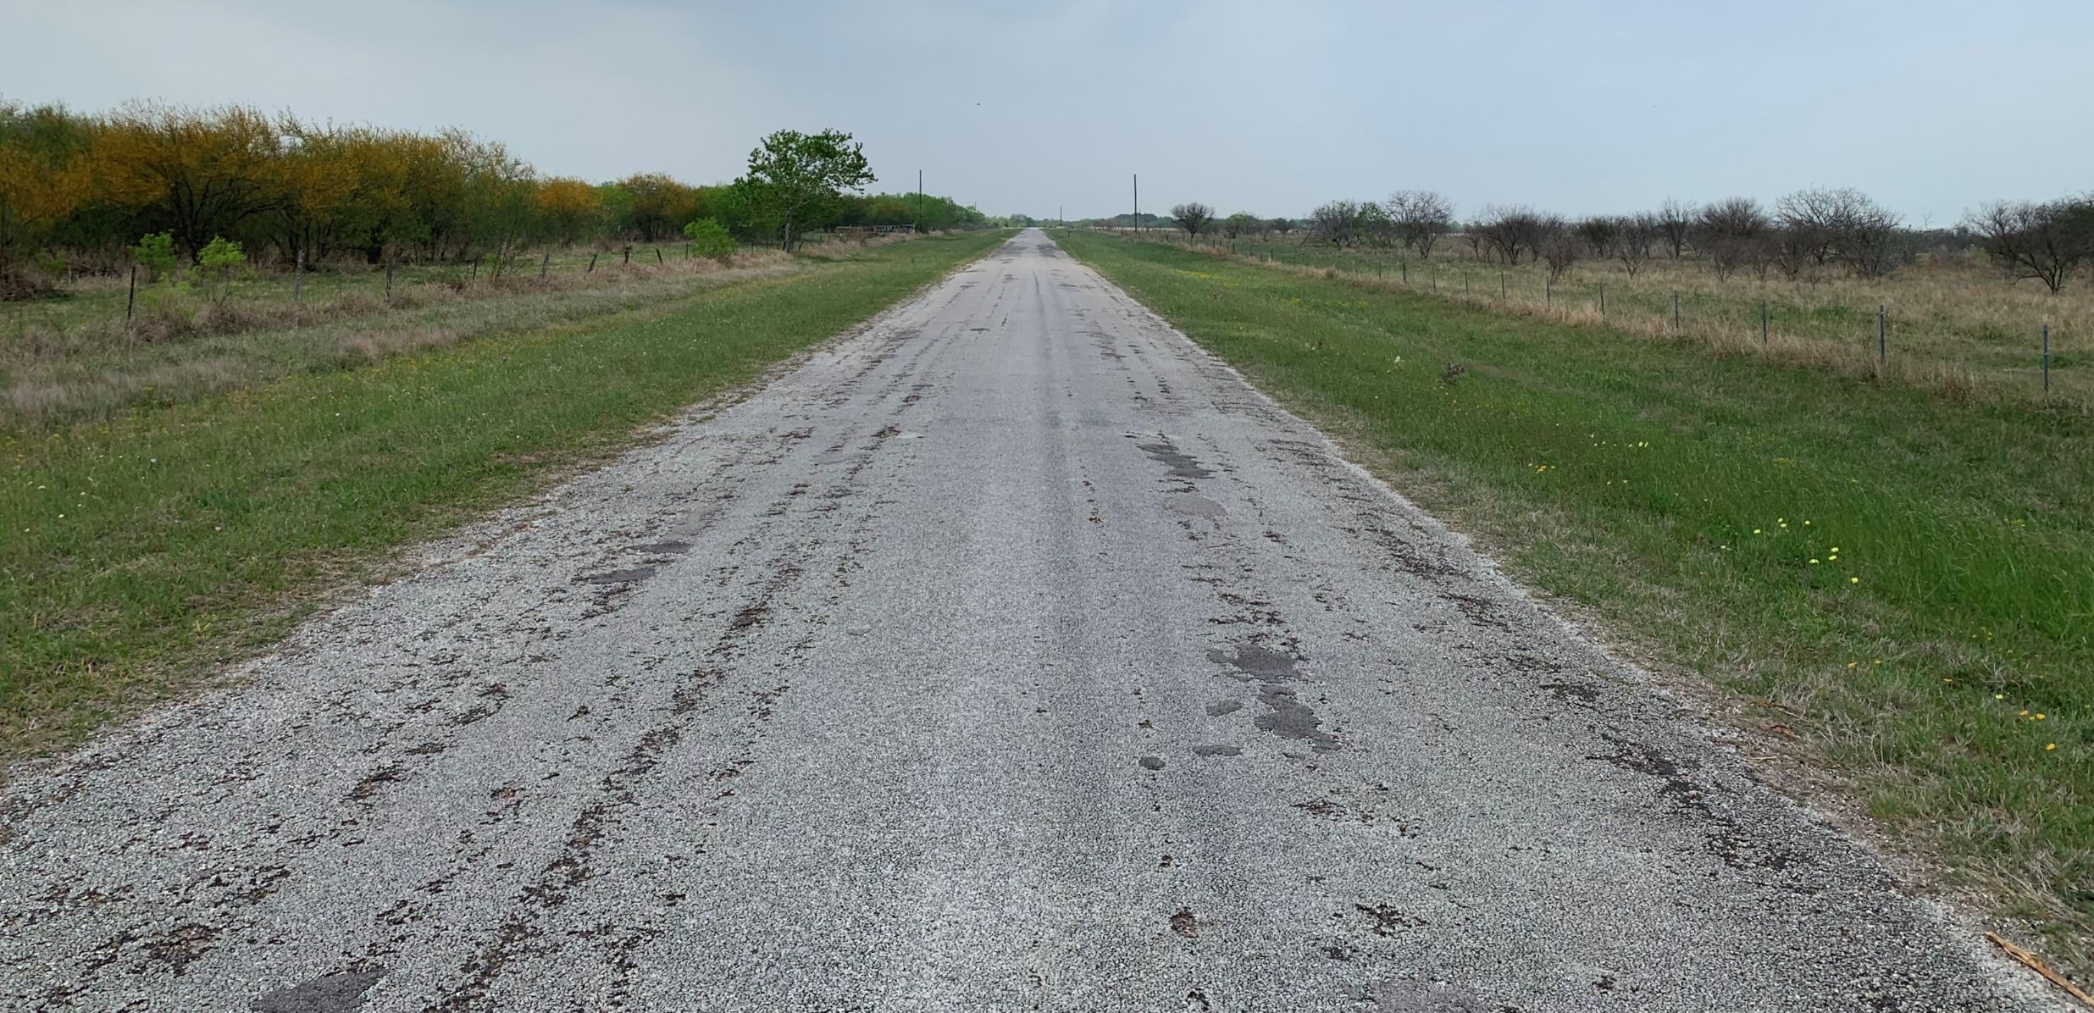
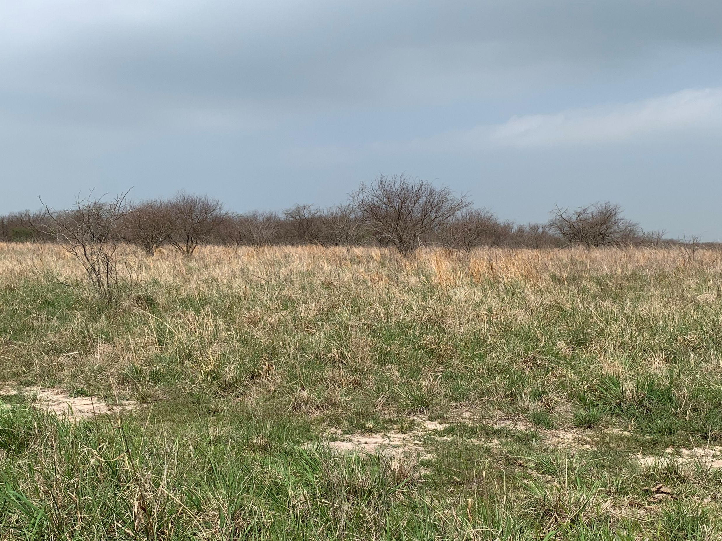
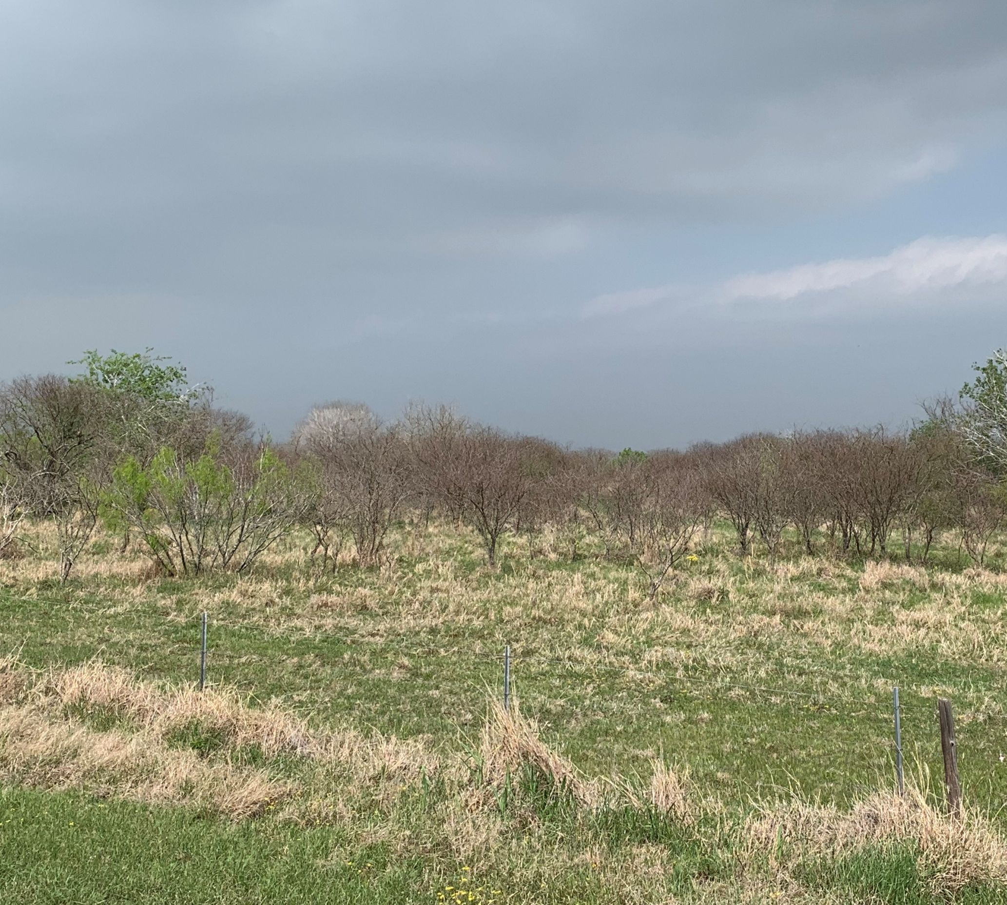
Huisache Methods

Slide 13
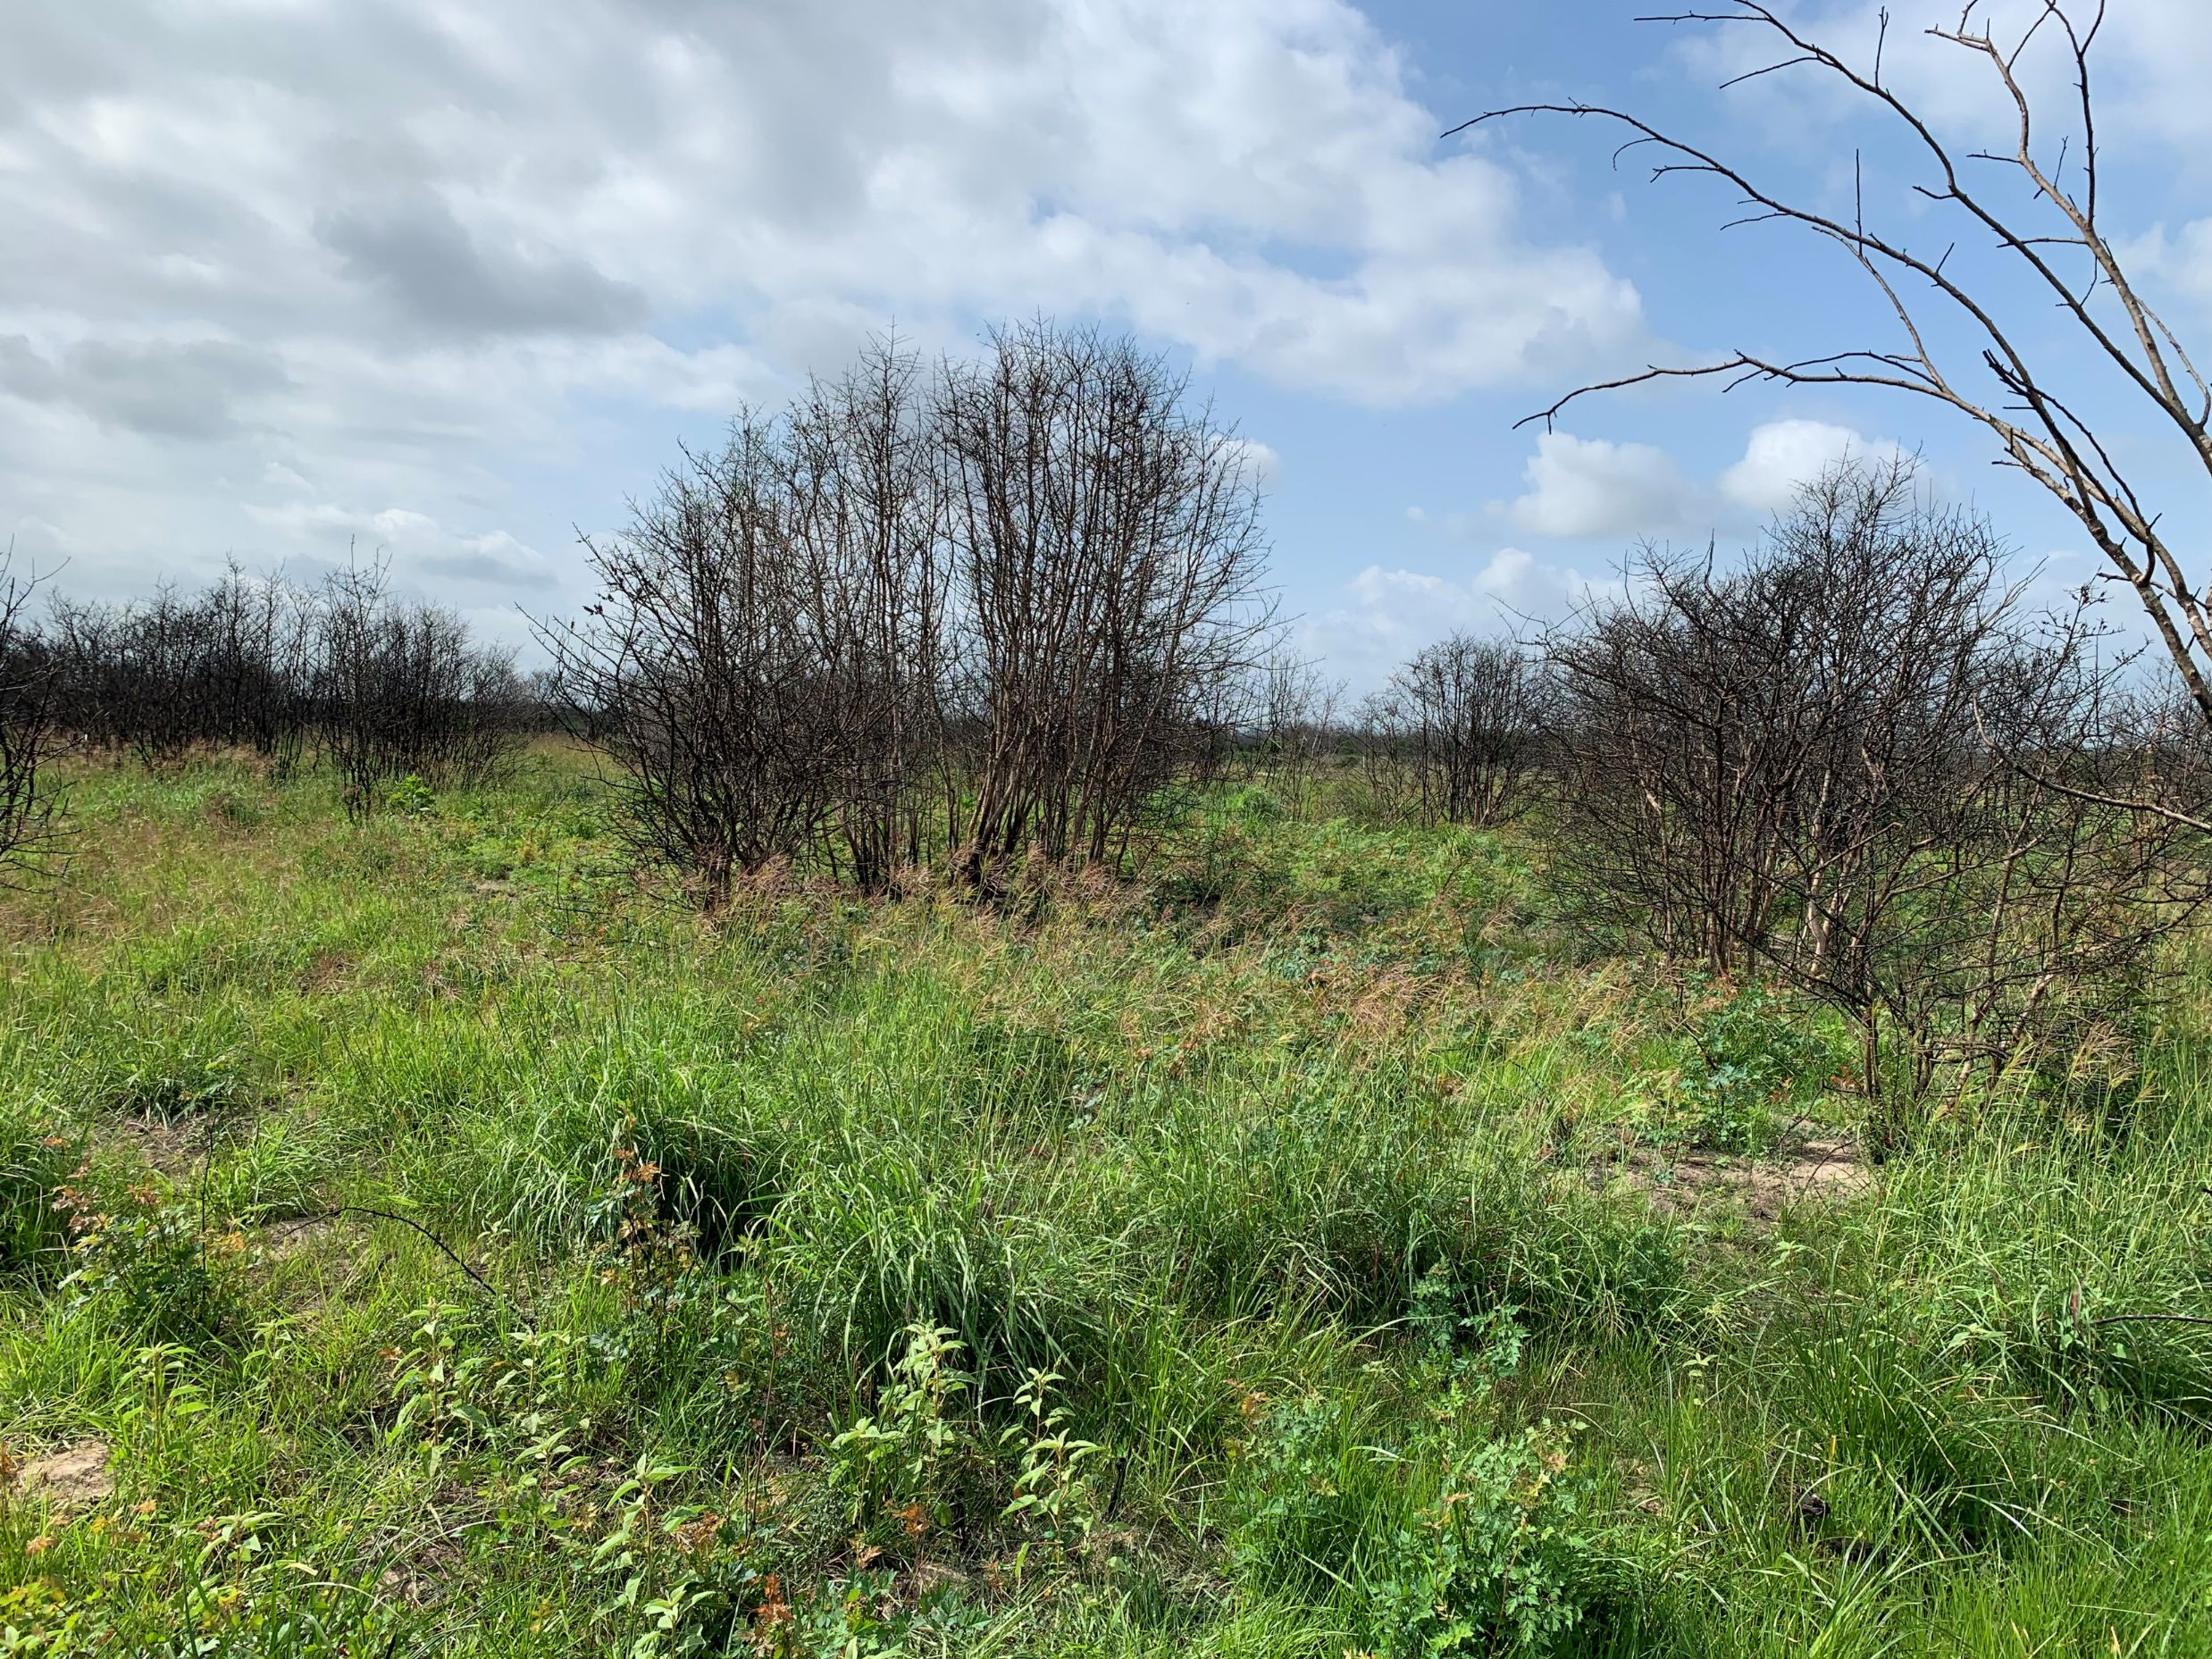
New Chemicals show promise but come at a cost.
Invora® Herbicide – restricted use
  Combination of aminocyclopyrachlor and triclopyr
  Long-term control – non hayed
    10 years for mesquite – spring to early summer
    5 years for huisache – Fall application
  Higher cost estimates.
    $60/acre
    Broadcast at 36oz per acre.

Slide 15
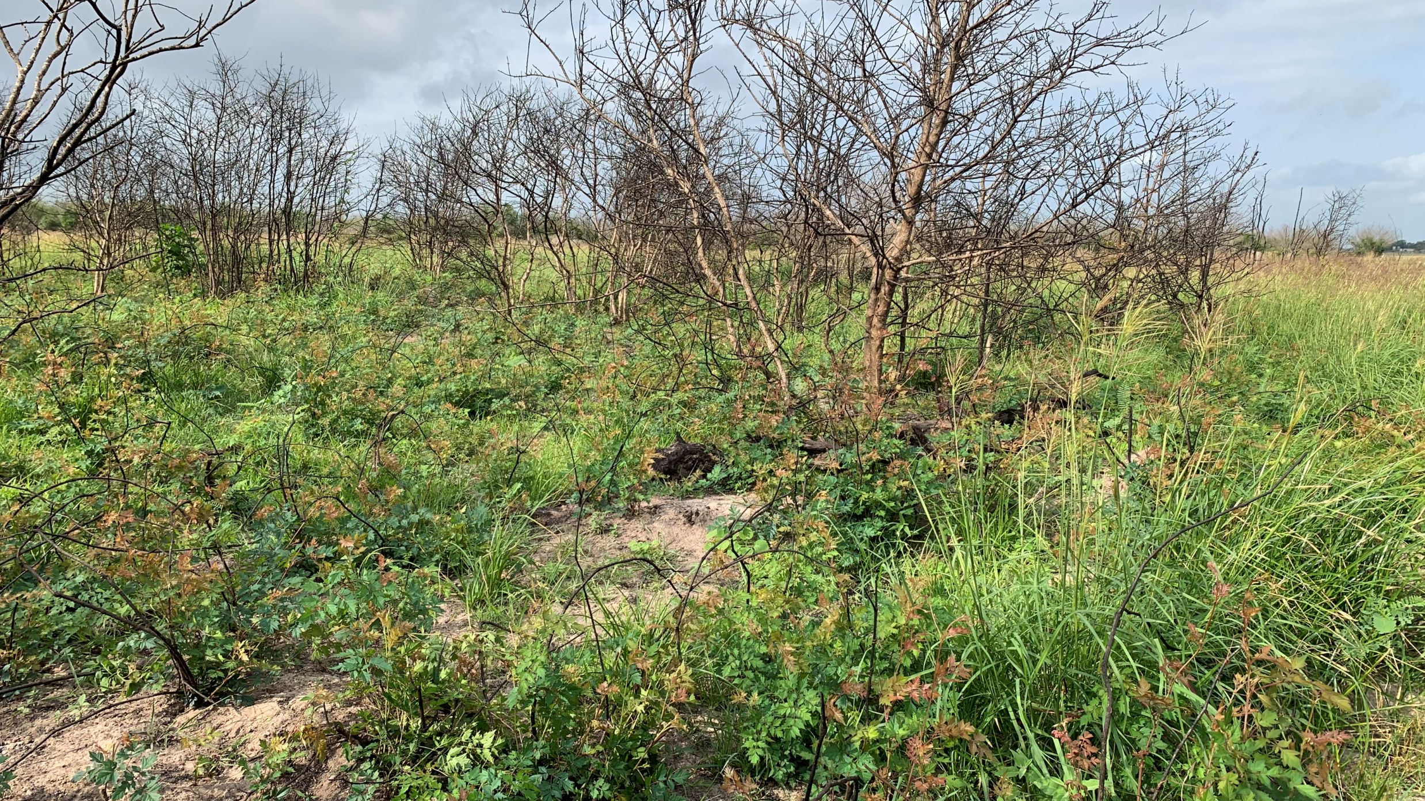

Slide 16
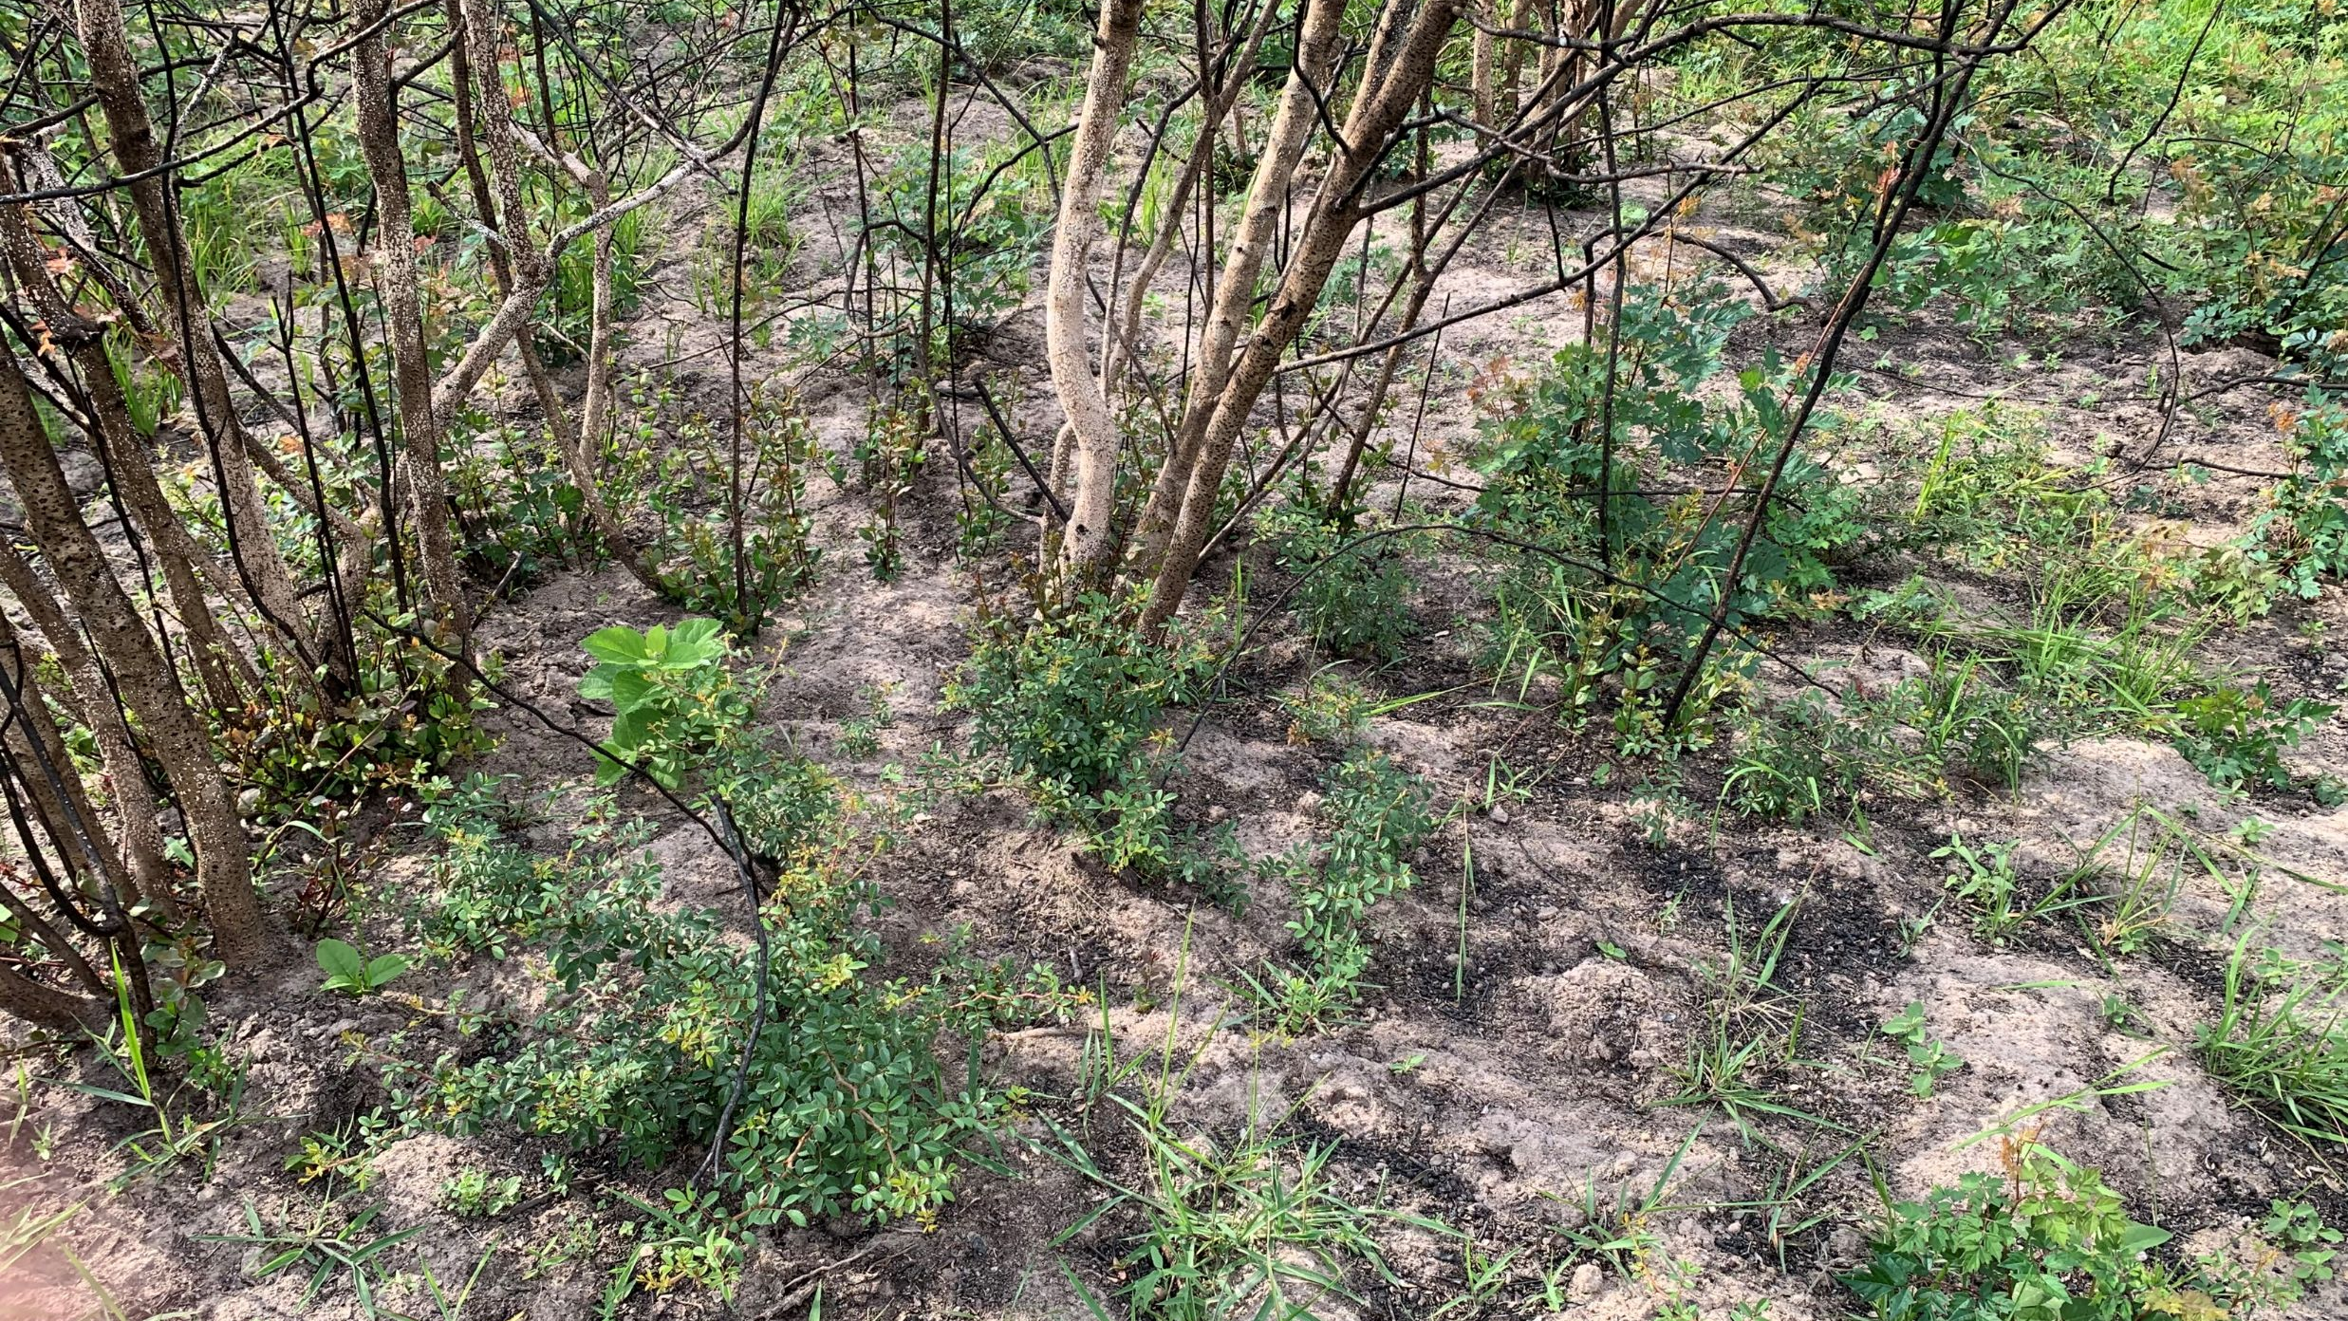

Slide 17
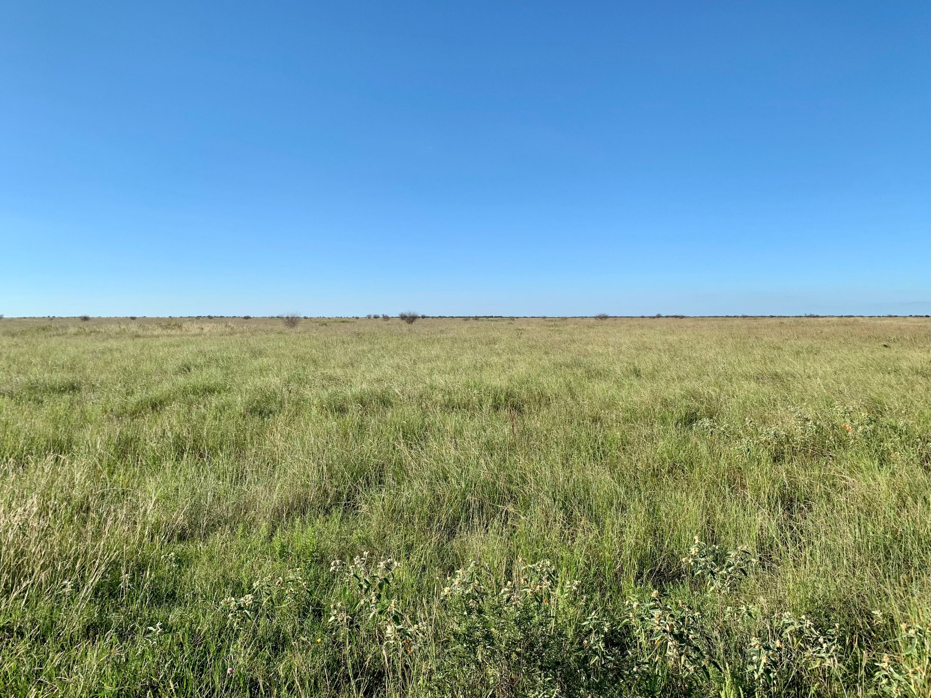
Huisache Methods
Low Volume Basal – IPT
  Individual Plant Treatment
    Spray bottom 12 inches of plant
    Up to around 4 inches
    Remedy/diesel mix
      25%/75%
  Excellent results
  Must be done for follow up of any treatment

Slide 18
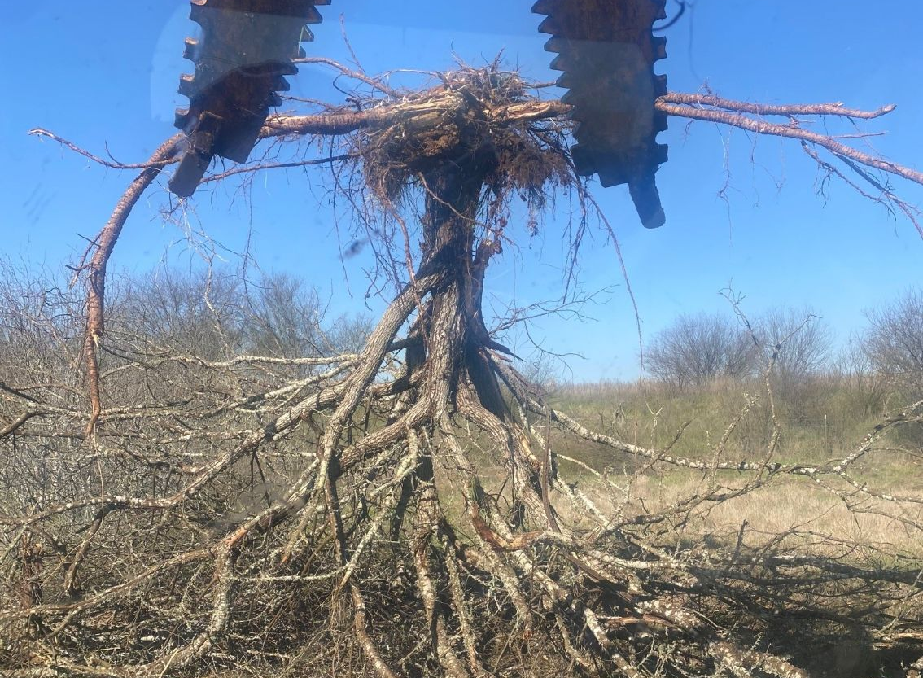
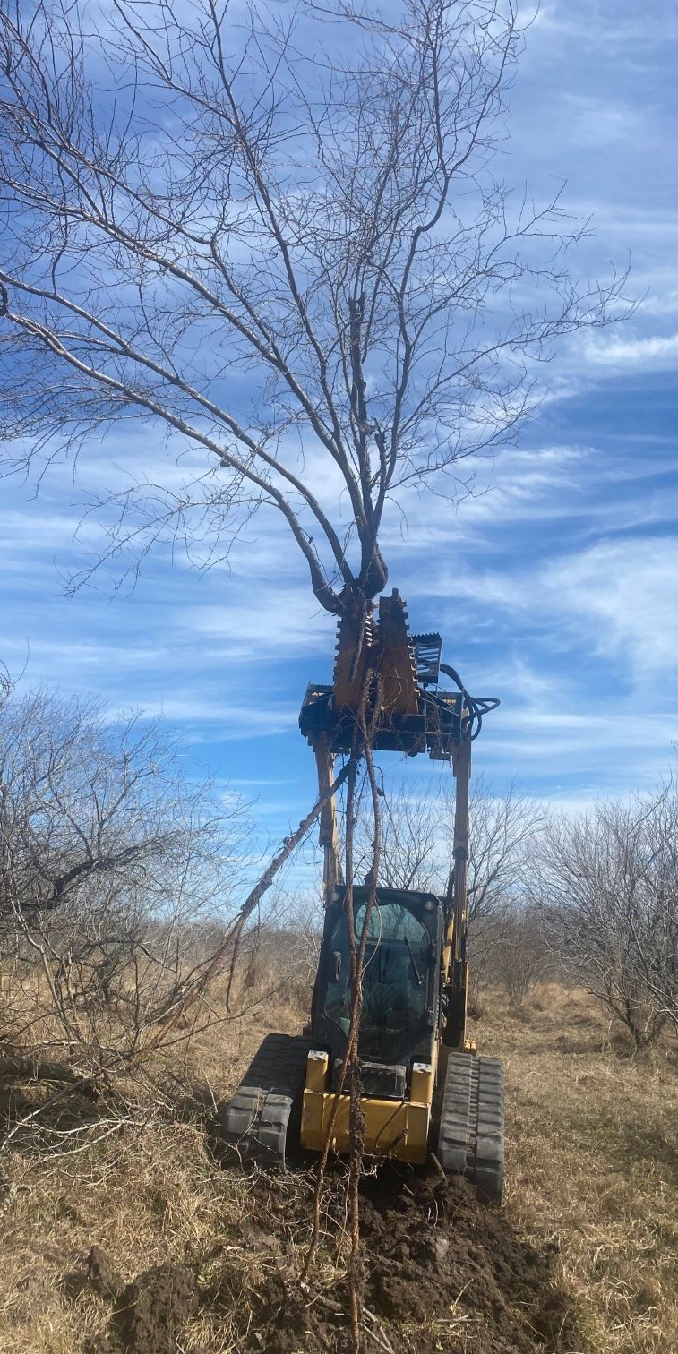
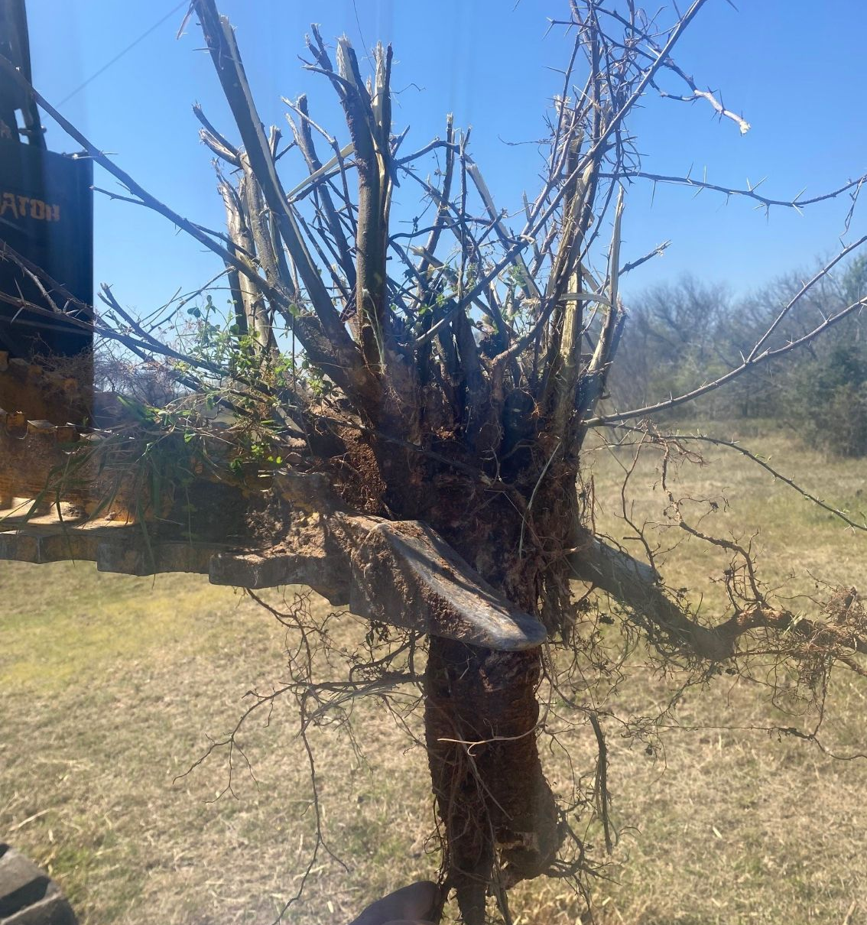
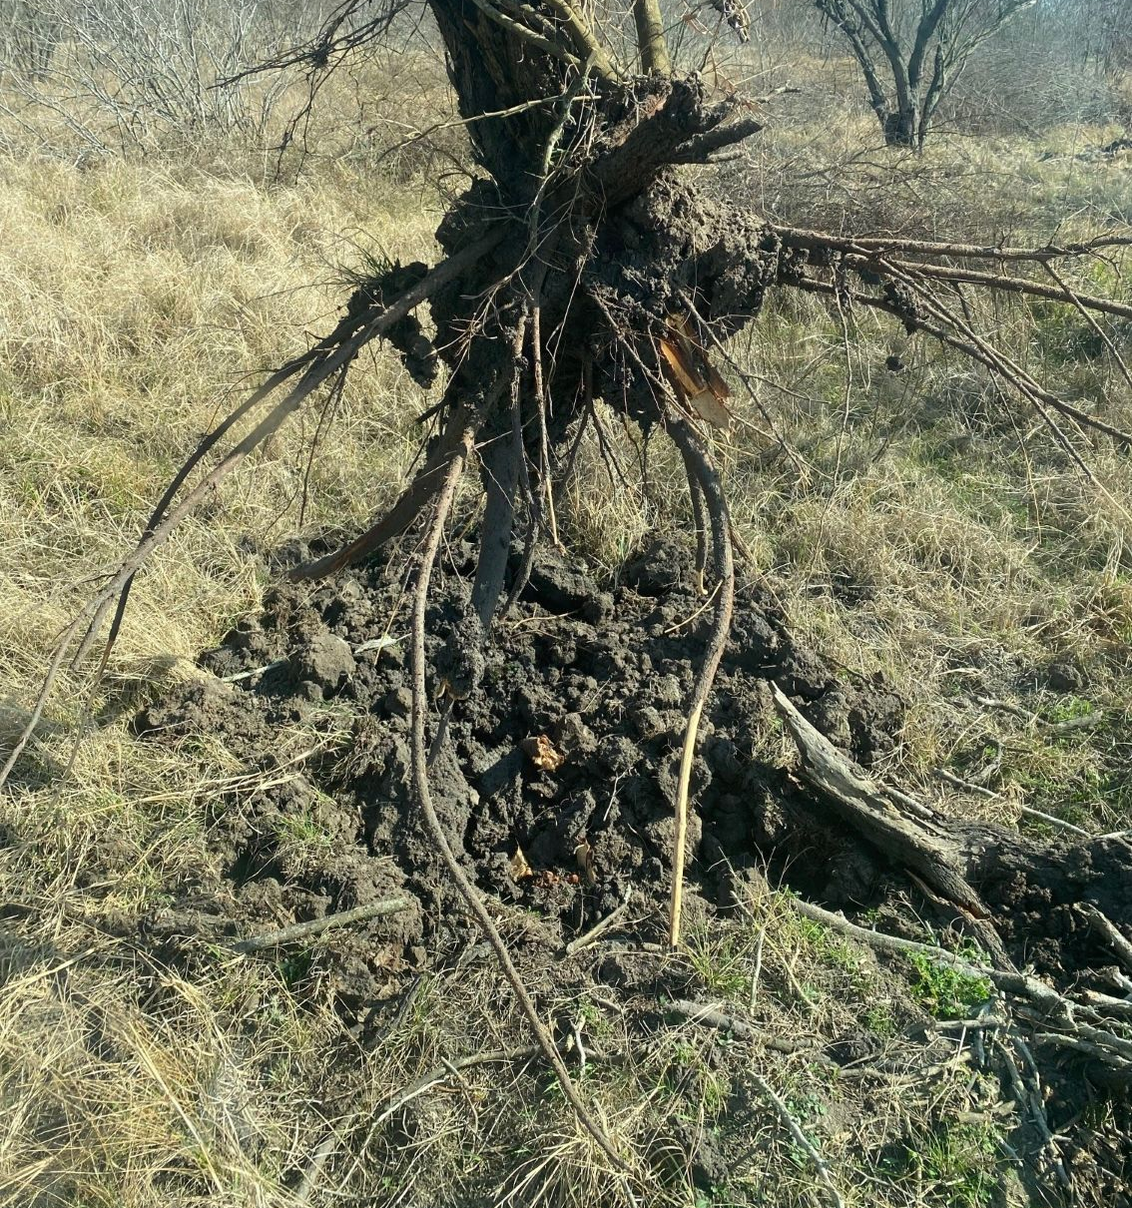
Huisache Methods
Mechanical
  Grubbing
    Removes individual plant
    Highly effective
  Dependent on operator
    Avg ~$100/acre with densities of 288 plants/acre or $0.35/plant
    NRCS Cost estimate
      $157.48 for 11-30% canopy cover
      $458.91 for >51% canopy cover

Slide 19
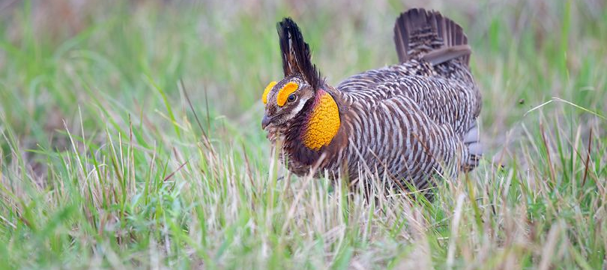
Don’t forget to follow up!!!!!

