Slide 1
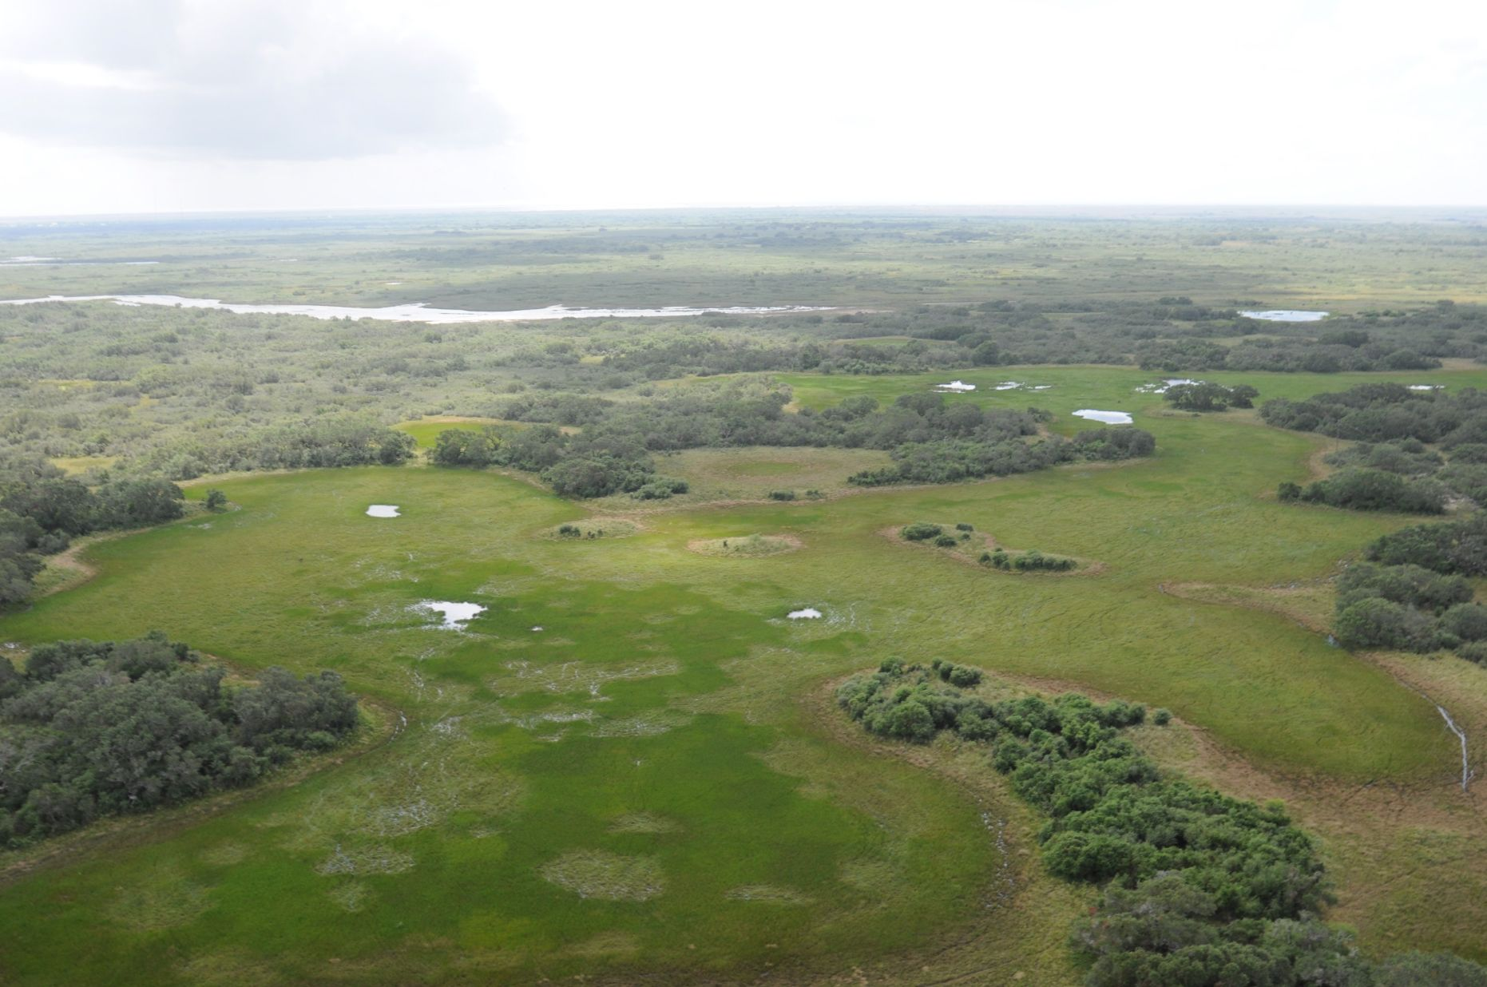
Powderhorn WMA
Calhoun County
17,351 acres
Cattle ranch

Slide 2
Acquisition
Purchased with funds resulting from the BP Horizon oil spill
Multi agency effort
  Texas Parks and Wildlife Foundation
  Texas Parks and Wildlife Department
  The Nature Conservancy
  The Conservation Fund
  National Fish and Wildlife Foundation
TPWF donated the property in October 2018

Slide 3
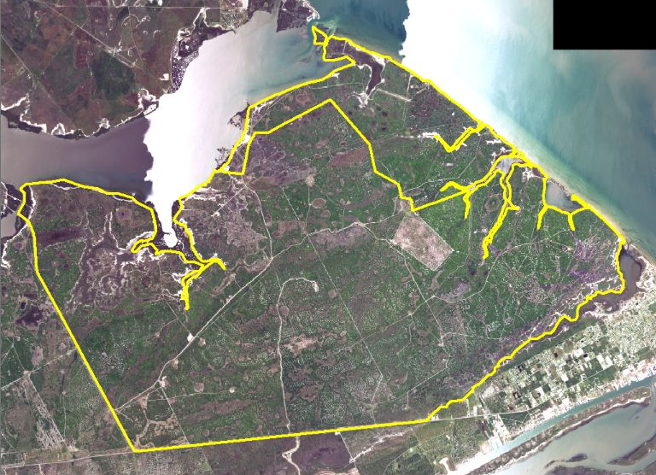

Slide 4
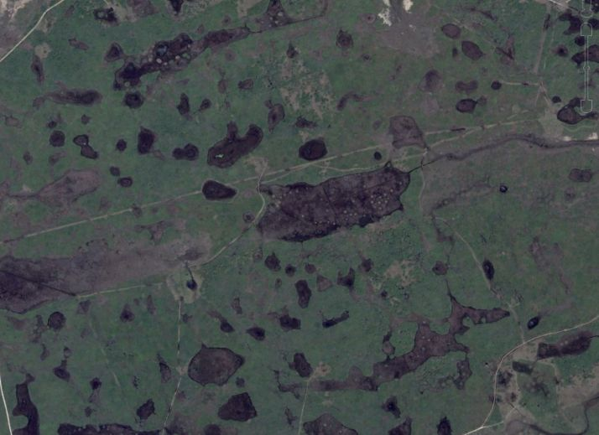

Slide 5
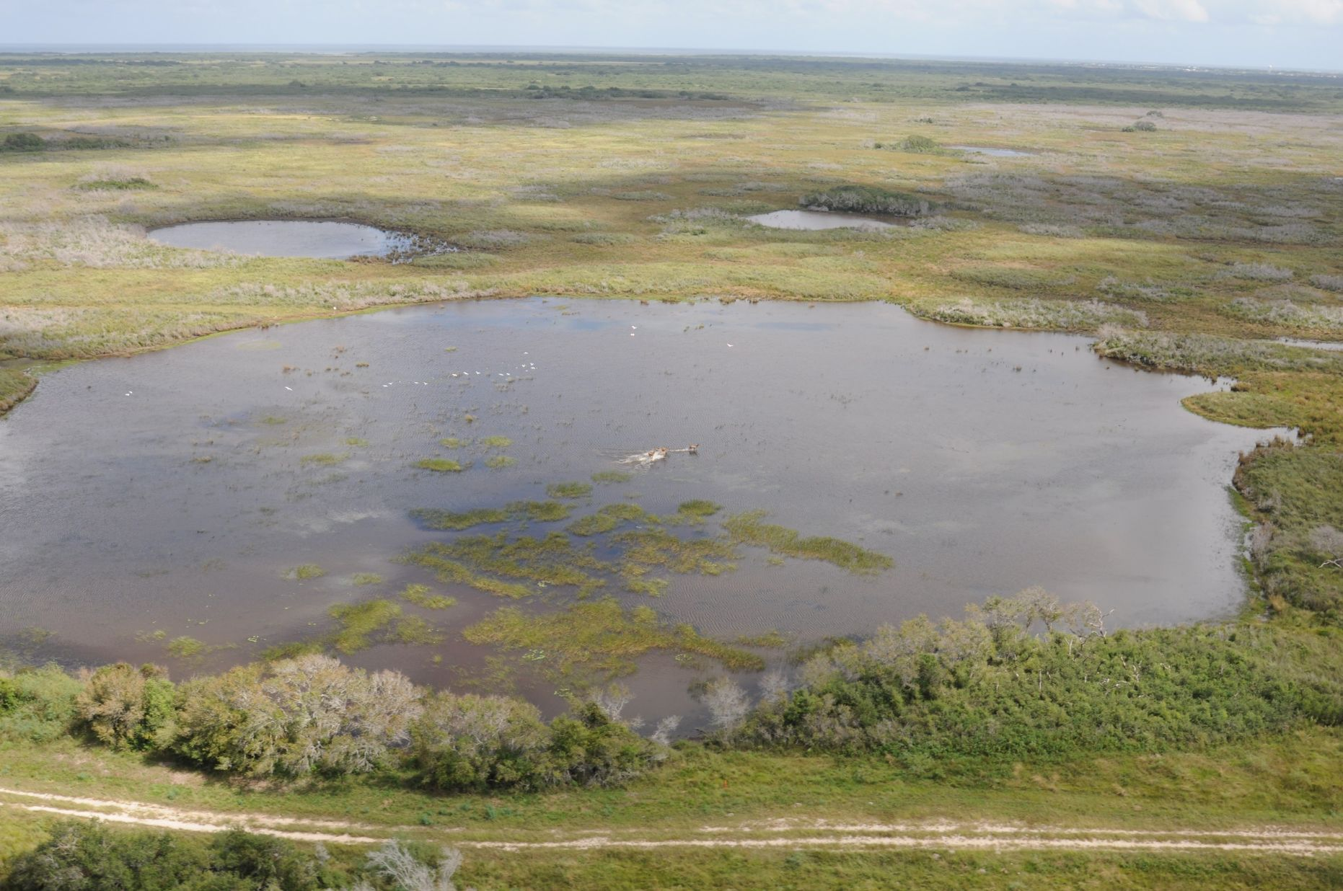

Slide 6
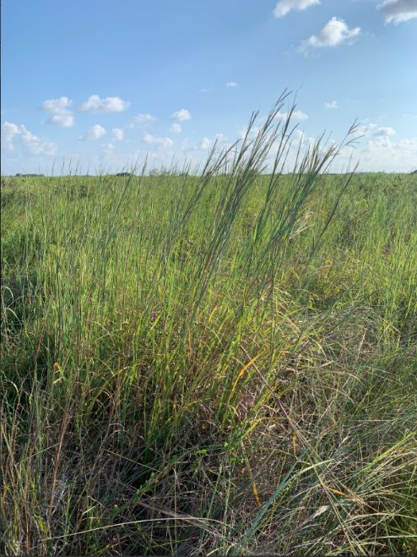
Habitat
Historically coastal prairie
Interspersed wetlands
Brush encroachment
  Suppression of fire
Almost 500 plant species

Slide 7
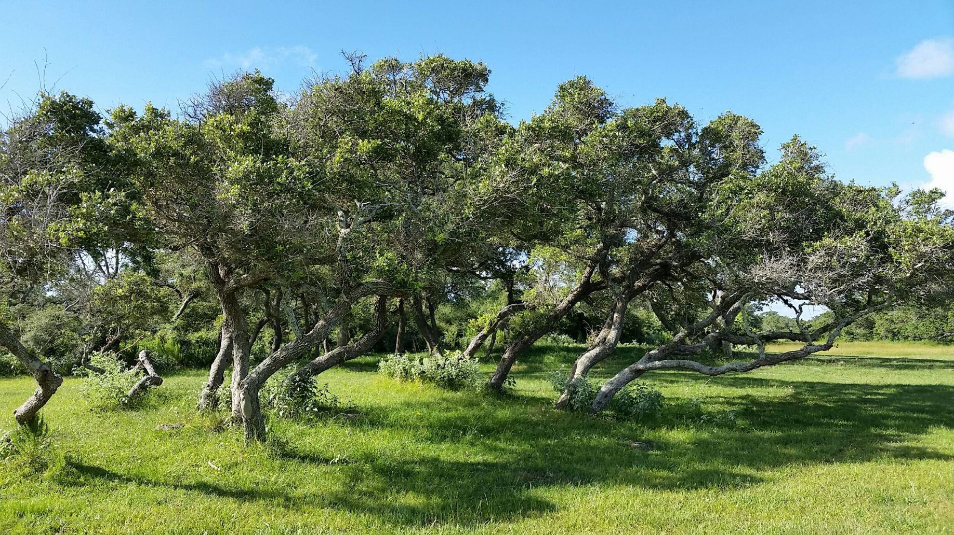

Slide 8
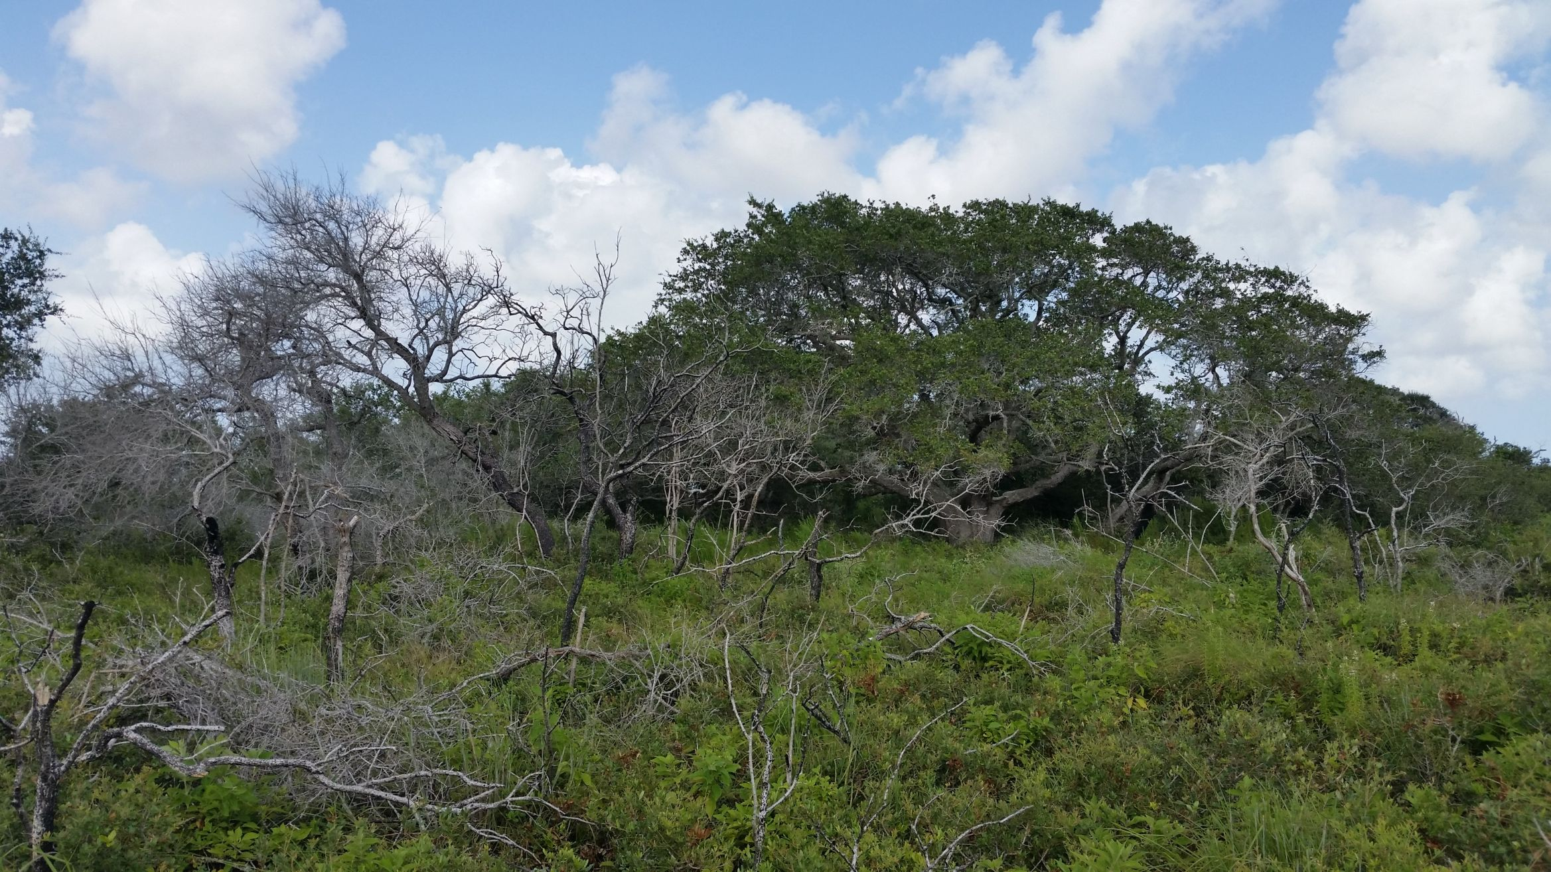

Slide 9
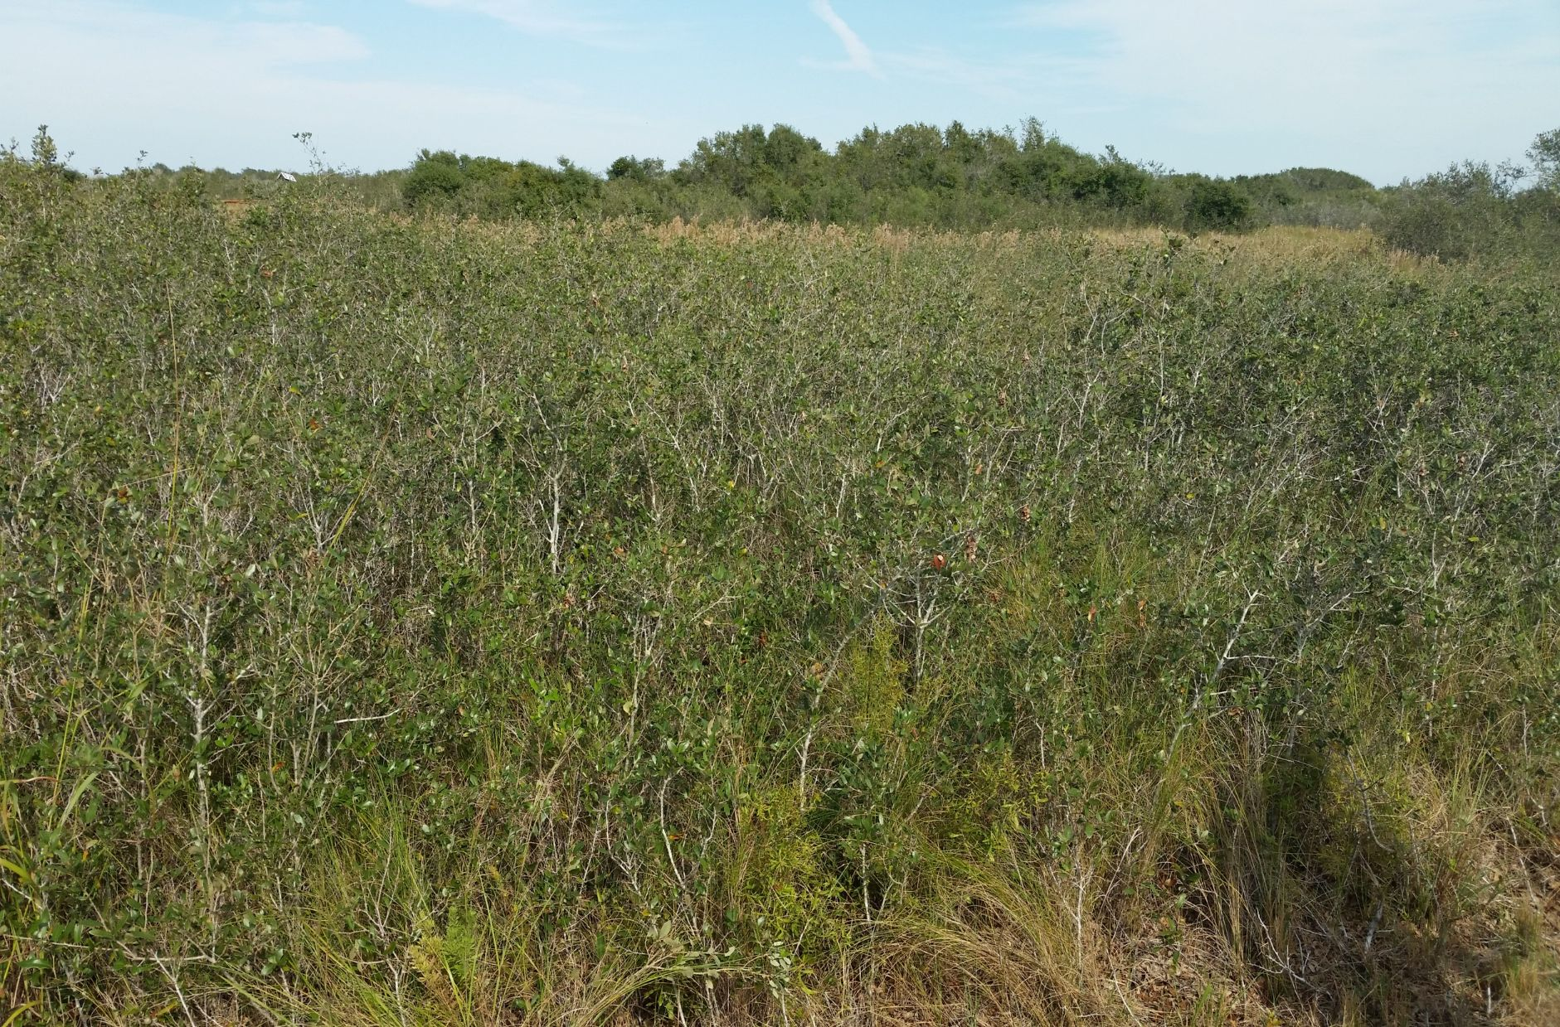
Running Live Oak

Slide 10
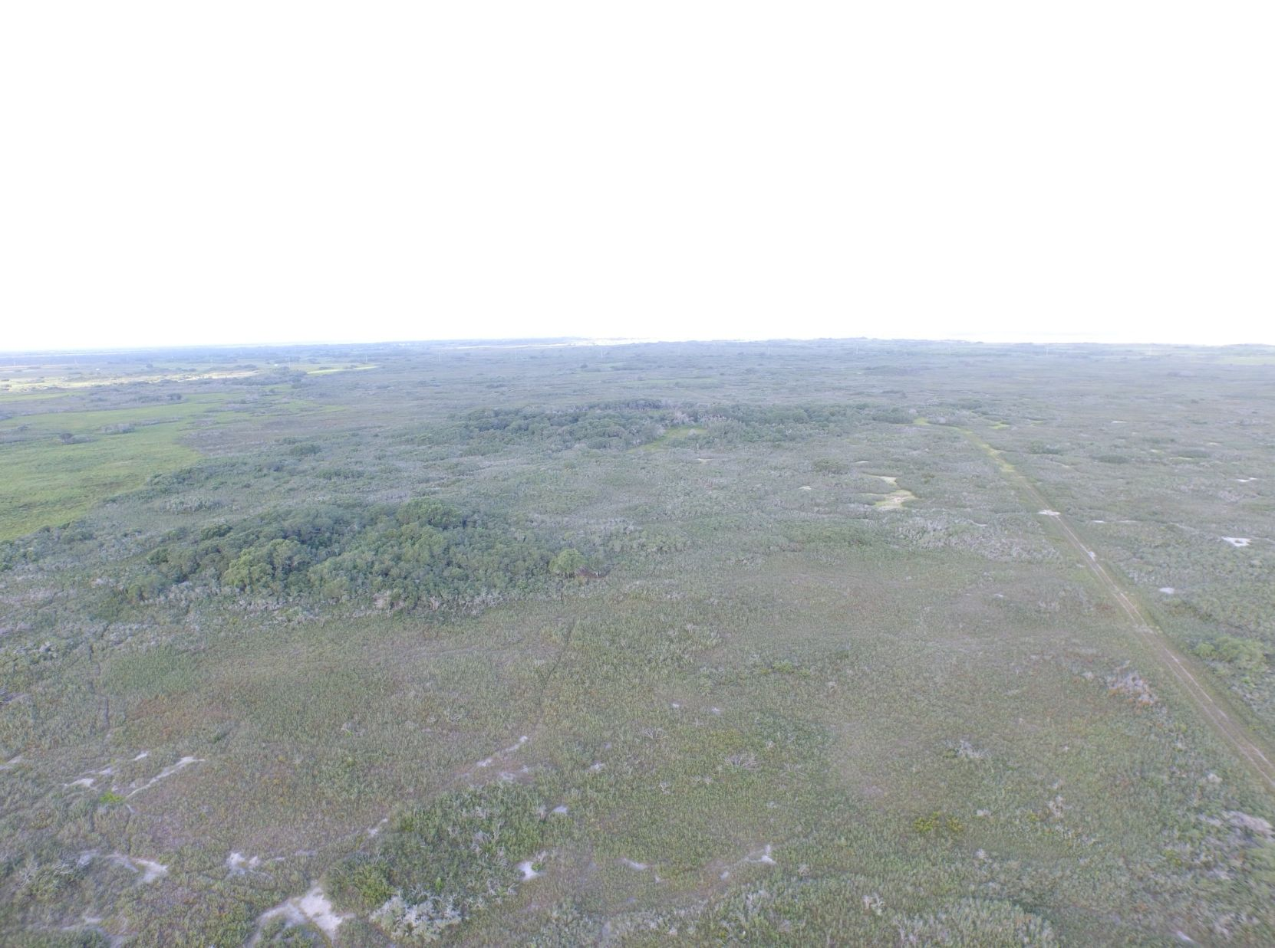

Slide 11
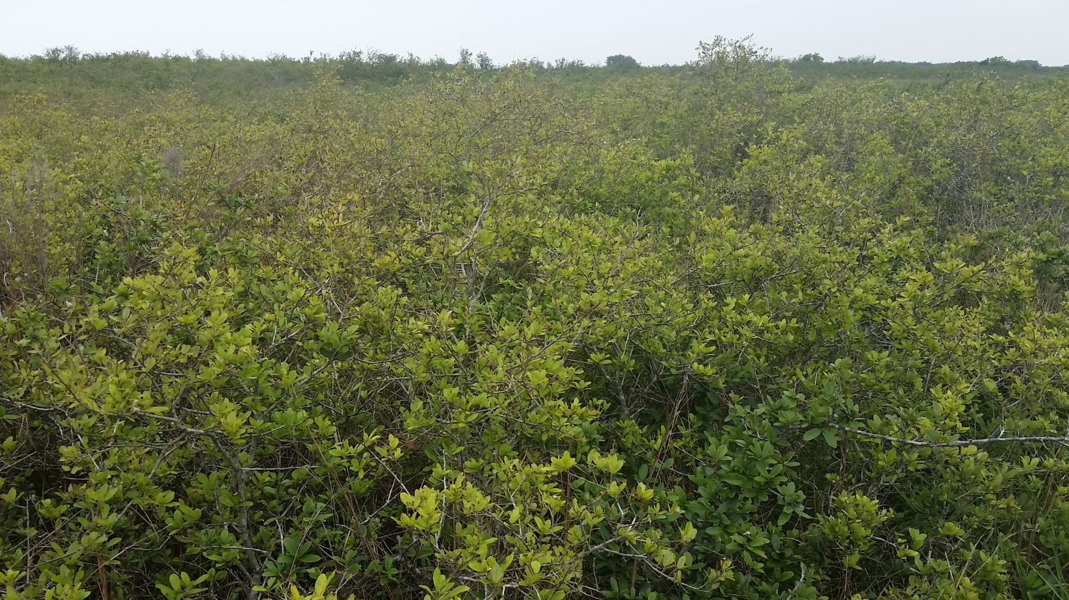

Slide 12
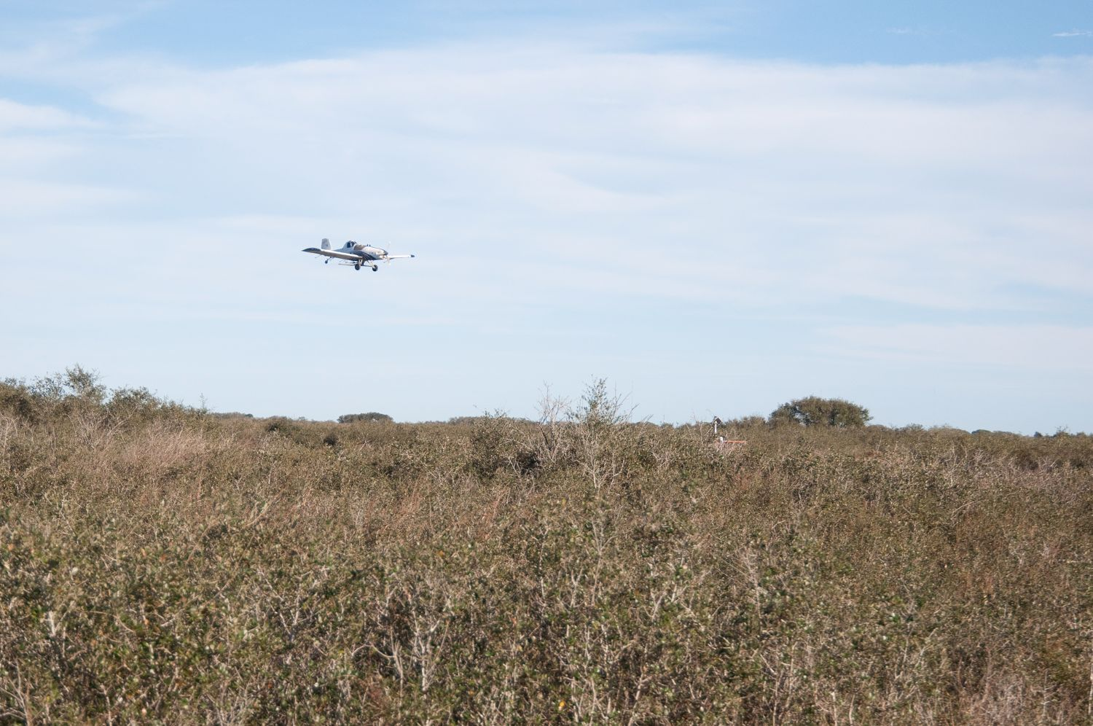

Slide 13
Herbicide Application
Not enough fine fuel to set back brush through prescribed fire
Herbicide used to open up brush and let grasses grow
Spike
  20p – pelleted form
  80df – granular, mixed with water before applying
  Both are absorbed through roots
  Don’t want excessive rain washing chemical away

Slide 14
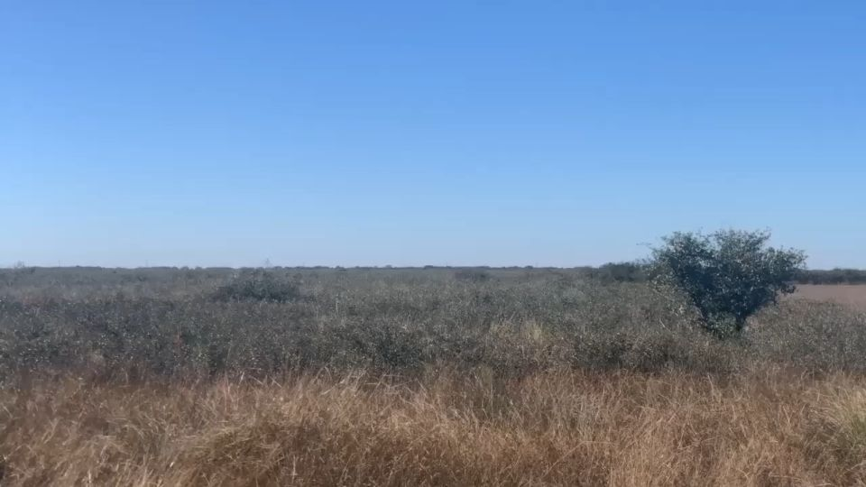

Slide 15
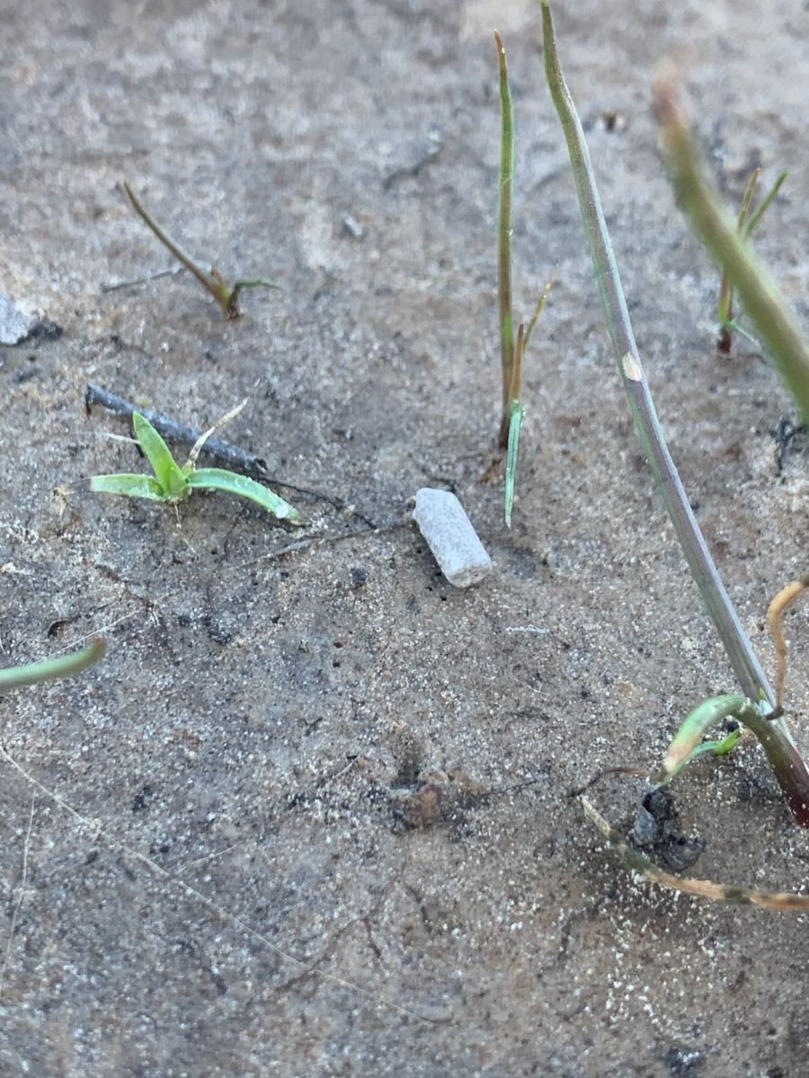
Spike 20p on Powderhorn WMA
Applied to 5800 acres
  Dec 2015 – 2900 ac
  Dec 2016 – 1200 ac
  Jan 2023 – 1700 ac
Fix-winged aircraft
  10 lbs/ac
Cost

Slide 16
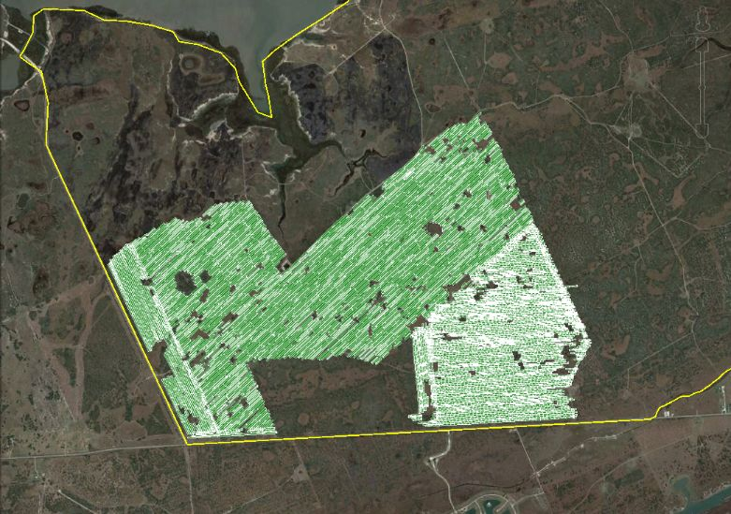

Slide 17
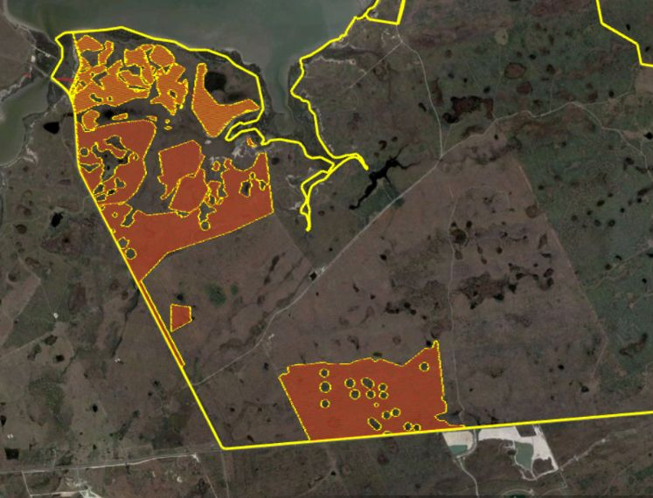

Slide 18
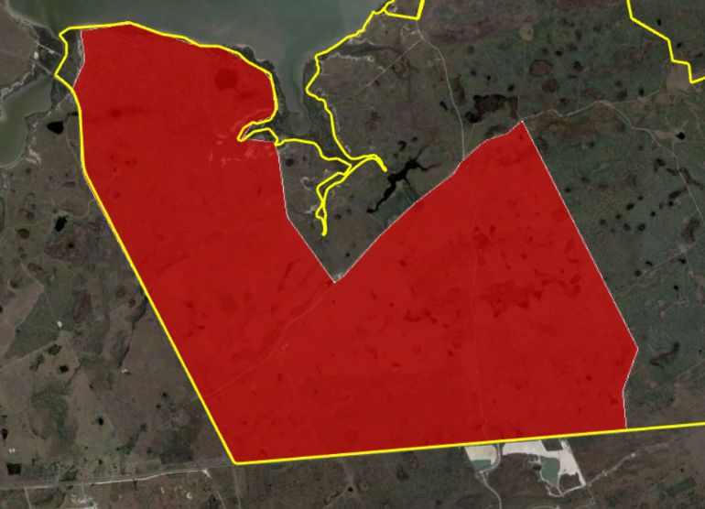

Slide 20
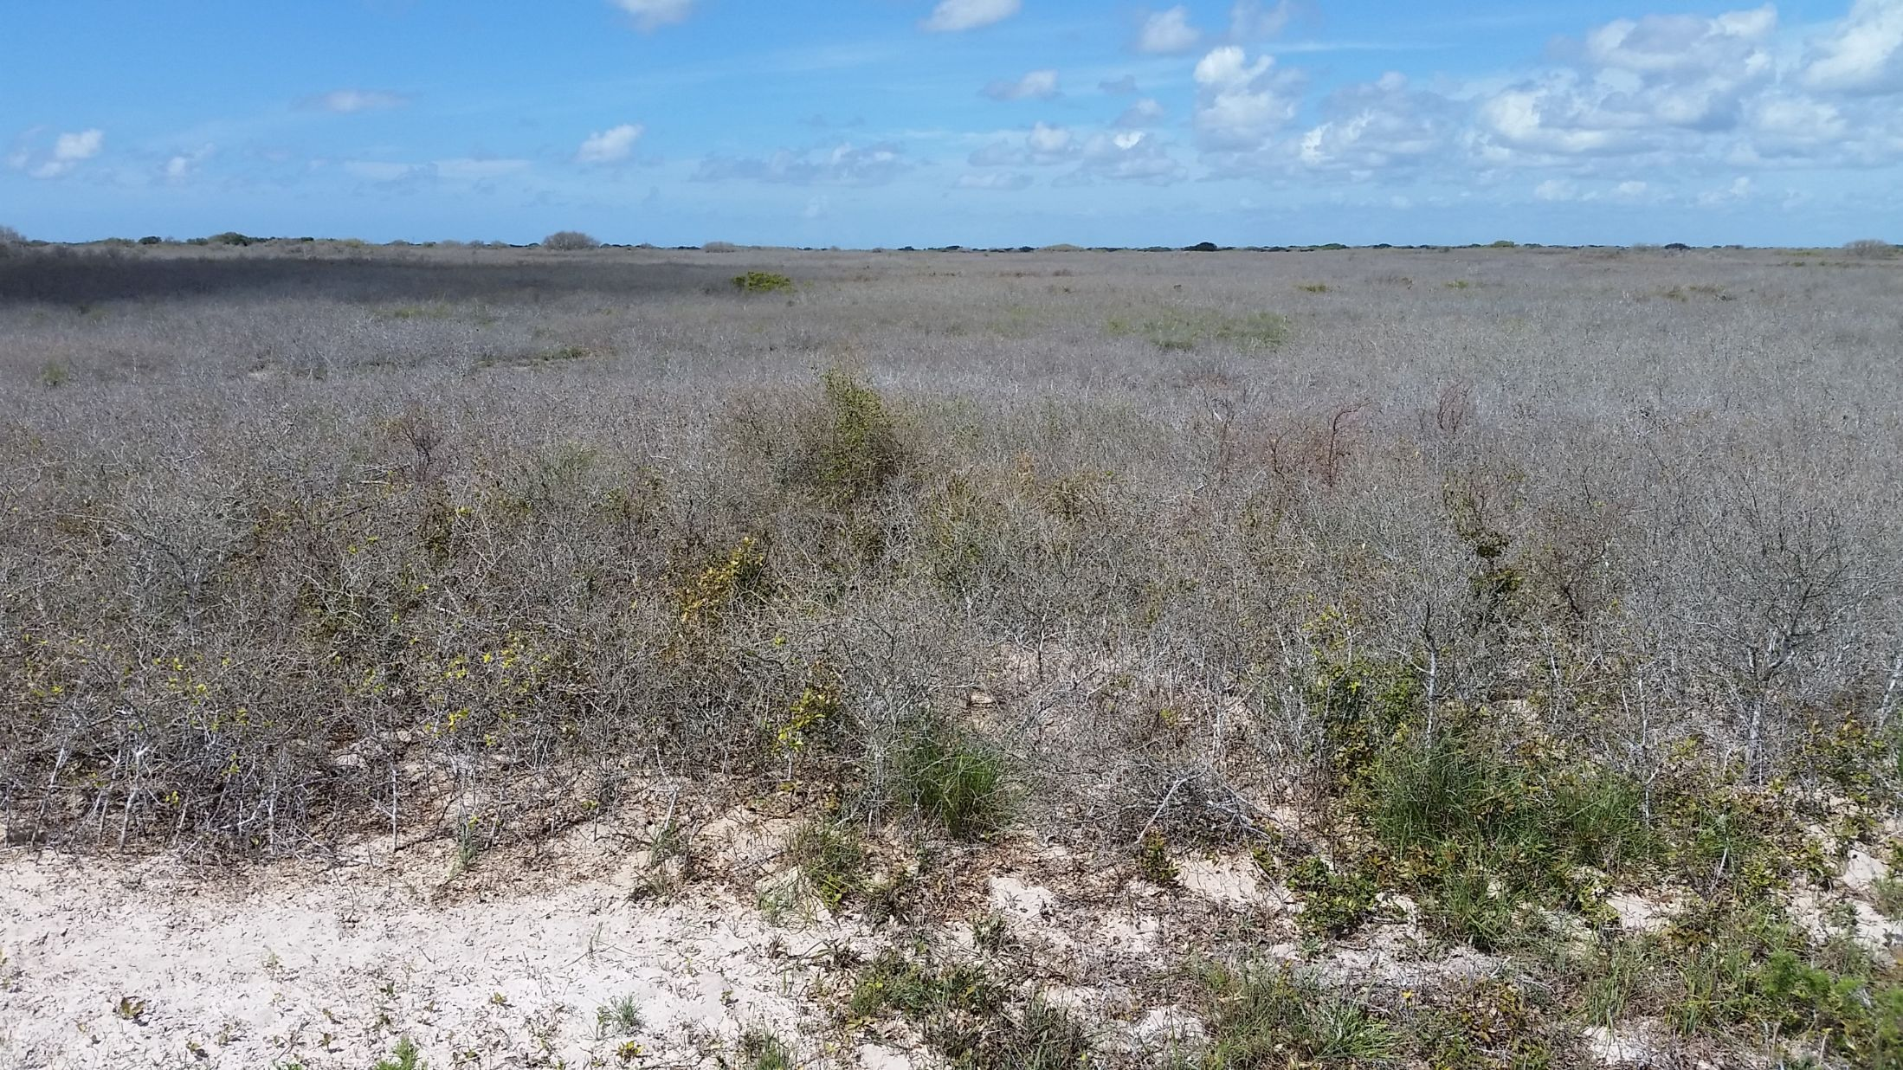

Slide 21
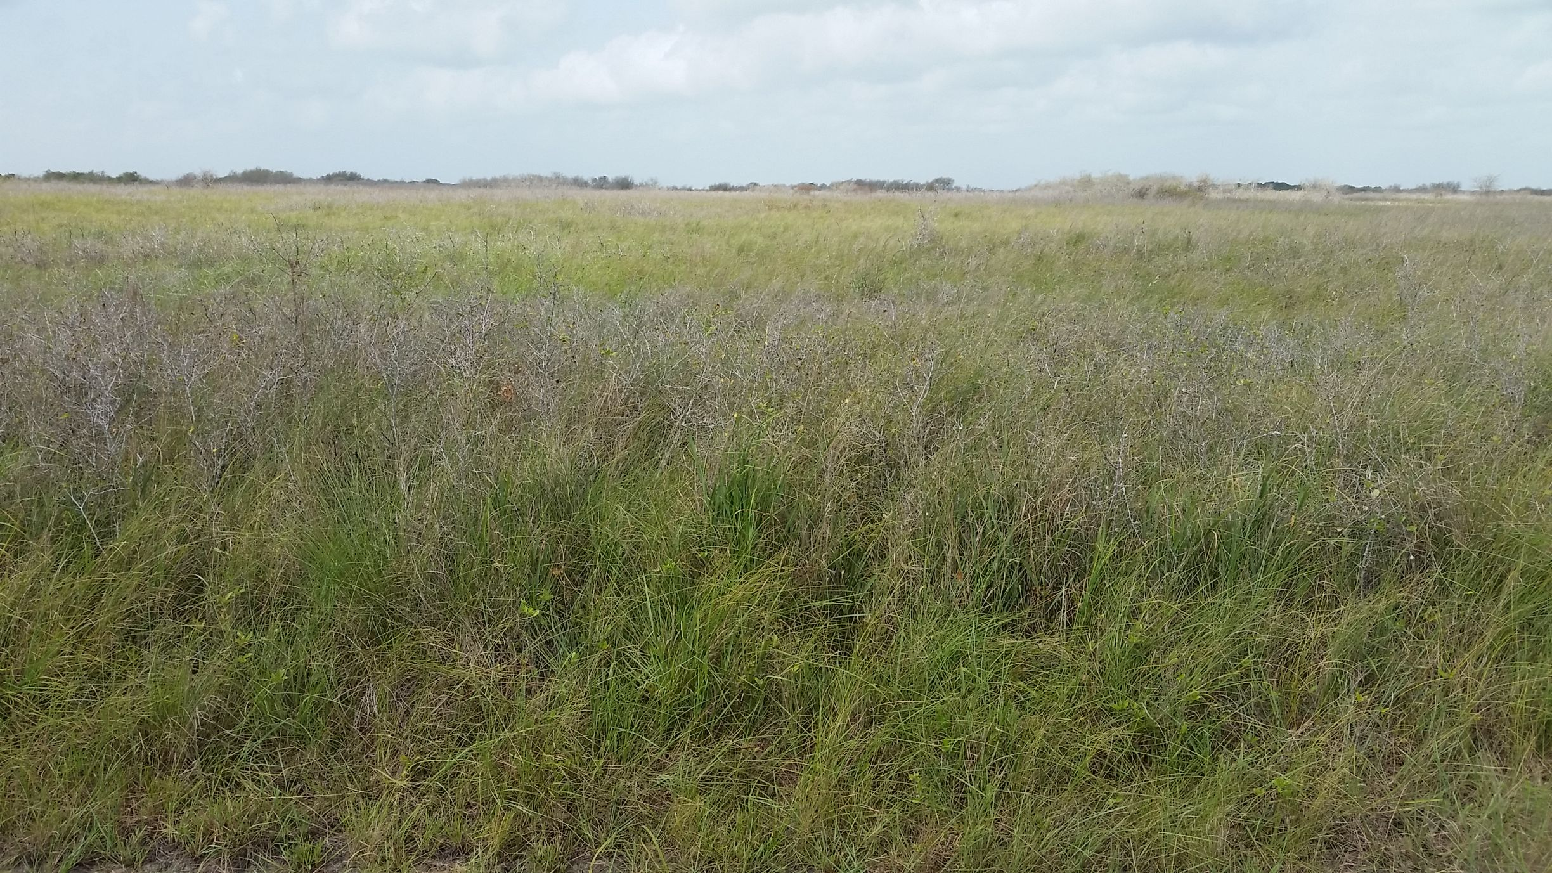

Slide 22
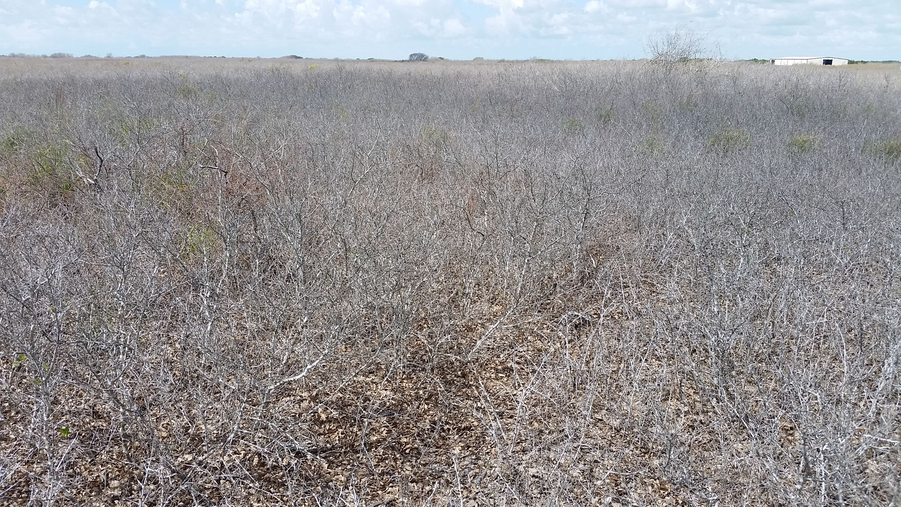

Slide 23
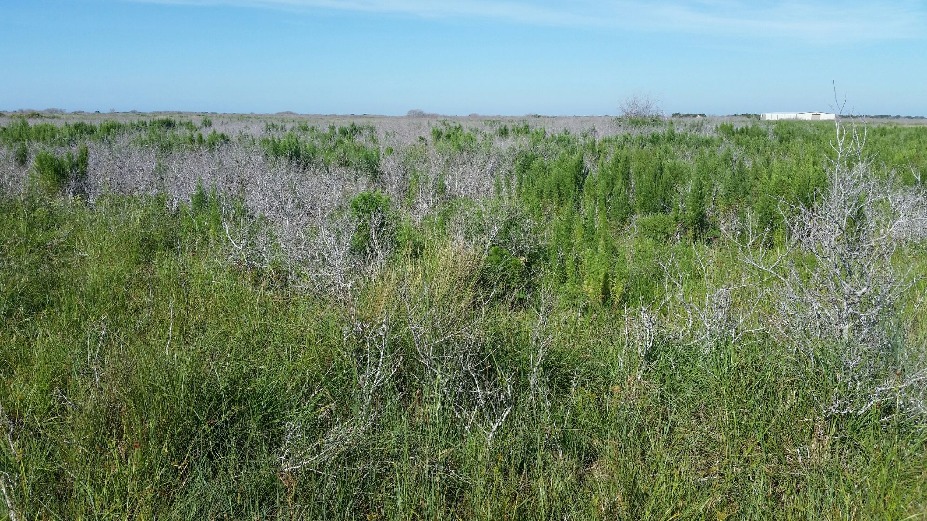

Slide 24
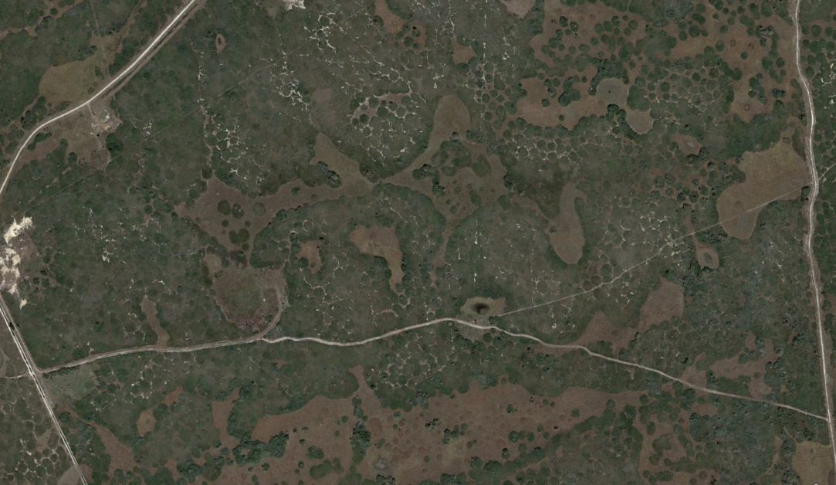

Slide 25
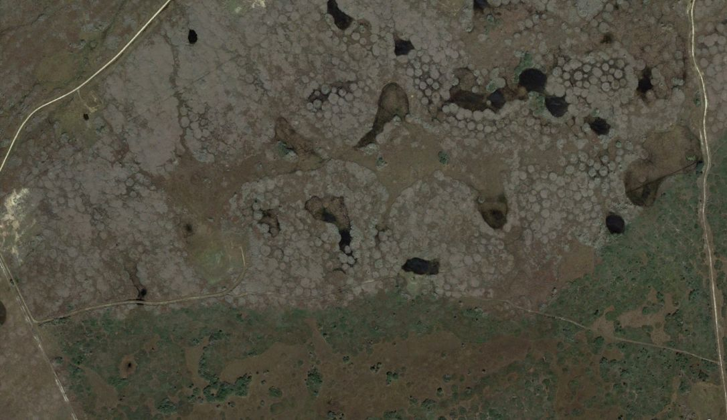

Slide 26
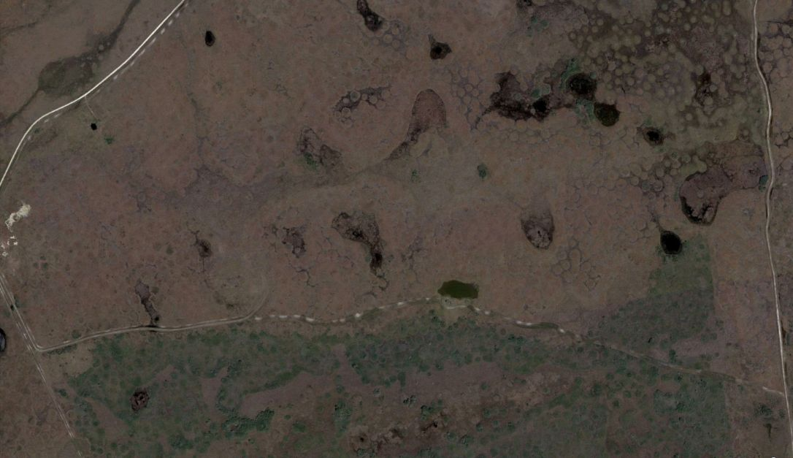

Slide 27
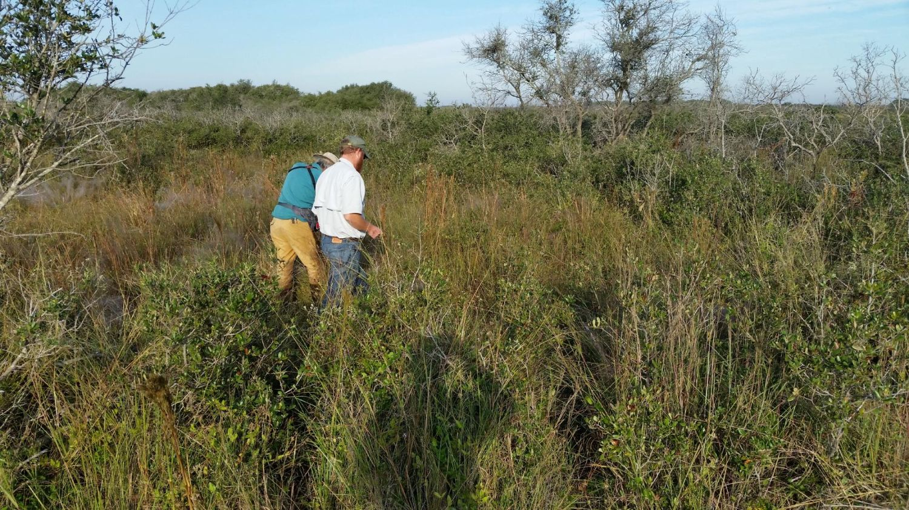
Oct 2015

Slide 28
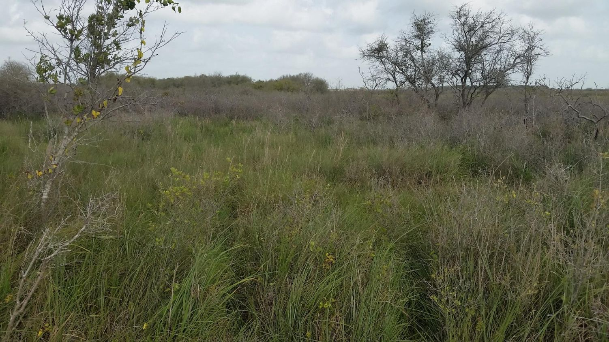
Oct 2016

Slide 29
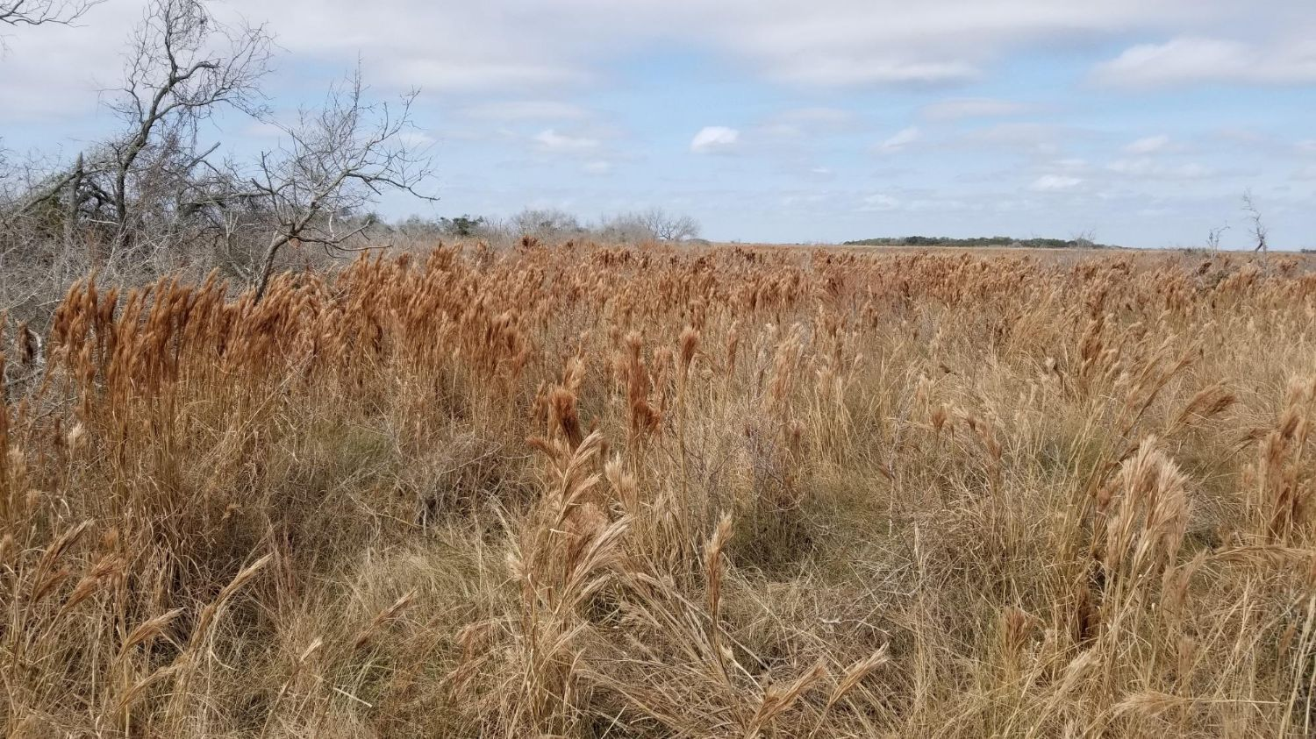
Feb 2018

Slide 30
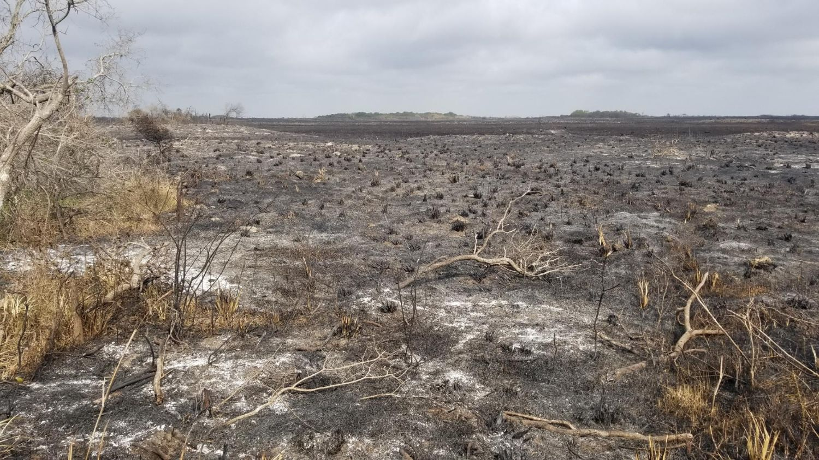
Mar 2018

Slide 31
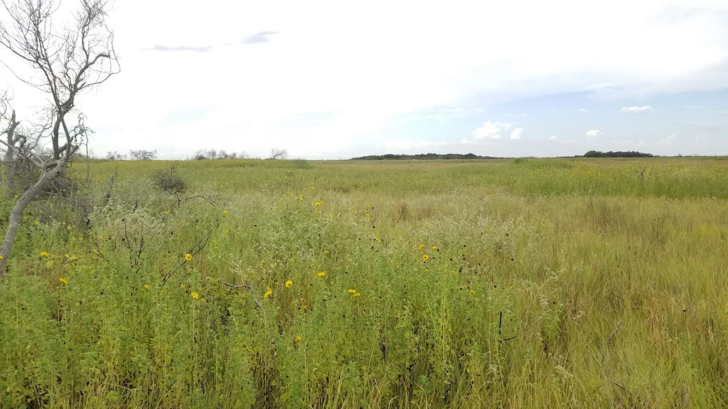
Aug 2018

Slide 32
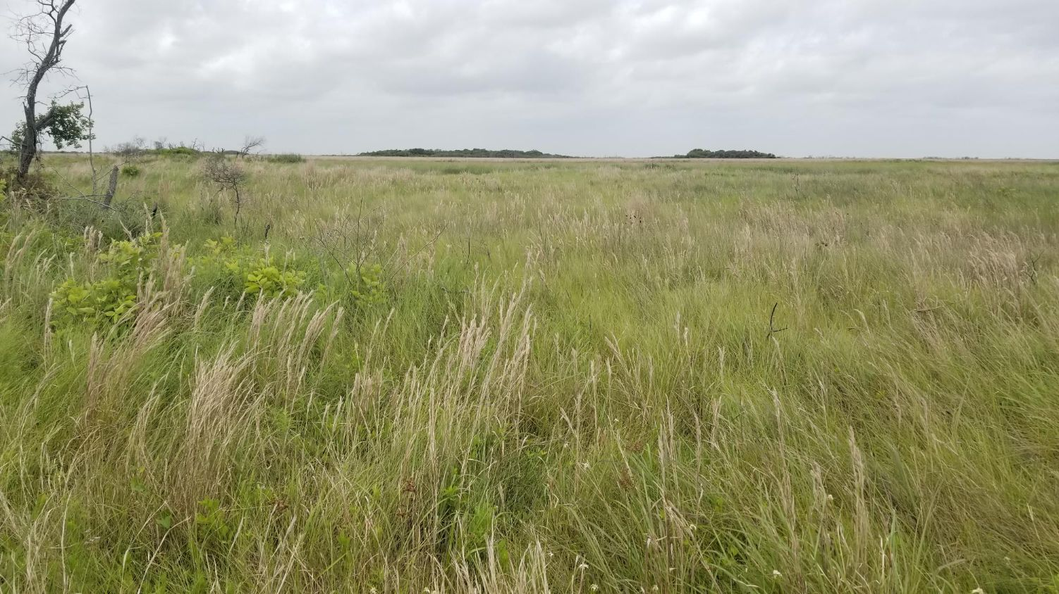
May 2019

Slide 33
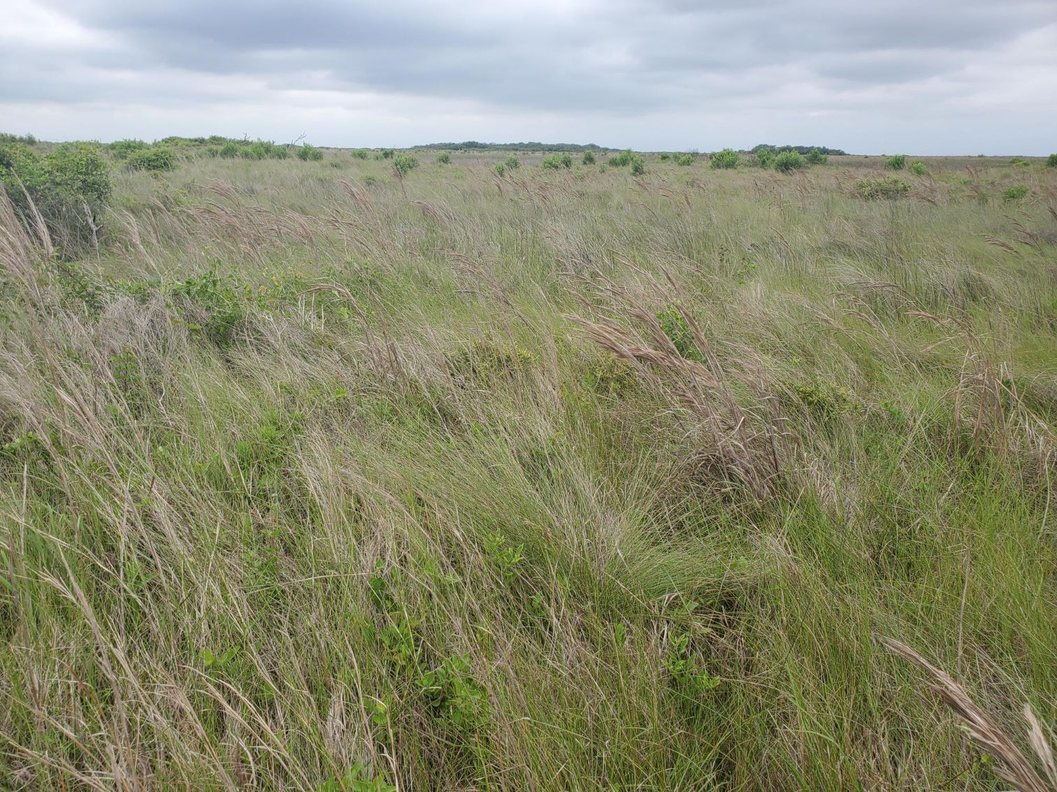

Slide 34
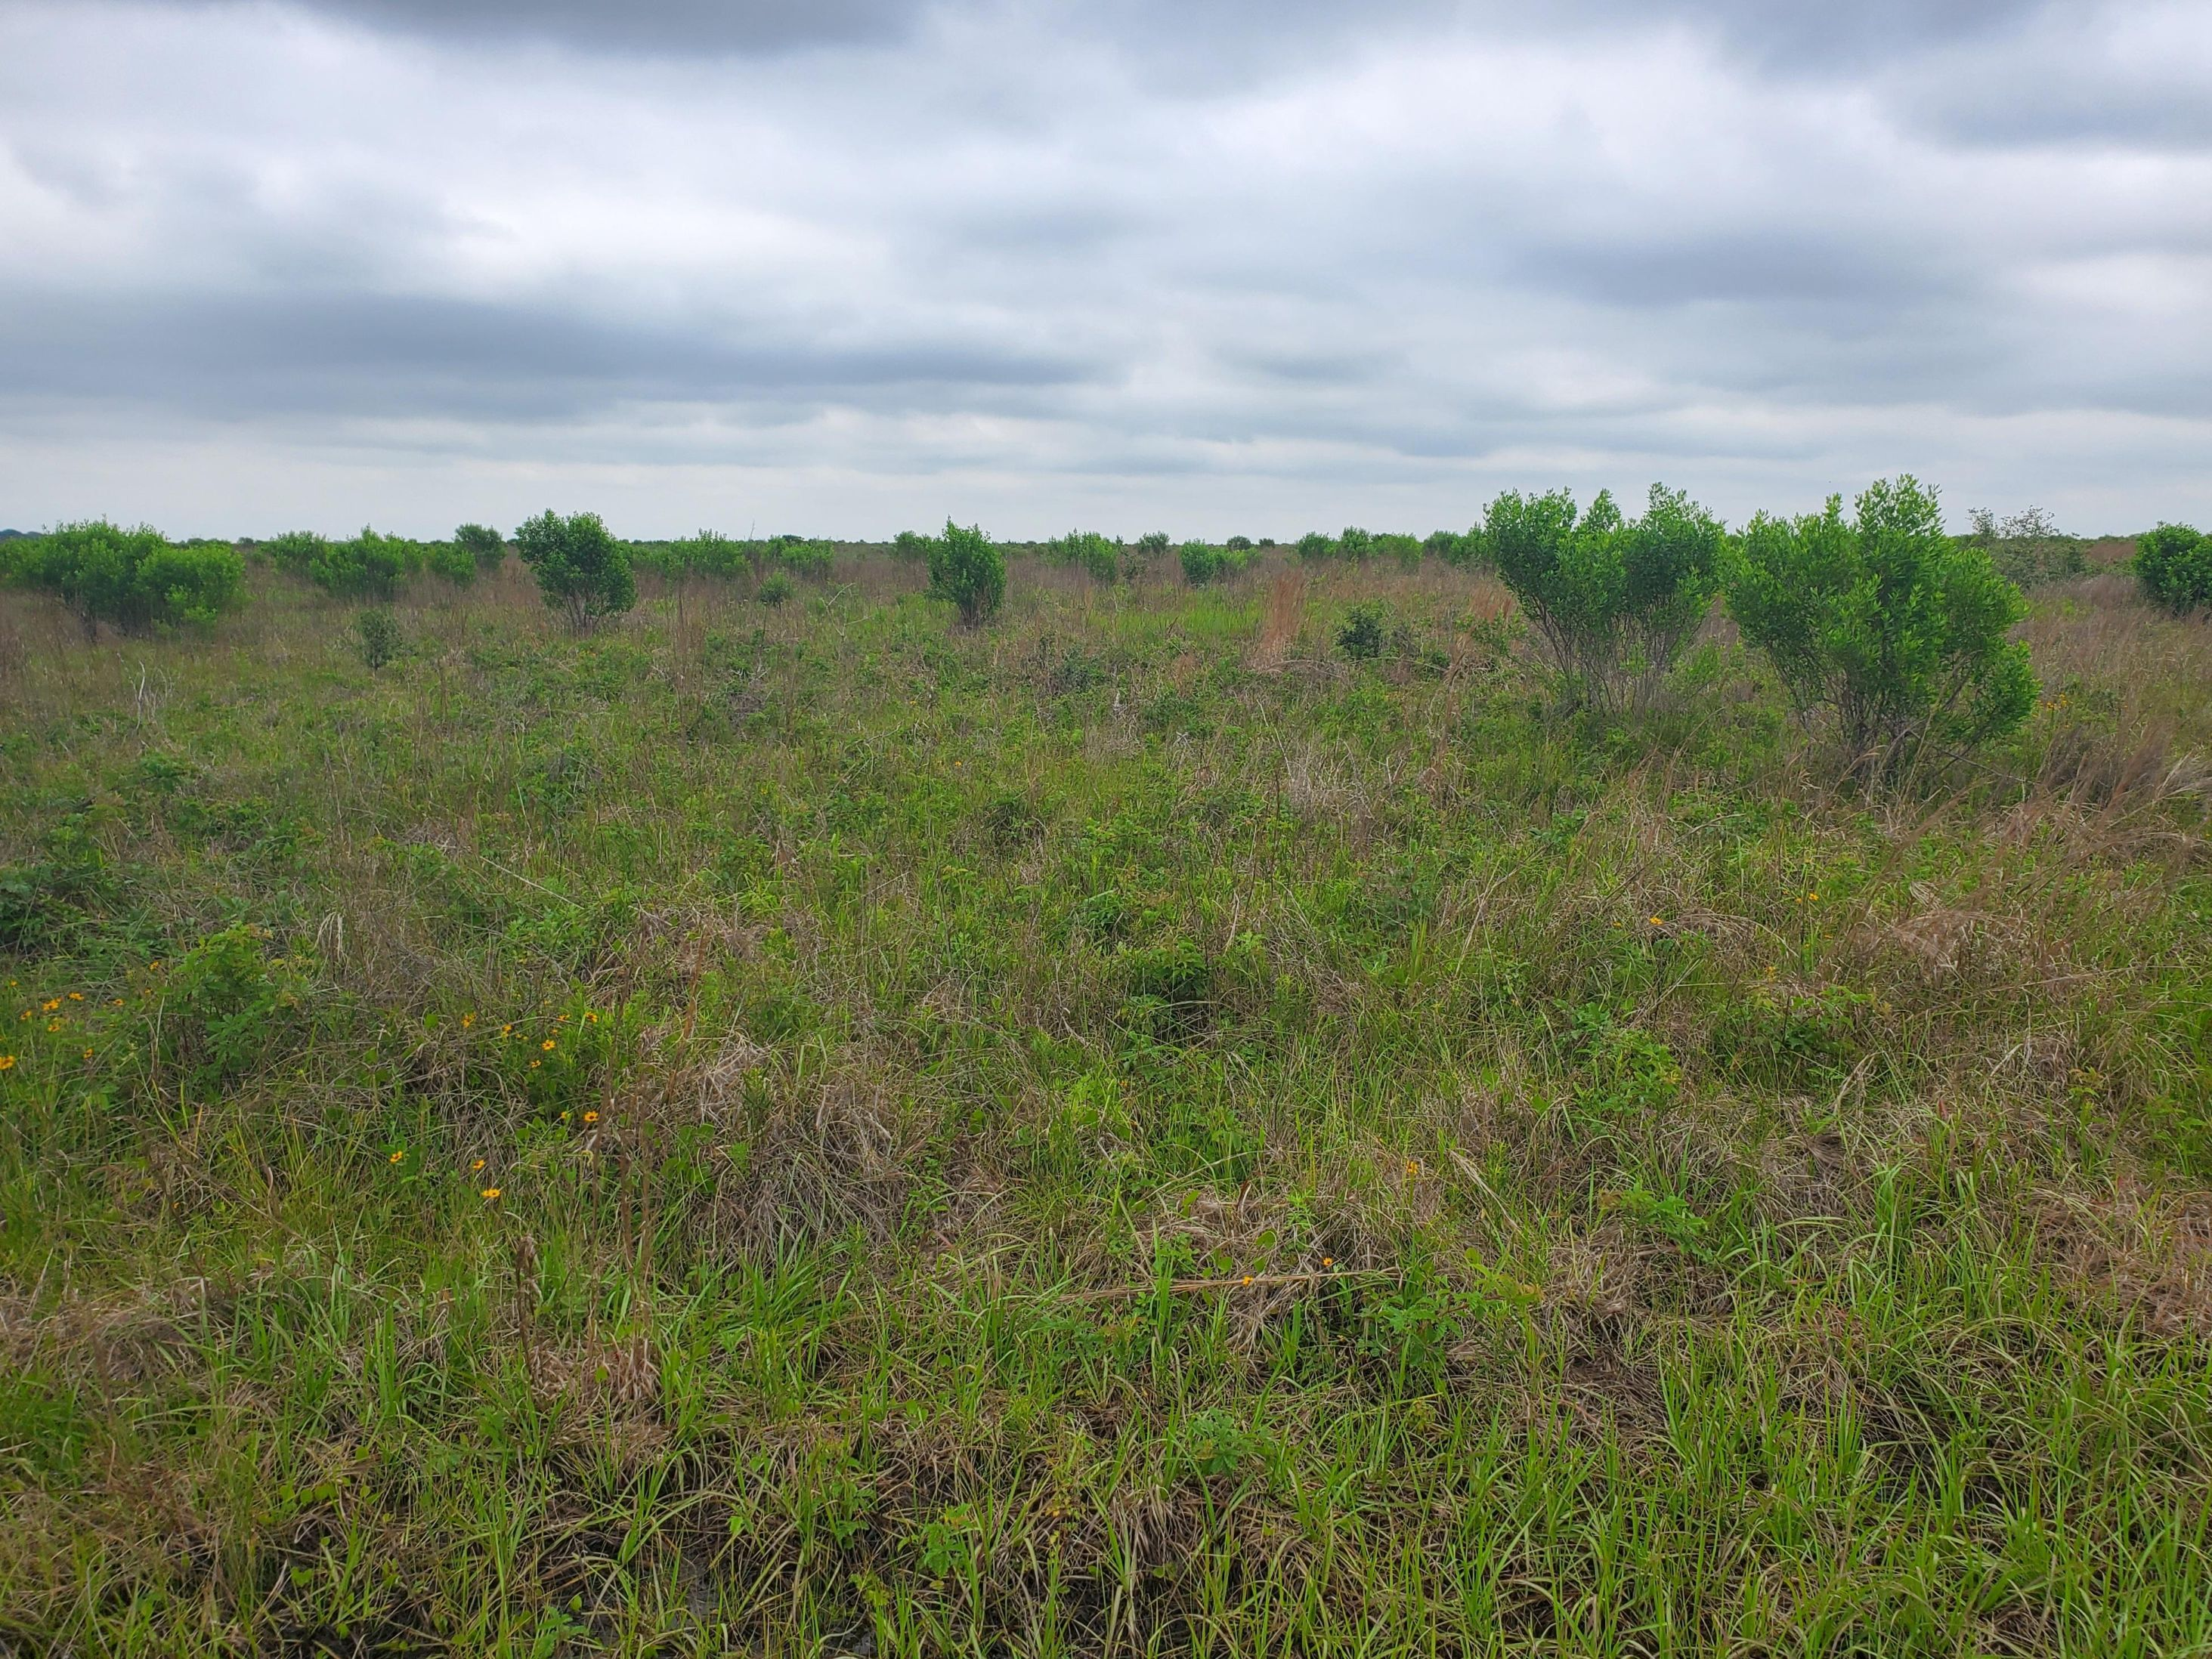

Slide 35
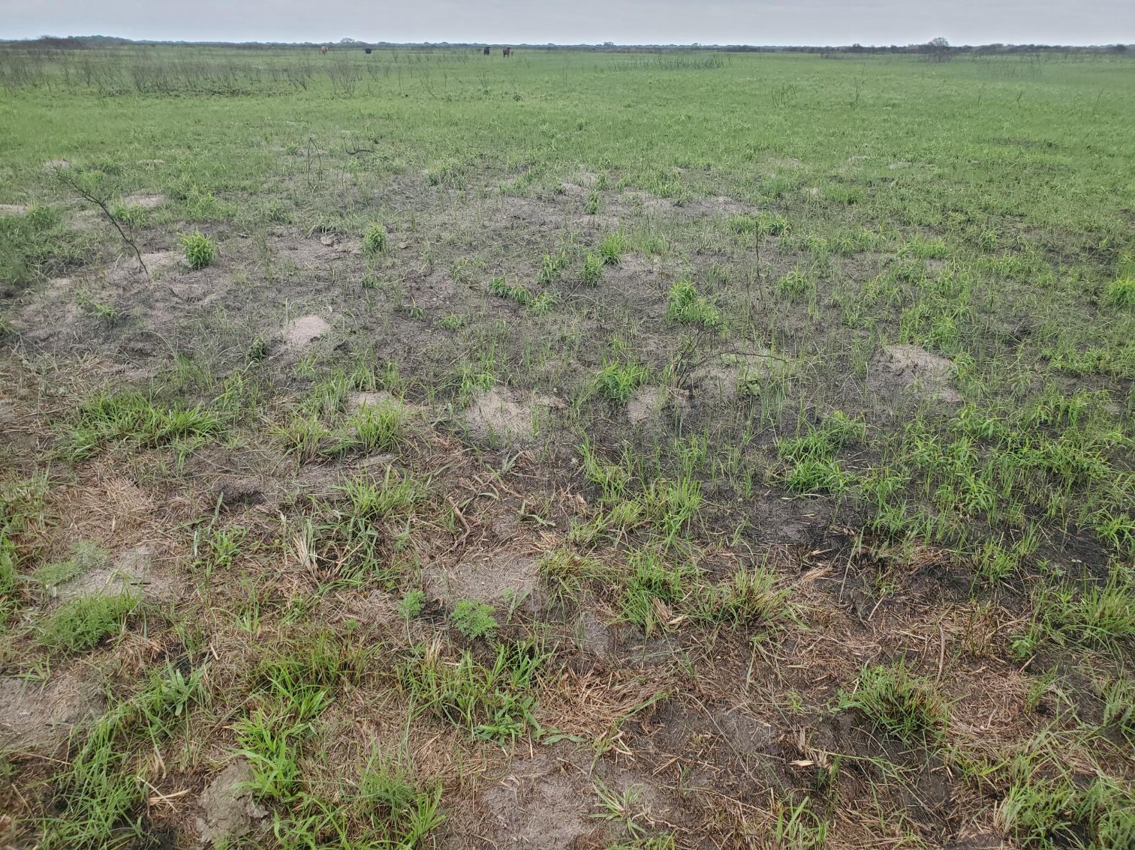

Slide 36
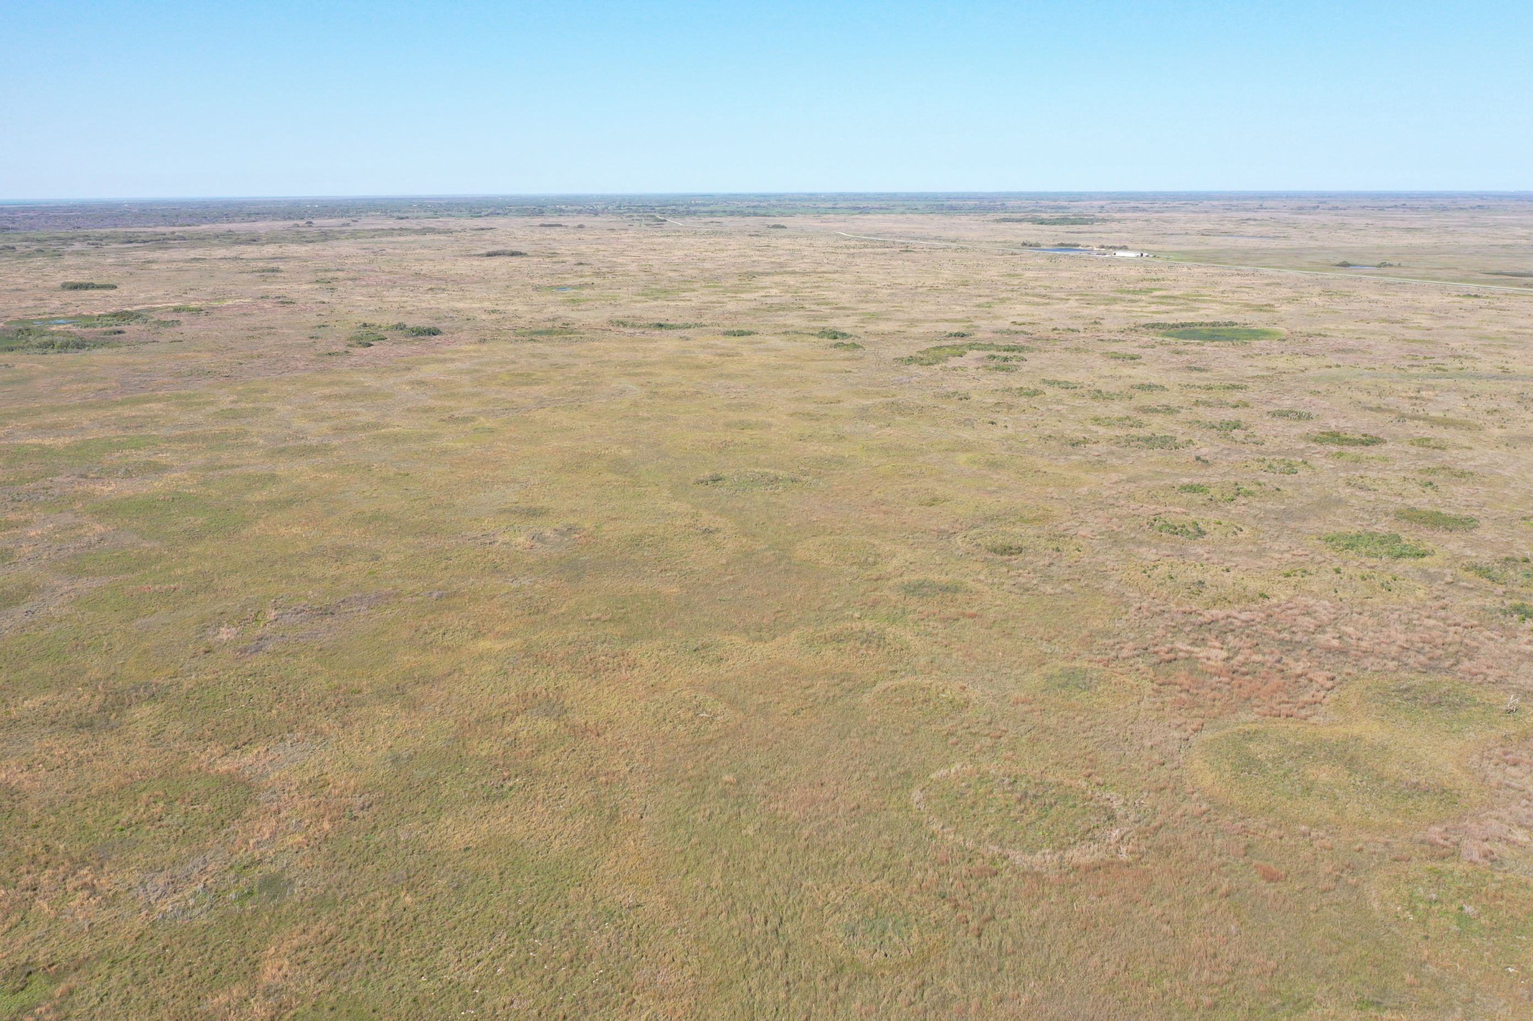

Slide 37
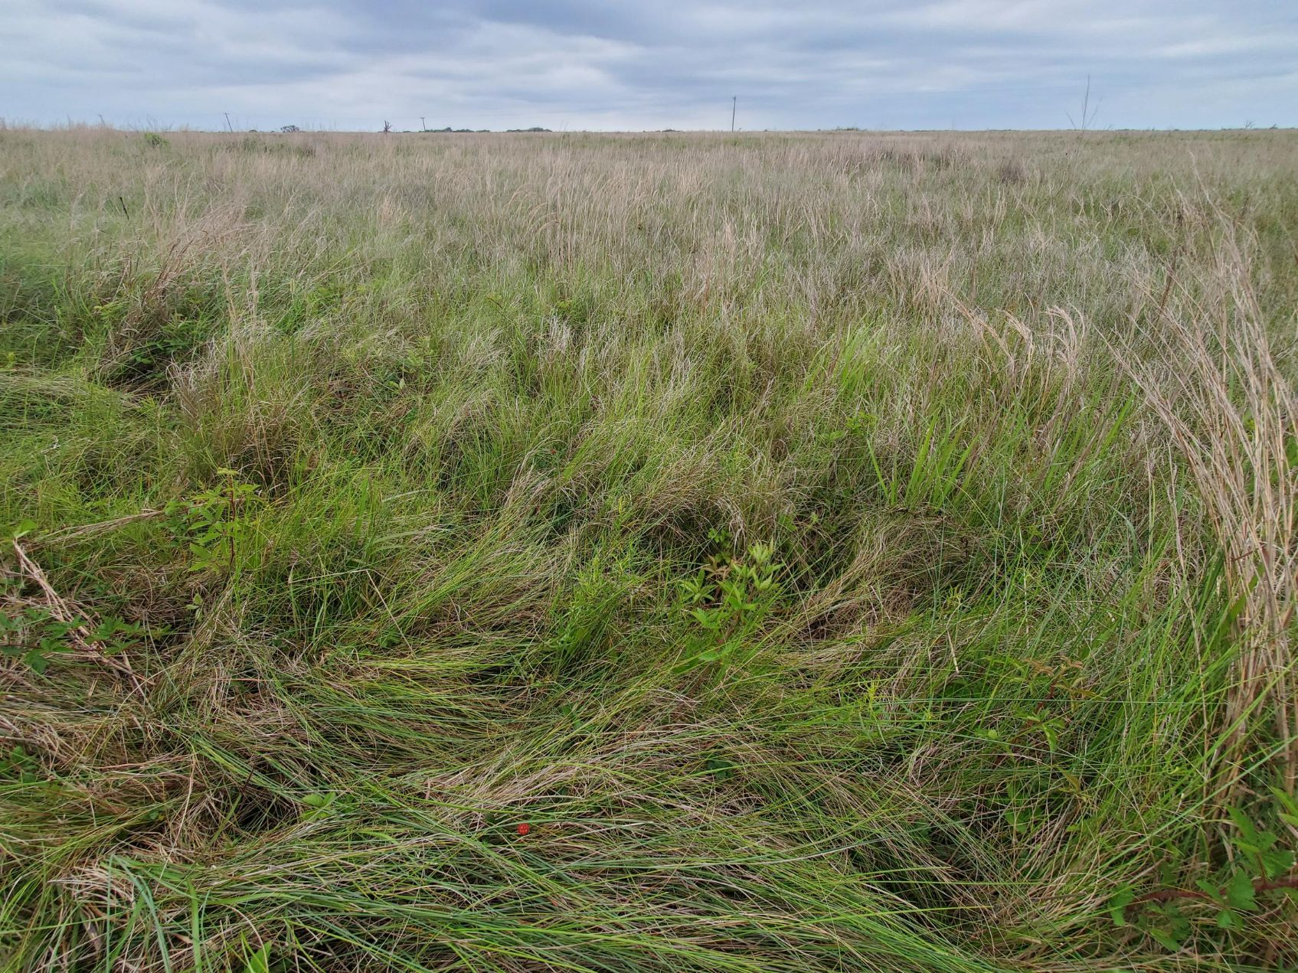

Slide 38
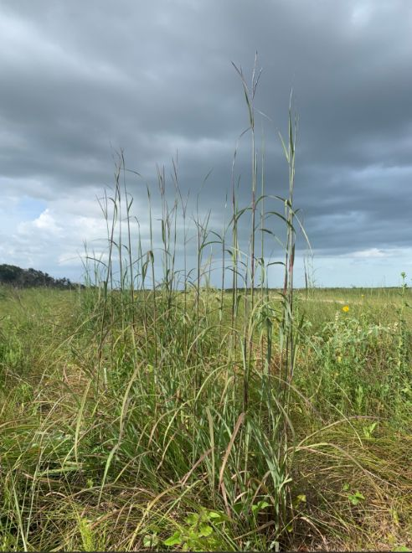
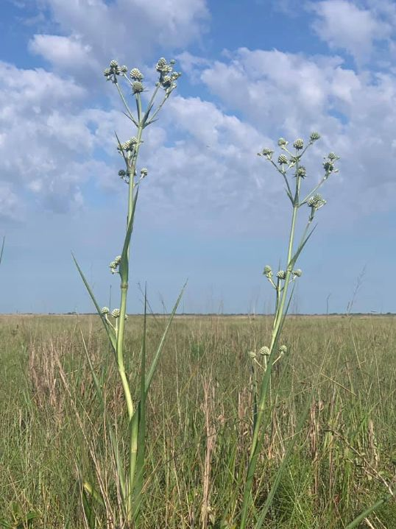

Slide 39
