Slide 1
Chinese Tallow and McCartney Rose Management on the Texas Mid-Coast
Texas
Notes:
GO TO VIEW > MASTER > SLIDE MASTER TO EDIT THE IMAGES ON THE TITLE AND DIVIDER SLIDES
RIGHT CLICK ON THE INDIVIDUAL IMAGES TO CHANGE THE IMAGE

Slide 2
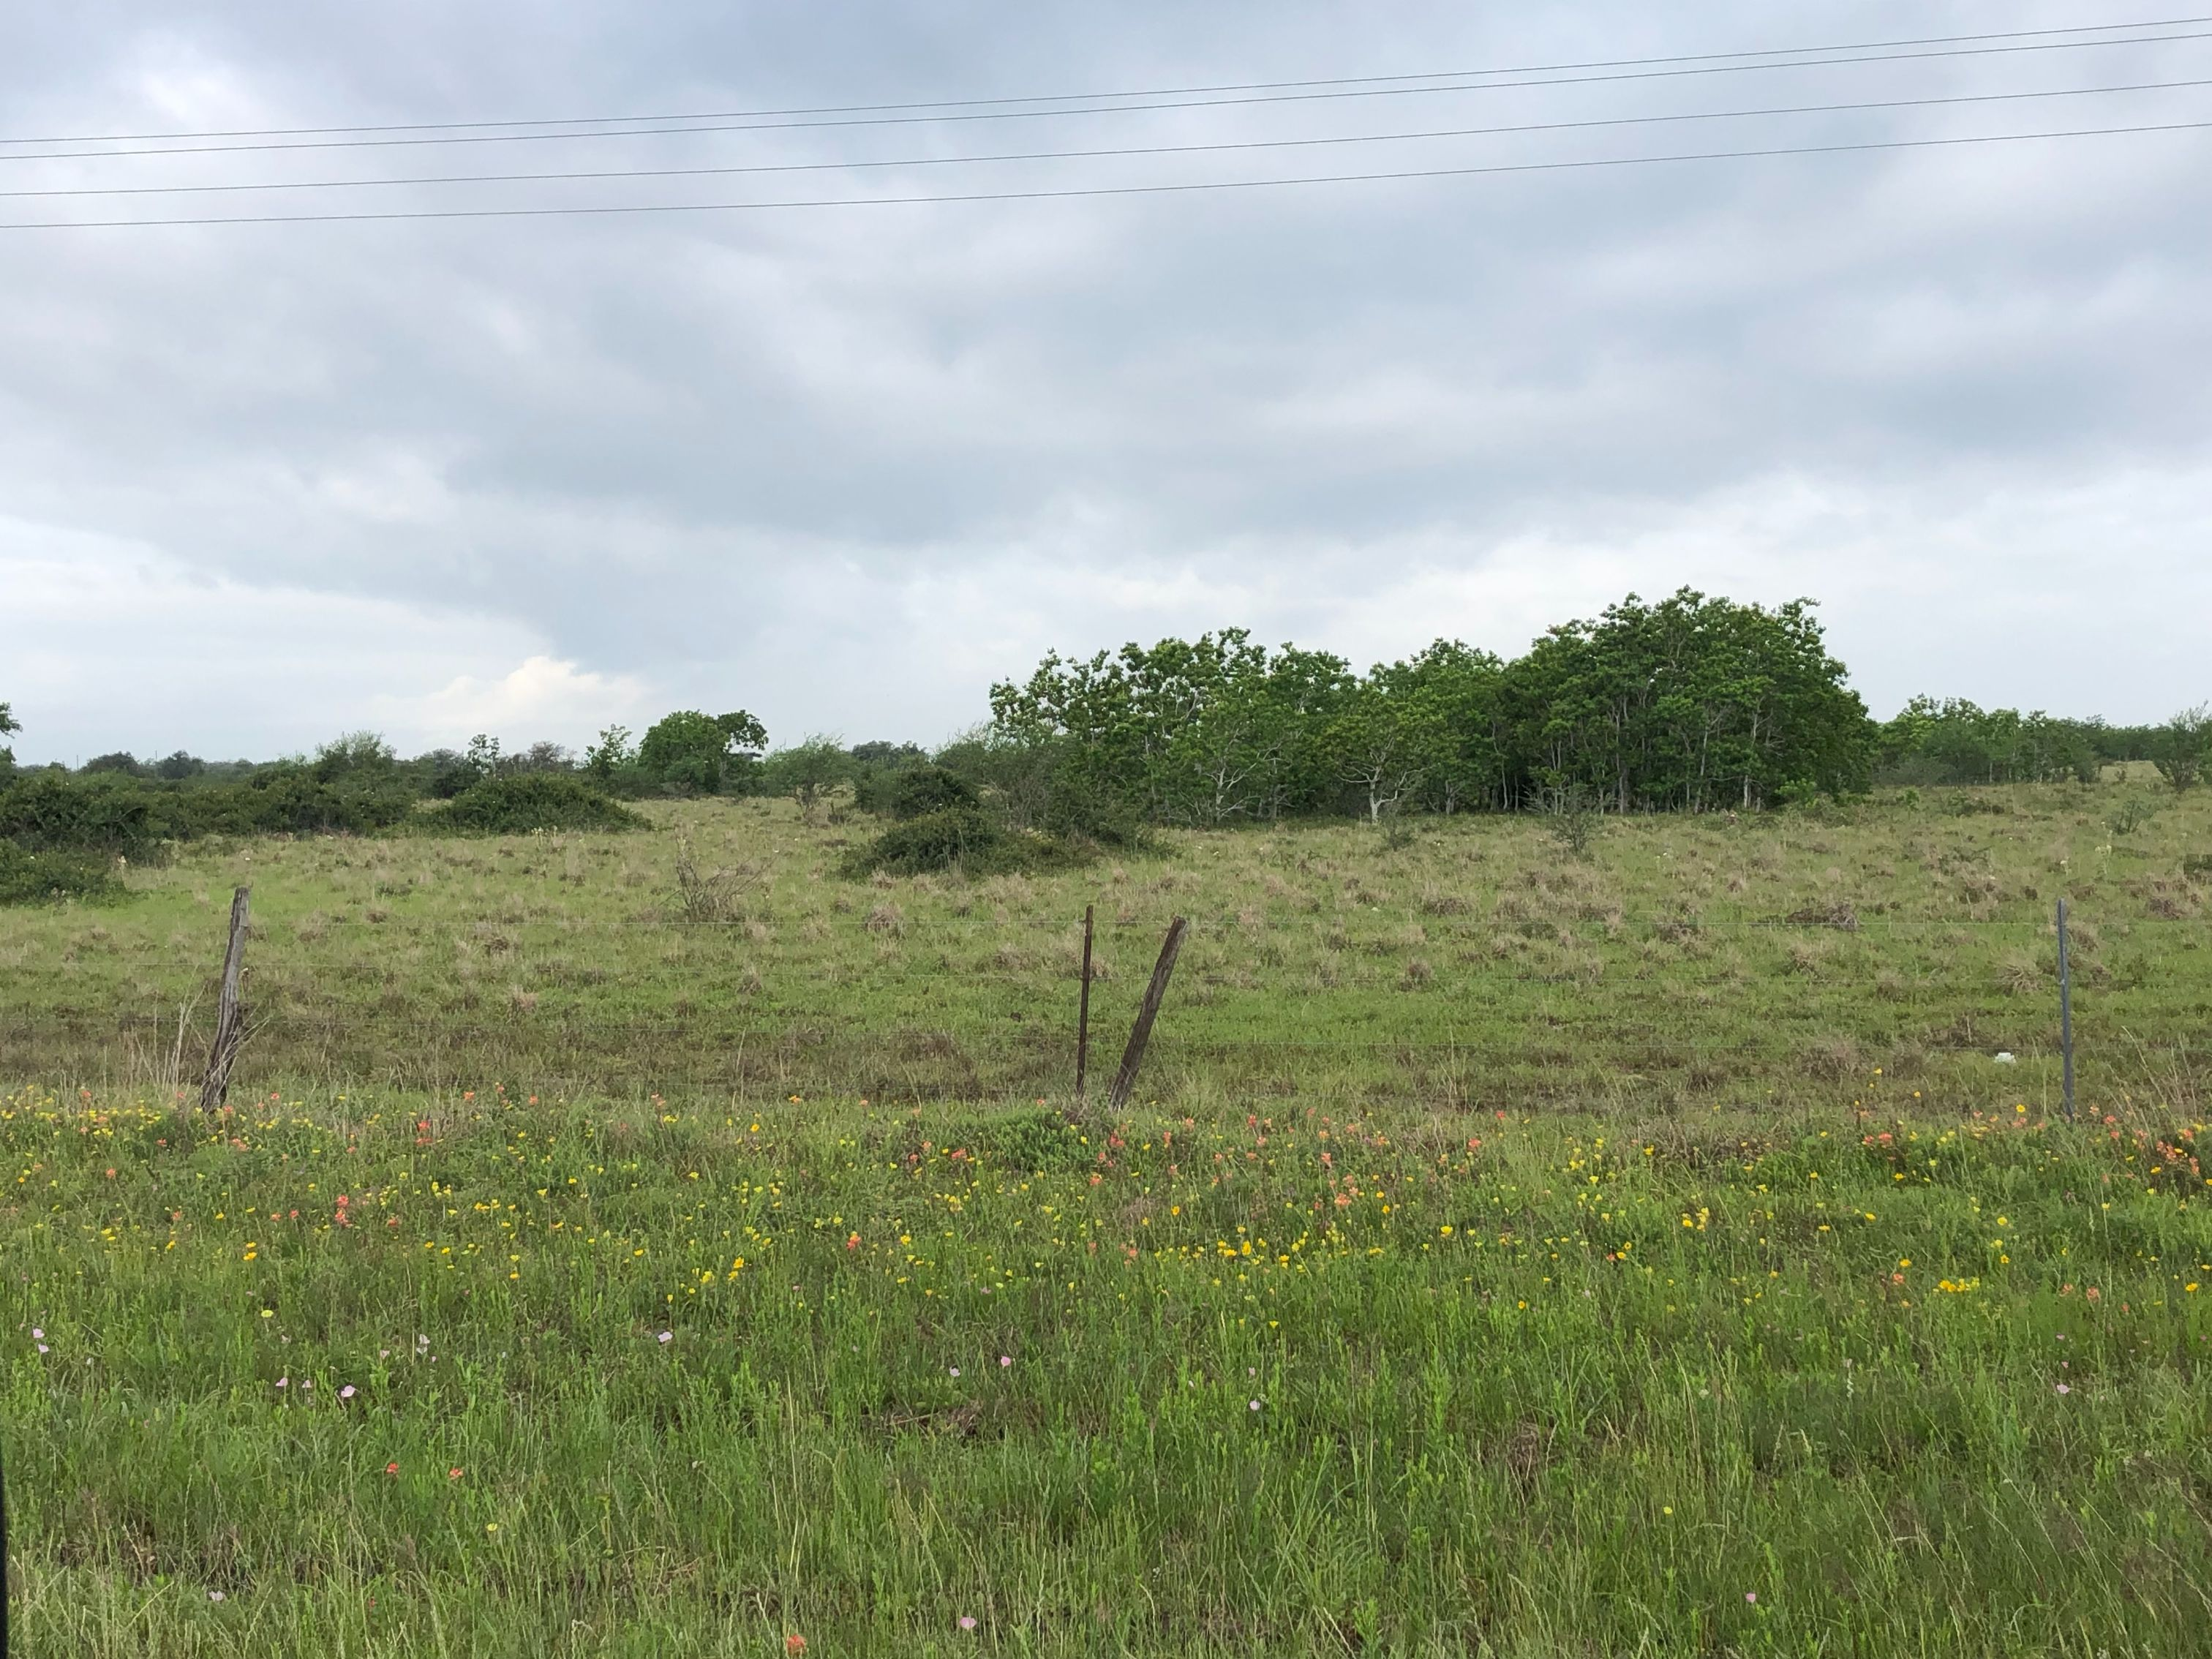
Agenda
Where Did it Come From & How it Invades
Land Treatments
Herbicide Options

Slide 3
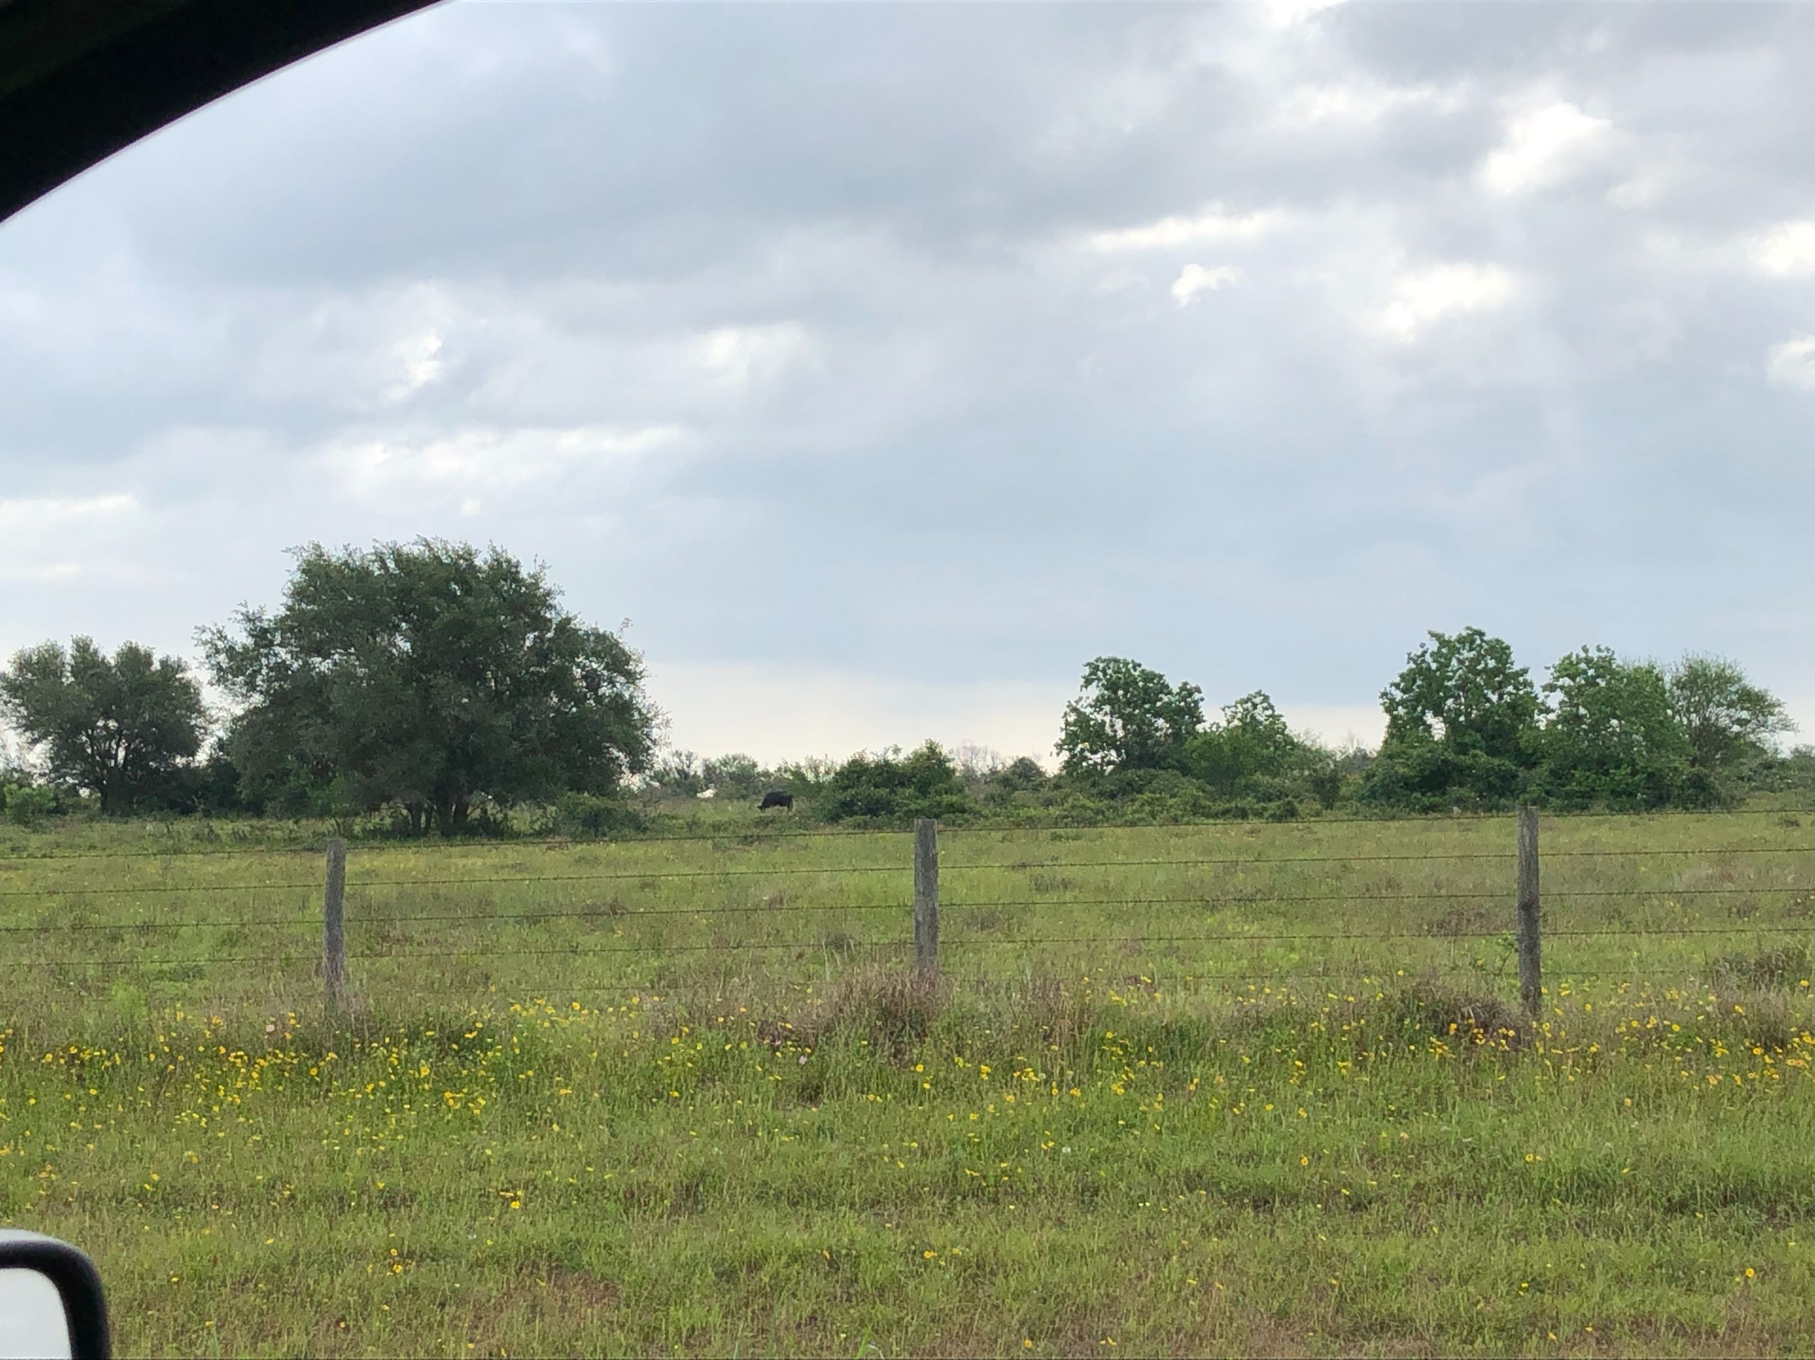

Slide 4
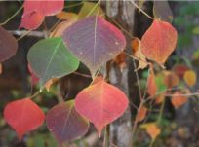
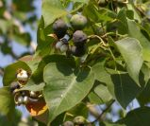
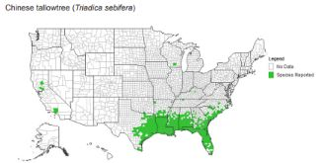
Chinese Tallow
Key Facts & Characteristics:
Introduced in 1770 to South Carolina.
Distributed in the Gulf Coast in the 1900s for soap making.
A single mature tree produces 100,000 seeds.
Transported by water and birds.
Invades stream banks, wet
areas, and open prairies
when soil is exposed.

Slide 5
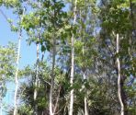
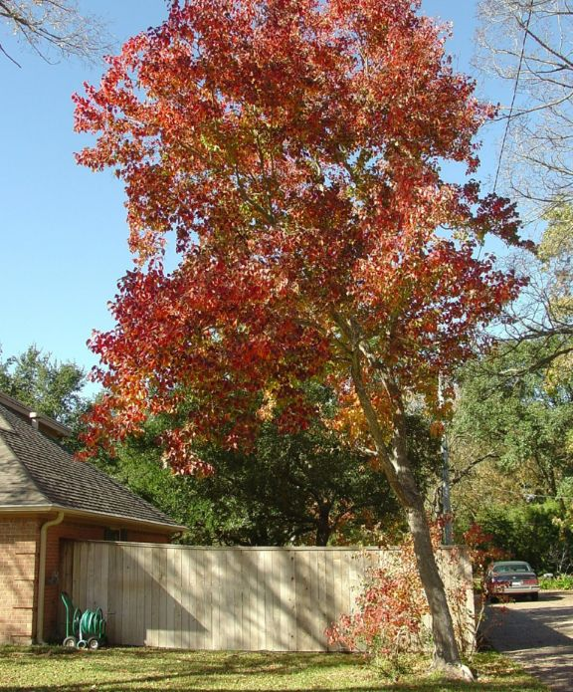
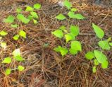
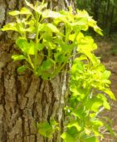
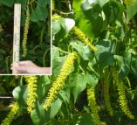
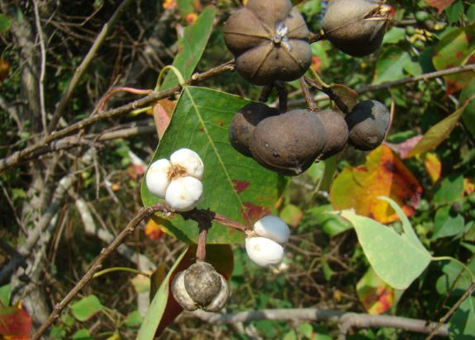
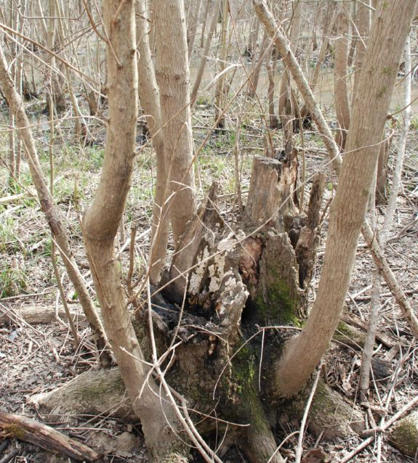
Chinese Tallow
www.southernforesthealth.net/plants

Slide 6
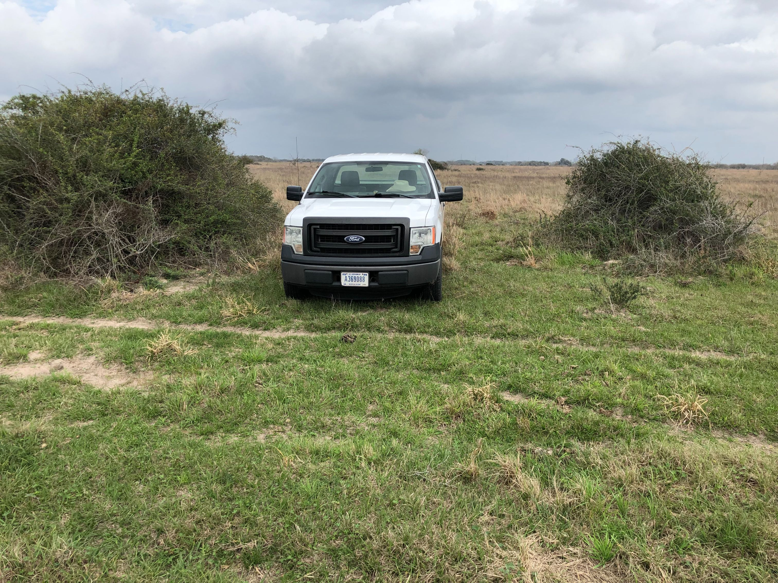
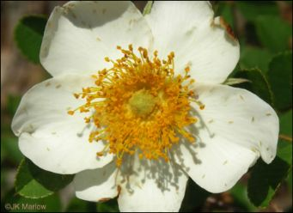
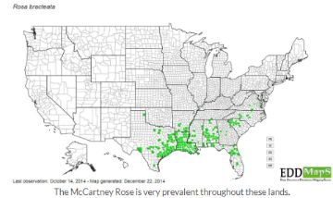
McCartney Rose
Key Facts & Characteristics:
Imported to Jackson County in the late 1800s as a hedge for fencing purposes.
Vegetative sprouting from the base and stem rooting results in colonization.
Shredding can cause it to spread like prickly pear.
Seeds are dispersed by birds, livestock, and wildlife. Seeds can germinate from cattle feces.
It finds it niche in the Gulf Coast in Clays, Loams, and Claypans.
Not as prevalent in deeper sands.
Further from the Coast it will thrive in clayey sites.

Slide 7
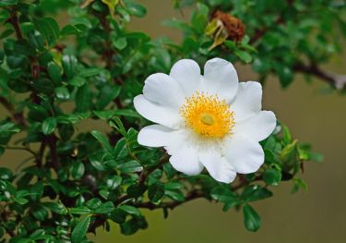
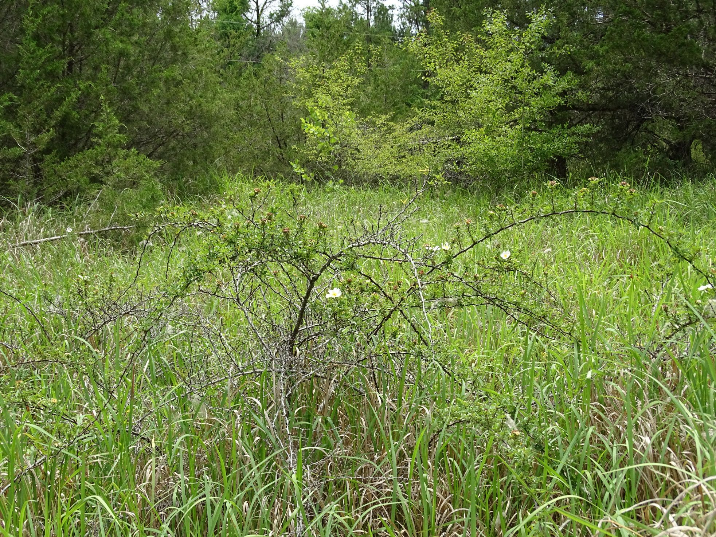
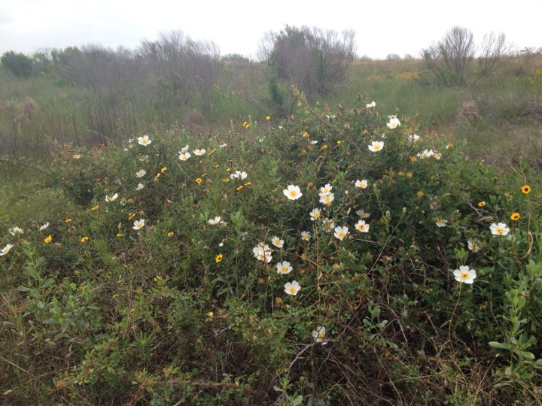
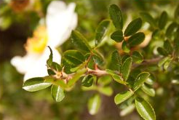
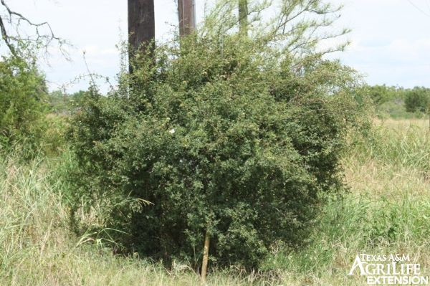
McCartney Rose

Slide 8
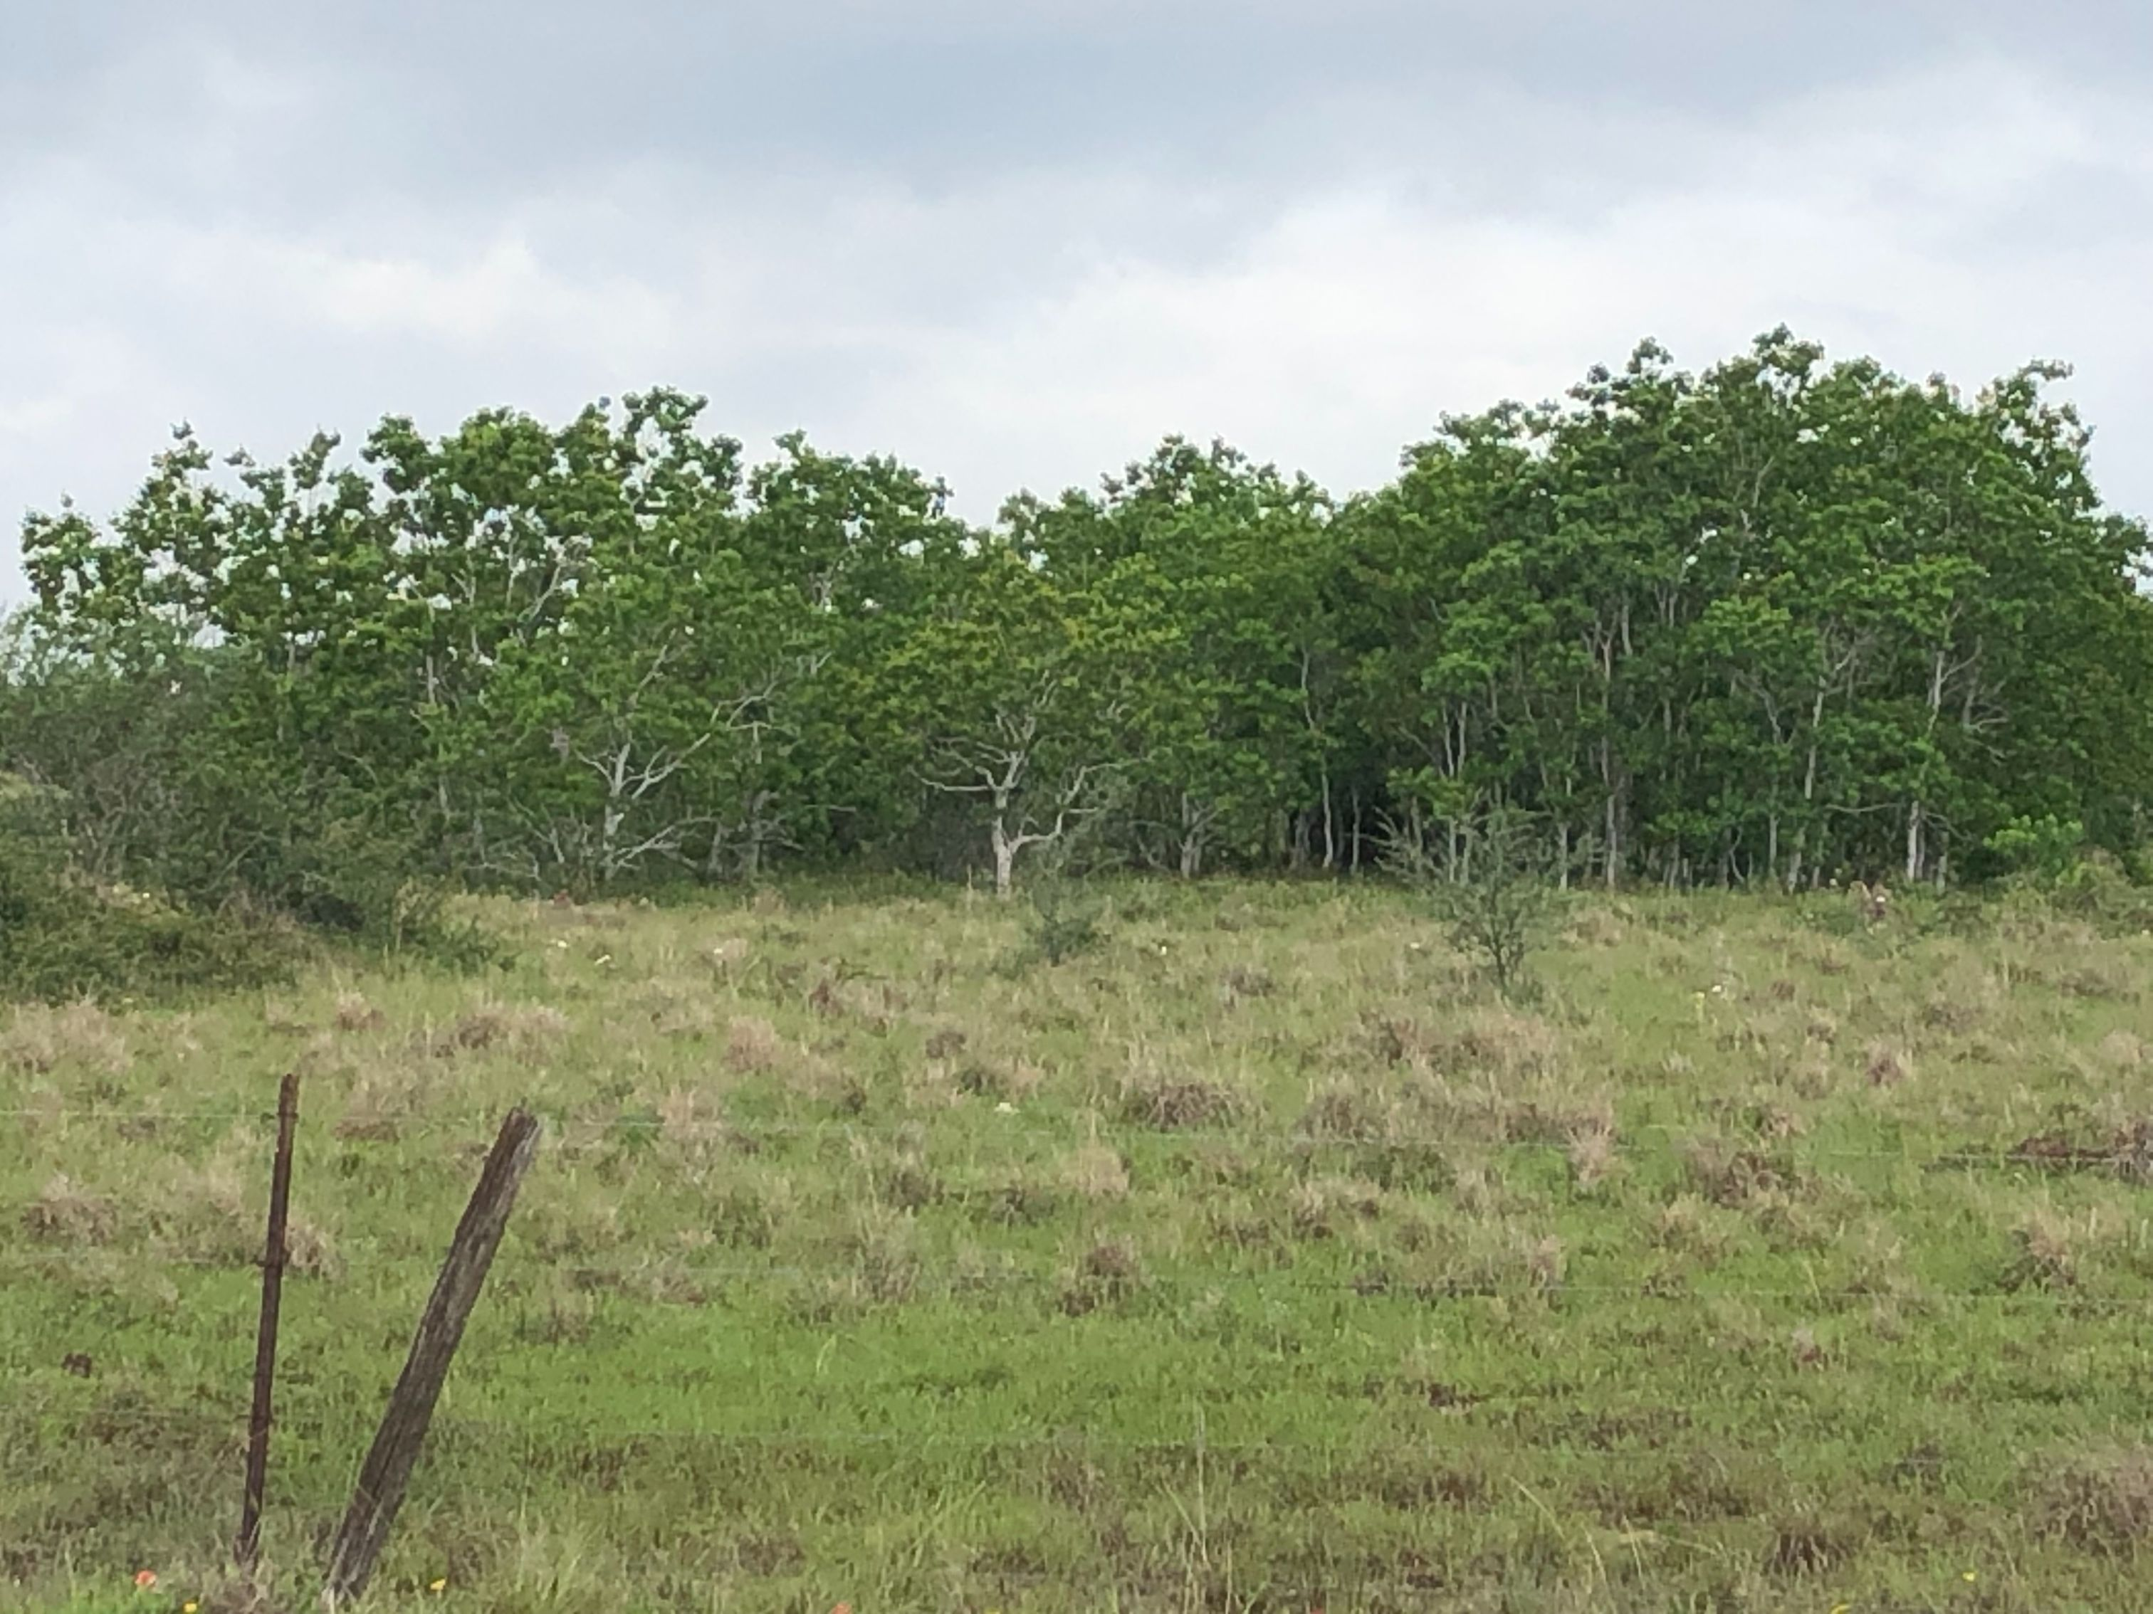
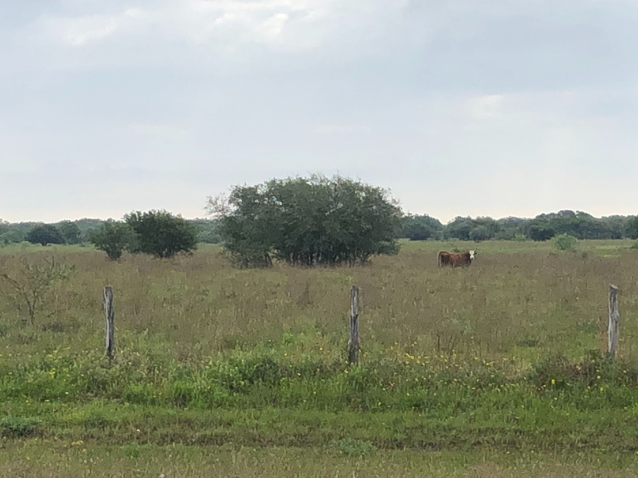
Invasion Context

Slide 9
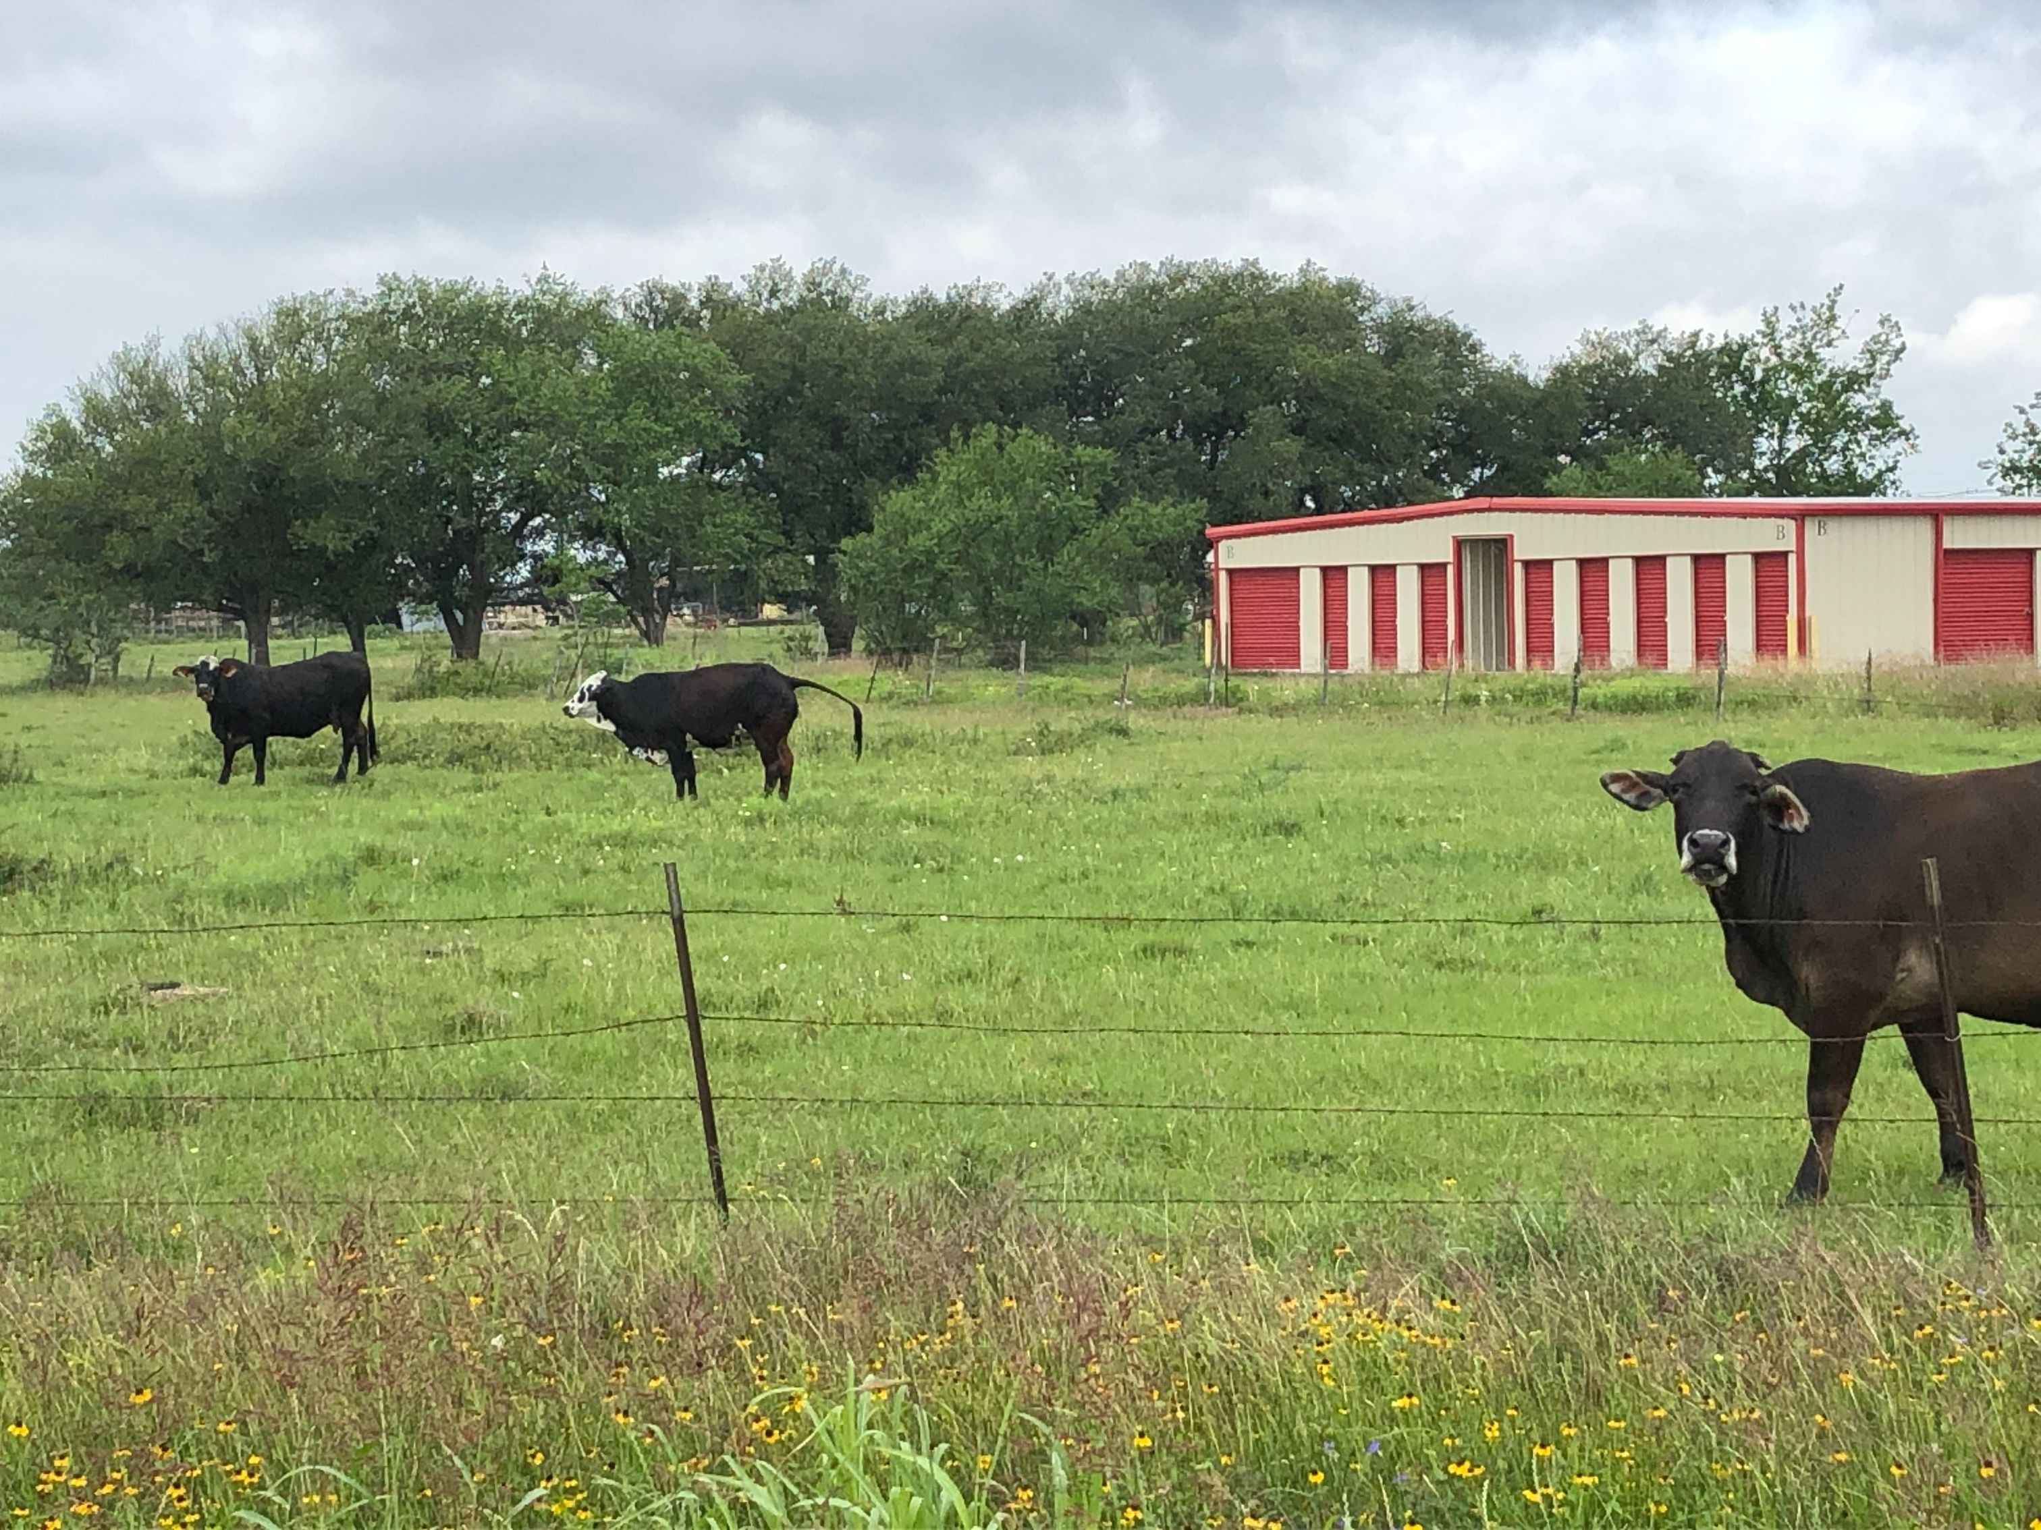

Slide 10
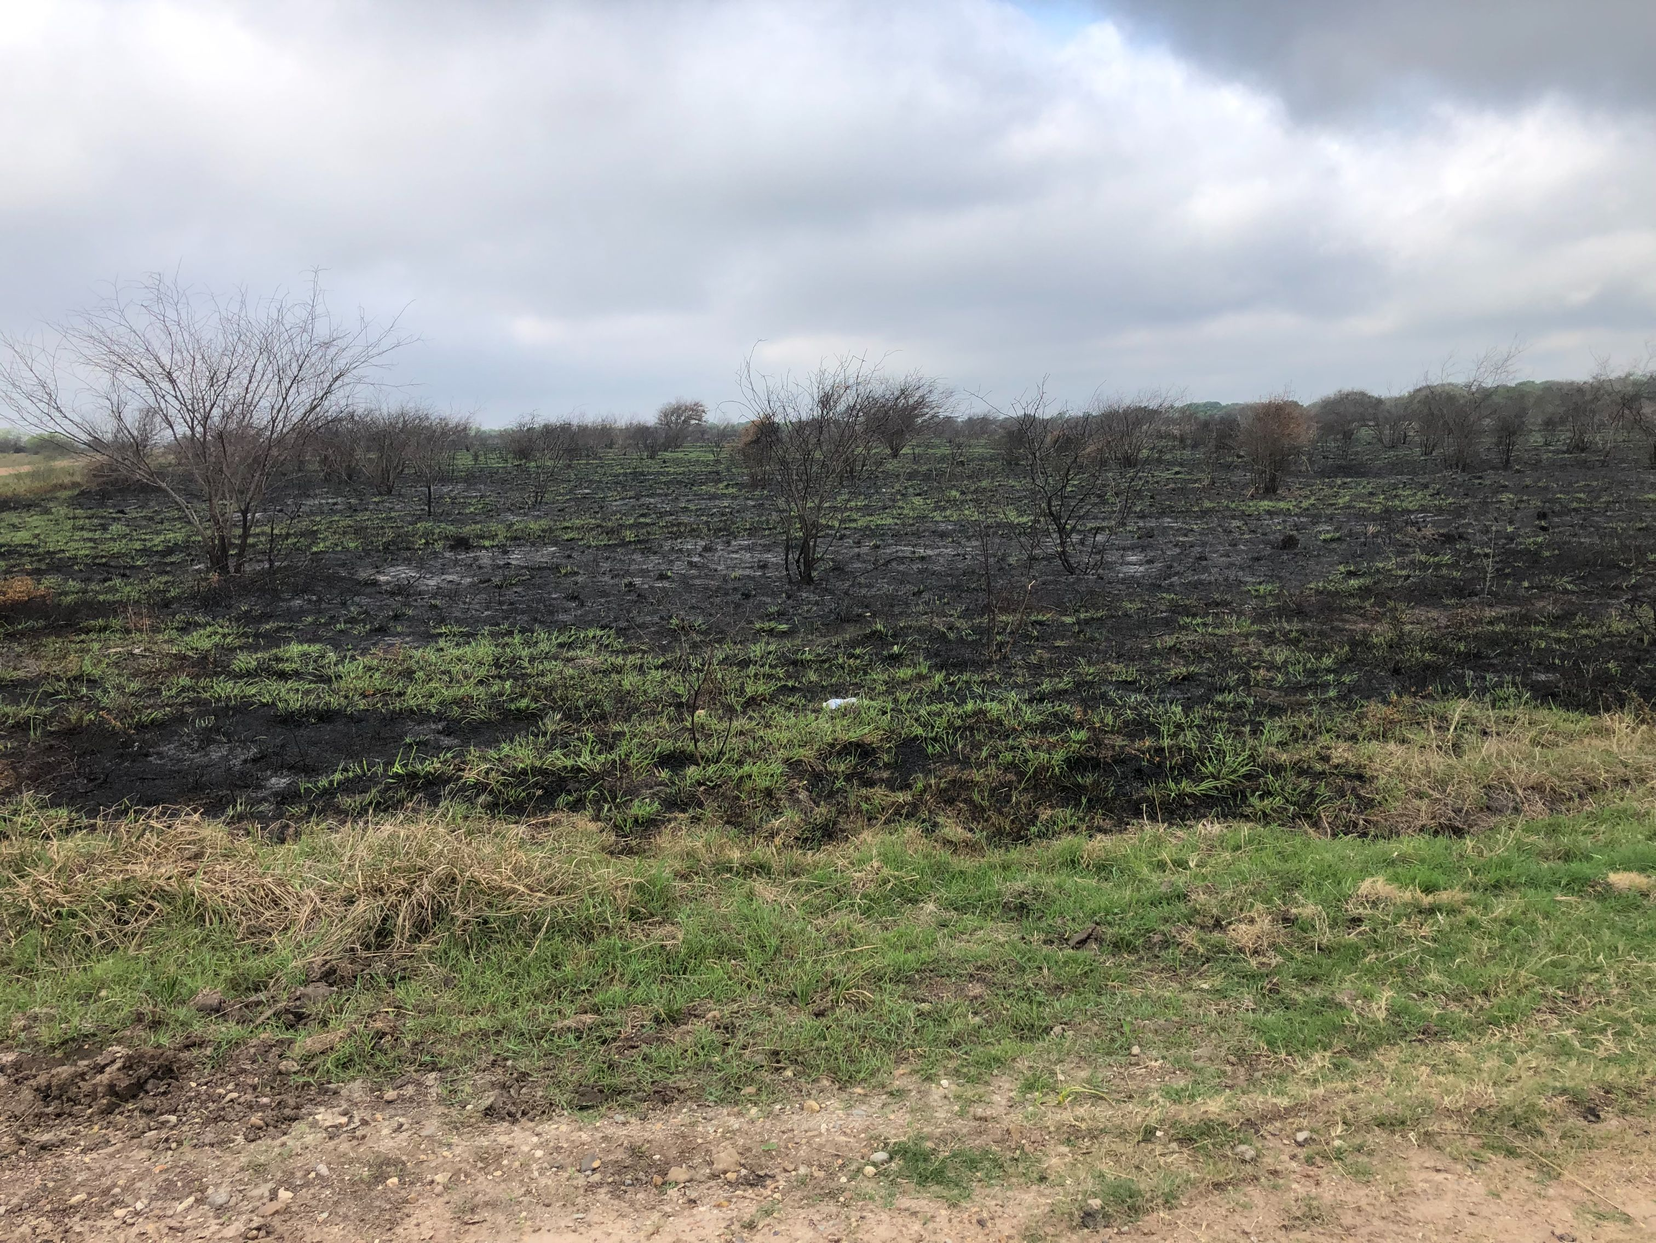
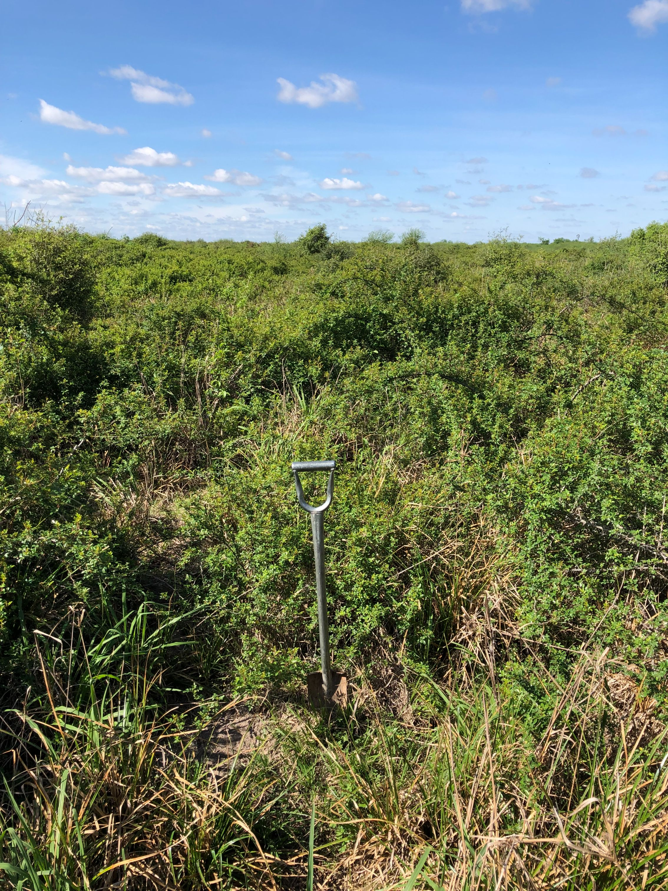
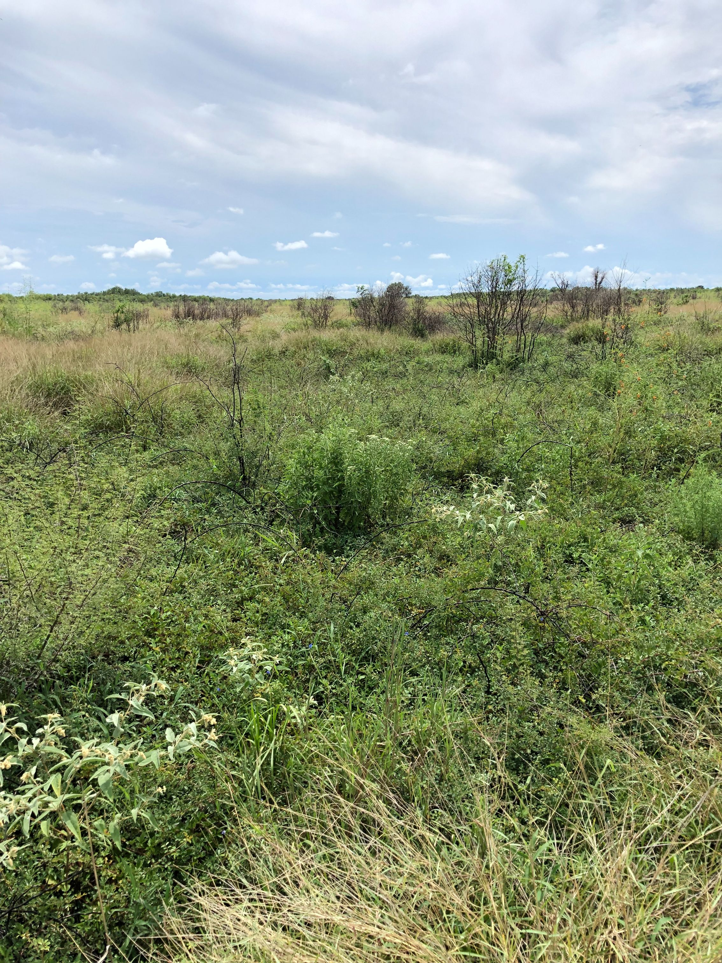
Rx Fire

Slide 11
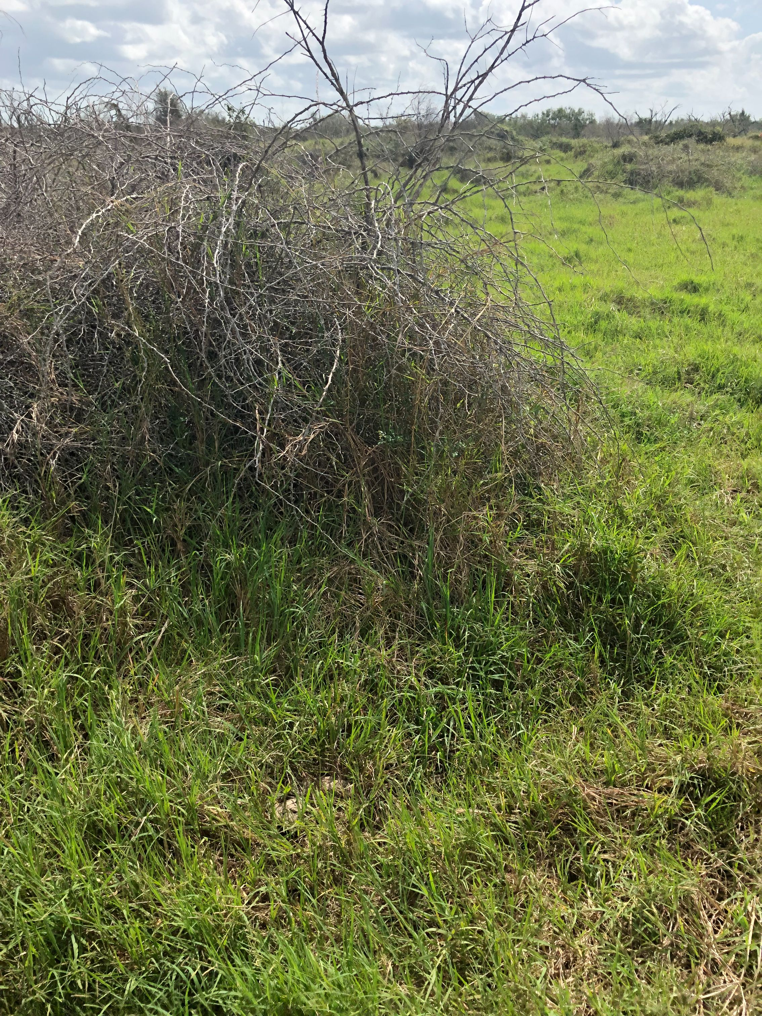
A Systems Approach

Slide 12
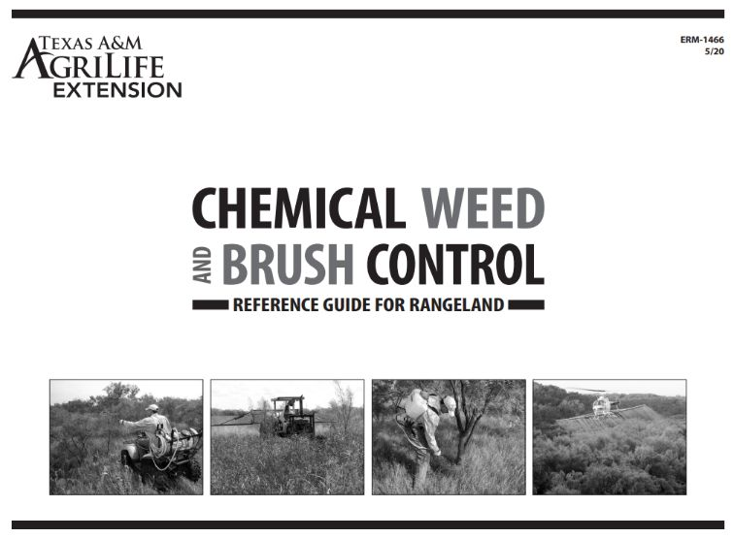
Herbicide Options
NRCS Does Not Make Chemical Recommendations!
Always Read & Follow the Label! Check each Product!

Slide 13
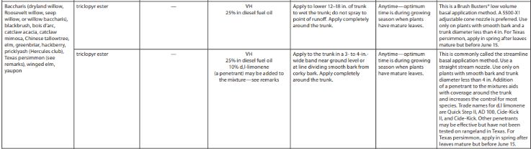
Chinese Tallow
Basal Treatments

Slide 14
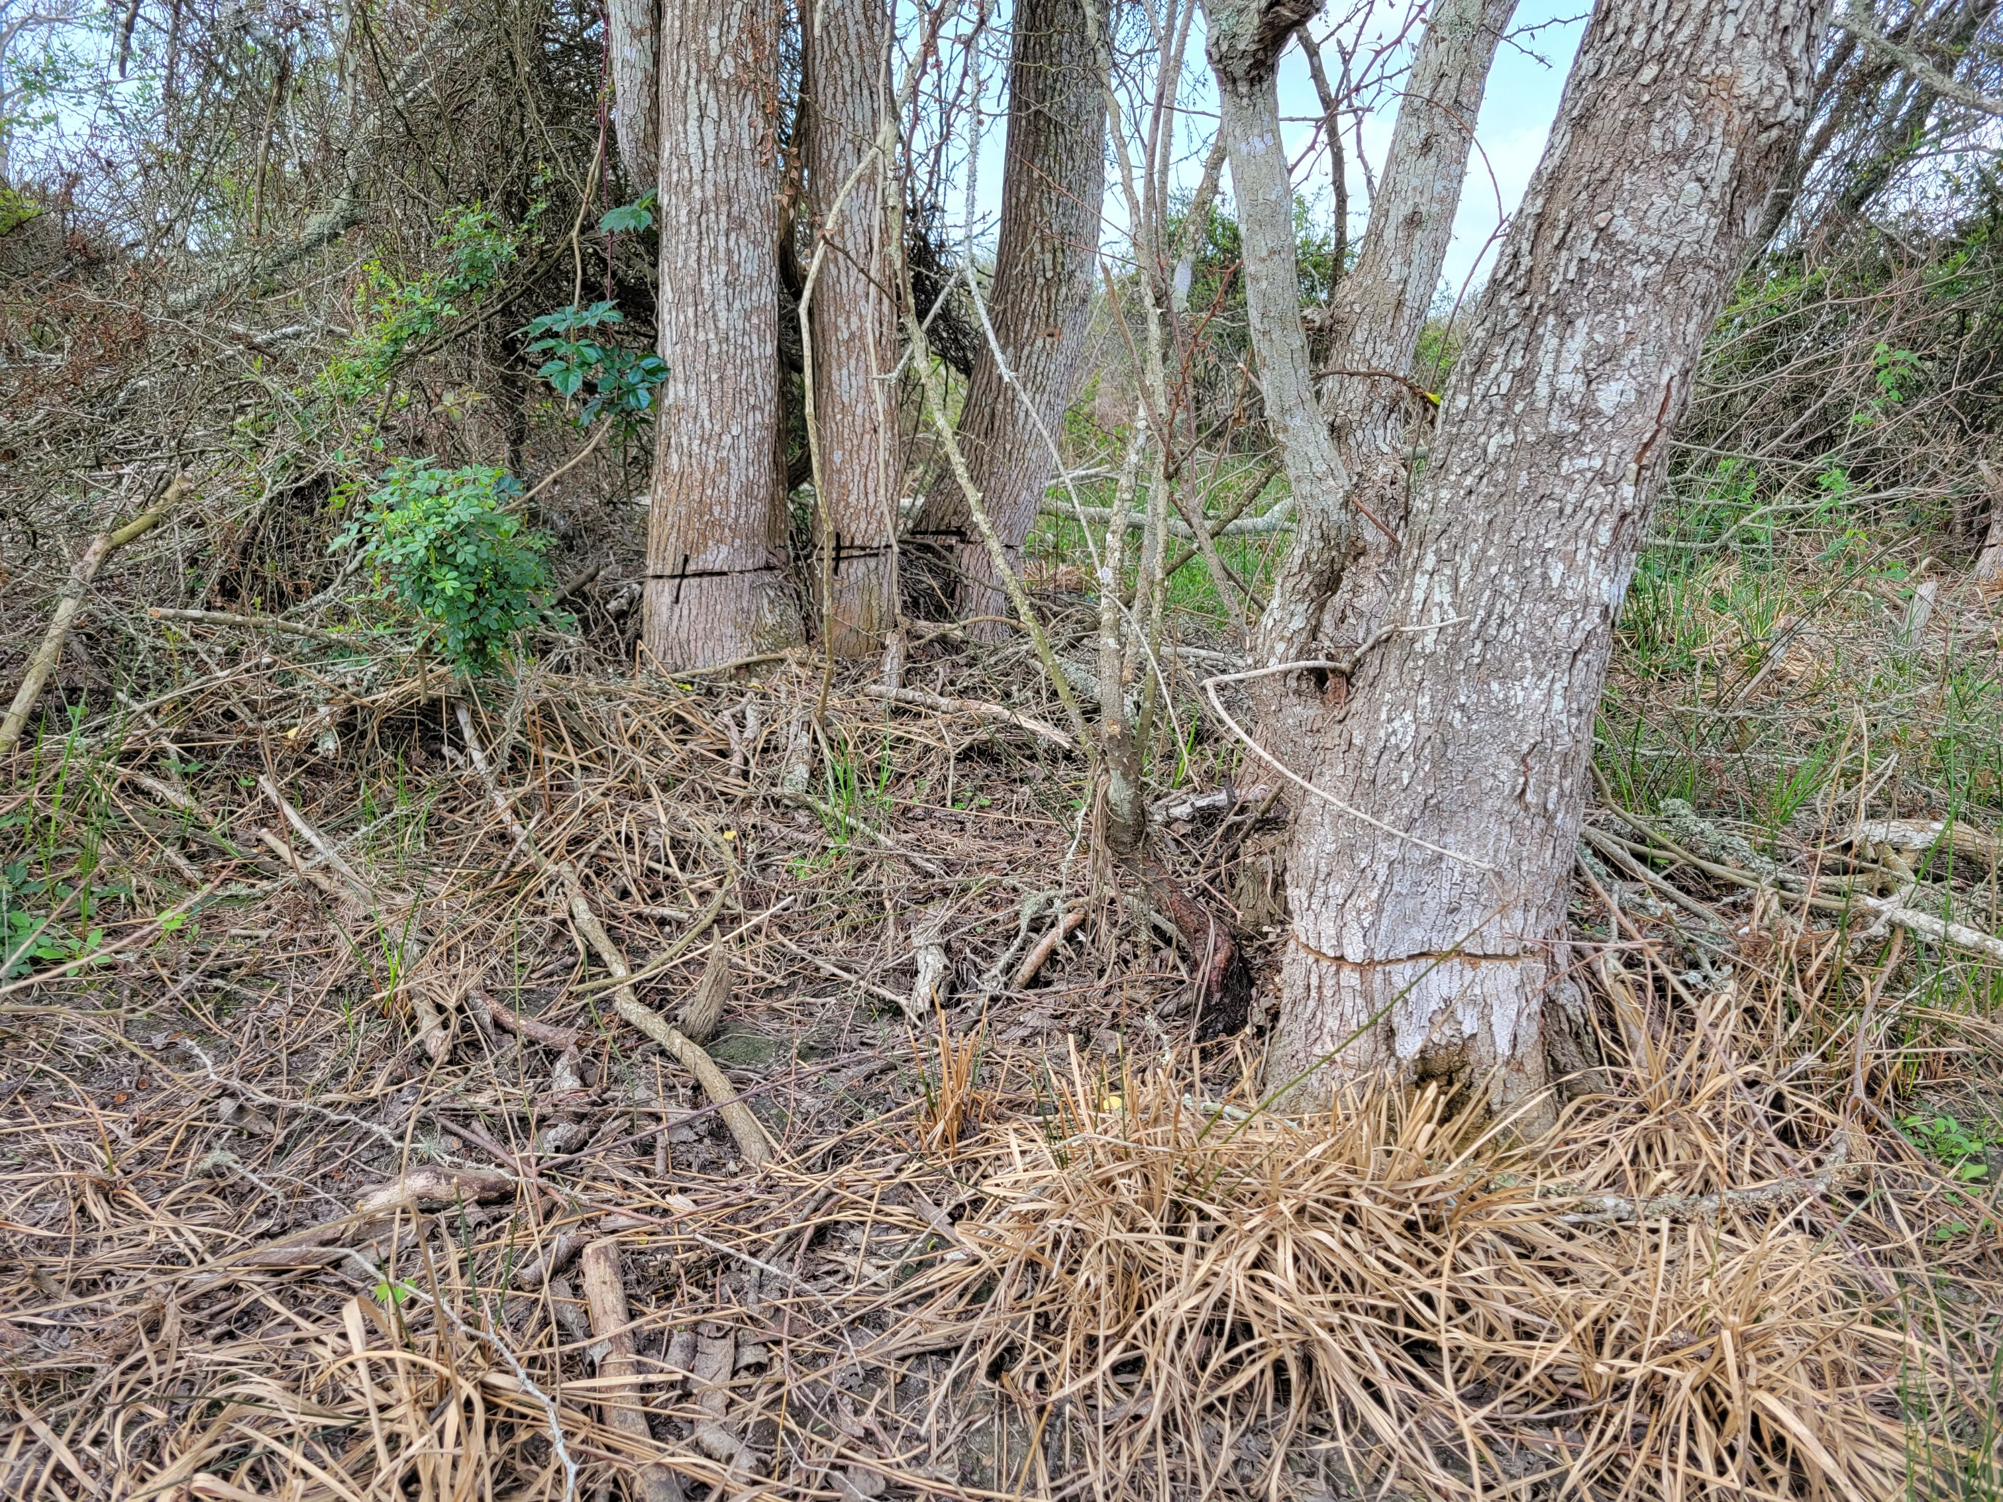
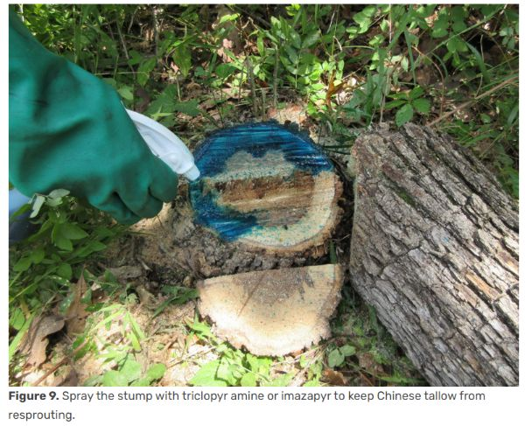
Chinese Tallow
Hack and Squirt / Cut Stump

Slide 15
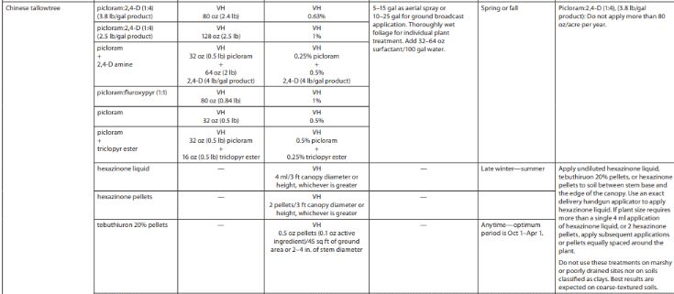
Chinese Tallow
Broadcast / IPT

Slide 16
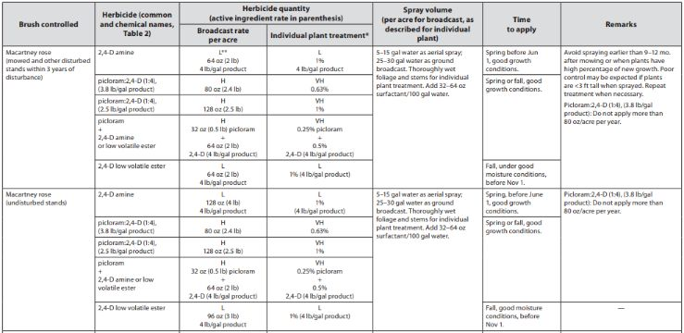
McCartney Rose
Broadcast / IPT

Slide 17
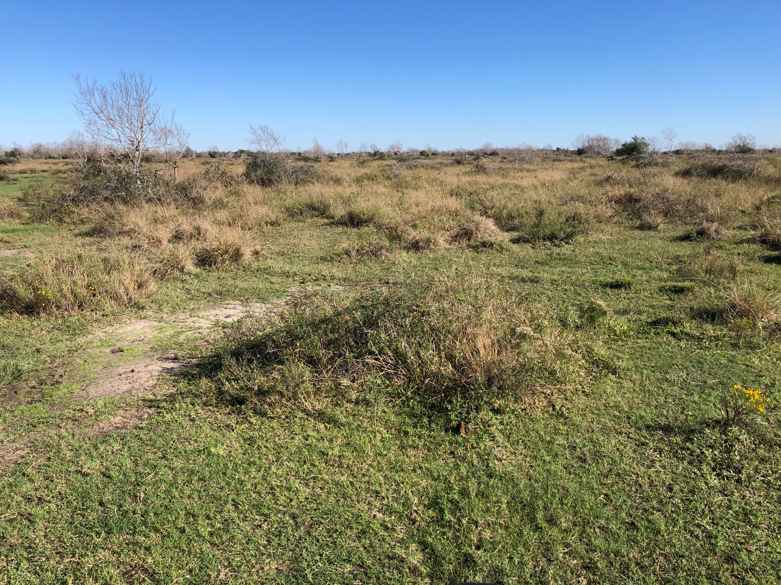

Slide 18
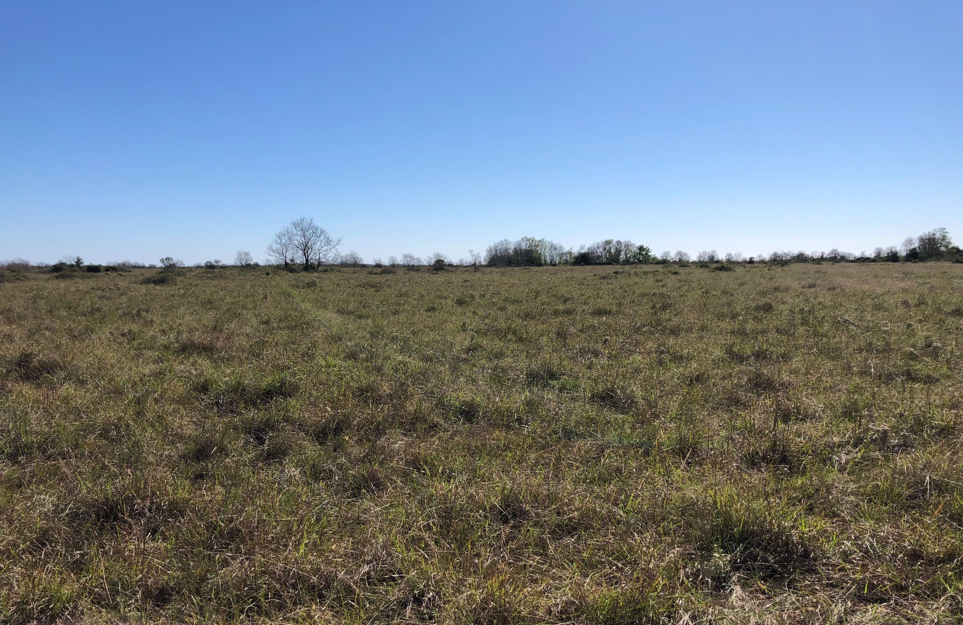

Slide 19
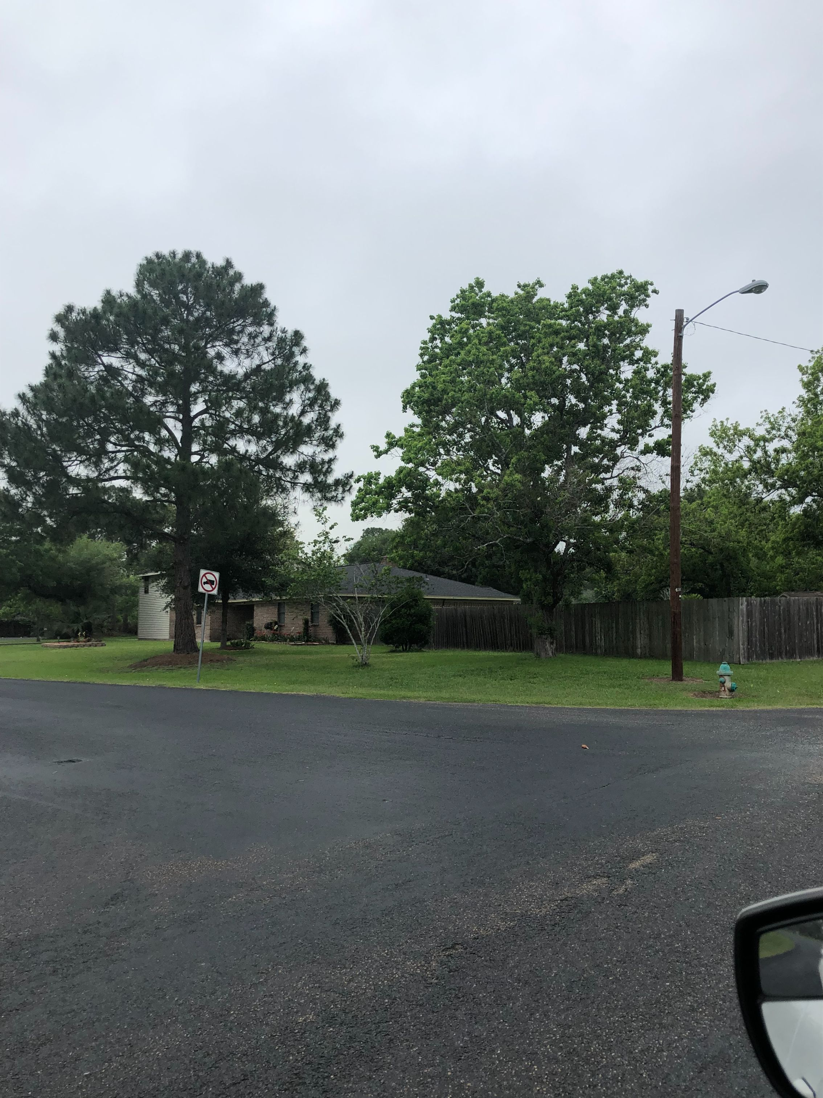
Help Your Neighbors Landscape!

Slide 20


Further Assistance
Matt Machacek- Victoria, TX
361-235-0440
matthew.machacek@usda.gov
Misti Thompson, Goliad, TX
361-645-2305 x 3
misti.thompson@usda.gov
USDA is an equal opportunity, provider, employer and lender.
Notes:
We have 228 field offices in 254 counties

