Slide 1
Prescribed Grazing as a Tool
Texas
Notes:
GO TO VIEW > MASTER > SLIDE MASTER TO EDIT THE IMAGES ON THE TITLE AND DIVIDER SLIDES
RIGHT CLICK ON THE INDIVIDUAL IMAGES TO CHANGE THE IMAGE

Slide 2
Agenda
It Starts with the Soil
How Grasslands Behave
Why Some Ranches are Always in Drought
Understanding Animal Needs
Stocking Rate 101
Why Overstocking is More Work and Pays Less
Being Adaptative

Slide 3
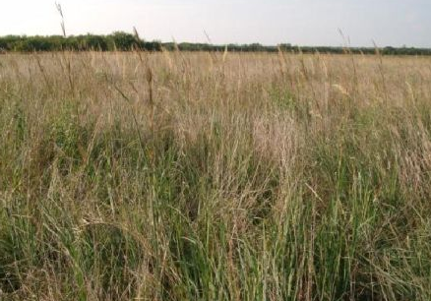
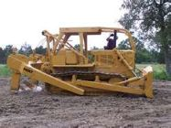
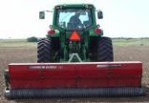
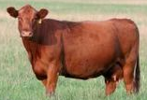
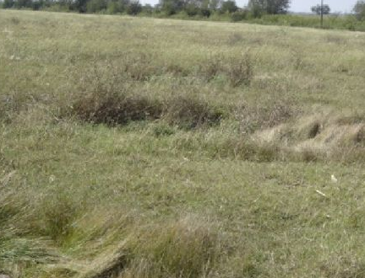
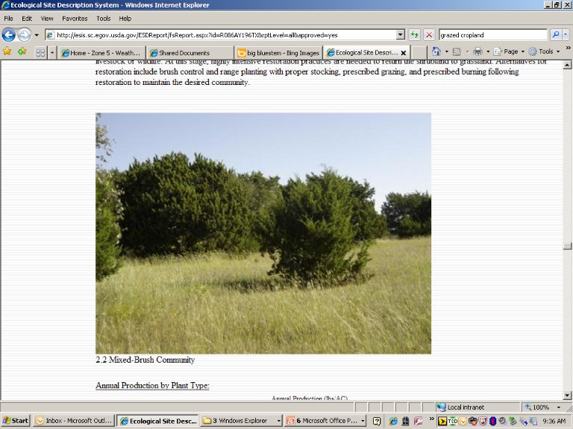
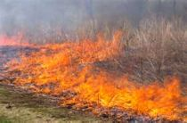
The Grassland Dynamic
Grasslands are ever changing and respond to our management!

Slide 4
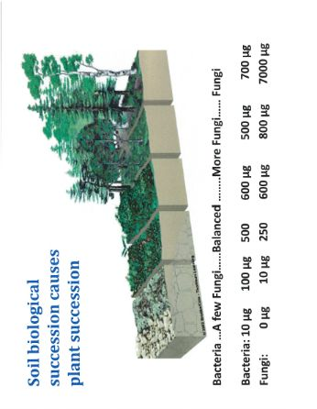
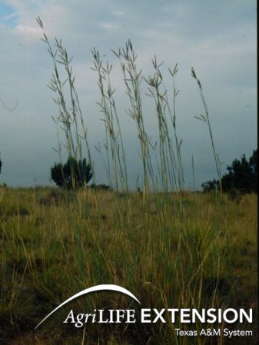
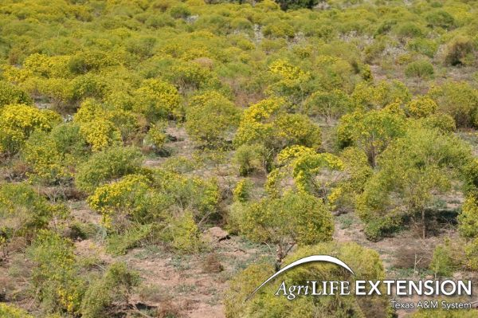
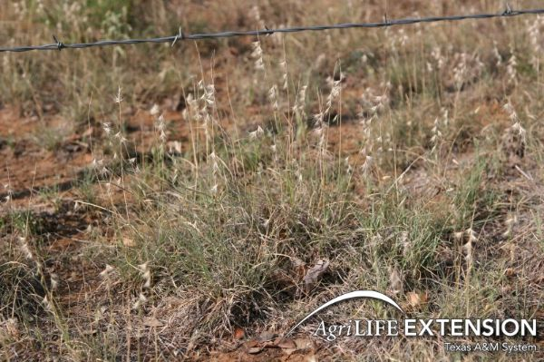
Plant Succession
Nature abhors a vacuum
Plant communities develop complexity as soil health improves
Rodale institute

Slide 5
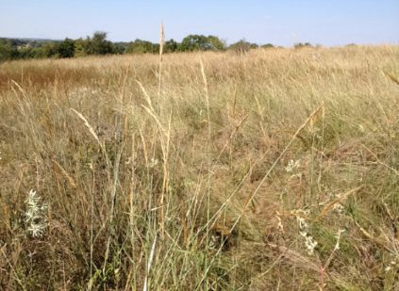
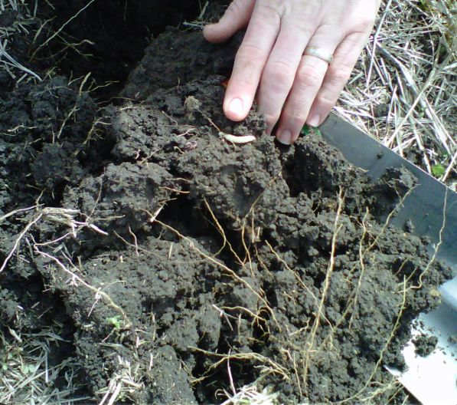
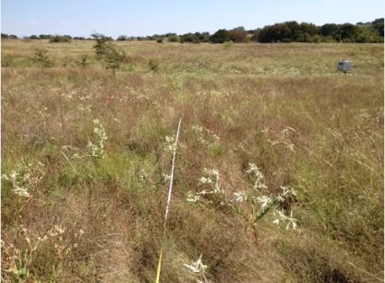
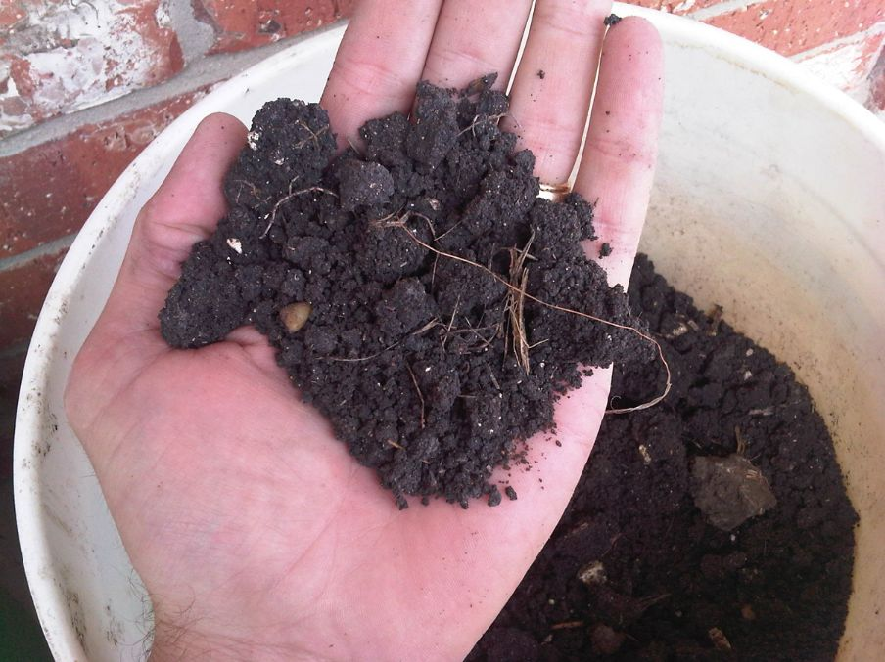
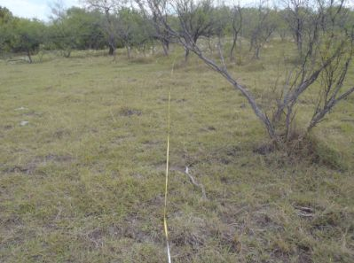
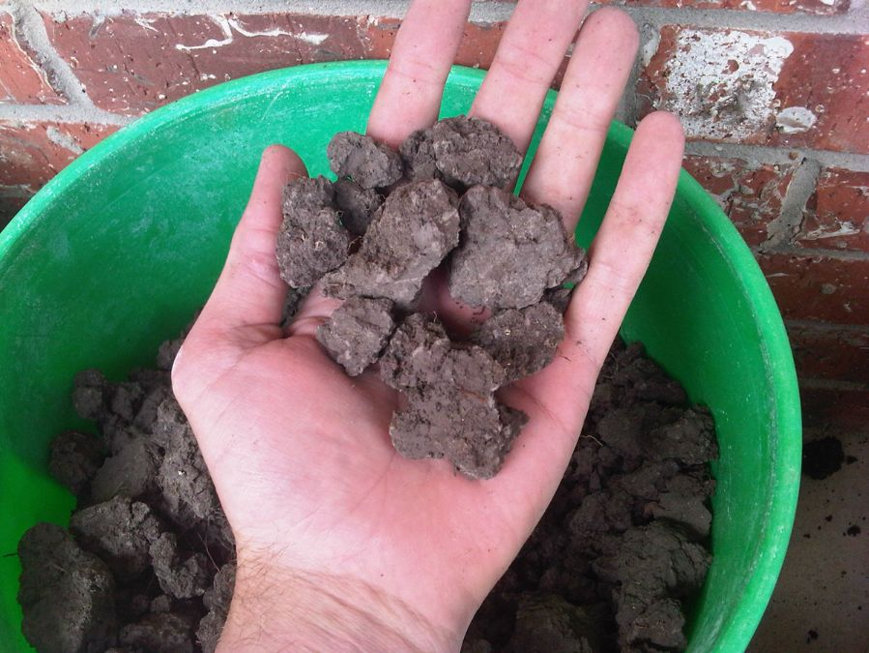
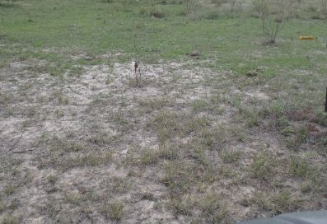
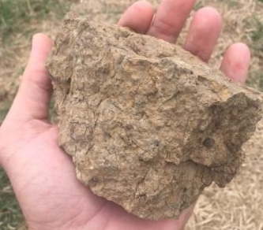
(Brady and Weil, 2010)

Slide 6
Soil Health Principles to Support High Functioning Soils
Maximize Living Roots
Minimize Disturbance
Maximize Soil Cover
Maximize
Biodiversity
Feed
Fuel Soil Biology
Improve Resilience
Improve SOM
Protect
Soil Aggregates
Organism Habitat
SOM
Notes:
Soil organisms are driving the benefits obtained through achieving and improving the condition of the four principles. Therefore, the principles can be viewed from the perspective of how they benefit the soil ecosystem.
Feeddiverse, continuous inputs (C sources, energy). The “feeding” benefits to the soil community arise predominantly from roots and diversity.
Protecthabitat (aggregates and organic matter). The “protecting” benefits to the soil community arise predominantly from disturbance and cover.
Maintain SOM & aggregates; Reduce erosion & runoff risk
Buffer temperature;Reduce evaporation
Feed: Break disease cycles; Stimulate microbial diversity; Increase SOM and nutrient cycling
Enhance plant growth; Increase predator & pollinator populations

Slide 7
Soil Health Principles to Support High Functioning Rangelands
Keep Plants Growing Throughout the Year to Feed the Soil
Keep the Soil Covered as Much as Possible
Manage Soils More by Disturbing Them Less
Plant Diversity Increases Diversity in the Soil
Feed
Fuel Soil Biology
Improve Resilience
Improve SOM
Protect
Soil Aggregates
Organism Habitat
SOM
Notes:
Soil organisms are driving the benefits obtained through achieving and improving the condition of the four principles. Therefore, the principles can be viewed from the perspective of how they benefit the soil ecosystem.
Feeddiverse, continuous inputs (C sources, energy). The “feeding” benefits to the soil community arise predominantly from roots and diversity.
Protecthabitat (aggregates and organic matter). The “protecting” benefits to the soil community arise predominantly from disturbance and cover.
Maintain SOM & aggregates; Reduce erosion & runoff risk
Buffer temperature;Reduce evaporation
Feed: Break disease cycles; Stimulate microbial diversity; Increase SOM and nutrient cycling
Enhance plant growth; Increase predator & pollinator populations

Slide 8
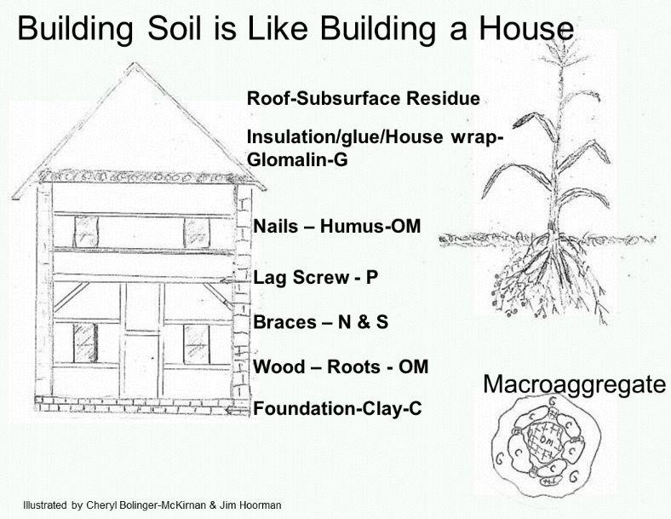

Slide 9
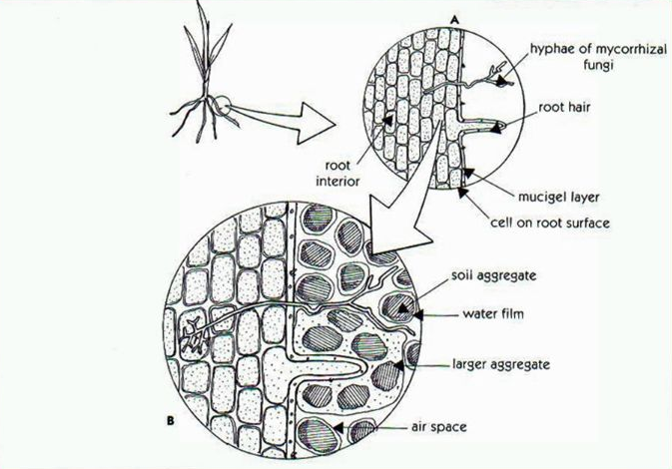
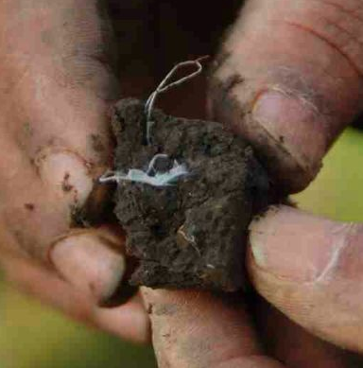
Mycorrhizal Fungus & Roots

Slide 10
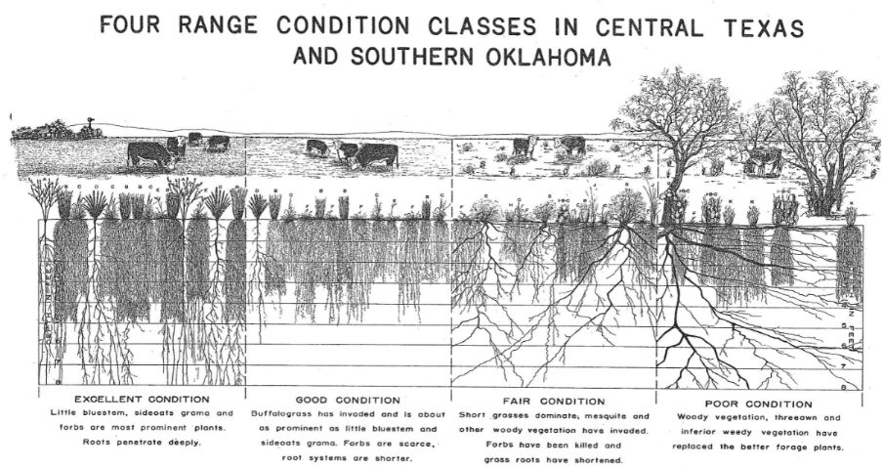

Slide 11
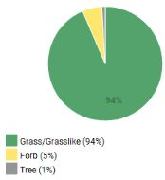
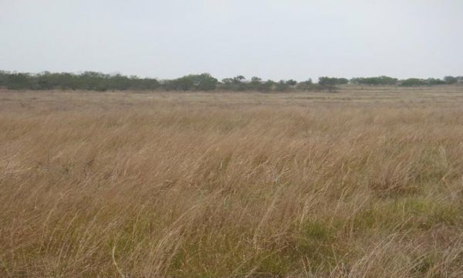
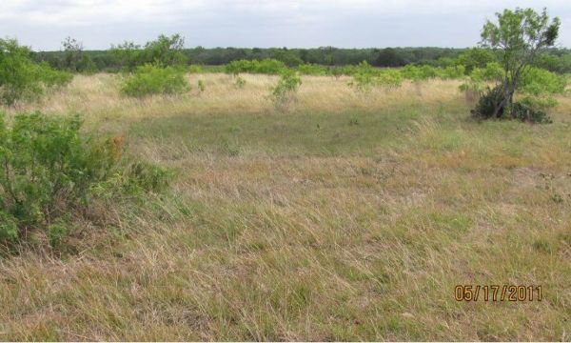
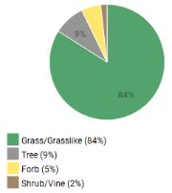
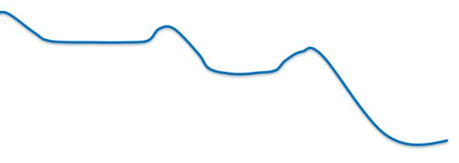
Cow to 9.5 Ac
Cow to 10.5 Ac
Proper Grazing / Fire / Brush Mgt
Overgrazing / Drought / No Brush Mgt.

Slide 12
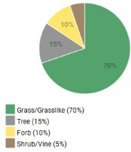
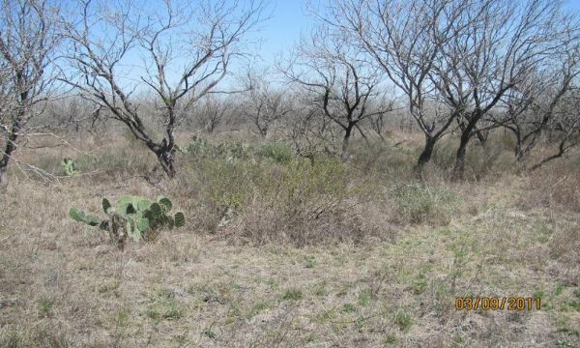
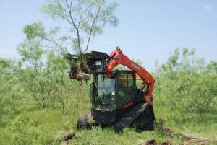
Cow to 9.5 Ac
Cow to 10.5 Ac
Cow to 13 Ac
Overgrazing
Proper Grazing
Prescribed Fire

Slide 13
Cow to 9.5 Ac
Cow to 10.5 Ac
Cow to 13 Ac
Overgrazing
Proper Grazing
Brush Management

Slide 14
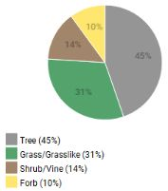
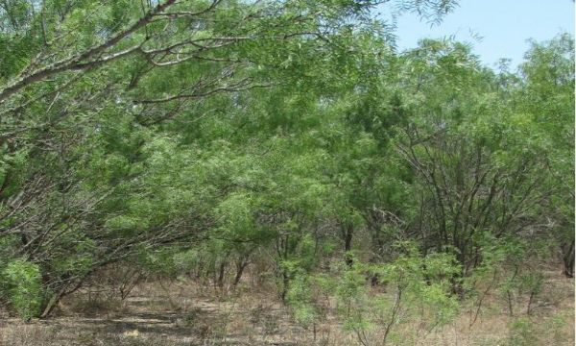
Cow to 9.5 Ac
Cow to 10.5 Ac
Cow to 13 Ac
Cow to 27 Ac
Overgrazing / Drought / No Brush Mgt.
Proper Grazing
Brush Management
Reseeding

Slide 15
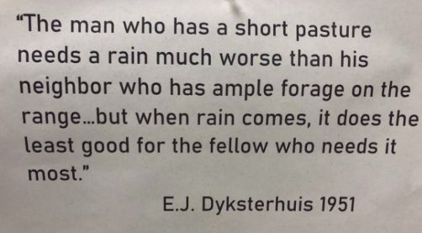

Slide 16
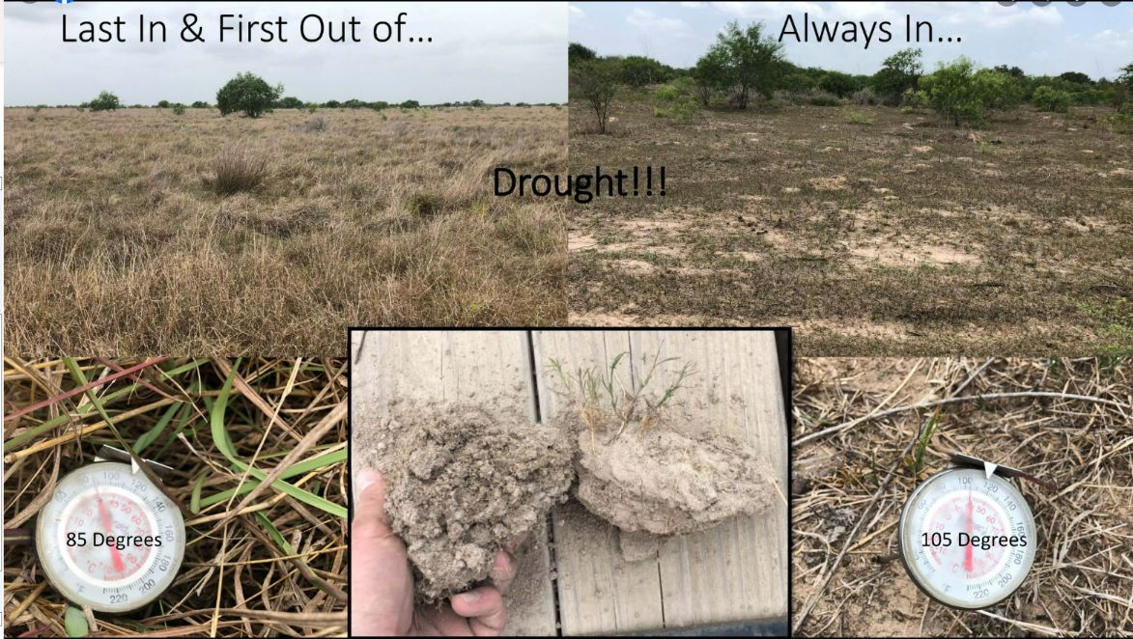
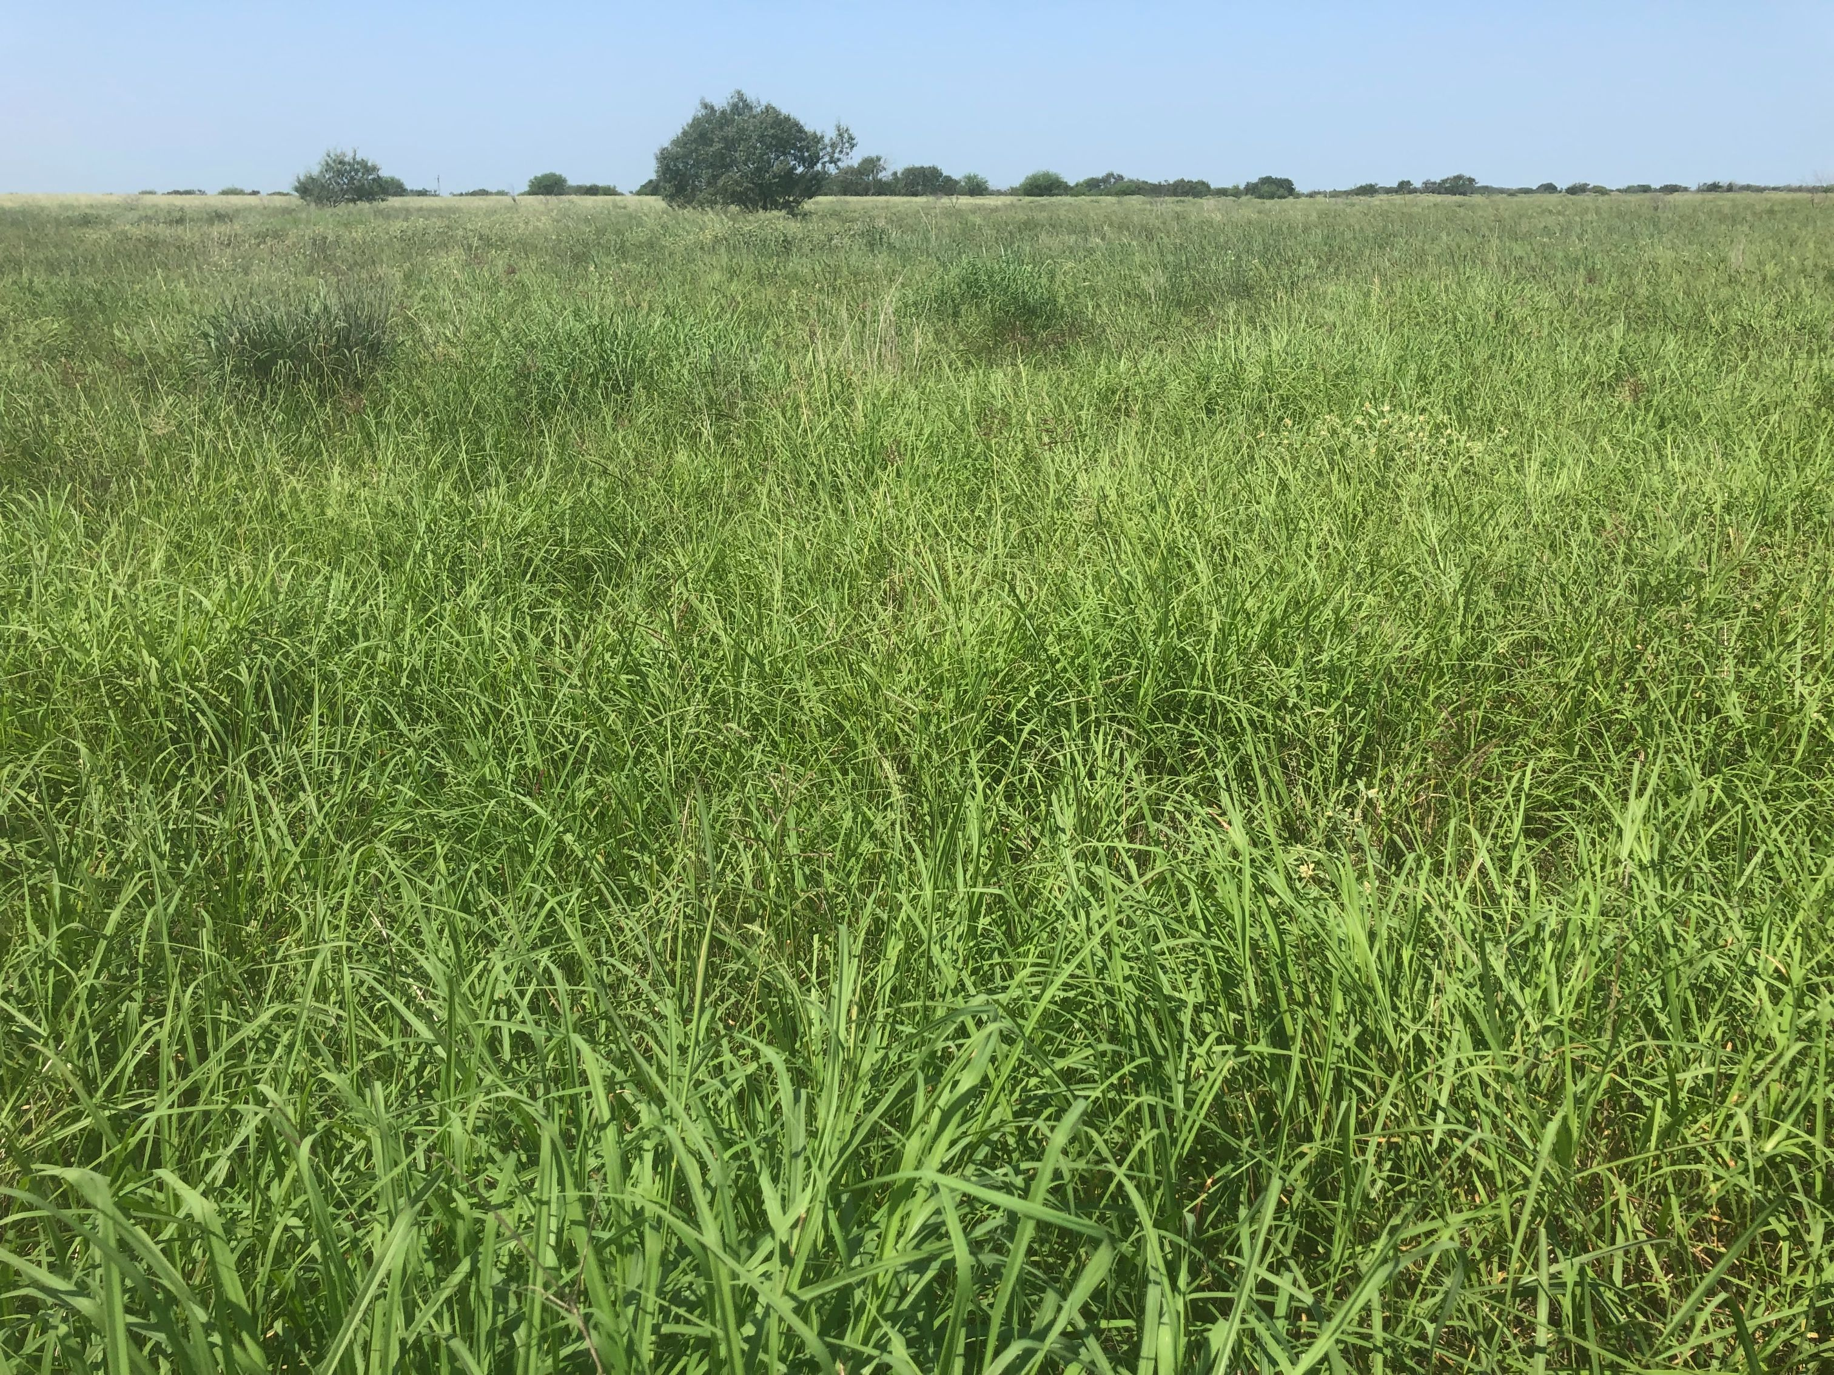
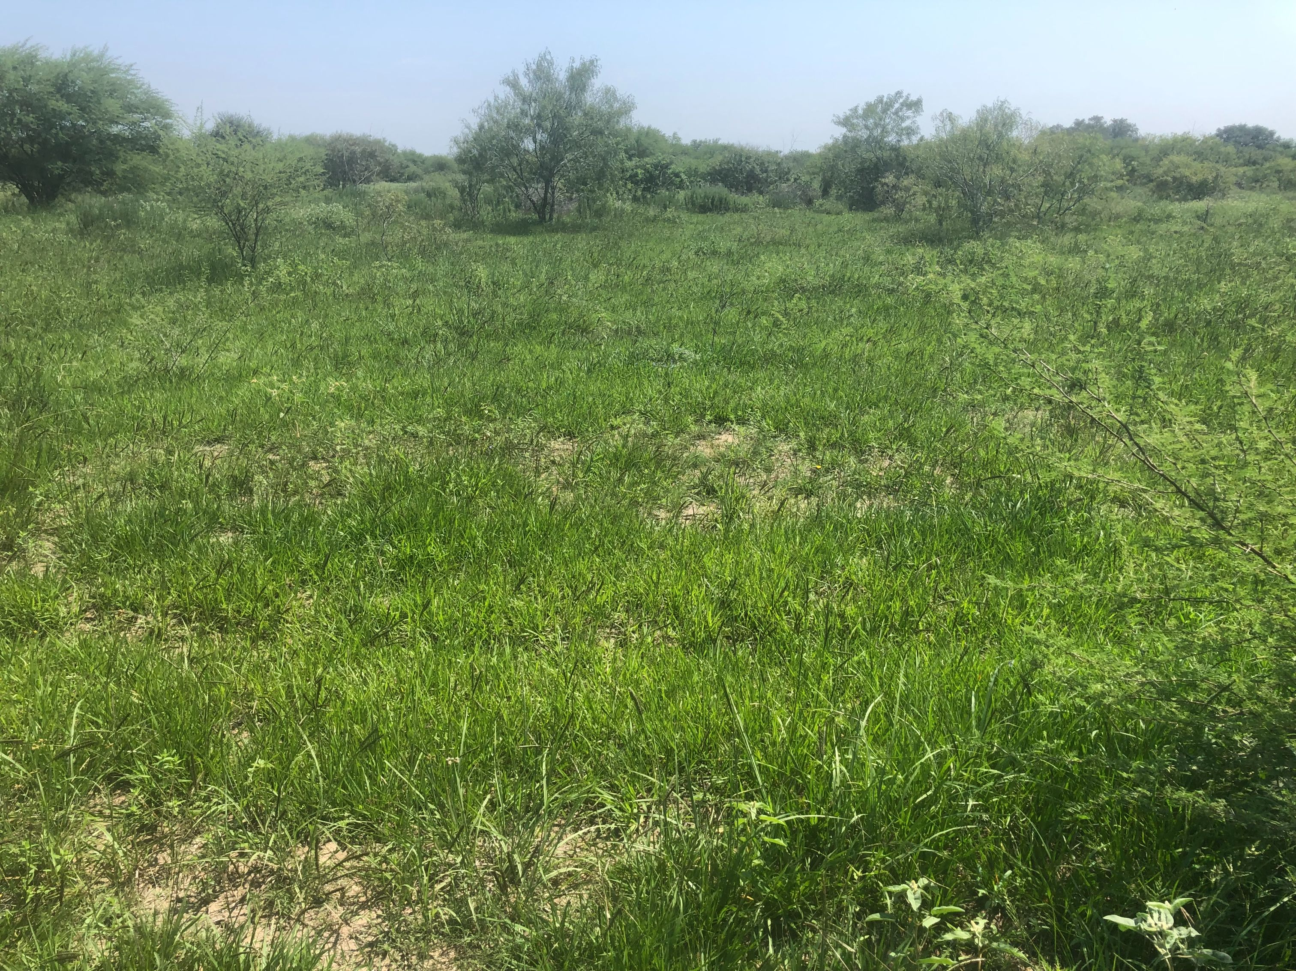

Slide 17
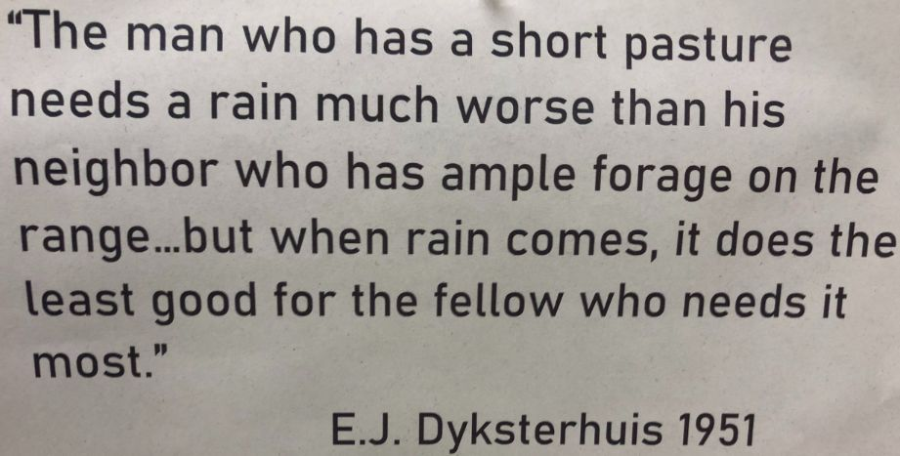
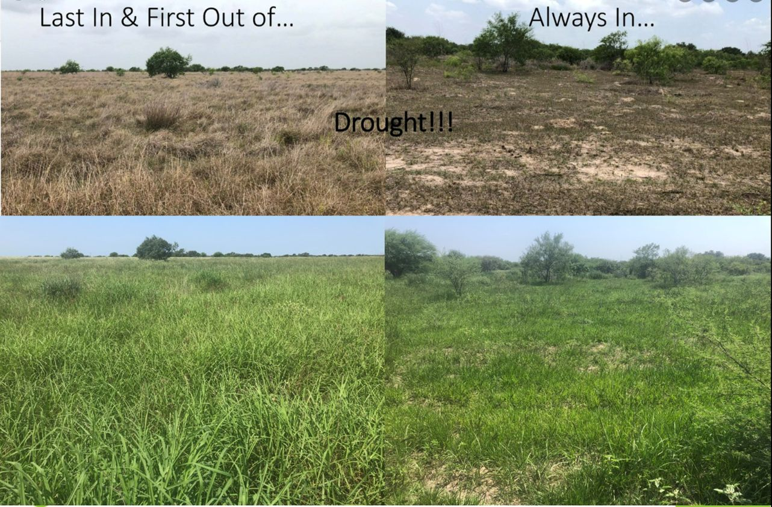
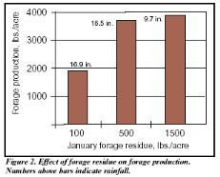
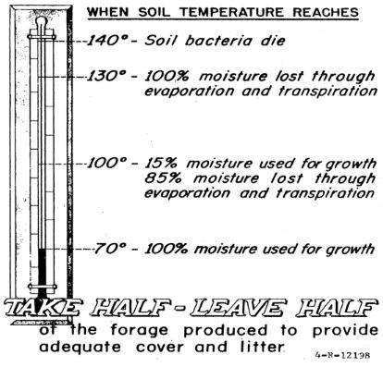
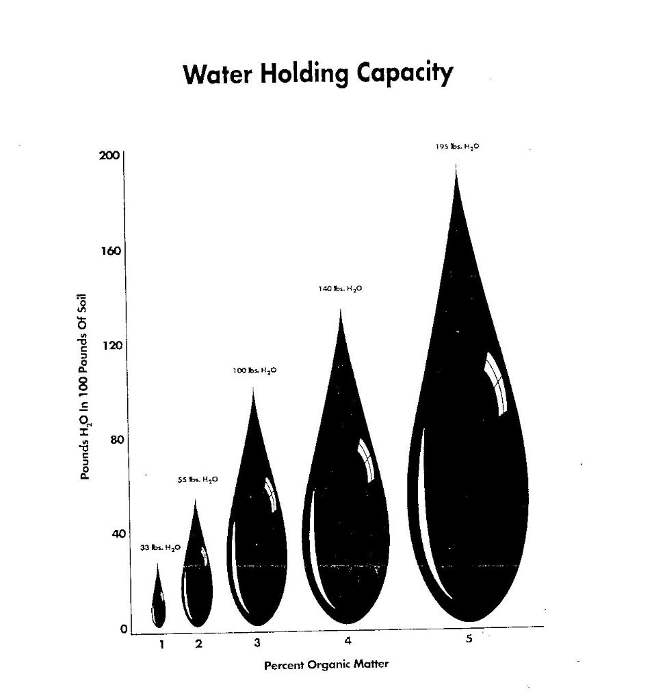
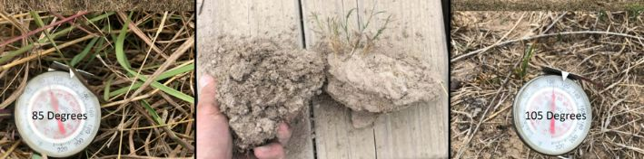
“The man who has a short pasture needs a rain much worse than his neighbor who has ample forage on the range…but when rain comes, it does the least good for the fellow who needs it most.”
E.J. Dyksterhuis 1951
June 2022 vs. September 2022

Slide 18
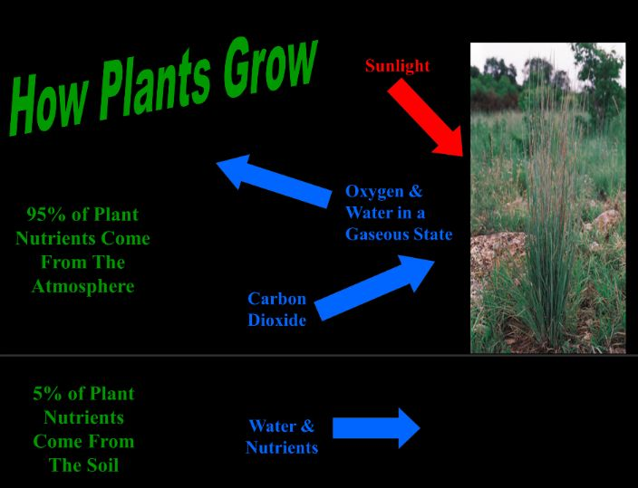
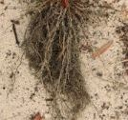
Notes:
Leafs = Stomach; Roots = Mouth; Carbohydrate storage (in stems, base, roots) = Fat Reserves
You can’t survive long without your mouth or stomach unless you have some fat reserves.

Slide 19
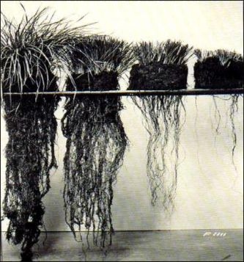
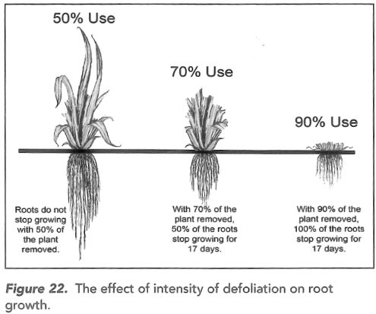
Carbohydrate Reserves

Slide 20
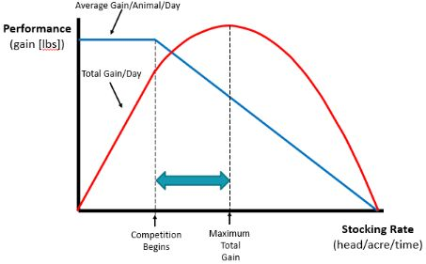
Understanding Stocking Effects
Light
Moderate
Heavy

Slide 21
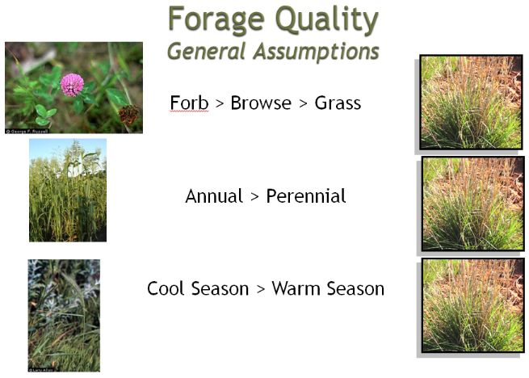
What do They Eat First?

Slide 22
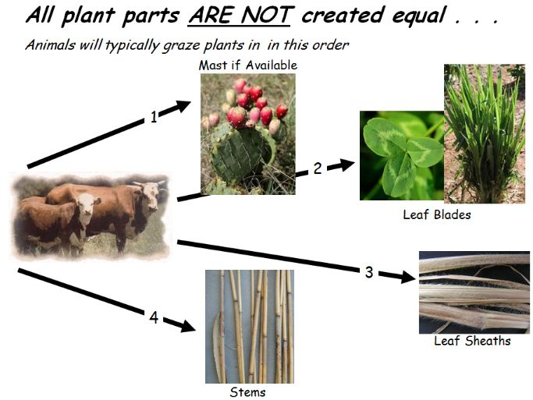
What do They Eat First?

Slide 23

What do They Eat Last?

Slide 24



Slide 25


Slide 26


Letting the Animal Tell you about Forage Conditions

Slide 27



Letting the Animal Tell you about Forage Conditions

Slide 28

Is Selectivity a Bad Thing?

Slide 29

Is Selectivity a Bad Thing?
It Depends of Objectives:
Reducing selectivity can help maintain forage reserves other areas during drought.
It can speed up range improvement.

Slide 30


Slide 31


Slide 32


Carrying Capacity vs Stocking Rate

Slide 33




Field Clipping
Tools to Determine Carrying Capacity
3,000 lbs
2,000 lbs
1,000 lbs

Slide 34





Forage Production- Ecological Site Descriptions!
Site Dynamics
Community Types, Production, and Growth Curves
Plant Preferences by Animal Type
https://edit.jornada.nmsu.edu/

Slide 35


Web Soil Survey Production Estimates!

Slide 36


Analysis of Substitution Feeding!
1 Animal Unit (1,000 lbs cow and calf) consumed 790 lbs of forage per month.
This roughly equals 1 roll of hay once wastage is accounted for.
Example
3 months of substitution hay feeding is ¼ of the year.
¼ reduction of head on the operation will likely get you closer to being properly stocked.

Slide 37


https://rangelands.app/

Slide 38

2 Key Grazing Management Decisions
Stocking Rate
Match forage demand to
forage supply
Grazing Strategy
Use grazing strategies that allow
forage to recover between grazing
periods

Slide 39


What is a Animal Unit?
https://extension.oregonstate.edu/pub/em-9327

Slide 40
Animal Demand
What if you do not have 1,000 lb Cows
Kind of Animal / Weight | Daily Intake Pounds | Annual Intake Pounds | AU per Head
1,000 lb Cow | 26 | 9,490 | 1
500lb Calf | 15 | 4,745 | .5
1,200lb Cow | 31 | 11,388 | 1.2
1,500lb Cow | 39 | 14,235 | 1.5
2,000 lb Bull | 52 | 18,980 | 2
150lb Ewe | 4.68 | 1,708 | .18
130 lb Nanny | 3.9 | 1,423 | .15
100 lb Deer | 2.86 | 1,043 | .11
150 lb Axis | 4.68 | 1,708 | .18

Slide 41


Slide 42




A Simple Review…. Grazable Acres!
2,965
645
38
7.2 (3 miles of Roads)
26
213 ac X .5 = 106.5
2,142

Slide 43


Understanding Forage Utilization

Slide 44
Understanding Forage Utilization
What's the problem with Take Half-Leave Half?
“Half” doesn’t mean “Graze” 50%…
25% Consumed | 25% Lost | 50% Left for the Resource
25% Harvest Efficiency
* Keeping in mind the “Take Half-Leave Half “ Rule, a pasture that produces 2,000 lbs./acre would have 1,000 lbs./acre harvested. Out of this only 500 lbs. would actually be consumed. Thus, a 25% Harvest Efficiency.

Slide 45

Determining Stocking Rate

Slide 46



Tips for Integrating Grazing
Leverage Existing Infrastructure

Slide 47

Grazing Plan / Schedule
Insert Grazing Schedule or picture

Slide 48

GOOD GRAZING MANAGEMENT
Maintain Adequate CHO Reserves
Maintain Residual Leaf Area
Stimulate Growth
Maintain Optimum Microclimate
Prolong High Quality
Daily Maturation
Maintain High-Growth Rate
< 50%
Maintain Root Growth
Increase Production
Defoliation
Reduce Leaf Area
Reduce Growth Rate
> 50%
Reduce Storage CHO
Create Harsh Microclimate
Decrease Production
Stop Root Growth for Long Periods
Reduce Vigor
Kill Plants
POOR GRAZING MANAGEMENT

Slide 49

Grass Carbohydrate Reserves
Short roots cannot capture as much water and nutrients as long healthy roots
Brush and weeds now have the competitive advantage to capture sunlight and root space
Harland Deitz – “Grass the Stockman’s Crop”

Slide 50

What happens when there isn’t a plan?
Early 2012, Colorado County
Notes:
Executing a realistic plan is key. Often, with no plan or, a risky plan, hardships can be costly in terms of economics, habitat, future forage production, and time.

Slide 51

Stocking Based on Average Rainfall
25% above average
48 inches
127-year average
38 inches
25% below average
28 inches
A rancher stocking based on expected grass production from rainfall could expect these results:
Stocking at 25% above normal rainfall one could expect to have enough grass 21 out of 127 years or 17% of the time.
Stocking based on average rainfall one could expect to have enough grass 63 out of 127 years or 50% of the time.
Stocking at 25% below normal rainfall one could expect to have enough grass 108 out of 127 years or 85% of the time.

Slide 52

What Can We Do Now
To prevent further soil and plant degradation
Prepare for the next rain

Slide 53
Feeding Your Way Through Drought The Cost of Supporting Additional Cows that the Land Cannot Support
Pasture Cost
Hay Cost
$180/AU/Year
1 AU consumes 10,950 lbs of forage per year or 5.5 tons.
$180/5.5 tons = $32.73/ton
$180/AU/Year
$100/Bale
800 lbs/Bale
2.5 bales/ton
$100 x 2.5 =
$250/ton
$250 x 5.5 tons = $1375/AU/Year
50 cows X $180 = $9,000
50 cows X $180 = $9,000
25 cows X &1375 = $34,375
75 cows Total = $43,375
Notes:
What is the quality of this hay? Do you still need to supplement cattle with protein?

Slide 54


What Can We Do Now
Protect the soil with as much cover as possible

Slide 55
Understanding Stocking Effects

Slide 56






Stocking and Profitability

Slide 57


Economic Scenarios: 300 ac ranch
Higher Inputs vs Lower
Forage base
Cows
Winter Feeding
Fertilized Bermudagrass
Rangeland
Hay
72
3 months hay feeding
.5 lb/day Protein for 90 days
Bermudagrass
Rangeland
38
2 week hay reserve
2 lb/day Protein for 120 days

Slide 58


Resource Base

Slide 59


Revenue

Slide 60


Variable Cost (Pasture)

Slide 61




Variable Cost (Everything Else)

Slide 62



Bottom Line

Slide 63


Ensure Herd Flexibility
For cow/calf operator we recommend 75% commercial cows and 25% stocker animals.
Flexible stocking allows the operator to adjust to market fluctuations, adjust rates up or down depending on available forage, and adds built in risk management.
“Marry your spouse, and not your cows”

Slide 64

https://rangelands.app/production-explorer/
https://rangelands.app/production-explorer/

Slide 65


What Does Success Look Like
“More ranches go broke on green grass in the spring than
brown grass in the fall!”
Jason Bagley, Navasota River Ranch

Slide 66


What Does Success Look Like
Green & Brown Year-Round
OCT 2021
April 2022

Slide 67




Adaptive Grazing
Concepts to consider when adapting your grazing plan!
Concept # 1 - Avoid Severe Defoliation.
Overgrazing results in less photosynthetic material and arrest root growth making desirable plants complete with neighboring plants that are less desirable.
Severe Defoliation on less desirable plants over time indicates a High Stocking Rate!!!
Concept # 2 - Recovery is required after defoliation
Length of recovery depends upon how much plants were defoliated, what the current growing conditions are.
Concepts from Dr. Tim Steffens,
West Texas A&M University

Slide 68


Adaptive Grazing
Concept # 3 - Timing is Important
Avoid grazing a pasture at the same time every year. The worst impact is the removal of the growth point. Before elevation or when dormant equals less impact.

Slide 69

Adaptive Grazing
Concept # 4 - Erratic Periods of Growth Due to Environmental Conditions Can Cause Plants to Recover at Variable Rates
Must Plan for Drought, Flooding, or extreme temperature.
Concept # 5 - Grazing Animals do not use Landscapes Evenly
Managers must manage barriers such as (fence, steep topography, etc.) or opportunities (such as desirable forage, water, shade, etc.) or both to achieve desired impact.

Slide 70


Adaptive Grazing
Concept # 6- The ability of the grazing animal to meet its nutritional requirements depends on both the quantity and quality of forage.

Slide 71


Adaptive Grazing
Concept # 7 - Increasing the number of paddocks will increase stock density, and May or May not affect plant selection! It is a rate and time issue!
Staying longer will encourage animals to select lower quality plants! (We must balance our performance and utilization goals)
Concept # 8 - When cattle use a greater proportion of a pasture or graze a greater variety of plants, stocking rate can be increased.

Slide 72

Contingency Planning
Key Times to Make Evaluations and Take Action:
Beginning of Growing Season
Middle of Growing Season
End of Growing Season
Helpful Variables to Monitor:
Standing Forage
Rainfall
Notes:
It can be very helpful to identify the growth curves for warm season and cool season forage production in your area. Identify % growth by month to determine specific dates. Standing forage in the pastures is the very helpful. A rotational system is helpful to identify how much forage is left. Rainfall can vary widely in amount and intensity.

Slide 73
Contingency Planning
Actions for the management intensive grazer to increase harvest efficiency:
Increase stock density with smaller temporary paddocks or, combine herds
Slow down the rotation

Slide 74

Contingency Planning
Actions that will decrease animal/herd demand:
Sell market ready animals
Early weaning
Market least productive animals
Relocate livestock to leased pasture
Destock in extreme conditions
Identify sacrifice areas
Notes:
Timely decisions are key to avoid selling much at the bottom of the market. Mid to large cow calf producers rarely destock due to genetics they have worked to develop in their herds. These actions are in no particular order. Tailor the plan to the livestock owner.

Slide 75

Monitoring
Grazing Exclosures / Cages

Slide 76





Beer Can Grazing
Monitoring
Works best for bermudagrass pasture
Can is 5” tall
Arrange a couple of cans near key grazing areas to determine intensity of defoliation (how much we leave)

Slide 77

Stocking Rate is the Key to Success
Proper stocking rates are successful when they balance forage production with animal demand.
Even the most sophisticated grazing management plan will not overcome an improper stocking rate.
Rotational grazing is useless if your out of grass.

Slide 78

What Can Good Grazing Benefit

Slide 79

What Can Good Grazing Benefit

Slide 80

What Can Good Grazing Benefit

Slide 81

Helps to Fund a Working Landscape!
Source: The Prairie Project https://www.theprairieproject.org/

Slide 82


Further Assistance
Matt Machacek- Victoria, TX
361-235-0440
matthew.machacek@usda.gov
Misti Thompson, Goliad, TX
361-645-2305 x 3
misti.thompson@usda.gov
USDA is an equal opportunity, provider, employer and lender.
Notes:
We have 228 field offices in 254 counties

