Slide 1
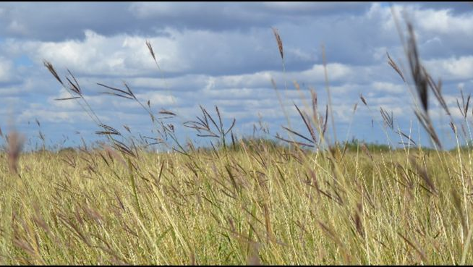
Introduction to
Introduced Bluestems
Meagan Lesak
Texas Parks & Wildlife Department
Wildlife Biologist
Notes:
Good morning everyone and thank you for having me. So our session topic this morning is Old World Bluestems. As the opening speaker, I will be introducing you to the most common OWBs and the issues that come with them. I will also share some of my research findings from several years ago when I was in graduate school at TAMUK.

Slide 2
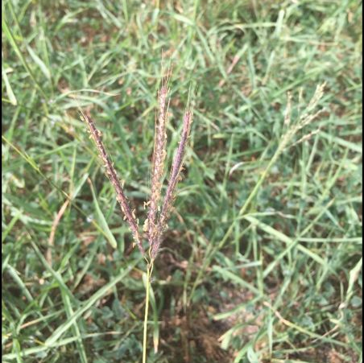
History
Early land managers introduced nonnative grasses to Texas
  Groundcovers
  Forage for livestock
~27 bluestem species in Texas
6 nonnative bluestems in Texas
  King Ranch (KR) Bluestem
  Kleberg Bluestem
Notes:
So let’s start with the history of these grass species. Early land managers introduced nonnative grasses to Texas for use as groundcovers or as forage for livestock. As with many new ventures, the drawbacks of bringing new plants to an area are often unknown until the damage is already done. For most situations, nonnative bluestems fall into this category. Now, not all bluestems are bad. There are at least 27 species of bluestems found in growing in Texas and only six are known nonnative species. The remaining 21, are native to Texas and can provide valuable forage for livestock as well as valuable habitat for wildlife. Examples of common native plants include, big bluestem, little bluestem, broom sedge, bushy, and silver bluestem. Bluestems in general are neither “good” nor “bad” because the species vary greatly. Land use goals often contribute to their value, especially if the land is used for cattle grazing only or for both cattle and wildlife habitat.
So, of the 6 nonnative bluestems there are two very common and prolific grasses that I will be focusing on today. These are the most common and the ones you are likely dealing with or will run into in many areas of Texas. These two species are King Ranch bluestem, hereafter referred to as KR, and Kleberg bluestem.

Slide 3
History
C4 perennial grasses introduced from Asia & South Africa
Arrived in Texas in early 1900s
  Both were found growing in the states and seed was brought to research stations or nurseries to increase seed production
Notes:
These two species are both C4 pathway, perennial grasses that were introduced from Asia and South Africa. They arrived in Texas in the early 1900s. Both of theses grasses were found growing in the states and their seed was brought to research stations or nurseries to increase seed production.

Slide 4
History
KR Bluestem
  Originated in China
    Brought to California ~1917
  Texas introduction was in 1924
    Angleton Agricultural Research Service Substation (USDA)
  1939- Texas Agricultural Research station named the plant yellow beardgrass and released the seed for commercial production
Notes:
KR bluestem originated in China and was brought to California as early as 1917. the first Texas introduction was in 1924 at the Angleton Agricultural Research Service Substation, which was a division of the USDA. After testing, the plant was named yellow beard grass in 1939 and released the seed for commercial production in 1949. The grass was used in rangelands and pastures and for erosion control and revegetation. Between 1924 and 1937, the plant was introduced to the King Ranch, where the Soil Conservation Service (presently known as USDA-NRCS) increased it for distribution; it is likely the source of present seed. KR bluestem & yellow beard grass are indistinguishable and considered to be the same plant.

Slide 5
History
KR Bluestem
  Between 1924 and 1937 KR was introduced to a south Texas ranch
  Soil Conservation Service (USDA-NRCS) increased the seed for production
  Likely the source of present day seed
    KR bluestem & yellow beard grass are indistinguishable
  Used in rangelands & pastures for erosion control and revegetation
Notes:
KR bluestem originated in China and was brought to California as early as 1917. the first Texas introduction was in 1924 at the Angleton Agricultural Research Service Substation, which was a division of the USDA. After testing, the plant was named yellow beard grass in 1939 and released the seed for commercial production in 1949. The grass was used in rangelands and pastures and for erosion control and revegetation. Between 1924 and 1937, the plant was introduced to the King Ranch, where the Soil Conservation Service (presently known as USDA-NRCS) increased it for distribution; it is likely the source of present seed. KR bluestem & yellow beard grass are indistinguishable and considered to be the same plant.

Slide 6
History
Kleberg Bluestem
  Originated in South Africa
  1939 it was found growing with KR on that south Texas ranch
  Soil Conservation Service nursery increased seed and released it around 1944
  Developed for pasture forage, hay production, & range reseedings
Notes:
Kleberg bluestem originated in south Africa. In 1939 it was found growing with KR bluestem on the King Ranch. A SCS nursery in San Antonio increased the seed and released it around 1944. Kleberg bluestem was developed for pasture forage, hay production, and range reseedings.

Slide 7
History
Did they work too well?
Like other introduced species, these grasses have tendencies to form monocultures
Incidental seed movement & the grasses invasive nature
  Introduced bluestems now occur in areas that were never intentionally seeded
  Encroaching into rangelands where they are not desired
    Decreasing native diversity
Notes:
As with many introduced grass species, KR & Kleberg bluestem often grow monocultures or thick stands with only one or very few plant species present.
So with all the traits that were quote “good” for these to nonnatives, that made folks want to mass produce them as resources available to landowners, did they work too well? These grasses were very appealing to livestock producers due to their ability to form solid stands a grass forage that was able to survive heavy grazing and unfavorable weather. Unfortunately we now know that many introduced bluestems do not always provide adequate nutrition for livestock even though they were purposely planted in grazing fields in a lot of counties in Texas. Livestock producers weren’t the only people to plants these OWBs, as they were also planted to decrease soil erosion along dams, spillways, and highways as well as depleted rangelands. They were very effective for this purpose.
It became apparent that these bluestems can quickly disperse into nearby pastures, especially on exposed soil or during drought. They establish quickly and crowd out other species. Because of incidental seed movement and the grasses invasive nature, introduced bluestems are common in many areas where they were never intentionally seeded. They encroached and are continuing to encroach into rangelands where they are not desired and causing a decrease in native diversity of plants which then causes a reduce fauna.

Slide 8
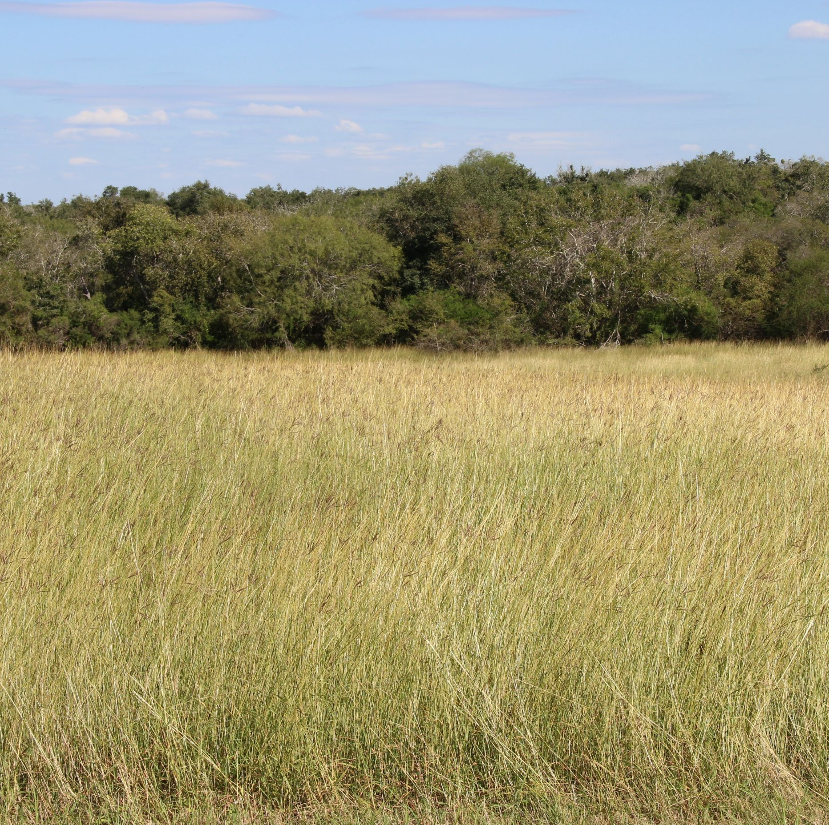
Present Day
Landowners & managers searching for appropriate control methods
Previous studies found only short-term control or no effect on OWBs
Led to my graduate research project
  Evaluate combining treatments
Notes:
Emphasize managers and landowners who wanting to return to native state

Slide 9
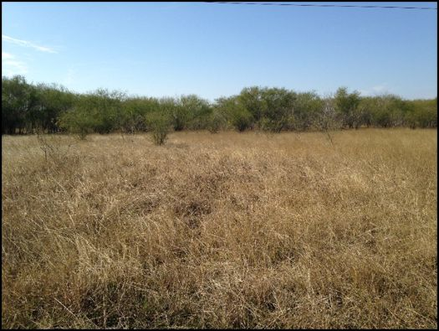
Management Theories
Eradication
Diversity management
Passive management
Notes:
There are three main approaches used to manage invasive grasses on native lands which are:
So let’s look at each of these real quick

Slide 10
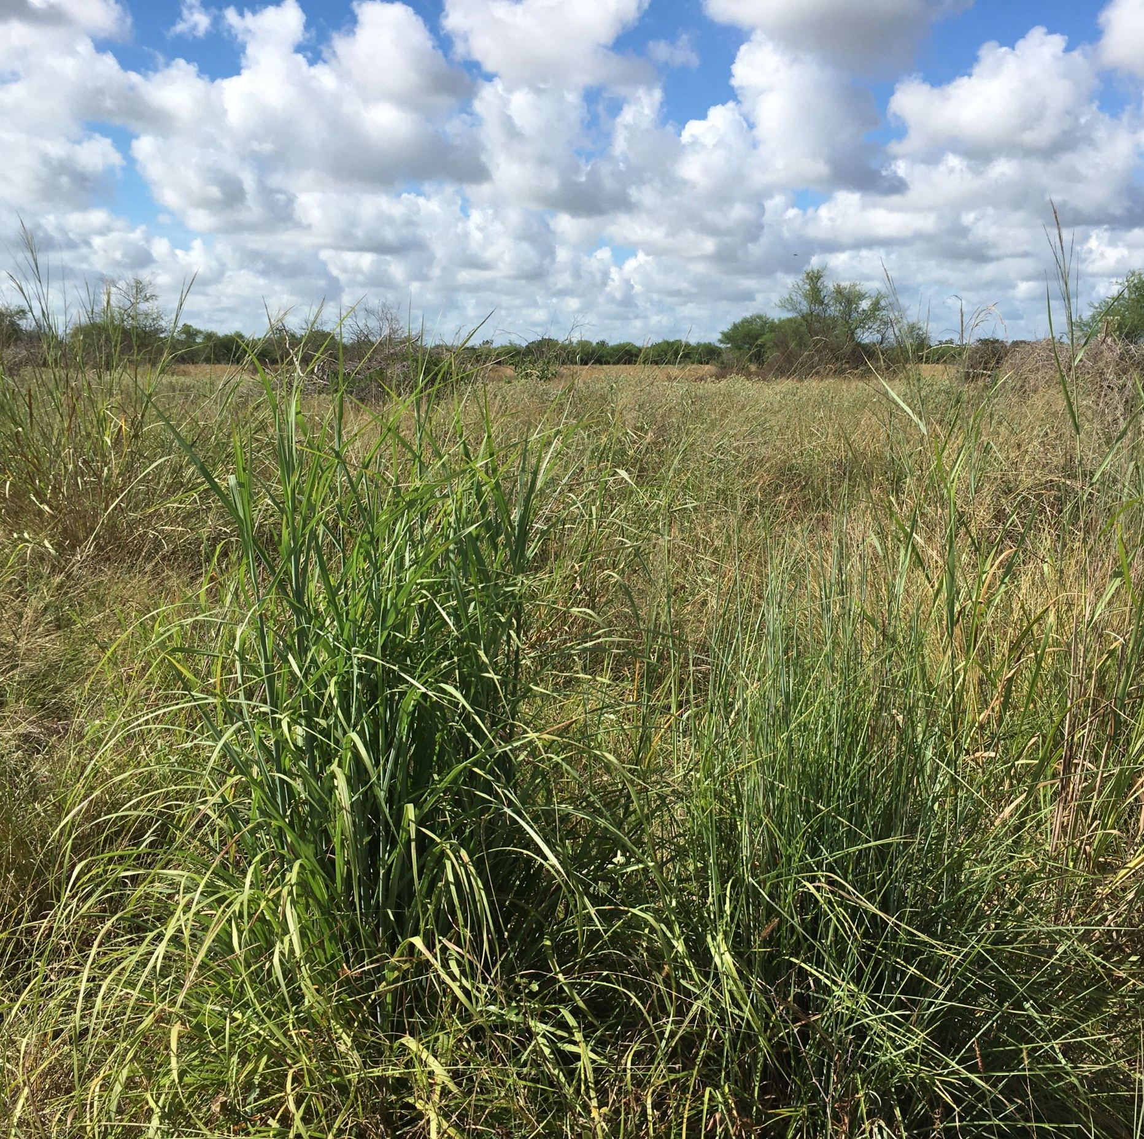
Eradication
Very, very difficult
Intensive control efforts
  replanting
  continuous follow up
Notes:
Eradication of KR/Kleberg is very difficult unless the grass was introduced only recently and in small amounts. To eradicate these grasses from even a single pasture, a land manager would have to begin intensive control efforts, replant, apply follow-up treatments continually, carefully choose the hay brought onto the property and protect pastures borders from encroachment. This management approach will not only be difficult, it will come with a very high price tag so often not feasible for most landowners.
This can be done with major effort and attention to detail. To reduce the likelihood of these grasses returning to the property , the manager would need to allow only clean equipment orvehicles to enter, request a weed wash of equipment, and carefully monitor for OWBs along pasture roads.
Not saying it can’t be done, just want to stress it is a lot of work and requires continual monitoring into the future.

Slide 11
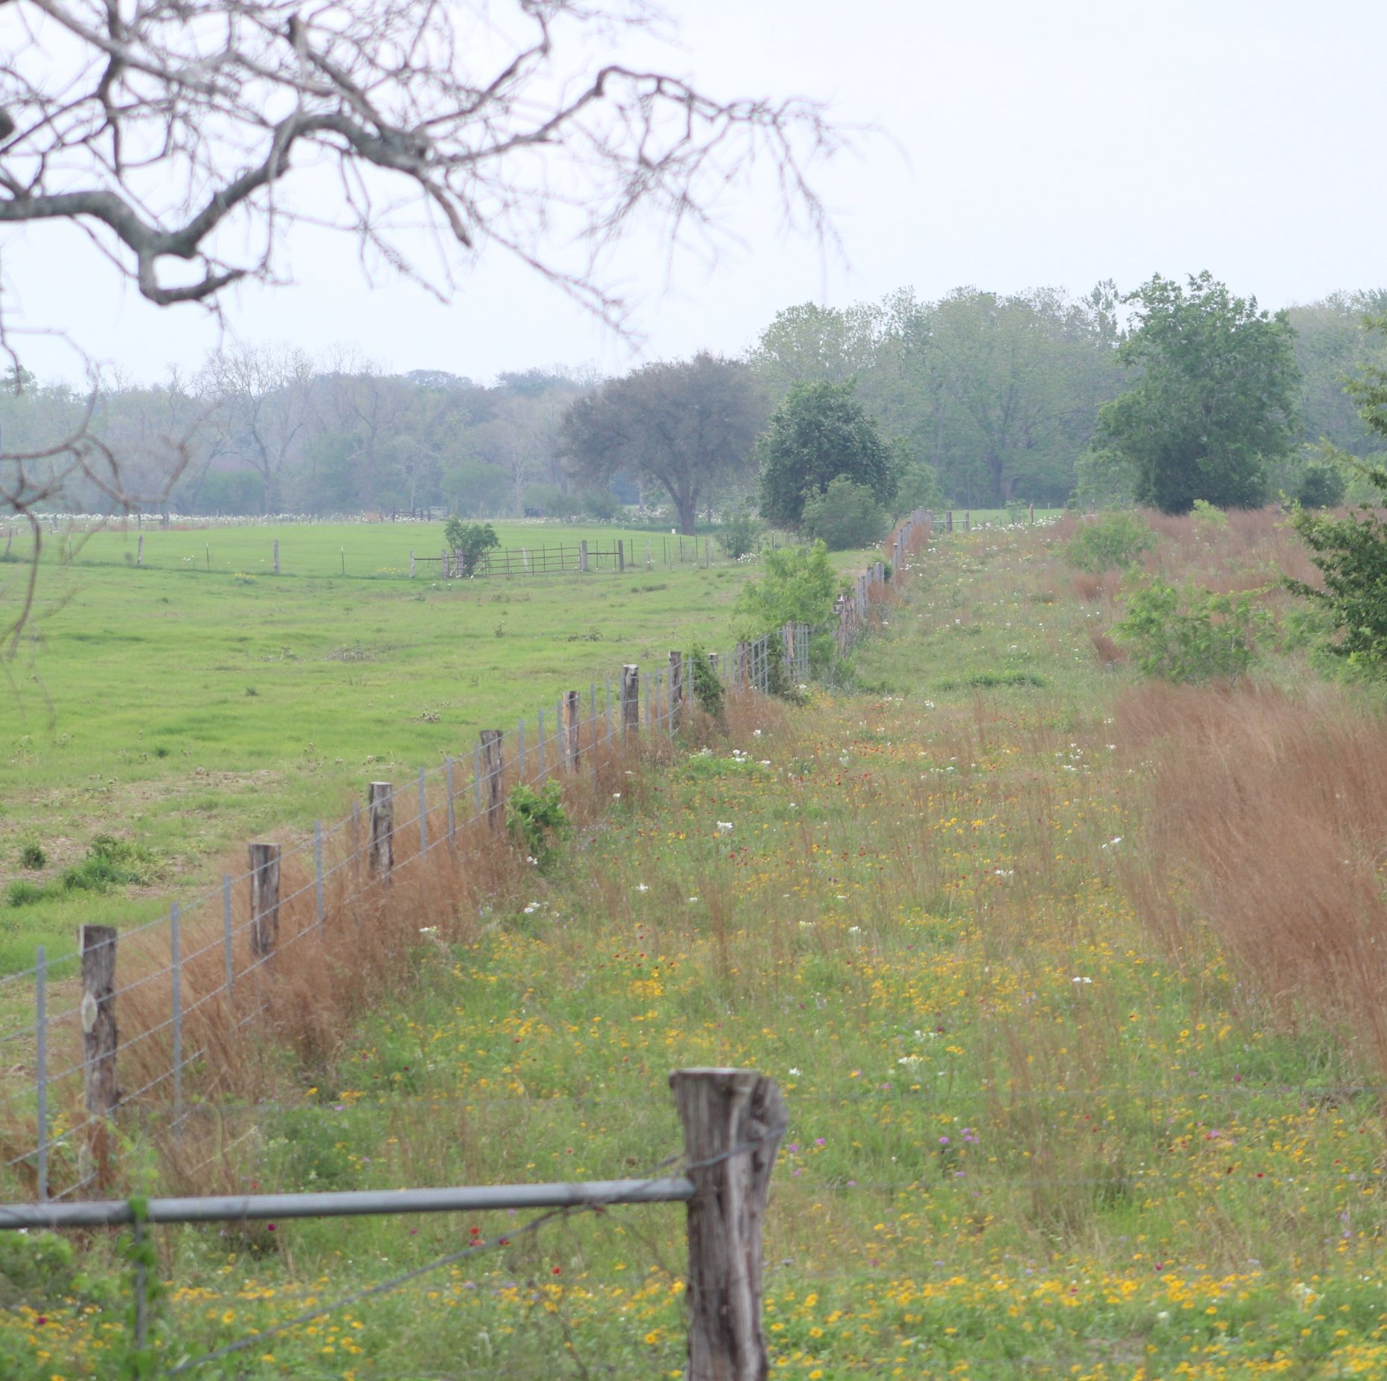
Diversity Management
Encourage plant diversity despite having introduced OWBs present
Retreatments must be timely
Notes:
Another approach is to manage the land to encourage plant diversity and reduce the dominance of KR/Kleberg. Native wildlife species generally do best in diverse plant communities.
These diverse plant communities are superior in providing all wildlife needs, including food, protection from predators and areas for nesting and brooding young.
This approach is not a one and done endeavor. To enable native plants to compete with KR/Kleberg, retreatments must be timely, repeated, and well planned.

Slide 12
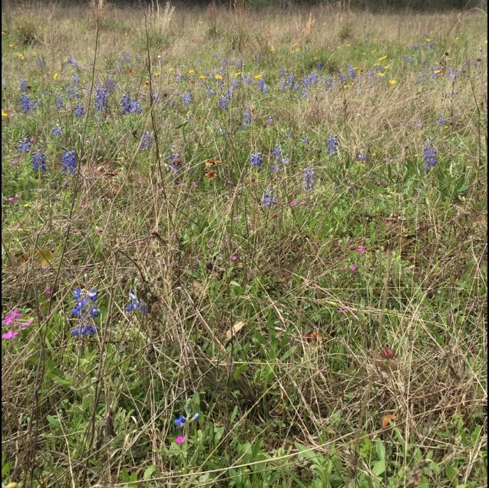
Passive Management
Do nothing
Best if not prepared to conduct proper, intensive, follow-up treatments
Put your effort into protecting areas not invaded by OWBs
Notes:
The final option is to do nothing. Although it can be difficult to watch an invasive grass species invade a once diverse native site, some managers cannot provide proper follow-up treatments to keep these grasses suppressed.
Research has confirmed that many management techniques disturb plants and soils, which encourages the further spread of these OWBs. KR has been observed to decrease in density on coarse (sandy) and drier soils when the land is left alone.
Rather than creating a disturbance and encouraging these invasive grasses, there are situations where it may be best to leave the area alone and put effort into protecting areas that have not yet been invaded.

Slide 13
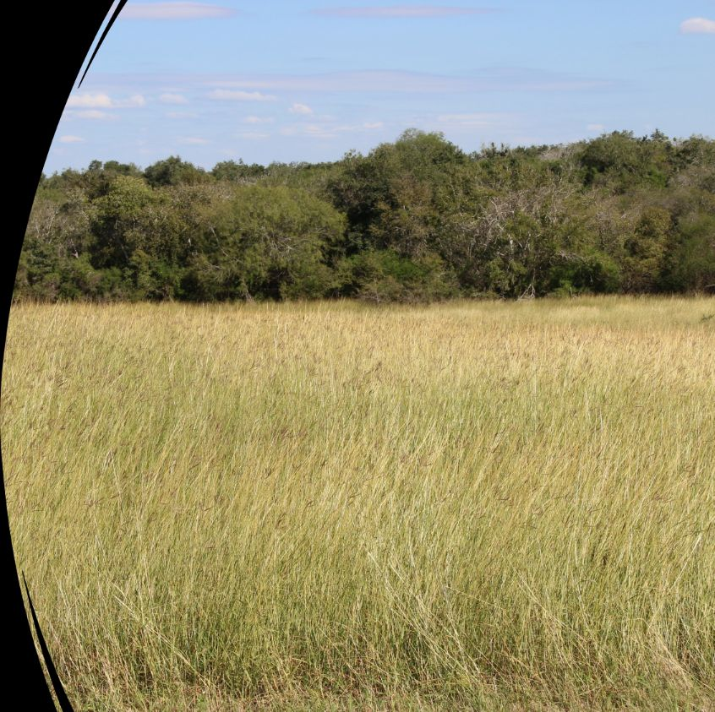
Management Options
Practices that benefit nonnative bluestems
Traditional practices-mowing, plowing, disking, & fire- increase KR & Kleberg bluestem
  Short-term suppression
  Ultimately failed to reduce these grasses
  Persistent seedbanks
Notes:
Several studies have found that the invasive grasses not only grow back within months, but they actually become more vigorous that before and out-compete the native plants.
A characteristic of introduced bluestems that makes them particularly difficult to manage is their large and persistent seed banks. To achieve long-term control, managers must address existing plants as well as their seedbanks.

Slide 14
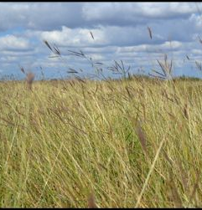
Management Options
Practices that benefit nonnative bluestems
Mowing:
  Shortens the plants
    Responds quickly to top removal
  Continuous mowing
    Plants to shift growth form
Notes:
Although mowing shortens the plants greatly, KR & Kleberg bluestem respond quickly after top removal. This trait is one of the reasons it was originally introduced for livestock forage.
Continuous mowing causes the plants to shift their growth form from bunch to prostrate, where the stems begin to grow parallel to the ground, they also get stemy at this point, as they try to survive to get more seed out
You can see examples of the along the highway rights-of-way, these areas are mowed twice annually and are typically dominated by these introduced bluestems, whereas in some cases you can look to nearby areas generally left unmowed, and often there is more diversity.

Slide 15
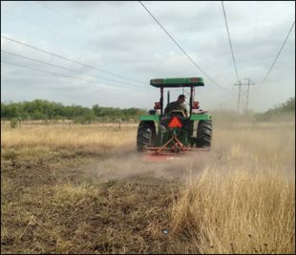
Management Options
Practices that benefit nonnative bluestems
Plowing:
  Crop production, fields are plowed to prepare for planting
    Uproot invasive grass plants
    May bury some seed
  Recover within months
Disking:
  Often used to promote forb growth
Notes:
In crop production systems, a field is often plowed to rid the area of unwanted plants before replanting. Deep plowing can uproot invasive grass plants, allowing their roots to dry out and die. Plowing can also potentially bury some introduced grass seed to prevent it from germinating as readily. However, we found that if used as a single treatment, these invasive bluestems can recover within months with rainfall, using their large seedbanks to take over exposed soil.
Disking, especially in winter, is often used . to promote forb growth in early spring. Though this practice does not control these grasses long-term, repeated disking may increase forb availability for wildlife on some soil types. Disking is still going to expose the soil, which can be invaded by OWB in no time.
As with any treatment, the success of disking depends on the soil moisture conditions before and after disking. In drier soils, invasive grass root crowns may not re-root as easily following disking event, whereas moist soils could promote quick reestablishment. Course, sandy soils are more easily manipulated with mechanical equipment and may allow invasive frass root crowns to dry out before they can reestablish, although long-term control with few treatments is not realistic.

Slide 16
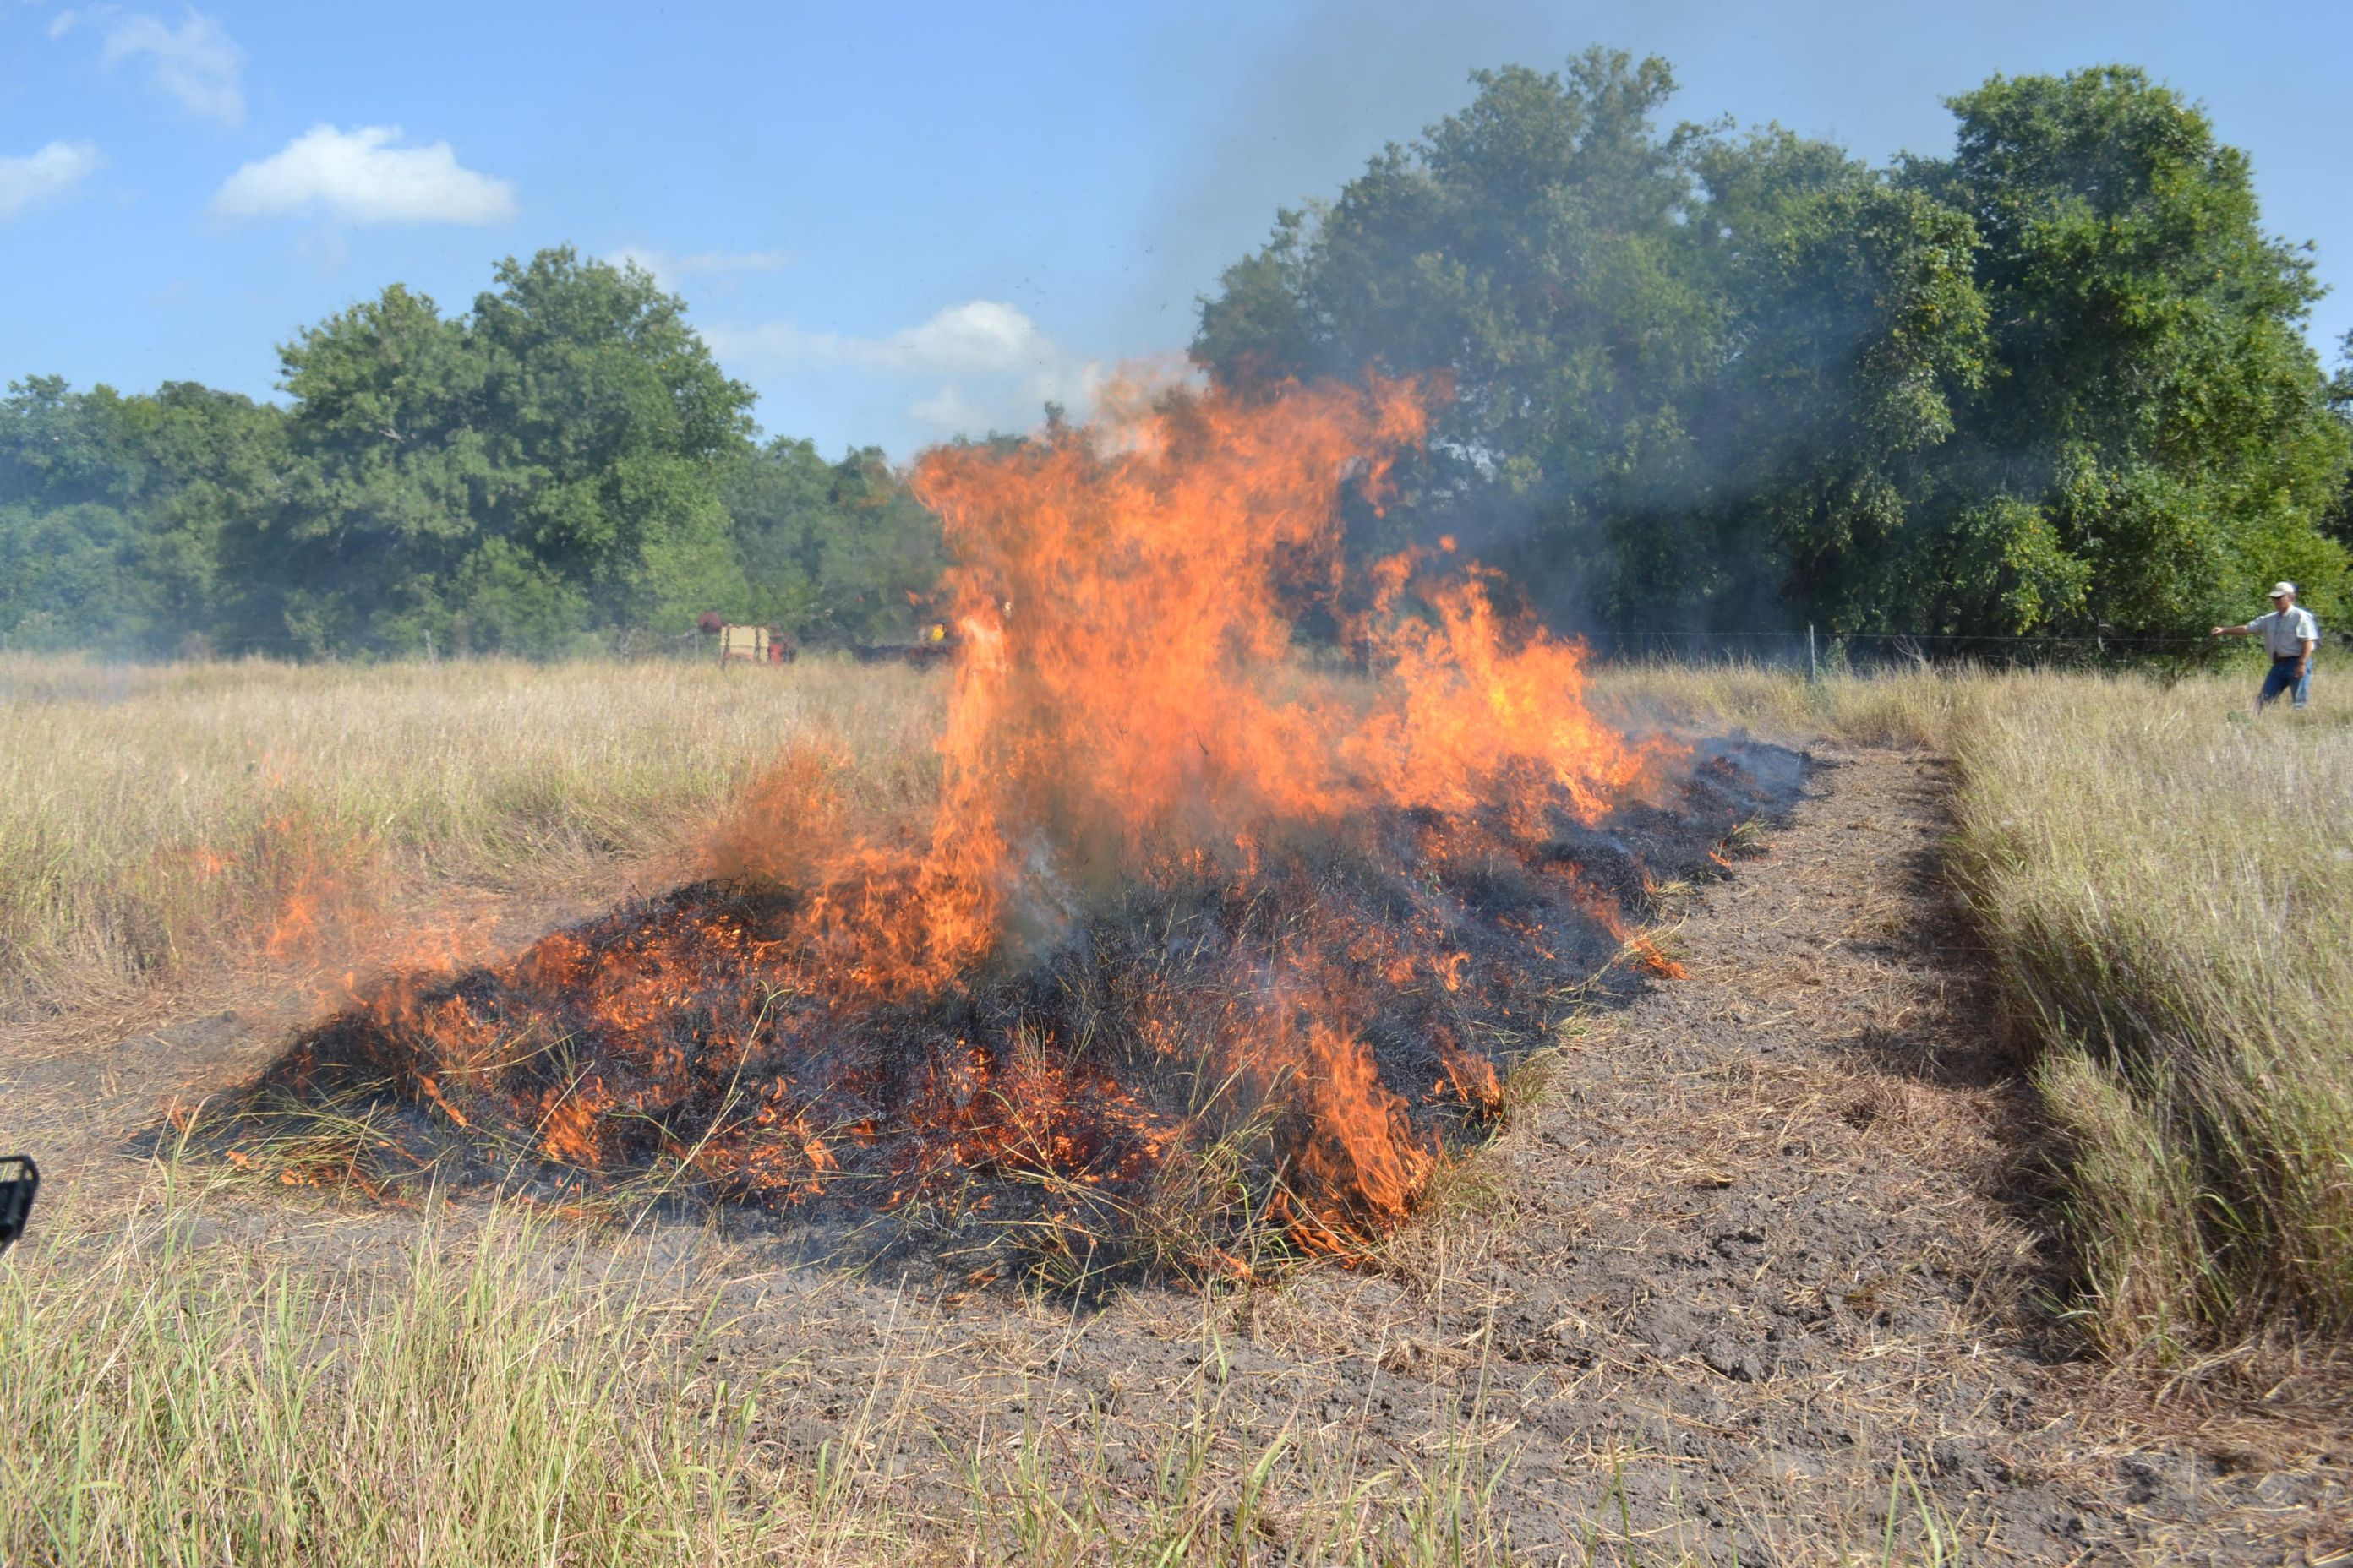
Management Options
Practices that benefit nonnative bluestems
Prescribed fire:
  Often used to increase nutrient cycling on rangelands
  Often promotes OWB
    Dormant season burns found to increase their presence
    Summer fire thought to be harsh enough however, found to eventually recover
  Use with caution in native areas that have some pockets or OWB in/near them
Notes:
Prescribed fire is often used to increase nutrient cycling on rangelands and to produce new plant growth. Many of our natives once thrived with fire. Research has found that dormant-season burns increase the presence of introduced bluestems. Summer fire was thought to be harsh enough during the invasive plant’s growing stage but it has generally been found to only reduce the amount of OWB on a site for up to a year, plant crown survival and new seedlings eventually increase until their coverage meets or greatly surpasses pretreatment densities.
The rate of return can be influenced by soil type and rainfall received both before and after burn.
Use extreme caution when burning a field where pockets of OWBs exist or where they are found close to burn unit. fire spreads introduced bluestems and is highly unlikely to produce long-term reductions of OWB populations.

Slide 17
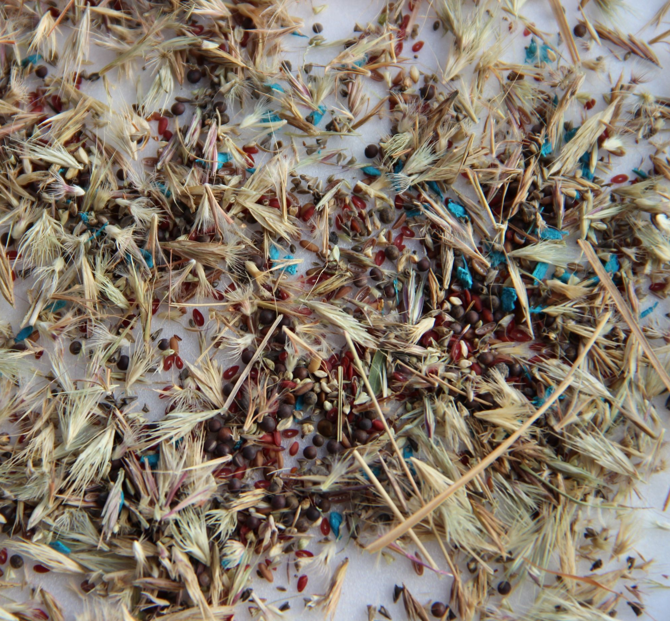
Management Options
Management combinations for suppression
Combining treatment practices
  Mowing
  Herbicide (Glyphosate)
  Fertilizing
  Plowing
  Prescribed fire
  Reseeding with native mix
Notes:
So now let’s look at combining treatments to see if giving it a one-two punch can knock OWB out. My research in grad school was focused on determining how long combination of treatments would suppress or control the invasive OWBs. I looked at combinations of summer fire, glyphosate, Pastora with plowing, mowing, plowing followed by reseeding with natives, and fertilizing.

Slide 18
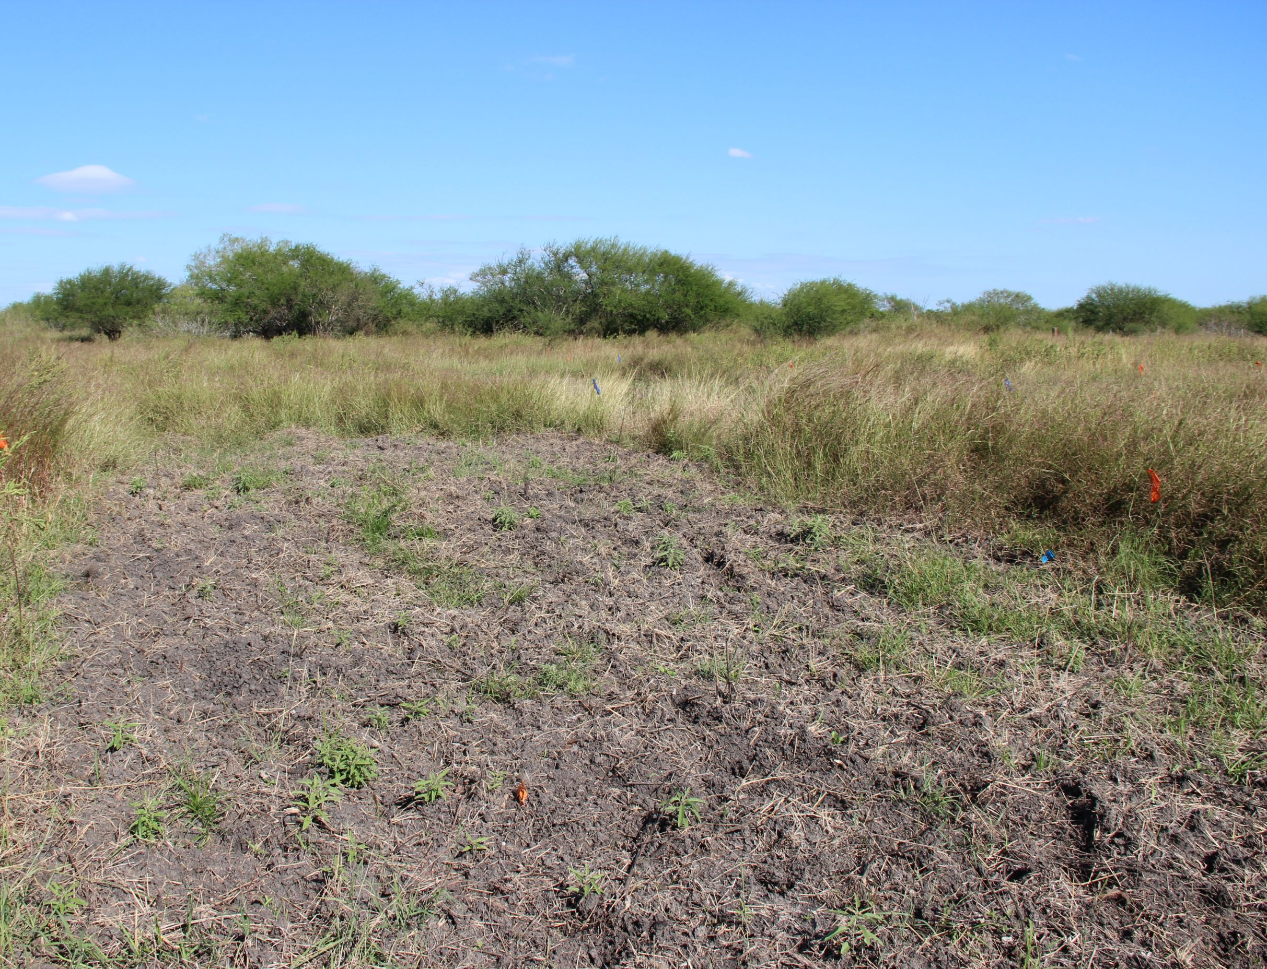
Management Options
Management combinations for suppression
Most returned to pre-treatment levels within 3-6 months, but all within 2 years
Plowing combinations lasted the longest
Likely best bet, is to combine plowing, herbicide, and reseeding
Notes:
We found that even combinations of management techniques reduced OWBs only for the short-term. After most management combinations, these bluestems generally returned to pre-treatment levels with 2 years, but more often after 3-6 months.
Plowing combinations yielded the longest lasting results, as you can imagine this is likely linked to the drastic change in successional stage. In most cases, the densities of OWB returned. The best combination included the herbicide along with plowing and reseeding which is a much higher cost and comes with risk from encroachment if nearby areas are not properly maintained. Seeds from that area can encroach overtime causing an invasion to occur again.
One thing we didn’t look at was repeated herbicide prior to seed bed prep. I think in most cases with larger management areas, doing repeated herbicide applications to knock back standing plants prior to re-seeding can yield a more diverse area.

Slide 19
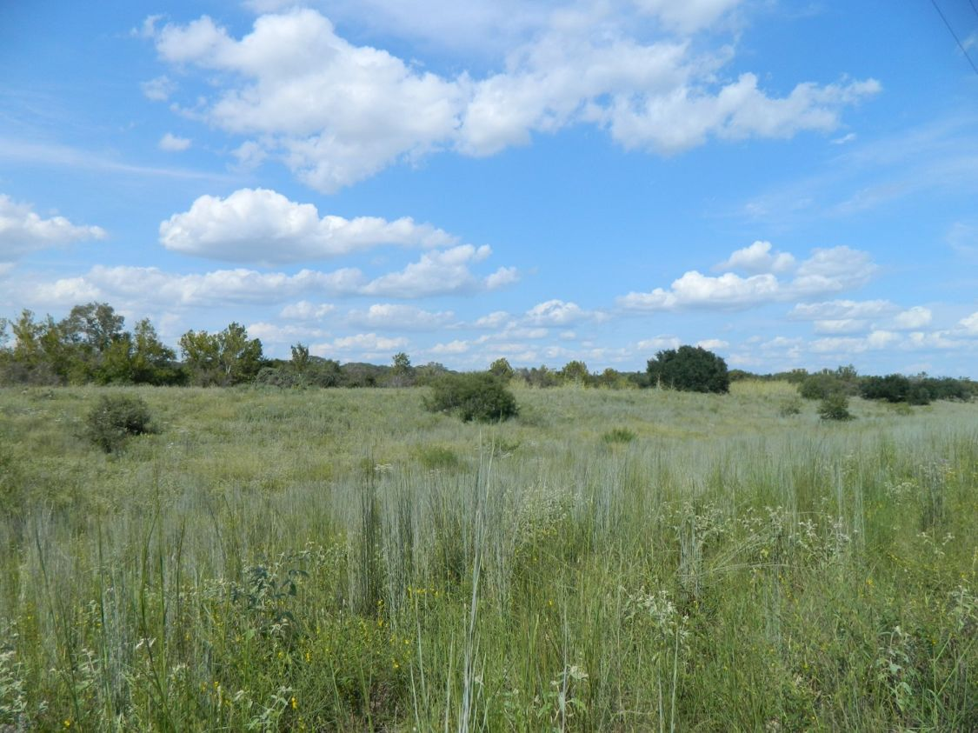
Prevention
Learn to identify invasive plants
  OWBs can invade from roads, livestock working areas, hay distribution points, and residential areas
Spot spray any new invasive grass recruits when area is small
Be careful when bringing in equipment
  Vehicles
  Rental
  Contractor
  Pipeline Companies
Notes:
If you are one of the lucky folks and either have no OWB or very little, your best bet is prevention. Some of the points I will cover can also be completed if you have OWBs to keep from bringing in new seeds.
First you want to learn to identify invasive plants species in your area. Routinely check pastures fro these plants so you can remover them before they become established.
Spot spraying any new recruits with glyphosate may help reduce these grasses ability to invade your pasture. Remember though that glyphosate will kill any green plants, so be careful what you spray.
Be careful when bringing in equipment or vehicles onto the property. equipment used where these invasive grasses grow can easily transport seeds and scatter them on your land. Ask pipeline companies, professional hay balers, hunters, and other who need access to your land to clean their equipment and vehicles before bringing them into property. OWBs are well established along most public roadways and seeds can readily be transported onto a ranch by any vehicle traveling public roads. Neighborhood encroachment

Slide 20
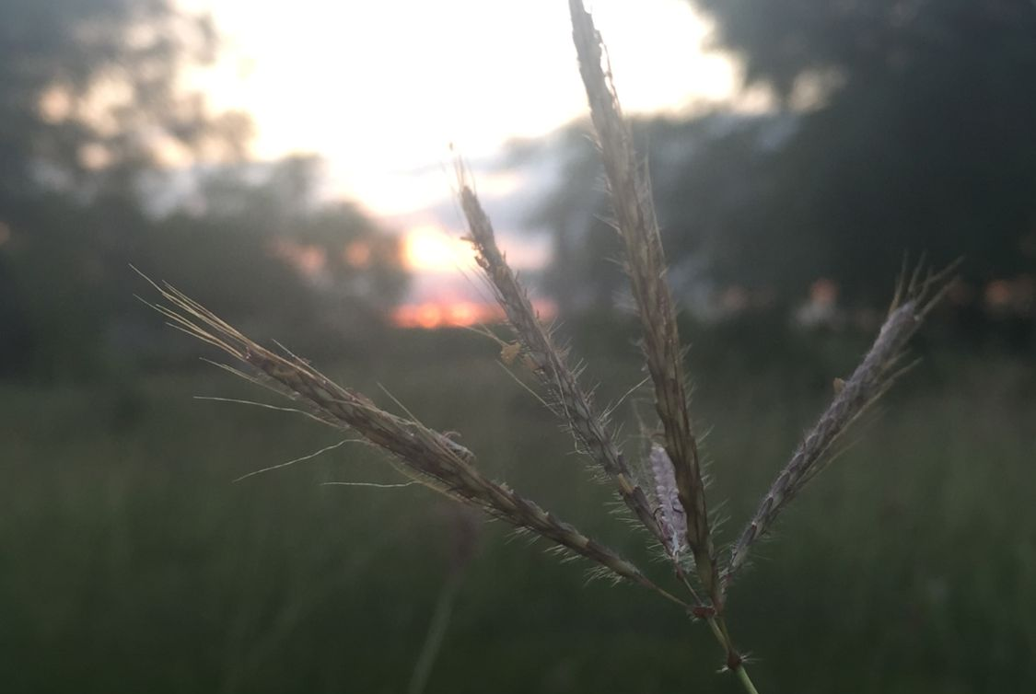
Questions
Discussion
Thoughts

