Slide 1
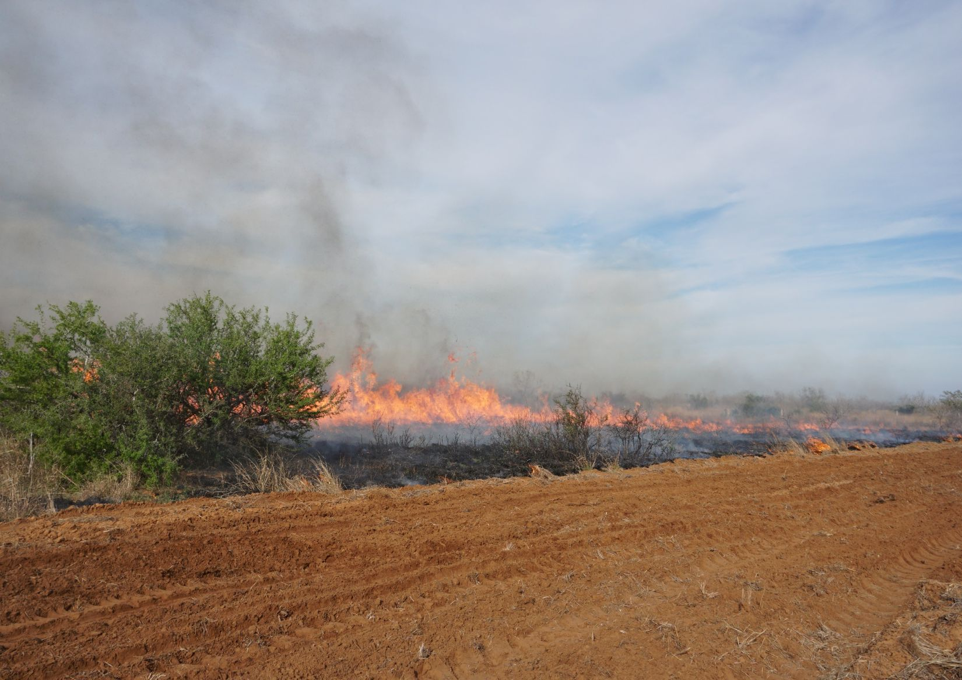
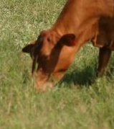
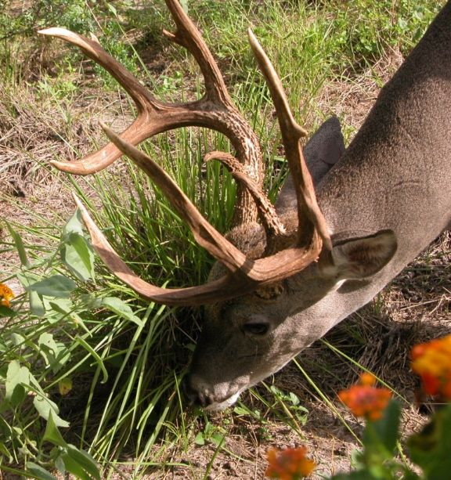

Managing Old World Bluestems for Structure with Patch Burning and Grazing
Poncho Ortega, Ph.D.

Slide 2
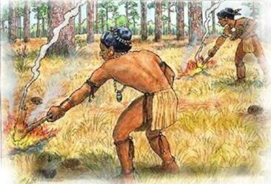
Fire in History

Slide 3
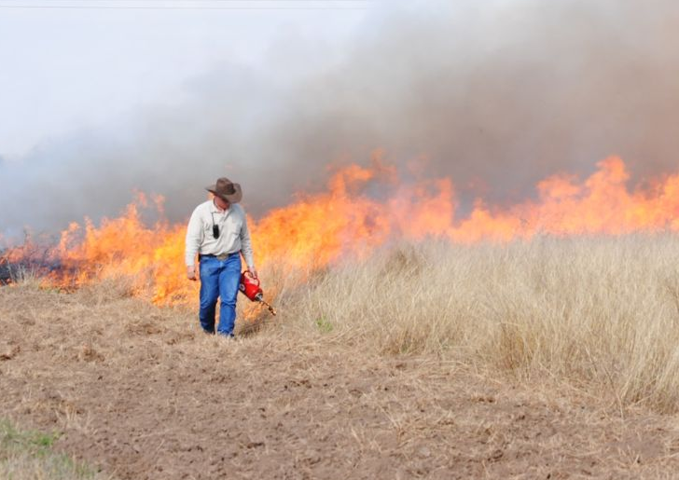
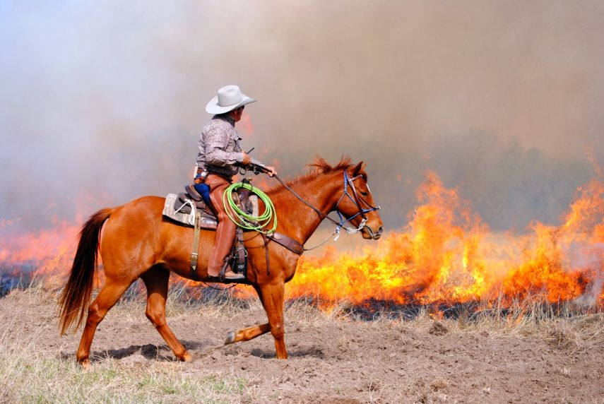
Prescribed Fire

Slide 4
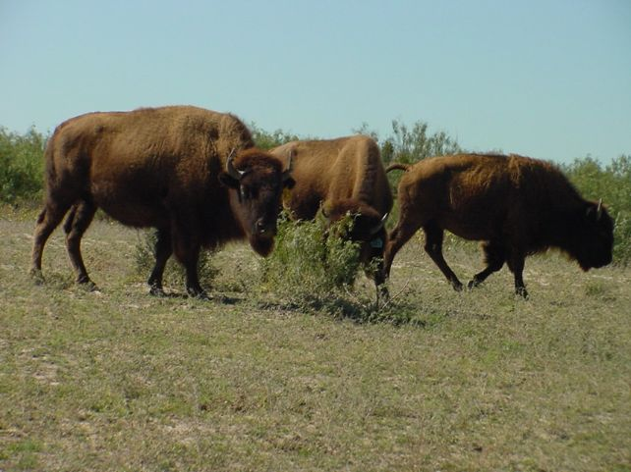
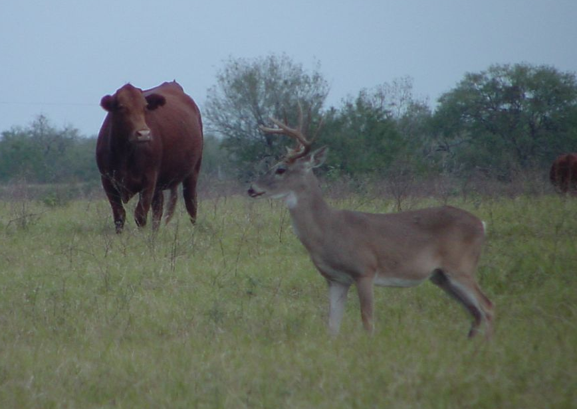
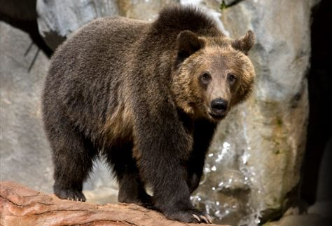
Grazing Domestic and Wild Animals

Slide 5
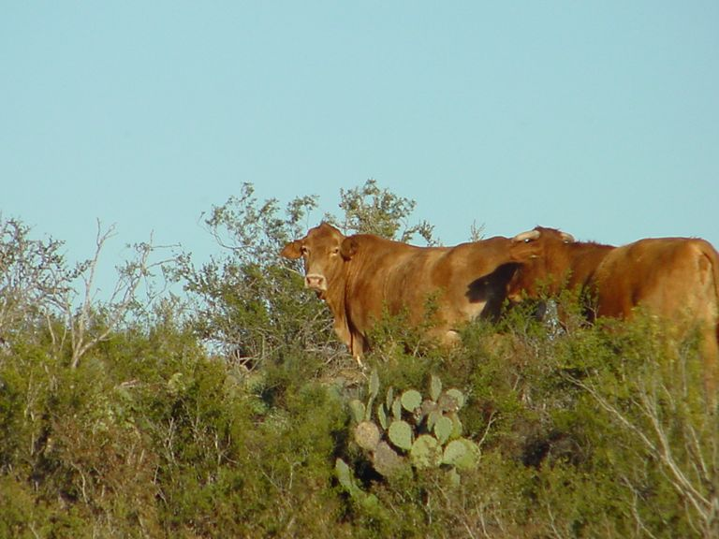
CATTLE GRAZING
Beneficial
Neutral
Detrimental

Slide 6
IS IT BETTER TO HAVE
ONLY WILDLIFE?
Heaviest Buck Harvested
(1996/1997)
200
Livestock
168
No Livestock
148
148
151
150
lbs
100
50
0
Western S. Texas
Eastern S. Texas
Bryant et al. (1999)

Slide 7
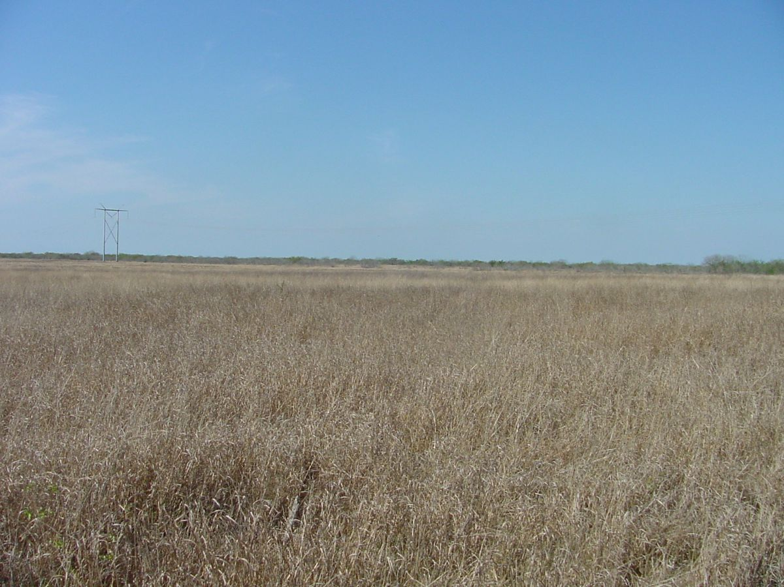
The Absence of Cattle Grazing
Encroachment of invasive grasses
Habitat loss for some wildlife species
Excessive accumulation of fine fuel…wildfires

Slide 8
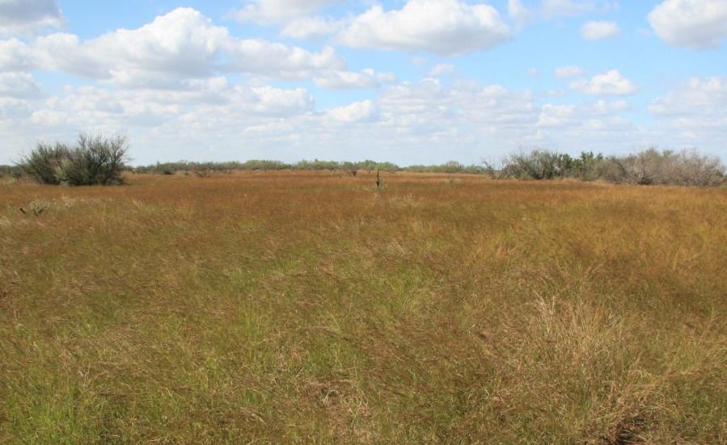
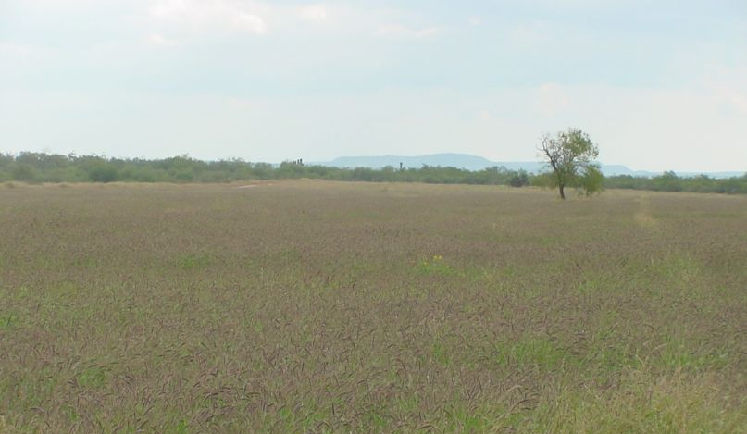
Remocion del pastoreo de ganado

Slide 9
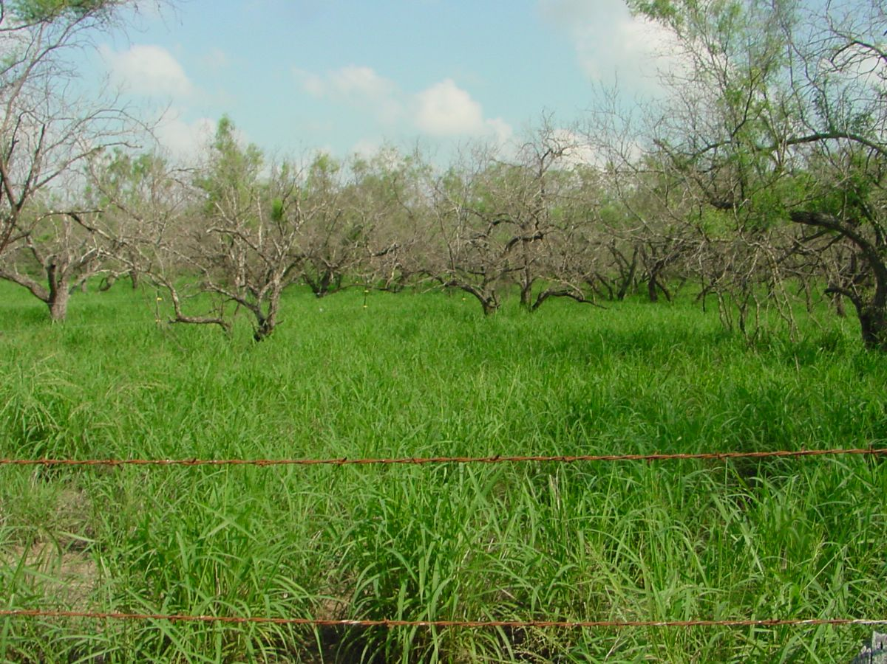
INVASIVE SPECIES
Guineagrass
Buffelgrass
Old world bluestems
Tanglehead
Four flower trichloris
Changes in rainfall patterns and temperature

Slide 10
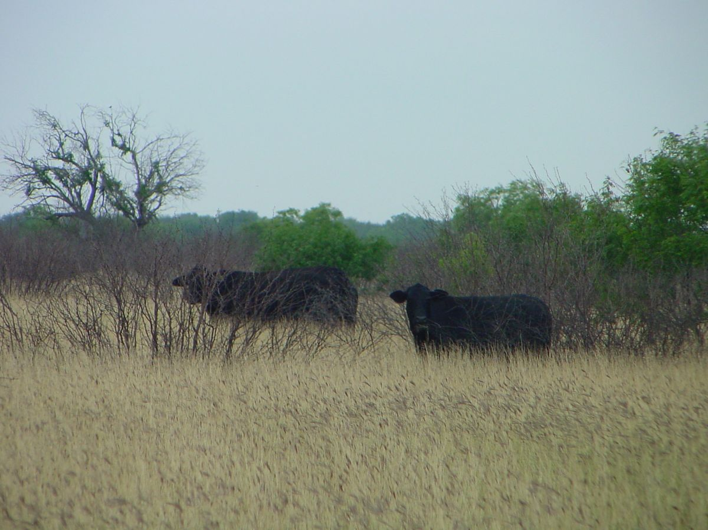
Can we eradicate exotic grasses ?

Slide 11
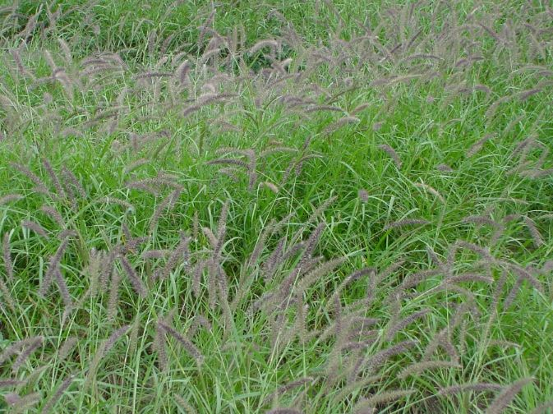
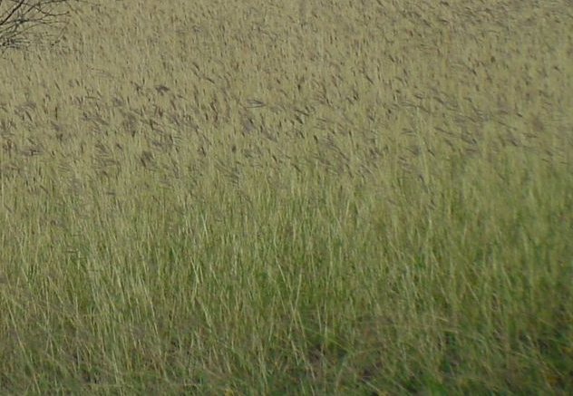
What we may have after eradicating one exotic grass?

Slide 12
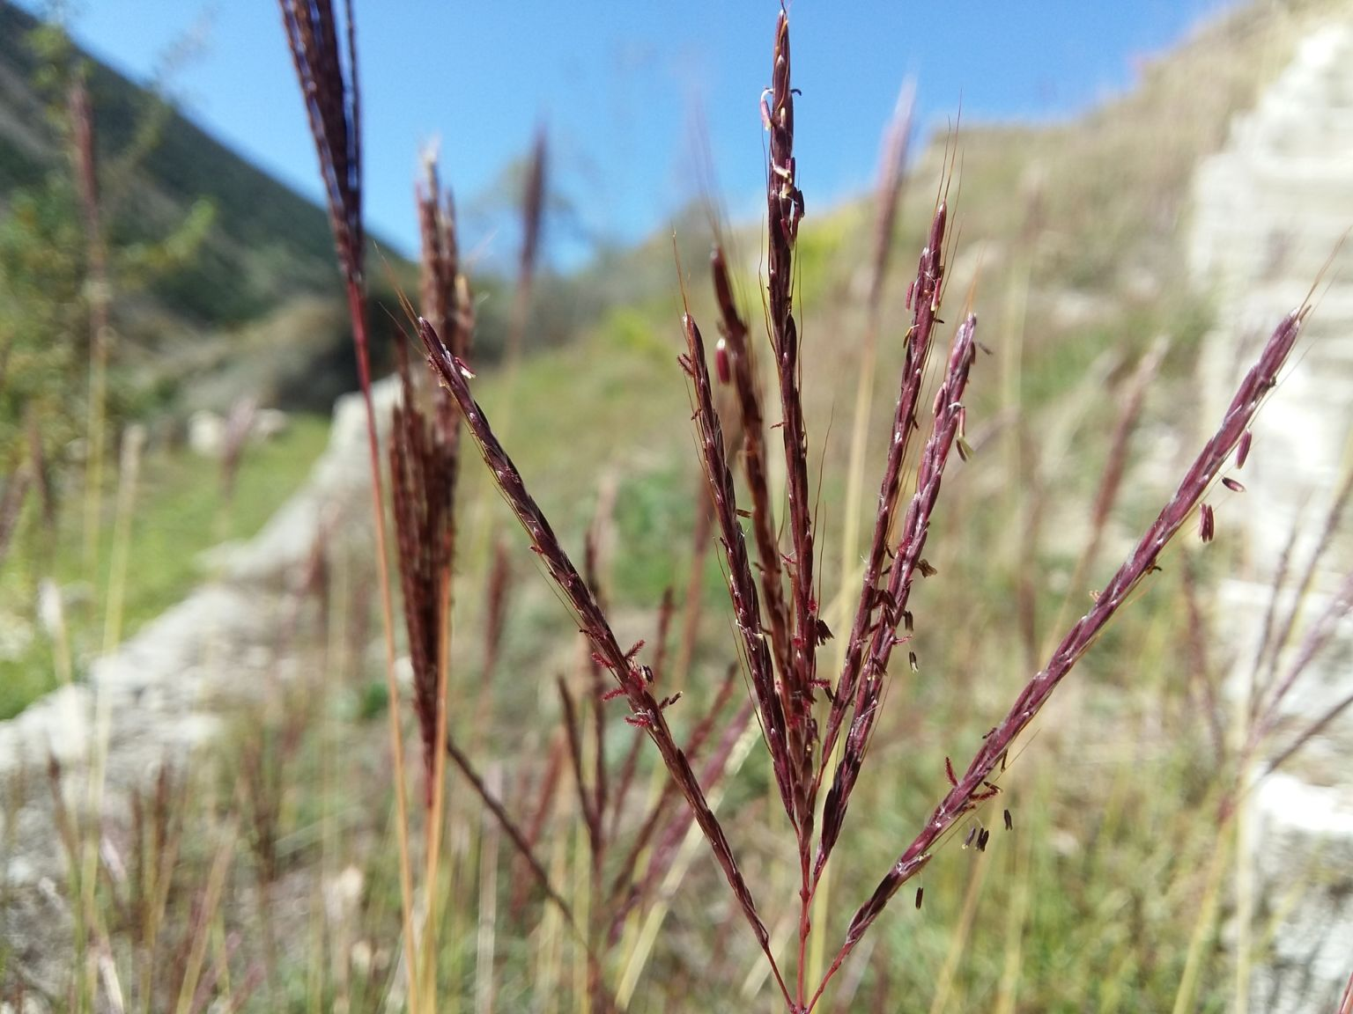
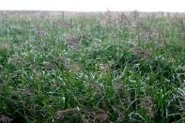
Old World Bluestems
Caucasian, King Ranch, Kleberg, Plains, WW-Spar, WW-lron Master, Medio, Gordo, WB Dahl…

Slide 13
Old World Bluestems Kill it or Use it?

Slide 14
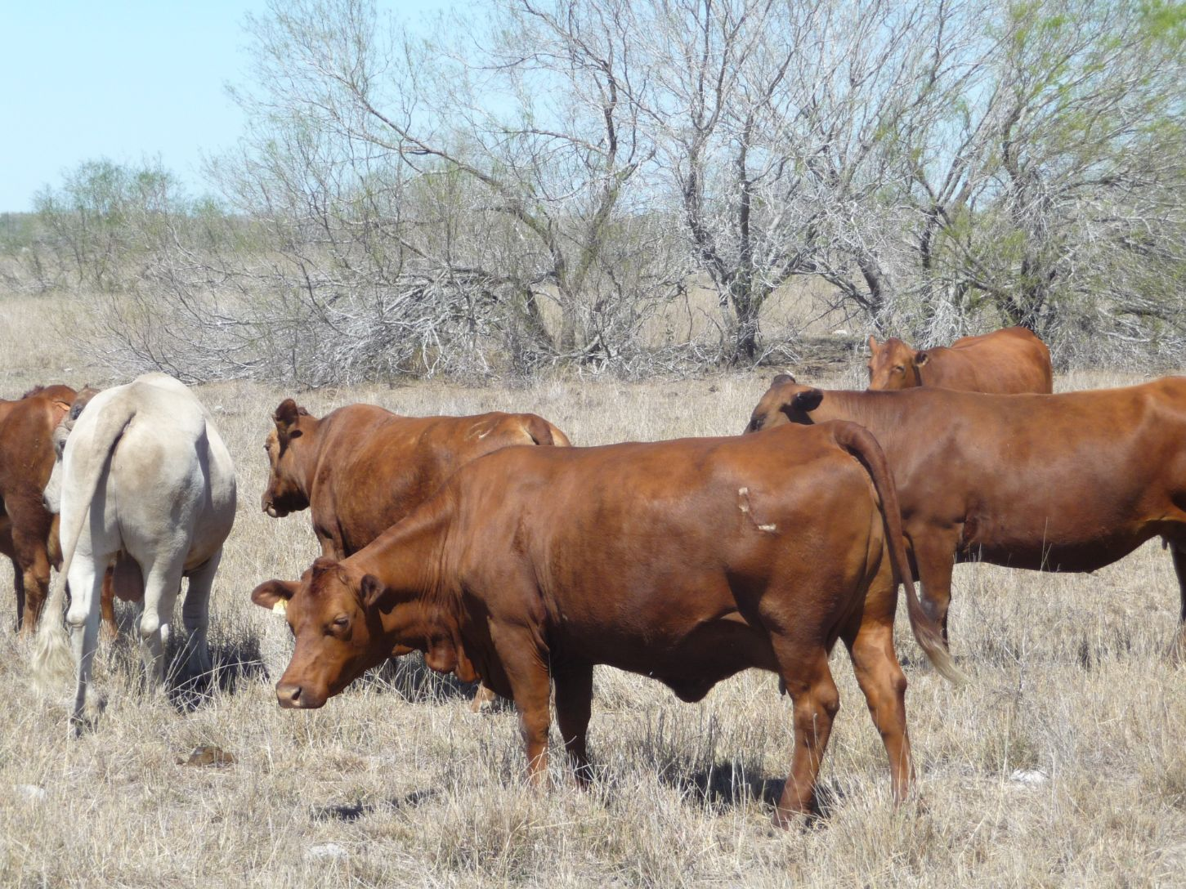

Slide 15
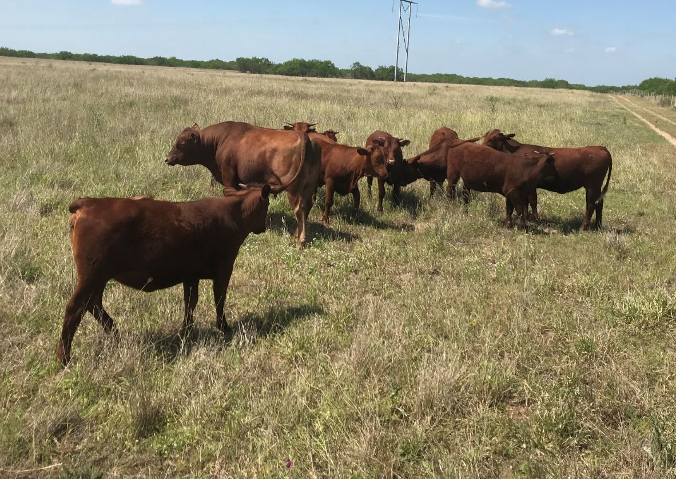

Slide 16
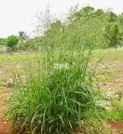
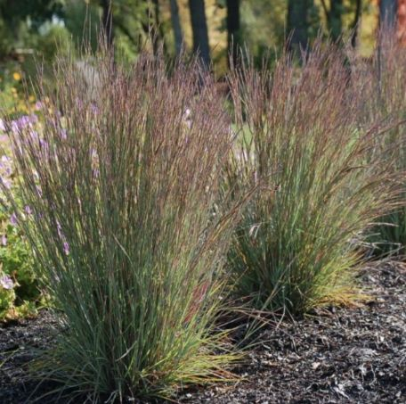
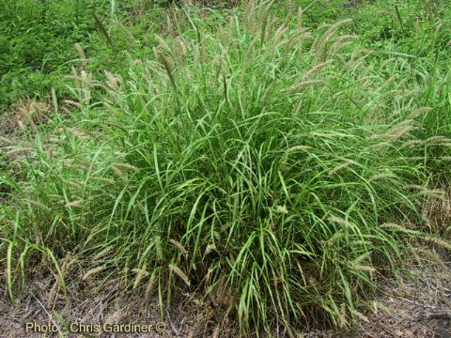
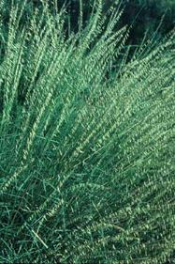
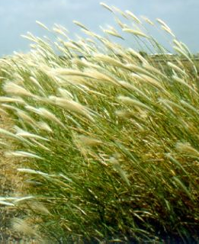
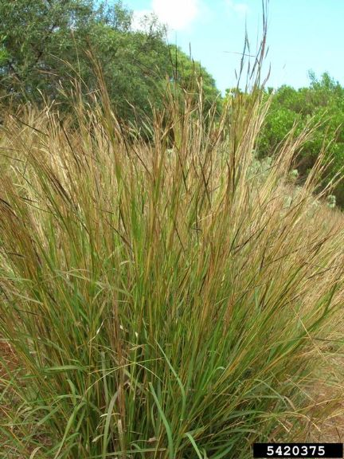
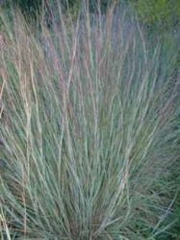
Palatability?

Slide 17
Managing Structure of OWB

Slide 18
Managing Structure of OWB

Slide 19
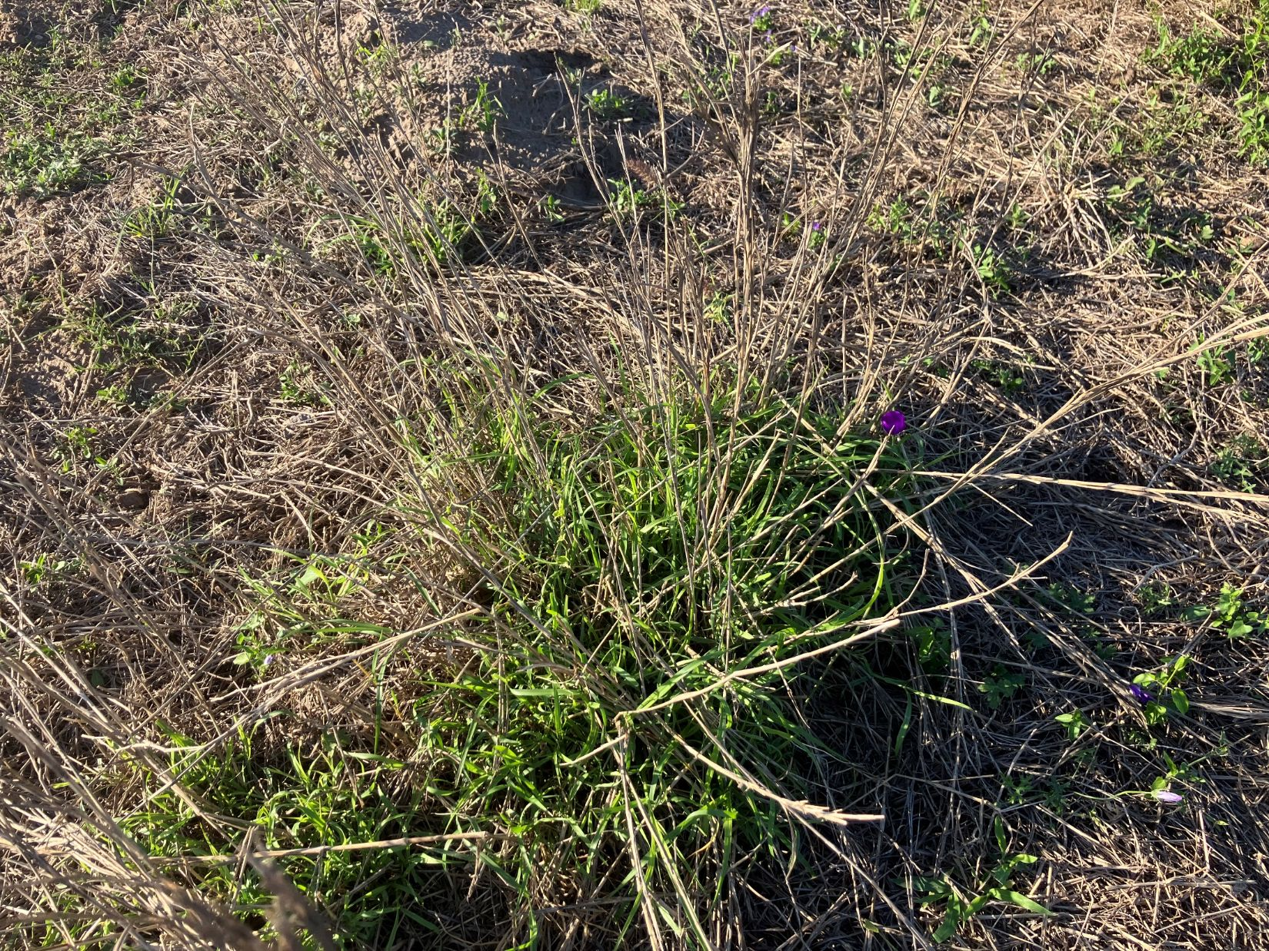
Managing Structure of OWB

Slide 20
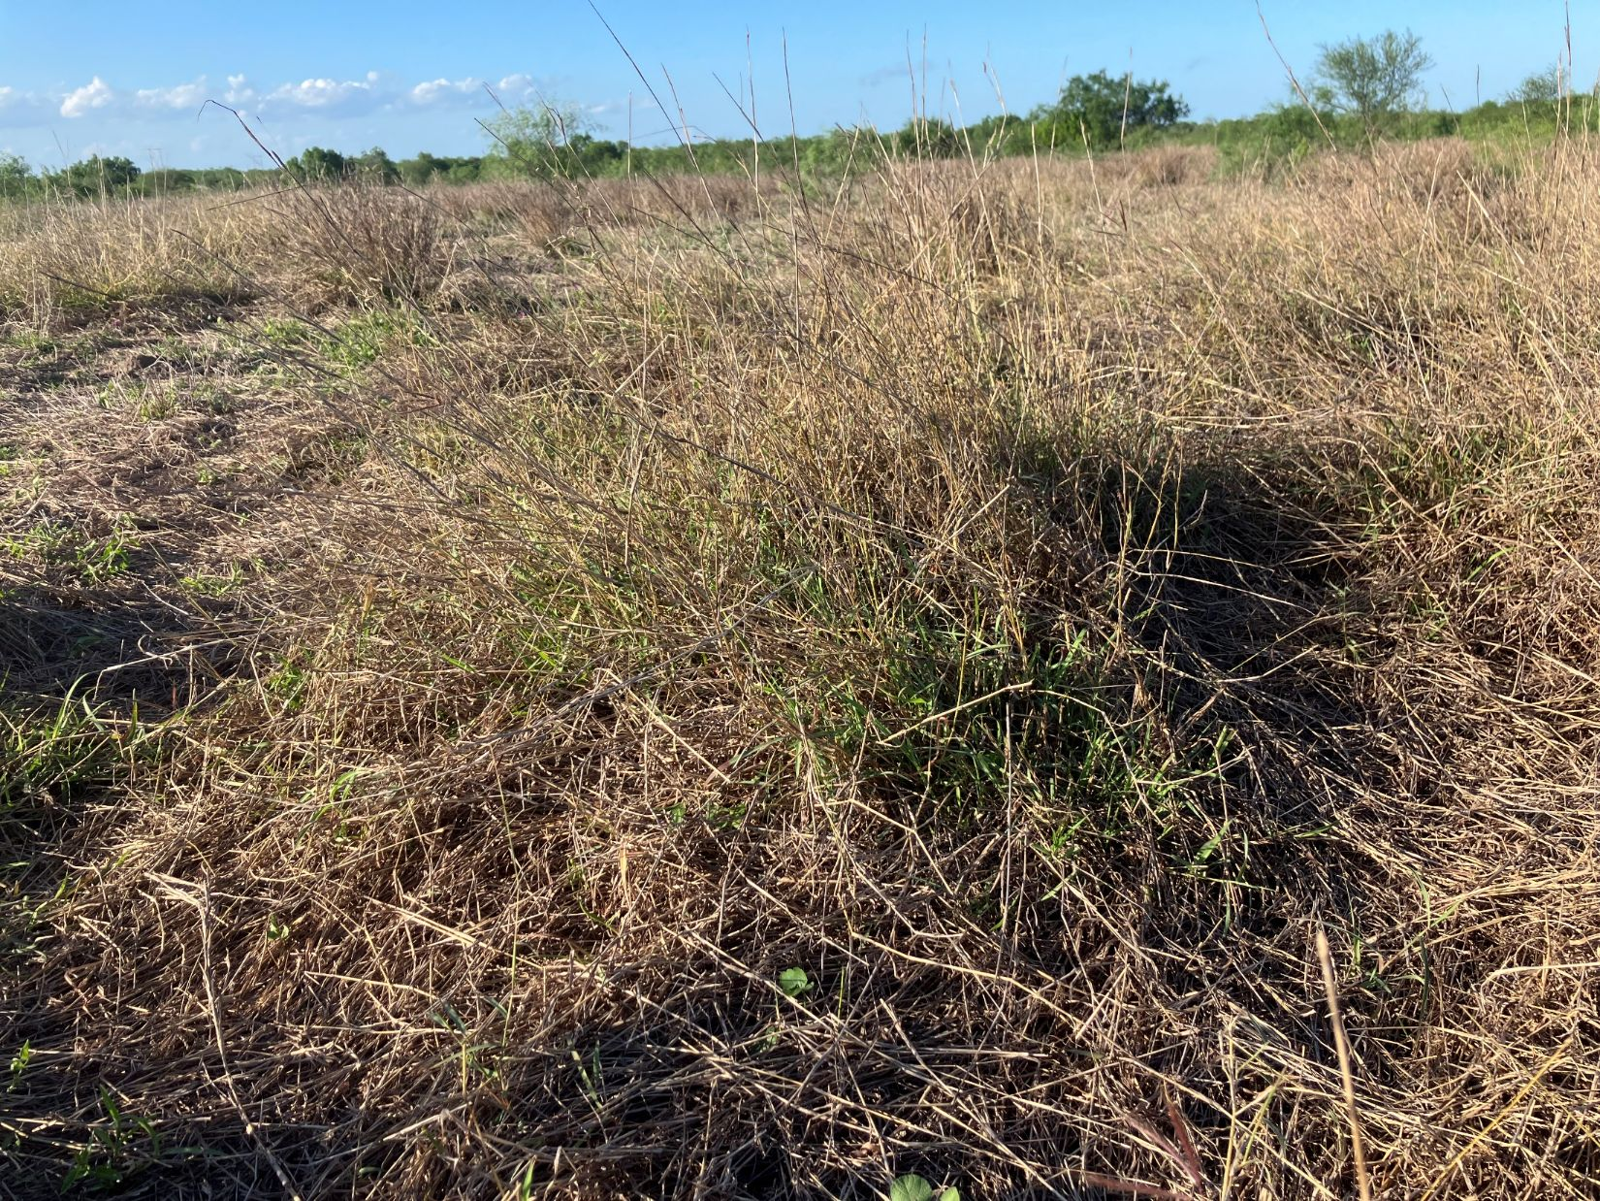
Managing Structure of OWB

Slide 21
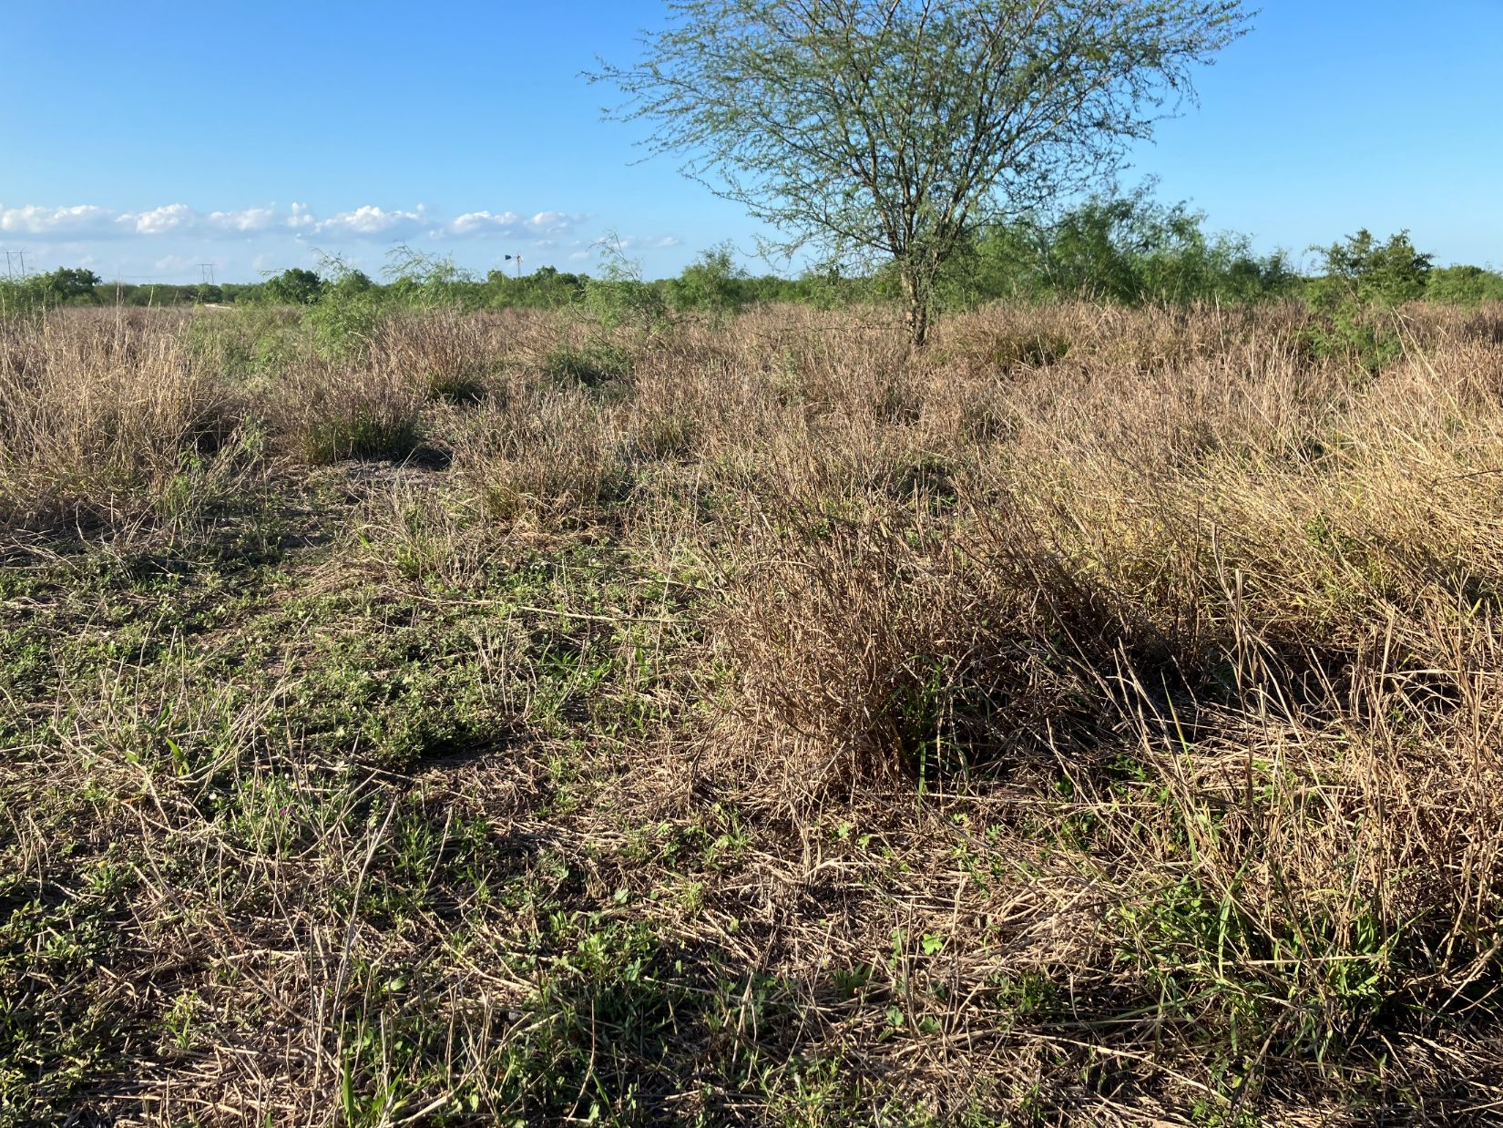
Managing Structure of OWB

Slide 22
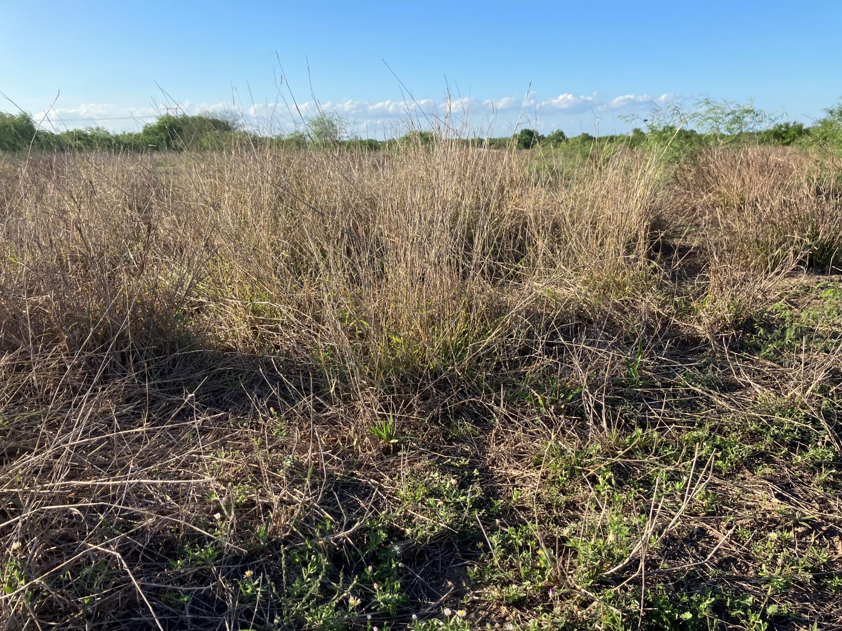
Managing Structure of OWB

Slide 23
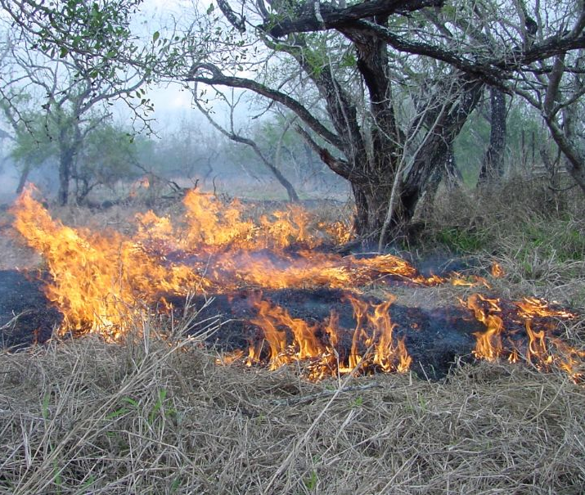
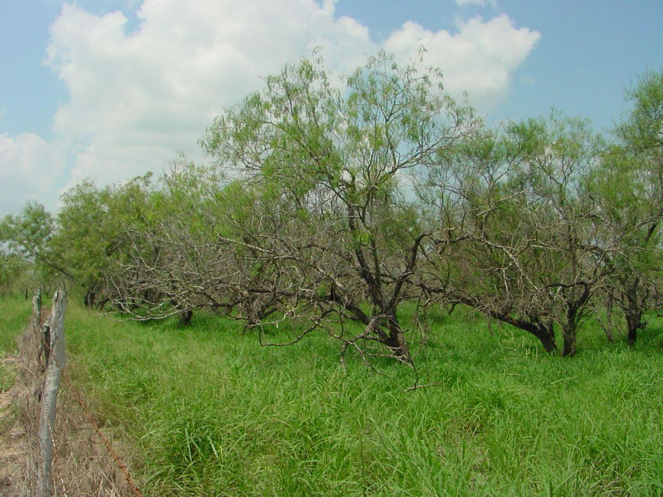
Patch Burning
and
Catle Grazing

Slide 24
PATCH BURNING
AND
CATLE GRAZING

Slide 25
Prescribed burning reduced guineagrass density
Burned areas: 58,667 plants/ha
Control: 93,333 plants/ha

Slide 26
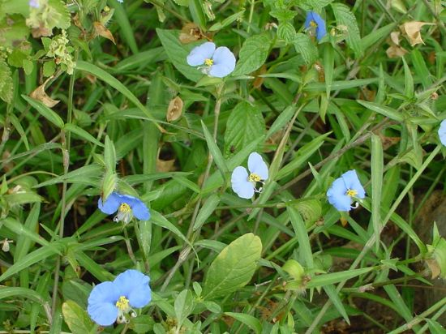
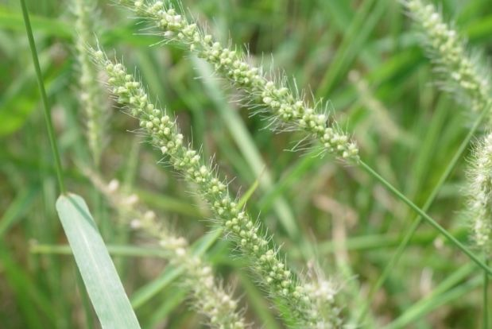
10 forbs for Deer
6 forbs and grasses for Bobwhites
Lazy daisy
Wine cup
Dayflower
Desmanthus
Silver bladderpod
Wood sorrel
Ridgeseed
Redseed plantain
American snoutbean
Verbena
Partrige pea
Dayflower
Coreopsis
Witchgrass
Bristlegrass
Smutgrass

Slide 27
Prescribed burning reduced guineagrass density
Burned areas: 58,667 plants/ha
Control: 93,333 plants/ha
Plant species richness increased over 300% in the burned and grazed treatment

Slide 28
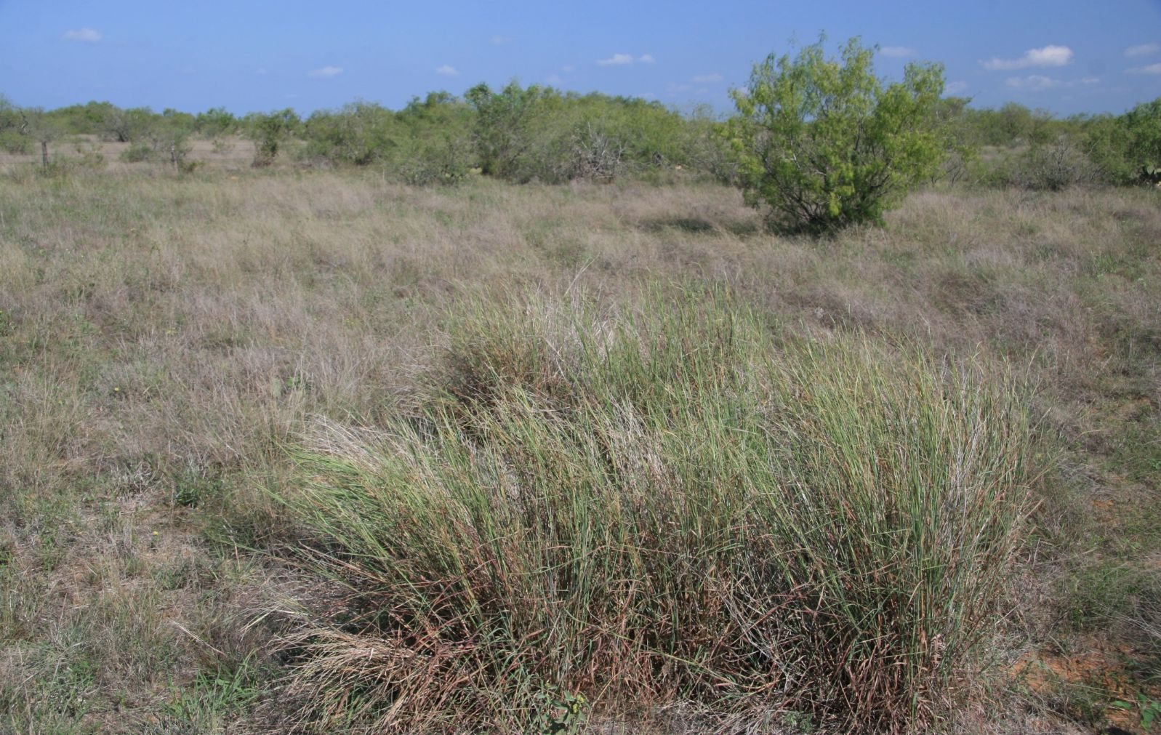
TANGLEHEAD

Slide 29
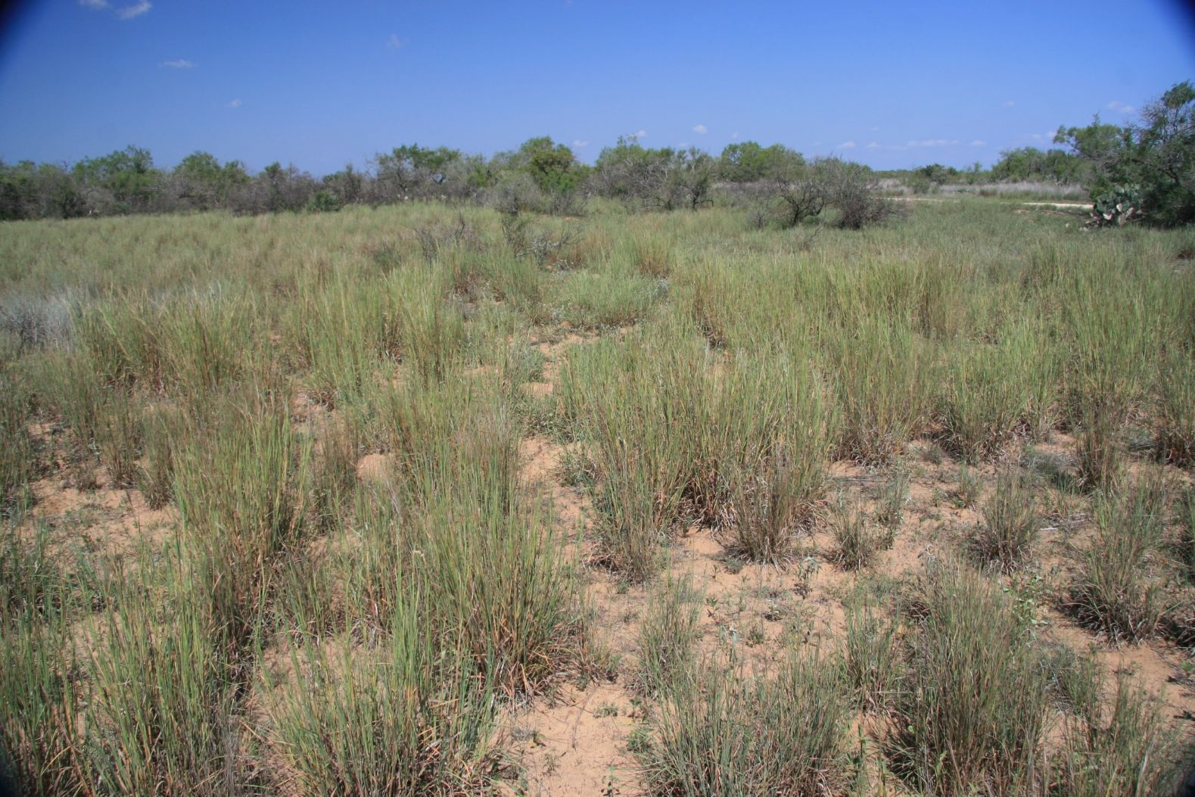
TANGLEHEAD

Slide 30

TANGLEHEAD

Slide 31


TANGLEHEAD

Slide 32
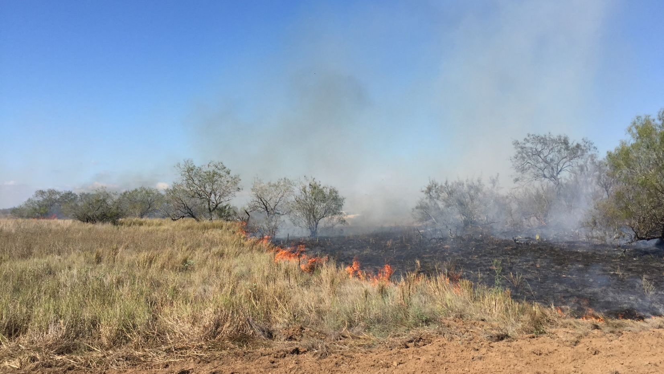
Long-term Responses of Tanglehead to Prescribed Burning and Cattle Grazing
Chase H. Walther¹, J. Alfonso Ortega-S¹, Humberto Perotto-Baldivieso¹,
Sandra Rideout-Hanzak¹,and David Wester¹
¹Caesar Kleberg Wildlife Research Institute, Texas A&M University-Kingsville, Kingsville, TX

Slide 33
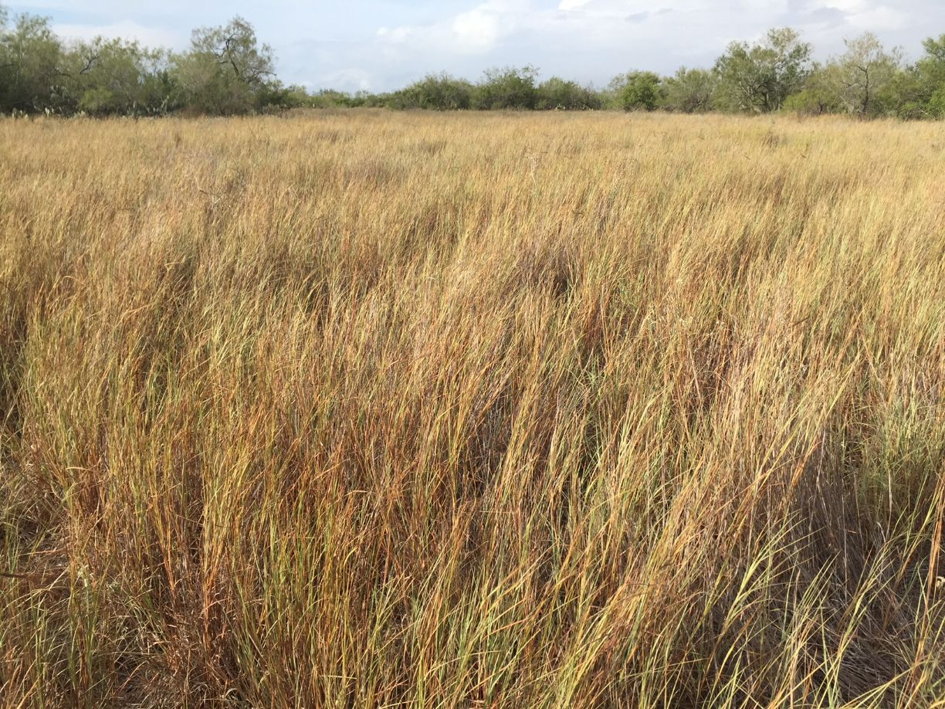

Slide 34
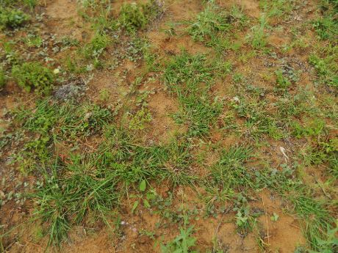
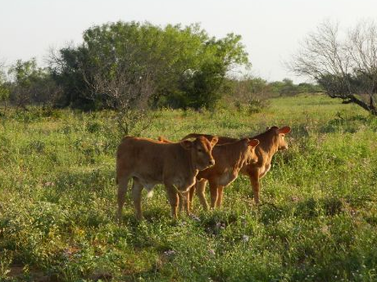
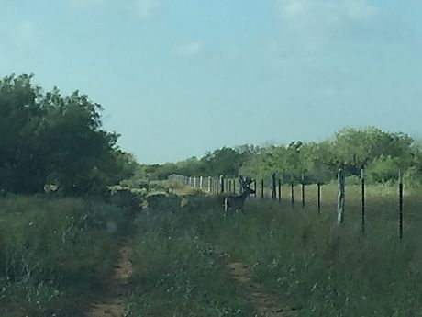
Determine prescribed fire and cattle grazing effects on:
Plant community composition
Pasture utilization by cattle and wildlife
Profitability of cow-calf operation

Slide 35
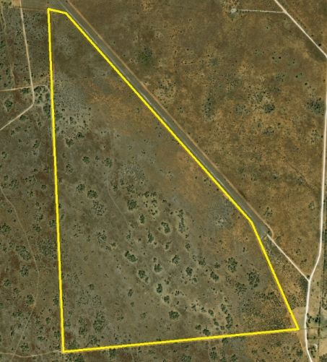
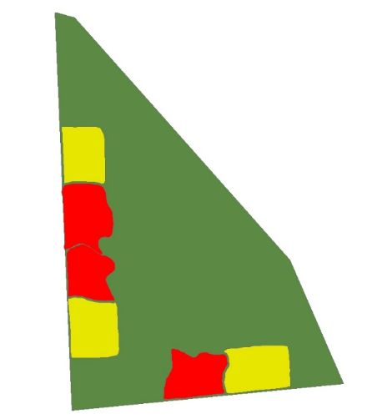
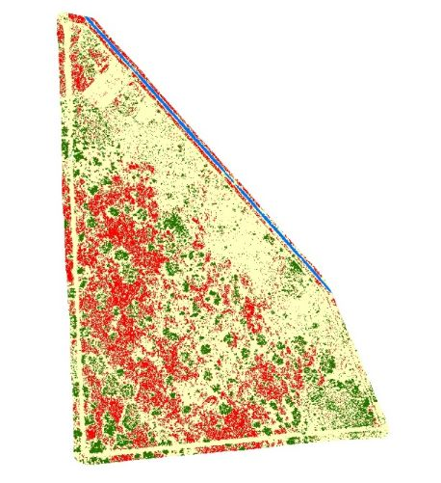
236 acre pasture heavily invaded by Tanglehead
Located on a private ranch in Jim Hogg county, Texas

Slide 36
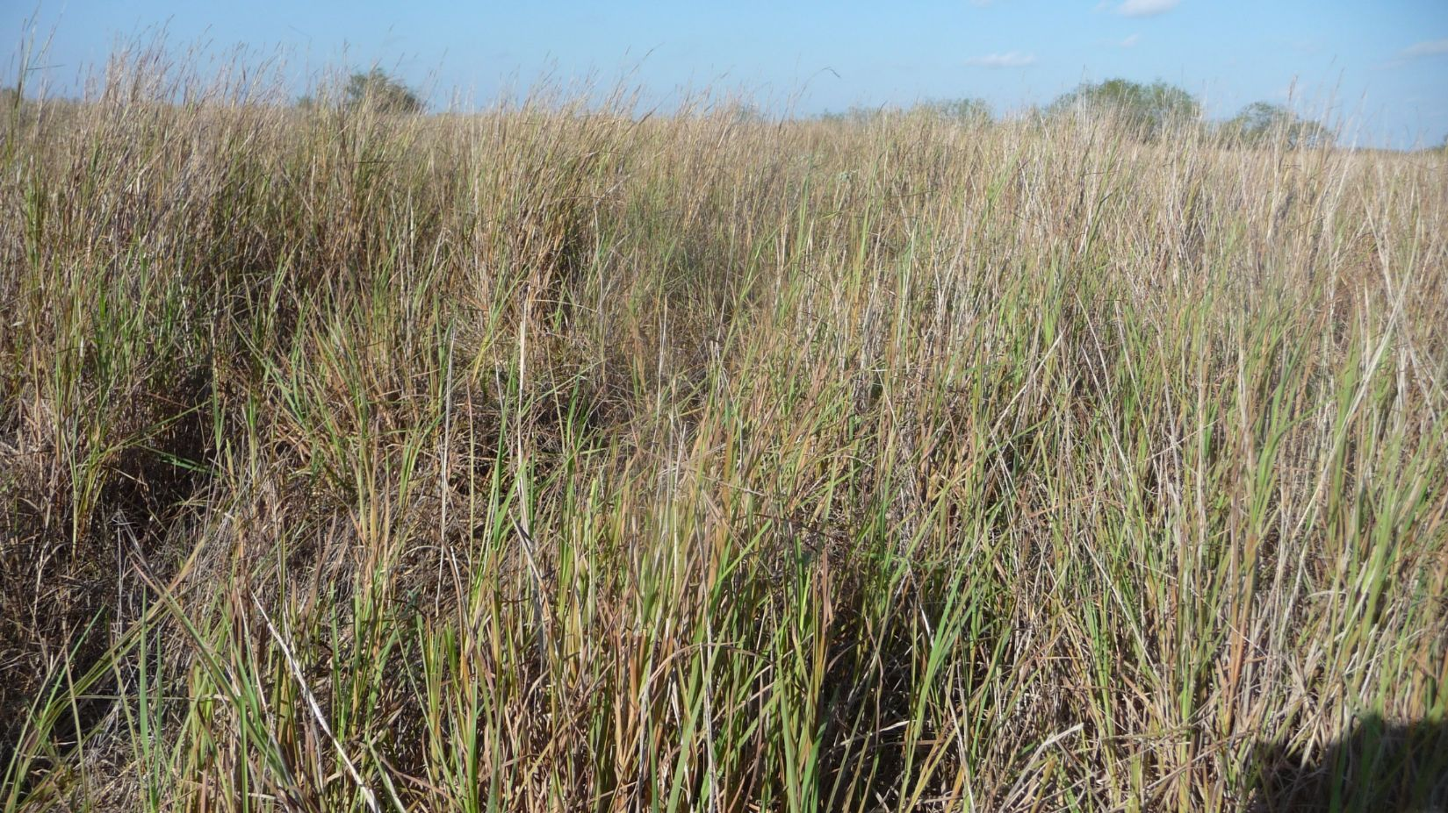

Slide 37
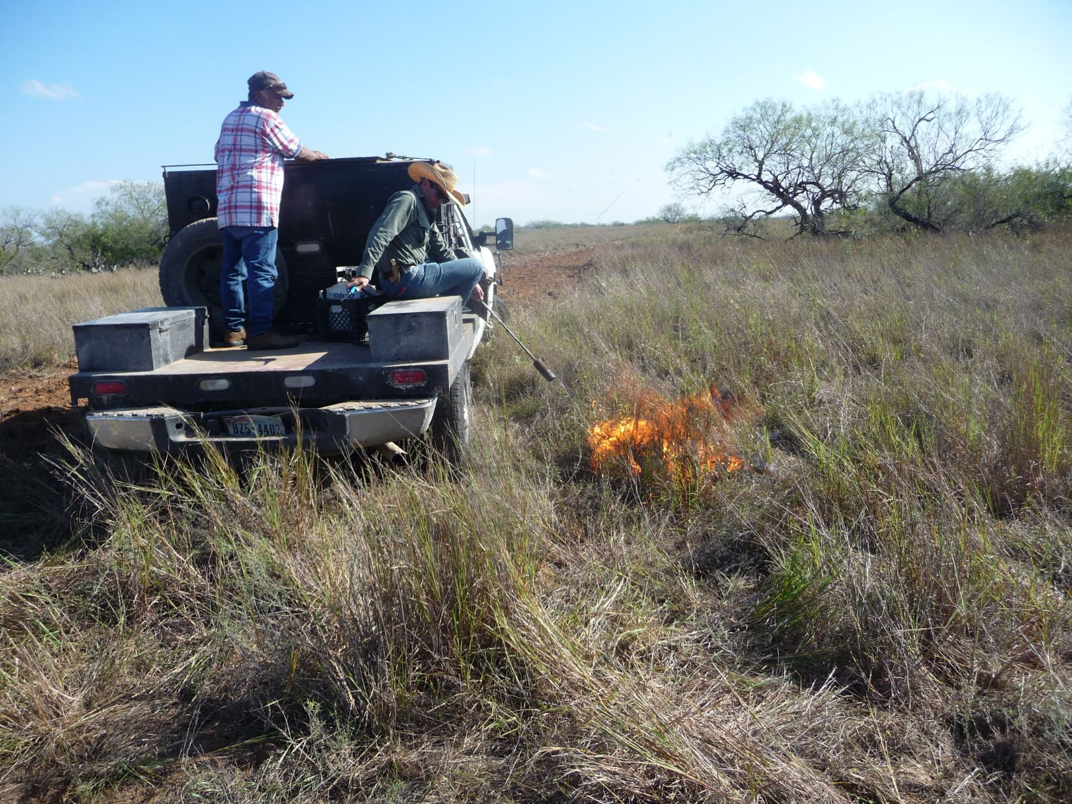

Slide 38
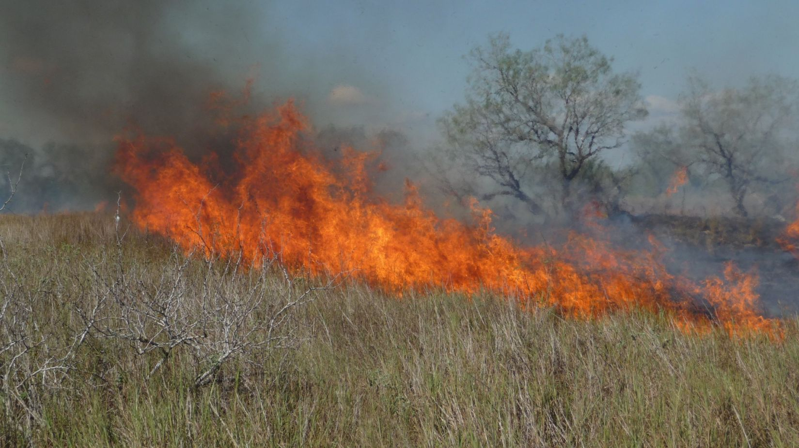

Slide 39
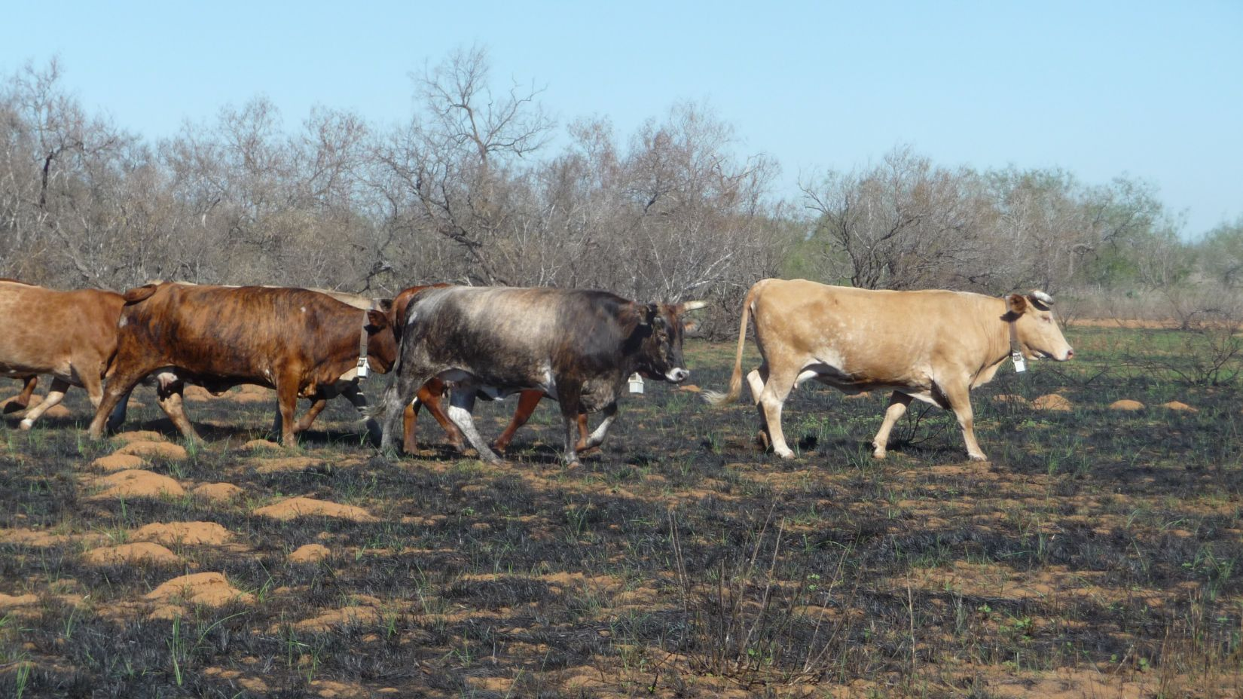

Slide 40


Slide 41


Slide 42


Slide 43


Slide 44


Slide 45


Slide 46

Plant community
Plant species richness
Before burning: 2.52 species/.25m²
After burning: 8.33 species/.25m²
Without burning: 4.83 species/.25m²
330% increase in species richness
Burned plots had 172% increase in species richness compared to control

Slide 47


Forage Utilization
Percent Utilization
Burned plots: 51.7% utilized
Unburned plots: 5.85% utilized
Cattle are using 8 times more of the available forage in the burned areas compared to the control areas

Slide 48



Slide 49




USE OF BURNED AREAS BY CATTLE
Mean percentage of forage-time GPS points
Prior to burning: 1.84% in treatment areas
6 months after burning: 8.38% in treatment areas
4.5 times more likely to use Tanglehead after burning

Slide 50

Weaning rate: 90% Weaning weight: 550 lb

Slide 51



Slide 52


Northern Bobwhite Response To Cattle Grazing In South Texas

Slide 53

Practices for bobwhite
habitat improvement

Slide 54

Practices for bobwhite habitat improvement

Slide 55

Cattle Grazing

Slide 56


Grazing
No grazing

Slide 57

Grazing Treatment
Control

Slide 58

Cattle grazing may be used to improve bobwhite habitat
Keeping a stubble height about 1 ft with the cattle grazing increased litter, and bareground, while maintaining proper nesting cover with the right cover to facilitate the movements of bobwhites.

Slide 59

Bobwhite density in 2020 was 0.563 bobwhites/ha in the area with no grazing and 0.911 bobwhite/ha in the grazing treatment.
In 2021 quail density increased in the area with no cattle grazing and in the grazed area with 1.630 y 2.040 bobwhites/ha, respectively.

Slide 60

Bobwhite density increased from 2020 to 2021:
No grazing 200 %
Grazing 124 %
The increase in the quail density in the area with no grazing may have been an indirect effect of the grazing since both areas were separated with 2.65 miles of fence.

Slide 61
Conclusions
Guineagrass, buffelgrass, old world bluestems are exotic grasses that may be managed with prescribed fire and cattle grazing to create proper habitat for game birds.
Cattle graing and prescribed fire and increase plant species richness and proper vegetation structure for bobwhites.
Tanglehead and four flower trichloris are native species that can form monocultures to tick for bobwhites, cattle grazing and prescribed fire can be used to make it usable for bobwhites.
Old world bluestems may be managed to improve vegetation structure and plant diversity using the same tools to improve habitat for bobwhites.

Slide 62

Grazing Management
and Prescribed Fire
We do not inherit the land from our ancestors, we borrow it from our kids…
Chief Seattle

