Slide 1
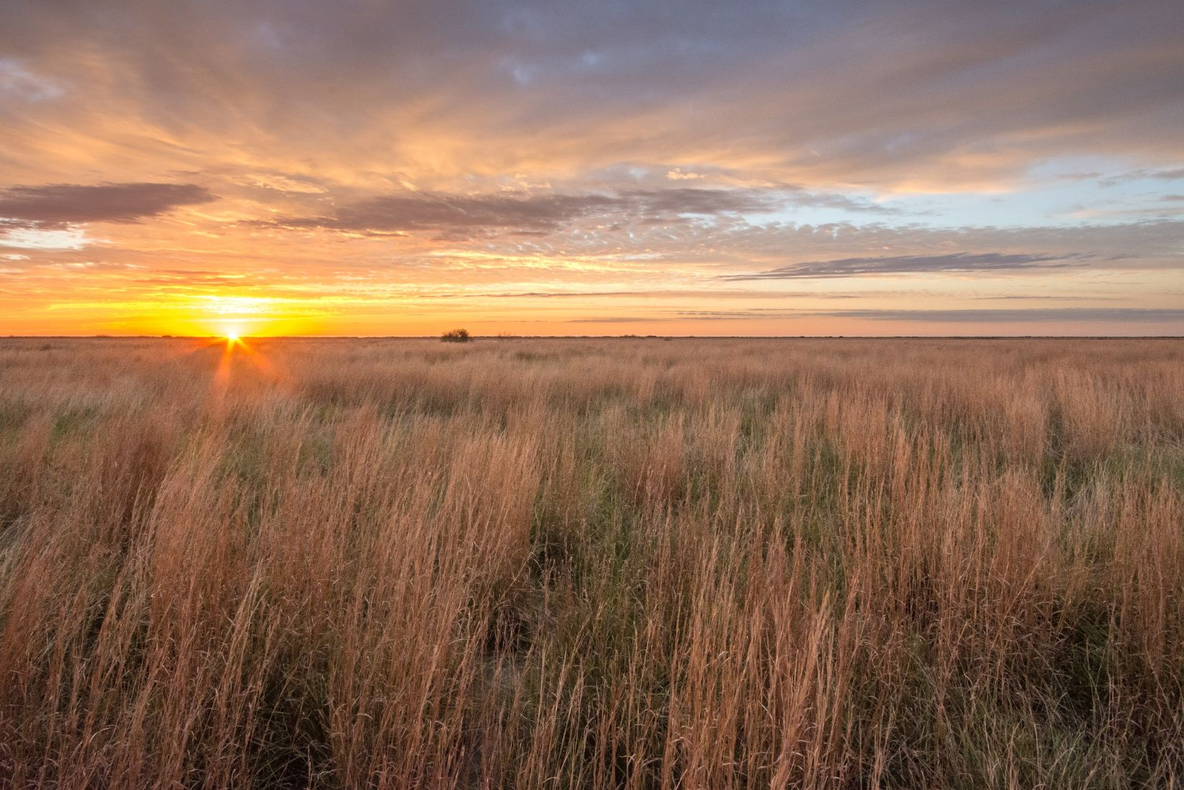

Old World Bluestem Treatment Mad Island Marsh Preserve
Steven Goertz

Slide 2
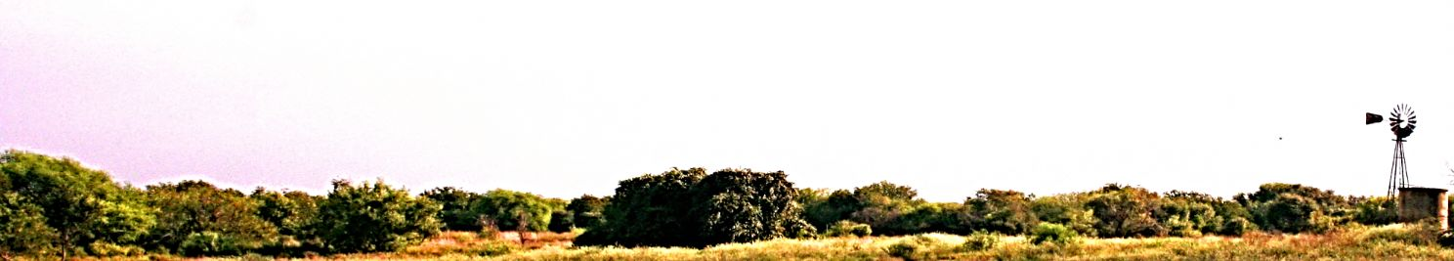
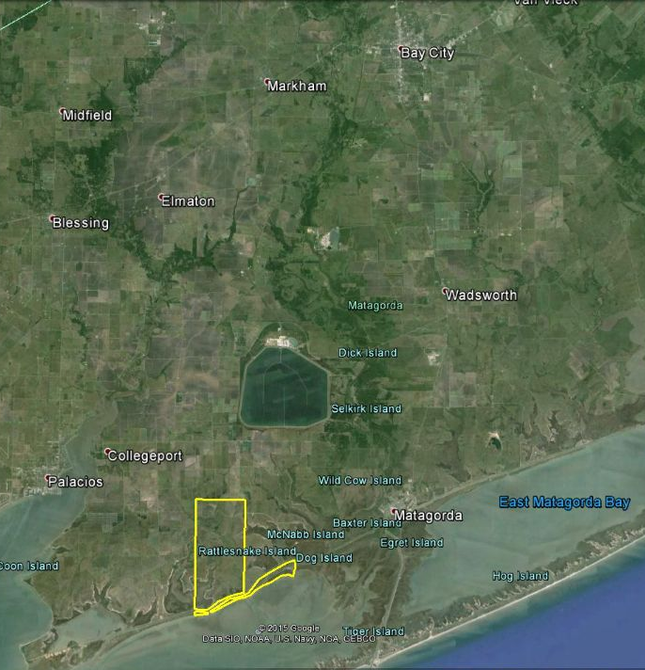
Mad Island Marsh Preserve
Southwest corner of Matagorda County
7,063 ac
5,200 ac coastal prairie

Slide 3
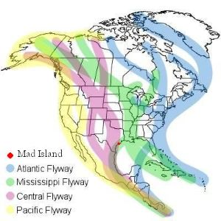
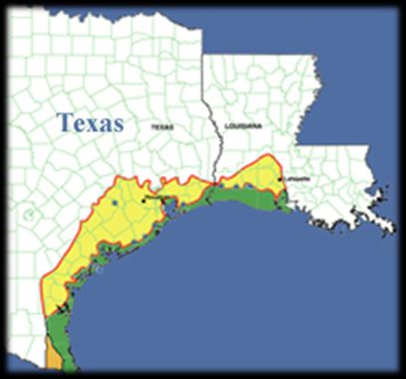
Mad Island Marsh Preserve
Gulf Coast Prairies and Marshes Ecoregion
Notes:
WHERE & WHY
Once a 9 million acre expanse across TX and LA, the gulf coast prairies and marshes ecoregion
On right, yellow is coastal prairie, and green is coastal wetland (USGS map)
Confluence of Central and Mississippi Flyway for migratory waterfowl
Estimated 65,000 acres remaining of remnant prairies in TX (1% of original amount by USGS estimates)
The remaining areas are critical habitat to a host of wildlife species that are endemic to this ecoregion.

Slide 4

The Nature Conservancy
Global Mission: To conserve the lands and waters on which all life depends.
Local Mission: To conserve the natural function of the coastal prairies and marsh ecotype.
Notes:
THE WHO, WHY, and some of WHAT
We cover 70 different countries (?)
Meeting conservation goals on a regional, case-per-case basis
Emphasis on CONSERVE….by definition of ecological conservation, this includes disciplines of ..
Protection
Preservation
Management
Restoration of natural environments and the ecological communities that inhabit them
Conservation generally held to include the management of human use of natural resources for current public benefit and sustainable social and economic utilization
This is all to say, we are an organization investing our efforts into a multi-faceted approach involving many components….not just management or preservation, etc…
Within the US, we operate in all 50 states, and within the state of TX, we are strategically located to have a programmatic involvement in conserving critical ecoregions…..including coastal prairies and marshes.
We are one of several projects working on conservation along the gulf coast of Texas.

Slide 5
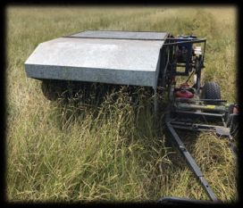
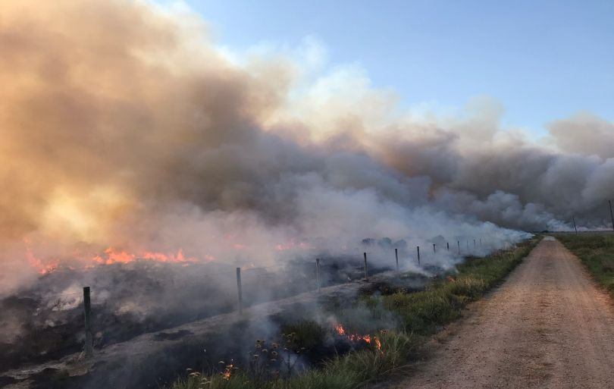
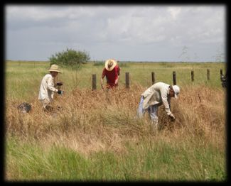
Coastal Prairie Conservation
Prescribed Fire
Invasive Species Treatment
Native Seed Harvest
Notes:
WHAT, WHY, & HOW
Prescribed Fire
Fire is an integral component to prairie conservation, and its’ necessity has been well documented throughout history
We operate under National Wildland Coordinating Group (NWCG) operating procedure; an interagency standard that is shared with all federal operations
Requires qualification standards, ensuring experience and equipment are capable of handling various complexities of fire scenarios
This region of the US has been documented to have one of the most frequently re-occurring fire regimes in North America
Our current goals are to get caught up and maintain a <3yr fire return interval; allowing a wide gamut of native species to flourish throughout each year under various conditions.
This increased fire-return interval also is intended to aid in focusing our efforts to control invasive woody and herbaceous species
Invasive Species Treatment
Grasses: Old World bluestem species complex (Angelton, King Ranch, Kleberg bluestems), guineagrass, Paraguayan windmillgrass, bahiagrass, bermudagrass
Deep-rooted sedge
Chinese tallow
McCartney rose
Other native, but aggressive species: Phragmites, soft-stem bullrush, cattails, eastern baccharis, mesquite, huisache
Treatments’ timing and focus are dependent on growth phase, past fire use (consumption), resources, and overall threat to site

Slide 6
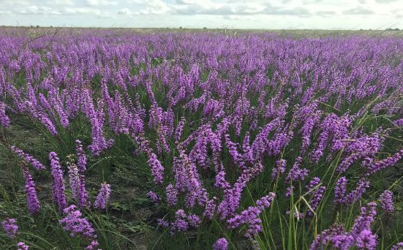
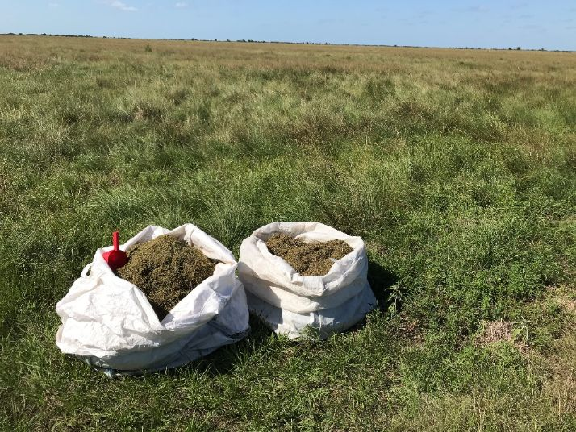
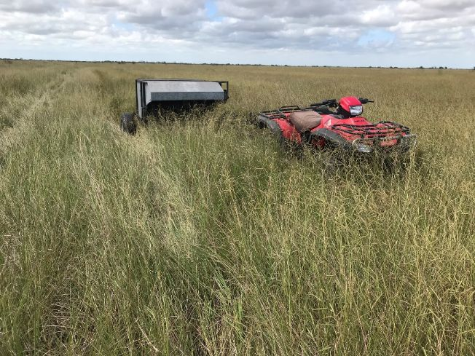
Coastal Prairie Conservation
Native Seed Planting
Coastal Prairie Restoration
Notes:
WHAT, WHY & HOW
Native Seed Harvest
Timing and abundance is driven by focus species, as well as previous year’s weather conditions and land use (especially RX fire).
Intent is to utilize native seed source from portions of the preserve to aid/induce further development of other portions of the preserve; later, provide for other projects
Promoting higher successional development and establishment of species possibly more resilient to non-native invasives.
Coastal Prairie Restoration
Conservation efforts are invested to promote/establish native biodiversity represented in coastal prairies and marshes
Restoration goals are to efficiently promote native biodiversity and function, with the highest cost: benefit ratio
Vegetation Monitoring
With these conservation investments, we need to have data over time to evaluate success/failure
150 transects throughout preserve in a stratified random displacement
130 plots distributed randomly along major roadways, investigating old world bluestem establishment and spread
540 total transects assessed throughout the month of June….10,800 individual data points
Annually collected to assess woody encroachment, and plant community composition (2014-2017 data collected, but analysis required)
Small Unmanned Aircraft System (sUAS) imagery used to assess restoration planting projects

Slide 7
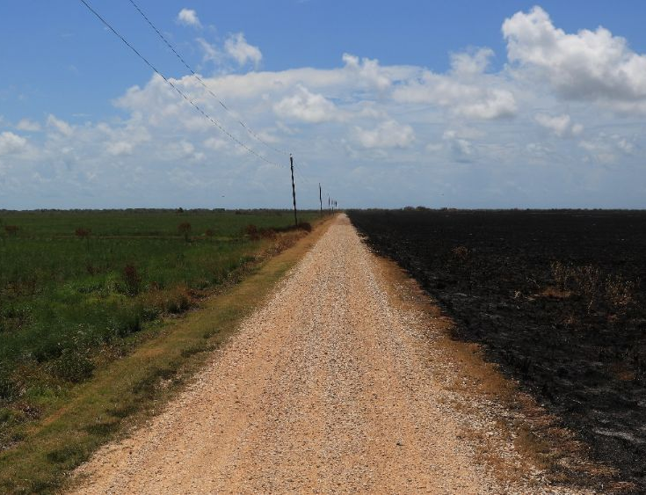
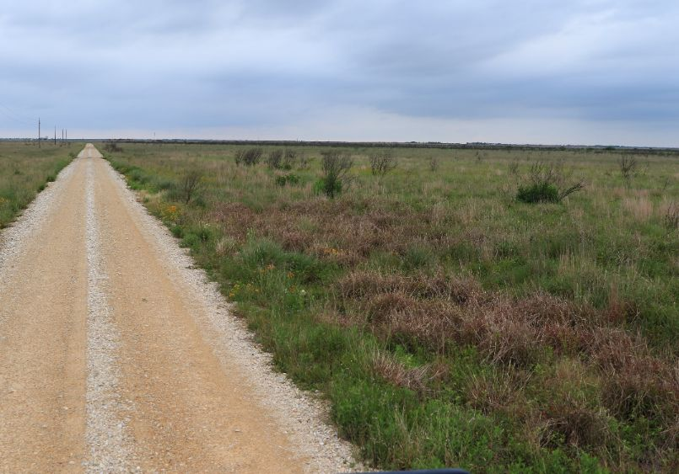
Old World Bluestem Treatment
Modified Boom Sprayer on Roadways
Roadside Spot Spraying (IPT)

Slide 8
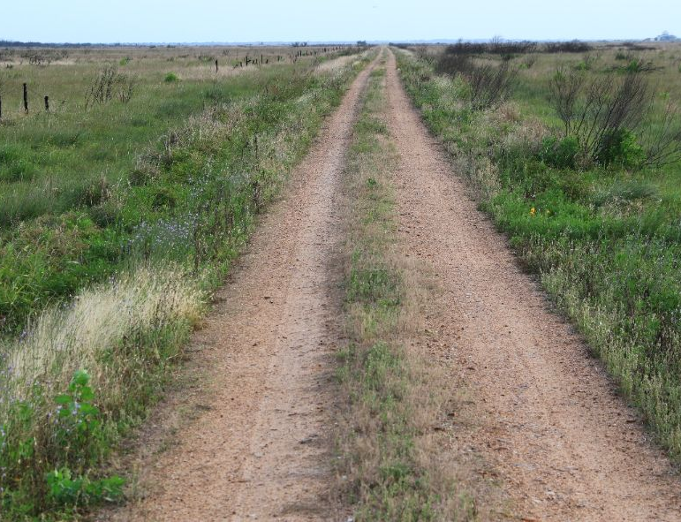
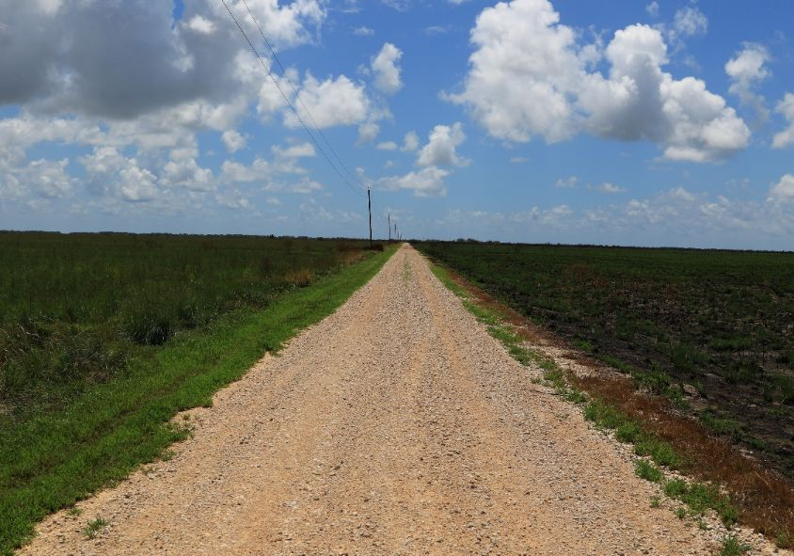
Roadway Spraying
Modified Boom Sprayer

Slide 9
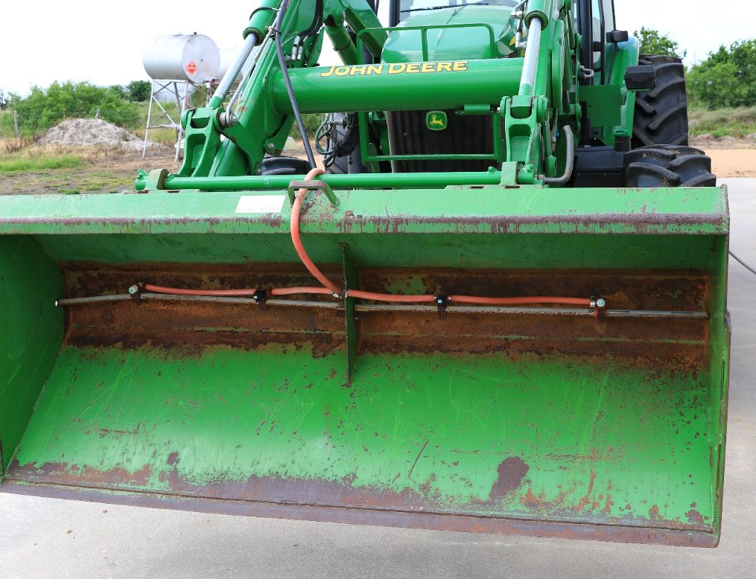
Roadway Spraying
Modified Boom Sprayer

Slide 10
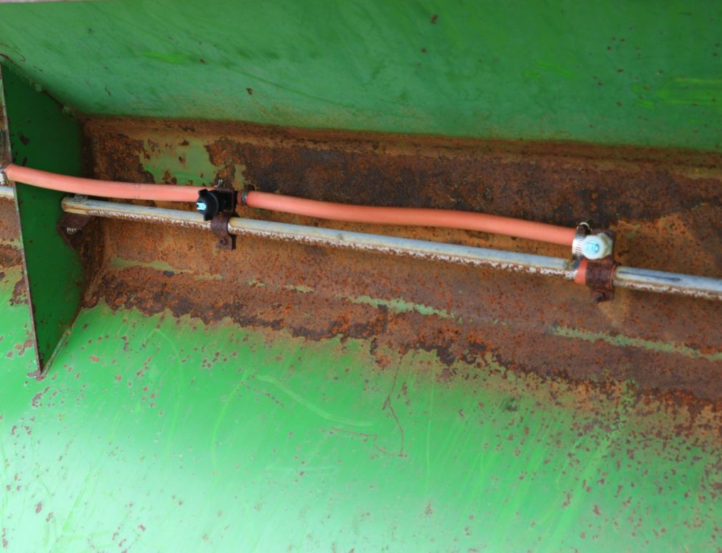
Roadway Spraying
Modified Boom Sprayer
Notes:
4 – 80 degree green tips.
Roughly 10 GPA at 5mph and 50 psi
2.5-3.5% solution of glyphosate
Occasionally add imazypyr at <1% solution to prolong effects without getting any adverse effects of soil mobility

Slide 11
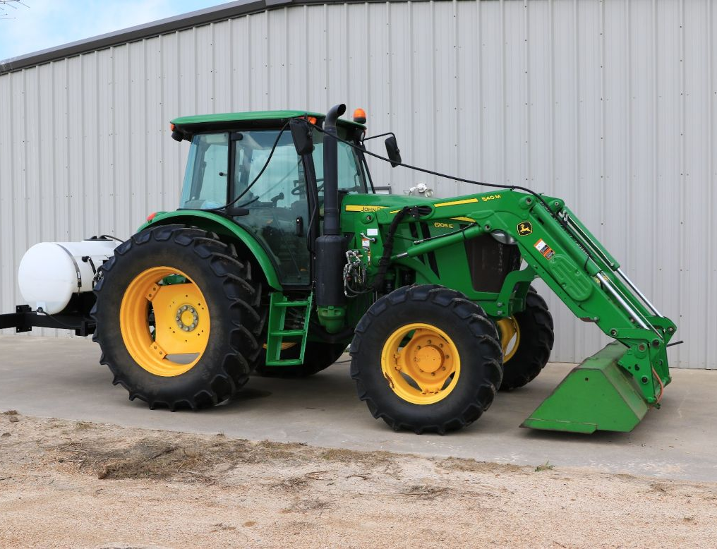
Roadway Spraying
Modified Boom Sprayer

Slide 12
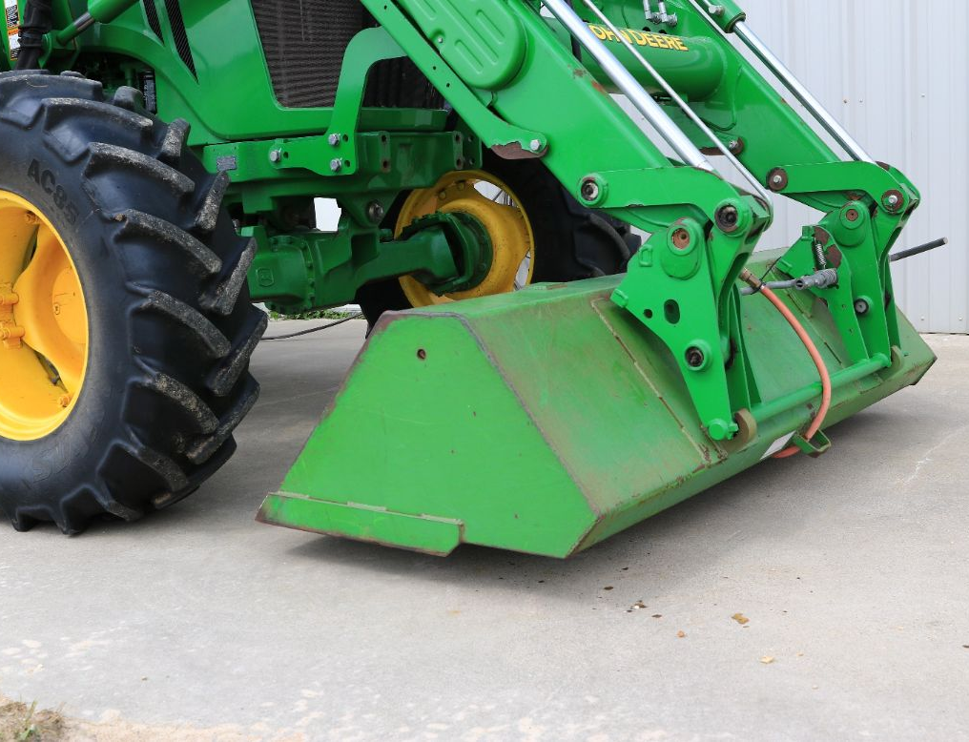
Roadway Spraying
Modified Boom Sprayer

Slide 13
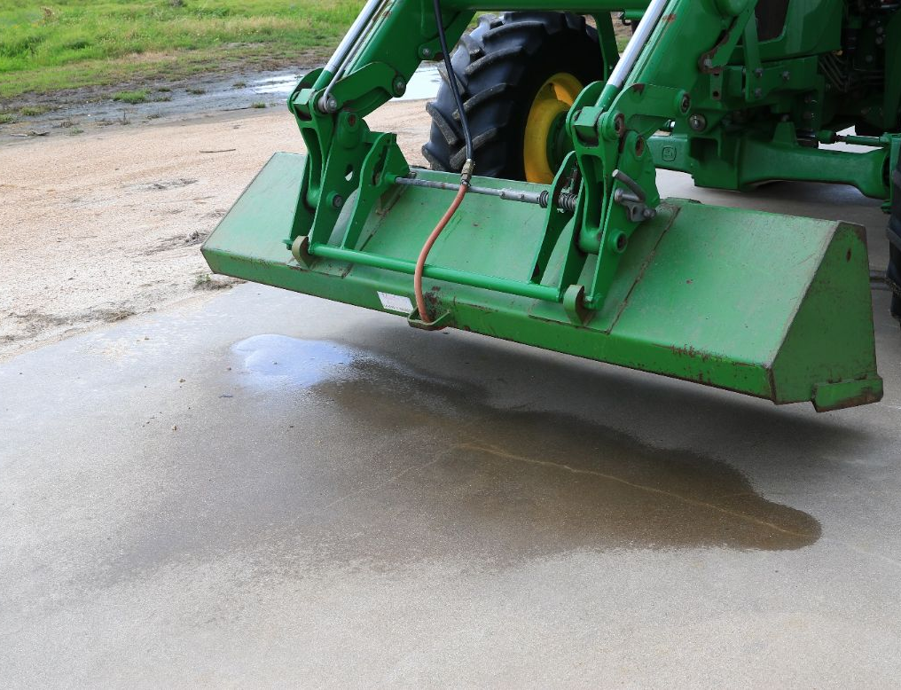
Roadway Spraying
Modified Boom Sprayer

Slide 14
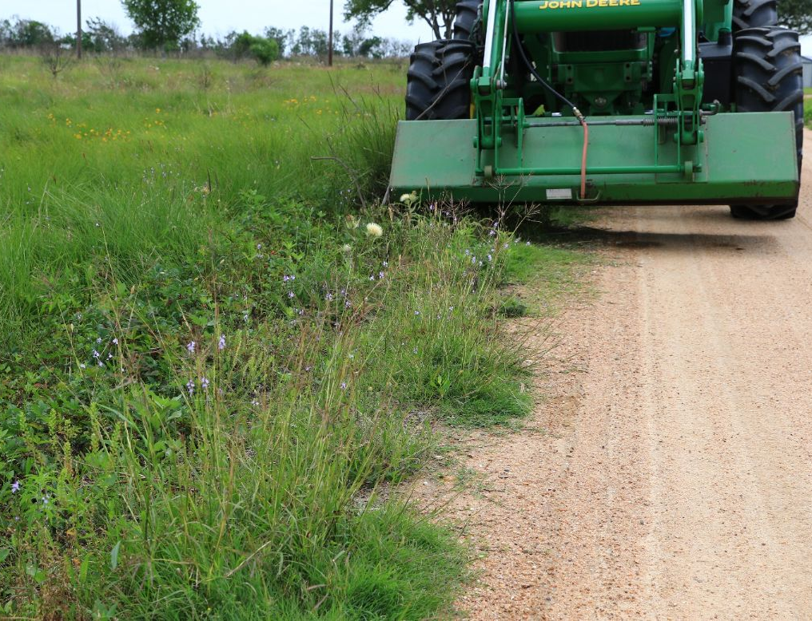
Roadway Spraying
Modified Boom Sprayer
Notes:
Normal operation at 6-8” AGL based on vegetation density

Slide 15
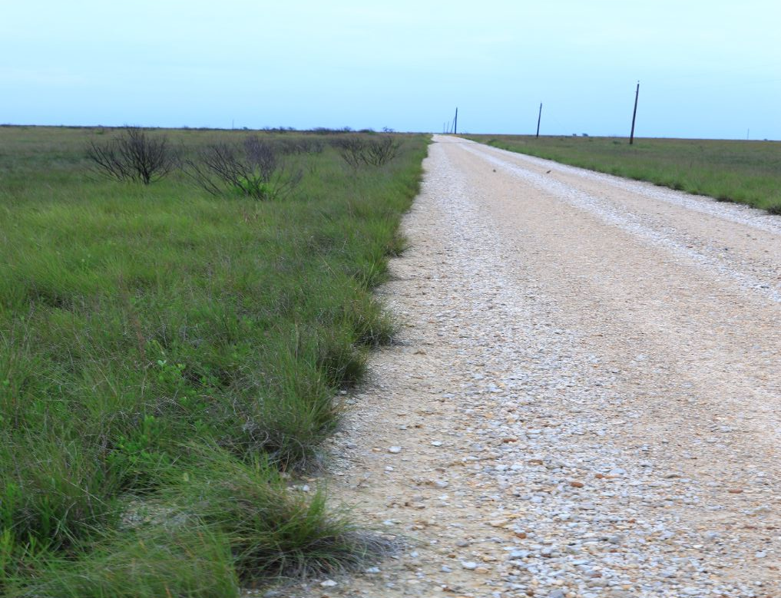
Roadway Spraying
Modified Boom Sprayer

Slide 16
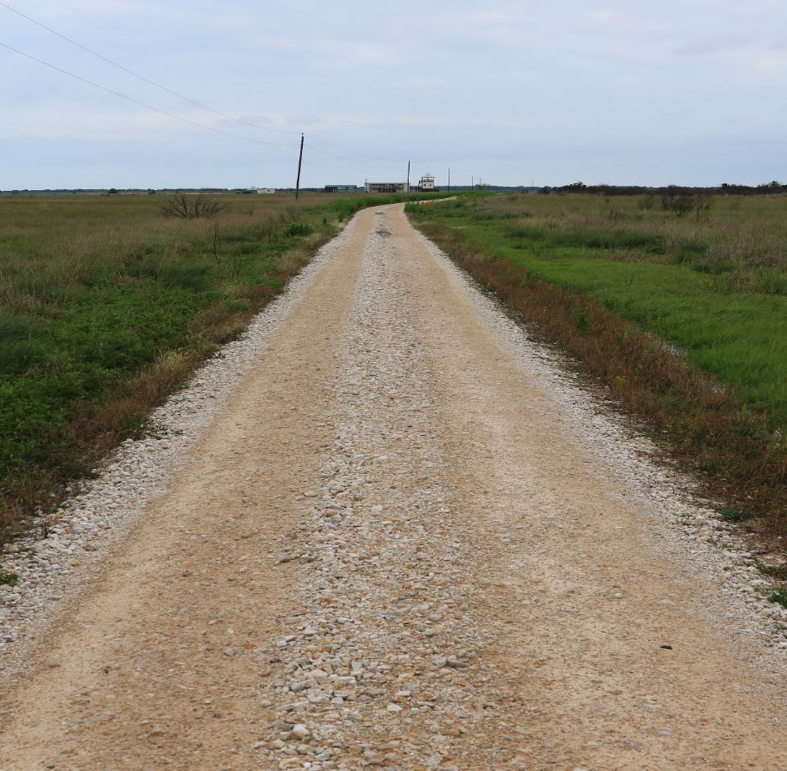
Roadway Spraying

Slide 17
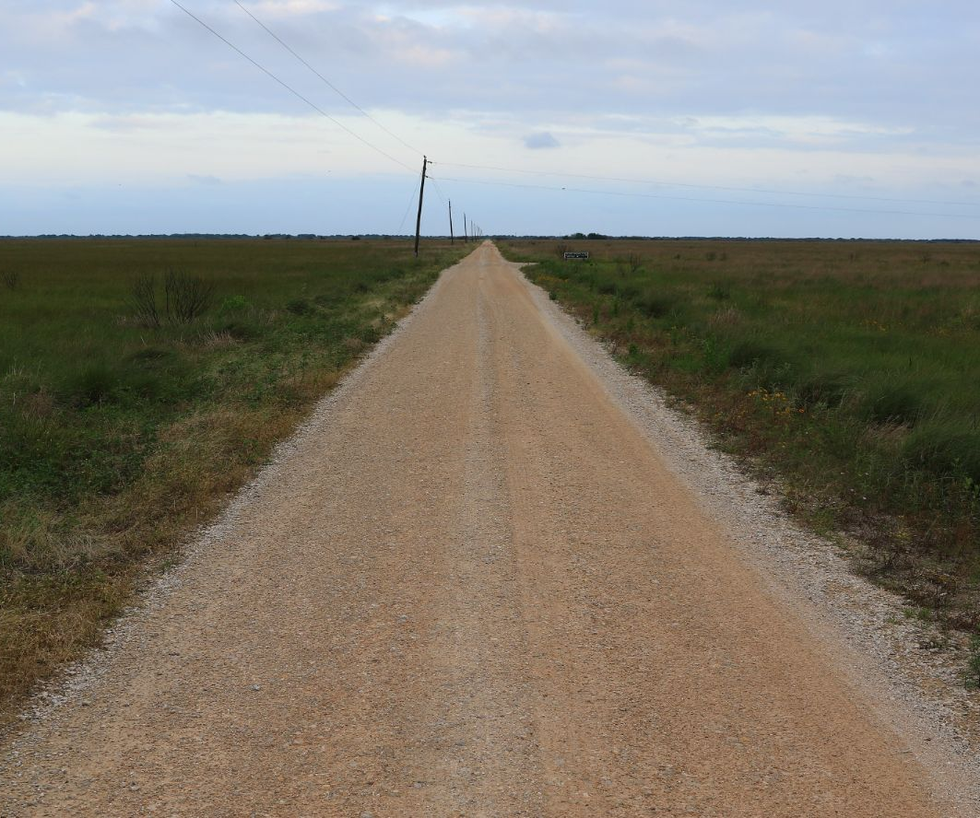
Roadway Spraying

Slide 18
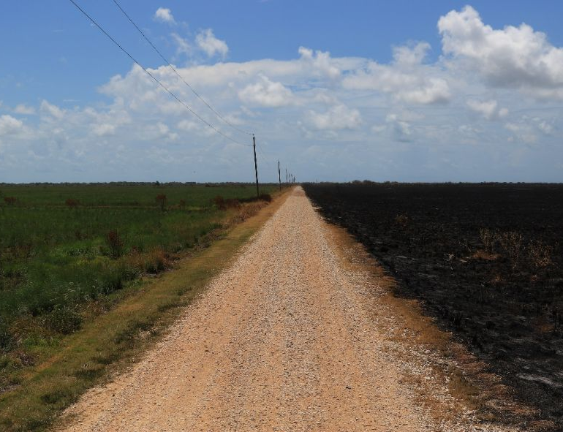
Roadway Spraying
Multiple benefits
Fireline boundaries
Road maintenance
Notes:
When in series with fire and routine road maintenance, this process is easy to administer.
Roughly 20 miles of road covered within a day.

Slide 19
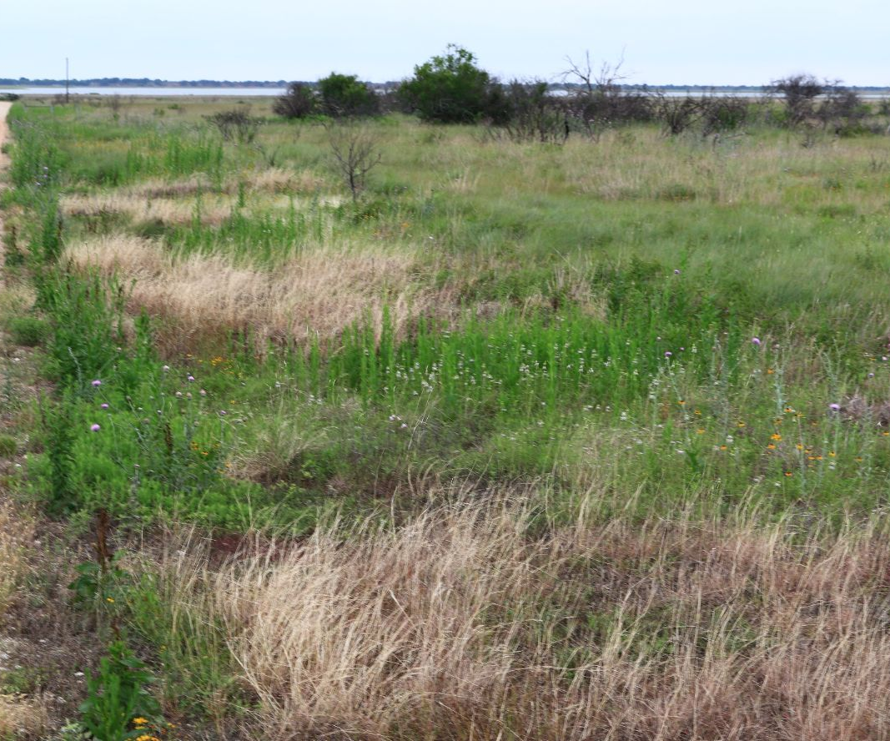
Roadside Spot Spraying
Notes:
Plant identification is critical
Early detection is critical

Slide 20
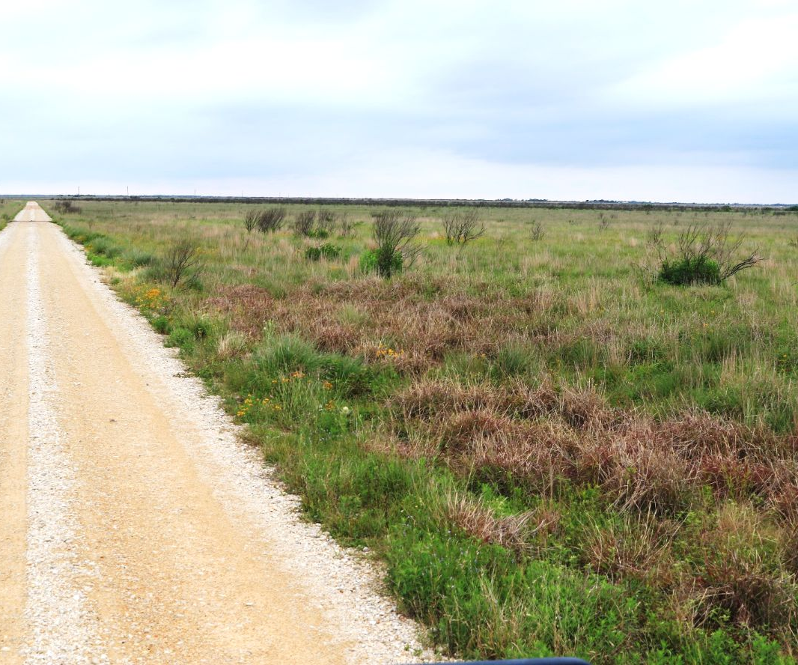
Roadside Spot Spraying

Slide 21
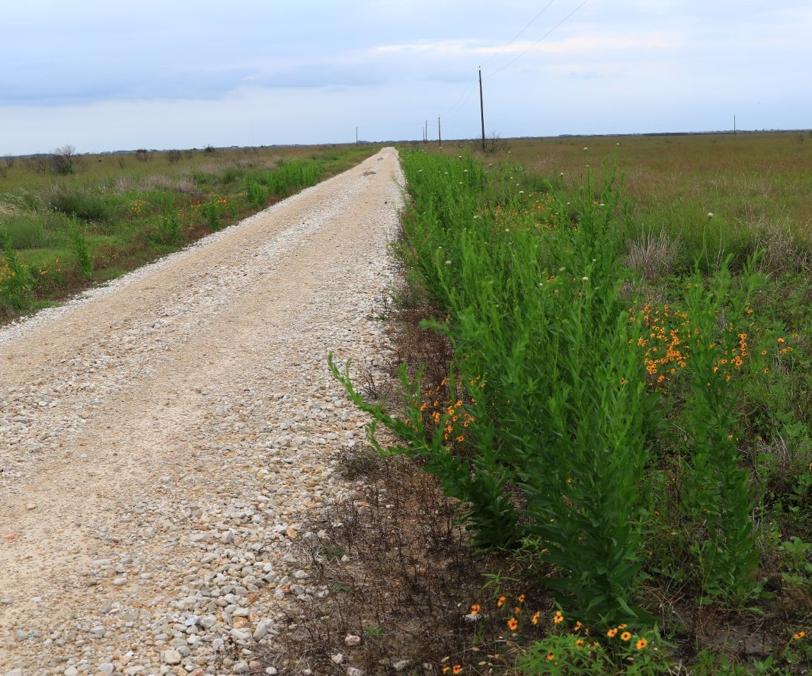
Roadside Spot Spraying

Slide 22
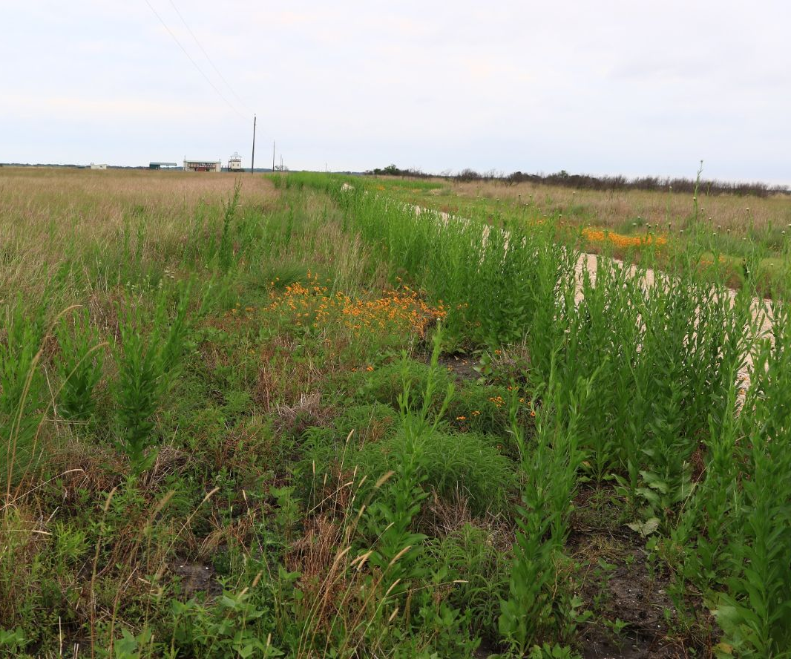
Roadside Spot Spraying

Slide 23
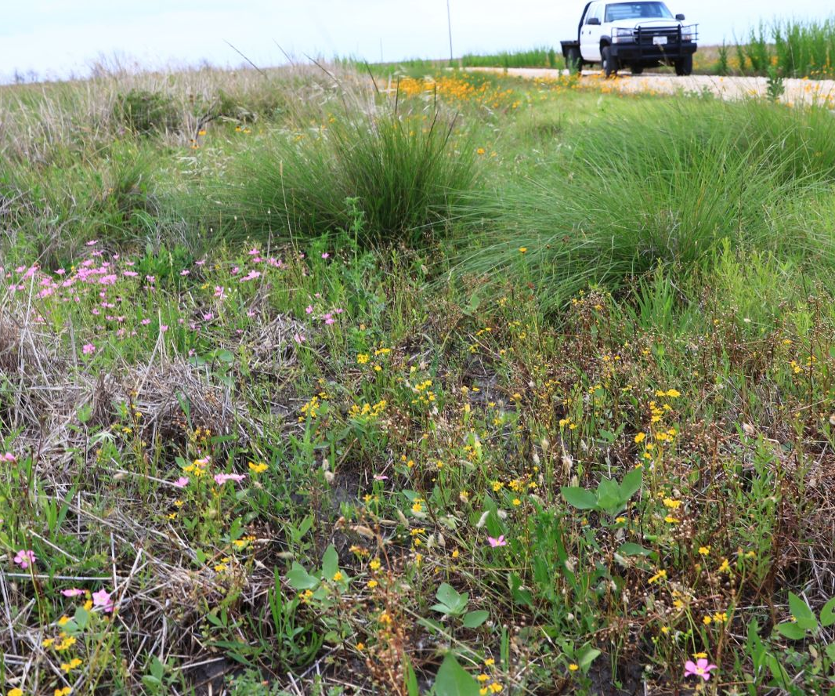
Roadside Spot Spraying

Slide 24
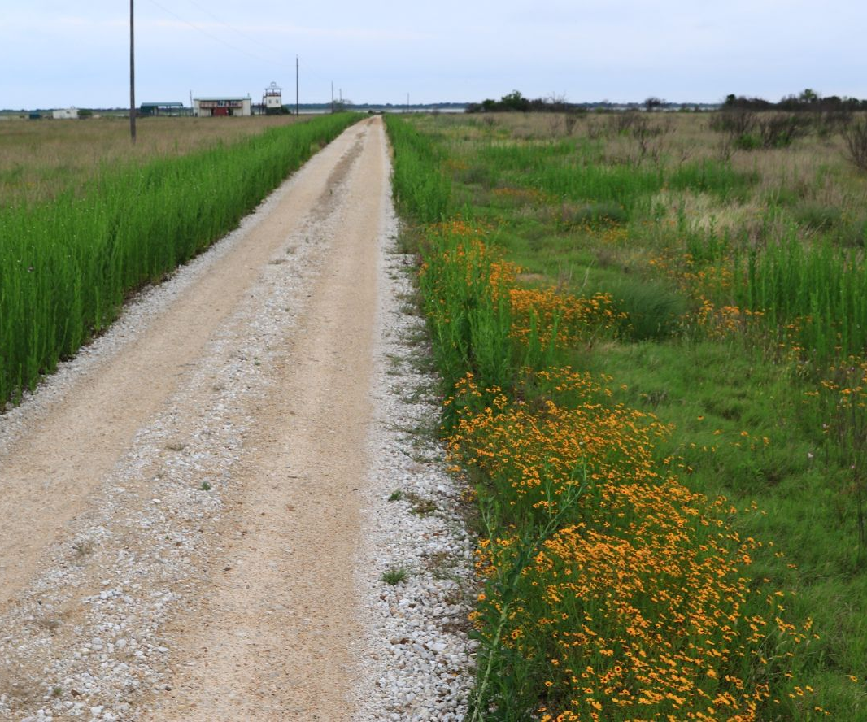
Roadside Spot Spraying

Slide 25
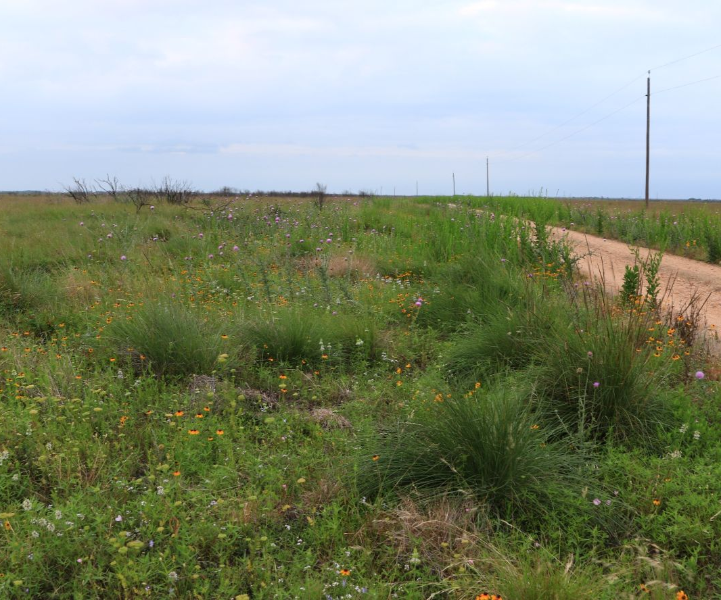
Roadside Spot Spraying

Slide 26
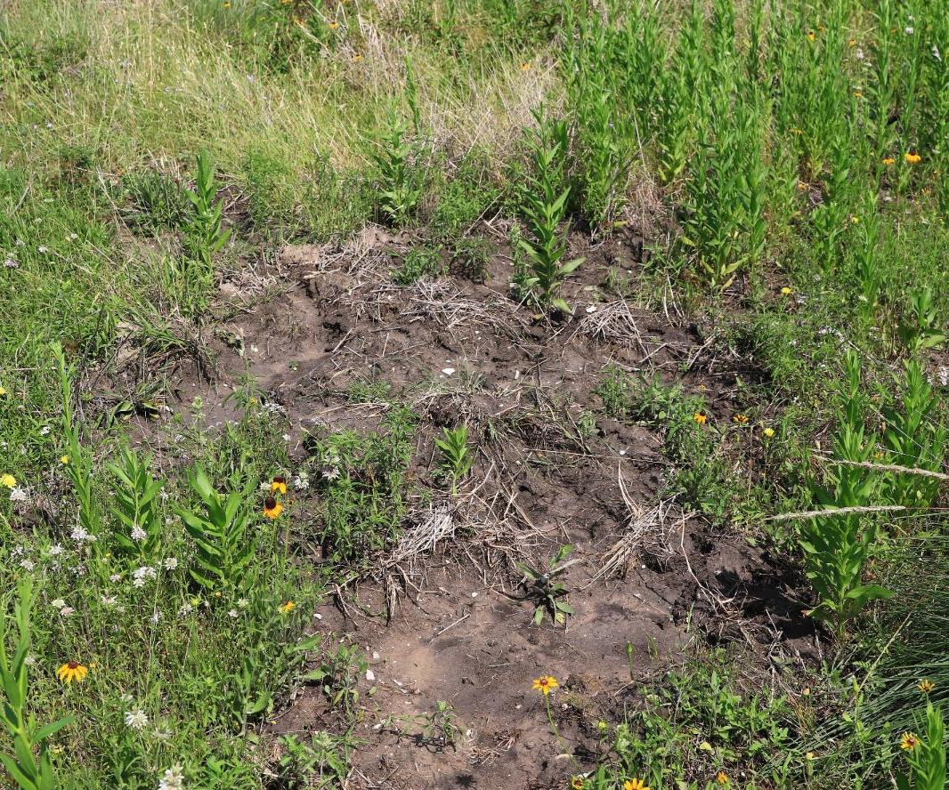
Feral Hog Damage

Slide 27
Patterns of OWB Growth

Slide 28
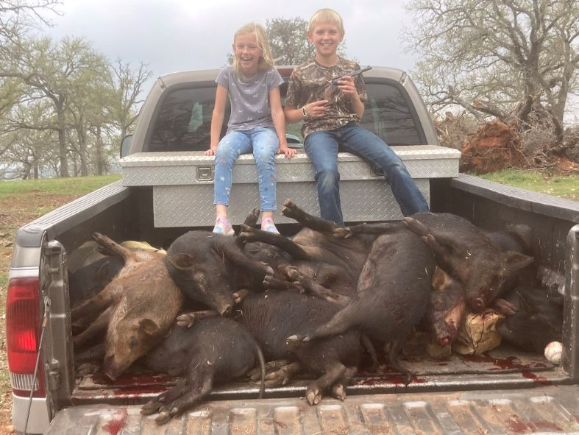
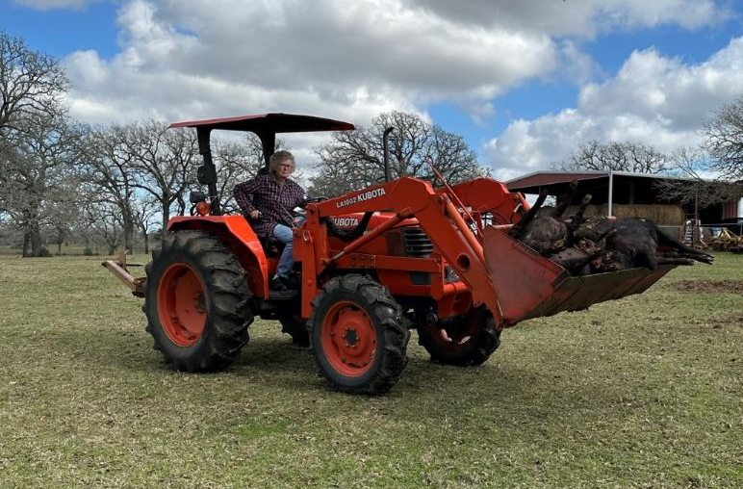
Feral Hog Treatment
Multiple options
Measures match magnitude
Feedback loop

Slide 29
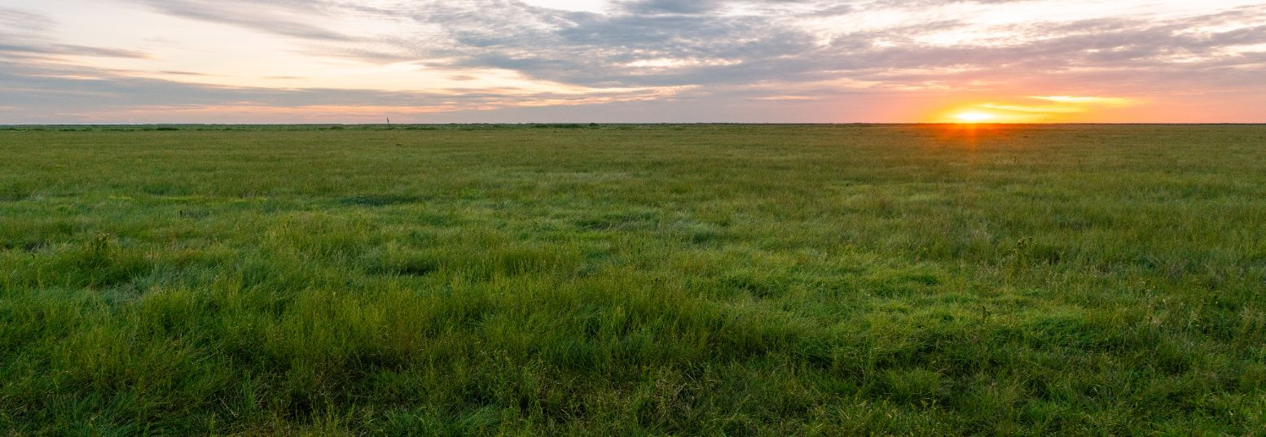
Contacts
Steven Goertz – sgoertz@tnc.org
Mad Island Marsh Preserve
P.O. Box 163 Collegeport, TX 77428

