Slide 1
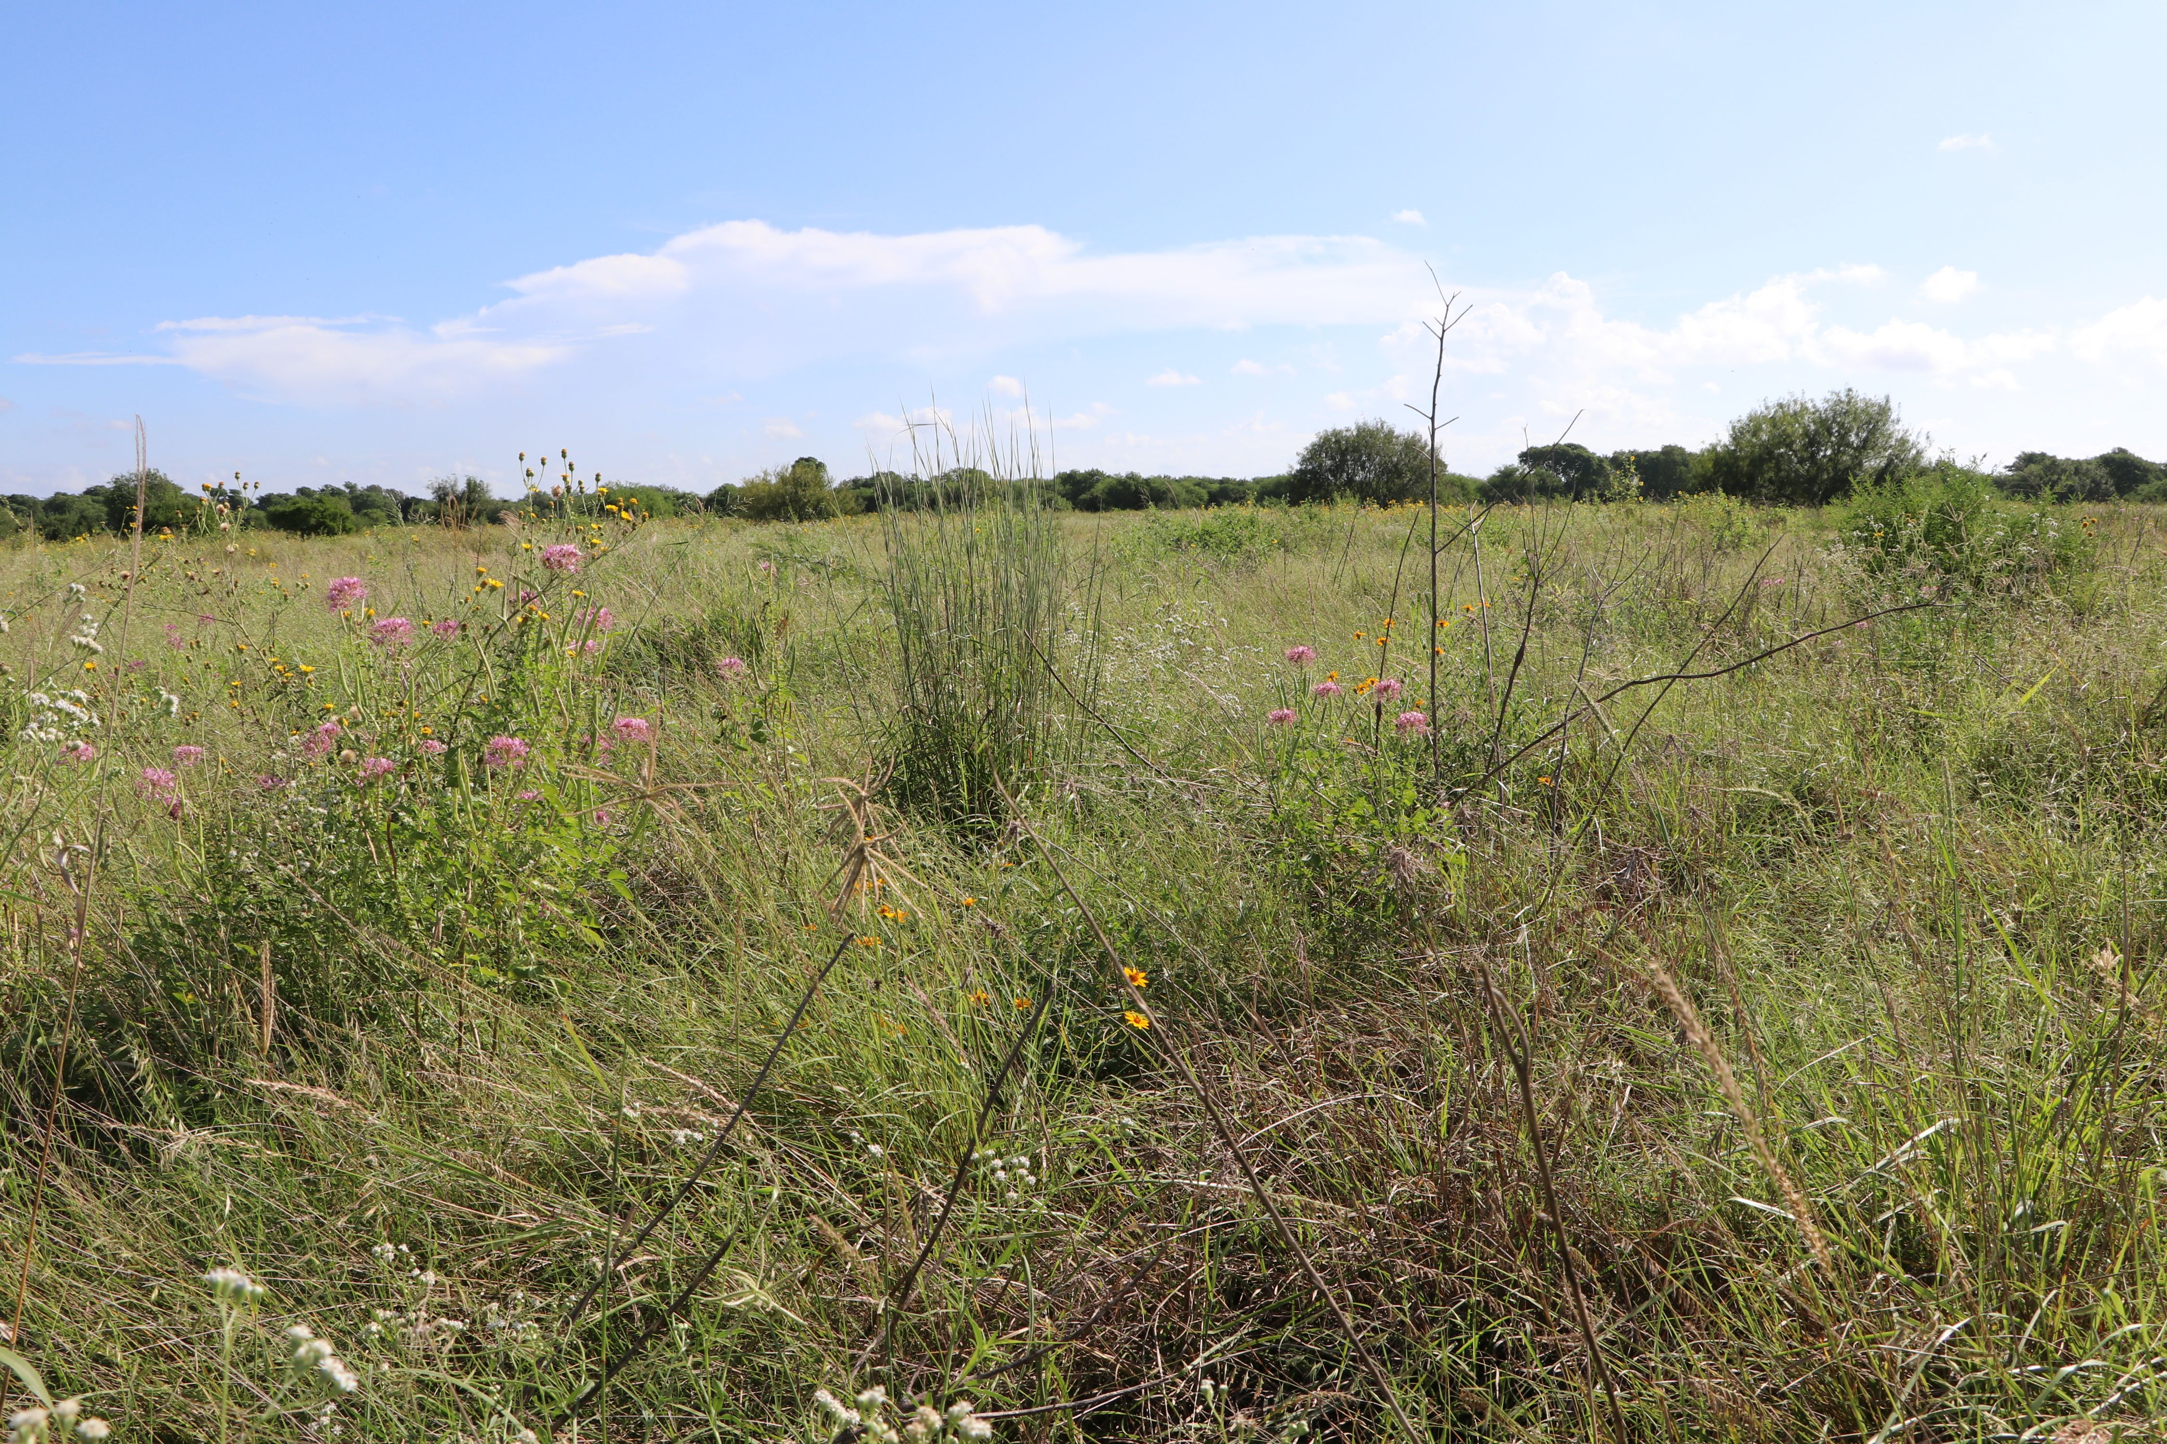
Seeding Your Coastal Prairie: Native Seed Germplasm Development and all things Seed

Slide 2
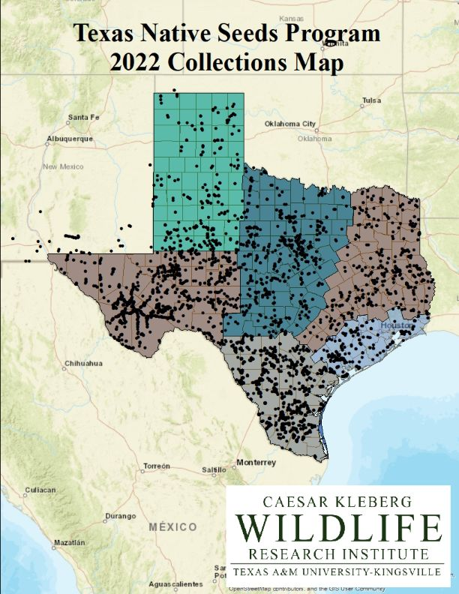
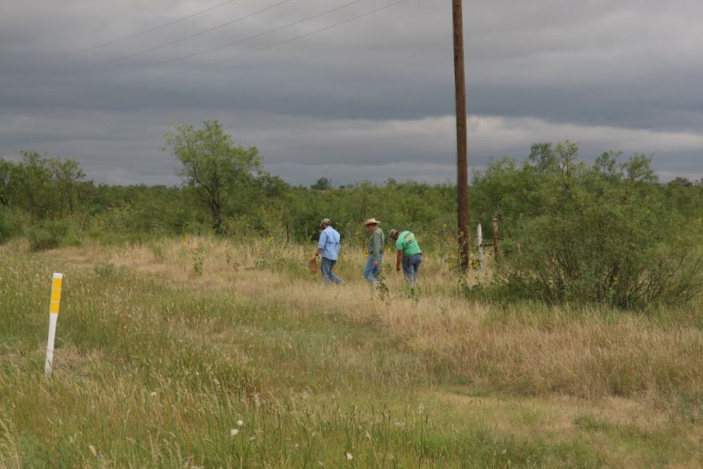

Slide 3
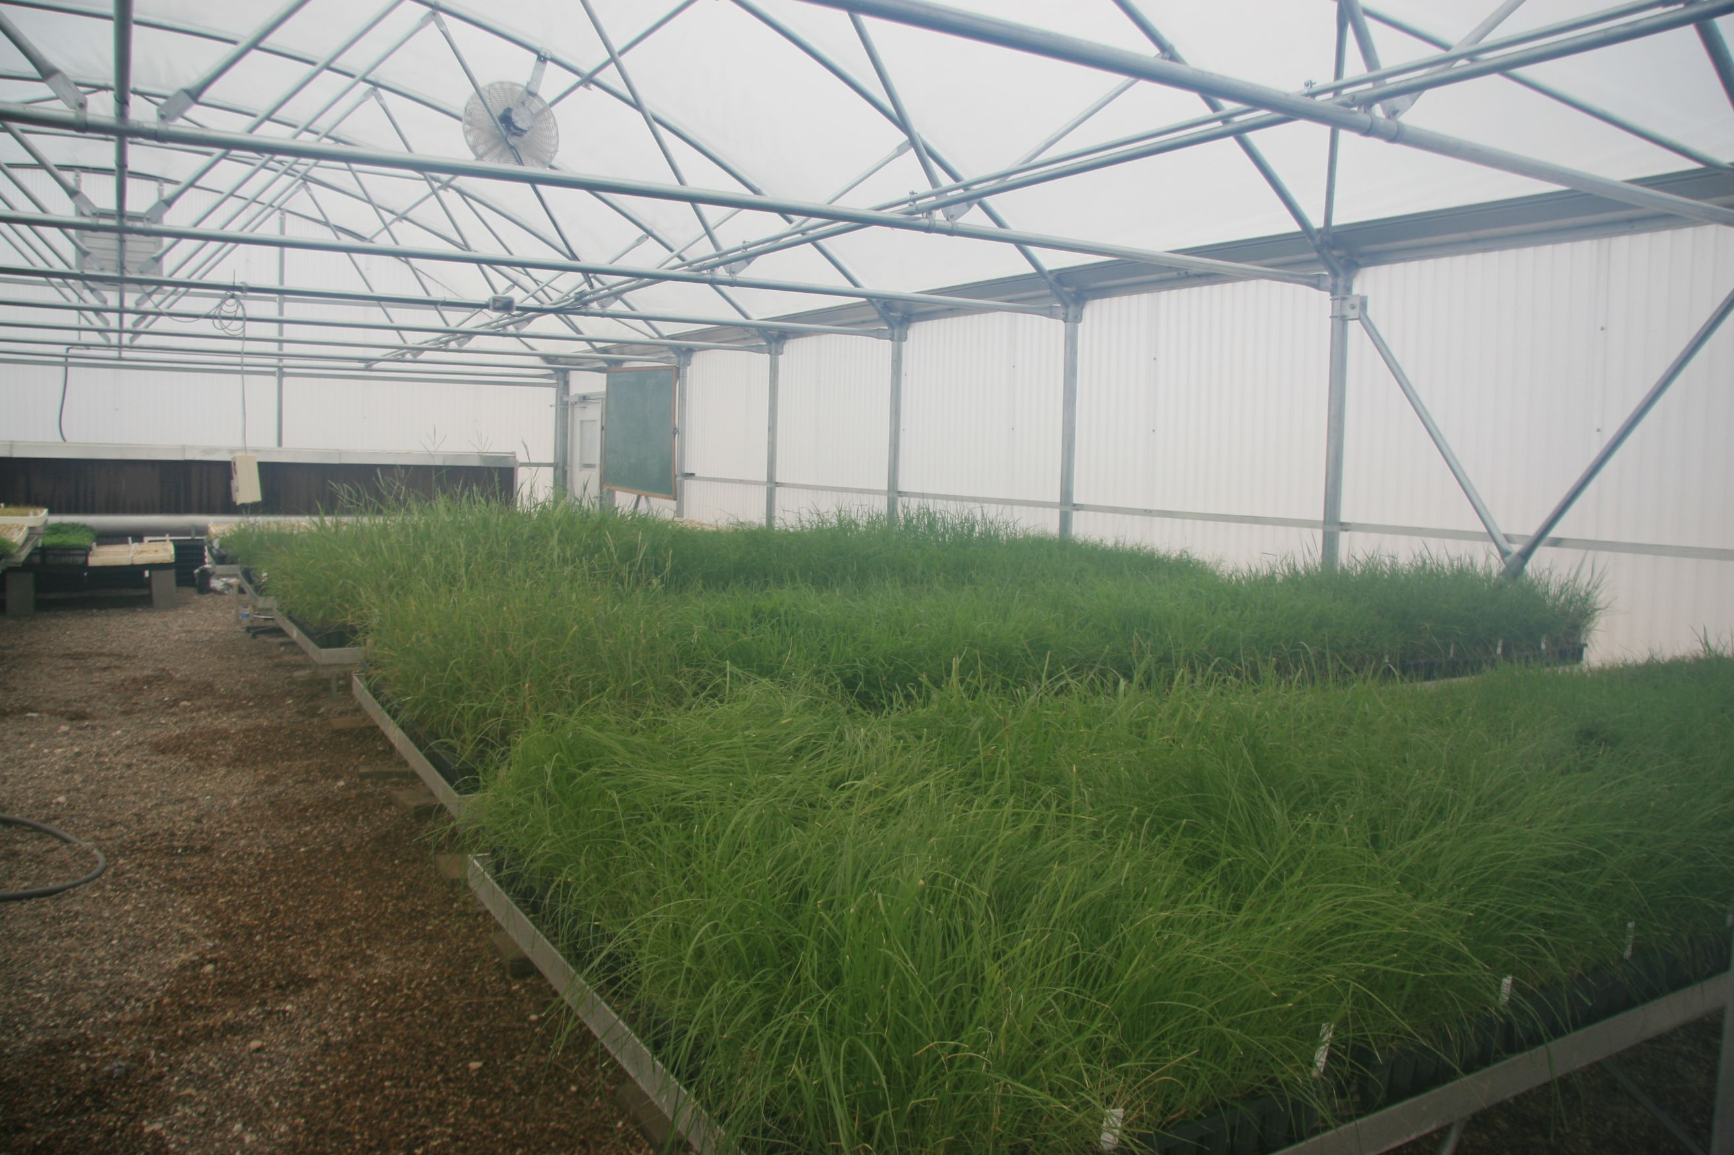

Slide 4
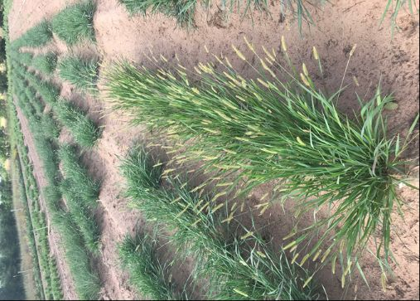
Date Collection
Visual rankings on
  Vigor
  Leaf density
  Seed production
  Forage Production
  Uniformity
Measure
  % survival
  Height
  Canopy cover
  Phenological stage
  Germination

Slide 5
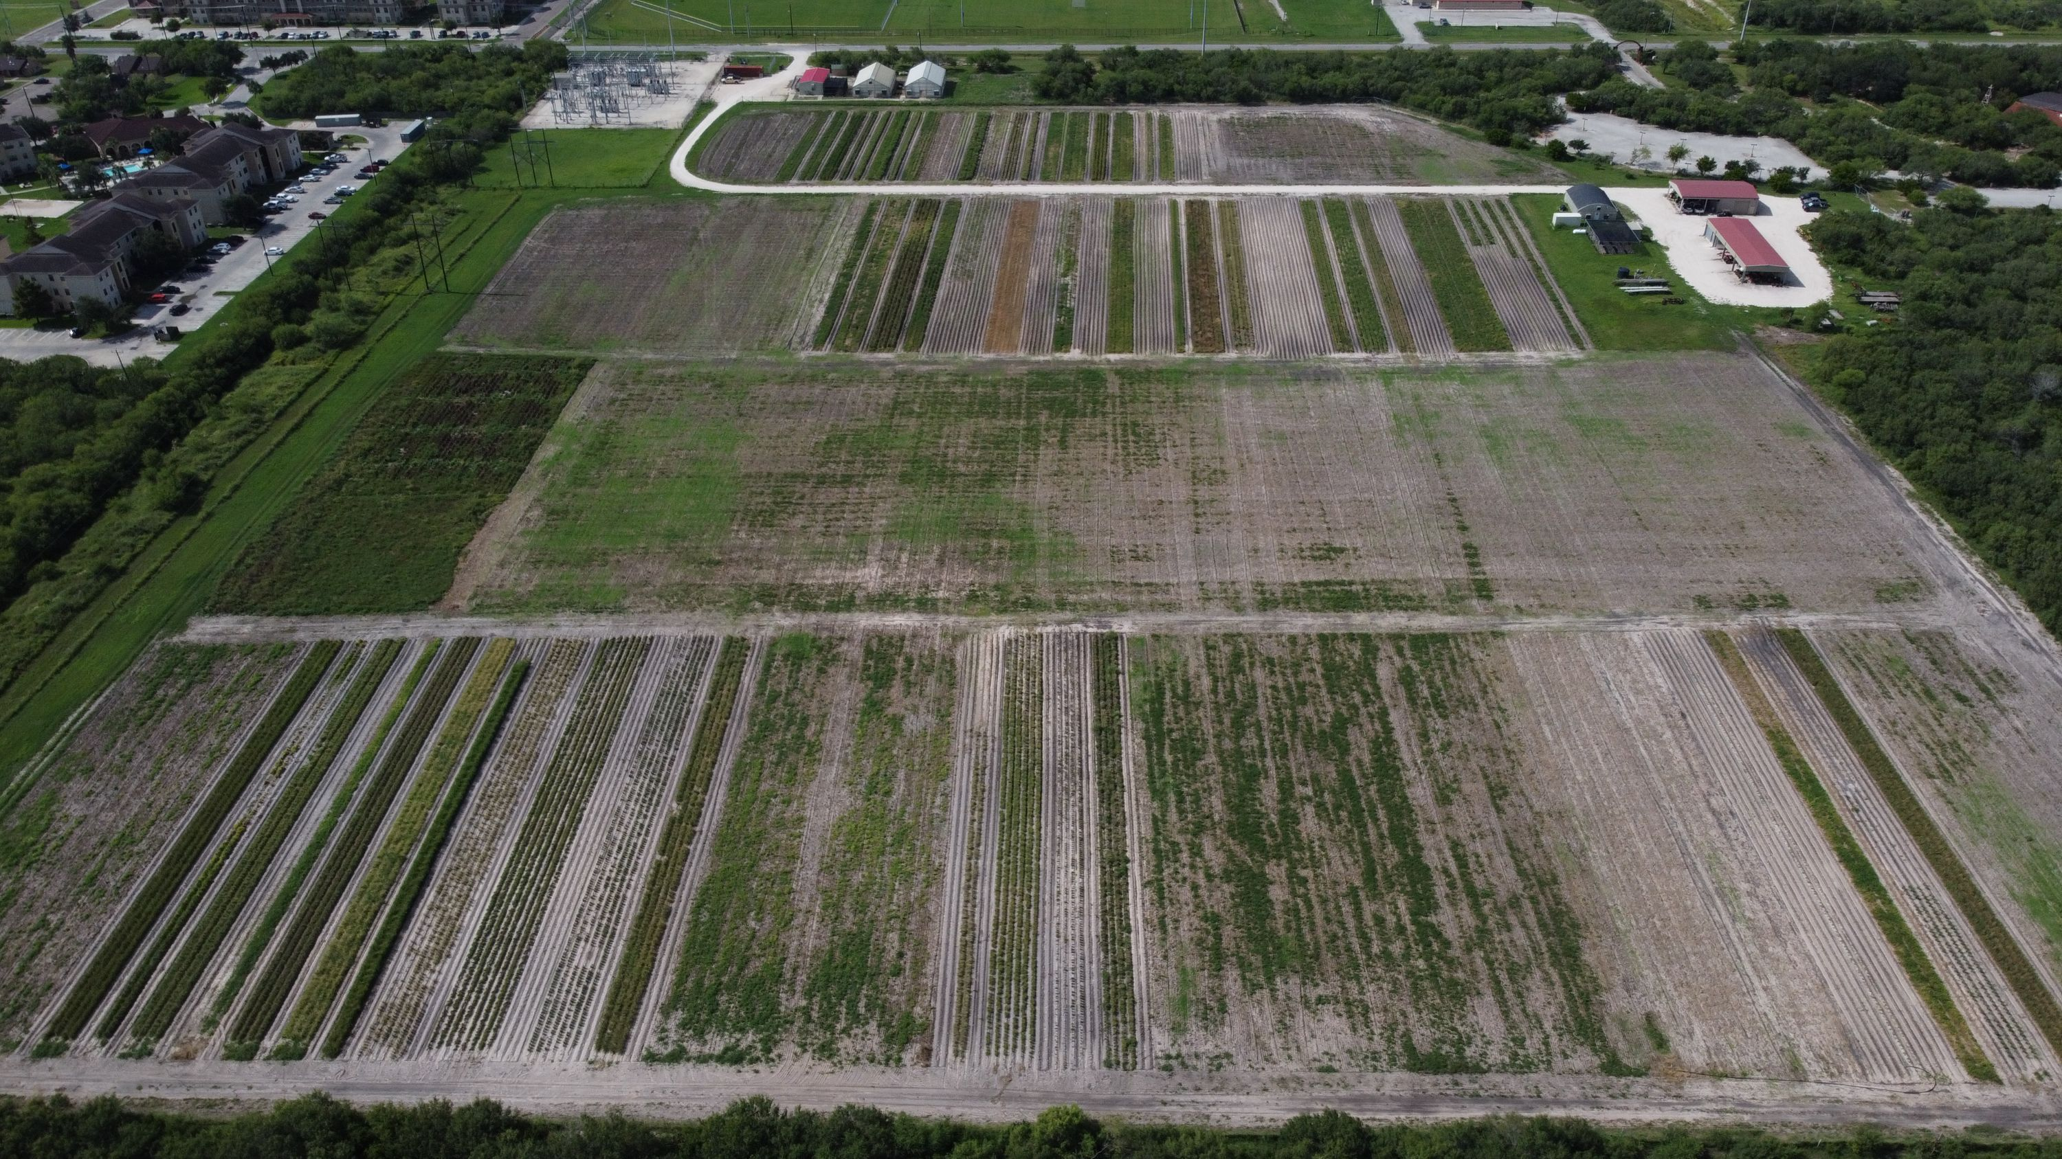

Slide 6
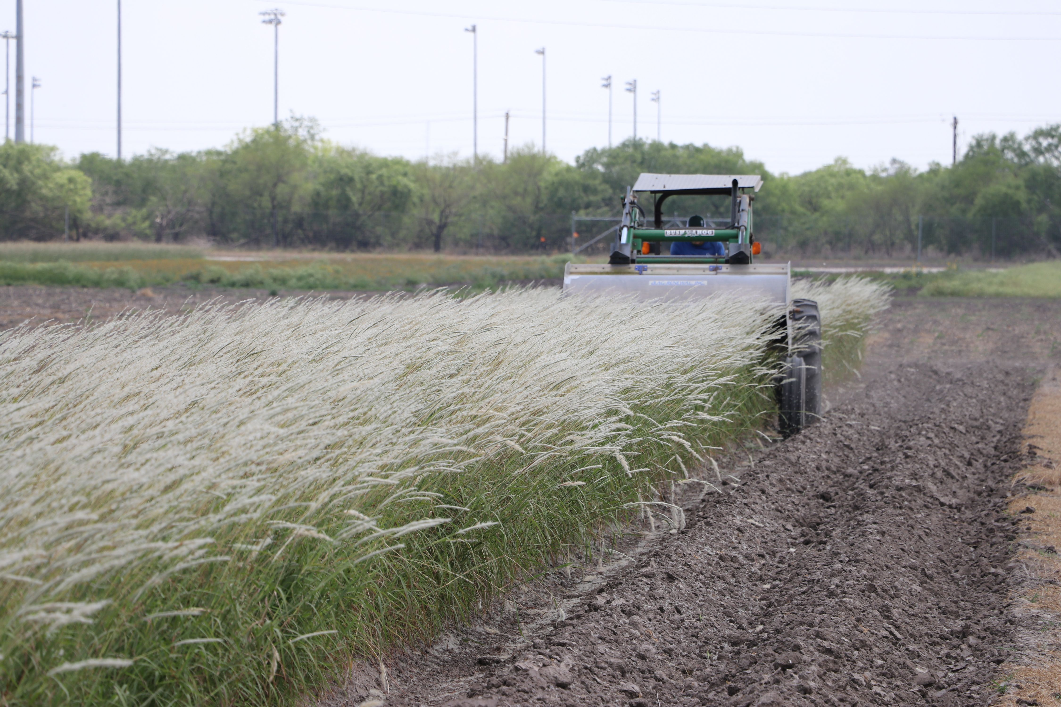

Slide 7
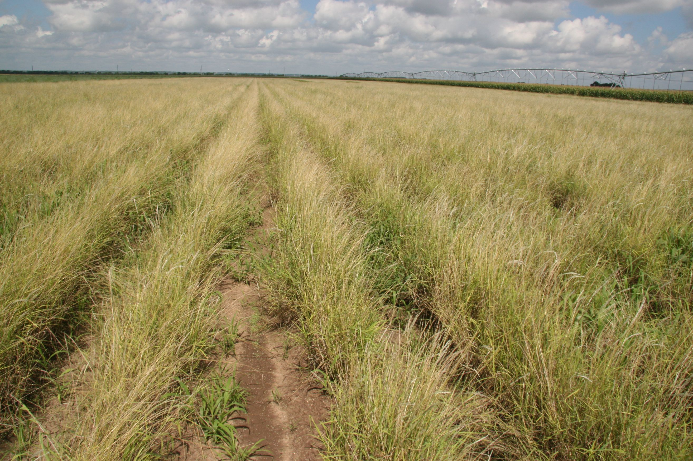

Slide 8
Types of seed sources
Germplasm
Made up of multiple source populations
  Broad areas of adaptation
  Lots of genetic material
Tested for 3-5 years
Commercially produced
Tested for quality and cleanliness
Not all species suitable
Premium product=premium price

Slide 9
Types of seed sources
Cultivar
Single source could be individual plant
  Repeatable genetics
  Can have limited area of adaptation
  Super plants
Tested for 7-10 years
Developed for specific use
Commercially produced
Tested for quality and cleanliness

Slide 10
Types of seed sources
Wild Harvest/Native/VNS
For some species only Seed source
single source
  Limited genetics
  Limited area of use
  In theory best possible material for some sites
May/May not be tested
Can be collected yourself
Closest seed source

Slide 11
Native seed consideration
Seed identity
Seed quality
Seed cleanliness

Slide 12
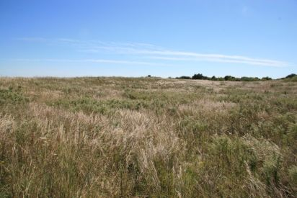
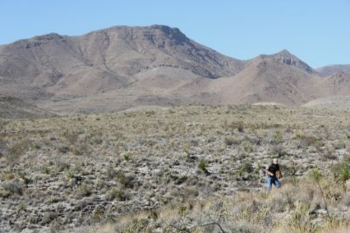
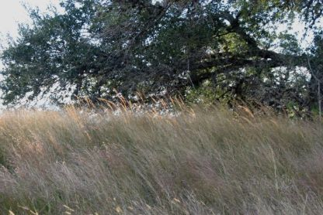
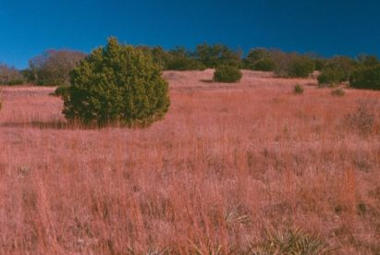
Seed origin is important
“Native” is relative
  Little bluestem is native from Canada to Mexico
  OK select Germplasm
    Southwest OK
  Cimarron
    Southwestern KS & panhandle OK
  Carrizo Germplasm
    Bexar Co & Zavala Co TX

Slide 13

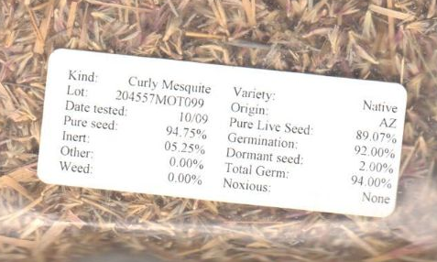

Slide 14
Locally adapted native seed?
Pertinent questions:
  How local is local enough?
  How far can seeds be move?
Answers:
    Each plant is different
    Most researchers suggests native seed should originate (order of preference): 1) from the same ecoregion; 2) an adjacent ecoregion; or 3) from no more than 200 m N/200 m S/100 m E/200 m W

Slide 15
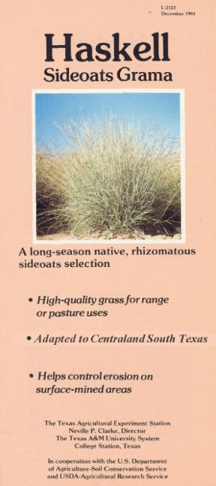
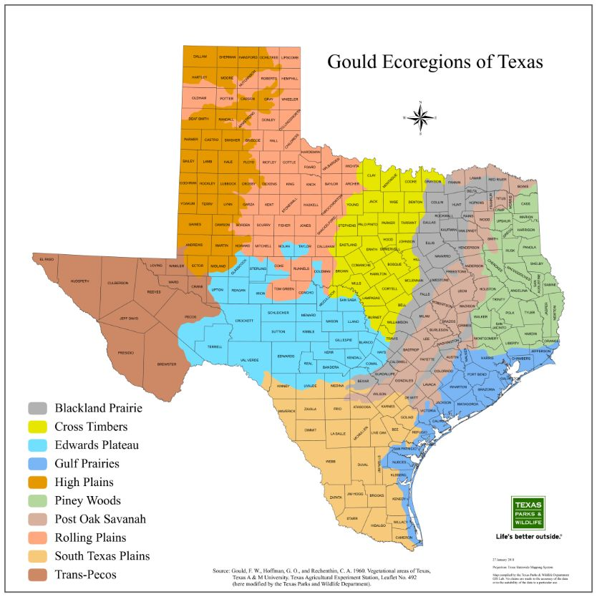
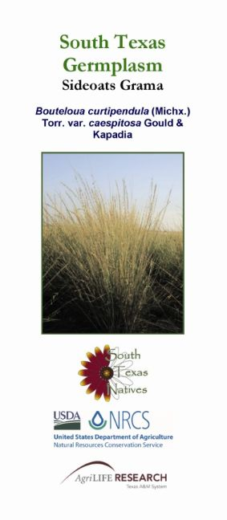
Where plants/seeds used in restoration originated from is very important!

Slide 16
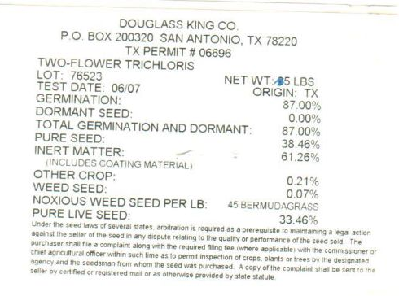
Seed Quality
Seed tags
  Pure Live Seed (PLS)
    Purity (%)
    Viability (%)
      Germination
      Dormancy
  Seed age/test date

Slide 17
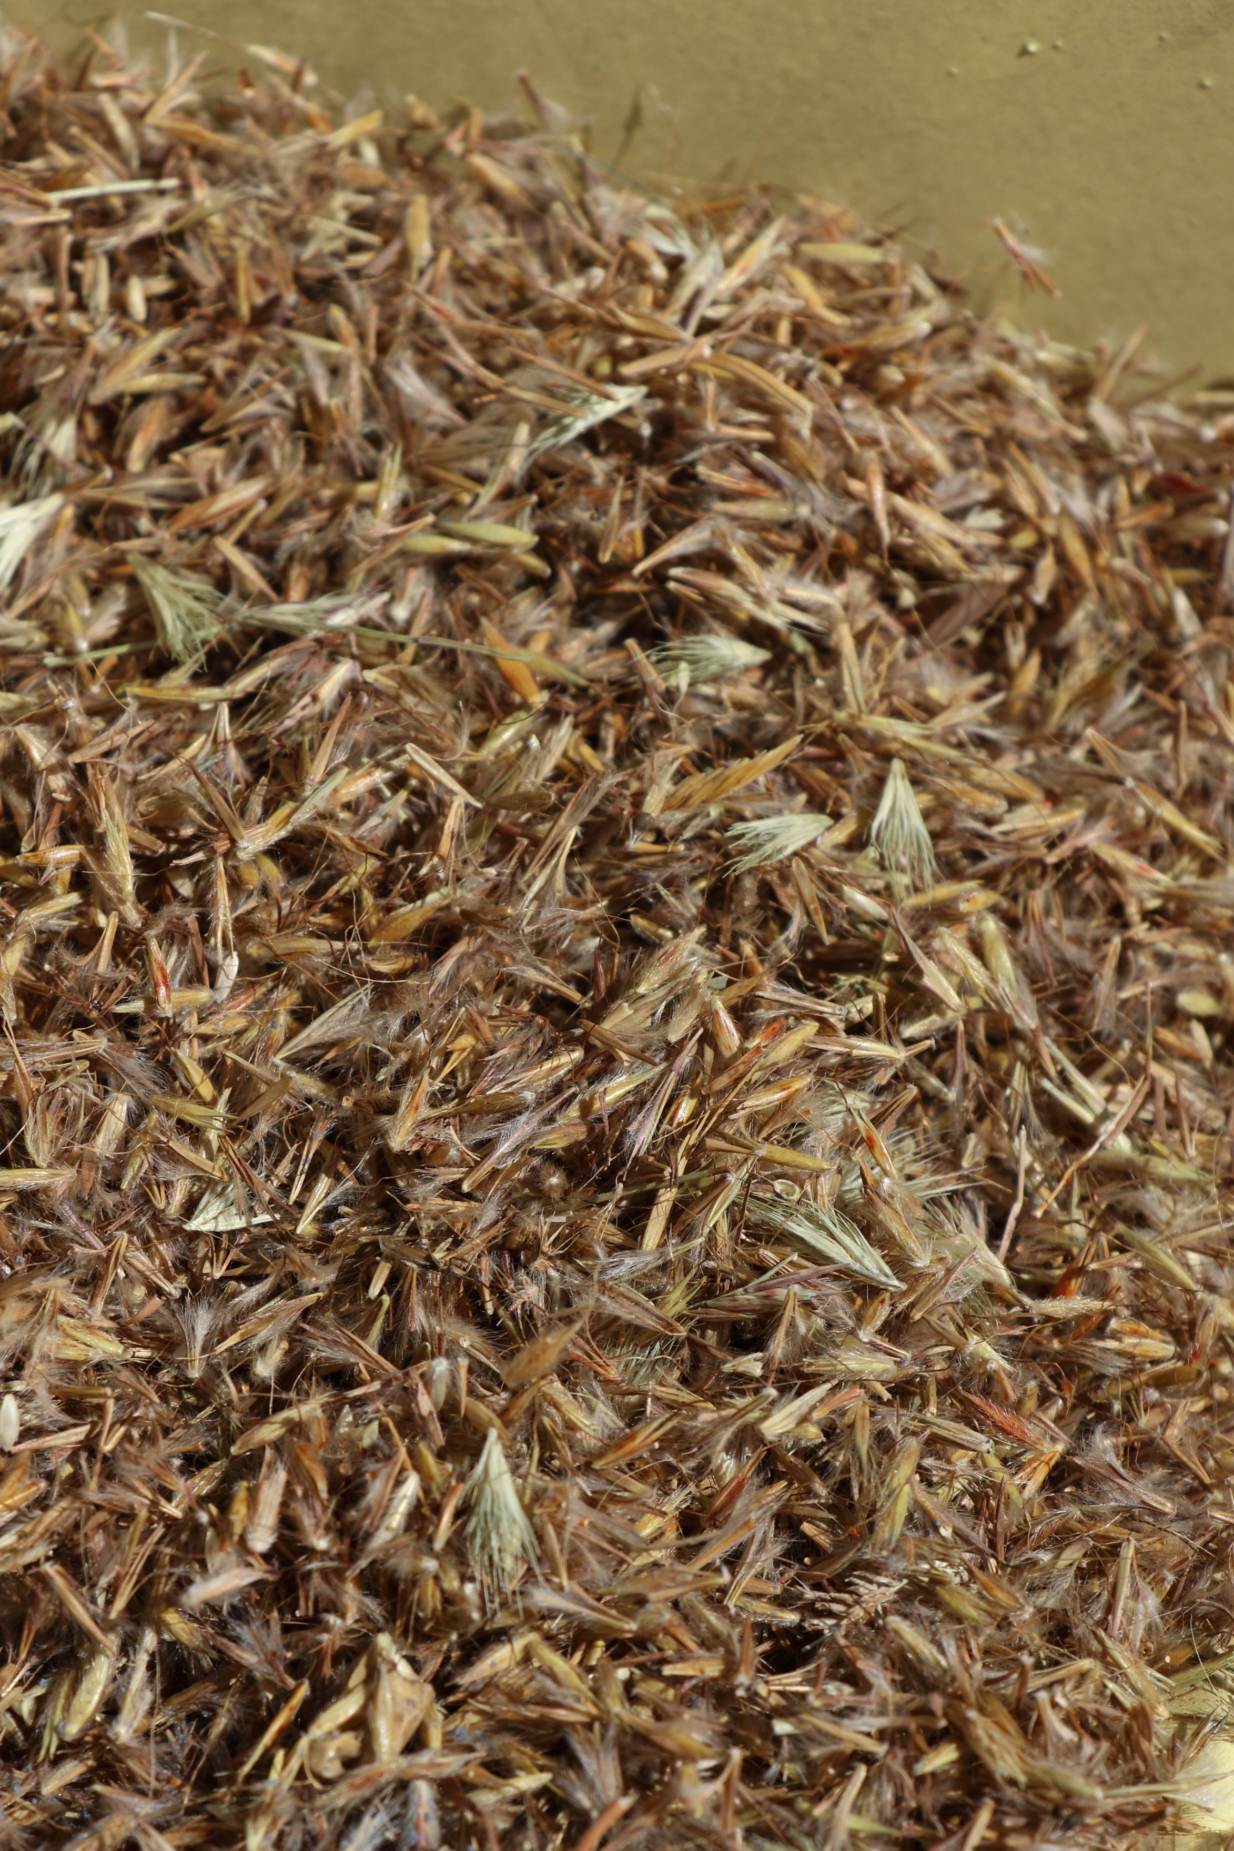

Slide 20
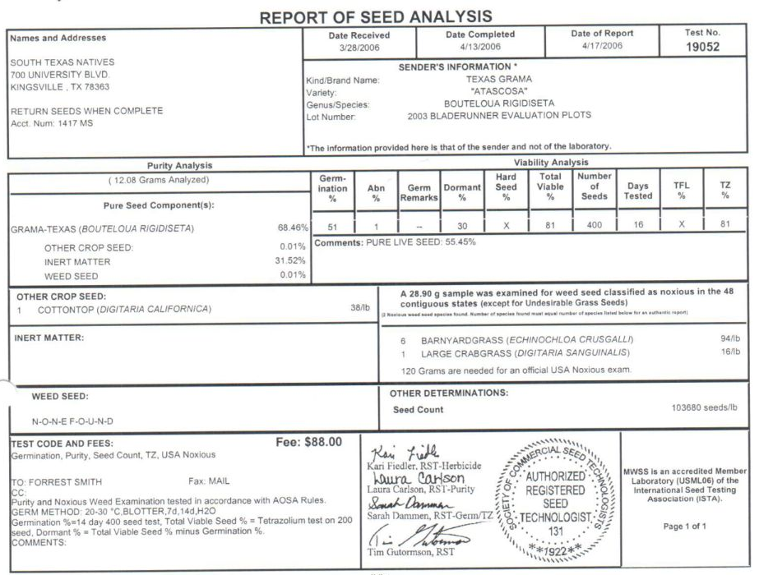
Information the dealer knows (ask for it):

Slide 21
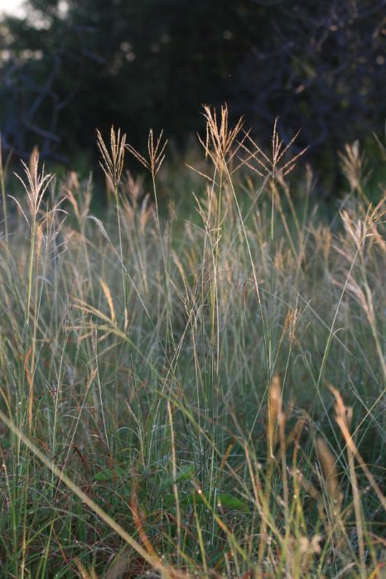
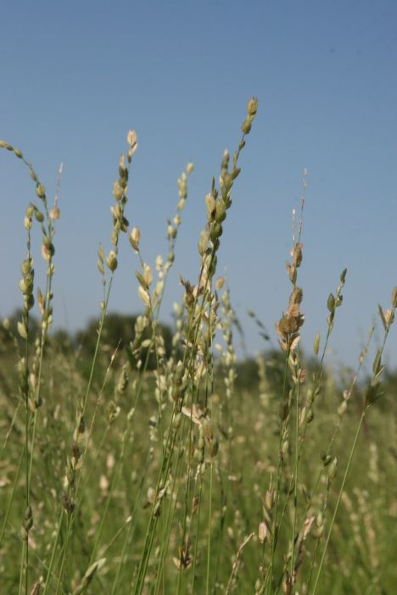
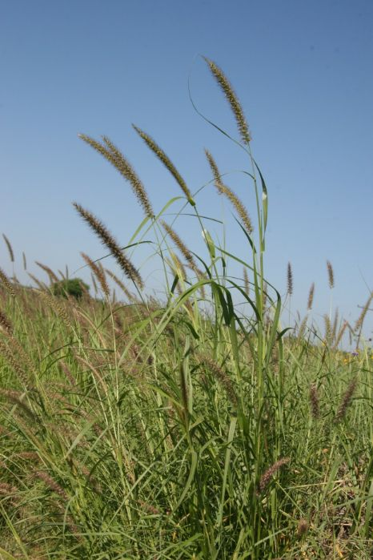
Why “other crop” seeds matter
Old World bluestems
African lovegrasses
Buffelgrass

Slide 22
What can go wrong?
Under plant (thin stands)
Over plant (waste of $)
Incidentally introduced unwanted/invasive spp
  Balcones Canyonlands NWR-spotted knapweed
Lack of establishment
Poor persistence
Financial obligation to replant

Slide 23
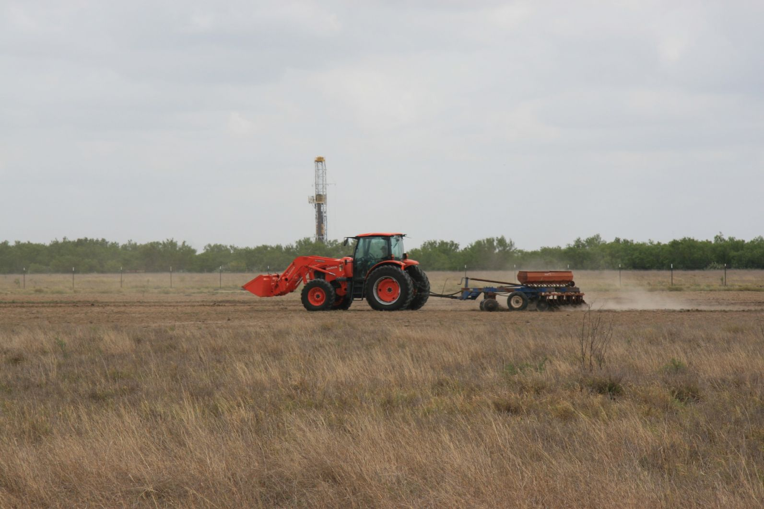

Slide 24
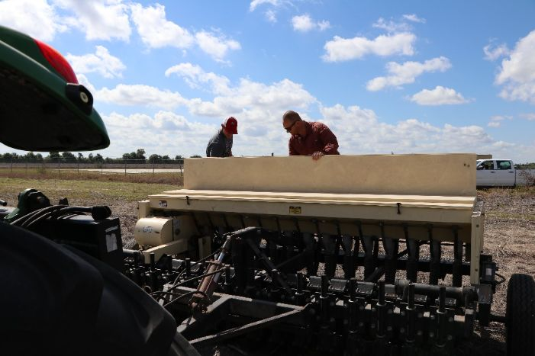
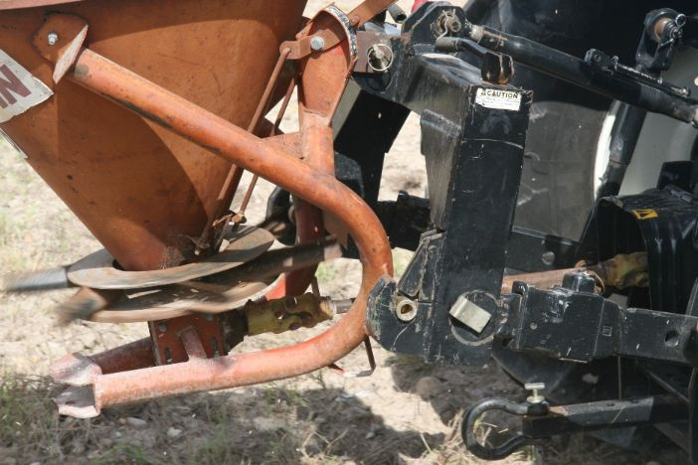
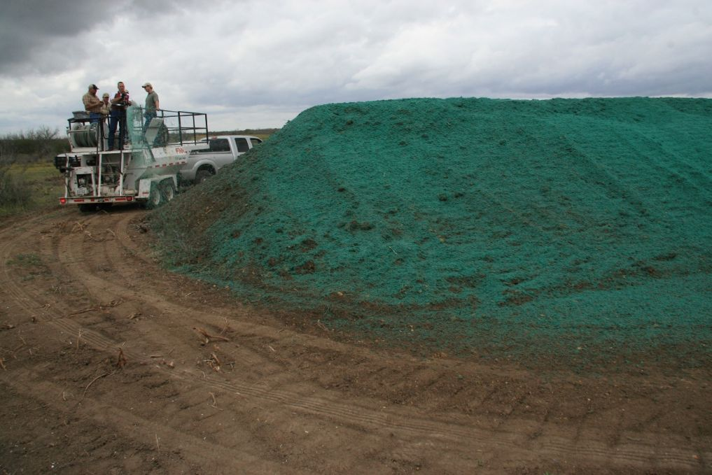
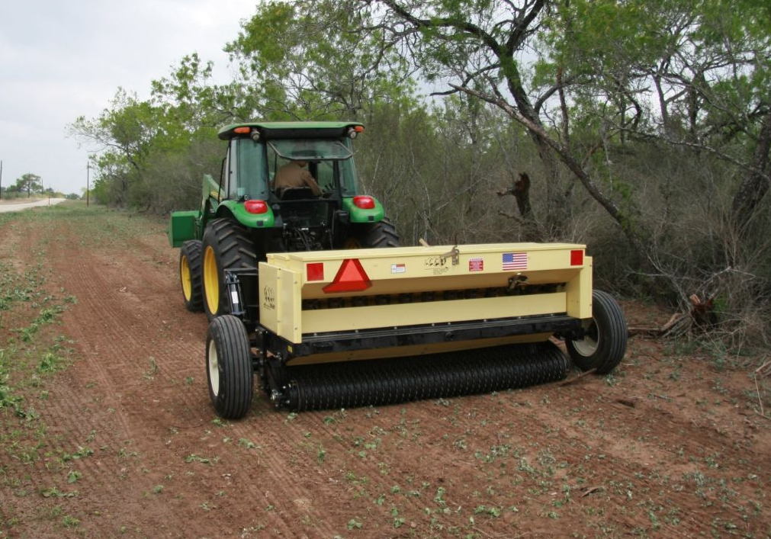

Slide 25

Broadcast seeding
Pros
  Fast
  Inexpensive
  Readily available
  Can handle difficult terrain
Cons
  Difficult to calibrate
  Cant separate based on size/shape
  Poor seed to soil contact
  Need for second pass

Slide 26
Dropseeder seeding
Pros
  Can handle soft/fluffy soils
  Can get them with multiple seed boxes
Cons
  Cant separate based on size/shape
  Poor seed to soil contact

Slide 27
Native Seed Drill
Pros
  Can separate by size/shape
  Can calibrate for multiple species
  Ideal seed placement in soil
  Relatively fast
Cons
  Hard to find
  Can be intimidating
  Cant handle fluffy soil
  Transportation can be challenging

Slide 28

Hydroseeder
Pros
  Increased moisture retention
  Increased germination
  Superior erosion control
Cons
  Expensive
  Slow
  Logistically challenging

Slide 29
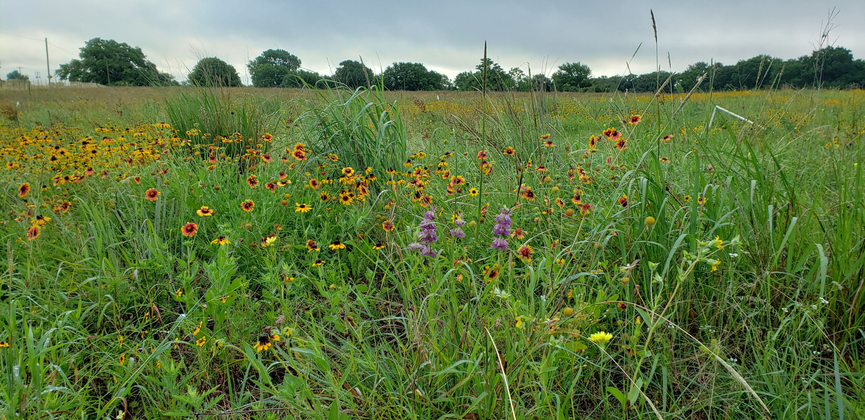
Questions?
Dr. Anthony Falk
815-762-6178
Anthony.falk@tamuk.edu

