Slide 1
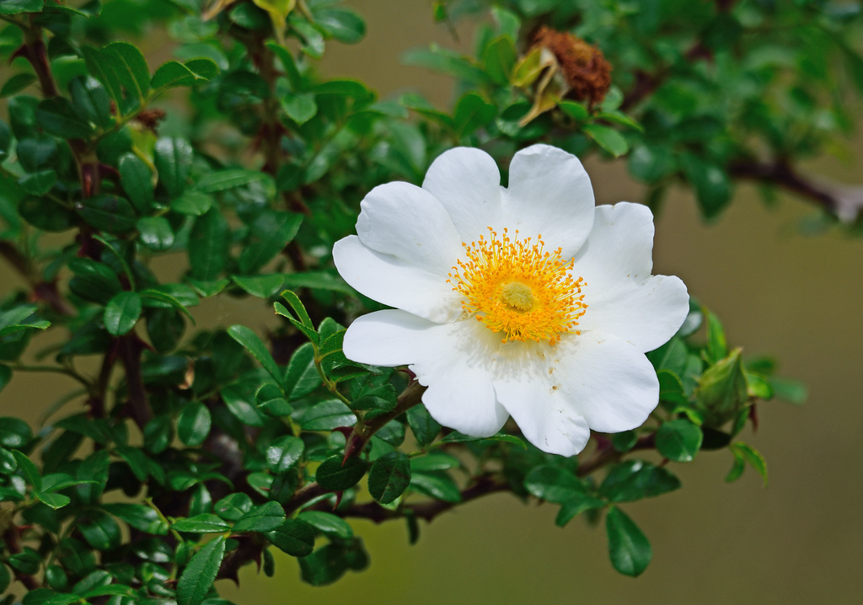

Macartney Rose Management

Slide 2
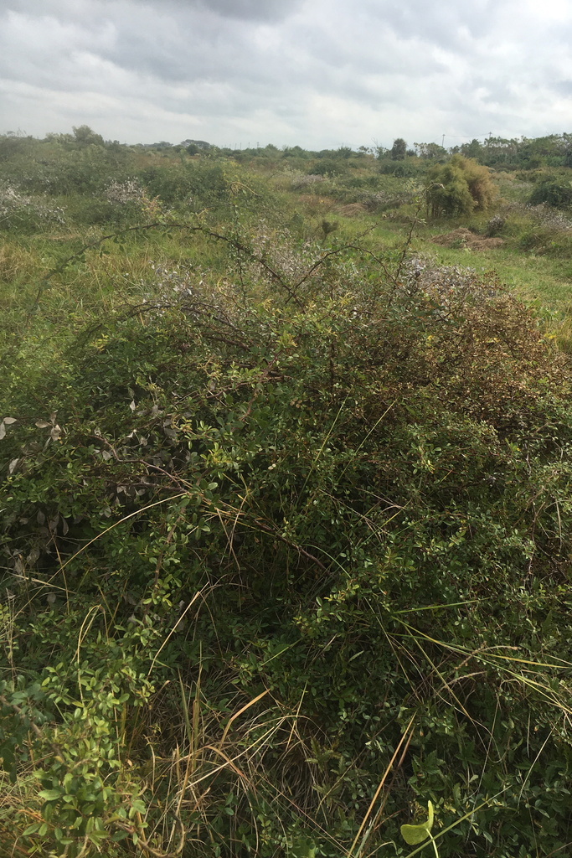
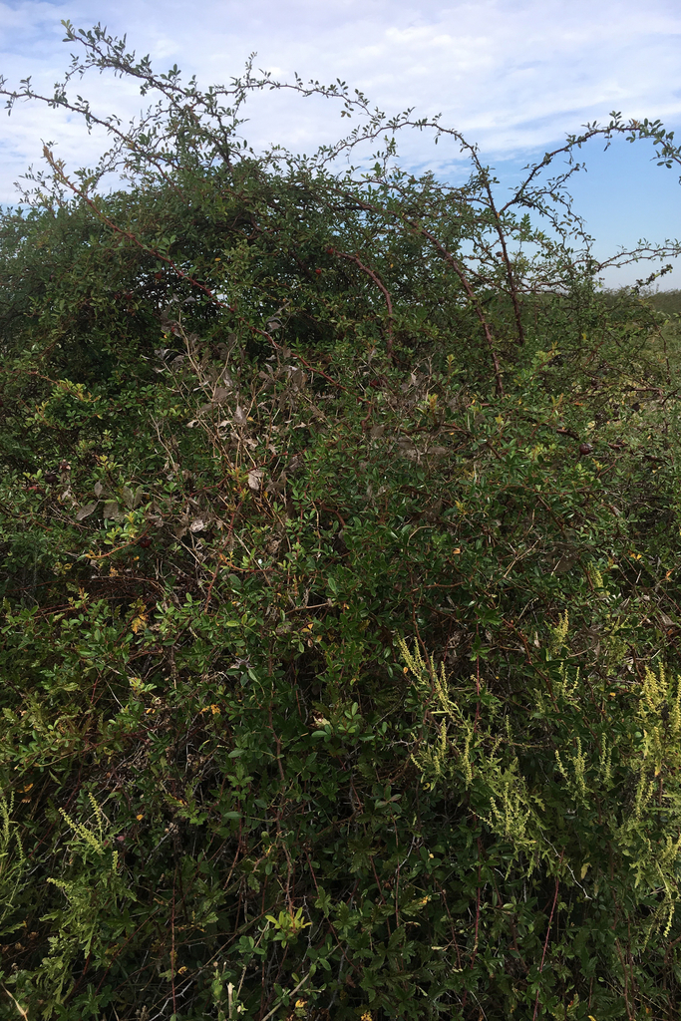

Slide 3
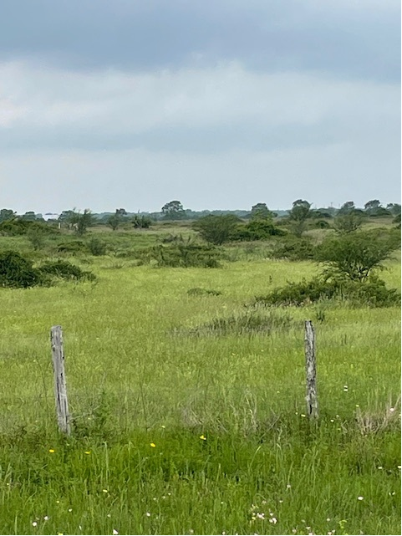
Lower more manageable density

Slide 4
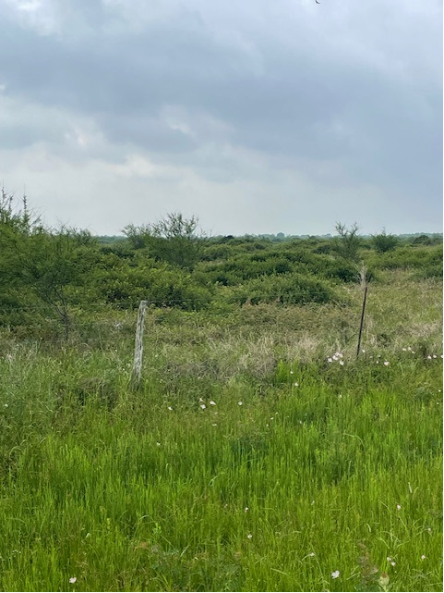
High density

Slide 5
Treatment methods.
Foliar
  Picloram:2,4-D (1:4) herbicide 1%
  Surfactant .25%
  Dye .25%
Undisturbed
Disturbed
  12 -36 months after disturbance
For best results, do not spray when:
  Rains have stimulated new growth at the end of stems
  Leaves are wet from rain or dew
  Plants are less than 3 feet tall after mowing
  Foliage shows damage from hail, insects, or disease
  Working upwind of desirable trees, shrubs, or crops
  Flowers or fruits are present
  Soil temperatures are below 75°F

Slide 6
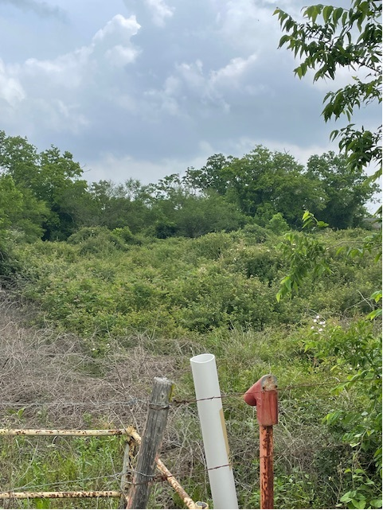
Recent debate
Aerial or IPT – that is the question…
At what point do you switch to aerial application

Slide 7
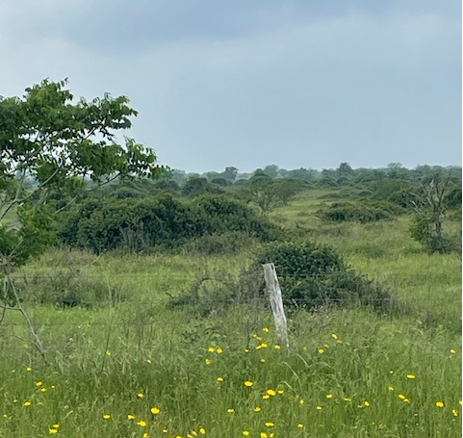
We don’t want to lose forb diversity.

