Slide 1

How to Use this Template to Make Your Poster for Coogs Without Borders at UH
Directions
Download and open this file in PowerPoint. Do not use in the Web App.
Pick a poster layout based on your global engagement. There are slides in the deck for Learning Abroad, Global-Local experiences, or Global Research.
You can also use the pre-made “Brick Template Poster 1” under “New Slide.”
Posters without the approved templates will not be accepted for this event.
Add content to your poster. The prompts are there to guide you, however you can also add text, sections, or photos as most relevant for your experience.
Once you have completed your poster, delete any extra slides (including this one) so that your poster is the only slide remaining. Save as a .pdf file.
Important Notes!
Do not cover up the UH logo or change the top banner of the poster layout. The only things you should add to the banner is your text.
Do not change the size or orientation of slides in this file.
Visual elements you add to your poster should be of high resolution. Your poster’s final printed size will be 40” wide x 36” tall, so make sure any photos/graphs/etc. you add will maintain their quality when sized up.

Slide 2

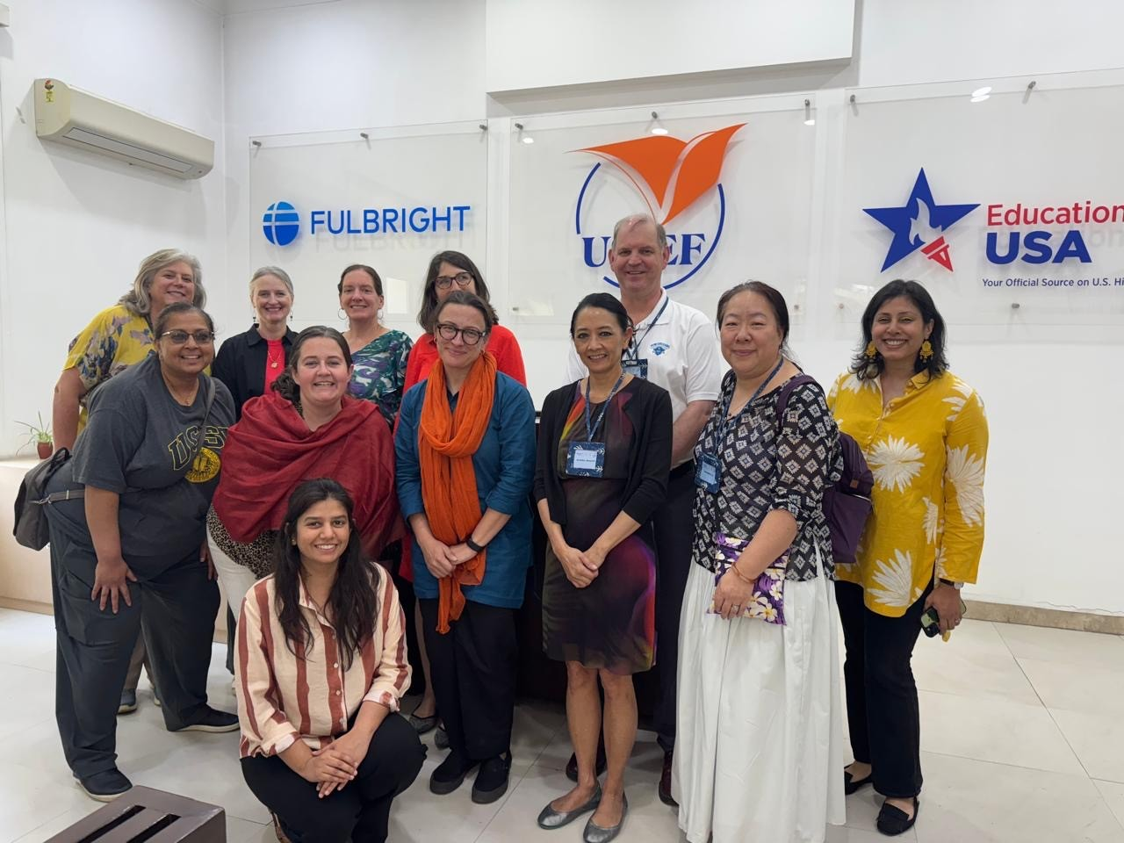
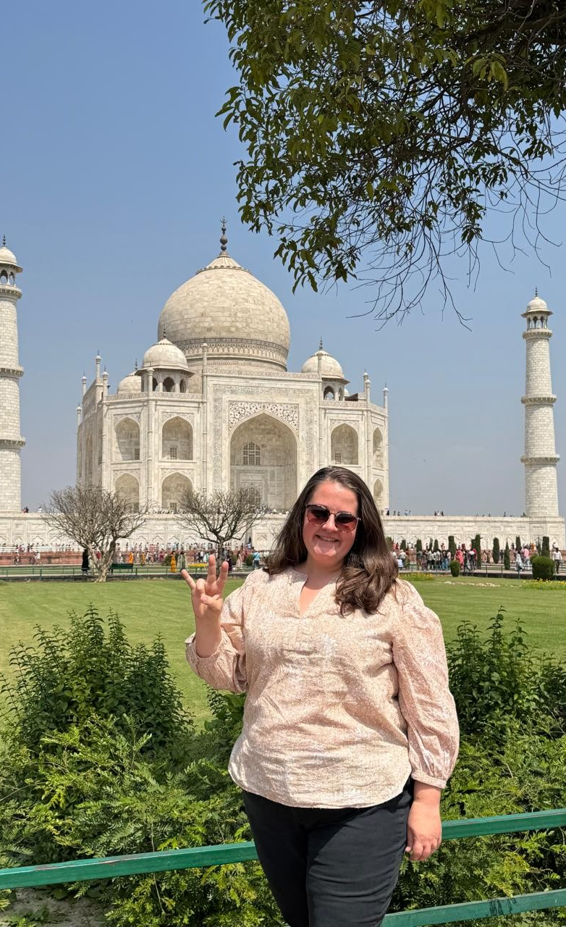



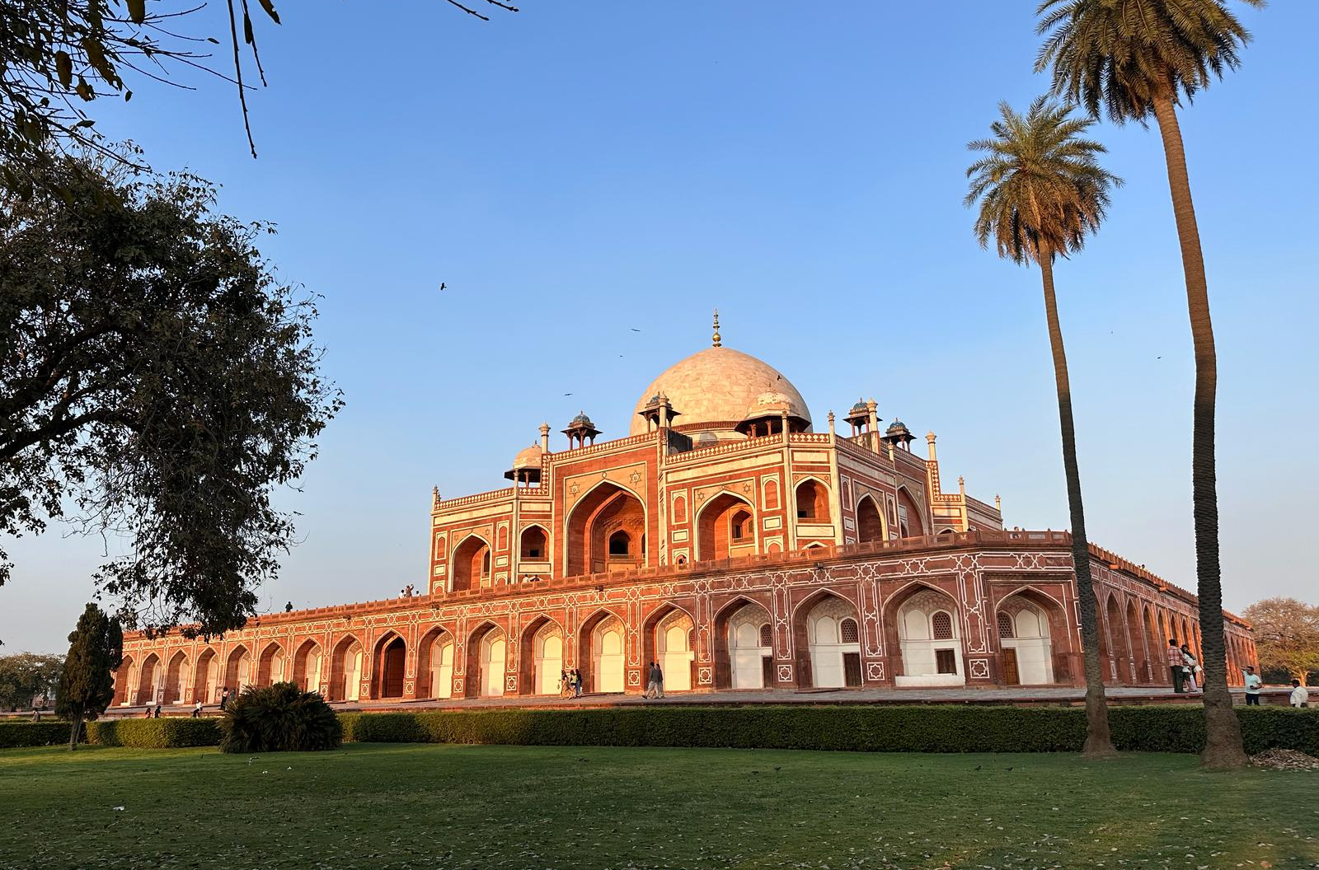
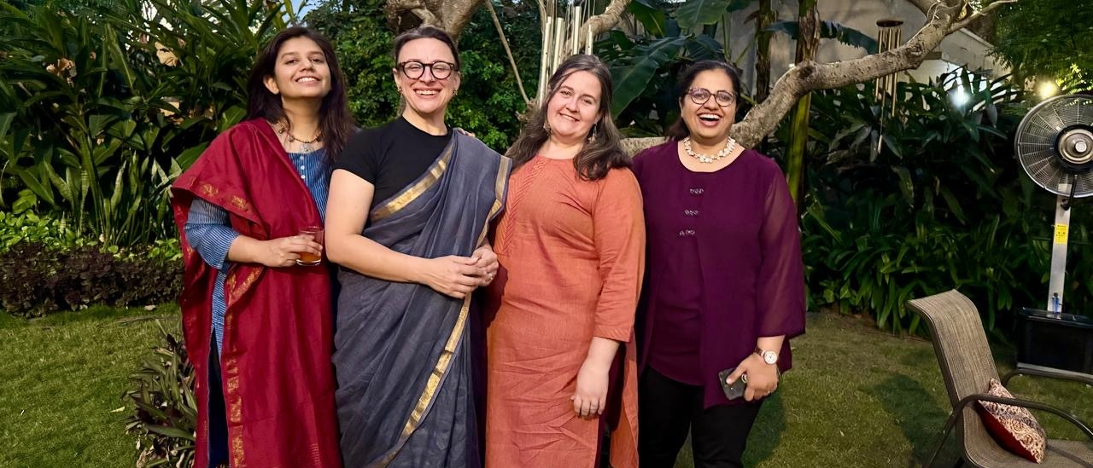




Learning Abroad Poster Title
Adjust Font Size & Text As Needed
Your Name, Major, Program Abroad
My Program Abroad
My Aha! Story Reflection
Global Career Skills Development
Your learning abroad experience: This section should include the major details of your program abroad.
Program – title, location, faculty leader/program provider/host institution
Length/term
Course(s)
Housing
Places visited
Your goals in going abroad
Feel free to edit the section title above!
Reflection – your Aha! story: Describe briefly the experience that caused you to change your view on the host culture, or something that taught you a meaningful lesson. What happened? Explain the situation, challenge, and how you handled it and learned from it. Feel free to edit the section title above!
Only use images that are high-resolution. Images that are too pixelated will appear blurry when printed.
Skills Development: Using the provided 8 NACE career readiness competency icons, pick 3-4 and share how you’ve grown in these areas. Learn more at naceweb.org/career-readiness/competencies. Feel free to edit the section title above!
Career + Self-Development
Explain your growth in this area.
Communication
Explain your growth in this area.
Critical Thinking
Professionalism
Global Fluency
Teamwork
Host Country/Culture
Reflection on your experience: Referencing your Aha! Moment and photos above, share your growth from your experience as explained through the Global Competence Development framework below.
Attitudes
How did this experience challenge your assumptions and perspectives? What did you become more open to? What did you learn about yourself?
Knowledge
What did you learn about other cultures? about global issues? about different perspectives?
Skills
What did you learn to do? Communicate, adapt, listen, collaborate, problem solve, etc.
Action
What actions are you doing (differently) then or now?
Leadership
Communication
About your host country/culture: Describe the host city, country, and culture from your time abroad. Share some of the cultural values and norms, the language(s) spoken, and other relevant details about your host location to your program experience and growth. Make sure to add a section title above!
Next On My Journey
Future Goals: This is a space to share how your academic and/or professional goals have changed, solidified, or if you’ve made new goals. How did your experience abroad connect to your coursework, major, academic, or professional goals? Feel free to use bullet points. Feel free to edit the section title above!

Slide 3
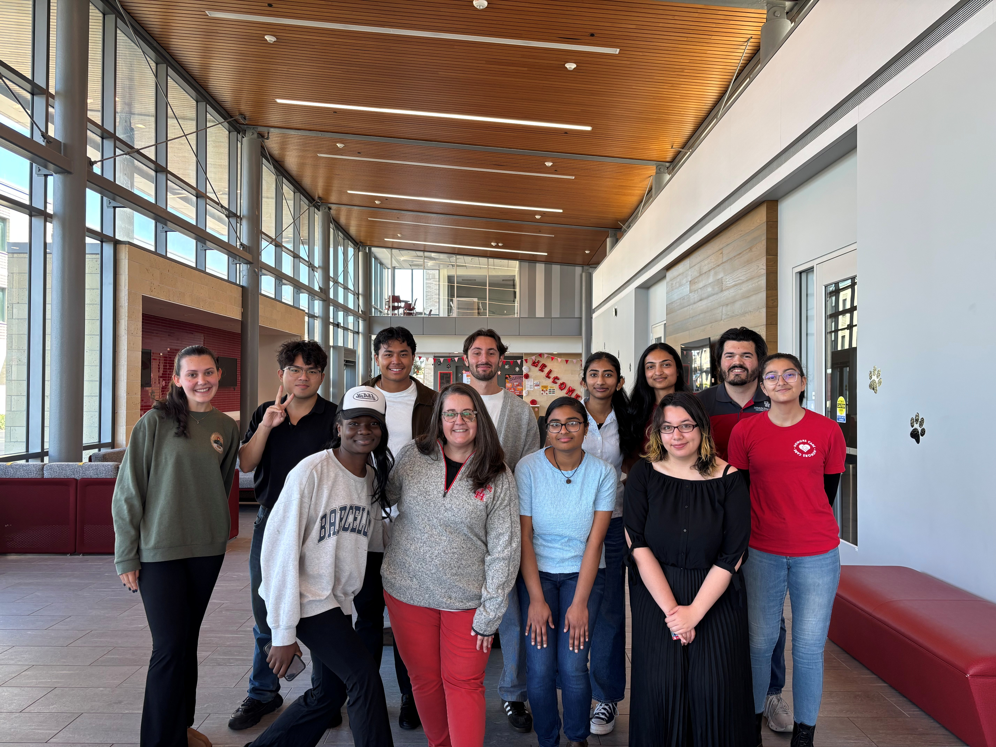
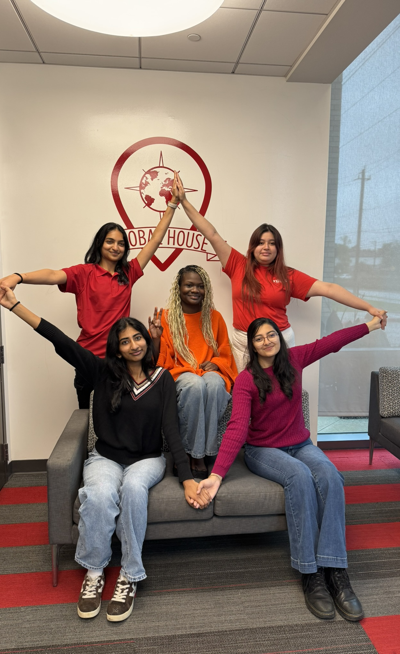
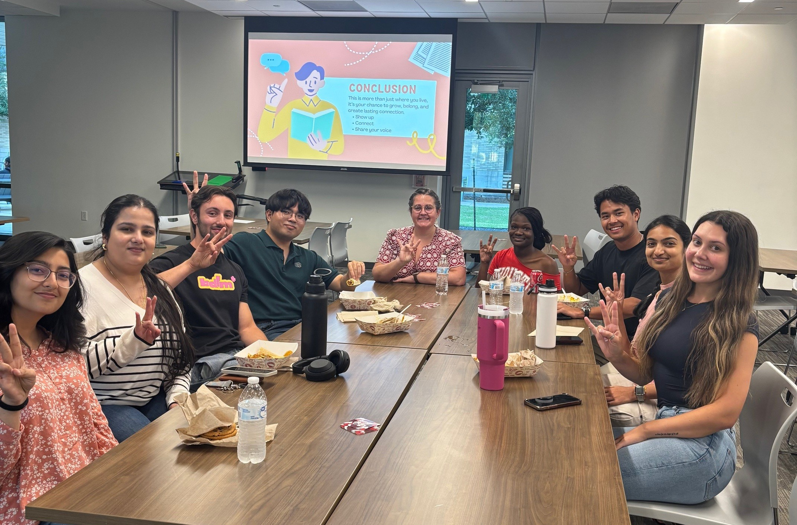
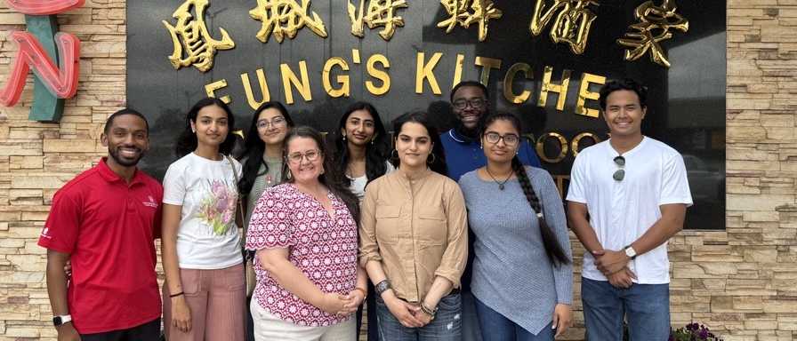
Global-Local Experience Poster Title
Adjust Font Size & Text As Needed
Your Name, Major, Global-Local Organization/Group/Effort
My Global-local Experience
My Aha! Story Reflection
Global Career Skills Development
Your global-local experience: This section should include the major details of your global-local program experience, including a global internship, course or course project, global research, leadership in a global organization, participation in one or many overall impactful global events, or others.
Program – your role/project, the affiliated group or organization, faculty/advisor/supervisor, other key stakeholders, key events/engagement
Length/term
Course(s) associated
Goals of the experience
Feel free to edit the section title above!
Reflection – your Aha! story: Describe briefly the experience that caused you to change your view on culture, or something that taught you a meaningful lesson. What happened? Explain the situation, challenge, and how you handled it and learned from it. Feel free to edit the section title above!
Only use images that are high-resolution. Images that are too pixelated will appear blurry when printed.
Skills Development: Using the provided 8 NACE career readiness competency icons, pick 3-4 competencies, delete the others, and share how you’ve grown in these areas. Learn more at naceweb.org/career-readiness/competencies. Make sure to add a section title above!
Career + Self-Development
Explain your growth in this area.
Communication
Explain your growth in this area.
Critical Thinking
Professionalism
Global Fluency
Teamwork
My Global Org/project
Reflection on your experience: Referencing your Aha! Moment and photos above, share your growth from your experience as explained through the Global Competence Development framework below.
Attitudes
How did this experience challenge your assumptions and perspectives? What did you become more open to? What did you learn about yourself?
Knowledge
What did you learn about other cultures? about global issues? about different perspectives?
Skills
What did you learn to do? Communicate, adapt, listen, collaborate, problem solve, etc.
Action
What actions are you doing (differently) then or now?
Leadership
Communication
About your global organization or project: Describe the global organization or project/engagement you were part of for your experience. Share some of the cultural values and norms, the mission of the org, the structure, and other relevant details about your engagement that are relevant to your program experience and growth. Feel free to edit the section title above!
Next On My Journey
Future Goals: This is a space to share how your academic and/or professional goals have changed, solidified, or if you’ve made new goals. Feel free to use bullet points. Feel free to edit the section title above!

Slide 4
Global Research Poster Title
Adjust Font Size & Text As Needed
Your Name, Major, Research Mentor and Department, Other Contributors
Introduction
Data Results & Analysis
Conclusion
Introduction: This section should include the background information on your topic. Introduce your audience to the issue or goal your research addresses and why it is important/relevant to your field. Discuss the previous work that has already been done in this area. Define key terms for your audience. Feel free to edit the section title above!
Data Results and Analysis: This should be your most in-depth section. Highlight the key data, findings, or themes that led to your conclusion. Feel free to edit the section title above!
Conclusion: Restate the problem you addressed in your background section. Summarize the key findings from your results. What is the significance of your results/findings? What are the next steps for this research topic for you or for others? Feel free to edit the section title above!
Methods/Approach/Theory
Methods/Approach/Theory: Describe the approach or method you used to acquire your data or findings. How did you do what you did? Explain the advantages and limitations of the approach you used. Why was this method chosen over others? Feel free to edit the section title above!
Global Career Skills Development
Skills Development: Using the provided 8 NACE career readiness competency icons from the previous slide templates, pick 2-3 competencies, delete the others, and share how you’ve grown in these areas. Learn more at naceweb.org/career-readiness/competencies. Feel free to edit the section title above!
Graphs, tables, or images can be a great way to add visually appealing components to your poster but make sure they are labeled and easy to read. Only use images that are high-resolution. Images that are too pixelated will appear blurry when printed.
Future Goals
Future Goals: This is a space to share how your academic and/or professional goals have changed, solidified, or if you’ve made new goals. How did your experience abroad connect to your coursework, major, academic, or professional goals? Feel free to use bullet points. Feel free to edit the section title above!

Slide 5
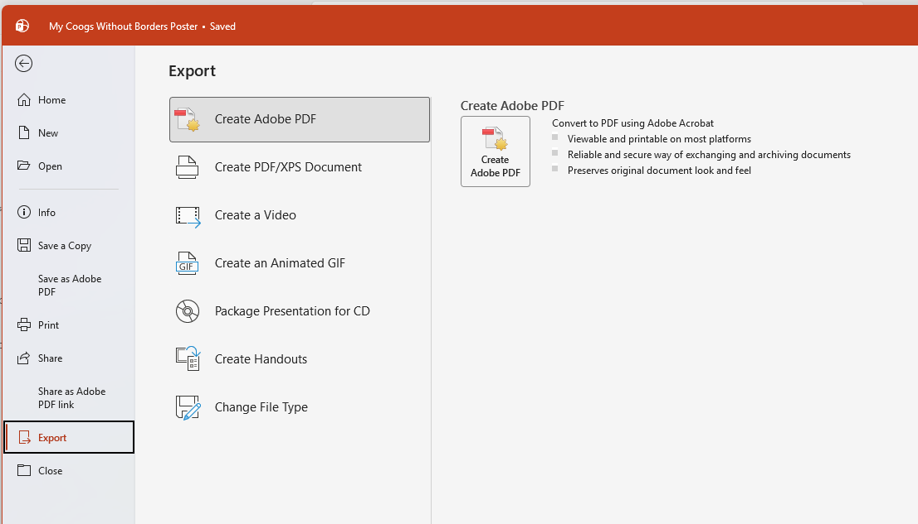
READ BEFORE YOU SAVE
To save, go to File -> Export…
When the save box opens,
make sure the file format is PDF
Send your PDF poster to uhglobal@uh.edu

