Slide 1
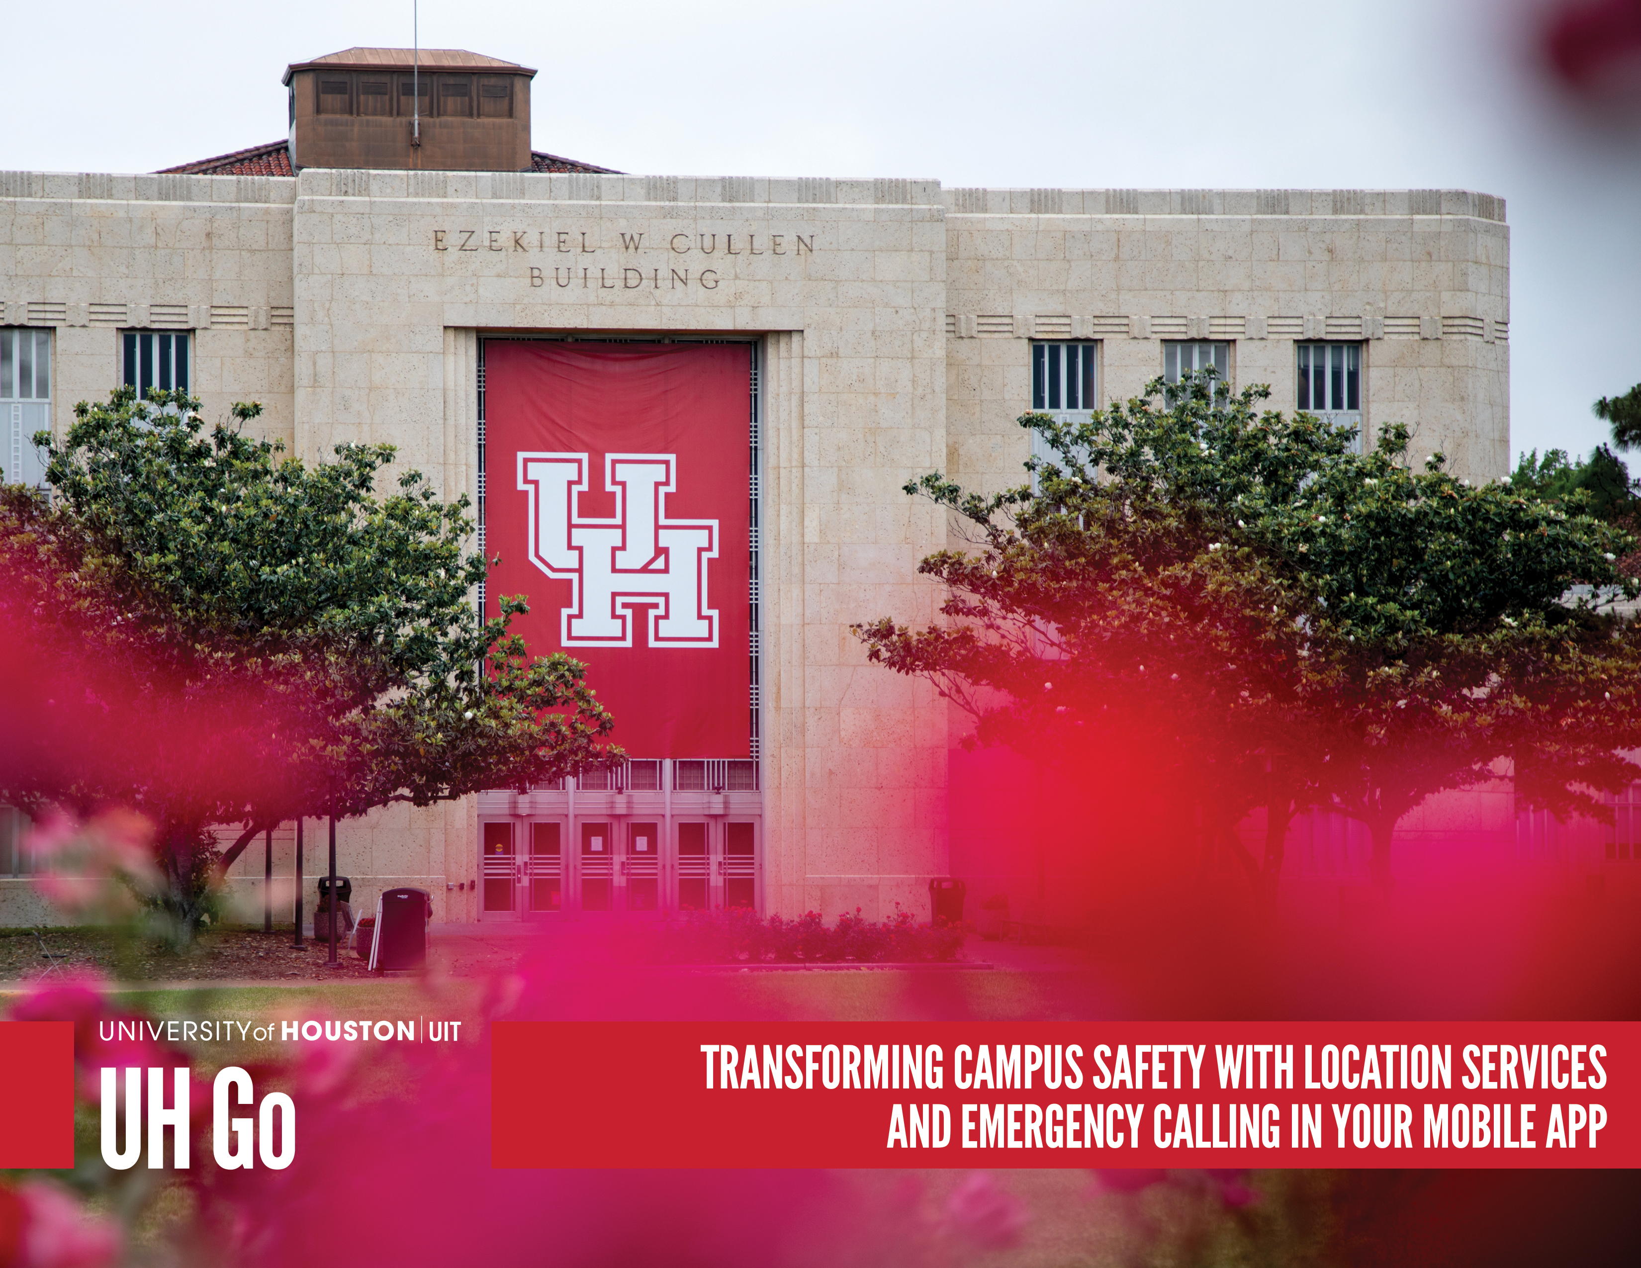
Notes:
Where we are, where we are headed and how we are going to get there

Slide 2
PLANNING

Slide 3

Criteria Used to Determine Success
CRITICAL SUCCESS CRITERIA
Caller is alerted if they are off-campus and then call is routed to City of Houston 911
Ease of Use with privacy and function: Preventing
unintentional location sharing and providing clear information for emergency services.
UHPD web-based map showing geo-location of the caller when the caller is on-campus
Maintain privacy

Slide 4
HOW UH PREPARED FOR OUR EMERGENCY CALLING FEATURE
Gathered requirements based on current infrastructure
Brainstormed with UH Go team that included Marketing to develop prototypes
Identified risks
Demonstrated feature
to University Police (UHPD) department communicating risk factors
Gathered additional requirements from University Police
Integrated all requirements into new designs for both frontend and backend
Tested 911 features
User tested with Student ambassadors
Full system test with UHPD
Deployed to Production
Notes:
Governance: good not evil…need policy include procurement
Shapes the entire environmental

Slide 5
BRAINSTORMING
Can we see people moving around?
How do we keep this private?
What if they are on campus?
Does dispatch need a script?
Make the user feel safe
What permissions has the user allowed?
What security measures do we need?
How do we make this easy to use?
What should reports look like?
How do we get the permission we need?
How to test 911?
What admin and reporting functionality do we need?

Slide 6
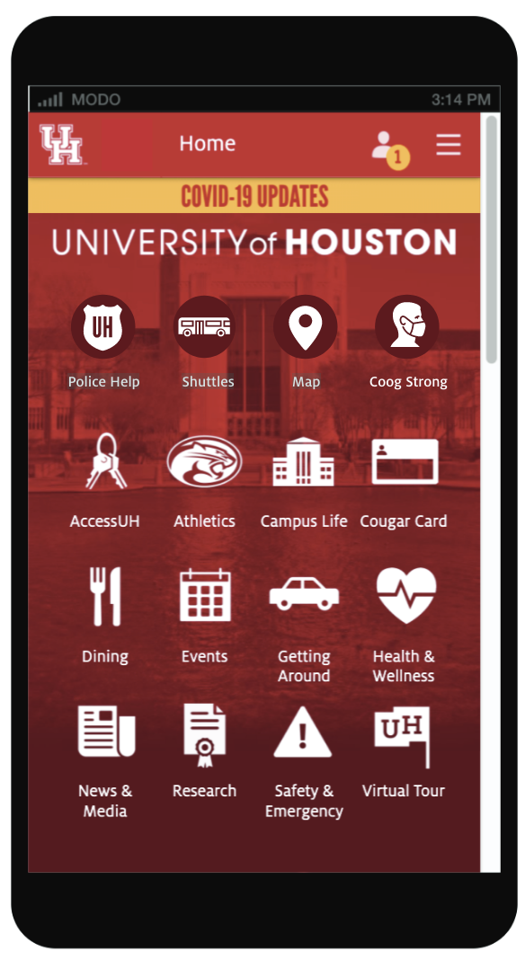
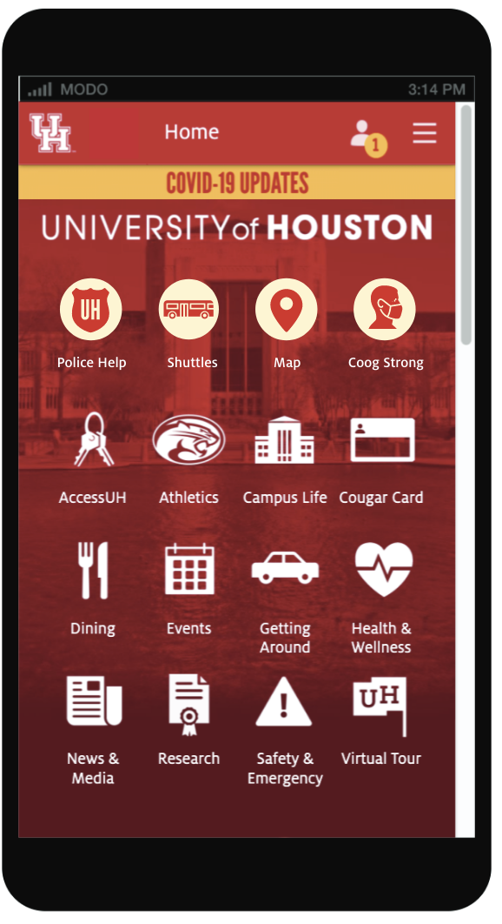
PROTOTYPING

Slide 7
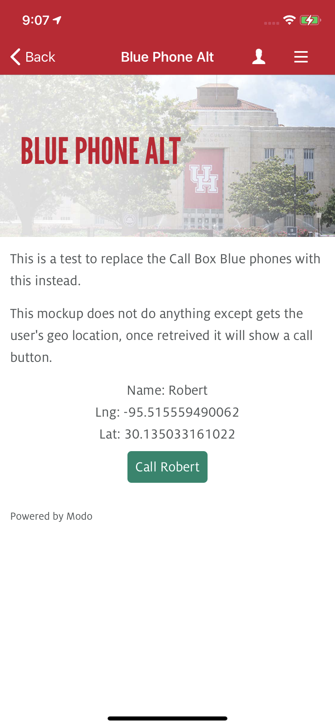
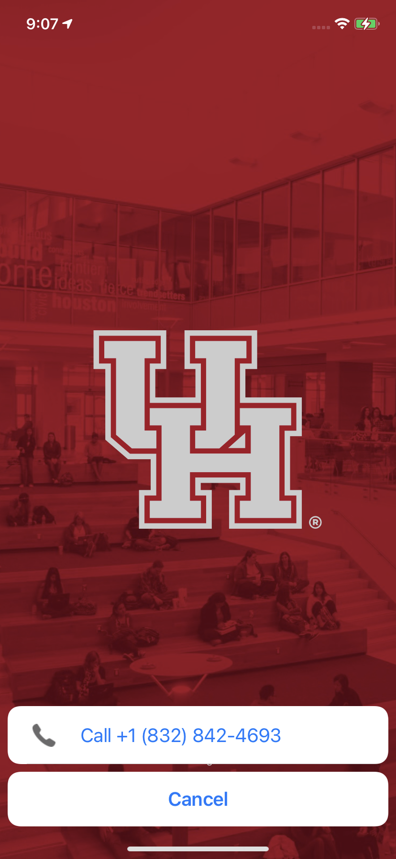
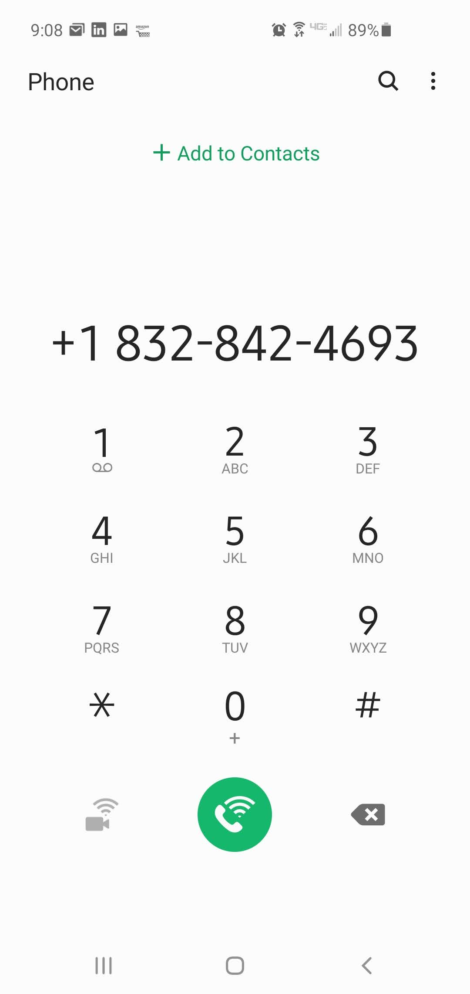
PROTOTYPING

Slide 8
IDENTIFYING RISK
During the development of this project several risk factors were identified and these MUST BE considered…
  Highly available even in an emergency
  Cost effective
  User friendly and easy to use in case of an emergency
  Police jurisdictions
  Backend reports available to UHPD to meet compliance requirements
  Limitations associated to geo-location
  Able to ”Close the Loop”
Notes:
Governance: good not evil…need policy include procurement
Shapes the entire environmental

Slide 9
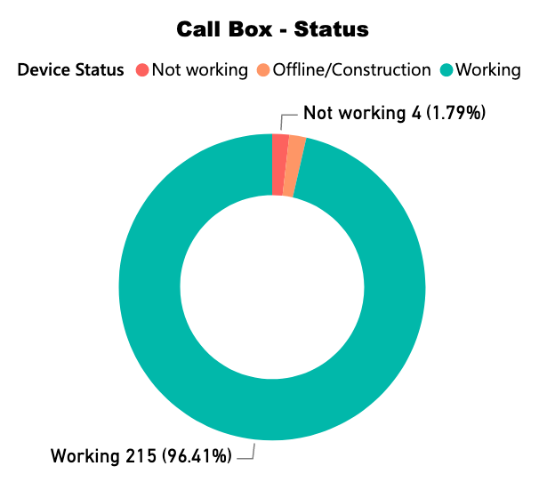
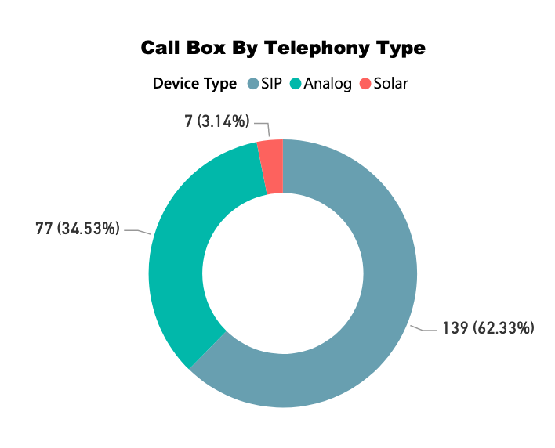
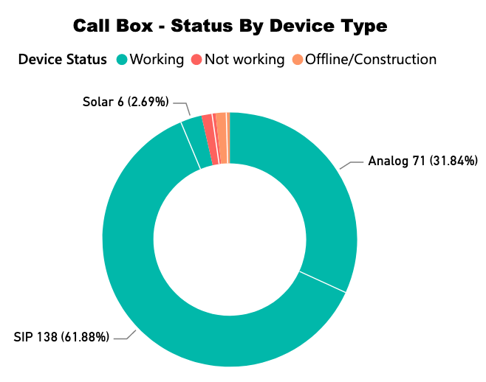
CURRENT ON-SITE INFRASTRUCTURE
Total call boxes: 219
1.79% - 4 not working
96.41% - 215 working
2.69% - 6 Solar
61.88% - 138 SIP
31.84% - 71 Analog
Notes:
Governance: good not evil…need policy include procurement
Shapes the entire environmental

Slide 10
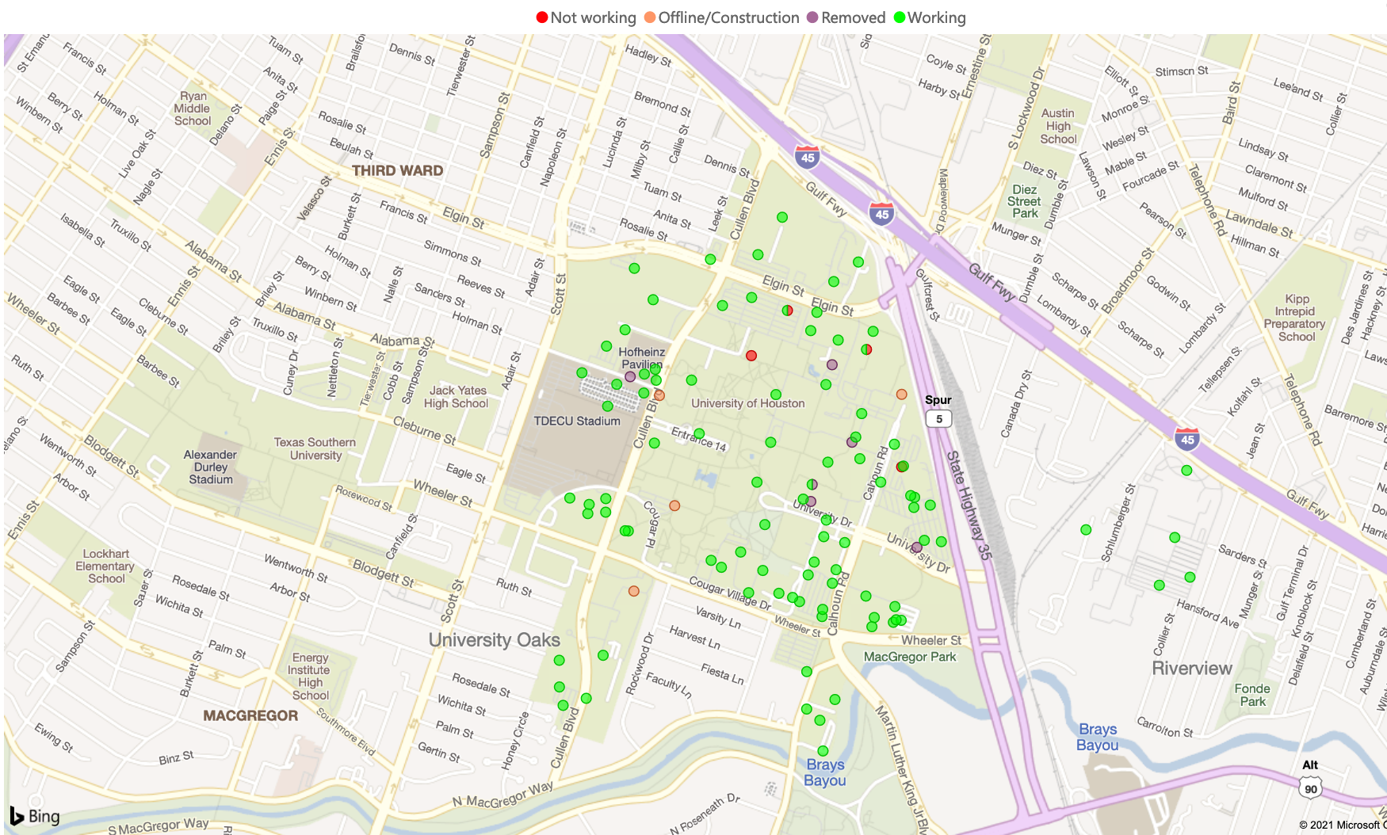
CALL BOXES ON A MAP
Notes:
Governance: good not evil…need policy include procurement
Shapes the entire environmental

Slide 11
USER EXPERIENCE

Slide 12
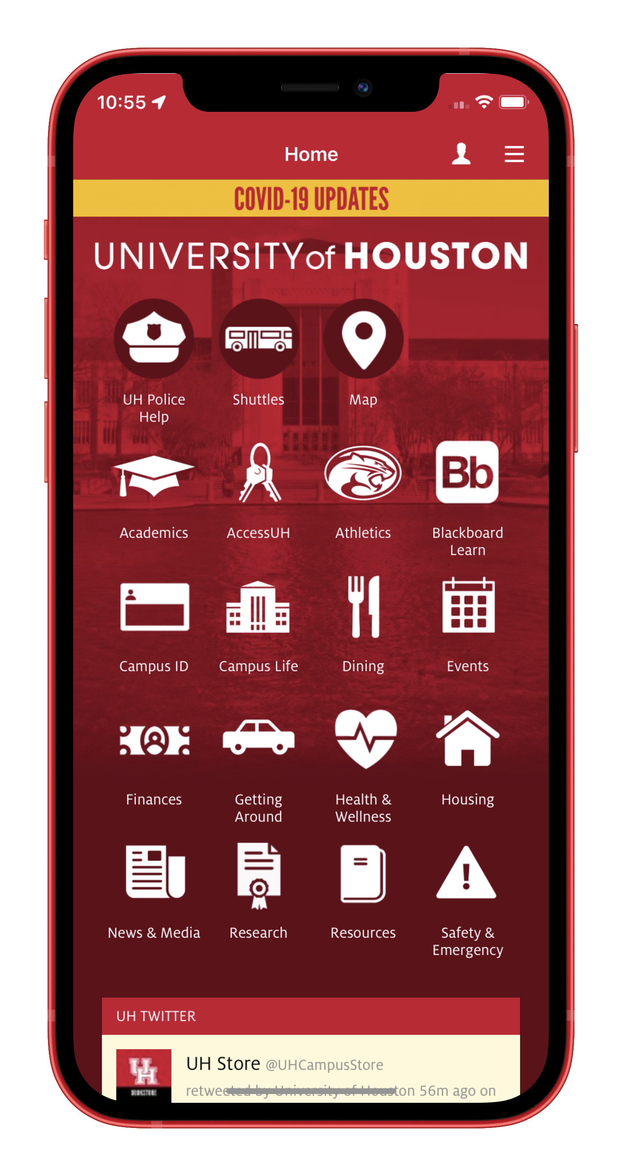
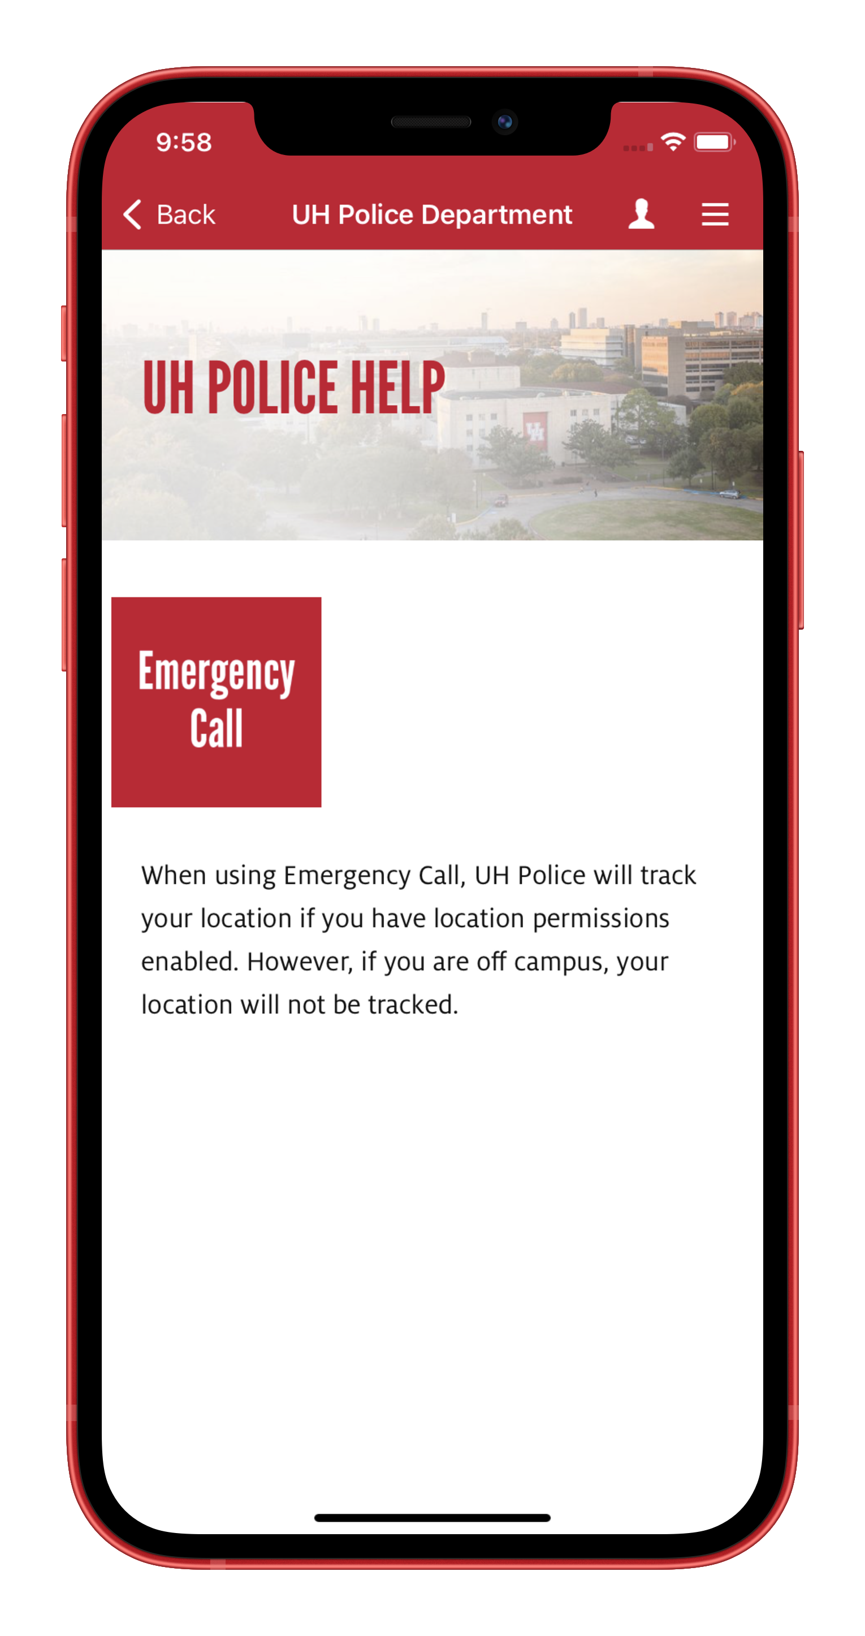
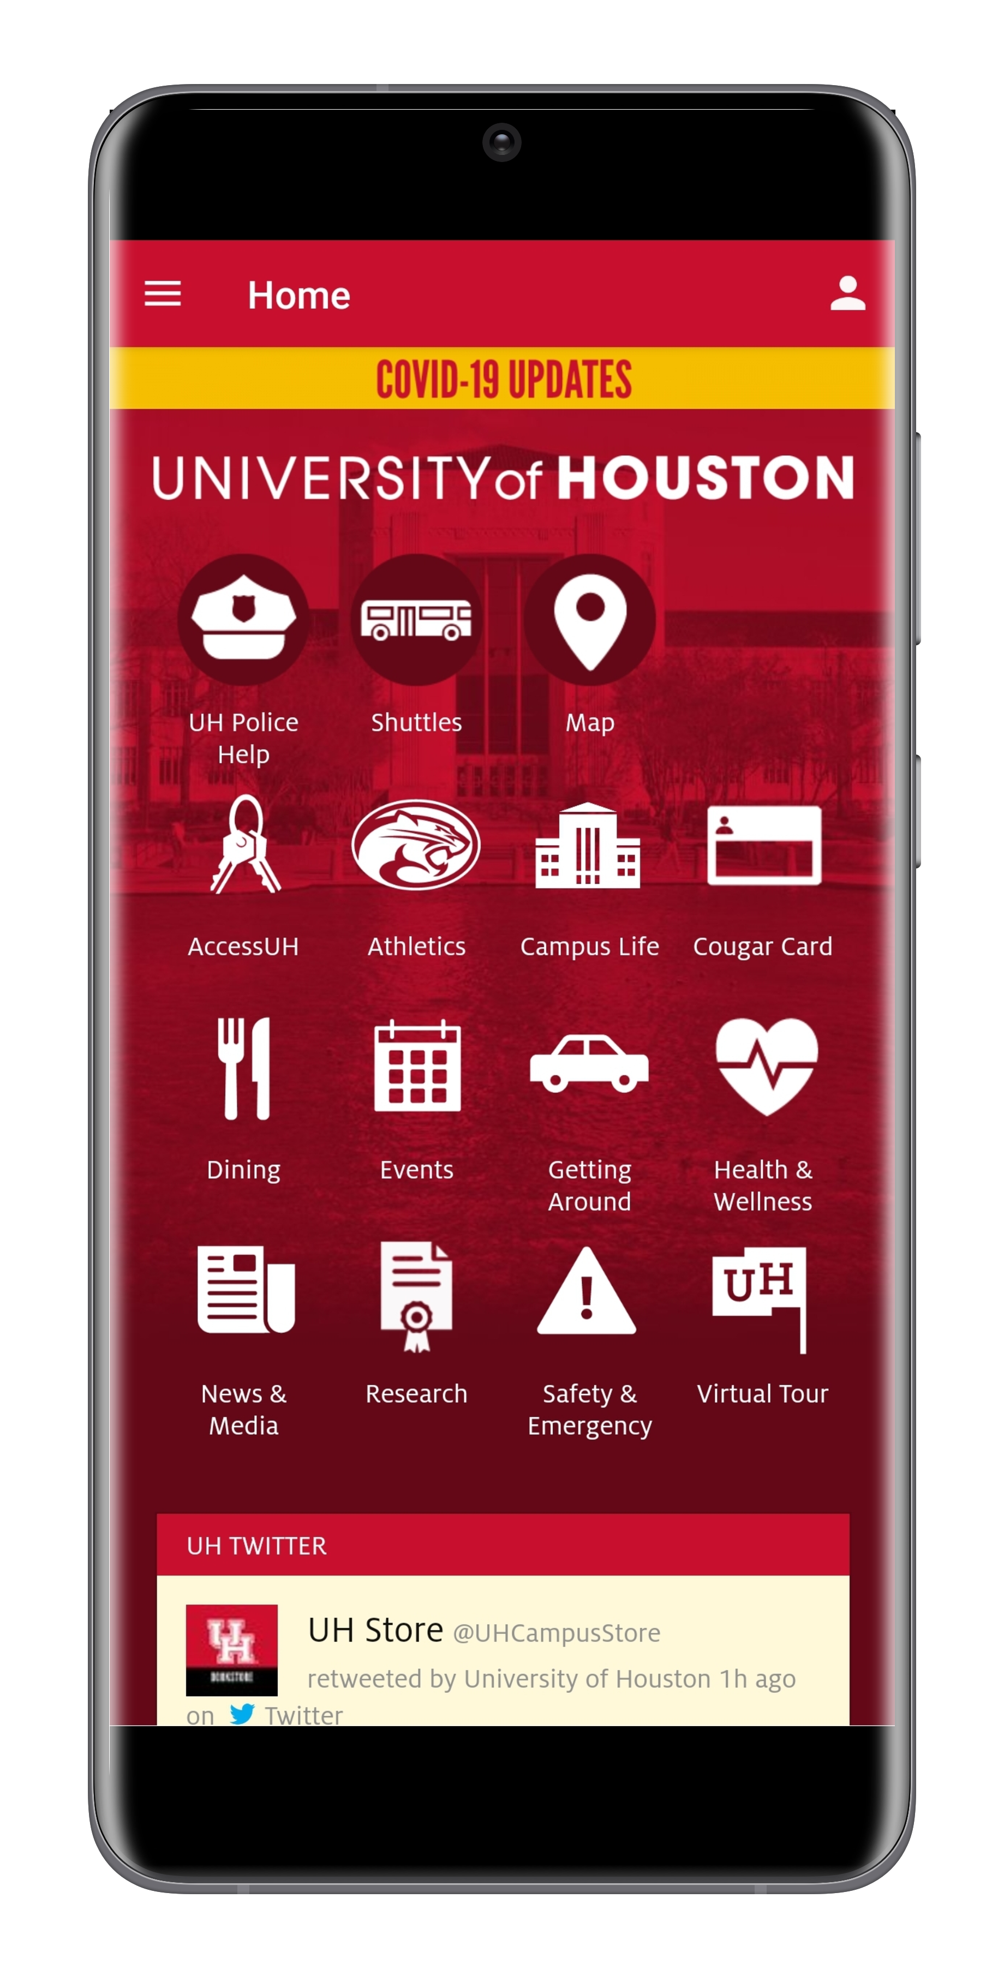
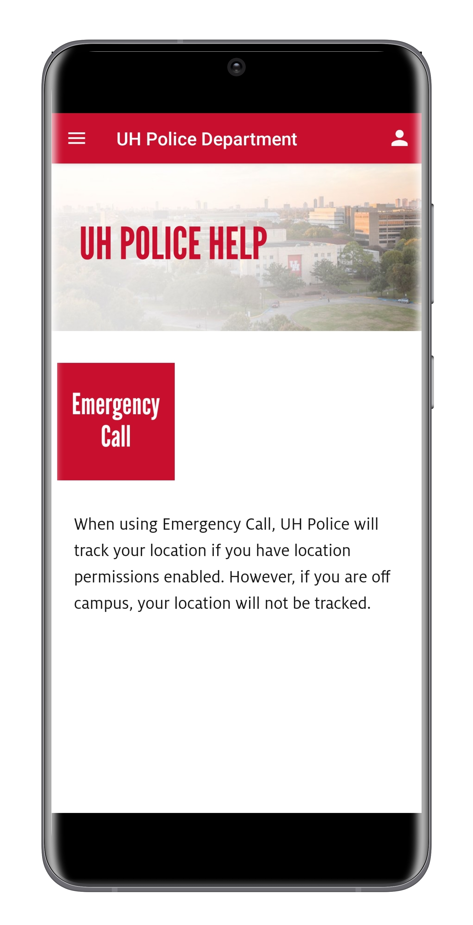
OUR APPROACH
It is important to have a unified look at feel. We strived to have the same look for both iOS and Android.
iOS iPhone 12
Android
Notice that both devices render the screen the same other than screen resolutions

Slide 13
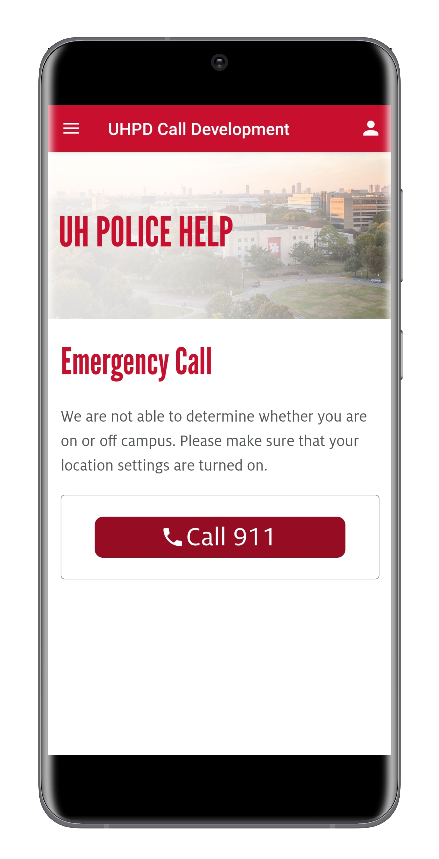
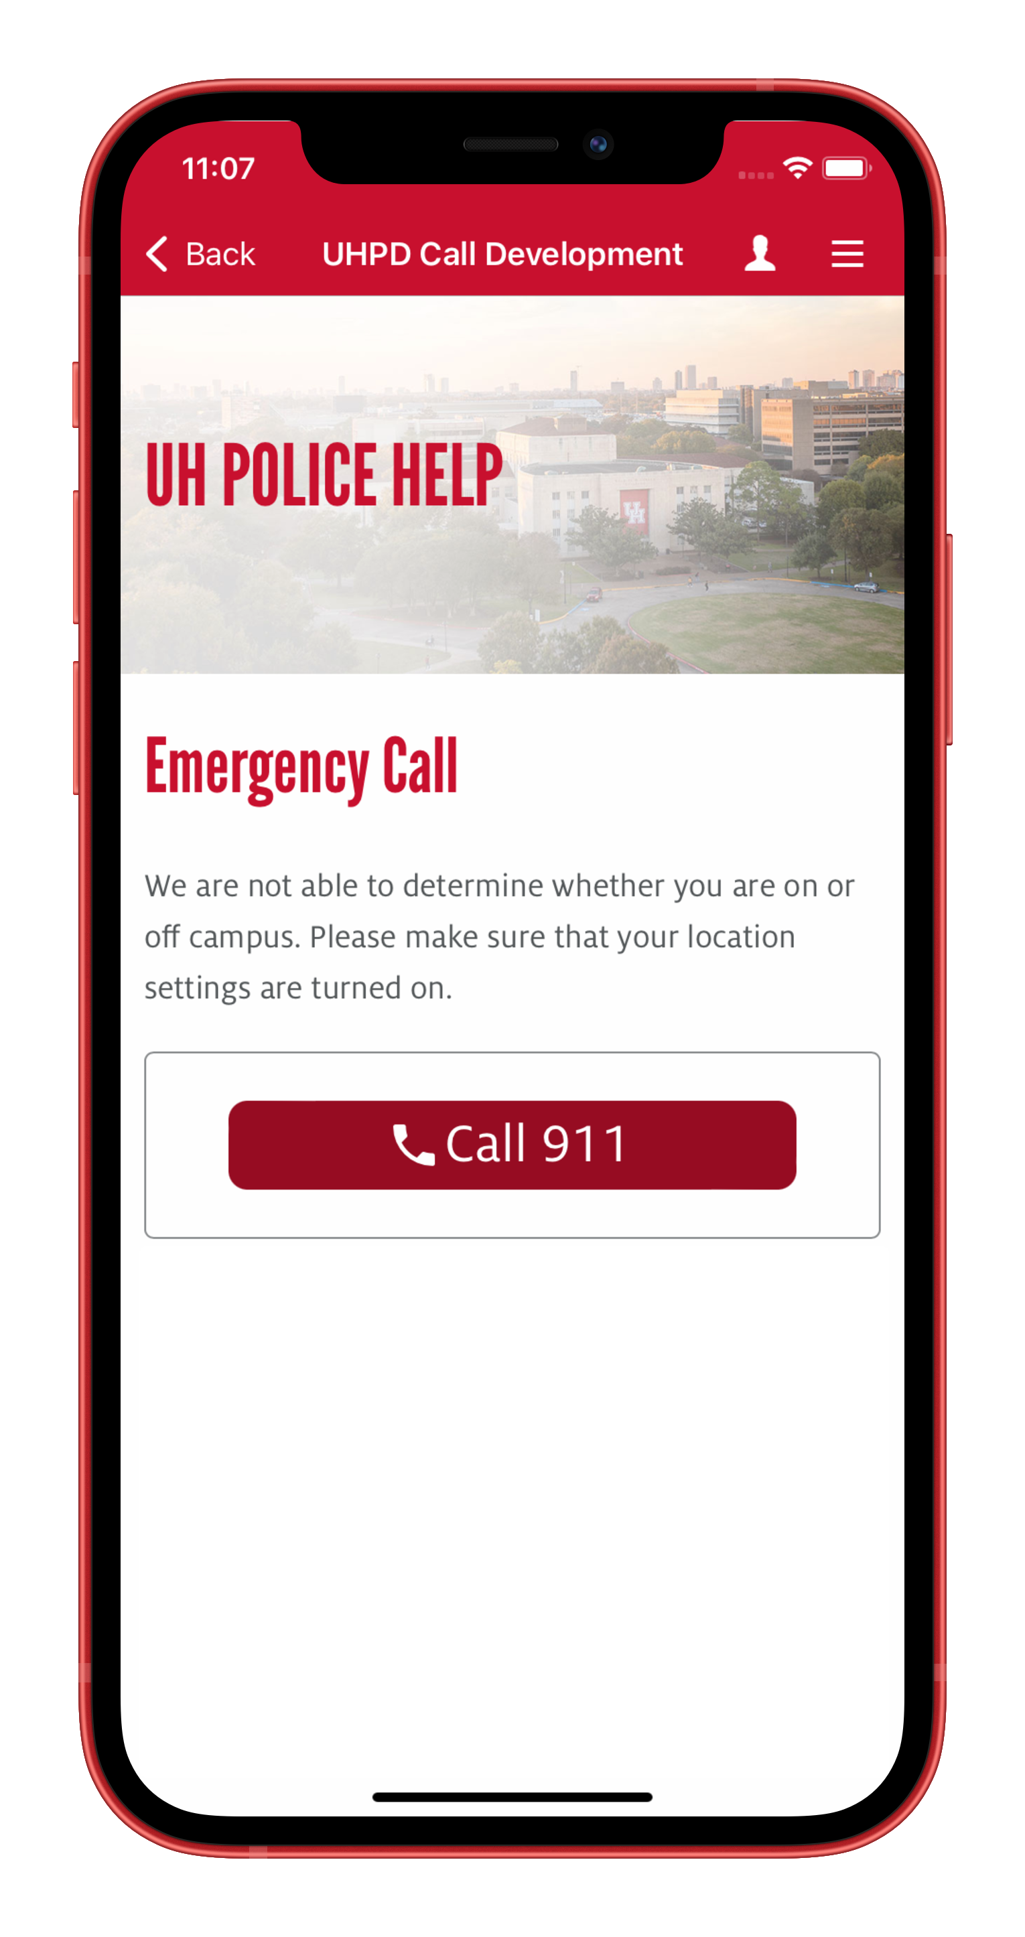
ANDROID VS IOS
* Screenshots have been taken from development screens
Android
iOS

Slide 14
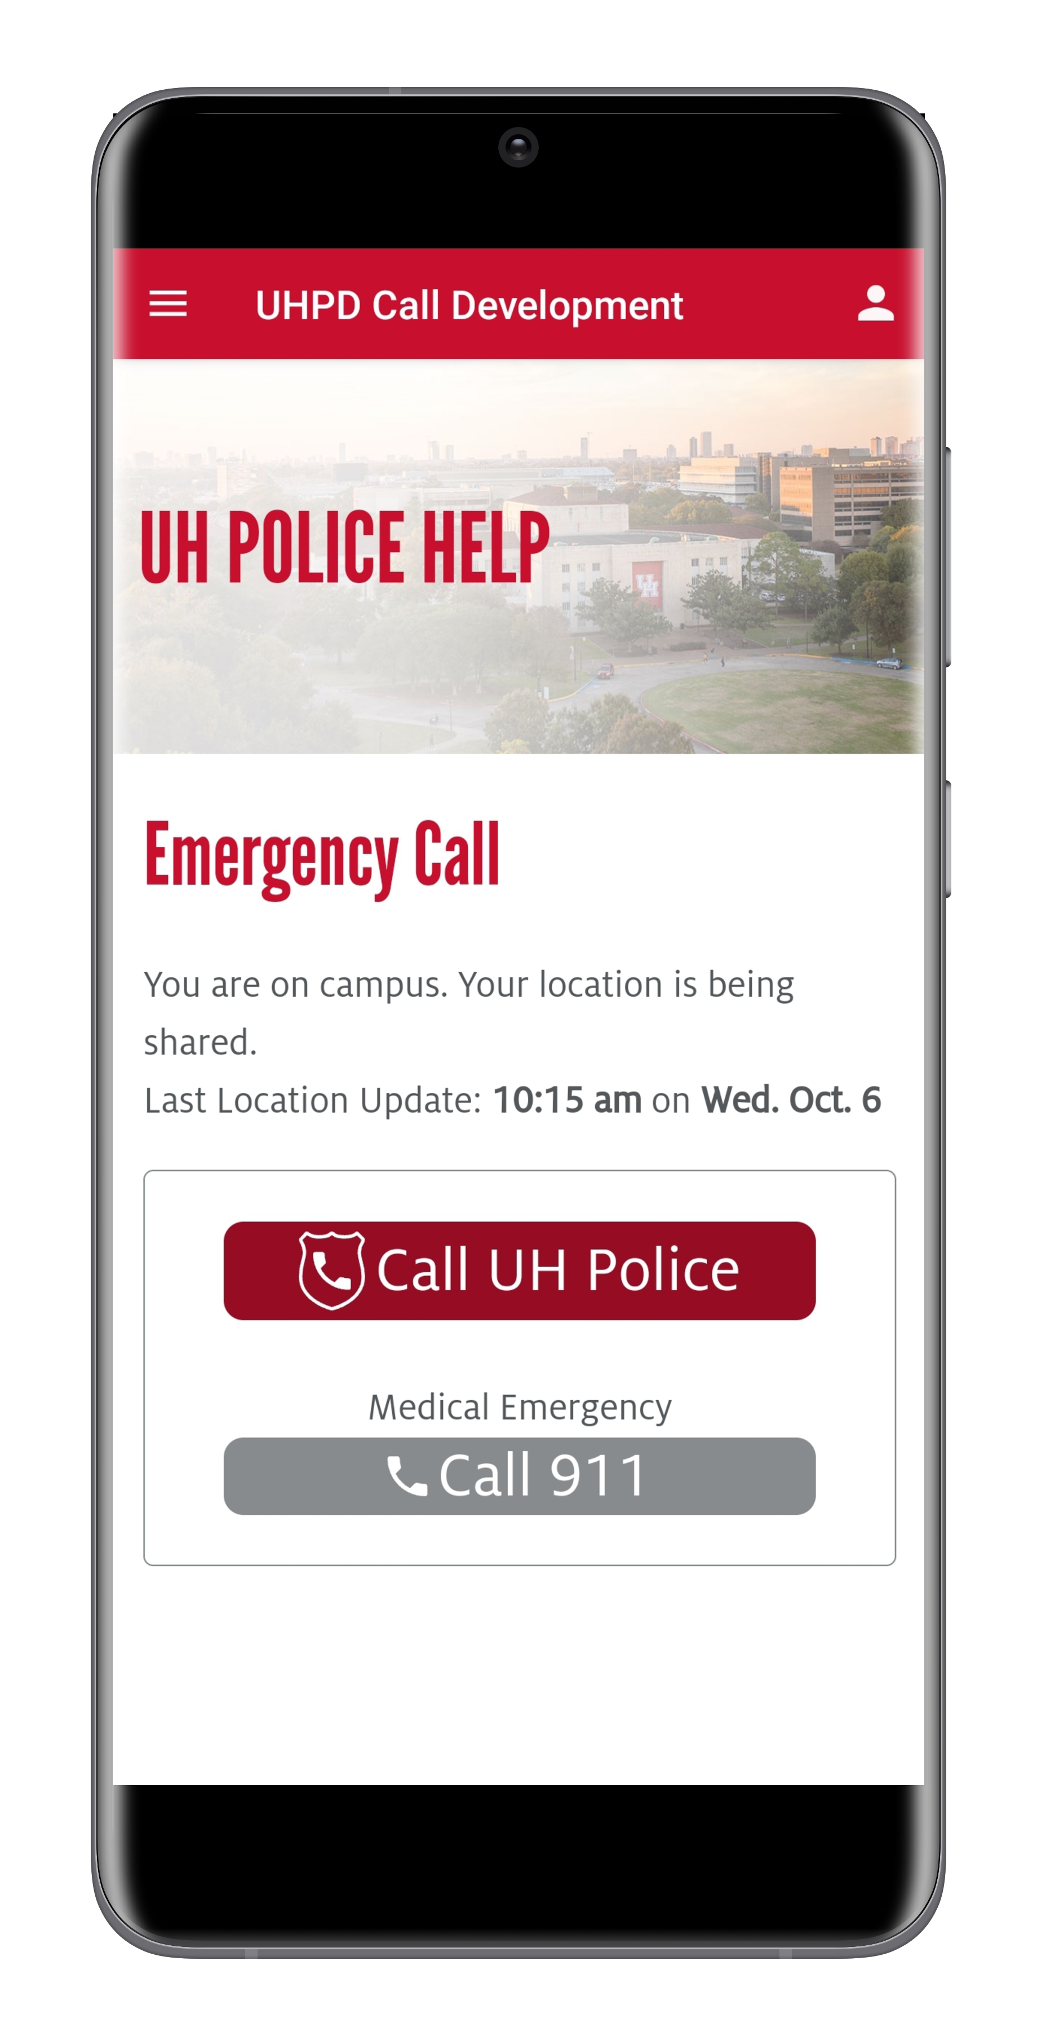
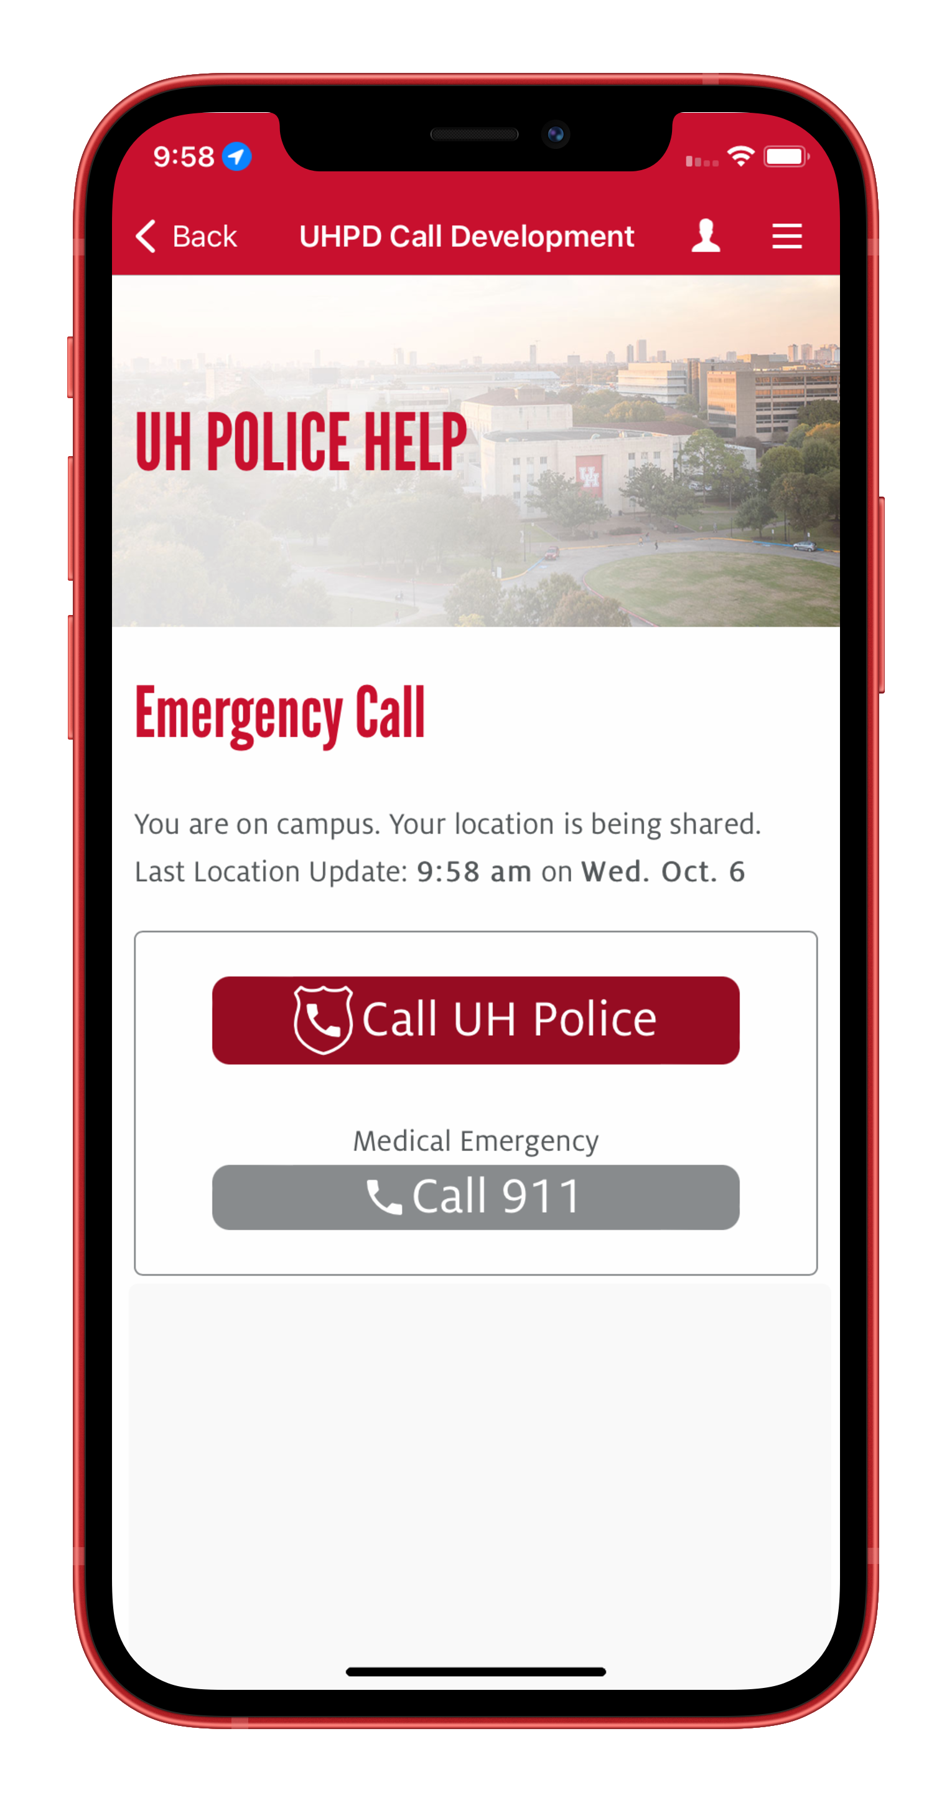
ANDROID VS IOS
* Screenshots have been taken from development screens
Android
iOS

Slide 15
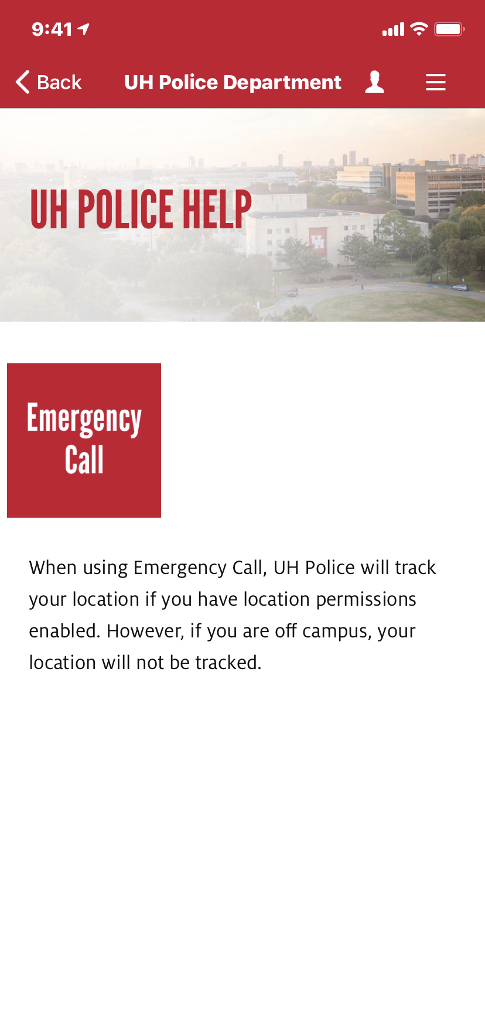
GETTING THE USER’S CONSENT
In order to allow the app to proceed with gathering the user's geo-location we need to consider the following:
User needs to know their location is being sent to University Police.
User needs to grant permissions to their location via app settings and we needed to communicate this.
We needed to tell the user that their location is being used to determine if on campus.
What if they don’t agree or set their permissions correctly?

Slide 16
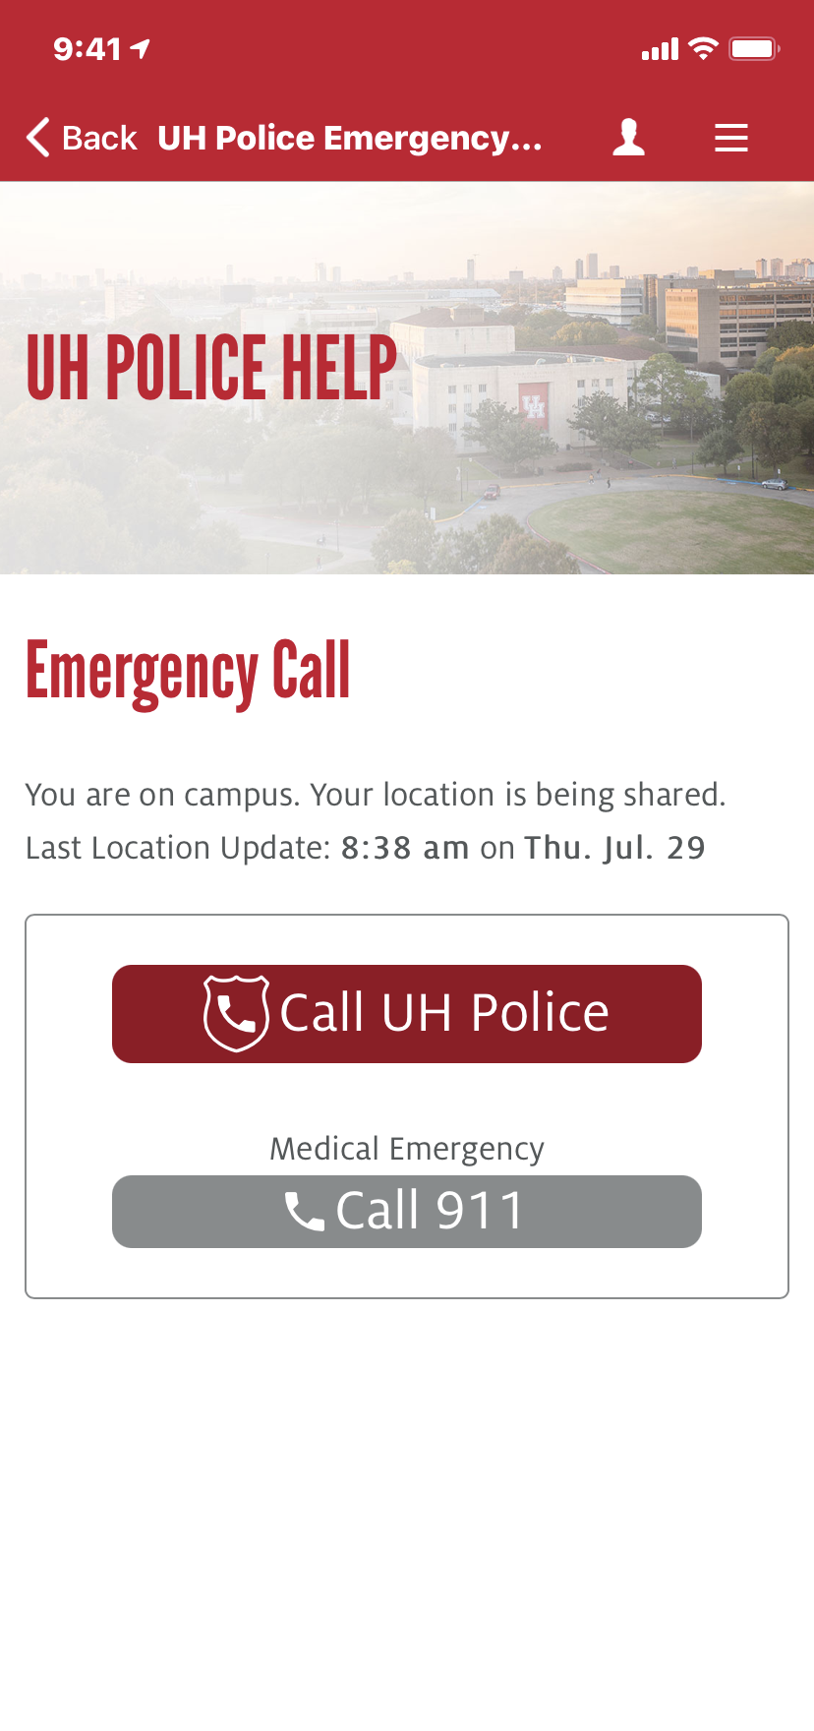

LOCATED ON CAMPUS
When a user is located on campus, they see a message like this…
Time stamp of when their location was last updated.
In the background the app refreshes the location of the user when the app detects a change in geo-location
Give the user options on actions to take, we don’t take the action for them, but University Police knows where they are.

Slide 17
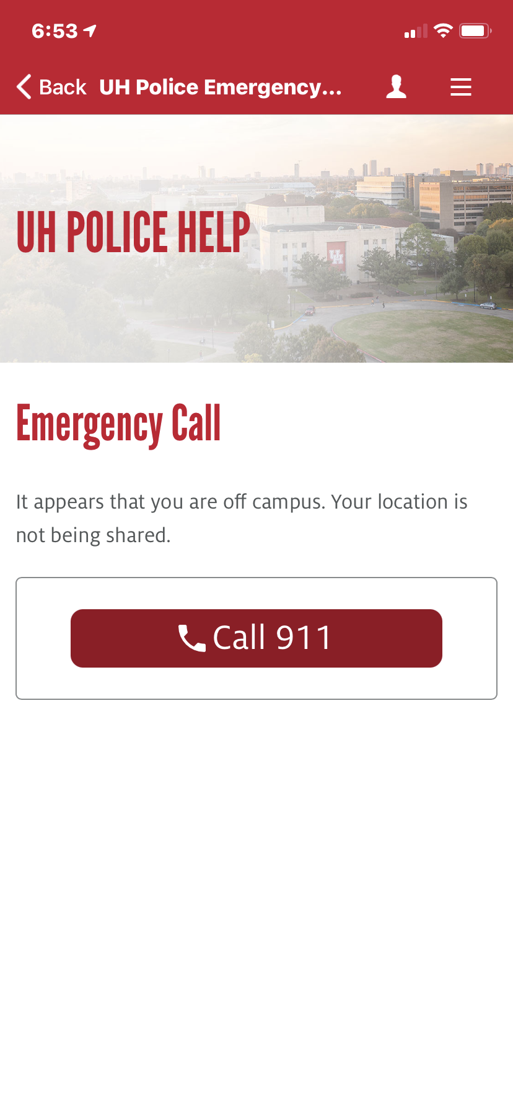
LOCATED OFF CAMPUS
When a user is located outside of the UHPD jurisdiction they are still prompted with a message.
The app responds with a limited response of call 911
In the background the app refreshes the location of the user when the app detects a change in geo-location. If the app detects you re-entering a geo fence, then the message will change.
* Additionally, the app begins to send the updated information to UHPD

Slide 18
User Flow OFF Campus
User location is sent
Location is compared to geo fences
Determined to be OFF campus
User Opens UH Go and taps on UH Police Help
User taps on Emergency Call
* NOTE: There is also the chance that Geo-location is off
User is provided option, user’s location is NOT stored

Slide 19
User Flow OFF Campus
User location is sent
Location is compared to geo fences
Determined to be ON campus
User Opens UH Go and taps on UH Police Help
User taps on Emergency Call
User is provided option, user’s location is transmitted to UHPD

Slide 20
BEHIND THE CURTAIN

Slide 21
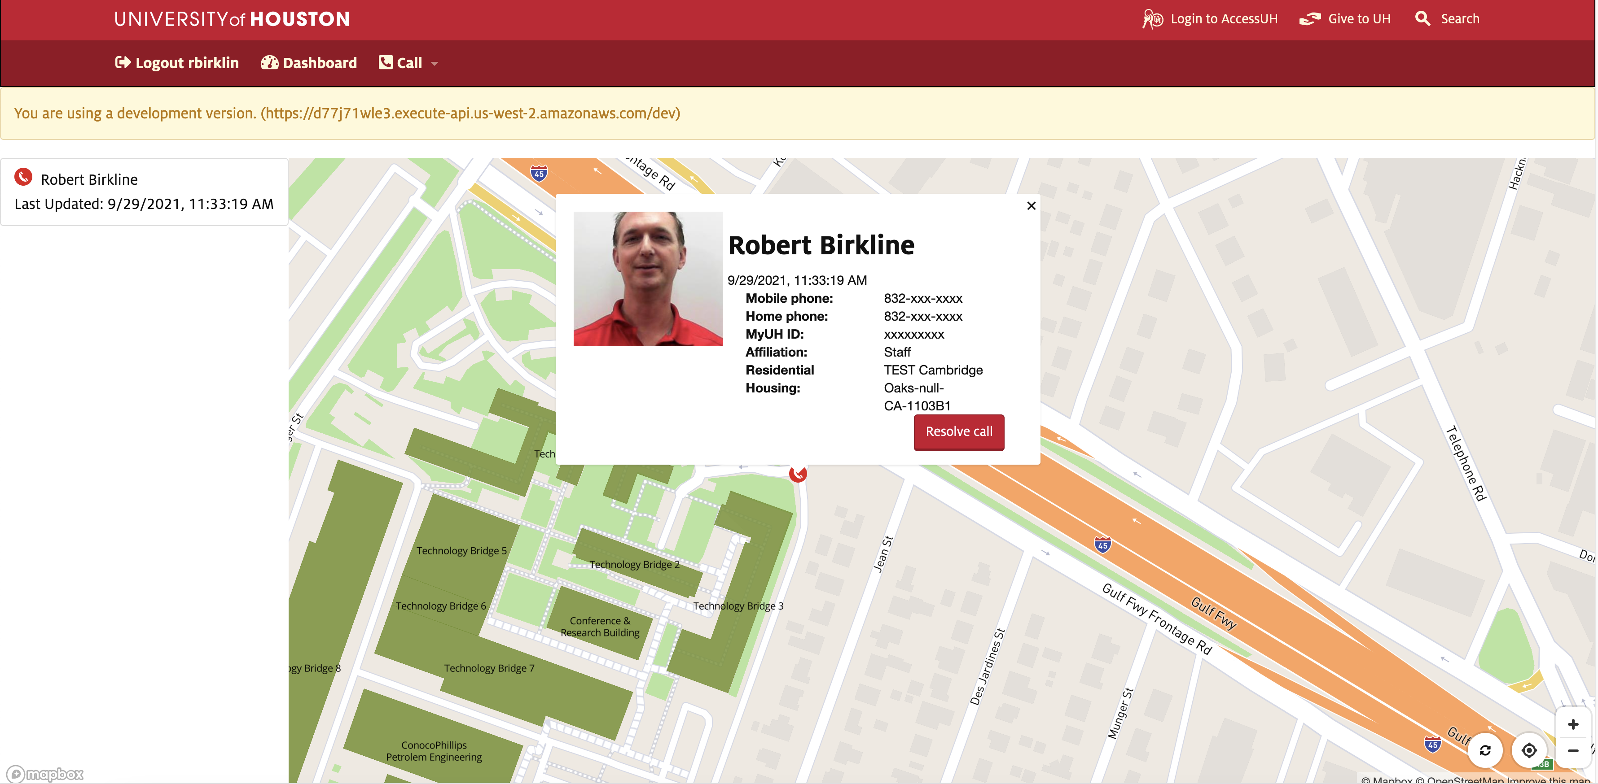
ADMINISTRATIVE USER LOCATION MAP

Slide 22
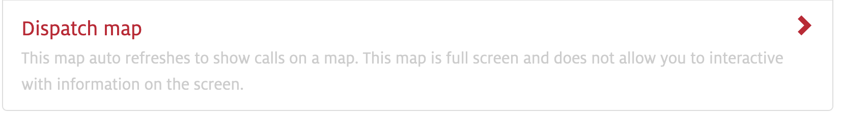
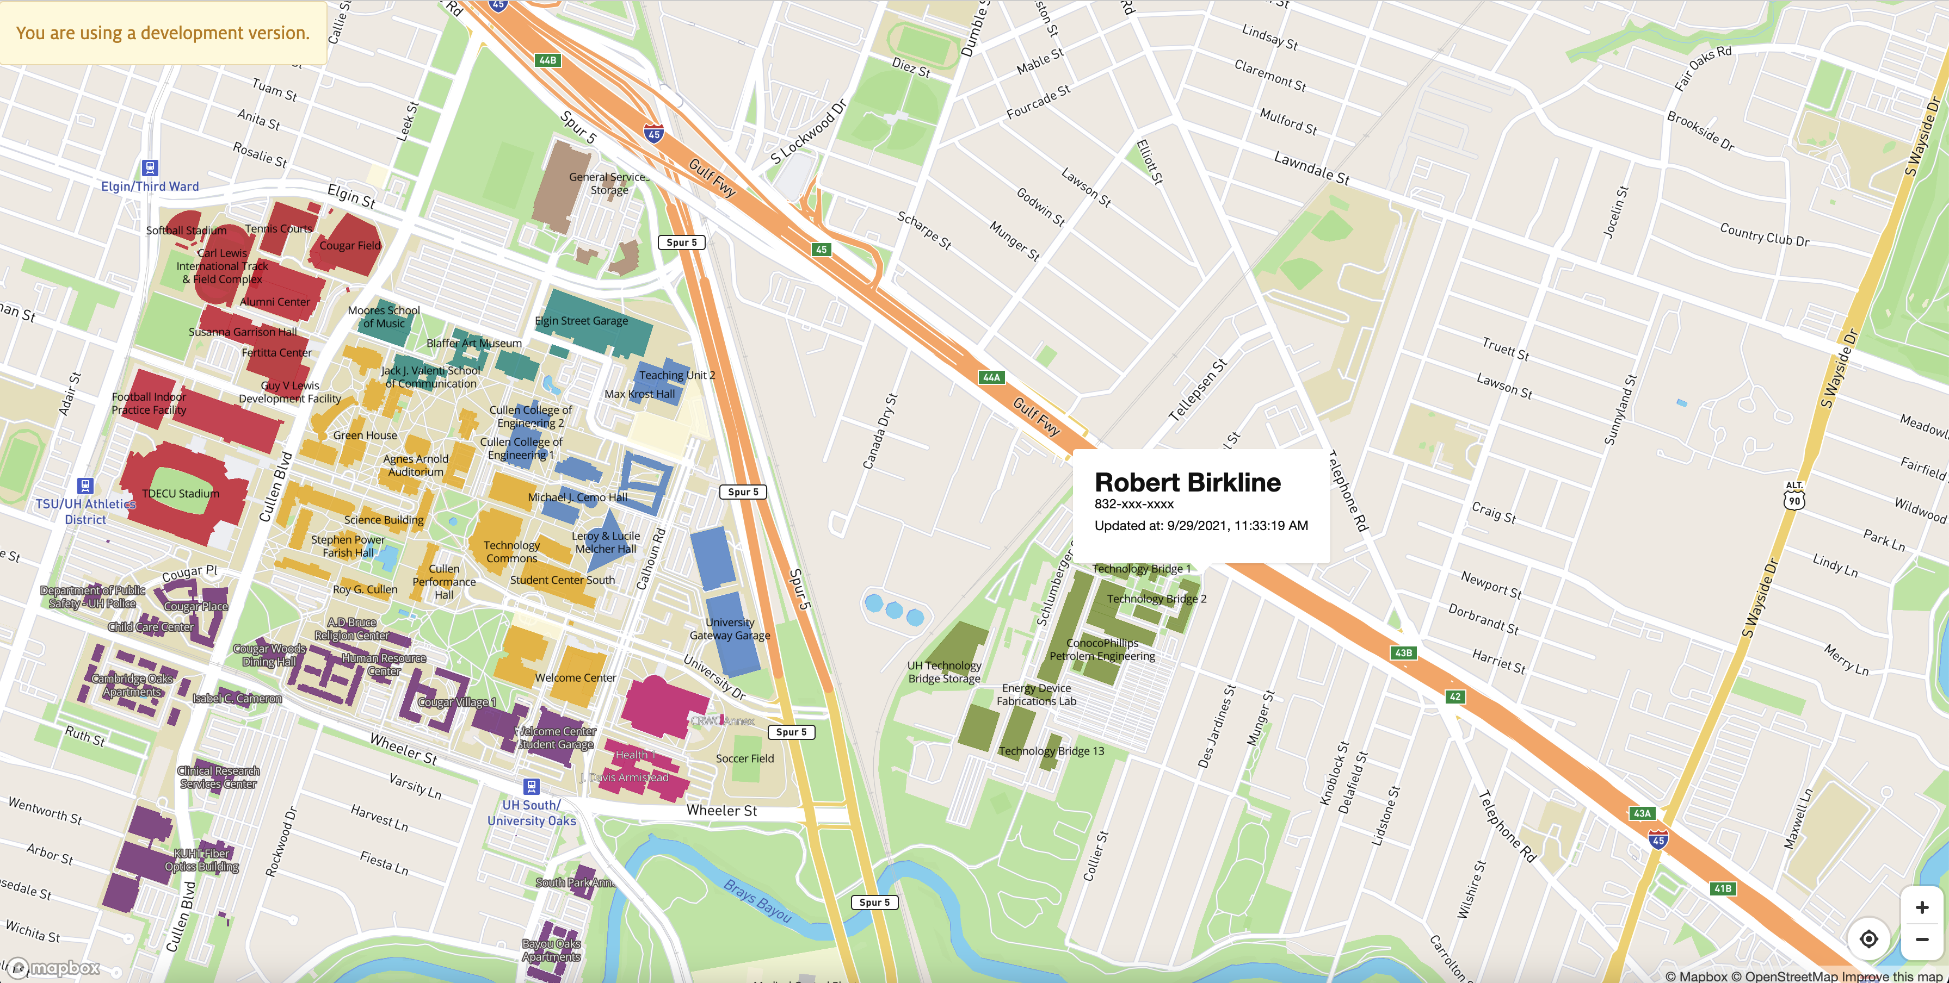
ADMINISTRATIVE DISPATCH MAP

Slide 23
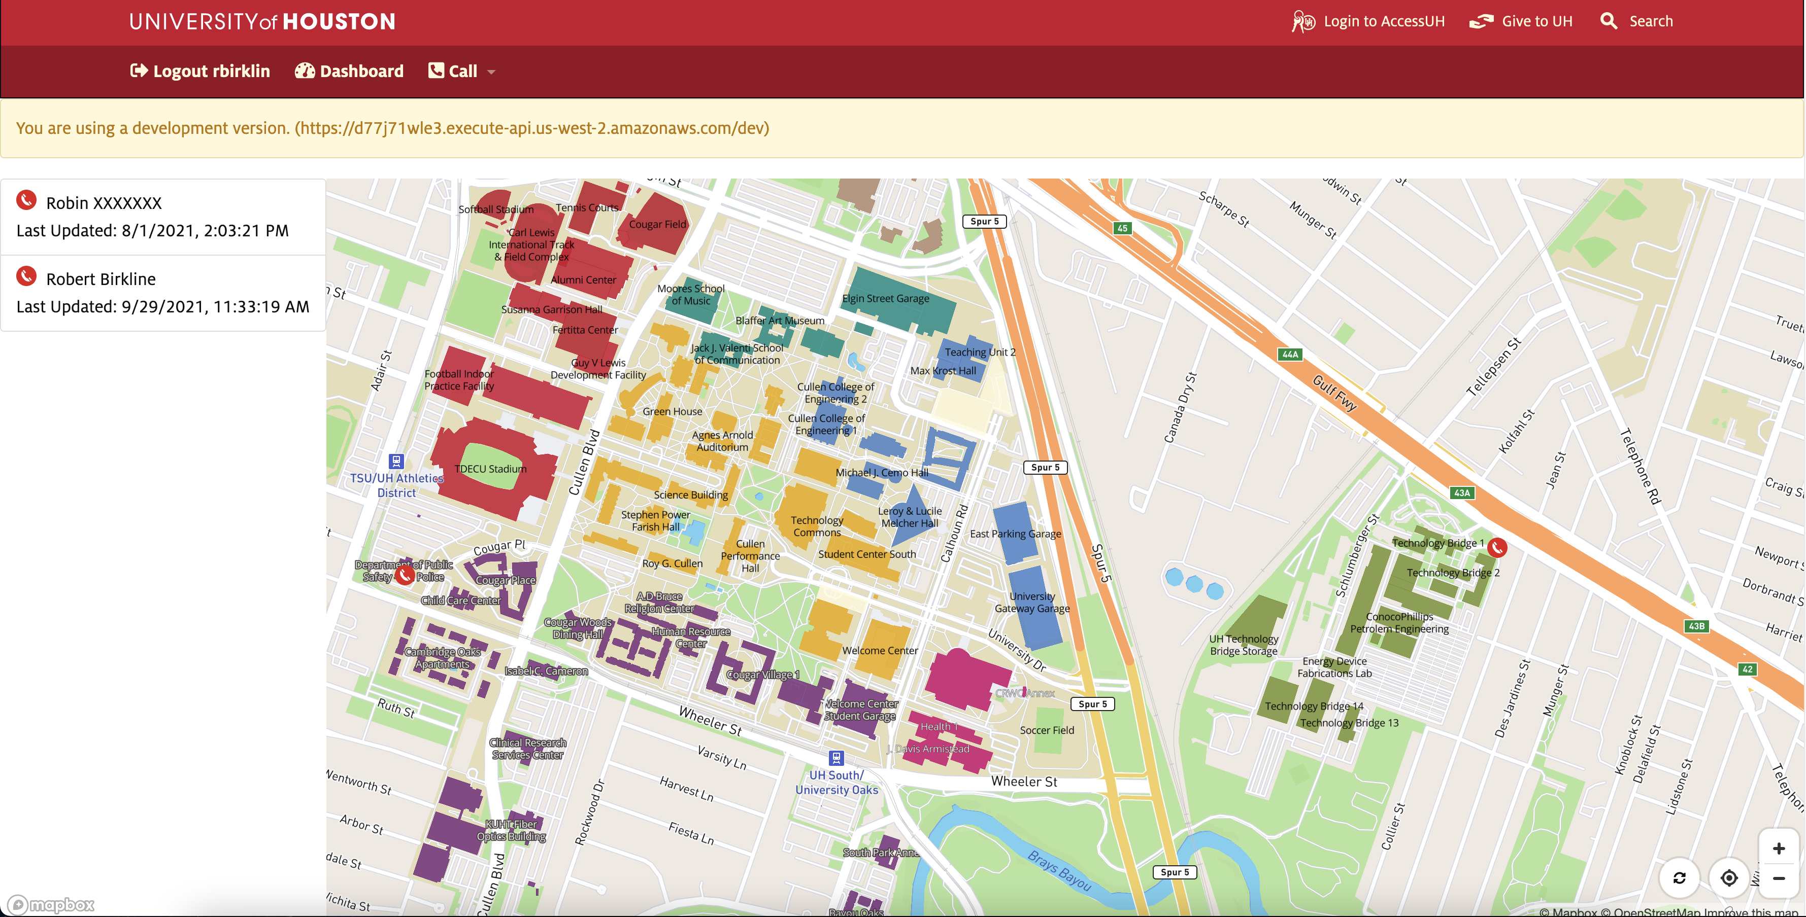
ADMINISTRATIVE PANEL WITH MULTIPLE PEOPLE
Map zooms in an out to show you a complete picture of activity

Slide 24

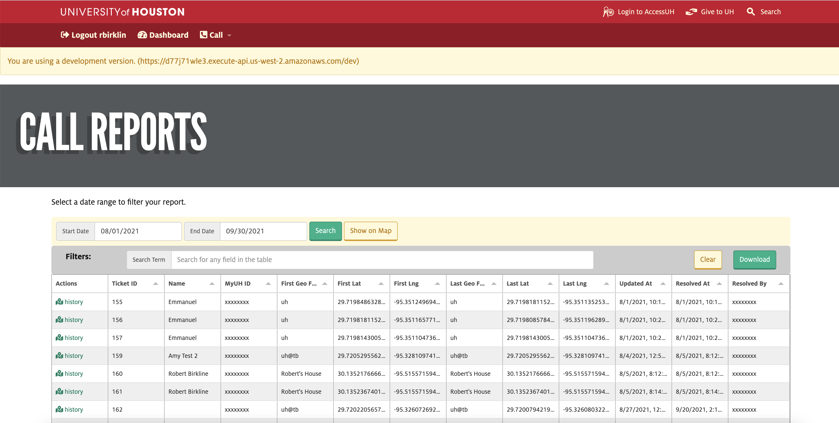
ADMINISTRATIVE REPORTING

Slide 25
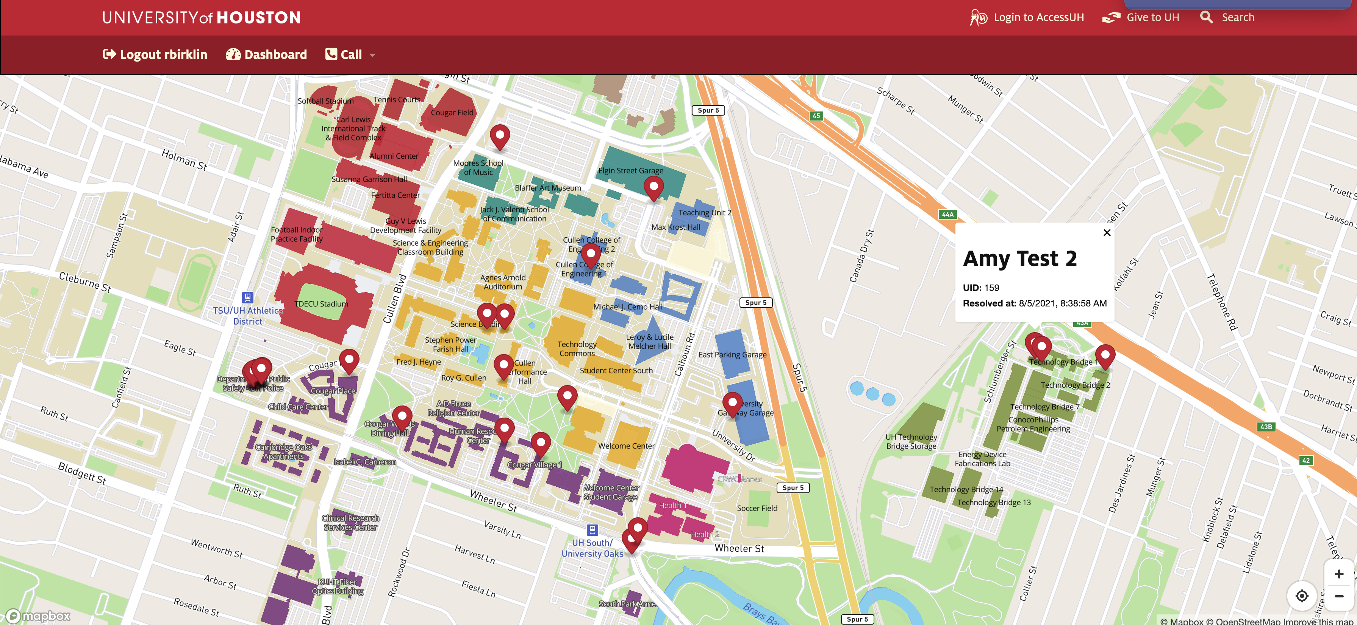
ADMINISTRATIVE REPORTING MAP
Run your report and show emergency calls on the map.
You can see if there are any clusters of calls.

Slide 26
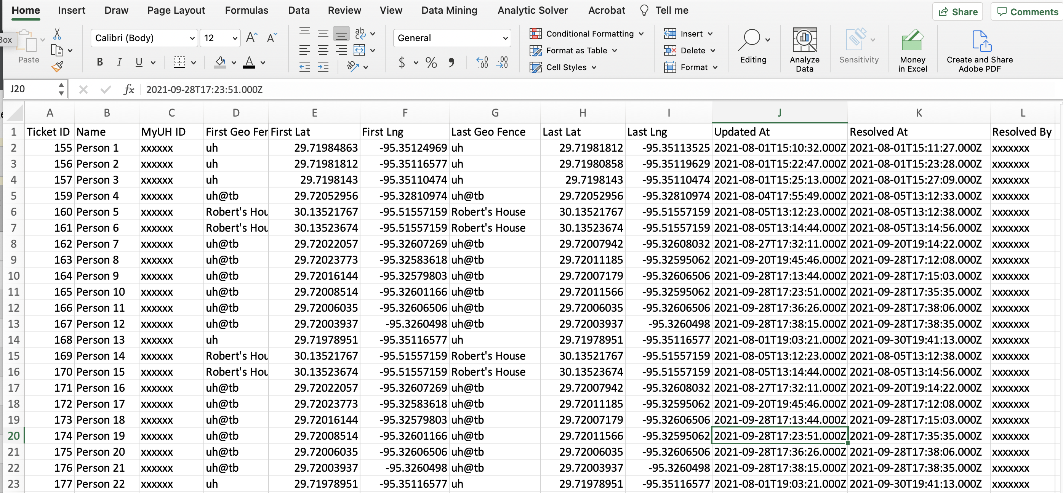
DOWNLOAD REPORT
Run a download of calls and get all the information available.
This gives you the ability to do external analysis

Slide 27
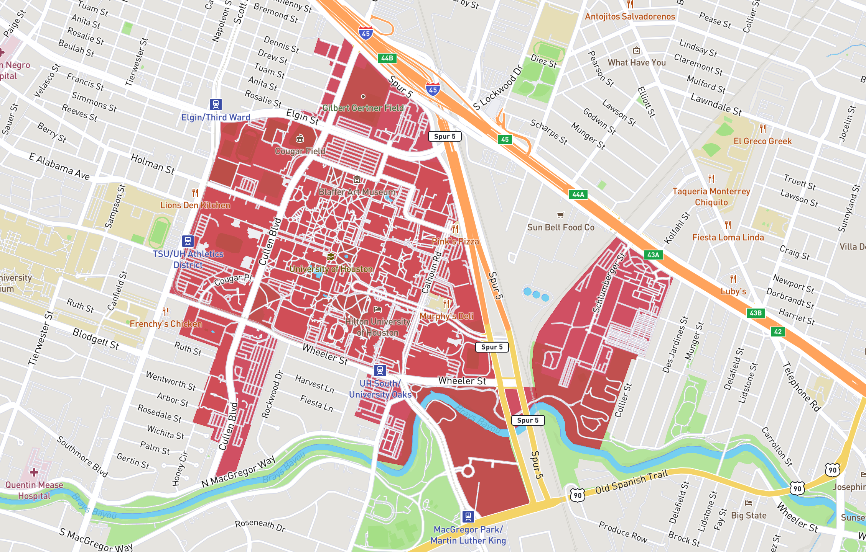
GEO FENCES
UH
UH @ Tech Bridge
Notes:
Governance: good not evil…need policy include procurement
Shapes the entire environmental

Slide 28
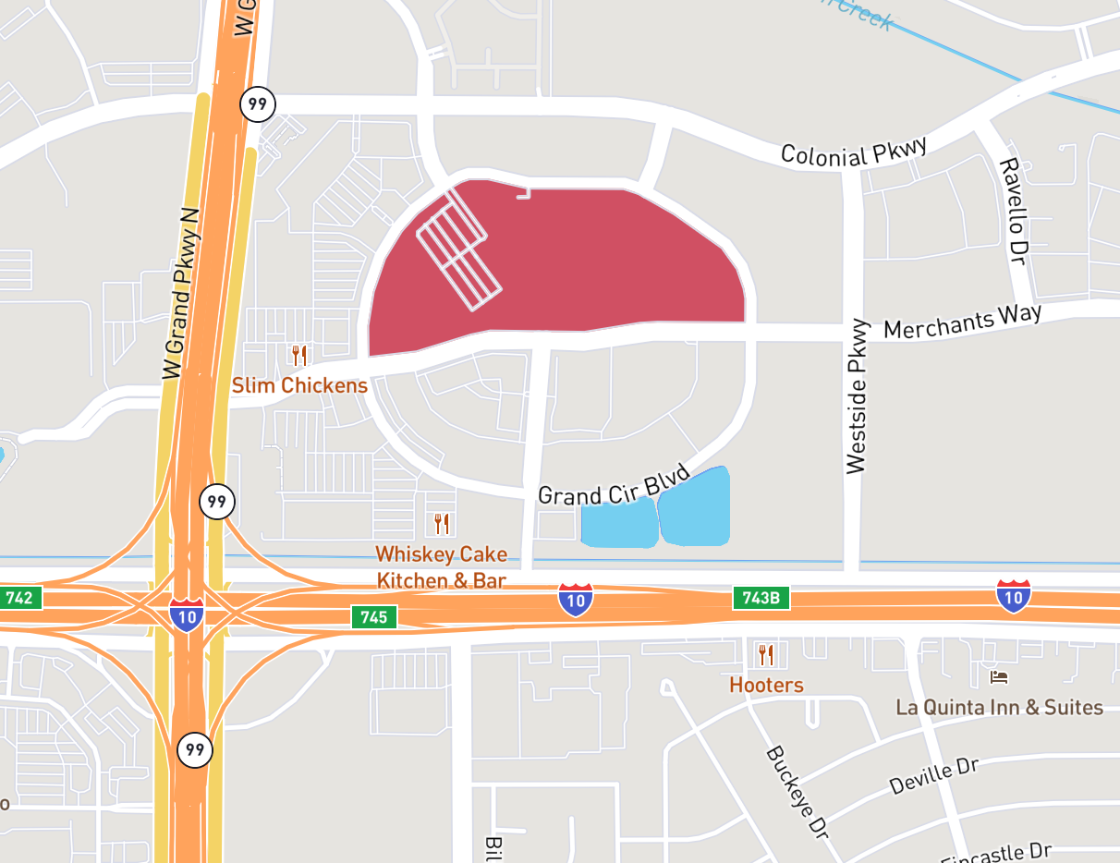
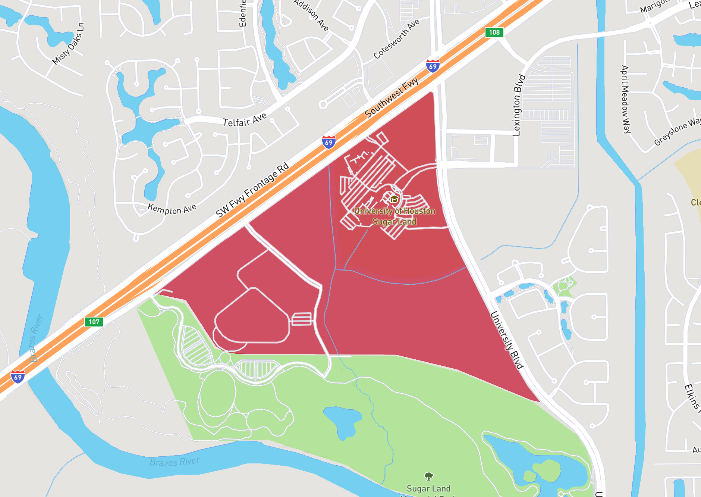
GEO FENCES
UH @ Katy
UH @ Sugar land
Notes:
Governance: good not evil…need policy include procurement
Shapes the entire environmental

Slide 29
Thank you!

