Slide 1
UH CMS Basics Training
Notes:
CMS Basics Training for the University of Houston website
Please Note:
UH webpage images used here for illustration purposes may contain outdated content/information.
For the most recent information, see live online site from: http://www.uh.edu

Slide 2
CMS Overview
Content Management System
Paradigm shift >> Stronger more unified UH identity
Enables non-technical contributors
Also enables magical illusions
And is designed to be a Web-Page Factory
Notes:
CMS stands for “the Content Management System” –
There are many different types of Content Management Systems – the one the UH Web uses is Cascade Server by Hannon Hill [currently version 8.3 – as of Spring 2017].
Paradigm shift –
Formerly (as the web evolved) each unit or area at the university had developed its own web presence, depending on whatever varying resources were available. A number of very talented people created a lot of great materials. However, we now know through user studies that a more unified look, feel, and functionality throughout a website contributes to its site visitors’ estimation of the organization itself.
With the CMS providing a common source of UH-focused styles, look, feel, and functionality, we can ensure a stronger, more unified identify for the university - with the students, the faculty, the staff, as well as the public – which helps us to achieve and maintain our Tier One status.
The CMS enables non-technical contributors –
Individuals without an IT or web background can still use the CMS to add and edit content on the UH website –
Magical Illusions –
later we will look at how the CMS leverages a browser’s sleight of hand; Seamless to site visitors, but important for website editors to understand when working inside the site;
And the CMS is many things to many different people – but basically, the CMS is designed to be a Web Page Factory –

Slide 3
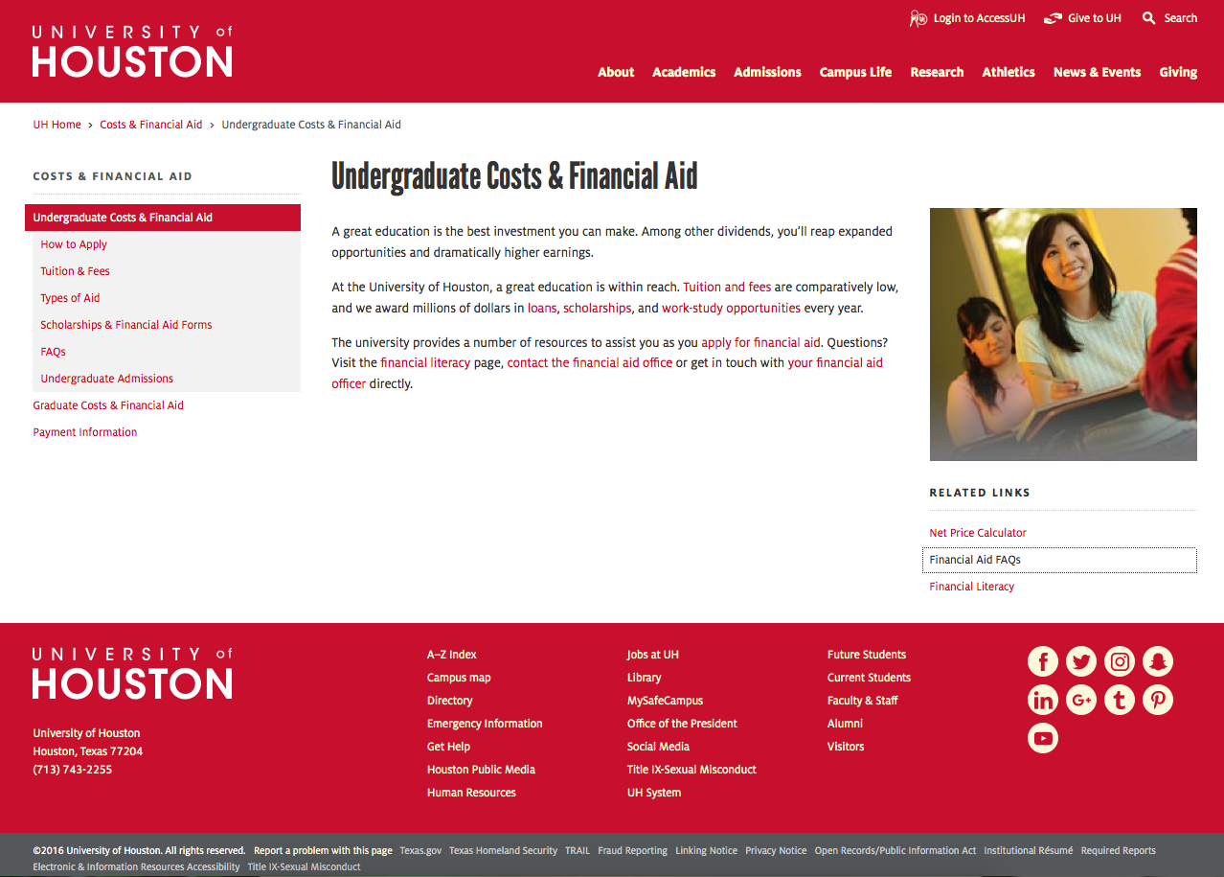
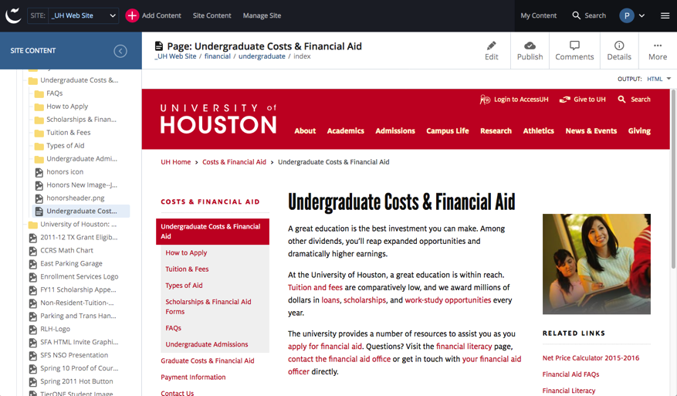
Web-Page Factory
staging/testing server
Server hosting
the CMS
Web
Page
(.php)
keep secure
do not share
URL
CMS
Page
Asset
LIVE/production server
Web
Page
(.php)
Notes:
Here is a visual overview/schematic of how the CMS is set up –
Users will edit and create within the CMS application interface (represented on the left); and when ready, the materials will be published out as the more familiar-looking UH webpages (represented on the right);
Pages will publish out as .php pages by default.

Slide 4
Web-Page Factory
staging/testing server
Server hosting
the CMS
Web
Page
(.php)
keep secure
do not share
URL
Cross-platform availability
via Browser access
Browser
Views
CMS
Page
Asset
LIVE/production server
Web
Page
(.php)
Notes:
Users will be working within a browser-based interface, and thus will be able to use a wide variety of browsers, such as FireFox, Chrome, Internet Explorer, and others –
Browser-access makes the CMS highly available cross-platform – if your system allows you to use a browser, chances are you can use the CMS;
While there are some minor incompatibilities depending on the browser (we are talking to you, legacy browsers and even IE), usually these can be solved by simply updating or switching browsers.

Slide 5
Web-Page Factory
staging/testing server
Server hosting
the CMS
Web
Page
(.php)
keep secure
do not share
URL
Cascade is not a live-edit application
CMS
Page
Asset
Publishing required
LIVE/production server
Web
Page
(.php)
Notes:
Within the CMS, you have access to the editing environment:
you will see your site’s file structure, and have access to editing panels consisting of fields to fill in, selections to make, links to create, rich-text editors to update content, and so on.
Please Note: Cascade Server is not a Live Edit application. A specific publishing step must be taken to write your pages out to the server where they can be viewed via a URL in a browser window.
As you will see: inside the CMS you will be creating and editing pieces of your web pages – these pieces are not yet actual web pages. It is only during the Publishing step that all the pieces (including those which may not be visible to you, such as CSS stylesheets, scripts, etc) will be brought together by the CMS and published out as a full web page.
Once a page is ready to be published, a user with Publishing-level permissions will go to a Publishing panel and activate the CMS Publisher function.
At that point, the CMS pulls all the “unseen” pieces (styles, scripts, etc.) together with the edited content, constructs the final webpage itself, and publishes it out to the server in the form everyone is familiar with.
FYI: The typical UH webpage publishes out as “PHP”.
In order to help web editors see how the page is working as a whole, and to allow content owners to proof things before they go live to the public, a minimum of two server locations are provided for each site:
‘Hidden’ (aka ‘Staging’ and/or ‘Testing’) locations, which the public does not access, and which search engines have been instructed not to crawl;
And the live location, which anyone, anywhere in the world can view.

Slide 6
CMS = internally, dynamically, manages your site’s resources: pages/files/graphics
/links/etc… and also acts as that ‘Web Page Factory’ – via its built-in Publisher functionality. Upon Publishing, the Publisher assembles all the various pieces
(some you see and work with, others you may never see) into your final web page(s), and then writes all the needed files to your site’s designated server location(s) as static page files.
CMS TERMINOLOGY
Server hosting
the CMS
staging/testing server
Static version
The Publisher
CMS functionality which
assembles all instructions and
creates separate, STATIC versions
of your materials on the server.
Items ‘update’ by being overwritten.
Dynamic -
but not live-edit
Publishing creates the
static webpage
LIVE/production server
Static version
Notes:
General CMS TERMINOLOGY/concepts – Focusing on Cascade Server-specific and UH-specific jargon
CMS as a Dynamic resource manager – vs. Static pages on the server
Many content edits/updates are reflected immediately throughout the site pattern inside the CMS, such as with navigation menu changes, internal links, etc.
due to the dynamic resource management functionality inherent in the CMS.
However, the CMS is not a LIVE-edit application. This means changes you make within the CMS will not show up immediately on your live site as you make them.
A separate Publishing step needs to be taken to write files to the server. And writing files to the server is ultimately what the CMS is all about!
THE PUBLISHER
Is the functionality within the CMS which assembles all the pieces and creates the final webpages, then writes the necessary files to a designated area of the server (live or staging –
where they can then be accessed by going to the appropriate web address via your browser.
Once Published out to the server, the resulting web pages are then Static,
and can only be “changed” through being re-Published (aka overwritten, or even deleted).
---------------------------------------------------------------------------------------------------------------------------------------------
*** Additional notes about Publishing –
The CMS takes all the templates, style sheets, scripts, code, documents, applications, files, content, and whatever other information you have uploaded, coordinates it all, tracks it all, connects it all, and then takes it all and writes out the source code for a web page, which in turn is written out to a server for browsers to find and interpret as a final web page.
The assembly includes internal directly-editable CMS assets, such as page assets, files, folders;
as well as assets which the user may not be able to edit directly, such as UH CSS styles, scripting which supports functionality, etc.
Now, it is important to keep in mind that
Once a page has been published out, the CMS in a sense is no longer “connected” to it. The only way the CMS can “change” a webpage is to write over it with a new version. While you are inside the CMS editing, you are creating what will end up as that new version. The new version can be seen via a web address only after you Publish the page.

Slide 7
CMS TERMINOLOGY
Server hosting
the CMS
staging/testing server
non-crawled
keep URL
private
Publishing
Destinations
Usually at least two
( may be more )
Permissions-based
LIVE/production server
public – viewable
by anyone
If you are granted permission to publish to a non-crawled staging address,
then that URL will be passed along to you.
Always avoid the use of staging/test URLs as links for live pages.
Cascade will manage “internal” links for you – i.e. any links created using the Chooser tools.
“External” inks – those requiring a manually entered URL - must not point to non-crawled web addresses.
Notes:
PUBLISHING DESTINATIONS
For both quality and security purposes, the CMS is set up to Publish out to at least 2 publishing “Destinations” for each site:
A “live” area - what most people recognize as the website itself – or, the material at the the web address (URL) you would ordinarily go to, to see the website;
this is the area on the UH server where pages are served to the public: where everyone from Poughkeepsie to Sri Lanka can see the web pages in their web browsers
– e.g. using Firefox, Internet Explorer, Safari, etc.. >> http://www.uh.edu to find the UH Home Page.
A “staging” (aka “hidden” or “non-crawled”) web address where your pages can be published out, viewed, and tried out or vetted before they go live –
This is a different “server location”, and thus will have a somewhat different web address.
It is considered to be “hidden” because search engines have been instructed to not crawl it;
however, the server “environment” should be virtually identical amongst live / staging (aka testing) destinations.
NOTE: many sites will have two “hidden” areas (distinquished as “staging” and “testing”, although both are within the hidden areas of the UH servers),
especially during site development, for example, as some features may require 2 destinations for them to work correctly.

Slide 8
Web-Page Factory
SOME CMS BEST PRACTICES
Server hosting
the CMS
staging/testing server
keep secure
do not share
URL
1
CMS
Web Page
Build
and
preview
inside CMS
LIVE/production server
public – viewable
by anyone
Notes:
Best Practices = Good habits
In order to minimize the number of errors which may get published out to the live website, we highly recommend users develop this habit and follow this pattern:
Build and edit your materials within the CMS

Slide 9
Web-Page Factory
SOME CMS BEST PRACTICES
Publish
to staging
and review
Server hosting
the CMS
staging/testing server
2
keep secure
do not share
URL
1
CMS
Web Page
Build
and
preview
inside CMS
LIVE/production server
public – viewable
by anyone
Notes:
Best Practices = Good habits
In order to minimize the number of errors which may get published out to the live website, we highly recommend users develop this habit and follow this pattern:
Build and edit your materials within the CMS
Publish first to the “hidden” Staging/Testing area to make sure everything looks okay and works alright. The staging environment is designed to be virtually identical to the live server environment – so, if something does not look or work correctly in Staging, chances are you will need to fix it

Slide 10
Web-Page Factory
SOME CMS BEST PRACTICES
Publish
to staging
and review
Server hosting
the CMS
staging/testing server
2
keep secure
do not share
URL
1
CMS
Web Page
Build
and
preview
inside CMS
LIVE/production server
public
Go Live !
3
Notes:
Best Practices = Good habits
In order to minimize the number of errors which may get published out to the live website, we highly recommend users develop this habit and follow this pattern:
Build and edit your materials within the CMS
Publish first to the “hidden” Staging/Testing area to make sure everything looks okay and works alright. The staging environment is designed to be virtually identical to the live server environment – so, if something does not look or work correctly in Staging, chances are you will need to fix it
When everything looks great, then Publish the page out LIVE!
And we cannot recommend this highly enough!
Updates should always be published out to the Staging/Testing address BEFORE going live
So that contributors and editors can see how the page will look and act in the specific UH server environment – which should be virtually identical between staging/testing and live –
AND ADJUST WHATEVER IS WANTED OR NEEDED BEFORE GOING LIVE.
It also follows that – to best serve its purposes - the web address (or “URL”) of the staging/testing server should not be shared with the general public.
Please also note that if a site is not yet “LIVE” there may only be one destination – a “hidden” area – available for Publishing.

Slide 11
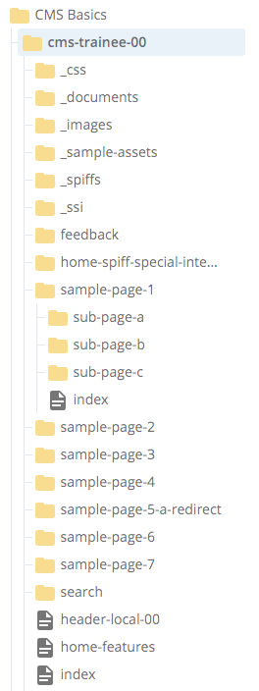
CMS:
The CMS Publisher “duplicates” your site structure by writing files to the server using the same relative organization you see with your site’s Asset Tree in System Name View.
Asset Tree System Names in CMS = File Structure on the Server
CMS TERMINOLOGY
Server hosting
the CMS
staging/testing server
non-crawled
keep URL
private
The Publisher
Writing files to the server
is really what
the CMS is all about!
LIVE/production server
public – viewable
by anyone
Notes:
General CMS TERMINOLOGY/concepts – continued…
The collection of materials and other information inside the CMS, and how it is organized, constitutes a structural pattern.
Your “site” will be constructed and published out based on that pattern.
Hannon Hill considers virtually everything you will be working with to be an “asset”: page assets, folder assets, file assets –
thus, inside the CMS the tree structure which represents your site is referred to as the Asset Tree.
CMS site’s Asset Tree = Site Structure on the Server
How your files are organized in your site’s Asset Tree is exactly how materials will be Published out to any of the Servers’ locations (aka CSM “Destinations”);
NOTE: The assets’ “system names” – of items in your site’s Asset Tree – will become literal filenames upon publishing – and filenames on the server must follow UH file naming conventions.
Be sure to review and follow the handout notes in regard to system names.
The system-name highlights:
Keep asset names all-lower-case; do not use spaces; separate words with hyphens;
Also, prefer hyphens to underscores – especially when naming page-bearing folders – because on live web pages any hyperlink underlining can obscure an underscore.
And avoiding special characters and punctuation characters is also highly advised.

Slide 12
CMS:
Thus, Publishable assets which are: Renamed, Moved, or Deleted will change your site structure. Cascade automatically un-publishes items for which these 3 actions have been taken, to help keep the server free of unwanted materials. Un-publish can also be done manually when wanted.
Re-publishing/New publishing is always at the discretion of a Publish-enabled site editor.
Caution: an editor lacking live publishing might not be able to thus clean up unwanted live files.
CMS TERMINOLOGY
Server hosting
the CMS
staging/testing server
non-crawled
keep URL
private
The Publisher
Writing files to the server
is really what
the CMS is all about!
LIVE/production server
public – viewable
by anyone
Notes:
General CMS TERMINOLOGY/concepts – continued…
The collection of materials and other information inside the CMS, and how it is organized, constitutes a structural pattern.
Your “site” will be constructed and published out based on that pattern.
Hannon Hill considers virtually everything you will be working with to be an “asset”: page assets, folder assets, file assets –
thus, inside the CMS the tree structure which represents your site is referred to as the Asset Tree.
CMS site’s Asset Tree = Site Structure on the Server
How your files are organized in your site’s Asset Tree is exactly how materials will be Published out to any of the Servers’ locations (aka CSM “Destinations”);
NOTE: The assets’ “system names” – of items in your site’s Asset Tree – will become literal filenames upon publishing – and filenames on the server must follow UH file naming conventions.
Be sure to review and follow the handout notes in regard to system names.
The system-name highlights:
Keep asset names all-lower-case; do not use spaces; separate words with hyphens;
Also, prefer hyphens to underscores – especially when naming page-bearing folders – because on live web pages any hyperlink underlining can obscure an underscore.
And avoiding special characters and punctuation characters is also highly advised.

Slide 13
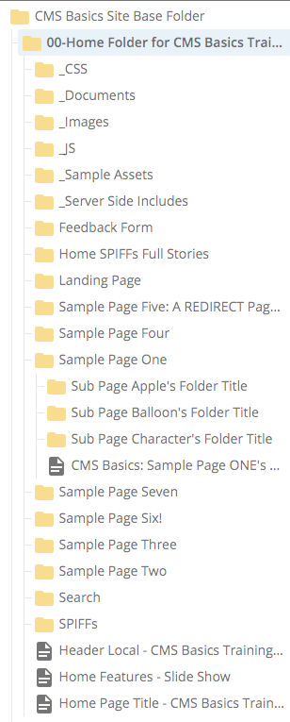
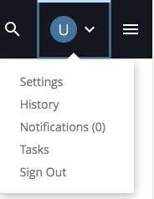
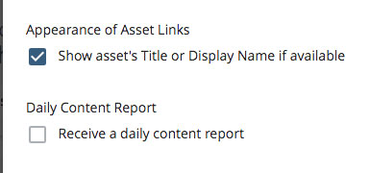
CMS:
In Cascade v.8 Users can switch between System Name and Asset Title views.
Shown above: Asset Tree in Title View = Show asset’s Title √ checked.
User area > Settings > Appearance of Asset Links > checkbox toggle
CMS TERMINOLOGY
Server hosting
the CMS
staging/testing server
non-crawled
keep URL
private
Asset Titles
== Title Metadata
User’s initial default view
LIVE/production server
public – viewable
by anyone
Notes:
General CMS TERMINOLOGY/concepts – continued…
Asset Title/Display Name: METADATA
An Asset’s Title and its Display Name both represent Metadata used within the CMS.
Metadata in the CMS is used to support dynamic functions, such as automated navigation menu building and management.
Metadata can be understood as data which is kept about other data.
Thus, whereas an Asset’s System Name might be considered to be its “real” main identity,
its Title and its Display Name, on the other hand, can be considered to be Metadata:
information which has been assigned to associate with the real identity.
The Cascade CMS has the potential to keep a full set of Metadata information for each and every asset within Cascade,
even though in practical reality, only a small number of items from that set are actually used.
The items which are used, however, often have critical importance (especially Titles)
– and it is important that users understand how those pieces of information fit in with the editing users need to do.
To read more about about the full set of Metadata and how it is used in Cascade, please see:
The Cascade CMS's basic Metadata Set
http://www.uh.edu/infotech/services/web-services/cms/cms-how-tos/understand-metadata/#cascademetadataset

Slide 14
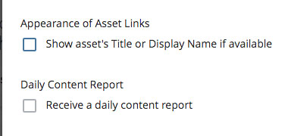
CMS:
In Cascade v.8 Users can switch between System Name and Asset Title views.
Shown above: Asset Tree in system-name View = Show asset’s Title unchecked.
User area > Settings > Appearance of Asset Links > checkbox toggle
CMS TERMINOLOGY
Server hosting
the CMS
staging/testing server
non-crawled
keep URL
private
Asset Names
== System Names
To view, check User Settings
LIVE/production server
public – viewable
by anyone
Notes:
General CMS TERMINOLOGY/concepts – continued…
Asset Names views
With Cascade CMS version 8, the user has the ability to change how asset names are presented
throughout the interface in various reports and lists, including the Asset Tree itself.
Previous to v.8 the view was always by System Name.
New users may see that their default view is now by Asset Title or Display Name (Metadata).
The Asset Title view can make many of the CMS’ user reports more meaningful and friendly.
However, understanding the System Name structure of the Asset Tree is important as well.
Users can toggle the view back and forth at will.
Go to: User area (blue circle showing your first username initial) and select “Settings”.
Find the “Appearance of Asset Links” setting and de-select (or re-select) the “Show asset’s Title or Display Name if available” checkbox.
If calling for CMS help, please let us know which view you are using, so we can follow along with what you are seeing more easily.
TIP: regardless of which view you have selected, you can always learn more about an icon or asset by hovering your cursor over the item until help text appears.
For an asset name, hover will reveal the full CMS system path. For Icons, hover can reveal the item’s name or purpose.
For example, the text names of the Editing/Information/action buttons (Edit, Publish, Comments, Details, More) will disappear
as the CMS’ responsive interface detects narrower browser window widths – but hovering your cursor over each item will reveal its name again.

Slide 15
Know System Name rules
SOME CMS BEST PRACTICES
System Names:
  Should be all lower-case characters (can include numbers)
  Should contain no spaces
  Prefer dashes over underscores to separate words
  Avoid “special” or punctuation characters within the name - e.g.
  ! @ # $ % & * ( ) = ? . , ; “ ”
  And only use the period character to introduce FILE extensions please!
  Relates exactly to the Web address of published materials
  - Cascade system names become server filenames
  Won’t usually show in the webpage’s content areas
  Wholly distinct from Metadata (but they should coordinate).
Notes:
Best Practices = Good System Names
System Names should follow UH website filenaming conventions.
In brief: all lower case; no spaces; use dashes in preference to underscores; avoid special/punctuation characters.
System names should be all lower-case, should NOT contain spaces, and dashes should be preferred over underscores for separating words.
For additional information about system naming rules and conventions, please see the CMS Basics handout.

Slide 16
Understand CMS Metadata
SOME CMS BEST PRACTICES
The CMS Metadata Set:
  Every Asset is eligible to carry and use information
  assigned to it from a standard set of metadata categories:
    Display Name
    Title
    Description
    Other: Article Author, Keywords, Summary, Teaser; Start Date,
    End Date, Expiration Folder, Review Date; Custom Fields
    (esp. Folder metadata which can govern the Left Nav, site header/footer)
  Learn more: https://www.uh.edu/infotech/services/web-services/cms/cms-how-tos/understand-metadata/
Metadata text is likely to be visible to your site visitor, and
so it should be grammatical - use those Capitals & spaces!
It can also contain limited punctuation (e.g. ‘&’ for ‘and’)
Notes:
Best Practices = Understanding Metadata
The CMS Metadata Set is a set of categories of information, standardized within the CMS,
Each and every Asset can carry its own unique information under every category.
In practical reality, only a handful of categories are used very often, including: Display Name, Title, and Description.
The Title category is most critical, as it feeds the automated functions such as the lefthand navigation menu;
The Display Name category may also contribute here and there to navigation menus, but also supplies the main headline for Standard Page-type assets;
Most of the text categories will provide search engine optimization support for web pages – especially Description.
For additional information about how Metadata is used in the CMS, please see:
http://www.uh.edu/infotech/services/web-services/cms/cms-how-tos/understand-metadata/

Slide 17
Understand the Differences
SOME CMS BEST PRACTICES
System information vs Metadata - tips:
  Metadata text is ALWAYS changed under the Edit panel
  for any asset. It may be set when an asset is created, or added later.
  System names are set originally when an asset is 1st created,
  and can be changed:
    from the Rename dialog;
    or when using a Copy dialog.
NOTE: While you may often want to change Folder or File system names, please remember:
Pages which publish out as the default page within a Folder, and are intended to display
directly to the public, will have a default system name of “index” and this system name
should not be changed. Changing the system name of a default page will cause automated navigation items to break.
Exceptions may include things like News articles, which may be numerous within a single Folder and have
their own content-owner-decided naming conventions (e.g. encoded date and subject matter) and navigation scheme.
Notes:
Best Practices = Understanding Metadata
The CMS Metadata Set is a set of categories of information, standardized within the CMS,
Each and every Asset can carry its own unique information under every category.
In practical reality, only a handful of categories are used very often, including: Display Name, Title, and Description.
The Title category is most critical, as it feeds the automated functions such as the lefthand navigation menu;
The Display Name category may also contribute here and there to navigation menus, but also supplies the main headline for Standard Page-type assets;
Most of the text categories will provide search engine optimization support for web pages – especially Description.
For additional information about how Metadata is used in the CMS, please see:
http://www.uh.edu/infotech/services/web-services/cms/cms-how-tos/understand-metadata/

Slide 18
CMS:
Un-publish = keeps asset in CMS but gets rid of it from the server.
CMS TERMINOLOGY
Server hosting
the CMS
staging/testing server
non-crawled
keep URL
private
Un-publish
vs
Delete
LIVE/production server
public – viewable
by anyone
Notes:
Naturally, people usually focus mainly on creating new material and/or editing existing material – and getting information out to their site visitors.
But at some point it is likely you will find that you will want to remove a page or file from your site –
so it is also important to learn the distinction the CMS makes between “Unpublishing” an item and “Deleting” it.
- - - - - - - - - - - - - - - - - - - - - - - - - - - - - - - -
Distinguishing between the common concept of Deleting a file (e.g. from a person’s own local machine)
vs.
the CMS concepts of Un-publishing and Deleting
CMS TERMINOLOGY:
UN-PUBLISHING = Erasing files from the server
Un-publishing keeps the asset inside the CMS, but erases its Static version from the server.

Slide 19
CMS:
Un-publish = keeps asset in CMS but gets rid of it from the server.
CMS TERMINOLOGY
Server hosting
the CMS
staging/testing server
non-crawled
keep URL
private
Un-publish
vs
Delete
LIVE/production server
public – viewable
by anyone
Notes:
CMS TERMINOLOGY:
UN-PUBLISHING = Erasing files from the server
Un-publishing keeps the asset inside the CMS, but erases its static version from the server.
When you ask the CMS to “Unpublish” a page or file, that means the CMS will look at your site-structure pattern to identify the item in question, and then it will go out to the server and erase whatever static version of the item it may have written there earlier.
(This is also often called deleting something from the server, but is a distinct process from using the CMS’ Delete Command to get rid of its source item (aka “asset”) from within the CMS.)
Immediately following Unpublishing, the CMS-asset will still remain visible and editable within the CMS, where, like any other asset, it can then be retained, updated, re-published, renamed, and/or moved to another place inside your site (such as to an “expired items” folder), etc. etc. etc..
If/when you choose to eliminate an (Un-published!) asset, then ask the CMS to Delete the source asset by going to the asset’s information panel >> More tab >> Delete.
Deleted assets generally go first to a CMS Recycle Bin - accessible from the Home Panel of the user who deleted the item – and can be Restored if desired, provided the Recycled item has not yet expired.
Recycle expiration times can vary by site – from 1month, 2 weeks, or never, depending on site-specific settings. If you have questions about the Recycle Bin expiration time for your site, please contact either WebMarketing@uh.edu or WebServices@uh.edu.
The CMS will generally prompt you, asking if you wish to automatically Un-Publish an item as you are Deleting it, Renaming it, or Moving it – and it is a good idea, and a best practice, to have the CMS to take the Unpublishing step at some point before an orphan file is left on the server.
not necessarily want to unpublish an active live item before considering how to minimize any adverse impact to your live site.
Within the CMS, Deleting, Moving, or Renaming assets are the 3 things which can potentially put the CMS-version out of sync with the published version –
So it makes sense to follow the prompts for UN-publishing for these actions. However, you may want to wait, and delay unpublishing until later when you are ready with a plan for managing any impact this action may have on the rest of your site (such as altering the left-nav change).
And, if for any reason you are not prompted, still consider that it may need to be done anyway if you have reason to believe your action inside the CMS will result in items which are out of sync.

Slide 20
CMS:
Un-publish = keeps item in CMS but gets rid of it from the server.
Delete = removes items from CMS itself.
CMS TERMINOLOGY
Server hosting
the CMS
staging/testing server
non-crawled
keep URL
private
Un-publish
vs
Delete
LIVE/production server
public – viewable
by anyone
Notes:
CMS TERMINOLOGY:
DELETING a CMS asset
Choosing the More >> Delete command will remove an asset from within the CMS site structure.

Slide 21
CMS:
Un-publish = keeps item in CMS but gets rid of it from the server.
Delete = removes items from CMS itself.
CMS TERMINOLOGY
Server hosting
the CMS
staging/testing server
non-crawled
keep URL
private
Un-publish
vs
Delete
LIVE/production server
public – viewable
by anyone
Notes:
CMS TERMINOLOGY:
DELETING a CMS asset
Choosing the More >> Delete command will remove an asset from within the CMS site structure.
NOTE: “Delete” is one of the three CMS commands which will prompt the CMS to ask if you want to Unpublish an asset:
Delete
Re-name
Move
These commands share the distinction of being able to change the site-structure pattern which the CMS uses to address the static files on the server
through Publishing and Unpublishing actions.
Delete – takes away the CMS asset itself;
Re-name – changes the system-name, so the Publisher and the Server consider it to be an entirely different item;
Move – changes the location of an item, so the Publisher points to a different place in the site-structure.
If the CMS’ site-structure pattern changes without judicious Un-publishing, it is possible for orphaned files to be left on the server for search engines to find;
and all simply because the CMS will “lose track of them”.

Slide 22
CMS:
Un-publish = keeps item in CMS but gets rid of it from the server.
Delete = removes items from CMS itself – so, remember the ‘unpublish’ part, or you could leave ‘orphaned’ files for search engines to find.
CMS TERMINOLOGY
Server hosting
the CMS
staging/testing server
non-crawled
keep URL
private
Un-publish
vs
Delete
LIVE/production server
public – viewable
by anyone
Notes:
CMS TERMINOLOGY:
UN-PUBLISHING = Erasing files from the server
Un-publishing keeps the asset inside the CMS, but erases its static version from the server.
DELETING a CMS asset = removing an asset from within the CMS site structure
(Along with Moving and Renaming, carries a risk of Orphaned files.)
REMEMBER: If the CMS’ site-structure pattern changes without judicious Un-publishing, it is possible for orphaned files to be left on the server for search engines to find;
and all simply because the CMS will “lose track of them”.

Slide 23
CMS:
Orphan files = an item previously Published out to the server for which the CMS cannot find a current match - and thus, cannot erase or overwrite it.
This can happen when Deleting, Moving, or Renaming without ‘Un-publishing’.
CMS TERMINOLOGY
Server hosting
the CMS
staging/testing server
non-crawled
keep URL
private
Orphaned
Files
LIVE/production server
public – viewable
by anyone
?
Notes:
CMS TERMINOLOGY:
ORPHANED FILES = an item previously Published out to the server (especially the LIVE server)
for which the CMS cannot find a currently matching asset, and thus cannot Un-publish older, obsolete versions.
Introducing discussion of handling the risk of ORPHANED FILES…

Slide 24
CMS TERMINOLOGY
Server hosting
the CMS
staging/testing server
non-crawled
keep URL
private
Orphaned
Files
LIVE/production server
public – viewable
by anyone
SO REMEMBER –
when Deleting, Moving, or Renaming > Un-publish.
Cascade should automatically do that for you when you take those actions! (but it can be good to double-check)
Then remember: you need to republish anything which needs to replace the changed materials.
CMS:
only you
can prevent Orphaned files
Notes:
CMS TERMINOLOGY:
ORPHANED FILES
Preventing / handling Orphaned Files
Prevention is easiest –
Before permanently Deleting any items, remember to Un-publish them first.
Generally speaking, that goes for Moving and Renaming also – but permanent Deletion can make handling orphaned files more difficult all around.
When Moving, or Renaming any items which have previously been Published, please consider that:
Copies of items can be used for Unpublishing,
then later be deleted without much site impact, because the server only cares about the system-names, not dynamic relationships.
See the training site’s How Do I…? page – “How do I Move, Rename, and/or Delete Stuff ( and without messing up my site?)”
for further discussion of planning to reduce site impact when Moving, Renaming, or Deleting assets.
http://staging.web.e.uh.edu/cms-trainee-00/sample-page-3/how-do-I/move-rename-delete/index.php#minimize-impact
Notes from impact planning discussion are reprised here also:
Remember: It is up to each individual Site's users who have Publishing Permissions to ensure that any and all pages within a section which are being Published are in fact ready for Publishing.
-----------------------------------------------------------------------------------------------
The following scenario is based on Moving site materials; however most of the advice applies also to Deleting and Renaming.
To minimize impact on a live site, you can follow this process:
1) First, Plan! How can you coordinate the desired changes to minimize the impact on the Live site?
POINTS TO REMEMBER:
You should work during times when few site visitors are likely to be impacted by the switchover: after hours, during weekends, between semesters, etc.
Only Publishing and Un-Publishing can change the files on the Server (e.g. the Live site).
When Moving materials, two areas of your site will be affected: the area the material is coming from, and the area the material is moving to.
To maximize continuity of availability, Publish the new arrangements of materials first, and then immediately afterwards Un-Publish the older version.
The CMS considers Copies of materials to be brand new assets, without any internal links pointing towards them (although links pointing outward are preserved).
Copied CMS materials, residing in the same location the originals were in, can be used to Un-Publish the original materials because the Server is only concerned with matching system names (aka Filenames), and not with CMS-driven dynamic relationships.
To ensure Synchronized Left-Nav menus throughout your site: the relative Parent Folders for both changed areas (old and new) will each need to be Published in their final form.
Note: You should also consider leveraging your site's two publishing destinations, especially if you can afford to freeze publishing to the live site until extensive changes may be completely finished, approved, and ready to go-live. Just remember that Un-Publishing still needs to be done on both your hidden (staging/test) site and your Live site. And between the two, it is most critical that you avoid any obsolete files or interrupted availability for your Live site, which the public sees and depends on for accurate information.
2) Start your Editing. Within the CMS you would first Move [or Rename] the material by using the Move/Rename tab/panel,
making sure the default Un-Publish setting is un-checked for now.
3) Make a COPY of the relocated material, to place back into the original location.
It is a good idea to make the Copy as soon as possible after Moving the material - especially if the intention is for things to be rearranged, deleted, or renamed in the new location.
4) Work with the Moved material as desired. When ready to go-live with the change: Publish the relocated material*, starting from its containing (aka Parent) folder for the area where the moved material has been placed. Choosing the correct parent folder will ensure that left-nav menus are properly synchronized between the CMS version and the Server/Live version(s).
*Note: Also be aware that, while this process would result in the Live site having some temporary content redundancy, it would also mean that the material will not be completely unavailable during the change-out process.
5) For the COPY:
Ensure that all system-names match EXACTLY with the static version(s) on the server.
Be sure to set the Copied material to be NOT Included in the Menu, and Not Indexed. You may also wish to set these obsolete materials to be Not Publishable, temporarily, until you are certain they are ready to be removed from the Server.
Re-Publish the parent folder of the original section, to Synchronize the Live site's menus for this section as well.
This removes the material from the original area's navigation menus.
If/when ready, go back to the COPIED materials and set them again to be Publishable, to enable the Un-Publishing step.
Un-Publish, using the COPIED materials, from all Destinations.
Once the COPIED materials are finished UnPublishing, they can be safely Deleted from within the CMS, if desired.
If the COPIED materials are going to be kept for any reason, they should then be set to be NOT Included in the Menu, NOT Indexed, and NOT Publishable.
-------------------------------------------------------------------------------------------------------------------------

Slide 25
CMS TERMINOLOGY
Server hosting
the CMS
staging/testing server
non-crawled
keep URL
private
Orphaned
Files
LIVE/production server
public – viewable
by anyone
ALSO REMEMBER –
When Moving or Renaming materials you temporarily wish to retain, remember that Copies can be made and used for managed Unpublishing, then deleted later without adverse impact, as the Server only cares about matching filenames and site structure, not dynamic CMS relationships.
CMS:
only you
can prevent Orphaned files
Notes:
CMS TERMINOLOGY:
ORPHANED FILES
Preventing / handling Orphaned Files
Prevention is easiest –
Before permanently Deleting any items, remember to Un-publish them first.
Generally speaking, that goes for Moving and Renaming also – but permanent Deletion can make handling orphaned files more difficult all around.
When Moving, or Renaming any items which have previously been Published, please consider that:
Copies of items can be used for Unpublishing,
then later be deleted without much site impact, because the server only cares about the system-names, not dynamic relationships.
See the training site’s How Do I…? page – “How do I Move, Rename, and/or Delete Stuff ( and without messing up my site?)”
for further discussion of planning to reduce site impact when Moving, Renaming, or Deleting assets.
http://staging.web.e.uh.edu/cms-trainee-00/sample-page-3/how-do-I/move-rename-delete/index.php#minimize-impact
Notes from impact planning discussion are reprised here also:
Remember: It is up to each individual Site's users who have Publishing Permissions to ensure that any and all pages within a section which are being Published are in fact ready for Publishing.
-----------------------------------------------------------------------------------------------
The following scenario is based on Moving site materials; however most of the advice applies also to Deleting and Renaming.
To minimize impact on a live site, you can follow this process:
1) First, Plan! How can you coordinate the desired changes to minimize the impact on the Live site?
POINTS TO REMEMBER:
You should work during times when few site visitors are likely to be impacted by the switchover: after hours, during weekends, between semesters, etc.
Only Publishing and Un-Publishing can change the files on the Server (e.g. the Live site).
When Moving materials, two areas of your site will be affected: the area the material is coming from, and the area the material is moving to.
To maximize continuity of availability, Publish the new arrangements of materials first, and then immediately afterwards Un-Publish the older version.
The CMS considers Copies of materials to be brand new assets, without any internal links pointing towards them (although links pointing outward are preserved).
Copied CMS materials, residing in the same location the originals were in, can be used to Un-Publish the original materials because the Server is only concerned with matching system names (aka Filenames), and not with CMS-driven dynamic relationships.
To ensure Synchronized Left-Nav menus throughout your site: the relative Parent Folders for both changed areas (old and new) will each need to be Published in their final form.
Note: You should also consider leveraging your site's two publishing destinations, especially if you can afford to freeze publishing to the live site until extensive changes may be completely finished, approved, and ready to go-live. Just remember that Un-Publishing still needs to be done on both your hidden (staging/test) site and your Live site. And between the two, it is most critical that you avoid any obsolete files or interrupted availability for your Live site, which the public sees and depends on for accurate information.
2) Start your Editing. Within the CMS you would first Move [or Rename] the material by using the Move/Rename tab/panel,
making sure the default Un-Publish setting is un-checked for now.
3) Make a COPY of the relocated material, to place back into the original location.
It is a good idea to make the Copy as soon as possible after Moving the material - especially if the intention is for things to be rearranged, deleted, or renamed in the new location.
4) Work with the Moved material as desired. When ready to go-live with the change: Publish the relocated material*, starting from its containing (aka Parent) folder for the area where the moved material has been placed. Choosing the correct parent folder will ensure that left-nav menus are properly synchronized between the CMS version and the Server/Live version(s).
*Note: Also be aware that, while this process would result in the Live site having some temporary content redundancy, it would also mean that the material will not be completely unavailable during the change-out process.
5) For the COPY:
Ensure that all system-names match EXACTLY with the static version(s) on the server.
Be sure to set the Copied material to be NOT Included in the Menu, and Not Indexed. You may also wish to set these obsolete materials to be Not Publishable, temporarily, until you are certain they are ready to be removed from the Server.
Re-Publish the parent folder of the original section, to Synchronize the Live site's menus for this section as well.
This removes the material from the original area's navigation menus.
If/when ready, go back to the COPIED materials and set them again to be Publishable, to enable the Un-Publishing step.
Un-Publish, using the COPIED materials, from all Destinations.
Once the COPIED materials are finished UnPublishing, they can be safely Deleted from within the CMS, if desired.
If the COPIED materials are going to be kept for any reason, they should then be set to be NOT Included in the Menu, NOT Indexed, and NOT Publishable.
-------------------------------------------------------------------------------------------------------------------------

Slide 26
CMS TERMINOLOGY
Server hosting
the CMS
staging/testing server
non-crawled
keep URL
private
Orphaned
Files
LIVE/production server
public – viewable
by anyone
UN-PUBLISH using COPY
ALSO REMEMBER –
When Moving or Renaming materials you temporarily wish to retain, remember that Copies can be made and used for managed Unpublishing, then deleted later without adverse impact, as the Server only cares about matching filenames and site structure, not dynamic CMS relationships.
CMS:
only you
can prevent Orphaned files
PUBLISH
NEW
Mat’ls
Notes:
CMS TERMINOLOGY:
ORPHANED FILES
Preventing / handling Orphaned Files
Prevention is easiest –
Before permanently Deleting any items, remember to Un-publish them first.
Generally speaking, that goes for Moving and Renaming also – but permanent Deletion can make handling orphaned files more difficult all around.
When Moving, or Renaming any items which have previously been Published, please consider that:
Copies of items can be used for Unpublishing,
then later be deleted without much site impact, because the server only cares about the system-names, not dynamic relationships.
See the training site’s How Do I…? page – “How do I Move, Rename, and/or Delete Stuff ( and without messing up my site?)”
for further discussion of planning to reduce site impact when Moving, Renaming, or Deleting assets.
http://staging.web.e.uh.edu/cms-trainee-00/sample-page-3/how-do-I/move-rename-delete/index.php#minimize-impact
Notes from impact planning discussion are reprised here also:
Remember: It is up to each individual Site's users who have Publishing Permissions to ensure that any and all pages within a section which are being Published are in fact ready for Publishing.
-----------------------------------------------------------------------------------------------
The following scenario is based on Moving site materials; however most of the advice applies also to Deleting and Renaming.
To minimize impact on a live site, you can follow this process:
1) First, Plan! How can you coordinate the desired changes to minimize the impact on the Live site?
POINTS TO REMEMBER:
You should work during times when few site visitors are likely to be impacted by the switchover: after hours, during weekends, between semesters, etc.
Only Publishing and Un-Publishing can change the files on the Server (e.g. the Live site).
When Moving materials, two areas of your site will be affected: the area the material is coming from, and the area the material is moving to.
To maximize continuity of availability, Publish the new arrangements of materials first, and then immediately afterwards Un-Publish the older version.
The CMS considers Copies of materials to be brand new assets, without any internal links pointing towards them (although links pointing outward are preserved).
Copied CMS materials, residing in the same location the originals were in, can be used to Un-Publish the original materials because the Server is only concerned with matching system names (aka Filenames), and not with CMS-driven dynamic relationships.
To ensure Synchronized Left-Nav menus throughout your site: the relative Parent Folders for both changed areas (old and new) will each need to be Published in their final form.
Note: You should also consider leveraging your site's two publishing destinations, especially if you can afford to freeze publishing to the live site until extensive changes may be completely finished, approved, and ready to go-live. Just remember that Un-Publishing still needs to be done on both your hidden (staging/test) site and your Live site. And between the two, it is most critical that you avoid any obsolete files or interrupted availability for your Live site, which the public sees and depends on for accurate information.
2) Start your Editing. Within the CMS you would first Move [or Rename] the material by using the Move/Rename tab/panel,
making sure the default Un-Publish setting is un-checked for now.
3) Make a COPY of the relocated material, to place back into the original location.
It is a good idea to make the Copy as soon as possible after Moving the material - especially if the intention is for things to be rearranged, deleted, or renamed in the new location.
4) Work with the Moved material as desired. When ready to go-live with the change: Publish the relocated material*, starting from its containing (aka Parent) folder for the area where the moved material has been placed. Choosing the correct parent folder will ensure that left-nav menus are properly synchronized between the CMS version and the Server/Live version(s).
*Note: Also be aware that, while this process would result in the Live site having some temporary content redundancy, it would also mean that the material will not be completely unavailable during the change-out process.
5) For the COPY:
Ensure that all system-names match EXACTLY with the static version(s) on the server.
Be sure to set the Copied material to be NOT Included in the Menu, and Not Indexed. You may also wish to set these obsolete materials to be Not Publishable, temporarily, until you are certain they are ready to be removed from the Server.
Re-Publish the parent folder of the original section, to Synchronize the Live site's menus for this section as well.
This removes the material from the original area's navigation menus.
If/when ready, go back to the COPIED materials and set them again to be Publishable, to enable the Un-Publishing step.
Un-Publish, using the COPIED materials, from all Destinations.
Once the COPIED materials are finished UnPublishing, they can be safely Deleted from within the CMS, if desired.
If the COPIED materials are going to be kept for any reason, they should then be set to be NOT Included in the Menu, NOT Indexed, and NOT Publishable.
-------------------------------------------------------------------------------------------------------------------------

Slide 27
CMS TERMINOLOGY
Server hosting
the CMS
staging/testing server
Finding
your way
around
the Webpage
non-crawled
keep URL
private
CMS
Page
Asset
LIVE/production server
Web
Page
(.php)
Notes:
CMS TERMINOLOGY:
Finding your way around a UH webpage.
Introducing UH webpage terminology.
NOTE: The CMS is set up to create webpages which share some common types of items and areas, in order to facilitate the application of UH styles and functionality.
Many of these areas are referred to using jargon which is shared amongst and understood by the UH web community.
The following slide outlines some of the most common, shared jargon.
Some of it is common amongst all web editors; some of it is specific to the UH CMS.
(A version of this diagram also appears in the larger handout.)

Slide 28
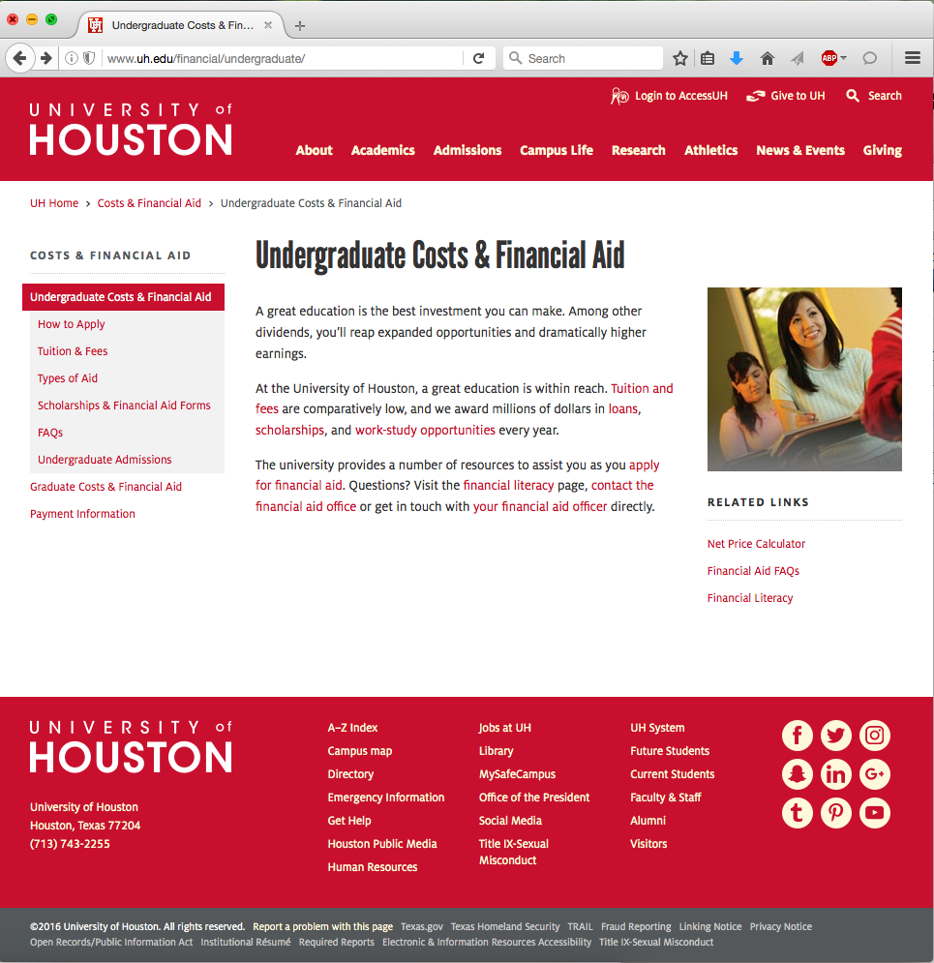
1
2
UH Header
6
Browser Window Title
Web Address (URL)
Breadcrumb
Site/Area Name
Left Nav Menu – left column
Display Name
Main Content Area
A Background Image
Related Links – right column
3
4
8
7
5
9
Link to the UIT CMS page: How Do I Edit That?
UH Footer
Notes:
Page-specific terminology for typical UH Webpages:
See also the Handout, and the UIT site:
https://www.uh.edu/infotech/services/web-services/cms/cms-how-tos/change-non-content-page-items/
The Browser Window Title
The information for the Browser Window’s Title bar is derived from the Page asset;
The Web Address / URL
the folder/page hierarchy inside your site is directly related to your site’s web address – Folder System Names are concantenated to create the URL;
The Breadcrumbs run along the top of the content area
– a series of links back to the previous level of the site, culminating in a link back to the UH Home page;
The Site/Area Name
– appears at the top of the left-nav area as well as immediately after the link to the UH Home page;
The Lefthand Nav Menu appears on most interior pages
– and represents the Menu the CMS is referring to when it asks “Include in Menu?”
NOTE: The information/text for both the breadcrumb and left-navigation menu items is drawn from the “Title” information of the Folders holding each webpage;
The Display Name
– is the main headline for your page
The Content Area
– is where the main content for your page resides; this usually includes the central column and can also include both the left and right columns as well.
Left column content will appear beneath the left-navigation-menu.
A Background Image
– here, a column image in the Right-hand column;
A Related Links set
– Related Links sets can be included in either (or both) the right-hand and left-hand columns depending on the page layout options.
--------------------------------------------------------
The standard UH Header and Footer are not available for individual editing – however, these will be built into the page upon publication.
Some sites will have a custom header, which can be edited/modified from within the CMS.

Slide 29
CMS Magic
MAGICAL ILLUSIONS: The CMS uses Browser Tricks
Web designers work hard to create seamless visual illusions –
so that site visitors can focus on the content, and not just on
figuring out the interface.
Browsers provide some of the sleight of hand.
When you go to a new page, they only “redraw” those things
which change, or are new – so things appear to load faster.
One side effect can be an illusion of animation: some things look like
they are static while others change; thus, we perceive action, motion.
So, when the CMS Web-Page Factory builds your pages,
it already has plans to take advantage of that sleight of hand.
What you need to know to perform magical left-nav menu tricks:
1. A lot of the magic is already built in to the CMS!
Notes:
Some discussion of the magical website illusions –
The main ways in which the CMS takes advantage of Web Browsers’ sleight of hand is in building the left-hand-navigation and the breadcrumbs –
The breadcrumbs run along the top of the content area
The lefthand nav menu appears on most interior pages, and is a block of stacked text, each item of which, when clicked, will take the site visitor to its designated page.
The information/text for both of these is drawn from the names of the folders holding each webpage;
Generally speaking, each folder’s system name correlates exactly to a segment of the page’s URL – aka web address.
Explaining The Magic:
1)
The CMS dynamically builds the breadcrumb strings and lefthand nav menu dynamically on the fly for each and every page inside the CMS, based on where that page lives inside the site structure. Every page has its own, unique left-nav menu built right in.

Slide 30
CMS Magic
MAGICAL ILLUSIONS:
What you need to know to perform magic menu tricks:
2. You do not have to specifically instruct the CMS to build a Left-Nav Menu.
Which is why this can be such a great feature!
But it also means you may not pay much attention to it, either,
and so it is important to be aware of what is happening
so you will know how to keep your live site well synchronized with its CMS source!
3. The left-nav menu does not exist or function separately from the
page on which it displays – each page has one, of its very own.
Each menu-eligible page has a left-nav menu built into it.
When a new page is created, the CMS automatically and dynamically includes
an appropriate left-nav menu for it based on the page’s position within the
structure of your site.
Notes:
Explaining The Magic:
2)
The CMS’ dynamic functions are so convenient, they may be ignored.
CMS editors can keep themselves, and the websites they are responsible for, out of trouble by understanding and purposefully managing what is going on.
Synchronization in this context means keeping the live site navigation working for your site visitors the same way it is working inside the CMS for you as a site editor.
3)
The CMS’ builds a left-nav menu for each and every eligible page, based on where the page is inside your site structure.
Some discussion of the magical website illusions –
The main ways in which the CMS takes advantage of Web Browsers’ sleight of hand is in building the left-hand-navigation and the breadcrumbs –
The breadcrumbs run along the top of the content area
The lefthand nav menu appears on most interior pages
The information/text for both of these is drawn from the names of the folders holding each webpage;
For the most part, each folder’s system name correlates exactly to each segment of the URL, and descriptively to each of the areas and nested areas inside the website;
The Magic:
The CMS dynamically builds the breadcrumb strings and lefthand nav menu dynamically on the fly for each and every page inside the CMS based on where that page lives inside the site
Thus, a sort of flip-card illusion is built – as users click from page to page, the left-nav appears to “open” and “close” to display the menu appropriate for each and every page.

Slide 31
CMS Magic
MAGICAL ILLUSIONS:
What you need to know to perform magic menu tricks:
4. Inside the CMS, pages’ left-nav menus stay dynamic –
so they may change if you change the site structure.
As long as a page asset’s “indexing” is active, this CMS feature is active: pulling in
whatever site-structure information (or changes) which may affect the left-nav menu.
Upon Publishing, the CMS captures whatever the current information may be
at that point in time, and writes a Static file to the Server.
5. Changes may affect more than the item(s) you are currently editing.
Especially within a section: All the Pages within a section, including the main page,
share much of the the same dynamic information for their menus. This makes it easy
for site visitors to get back to any page of a section after visiting another page. It also
means you will need to remember to publish ALL affected items, not necessarily
just the page you updated, to keep your live site Synchronized with the CMS.
Notes:
Explaining The Magic:
4)
The CMS’ dynamic functions are always active.
As long as an asset’s indexing is active, it may be picking up whatever changes have been made which affect the site navigation items.
Once an item has been Published, however, it is considered a Static file. The static file on the server represents a point-in-time-capture of the site navigation’s state at the moment of Publishing.
5)
Remember, also, that the CMS’s dynamic functions may affect more than just the local asset you are editing;
and this is especially true of internal links and site navigation information.
Therefore, you will need to remain aware of how your local edits may affect other parts of the whole site.
Some discussion of the magical website illusions –
The main ways in which the CMS takes advantage of Web Browsers’ sleight of hand is in building the left-hand-navigation and the breadcrumbs –
The breadcrumbs run along the top of the content area
The lefthand nav menu appears on most interior pages
The information/text for both of these is drawn from the names of the folders holding each webpage;
For the most part, each folder’s system name correlates exactly to each segment of the URL, and descriptively to each of the areas and nested areas inside the website;
The Magic:
The CMS dynamically builds the breadcrumb strings and lefthand nav menu dynamically on the fly for each and every page inside the CMS based on where that page lives inside the site
Thus, a sort of flip-card illusion is built – as users click from page to page, the left-nav appears to “open” and “close” to display the menu appropriate for each and every page.

Slide 32
CMS Magic
MAGICAL ILLUSIONS:
What you need to know to perform magic menu tricks:
6. So what determines a Left-Nav Menu’s actual contents?
INHERITANCE —
The CMS uses a specific algorithm to build the left-nav menu – based largely on
‘inheritance’ or parent:child relationships amongst the Folders and their Pages.
A Folder containing other items is considered the “parent” for those items –
and by the same token, the contained items are considered that folder’s “child” items.
Inheritance is relative: Child Folders might also be considered Parent Folders if they
contain Child items, and so forth.
FOLDER TITLE TEXT and other settings —
The text itself which appears in the Left Nav Menu (as well as the Breadcrumb) is drawn
from each included Page’s immediate Parent Folder.
See under: Edit > System > Inline Metadata > Title to review or change the Left-Nav
or breadcrumb text for any Folder containing an active Page.
“Display in Menu” & “Include when Indexing” also need to be selected.
Notes:
Explaining The Magic:
6)
What determines the actual contents of the Left Nav Menu?
Inheritance is an important concept in understanding how the CMS dynamically updates site navigation as you make changes within your site.
The Folder asset and Page asset work together to represent the page in the site’s breadcrumb and left navigation menu.
Generally speaking, folders act as “parent” items, and may contain one or more “child” items, including other page-bearing folders.
The actual text which appears in both the breadcrumb and the left-nav menu is drawn from each page-bearing Folder’s Title field.
The order in which the left-nav items appear on the page is determined by how the parent folder sees their child-folders’ “order” numbers.
The child-folder (and thus its contained page) with the smallest Order Number, will appear highest in its parent’s left nav menu.
Note: the initial “Order Number” is determined by when each child item is created;
however, the number can be reassigned using the Order tools in the View pane for the Parent folder.
Remember: If a child-folder’s “order number” is changed, then its other peer items’ order will change accordingly.
Each page-bearing Folder’s Inline Metadata settings “Display in Menu” & “Include when Indexing” also need to be checked as active,
in order for that Folder to contribute/share navigation information with the rest of the site.
Please keep in mind that, in CMS parlance, “Pages” are often spoken of as being synonymous with the Folders/Directories which hold them,
especially as another UH website convention holds that each page destined to be included in the navigation must be named “index”,
so, the pages all have identical system names – and the distinguishing, descriptive information is provided by the folder’s system name.
ALSO PLEASE NOTE - Another way in which inheritance is important in the CMS:
Settings in the CMS which affect a “parent” item may also be “inherited” by its “child” items –
e.g. a Folder which is set to not-publish will prevent anything inside that folder from publishing either, regardless of the publishing settings for the child items.
Some discussion of the magical website illusions –
The main ways in which the CMS takes advantage of Web Browsers’ sleight of hand is in building the left-hand-navigation and the breadcrumbs –
The breadcrumbs run along the top of the content area
The lefthand nav menu appears on most interior pages
The information/text for both of these is drawn from the names of the folders holding each webpage;
For the most part, each folder’s system name correlates exactly to each segment of the URL, and descriptively to each of the areas and nested areas inside the website;
The Magic:
The CMS dynamically builds the breadcrumb strings and lefthand nav menu dynamically on the fly for each and every page inside the CMS based on where that page lives inside the site
Thus, a sort of flip-card illusion is built – as users click from page to page, the left-nav appears to “open” and “close” to display the menu appropriate for each and every page.

Slide 33
CMS Magic
MAGICAL ILLUSIONS:
What you need to know to perform this magic menu trick:
7. Whenever the CMS builds a standard page’s Navigation Menu –
it will include, by design and by default, all of the following items:
  the page itself and each of the page’s peers;
  any ‘child’ item(s) immediately subordinate to the page on display.
  (i.e. no ‘grand-children’ will appear);
  the parent page of the page on display;
  (note: if the page is a top-level item, this would be area’s home page/folder,
  and thus item 4, Site name - from the earlier page-items diagram)
  each of that parent’s peers, if any;
  each of that parent’s ancestors and each of those peers.
  UH styles will highlight each level differently, to distinguish them visually.
Notes:
Explaining The Magic:
7)
The UH website uses certain adpopted conventions for deciding what will appear in the left-nav menu.
Items the UH left-nav menu includes:
---------------------------------------------------------------------------------------
1) the page itself;
2) any immediate ‘child’ item(s) – children immediately subordinate to the page on display (i.e. no ‘grand-children’ will appear);
3) the parent page of the page on display;
note: if the page is a top-level item, this would be area’s home page, and thus item 4, “Site name” - from the earlier slide – which might also be considered that area’s “root’.
4) each of that parent’s peers, if any;
each of that parent’s ancestors and each of those respective peers.
NOTES:
The CMS algorithm for building a page’s left-nav menu uses an inheritance model, based on the relationships of the directories holding each of the pages.
See explanations for previous slide.

Slide 34
CMS Magic
MAGICAL ILLUSIONS:
What you need to know to perform magic menu tricks:
8. So when your site visitors click around from item to item . . .
• Basically, they will see left-nav menus which offer links to whatever
relevant relatives any particular selected page may have.
• Those pages’ related menu items may seem to magically “appear” or “disappear”
as site visitors select various pages and new child items
“magically appear” to replace the children of previously selected pages.
A sort of flip-book animation results.
Want to Try It ?
Go to the UH website and navigate around using the left-nav menus.
Look for left nav menus which show descendants and ancestors, such as:
https://www.uh.edu/nsm/biology-biochemistry/graduate/
Notes:
Explaining The Magic:
8)
Thus, a sort of flip-card illusion is built – as users click from page to page, the left-nav appears to “open” and “close” to display the menu appropriate for each and every page.
Try it –
Go to the UH website and navigate around using the left-nav menus.
A good example is often the Undergraduate Admissions area, which uses fairly standard navigation: http://www.uh.edu/admissions/
You may also see that certain menu items/areas open into what looks like an entirely new area – where the navigation has “reset” to a different parent folder –
this technique is often used for departments, such as the departments within a college, or each college within the UH University structure; or sometimes Offices within a university Division; or independent organizations.

Slide 35
Cascade CMS at UH
Learn More:
Visit the staging-published version of the training materials (off-campus requires VPN):
Links on the home page lead you to CMS features examples and resource downloads.
https://staging.web.e.uh.edu/cms-trainee-00/.
Web Tech Cascade CMS team pages:
Cascade How-to’s, Training & General info, Glossary, concept discussions; more ...
https://www.uh.edu/infotech/services/web-services/cms/cms-how-tos/
UH Web Marketing Resources:
Cascade,UH Bootstrap, Google Analytics, Forms, UH Web community, Downloads, More...
https://www.uh.edu/marcom/resources/
Guidelines for Custom Headers, Landing pages; recommended image sizes/specs:
https://www.uh.edu/marcom/resources/cascade/
UH Web Best Practices:
https://www.uh.edu/marcom/guidelines-policies/web-best-practices/
Meet the Web Marketing Team:
https://www.uh.edu/marcom/team/index.php – see:
Online Marketing and User Experience team
Contact: webmarketing@uh.edu
Note: Web Marketing is the business owner of the Cascade CMS at UH/UHS.
UH Communications/Web / Standards and Branding / Guidelines and Policies:
UH Branding: https://www.uh.edu/marcom/departments/branding/
UH Communications Guidelines and Policies: https://www.uh.edu/marcom/guidelines-policies/
UH Web Style Guide: https://www.uh.edu/marcom/guidelines-policies/web-style/
Notes:
Cascade CMS Resources
https://www.uh.edu/infotech/services/computing/networks/vpn/
https://uh.edu/marcom/
https://uh.edu/marcom/guidelines-policies/
https://uh.edu/marcom/guidelines-policies/brand/visual-identity/
https://uh.edu/marcom/resources/
https://uh.edu/marcom/resources/cascade/
Request to join Web Communicators listserv:
https://www.uh.edu/marcom/resources/web-communication-network/
Manage your CMS-USERS mailing list subscription [LISTSERV]
https://uh.edu/infotech/services/web-services/cms/cms-related-updates/
https://uh.edu/infotech/services/web-services/cms/
https://uh.edu/infotech/services/web-services/cms/cms-how-tos/
see REFERENCE DOWNLOADS and instructional videos; and links to various How-to pages
some specific pages follow:
https://uh.edu/infotech/services/web-services/cms/cms-how-tos/website-cleanup/
https://uh.edu/infotech/services/web-services/cms/cms-how-tos/use-the-folder-edit-panel/
https://uh.edu/infotech/services/web-services/cms/cms-how-tos/different-page-types/
https://uh.edu/infotech/services/web-services/cms/cms-how-tos/use-the-styles-popout/
https://uh.edu/infotech/services/web-services/cms/cms-how-tos/metadata-use-table/
https://uh.edu/infotech/services/web-services/cms/cms-how-tos/work-with-edit-panel-boxed-sets/
https://uh.edu/infotech/services/web-services/cms/cms-how-tos/known-issues/index.php#generalinfo
Discussion of UH VPN use of full-vpn.uh.edu for any off campus login to Cascade

