Slide 1
Voucher Creation Tips
University of Houston – Accounts Payable

Slide 2
Voucher Creation Tips
Invoice Numbering
Duplicate Payments
Date Accuracy
Identifying Fraud

Slide 3
Invoice Numbering

Slide 4
Invoice Numbering-Overview
Invoice Numbers
Reimbursements
Vendor uses Repeat Invoice Numbers
State Payments Reissues

Slide 5
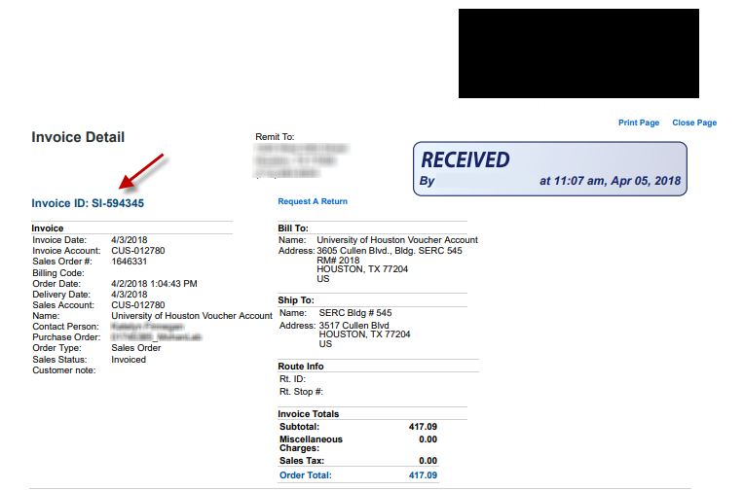
Vendor Issued Invoices
Invoice number must match what is printed on invoice provided by the vendor.

Slide 6
Invoice Number
Audit Finding:
Voucher will be denied to remove space inserted on invoice number.

Slide 7
Invoice Number
Audit Finding:
Voucher invoice number matches vendor invoice.

Slide 8
Invoice Numbers for Reimbursements
Departments should determine a consistent approach when assigning invoice numbers for reimbursements.
May consist of the following:
  Date issued
  Receipt date
  Reimbursement date
  Term, Period or Contract end date
  Name of project or task,
  Date of trip,
  Name of reimbursee,
  Company name on receipt,
  Rental location or information

Slide 9
Invoice Numbers for Reimbursements
If you use Last name-MM/DD/YY for one reimbursement, then use that consistently for others.
You may also identify consistency based on the type of reimbursement.
  E.g., if reimbursing business meals, you use company name and receipt date, then consistently use this method for all business meals.

Slide 10
Same Invoice Number, Same Vendor… What to do?
In this case, verify that it is truly not a duplicate invoice.
If the vendor reuses invoice # 12345, then the second invoice should be paid using invoice # “12345.1” and a third (hopefully not) invoice using the same invoice # will be paid using invoice # “12345.2” to allow the payment to pass People Soft validations.
In the comments, indicate that the vendor reused the same invoice number, and the invoice is not a duplicate.

Slide 11
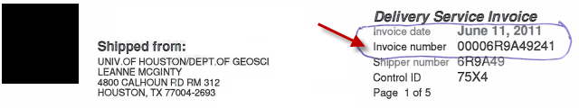
Different Invoice, Duplicate Invoice Number
Examples:
Date: June 11, 2011
Invoice number: 00006R9A49241
Date: June 12, 2021
Invoice number: 00006R9A49241.1

Slide 12
State Payment Reissues
With Local payment reissues, we can simply use the same voucher and reissue at the AP level. The State requires us to create a new voucher for a reissued payment using state funds.
Reissuing a state payment must use the format “Invoice Number.#”
  The invoice number would have to be adjusted with a period and number sequence after the invoice number.
  E.g., a first reissue of invoice # 12345 uses invoice # “12345.1” and a second reissue uses “12345.2” to allow the payment to pass People Soft validations.
Department creates the second voucher at the request of AP.

Slide 13
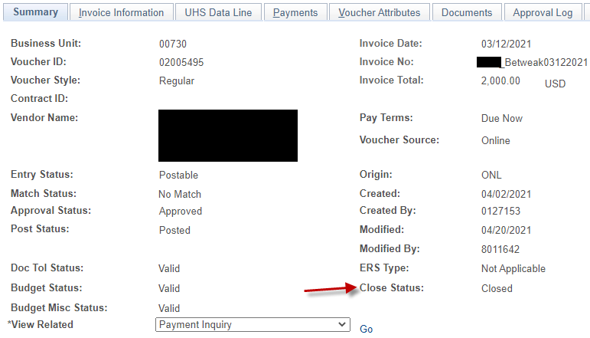
State Payment Reissues Process
Email from Department to AP to Cancel/Void Payment for State Voucher. Sometimes AP starts this dialog and will reach out to the department to ask that they create a new voucher to reissue payment.
AP will email to confirm cancellation.
Snapshot below showing voucher 02005495 closed completely in People Soft (first screenshot of Summary tab, second two of Payment tab.

Slide 14
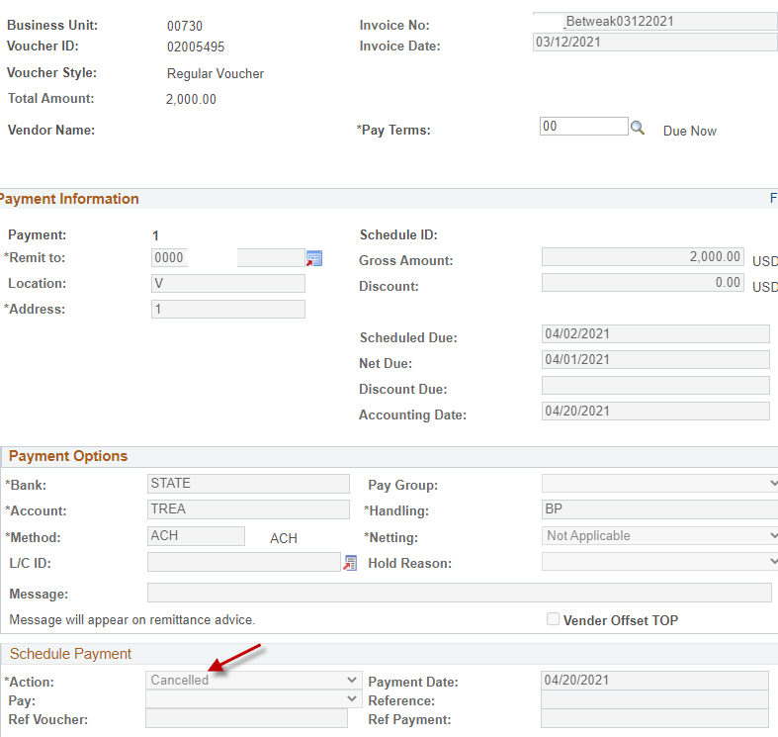
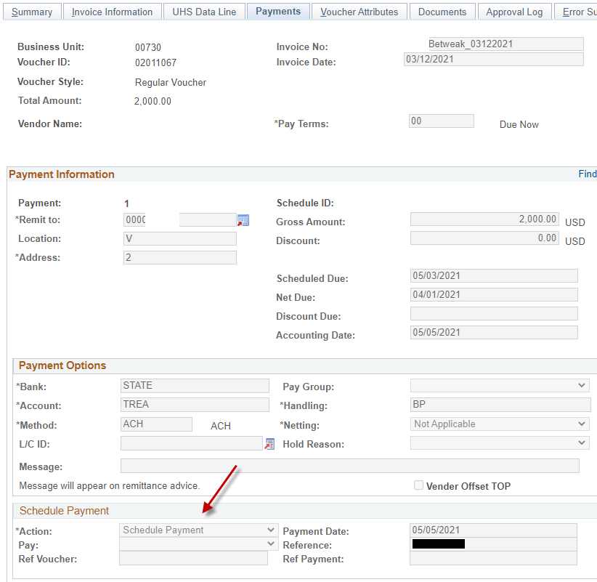
State Payment Reissues Process – Results
Cancelled & Closed voucher:
Reissued voucher:

Slide 15
Duplicate Payments

Slide 16
Duplicate Payments – Overview
Common causes of Duplicate Invoice Payments
Data Entry errors
Tips to reduce Duplicate Payments

Slide 17
Common Causes of Duplicate Invoice Payments
Data entry errors, such as a misread number or a typo
Adjusted invoice numbers by adding spaces, special characters, or zeros
Vendor sent same invoice twice- (invoice number adjusted)
Incorrect vendor paid
  Must reissue to the correct vendor (same invoice number)
  This could be due to a DBA difference or a closely named vendor.
Paid via Voucher and Pcard
  Verify payment in PeopleSoft before charging invoices on a Pcard.

Slide 18
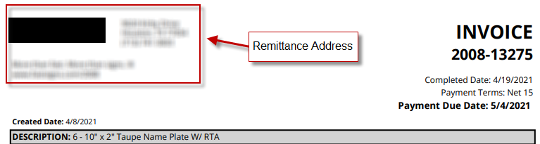
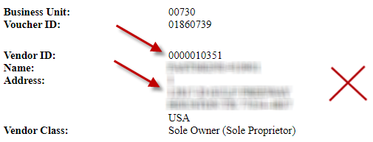
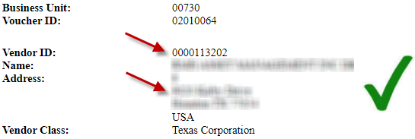
Data entry errors – Selecting the wrong Vendor for payment
Incorrect Vendor:
Voucher will be denied to correct vendor entry.
Correct Vendor:
Voucher address correctly matches the Invoice remittance address.

Slide 19

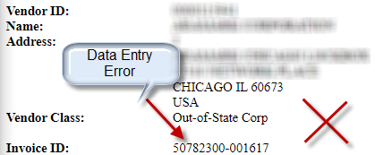
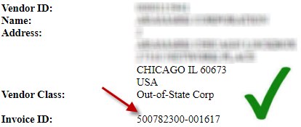
Data entry errors – Voucher number entry error
Incorrect Invoice Number:
Voucher will be denied to correct voucher entry
Correct Invoice Number:
Voucher entry correctly matches the Invoice Number.

Slide 20

Tips to Reduce Duplicate Invoicing
Self Audit
Audit invoice number on People Soft vs. invoice number on the invoice
Audit the vendor information in People Soft vs. the invoice.
Research well before paying an older invoice or reimbursement.

Slide 21
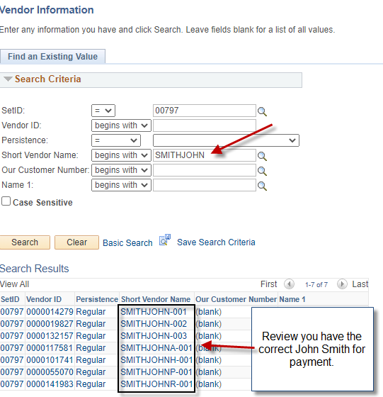
Tips to Reduce Duplicate Invoicing
Double check reimbursement vouchers for employee payments to ensure that the employee has not been reimbursed before for this receipt.
For payments to Individuals/Employees, ensure that we have selected the correct vendor. E.g., there are multiple vendors with the same name in the system. Verify the address.

Slide 22
Date Accuracy

Slide 23
Date Accuracy – Overview
Date Accuracy Importance
Invoice Receipt Date
  Date stamp
  How to add Stamp in Acrobat
Goods Receipt and Acceptance Date
Timeliness of these Dates
Recent Changes in PeopleSoft
Tip to Speed the Invoice and Goods Receipt

Slide 24
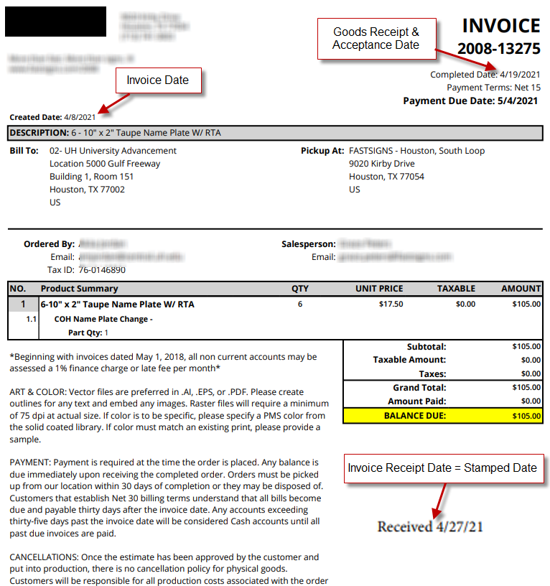
Date Accuracy
Invoice Date = Date on the invoice
Invoice Receipt Date = earliest Stamped Date on Invoice
Goods Receipt Date & Acceptance Date = the day you received, inspect, and accept the goods
  This may not be printed on the invoice.

Slide 25
Date Accuracy Importance
Agencies are responsible for ensuring that each payment is treated correctly in USAS according to the prompt payment law. A state agency’s payment is due on the 30th day after the latest of:
  The date the agency receives the goods under the contract.
  The date the performance of the contracted service is completed.
  The date the agency receives an invoice for the goods or services.

Slide 26
Invoice Receipt Date
Invoice receipt date = date that UH receive the invoice, not the date that the employee receives it for payment (although these are often the same)
  Received in one location, forwarded to another: invoice receipt date should be the date the first location receives it. The following are examples:
    Invoice received by AP, stamped, then forwarded to another unit.
    Invoice received by General Counsel, stamped, then forwarded to another unit.
    Invoice received by main campus Facilities, then forwarded to one of the campuses to complete payment.
    Invoices misrouted originally and then finally making it to the paying unit.
    If the invoice is not yours, get it where it needs to go, and fast.

Slide 27
Invoice Receipt Date
Invoice received via email: invoice receipt date should be the date the email was received. The email can be used as backup documentation of the invoice receipt date, highlight or circle this date so it is easily identifiable
Invoice receipt date = date that UH receives the invoice, not the date that the employee receives it for payment (although these are often the same)
Invoice receive by one employee and handed to another employee on a later date to pay: the invoice receipt date should be the date the first employee receives the invoice.

Slide 28
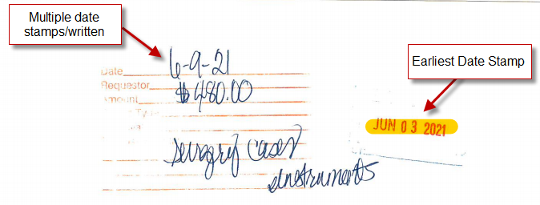
Invoice Receipt Date
Invoice stamped on one date and counter-stamped on another date—the first stamp date should be used.

Slide 29
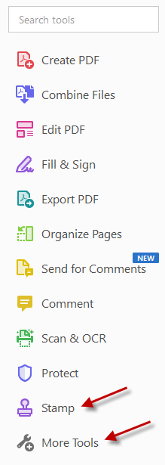
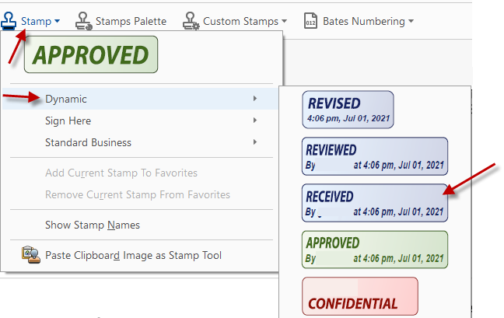
How to add an Invoice receipt stamp in Acrobat
Select Stamp tool or search for Stamp tool under More Tools.
On drop down menu select Dynamic, choose the RECEIVED stamp.

Slide 30
Goods Receipt and Acceptance Date
These should be the same date, which is equal to the day you received, inspect, and accept the goods. If these are on two different dates, choose the latter date of the two.

Slide 31
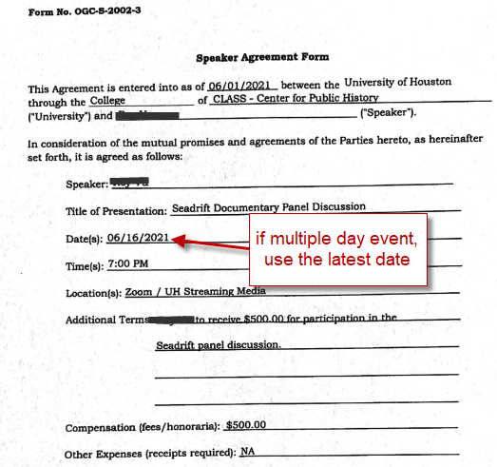
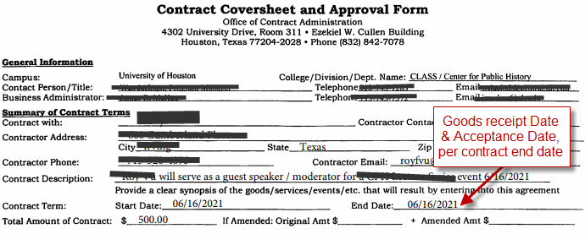
Goods Receipt and Acceptance Date
Contracts
  Goods receipt date and Acceptance date
  End date of the term if you are paying in full.
  Last date of a multi-date time period covered by an invoice. E.g., a monthly invoice’s goods receipt and acceptance date would be the last date of that month.
  The date services were rendered.

Slide 32
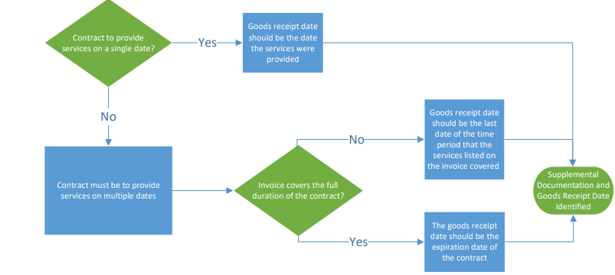
Goods Receipt and Acceptance Date

Slide 33
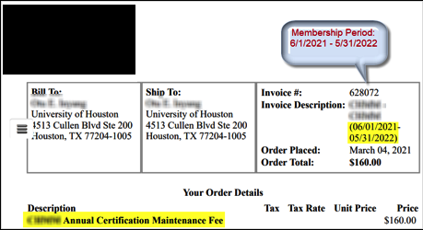
Goods Receipt and Acceptance Date
Memberships or Subscriptions
  Both dates should be on the end date of the membership/subscription period.
Example:
Goods Receipt Date & Acceptance Date for this invoice is 05/31/2022

Slide 34
Goods Receipt and Acceptance Date
Non-contracted service
  Last date of a multi-date time period covered by an invoice
  The date services were rendered
Advanced Payments
  Still maintain the appropriate goods receipt date for the situation as described above.

Slide 35
Timeliness of these Dates
  When a particular Change Request is completed, it will flag users with a message to include a justification statement for any situations in which more than 60 days have elapsed between the:
    Goods received/acceptance date and the Invoice Date, or
    Invoice Receipt Date and the Invoice Date.

Slide 36
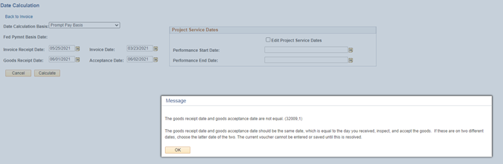
Recent Changes in PeopleSoft
This error message will come up if Goods Receipt Date and Acceptance Date are not equal:

Slide 37
This warning message will come up if Goods Receipt/Acceptance or Invoice Receipt Date is more than 60 days after the Invoice Date.
Recent Changes in PeopleSoft

Slide 38

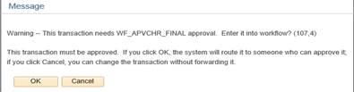
Recent Changes in PeopleSoft
Clicking No will give the user the ability to either add a justification or check to see if a justification is already added
Clicking Yes will move the voucher to the next stage in the approval process.

Slide 39
Tip to Speed the Invoice and Goods Receipt
    The biggest challenge is getting the invoice
    to the unit that placed the order.
    When placing orders, ask the vendor to log your contact information on the invoice or the order, so that they know where to send the invoice.

Slide 40
Identifying Fraud

Slide 41
Identifying Fraud- Overview
Tips to Identify Fraudulent Invoice
Tips to Identify Fraudulent Purchase Order
Fraudulent Purchase Order Example

Slide 42
Tips to Identify a Fraudulent Invoice
Invoice looks different than historical invoices from that same vendor.
Vendor name is slightly different from the accurate vendor.
You did not order the items on the invoice.
Invoice has a different address from the vendor file and vendor setup.
Invoice was sent via email with a suspicious looking email or from an address that is not linked to the vendor.
Audit “Bill to information” on Vendor’s invoice, confirm ”University of Houston” with correct addresses
Invoice references a Purchase Order that does not exist.

Slide 43
Tips to Identify a Fraudulent Purchase Order
PO has unauthorized signatures
PO doesn’t look like our usual PO
References an unidentified PO number
Even a picture-perfect invoice can be fraudulent, but this would not be easily protected against on the invoicing side.

Slide 44
Fraudulent Purchase Order
PO doesn’t look like our usual PO
Different format heading
Invalid email address
Invalid phone numbers

Slide 45
What was covered…
Invoice Numbering
Duplicate Payments
Date Accuracy
Identifying Fraud

Slide 46
Questions?

