Slide 1
US Bank P/T Card Training
University of Houston
Accounts Payable Department
January 2026

Slide 2
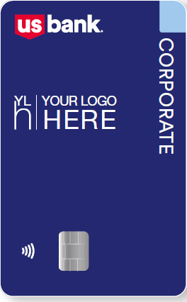
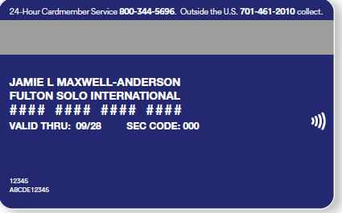
Transition from Citi to US Bank
Please begin using US Bank card starting from 2/4/2026;
All Citi Bank cards will be deactivated on 1/30/2026, if you need to make purchase during this time period, please use your personal card and then get reimbursed.

Slide 3
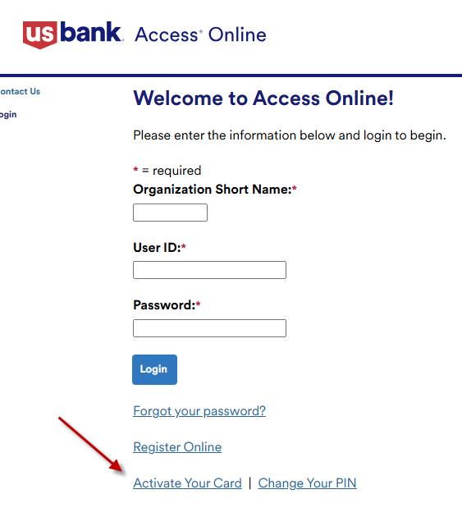
Card Activation Process
All cards must be activated before using. Cardholder can to go to www.access.usbank.com and select “Active Your Card” link at the bottom of the page

Slide 4
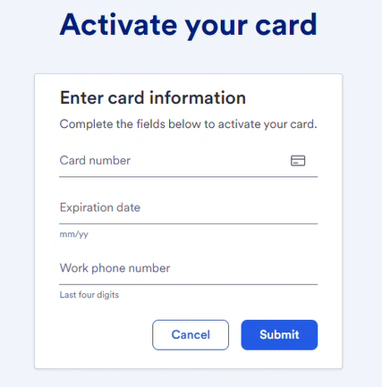
Card Activation Process
You will see this screen, please enter your 16 digits of credit card number without hyphens or spaces, enter the expiration date showing on the back of the card, and the last 4 digits of your work phone. Please enter 7388 as work phone number for all individual travel cards.

Slide 5
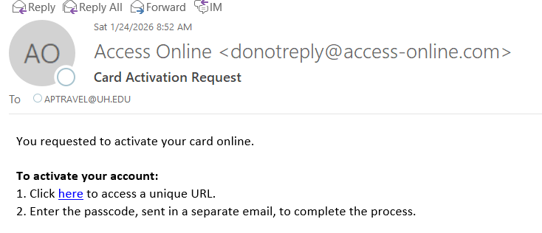
Card Activation Process (cont.)
Your will receive two emails: one containing your unique URL link, and another with your one-time passcode

Slide 6
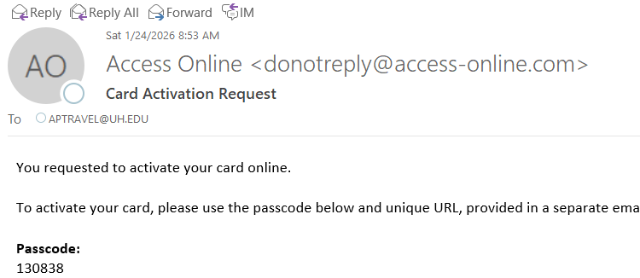
Card Activation Process (cont.)
Your will receive two emails, one containing your unique URL link, and another with your one-time passcode

Slide 7
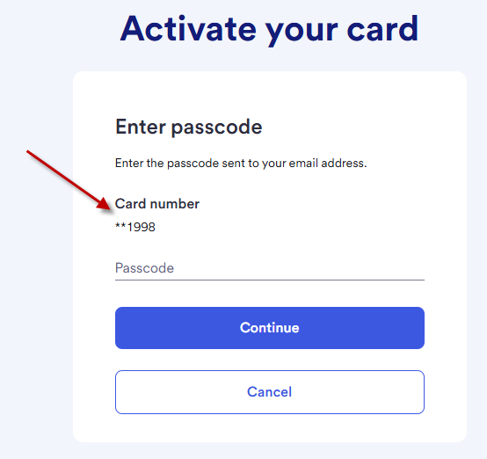
Card Activation Process (cont.)
Click the URL link on the email, make sure the account number is the last 4 digits of your card, enter the one-time passcode you received, click “Continue”

Slide 8
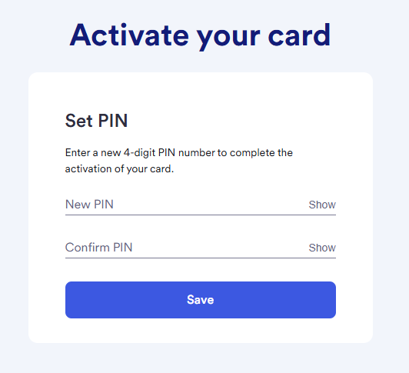
Card Activation Process (cont.)
You will be asked to reset your new 4-digit PIN, and then click “Save”

Slide 9
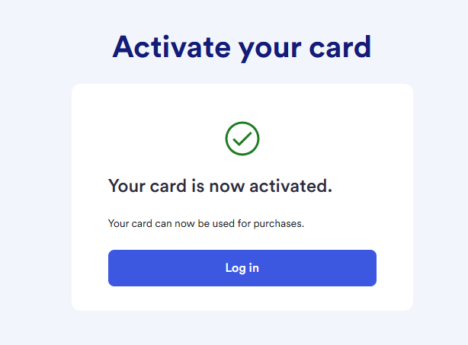
Card Activation Process (cont.)
Your card is now activated, you can click “Log in” to register your card.

Slide 10
Register Online
All P-cardholders must register online so that they can review their account information
P-card business contact’s register are handled by P-Card Team, once it is done, business contact will be able to review transactions, allocate cost center, put comments, and print transactions for approval
Individual travel cardholder are recommended to register their account online;
Department/Multi-user travel cards activation and register are handled by Travel Team

Slide 11
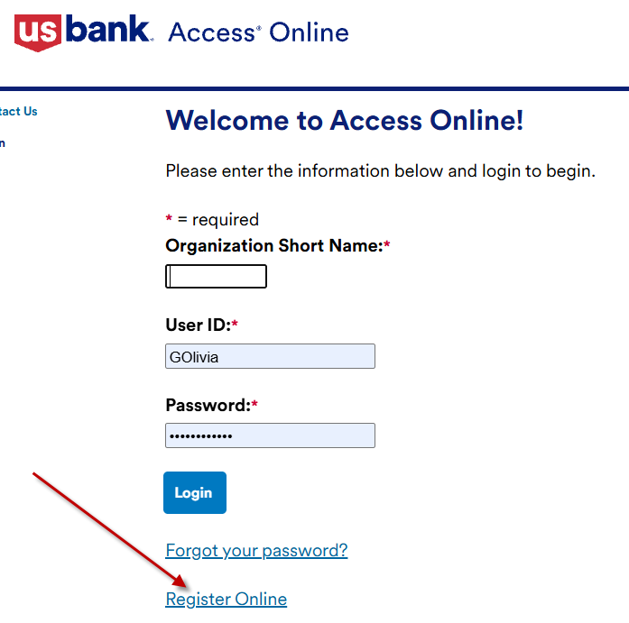
Register Online (cont.)
Click “Register Online” on access.usbank.com homepage:

Slide 12
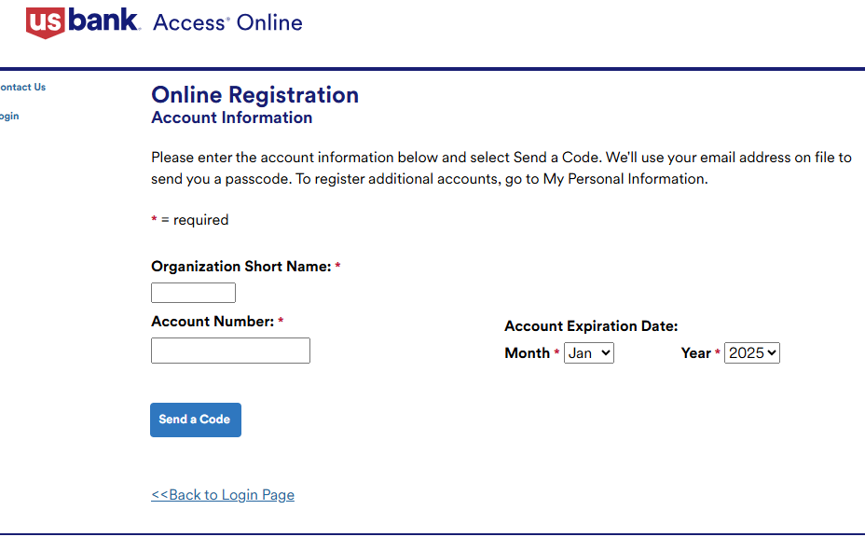
Register Online (cont.)
Enter “UHMAIN” in Organization Short Name box, full card number, expiration date, and click “Send a Code”

Slide 13
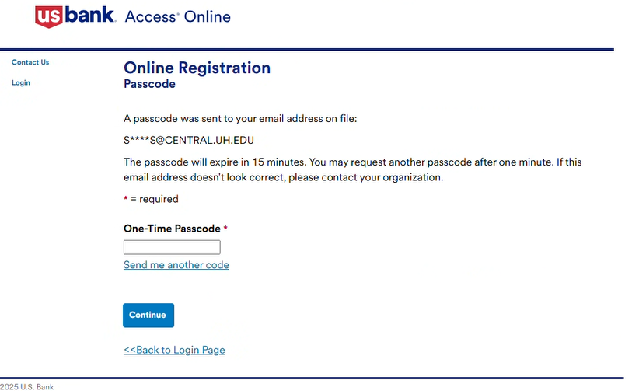
Register Online (cont.)
Enter the passcode sent to your email address and click “Continue”

Slide 14
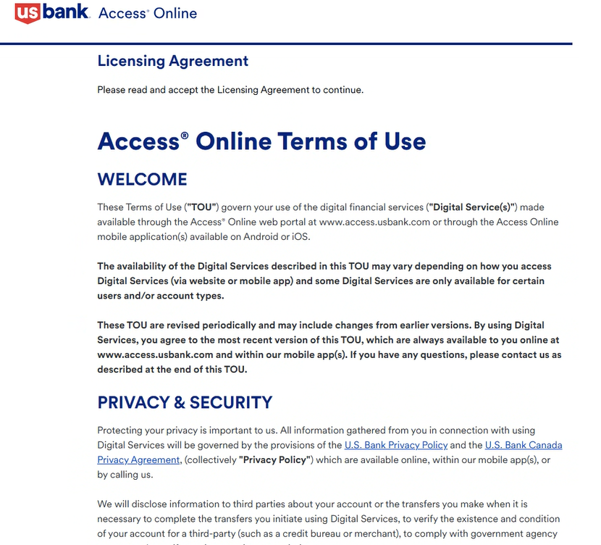
Register Online (cont.)
The Licensing Agreement displays, please click “Agree”

Slide 15
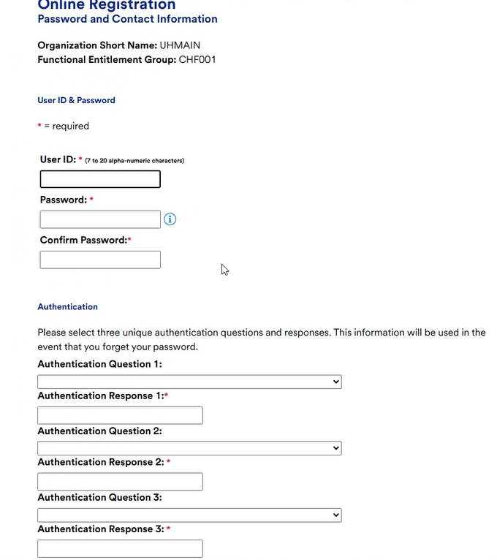
Register Online (cont.)

Slide 16
Register Online (cont.)
Create your User ID, which must be 7-20 alphanumeric characters, should start with last name initial and full first name, for example SJohn for John Smith, and then followed by numbers;
Please create your own passcode and enter twice;
Specify your three authentication questions and answers;
Enter your contact information and click “Continue”

Slide 17
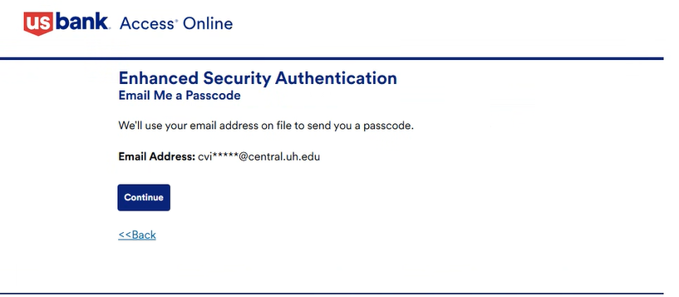
Register Online (cont.)
An one-time passcode will be send to your email address or cellphone number

Slide 18
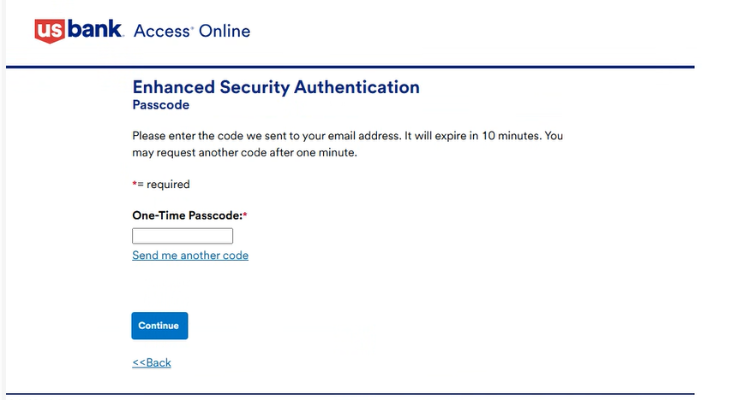
Register Online (cont.)
Enter the passcode your received and click “Continue”, and then you are done with online registration

Slide 19
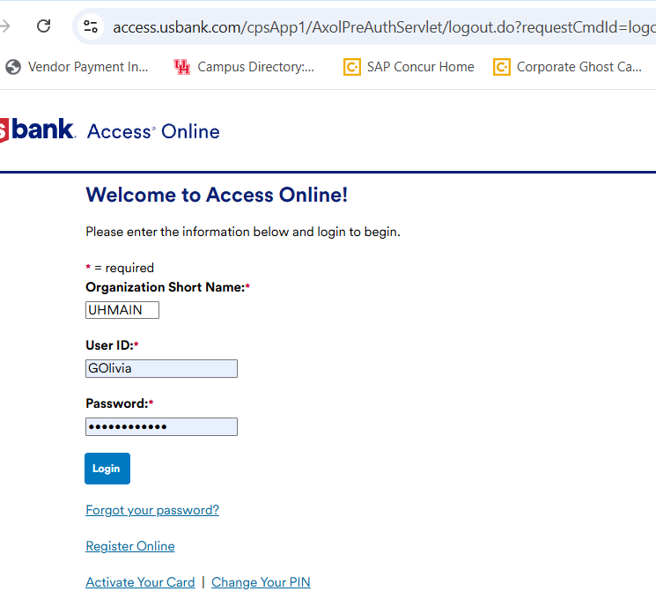
Access USBank --- Dashboard
After registration, cardholder can go online to view/work on your transaction. Go to access.usbank.com, enter the Organization Short Name (UHMAIN), User ID and Password, and then click “Login”

Slide 20
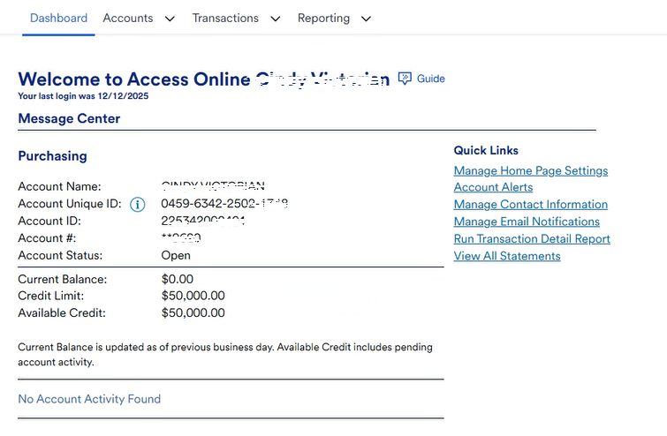
Access USBank --- Dashboard (cont.)
You will be able to see the general information of your account(s)

Slide 21
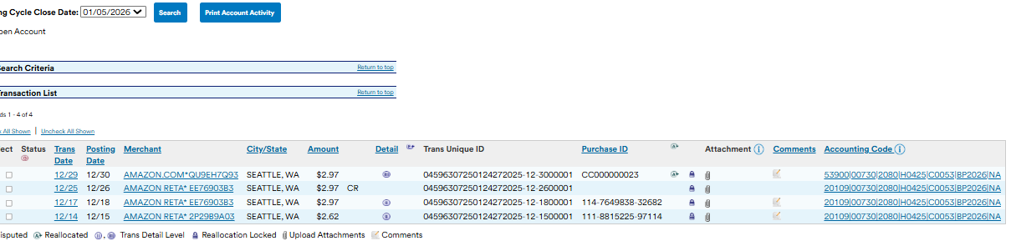
Access USBank --- Dashboard (cont.)
You will be able to see the most recent 10 transactions already posted at the bottom of dashboard

Slide 22
Access USBank --- Dashboard (cont.)
Note: card status and credit limit can only be updated by P-card/Travel Team with CDA’s approval
“Available Credit” is real-time information

Slide 23
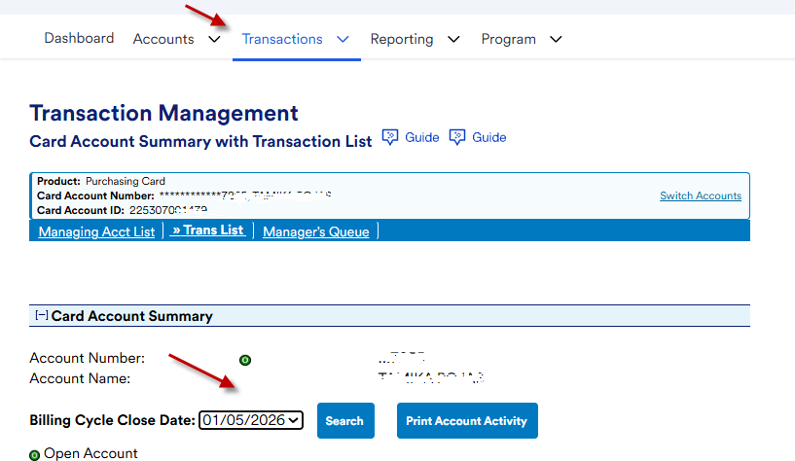
Access USBank --- Reviewing Transactions
You can review and work on your transactions by selecting “Transactions” tab and “Billing Cycle Close Date”

Slide 24
Access USBank --- Reviewing Transactions (cont.)
Please noted that the Billing Cycle Close Date is the 3rd of each month. If the 3rd falls on a weekend or holiday, the close date will move to the next business day.

Slide 25
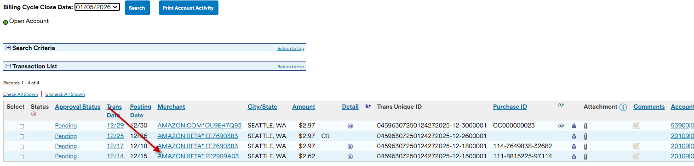
Access USBank --- Reviewing Transactions (cont.)
Click the transaction you are going to review or work with

Slide 26
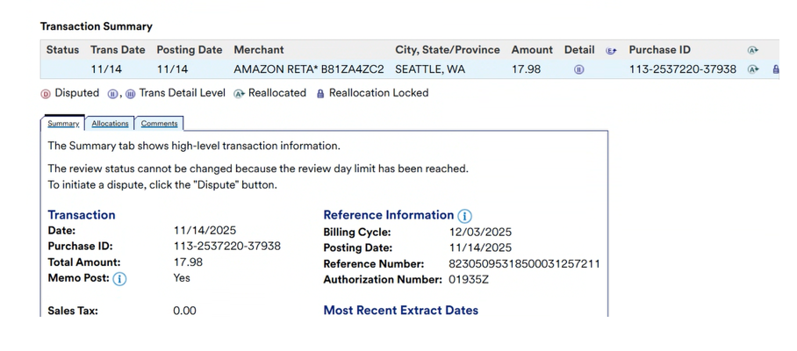
Access USBank --- Reviewing Transactions (cont.)
You will be able see the details about that transaction

Slide 27
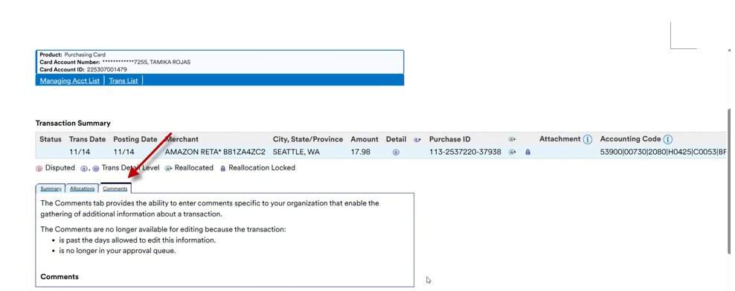
Access USBank --- Reviewing Transactions (cont.)
For P-card transactions, cardholder or business contact need to add Purpose/Benefit on Comment section; if the purchase was made through Jagger, please indicate “ Purchase was made through Jagger”

Slide 28
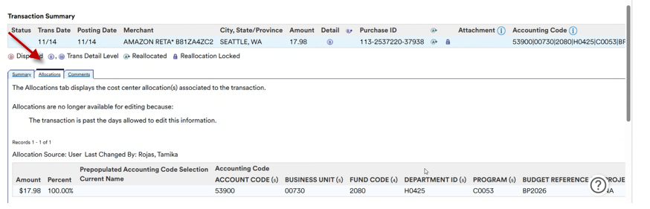
Access USBank --- Reviewing Transactions (cont.)
P-card cost center was set as default with liability account code under Allocation tab, cardholder or business contact is able to change the account code

Slide 29
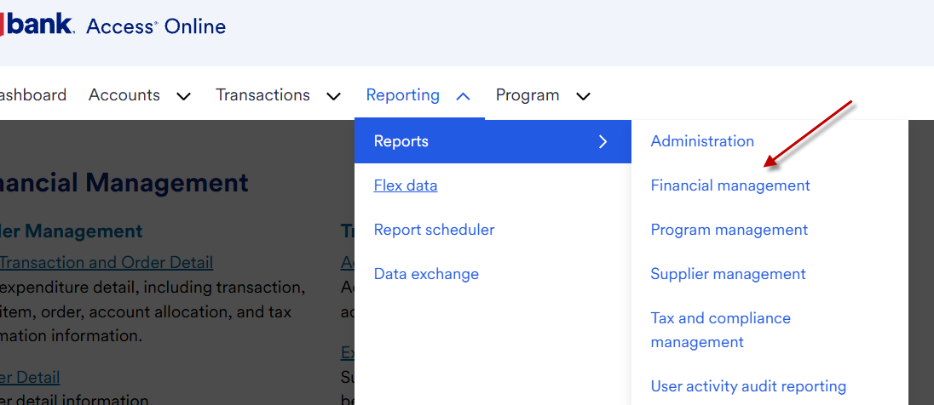
Access USBank --- Reporting
Reporting function allows you to view, generate and export details of your transactions/activities.

Slide 30
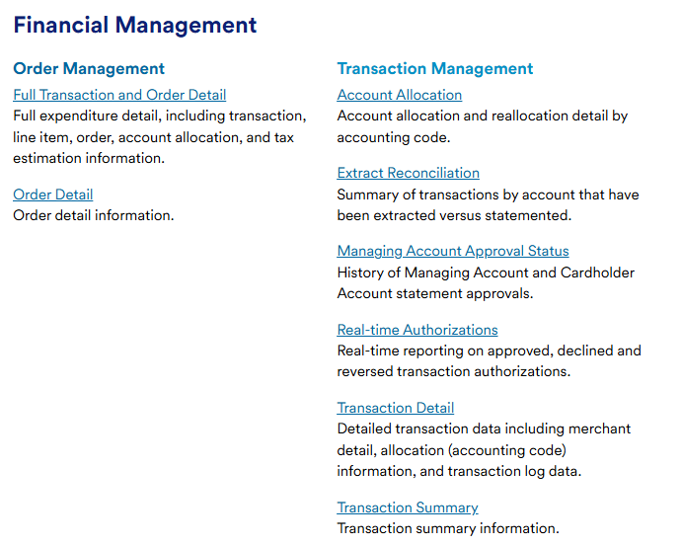
Access USBank --- Reporting (cont.)
Here is the list of all pre-built reports

Slide 31
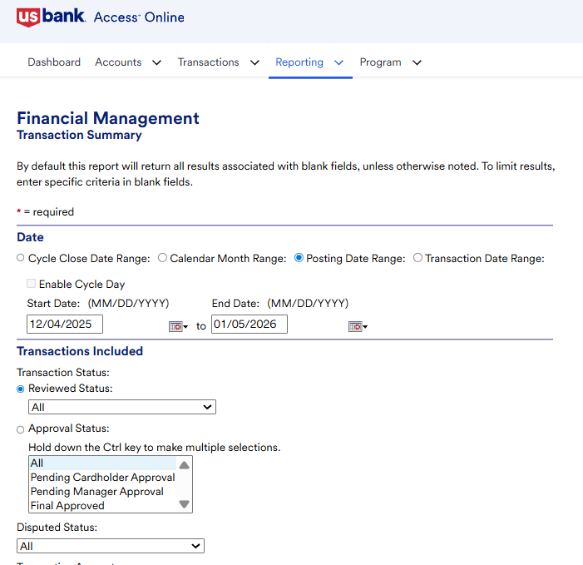
Access USBank --- Reporting (cont.)
Transaction Detail is the report P-card cardholder and business contact run after billing cycle close date and attach to expense report in PeopleSoft

Slide 32
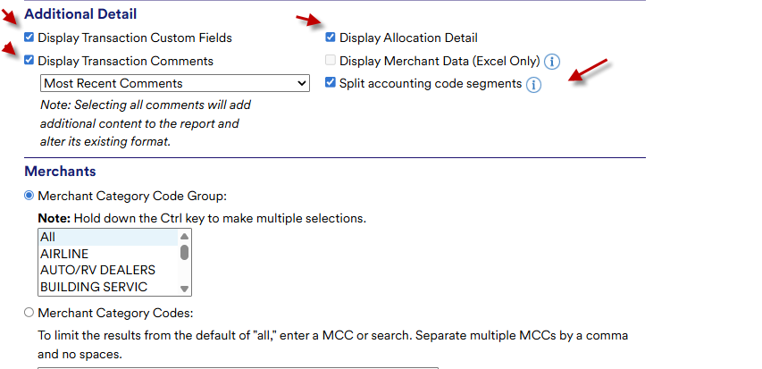
Access USBank --- Reporting (cont.)
Make sure to select all the boxes below so that these information will show on your report

Slide 33
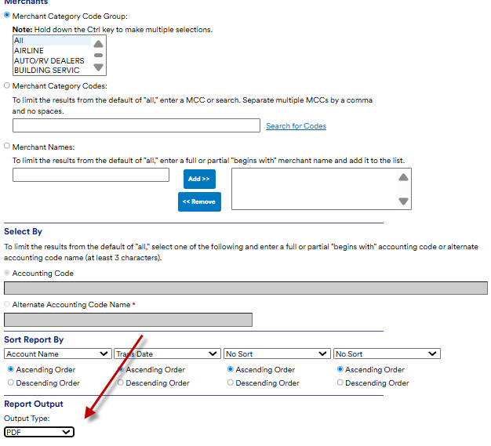
Access USBank --- Reporting (cont.)
Make sure to select PDF as report format

Slide 34
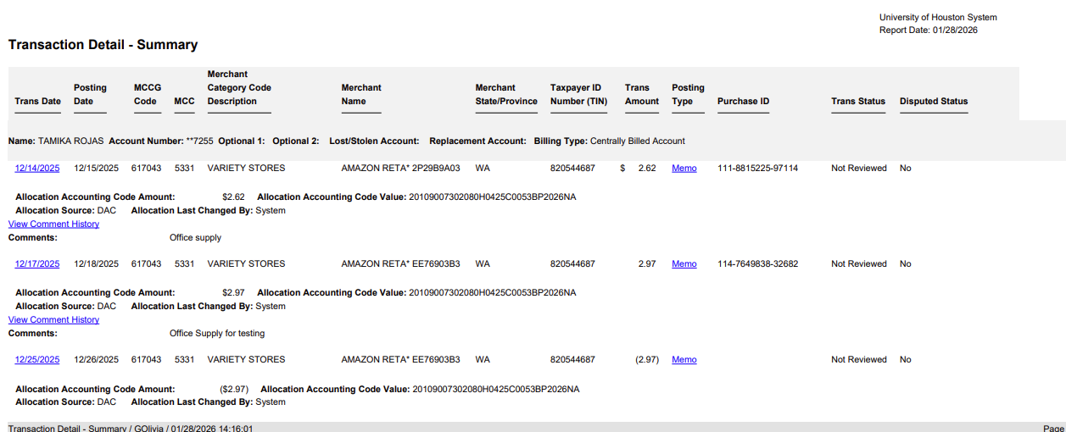
Access USBank --- Reporting (cont.)
This is how the report looks like

Slide 35
Access USBank --- Reporting (cont.)
Please note: since US Bank does not have the signature function, for P-card transactions, please print the report, obtain cardholder and Certifying Signatory’s signature, and upload to PeopleSoft as supporting documentation, this is the same procedure as what we are doing now.

Slide 36
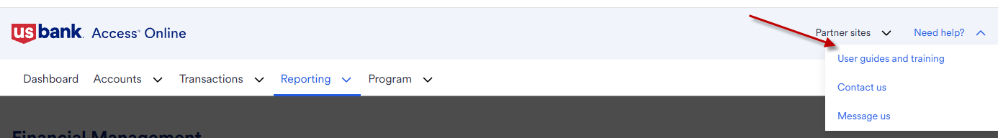
Access USBank --- Training
More training material can be found at:

Slide 37
Questions?
Please contact P-card Team/Travel Team for any questions/issues

