Slide 1
Travel Rules Training
--- College of Medicine
Olivia Guo ---AP Travel
November 2024

Slide 2
UH Cap Update (10/01/24-09/30/25)
Combined Meals and Lodging Travel Limits ( local fund )
Overnight Travel to Texas Destinations: $275
Overnight Travel to Boston/Cambridge, MA; New York City, NY; Bar Harbor/Rockport, ME; Sedona, AZ and Santa Monica, CA: $445
All Other Overnight Travel to Destinations Outside of Texas but within the Continental United States $395
Overnight Travel to Destinations Outside the Continental United States (Alaska, Hawaii and foreign countries): $490

Slide 3
UH MAPP 04.02.01B Update
If traveler’s actual airfare includes a personal destination( local fund )
Traveler must provide a lowest priced airfare quote that only includes business destinations
The quote must be obtained at the time of booking, otherwise please obtain MAPP exception
The lesser one will be reimbursed;
Travel card can not be used

Slide 4
UH MAPP 04.02.01B Update (cont.)
If the travel combining both business and personal and is considered as primary business travel
If the personal follows business portion, once the business portion of the trip is complete, the trip is considered complete, all the expenses occurs after that will not be reimbursed except airfare
If the business follows personal portion, the trip won’t start until the business activity/conference starts, all the expenses occurs prior that will not be reimbursed except airfare
If day 1 is travel day, day 2 is personal day, day 3-5 is business day, then all the expenses on day 1 and day 2 will not be reimburse except airfare, although UH allows traveler arrives business destination one day earlier

Slide 5

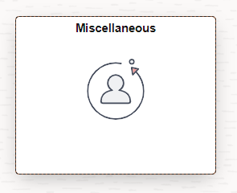
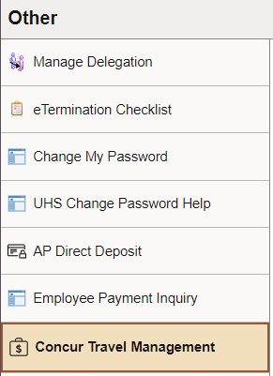
How to set up a new Concur account
Employee Account: Go to P.A.S.S., select Miscellaneous, and click on Concur Travel Management. If the employee is not already set up as a Concur user, the self registration page will appear. Complete the required information and save.
  Self Registration is an overnight process; the new Concur profile will become available the next day.
  If any updates are needed later (e.g., default cost center change, change of delegate to approve, adding newly created Vendor ID), complete “Concur Supplemental Form for Employee Access Updates” and submit it to concur@central.uh.edu. The form can be obtained from the Finance Form website http://www.uh.edu/finance/pages/forms.htm

Slide 6
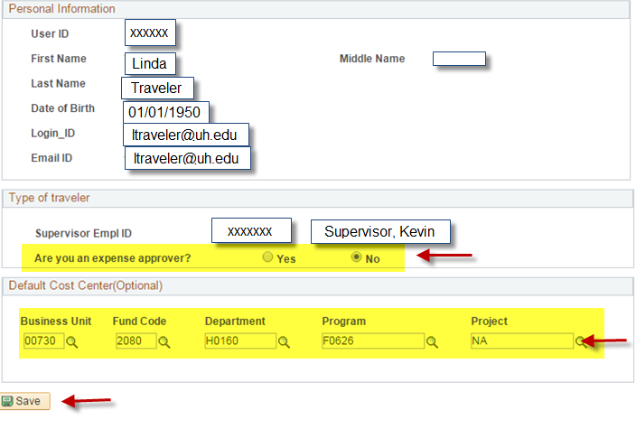
Concur Self-Service

Slide 7
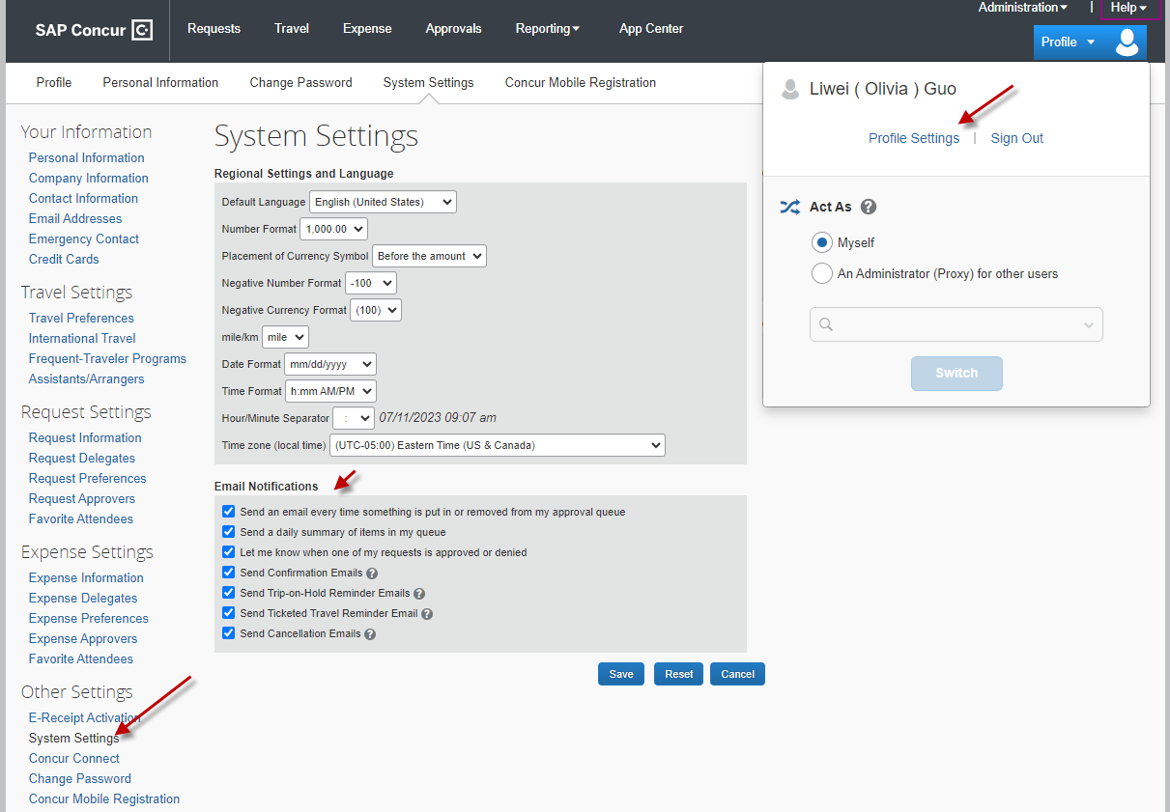
Concur Self-Service
After profile is set up, go to Profile Settings – Other Settings – System Settings and enable “Email Notifications” function

Slide 8
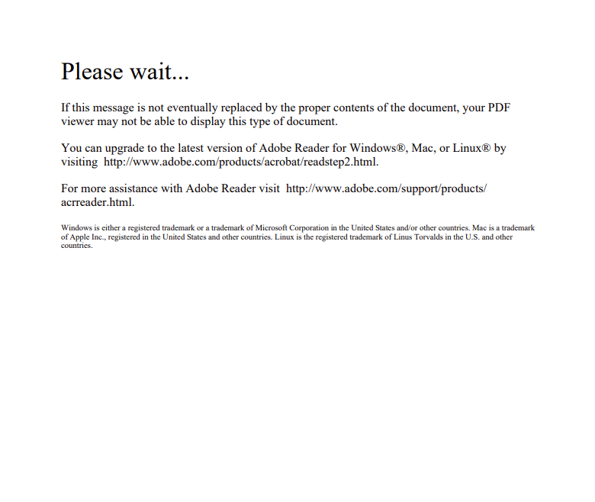
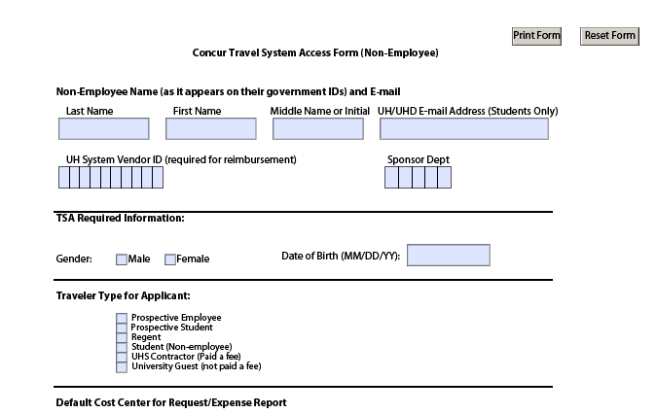
Non-Employee Concur Accounts
Send a “Concur Non-Employee Access Form” to concur@central.uh.edu. The form can be obtained from the Finance Form page: http://www.uh.edu/finance/pages/forms.htm
  The document may look like this. Just download it and it should look like this:

Slide 9
Travel Request
All UH travel for employees, prospective employees, students, prospective students, university guests, contractors, and regents
Submitted and Approved before travel begins
Estimate of expenses
Authorization to travel
Reimbursement
If Travel request is approved after travel starts, justification is needed
Travel Request must be created in the profile of the person who will be traveling, not delegate or custodian

Slide 10
Travel Request
Created in Concur by traveler or delegate
Workflow approval
  Employee travelers must submit their own TR into workflow to acknowledge their review
Approvers are automatically notified when a Travel Request is pending their approval
An approved Travel Request is required for all university travel, whether paid by UH or not
Travel Request can not be transferred
Travel should NOT be booked until the TR is fully approved

Slide 11
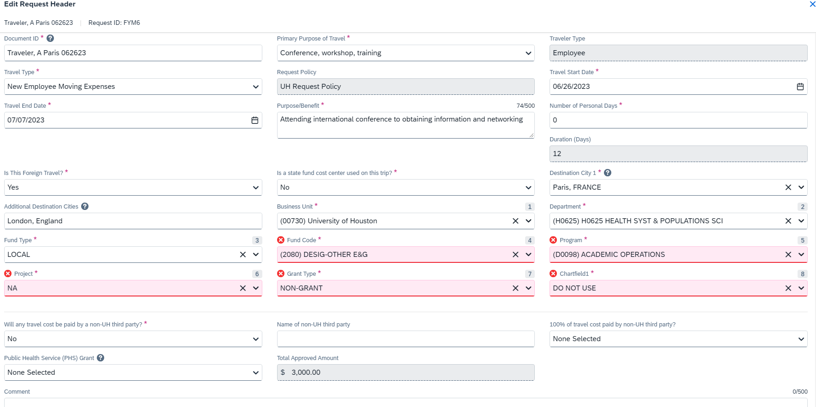
Travel Request

Slide 12
Travel Expenses
Airfare
Must be purchased at the lowest price available (i.e., economy/coach class).
Add-ons to economy airfare such as extra leg rooms, additional luggage, early-bird check-in, and seat selection is allowed, seat upgrade with fees is not allowed, first class or business class is not allowed.
Additional baggage fees incurred due to unauthorized travelers are Not Allowed.
Rental Car
Luxury vehicles and additional cost upgrades are Not Allowed.
SUVs, Vans and larger sized vehicles may be permissible if three or more travelers will be traveling in one vehicle. The Concur Expense Report must indicate the number of travelers in the expense comments field.
Hotel
Must adhere to the daily Meal & Lodging Limits, the receipt must be itemized and attached with proof of payment.
Additional fees for unauthorized travelers or upgrade fee are Not Allowed (i.e., rollaway bed).

Slide 13
Travel Expenses --- Continued
Conference/Workshop/Convention/Training Hotels
If the conference hotel is used, and the daily meals/lodging combined amount does not exceed the university daily limit, the amount will be reimbursed without additional documentation;
If the conference hotel is used, and the daily meals/lodging exceeds the university daily limit, the published hotel expenses and actual meals up to the federal travel regulation meal rate (M&IE) for the travel destination may be reimbursed if the traveler provides one of the following
  The publicized document showing the conference hotel rate (must be the lowest rate) in the expense report;
or
  The appropriate Division Vice Presidents’ approval ( VP approval can be provided in the form of an email or by adding them to Concur Expense Report approval flow)

Slide 14
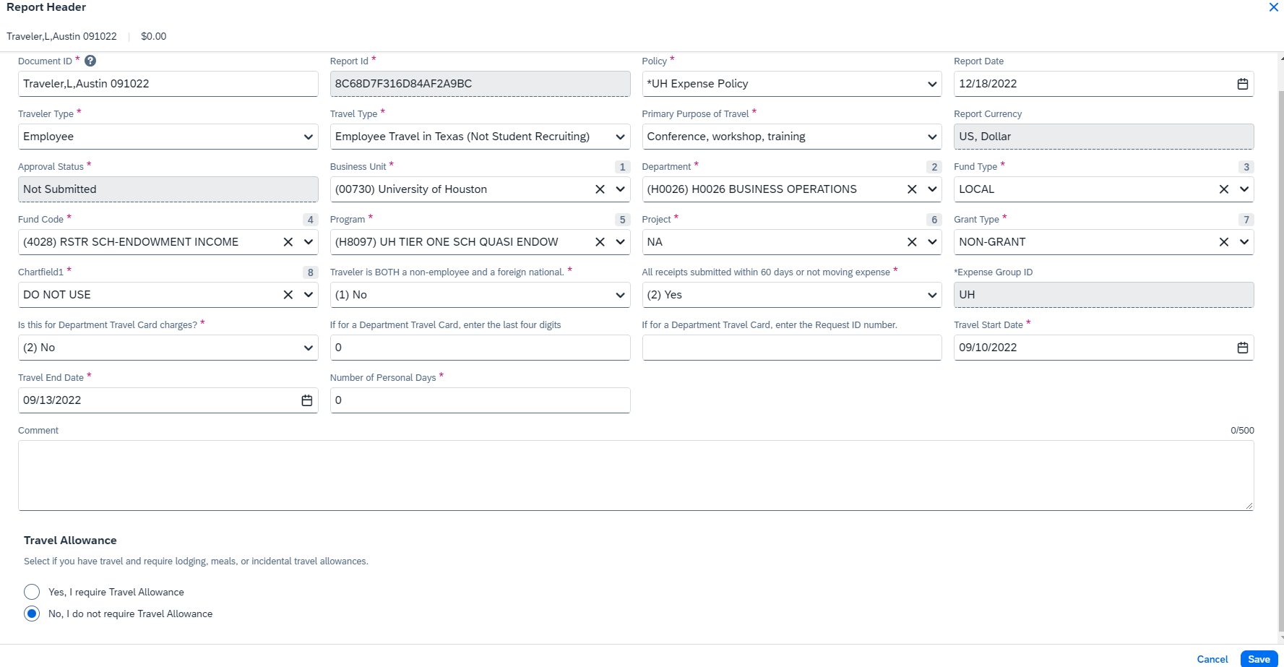
Travel Expenses Report

Slide 15
Travel Expenses Report
Expense report name format: Last Name, First Name Initial, Destination, Travel Start Date (MMDDYY), if you don’t have enough space, you can abbreviate the city’s name;
Travel type and traveler type must match;
If the answer to question “Traveler is BOTH a non-employee and a foreign national” is “Yes”, the expense report will be routed to Tax Department;
If the answer to question “All receipts submitted with 60 days or not moving expense” is “No”, the expense report will be routed to Tax Department
Reimbursement expense report must be created from traveler’s profile, not delegate/custodian’s profile

Slide 16
Deadline for Submittal of Reimbursement Expense Reports
Traveler has up to 60 days after completion of travel to turn in receipts to the dept.
  If turned in after 60 days, must get routed to the Tax Department (with Taxable Payments or Reimbursements to Employees form-Exhibit B, SAM 03.D.06) before submitting to AP, this form need to be processed through DocuSign
Department has a maximum of 15 days after received from traveler to submit to AP
  If submitted after 15 days, justification is needed
Notes:
If last travel day fall on a Friday, days are counted beginning Saturday.

Slide 17
Required Documentation for Expense Report Reimbursement
Daily itinerary/conference agenda is required for all expense report, if personal day is included in the trip, conference agenda is not sufficient;
International Travel Export Control Form is required for all travelers to destination outside the United States and the U.S territories and possessions, this form should be processed through DocuSign
Port Trip report is required for all foreign travels unless the traveler is guest or contractor;
Hotel folio is required as supporting documentation if traveler claims meal;
Rental car receipt is required as supporting documentation if traveler claims gasoline;
Airfare itinerary is required as supporting documentation if traveler claims baggage fee;

Slide 18
Required Documentation for Expense Report Reimbursement
Roster is required for group travel;
Supervisor’s approval is required for business meal expense;
Justification form is required if travel request is approved after travel starts;
Justification form is required if expense report does not submitted to AP within 15 days after department receives receipts;
Justification form is required if traveler claims GSA meal limit during the whole trip (this is only allowed when traveler’s actual meal expense exceeds GSA rate but can not provide itemized receipts)
Itemized meal receipt is required if meal expense exceeds GSA rate;
Itemized receipt and proof of payment is required for airfare, lodging, rental car, registration and all incidentals over $75;
Invitation letter or corresponding email is required for guest travel;

Slide 19
Documentation Requirements for Reimbursement
Airfare
  The employee’s name
  The transaction service provider’s name
  The ticket number
  The class of transportation
  Travel dates
  The amount charged for the transaction
  The origin and destination
  Proof of payment

Slide 20
Documentation Requirements for Reimbursement (continued)
Lodging
  Must be issued by commercial lodging establishment or travel agent or broker who purchased the lodging
  The name and address of the commercial lodging establishment
  The name of the employee
  The single room rate
  A daily itemization of the lodging charges
  Proof of payment

Slide 21
Documentation Requirements for Reimbursement (continued)
Rental car
  The rental company name
  The renter’s name
  Start and end date of rental
  An itemization of expenses incurred
  Proof of payment
  Rental car class (midsize, full, SUV, …)
Note: Rental car gas charges can only be reimbursed if the rental car information is provided.

Slide 22
Deadline for Submittal of
Travel Card Expense Reports
Cardholders and custodians are responsible for submitting Expense Reports correctly in Concur through the certifying signatory to Accounts Payable no later than the 25th of the month following the month in which those transactions occurred, otherwise violation will be recorded, this includes the resubmitted reports
  For example:
  Charges with a transaction date in September (September 1 – September 30) must be submitted to Accounts Payable correctly on an Expense Report by October 25 in Concur. If the 25th falls on a weekend or holiday, the due date will be the following business day unless otherwise announced by AP.

Slide 23
Foreign Travel
Travel Request
VP Approval (Concur automatically routes TR through VP)
International Travel Export Control Form --- all travelers to destination outside the United States and the U.S territories and possessions, this form should be processed through DocuSign
Agenda
Fly America Act Waiver Checklist (if applicable)
  Foreign air carrier
  Fund: State fund, 5013, 5014, 5015, 5033, 5034 and 5035.
Documents available in Concur (Travel tab)
Link: http://www.uh.edu/research/sponsored-projects/proc-pol-guide/travel/
Notes:
Left off here

Slide 24
Travel to Canada/Mexico
Treated as domestic travel
  Does not require VP approval
  Post-Trip report not required
  Charge to domestic account codes.
    See Employee-Out-of-State: Alaska, Hawaii, Canada, Mexico, Puerto Rico, and US Possessions/Territories
Treated as foreign travel
  Daily Meal and Lodging Cap: $490 October 1st 2024 to September 30th 2025)
  International Travel Export Control Form is required.
  Fly America Act (if applicable)
  Does not apply the calculation of personal vs. business, all approved travels are considered as business trip even the number of personal days is bigger than the number of business days

Slide 25
Post Trip Report
Must be uploaded to the Expense Report
A brief explanation of the activities that occurred each day on the trip
A statement explaining the purpose for the travel and how it benefits the university

Slide 26
State Contracted Vendors for Car Rental
(12/21/2022-05/21/2025)
Travelers are strongly encouraged to book rental car from state contracted vendors because the rate is fixed and LDW ( liability and loss/damage waiver) insurance is included in the base rate. Instructions on how to book a State contracted rental car ban be found at:
https://www.uh.edu/office-of-finance/ap-travel/uh-travel/transportation/rental-rates/
Enterprise Rent-A-Car/National Car Rental
Hertz
Please contact AP Travel for contract verification code

Slide 27
State Contracted Vendors for Car Rental continued (12/21/2022-05/21/2025)
Making reservation on Enterprise:
Please use UH reservation link: https://etd.ehi.com/#/unauthorised
DBAs: Please reach out AP Travel to add you as company admin
Travelers: Please reach out your DBA to add you as company employee

Slide 28
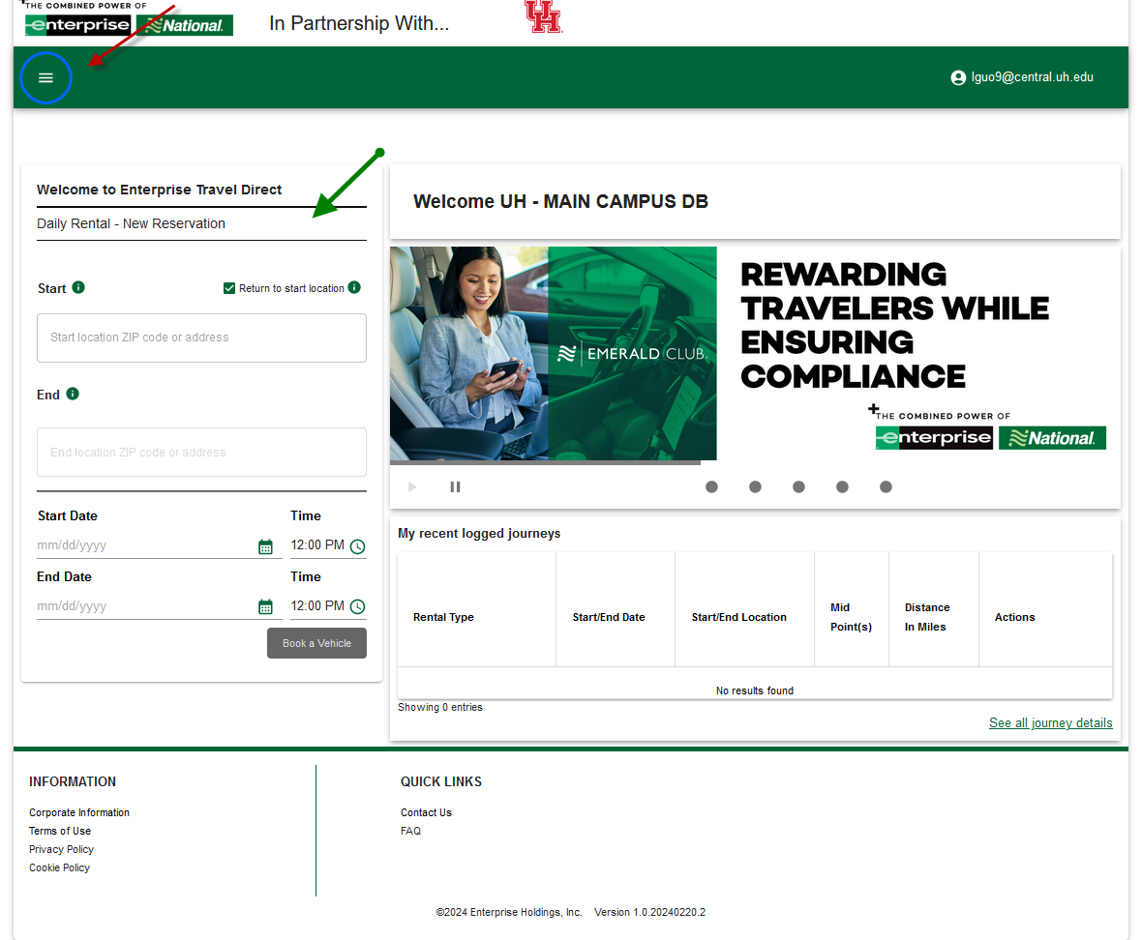
State Contracted Vendors for Car Rental continued (12/21/2022-05/21/2025)
DBA is able to make reservation and pull invoice from home page ( red arrow )
Traveler is able to make reservation from home page ( green arrow )

Slide 29
State Contracted Airline Company
(09/01/2023-08/31/2024)
American Airlines
Delta Airlines
Southwest Airlines
  www.swabiz.com
  Reach out AP Travel for Company ID
  Two baggage's free, no change or cancel fees as long as you cancel the flight 10 minutes prior scheduled departure time
  Points/Credits never expire

Slide 30
Moving & House Hunting Expenses
Not allowed on a travel card
Not allowed with 1XXX fund (state cost centers)
Only one house hunting trip allowed up to one week
Required documents:
  Travel Request
  Note: Create a Travel Request for House hunting expenses and another one for the actual Relocation expenses.
  Addendum A
  Offer Letter
  Exhibit B
  Itemized receipts for all expenses(including meals while moving)
Link: http://www.uh.edu/administration-finance/tax-information/moving-and-relocation/

Slide 31
Texas Hotel Occupancy Tax Exemption Certificate
State portion of tax exempt in Texas for employees (6 percent tax), but not prospective employees
Traveler needs to present Certificate when check-in
https://uh.edu/office-of-finance/tax-information/official-tax-documents/
Employee can be reimbursed with explanation if failed to provide the Certificate when check in. But if travel card is used, it is traveler/custodian’s responsibility to get refund
Note: Federal grants or contracts may not permit reimbursement of the state hotel occupancy tax

Slide 32
Meal and Lodging Limit --- Cap
UH travel will continue using the combined travel meals and lodging limits --- cap, this information is updated every October 1st.
Meals and lodging expenses exceeding the daily cap will no longer require a MAPP exception, but the appropriate Division Vice President’s approval will be required, VP approval can be added to the Concur approval flow.
Instruction for how to add the appropriate Vice President can be found on the Travel Website at: https://www.uh.edu/office-of-finance/ap-travel/concur-tcard/tm-printable/creating-a-travel-request.pdf
An exception has been added to Concur to alert the Expense Report initiator and Travel Office if the GSA rate has been exceeded. This would indicate receipts are required.

Slide 33
Meals and Lodging Expense Narrative
Meals/Lodging combined amount
  The UH cap will tell you the maximum amount you can get reimbursed for your daily meals/lodging
  Requirement for Meal Receipts
The General Services Administration (GSA) Federal meal rate is used to determine if itemized receipts are required for your meals.
  If your actual daily meal amount is more than the GSA Federal meal rate, you must provide itemized receipts
  If it is equal to or less than the GSA Federal meal rate, you don not have to provide meal receipts unless department requires
  If you use multi-user or individual travel card to pay meal expense, itemized receipts are always required;
  Note that the GSA rate varies depending on your travel destination, usually we use the location of your hotel to determine the rate. Your daily meal expense cannot exceed 200% of the GSA Federal meal rate

Slide 34
Meals and Lodging Expense Narrative (continued)
Requirement for Lodging Receipts
  An itemized receipt is always required for your lodging expenses, regardless of the GSA Federal rate
Conference Hotel **
If you used a conference hotel published by your conference and your daily meals/lodging amount exceeded the UH cap, the university may pay or reimburse the full conference hotel expenses (lowest published rate) and actual daily meal expenses up to the GSA Federal meal rate. To be qualified for this exception, you will need to upload the document published by the conference showing the lowest conference hotel rate or obtain your VP’s approval

Slide 35
Lavish/Extravagant
The IRS requires all travel expenses to be reasonable and ordinary, specifically precluding lavish and extravagant expenses from reimbursement. Expenses considered lavish/extravagant is not allowed.
The following expenses may be defined as “lavish/extravagant”:
  Hotel: Resort hotel (except for conference) and/or suites, room upgrade without appropriate explanation
  Meal: 200% of GSA rate
  Car Rental: SUVs or vans for less than three business travelers, sports car, limousines
  Any upgrade other than additional charges for airfare and rental car for three or more travelers as mentioned in the MAPP

Slide 36
Alcohol & Business Meals
Alcohol cannot be purchased during normal business hours by employees.
Must be itemized and charged to account 53113, whether part of a business meal or travel meal.
Cannot be charged to tuition, sponsored project, federal indirect cost, or Athletic cost centers (2064, 2160, 2164, 2072, 1000s, 5000s, or Athletics).
Entertainment expenses cannot be charged to tuition funds (2064, 2160, 2164)

Slide 37
Business/Personal Travel
Travel Outside the United States
  All approved university employee business travel outside the US that includes some personal travel days is “Considered to be entirely for business” because the employee is considered to have “no substantial control” over making the trip. The only exception is the President’s travel outside the US.
  The appropriate vice-president/president has the ultimate responsibility for determining the extent of reimbursement for the transportation costs and other travel expenses.
Travel Primarily for Personal Reasons in the US
  The cost of traveling to/from the destination (airfare, mileage to/from airport, airport parking, etc.) may not be directly charged to the university or reimbursed. Only expenses that are directly related to conducting university business may be charged to or reimbursed by the university, such as lodging and meals on “days spent on business activities,” and local transportation costs to/from business meetings.

Slide 38
Travel Days
The university of Houston allow travelers to travel to their business destination one contiguous day before and one contiguous day after business days without providing additional documentation or explanation. (Note that these days will be counted as business versus personal days.)
Travel days more than one day before a business purpose or more than one day after a business day will require additional explanation and documentation such as an airfare price quotation plus other expenses showing better value, and may be counted as personal days if the additional day is for personal purpose.

Slide 39
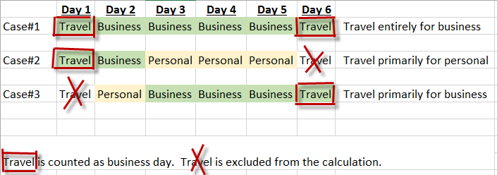
What days count as business days for domestic travel
https://uh.edu/office-of-finance/ap-travel/types-of-travel/foreign/personal-vs-business/

Slide 40
What days count as business days for domestic travel (continued)
Note:
On case #3, lodging on Day 1 and Day 2 is not reimbursable;
Weekends and holidays that fall between business days are not personal days

Slide 41
State Fund Travel
Only travel for employees and prospective employees
Travel Request must be approved before travel starts, no exception
Travel type can not be House Hunting or Moving
Cost center on Travel Request must be state fund
Must stay within GSA rate for meal and lodging, no exception
Travel card can not be used
Gratuity/alcoholic beverages are not allowed
State occupancy tax not allowed when travelling inside Texas

Slide 42
State Fund Travel ( continued )
Business meal not allowed
No food or alcoholic beverage of any kind except for traveler meals
When non-contracted travel vendors are used, please complete Travel Exemption Form and attach to Expense Report
When four or less travelers travel together, only one traveler can get reimbursement for personal car mileage
Expense can not be reallocated to local fund on Concur expense report
Fund code 5014, 5016, 5017 and 5018 must follow state travel guidelines because the funding originated from a state agency or university

Slide 43
Frequently Made Mistakes
  Incorrect travel/traveler type on expense report, or not same as Travel Request
  Not linking Expense Report to Travel Request unless it is department travel card expense report
  Not providing Travel Request (department travel card expense report)
  Incorrect expense report ID format, should be: Last Name, first name initial, Destination, first day of travel(MMDDYY)
  Conference agenda or daily itinerary is not attached
  Itemized meal receipt is not provided when daily meal expense exceeds GSA rate
  When claim personal mileage, “Point to Point” address is not used
  Reallocation using both state fund and local fund in same expense report

Slide 44
Frequently Made Mistakes (continued)
  Airbnb cleaning fee and service fee are not listed as part of room rate
  Missing post-trip report after foreign travel
  Missing hotel folio as supporting document when claiming meal expense
  Missing car rental invoice as supporting document when claiming gasoline for rental car
  Missing proof of payment for airfare/lodging/car rental/registration
  Gasoline for UH vehicle is code as gasoline for rental car --- should be coded as other incidental
  Uber/Lyft expense is coded as “other public transportation” --- need to code as taxi

Slide 45
Frequently Made Mistakes (continued)
  Require reimbursement for future travel
  Expense Report Name does not reflect actual travel start date, even different with Travel Request
  Put pipeline character on expense report description field, for example: “Starbucks | HMS Host”, this will cause Concur system error

Slide 46
Booking from Third Party
  For local funds, third party vendors can be used, but we advise against using them especially when bundle expenses. Third party vendors usually do not provide an itemization of the expenses, which can lead to issues when processing an expense report due to lack of documentation, or determining the appropriate amounts for each expense entry. If overbooked, merchants tend to cancel the hotels/airfares that were booked by a third party first, which may lead to additional cost. For rental car, the state contracted rate is the most cost effective as the rate stays low, and it includes LDW.
  Hotel engine is another option for lodging expenses, and is a private hotel booking platform that connects State of Texas travelers to rates unavailable to the public. Please contact AP Travel for invitation.

Slide 47
Booking from Third Party (continued)
    If you are booking through a third party, such as expedia.com, per MAPP policy, you are still required to obtain an itemized receipt. We recommend that travelers contact the Help Center or Customer Service of the third party company before their trip to advise them that they will need an itemized receipt after their trip since this is business trip. If the traveler doesn’t do so, however, they can still request an itemized receipt after their trip.

Slide 48
Trouble Shooting
  Can not find supervisor or certifying signatory’s name – Contact concur@central.uh.edu to update approval workflow
  Have not receive reimbursement payment 3 business days after expense report is approved --- Make sure vendor status is approved/active and not on hold
  Error message when creating expense report: “An error occurred attempting to look up the account code(s) for the entry” --- Make sure the travel type on expense report header is correct, for example if the travel type is house hunting, expense type can only be “Househunting All Expenses”
  Can not open “Concur Non-Employee Access Form” --- Use Firefox as browser instead of Google Chrome

Slide 49
Travel and Non-Travel
Expenditure | Non Travel | Travel | Travel
 | Inside Houston Metro Area Trip | Outside Metro | Outside Metro Overnight Travel
 | Outside Metro Same Day Trip without Transportation | Same Day Trip with Transportation
Transportation: Airfare | N/A | Paid or Reimbursed (Not Taxed) | Paid or Reimbursed (Not Taxed)
Transportation: Rental Car | N/A | Paid or Reimbursed (Not Taxed) | Paid or Reimbursed (Not Taxed)
Transportation: Other Transportation (e.g., Train, Bus) | N/A | Paid or Reimbursed (Not Taxed) | Paid or Reimbursed (Not Taxed)
Local Transportation within Metro Area (Metro, Taxi, Uber, etc.) | Paid or Reimbursed (Not Taxed) | Paid or Reimbursed (Not Taxed) | Paid or Reimbursed (Not Taxed)
Mileage | Reimbursed (Not Taxed) | Reimbursed (Not Taxed) | Reimbursed (Not Taxed)
Meal | Not Paid or Not Reimbursed | Not Paid or Not Reimbursed for employee | Paid or Reimbursed (Not Taxed)
Lodging | Not Paid or Not Reimbursed | Not Paid or Not Reimbursed | Paid or Reimbursed (Not Taxed)
Incidental | Not Paid or Not Reimbursed | Not Paid or Not Reimbursed | Paid or Reimbursed (Not Taxed)

Slide 50
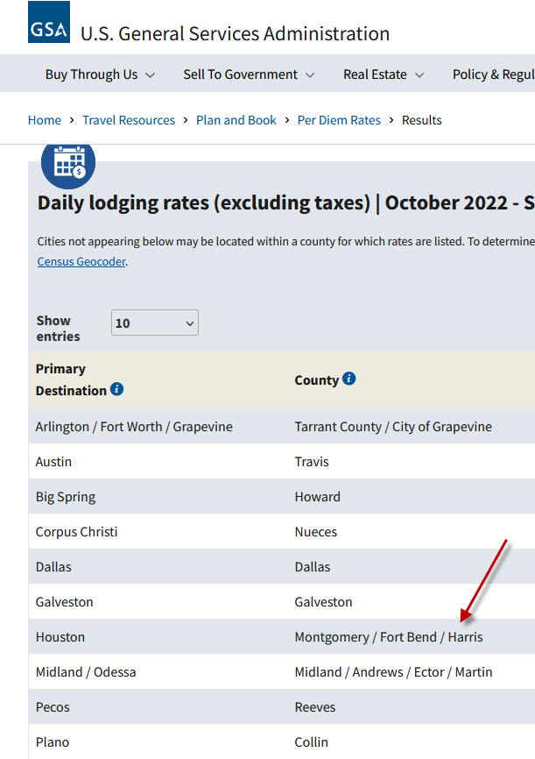
Travel and Non-Travel (continued)
How to definite “Houston Metro Area”
Per GSA, the following three counties are considered as “Houston Metro Area”

Slide 51
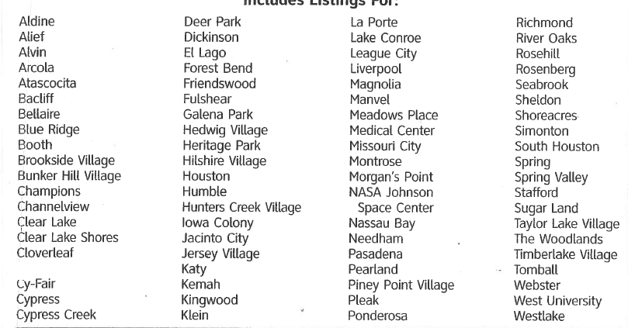
Travel and Non-Travel (continued)

Slide 52
Same Day Trip
How to process non-overnight travel expenses?
  Concur or;
  PCC9 Regular Purchase Voucher
When to use Concur?
  If a UH travel card is used for airfare, rental car, taxi or registration expenses
  If traveler paid for airfare, rental car, registration, public transportation or taxi outside of Houston metropolitan area
  Travel Request is required
When to use PCC9 Regular Purchase Voucher?
  Account code 54807 should be used if ALL of the following conditions are met:
  Payment for an employee (not a student, regent, prospective employee, contractor, or university guest
  On mileage, parking and tolls charged on non-overnight travel
  On public transportation and taxi in the Houston metropolitan area
  The payment is made with local (not state appropriated) funds
  Travel request is not required
  Reimbursement to organization in stead of individual traveler
  Department is not supposed to create PCC1 voucher

Slide 53
Additional Information
Concur and T-card Training Material
Visit: https://www.uh.edu/office-of-finance/ap-travel/concur/tm-printable/
University of Houston Travel Policies
Visit: https://www.uh.edu/office-of-finance/ap-travel/travel-policies/
University of Houston Travel Rules
Visit: https://www.uh.edu/office-of-finance/ap-travel/travel-rules/
Travel Forms
Visit: https://www.uh.edu/office-of-finance/ap-travel/travel-forms/

Slide 54
AP Travel Contacts
Olivia Guo– AP Manager
713-743-6920
lguo9@central.uh.edu
Victor Rodriguez-- AP Analyst II
713-743-3260
vjrodri4@cougarnetl.uh.edu
Tripti Das -- AP Analyst II
713-743-2542
tdas2s@central.uh.edu
Monica Li -- AP Analyst II
713-743-8496
smli3@central.uh.edu
Ace Anzaldua – AP Analyst II
713-743-0365
crguyanz@central.uh.edu
Tax Dept.
Tax Office
tax@uh.edu
Concur System
Concur Support
Frank Pham – Coordinator, Application Security, Financial Computing Systems
713-743-5112
concur@central.uh.edu

