Slide 1
Jaggaer Training
Adding a P-Card in Jaggaer

Slide 2
Purpose of Training
Both Shoppers and Requester roles have the ability to add a P-Card to their profile and to a requisition in Jaggaer. Only Requesters will be able to submit and approve shopping carts for their departments.
This training will go over how to add a P-Card to your profile, Adding a P-Card to the Billing section on the requisition, and Amazon-specific P-Card instructions.

Slide 3
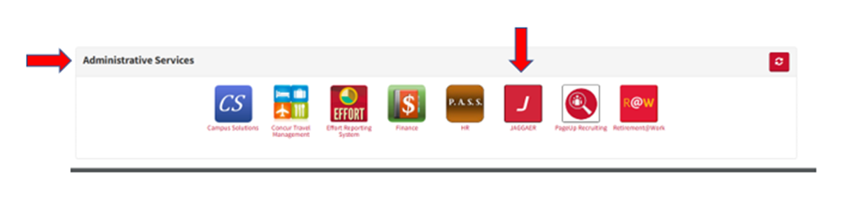
Step 1: Log in to Jaggaer from AccessUH
Go to: https://accessuh.uh.edu/home.php
Log in using your University of Houston credentials.

Slide 4
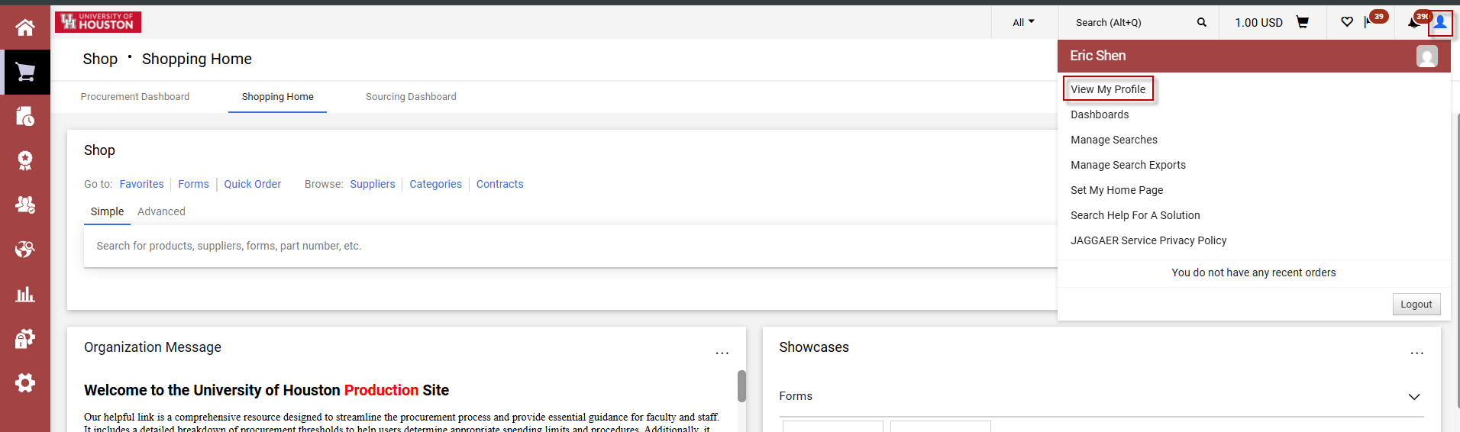
Step 2 – Navigate to your user profile
Click on your profile icon on the top-right hand side of the screen and click on View My Profile

Slide 5
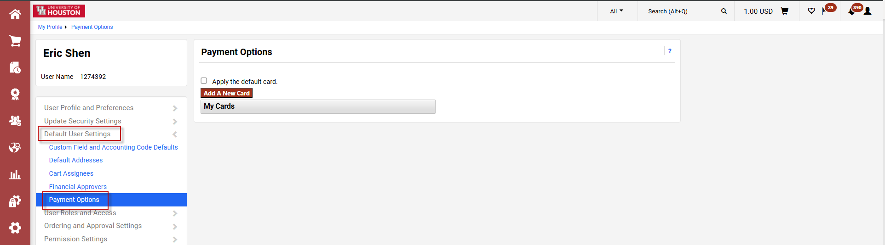
Step 3 – Payment Options
Click on Default User Settings, then Payment Options. You will see the option to Add a New Card, save multiple cards and making one of them the default via a checkbox.

Slide 6
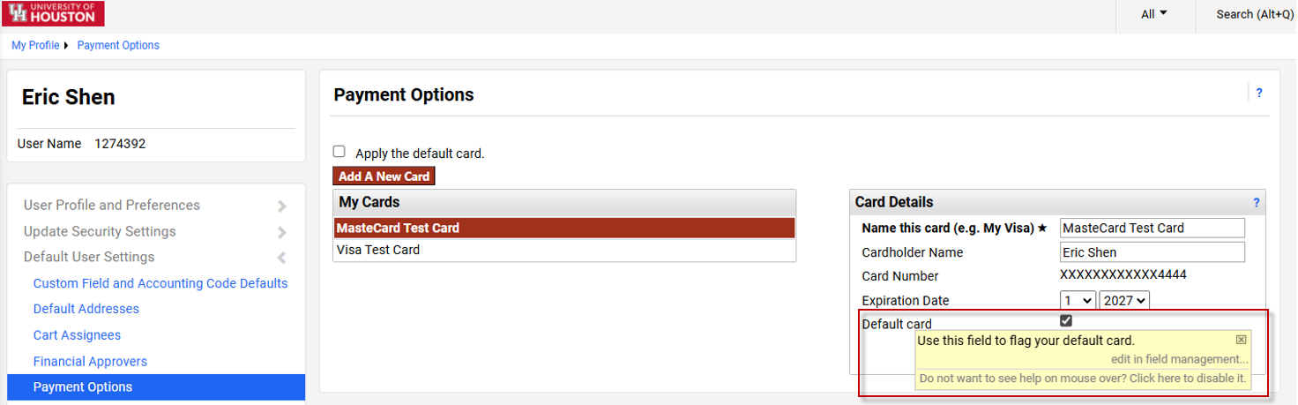
Step 3 – Payment Options
Clicking on Add a New Card will allow you to enter and save the card info. You can save multiple cards to your profile.
Clicking on the Default Card checkbox will make that your default card.

Slide 7
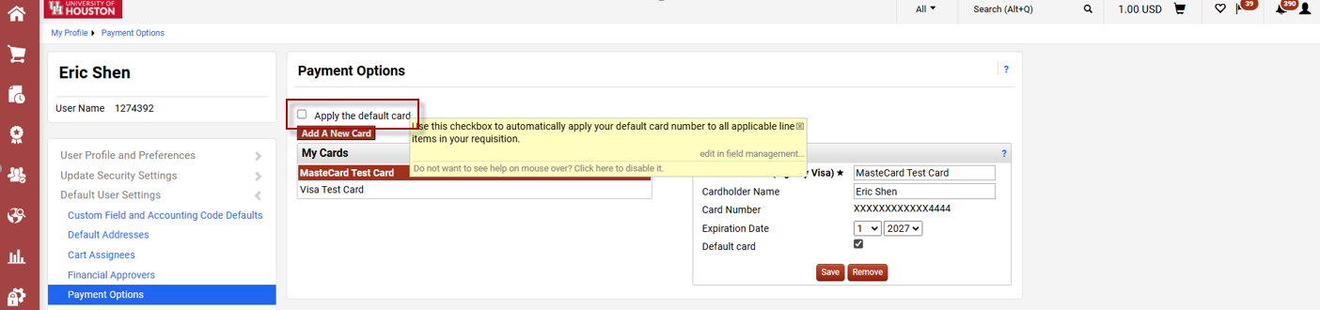
Step 3 – Payment Options
Optional: Clicking on the Apply the default card checkbox will automatically apply your default credit card to all applicable line items in your requisition.

Slide 8
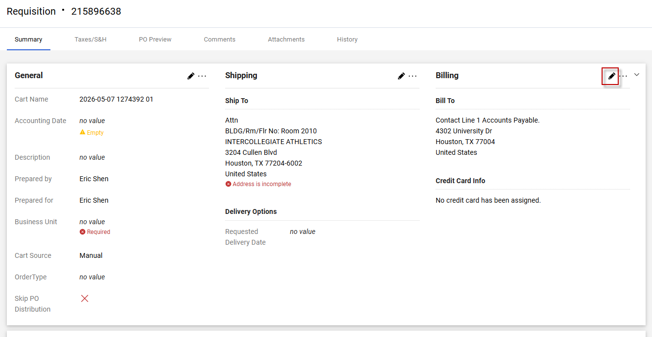
Step 4 – Adding P-Card to Billing
Once the P-Card is added to your profile, you can add it to your requisition as the payment method. Click on the pencil icon next to Billing on the Requisition.

Slide 9
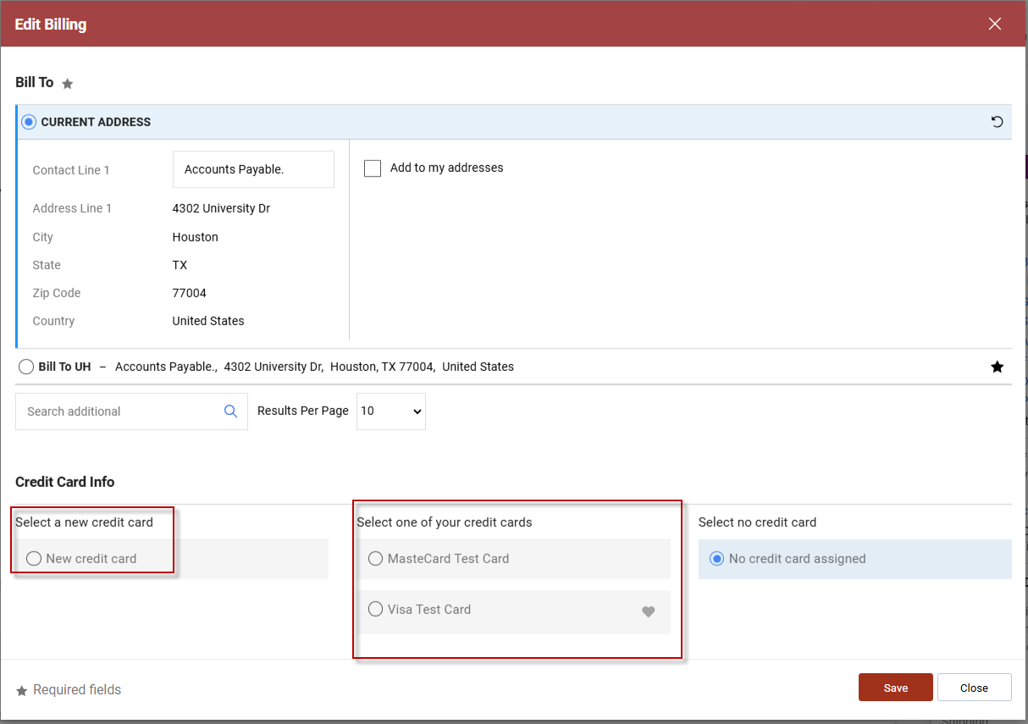
Step 4 – Adding P-Card to Billing
From here, you can select one of your saved P-Cards or add a new card. Click Save when you are done.

Slide 10
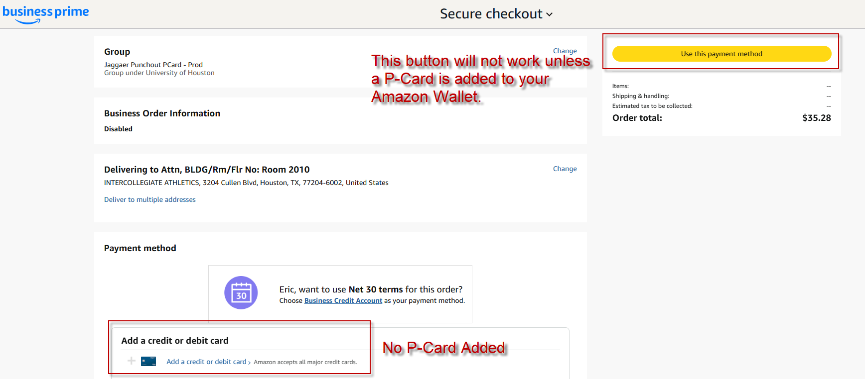
P-Card Instructions - Amazon-Specific
Amazon will require the user to have a P-Card in order to check out. The user will be stuck on the Use this payment method screen until one is added to the user account. Shoppers without a P-Card will need to do a cart transfer within Amazon to a user with access to a P-Card in order to place the order.

Slide 11
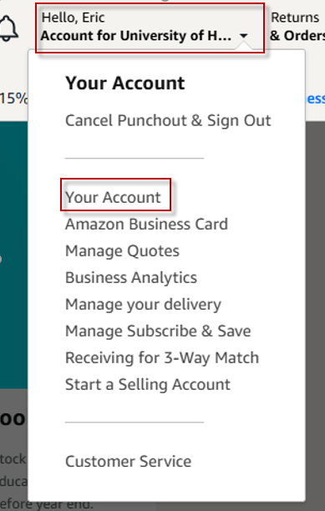
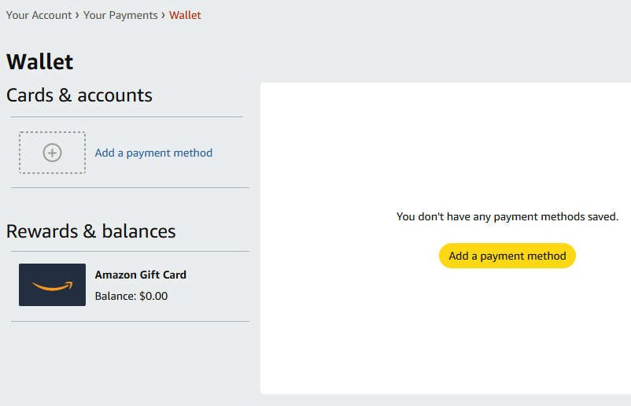
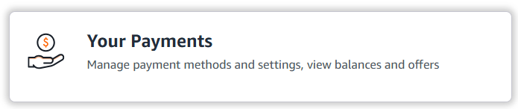
P-Card Instructions - Amazon-Specific
Adding to Amazon Wallet – Click on Your Account dropdown on the top-right of the screen -> Click on Your Payments -> Click on Add a payment method.

Slide 12
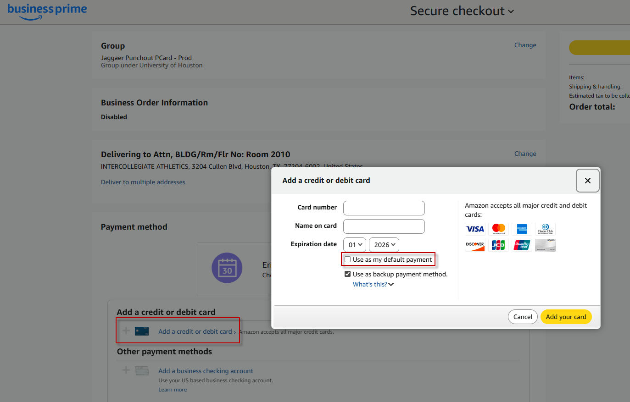
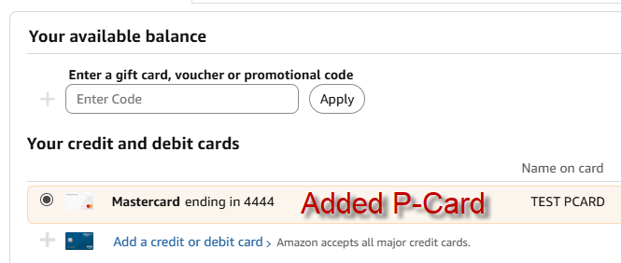
P-Card Instructions - Amazon-Specific
Click on Add a credit or debit card and enter in your P-Card info. You can add multiple cards and select one as the default payment via the checkbox

Slide 13
You’re Done!
Need help? Contact the Purchasing Office or your department’s Jaggaer administrator.

